Slide 1
Internet Security: How the Internet works and some basic vulnerabilities
ECE 458
Winter 2013
Dan Boneh
(Modified by Vijay Ganesh)

Slide 2
Internet Infrastructure
Backbone
ISP
ISP
Local and interdomain routing
TCP/IP for routing and messaging
BGP for routing announcements
Domain Name System
Find IP address from symbolic name (www.cs.stanford.edu)

Slide 3
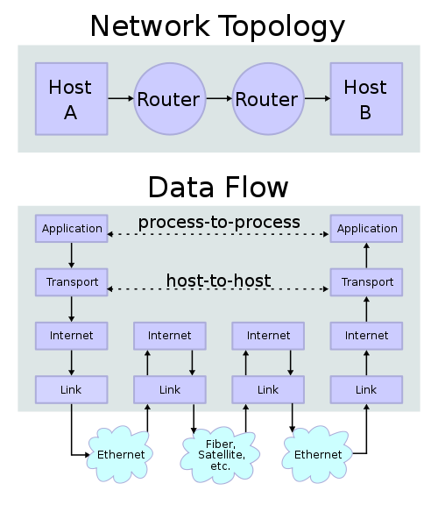
Internet Topology

Slide 4
TCP/IP Protocol Stack
Application protocol
Application
Application
Transport
TCP protocol
Transport
Network
IP protocol
IP
IP protocol
Network
Link
Data Link
Network Access
Data Link
Link

Slide 5
Data Formats
TCP Header
Application
Application message - data
message
Transport (TCP, UDP)
segment
TCP
data
TCP
data
TCP
data
Network (IP)
packet
IP
TCP
data
Link Layer
frame
ETH
IP
TCP
data
ETF
IP Header
Link (Ethernet)
Header
Link (Ethernet)
Trailer

Slide 6
Internet Protocol
IP
Connectionless
Unreliable
Best effort
Notes:
src and dest ports not parts of IP hdr
Version
Header Length
Type of Service
Total Length
Identification
Flags
Fragment Offset
Time to Live
Protocol
Header Checksum
Source Address of Originating Host
Destination Address of Target Host
Options
Padding
IP Data

Slide 7


IP Routing
Meg
Office gateway
Packet
Source
121.42.33.12
Tom
121.42.33.12
Destination
132.14.11.51
132.14.11.1
ISP
132.14.11.51
121.42.33.1
Typical route uses several hops
IP: no ordering or delivery guarantees

Slide 8
IP Protocol Functions (Summary)
Routing
IP host knows location of router (gateway)
IP gateway must know route to other networks
Fragmentation and reassembly
If max-packet-size less than the user-data-size
Error reporting
ICMP packet to source if packet is dropped
TTL field: decremented after every hop
Packet dropped if TTL=0. Prevents infinite loops.

Slide 9
Problem: no src IP authentication
Client is trusted to embed correct source IP
Easy to override using raw sockets
Libnet: a library for formatting raw packets with arbitrary IP headers
Anyone who owns their machine can send packets with arbitrary source IP
… response will be sent back to forged source IP
Implications:
Anonymous DoS attacks

Slide 10
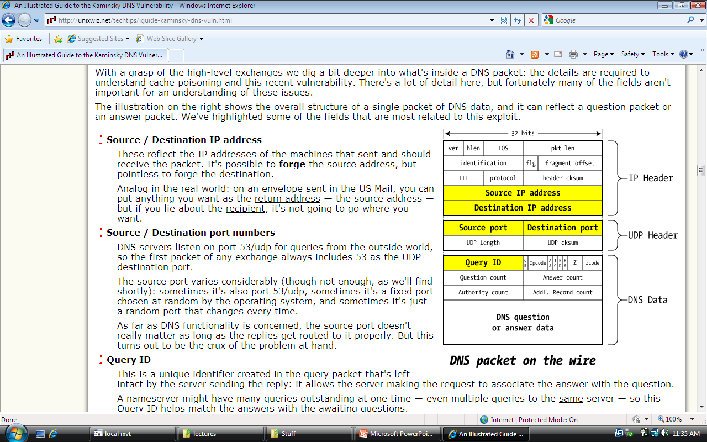
User Datagram Protocol (protocol=17)
UDP
Unreliable transport on top of IP:
No acknowledgment
No congenstion control
No message continuation

Slide 11
Transmission Control Protocol
TCP
Connection-oriented, preserves order
Sender
Break data into packets
Attach packet numbers
Receiver
Acknowledge receipt; lost packets are resent
Reassemble packets in correct order
Book
Mail each page
Reassemble book
1
19
1
5
1

Slide 12
TCP Header (protocol=6)
Source Port
Dest port
SEQ Number
ACK Number
U
R
G
A
C
K
P
S
H
P
S
R
S
Y
N
F
I
N
TCP Header
Other stuff

Slide 13
Review: TCP Handshake
C
S
SYN:
SN_{C}←rand_{C}
AN_{C}←0
Listening
SN_{S}←rand_{S}
AN_{S}←SN_{C}
Store SN_{C} , SN_{S}
SYN/ACK:
Wait
SN←SN_{C}+1
AN←SN_{S}
ACK:
Established
Received packets with SN too far out of window are dropped

Slide 14
Basic Security Problems
1. Network packets pass by untrusted hosts
Eavesdropping, packet sniffing
Especially easy when attacker controls a machine close to victim
2. TCP state can be easy to guess
Enables spoofing and session hijacking
Denial of Service (DoS) vulnerabilities

Slide 15
1. Packet Sniffing
Promiscuous NIC reads all packets
Read all unencrypted data (e.g., “wireshark”)
ftp, telnet (and POP, IMAP) may send passwords in clear
Eve
Network
Alice
Bob
Prevention: Encryption

Slide 16
2. TCP Connection Spoofing
Why random initial sequence numbers? (SN_{C} , SN_{S} )
Suppose initial sequence numbers are predictable
Attacker can create TCP session on behalf of forged source IP
Breaks IP-based authentication (e.g. SPF, /etc/hosts )
TCP SYN
Server
attacker
srcIP=victim
Victim
SYN/ACK dstIP=victim
SN=server SN_{S}
ACK
srcIP=victim
AN=predicted SN_{S}
server thinks command is from victim IP addr
command
Notes:
Example commands: send spam email on behalf of victim IP address

Slide 17
Example DoS vulnerability [Watson’04]
Suppose attacker can guess seq. number for an existing connection:
Attacker can send Reset packet to close connection. Results in DoS.
Naively, success prob. is 1/2³² (32-bit seq. #’s).
Most systems allow for a large window of acceptable seq. #’s
Much higher success probability.
Attack is most effective against long lived connections, e.g. BGP

Slide 18
Random initial TCP SNs
Unpredictable SNs prevent basic packet injection
… but attacker can inject packets after eavesdropping to obtain current SN
Most TCP stacks now generate random SNs
Random generator should be unpredictable
GPR’06: Linux RNG for generating SNs is predictable
Attacker repeatedly connects to server
Obtains sequence of SNs
Can predict next SN
Attacker can now do TCP spoofing (create TCP session with forged source IP)

Slide 19
Routing Vulnerabilities

Slide 20
Routing Vulnerabilities
Routing protocols:
ARP (addr resolution protocol): IP addr ⟶ eth addr
Node A can confuse gateway into sending it traffic for B
By proxying traffic, attacker A can easily inject packets into B’s session (e.g. WiFi networks)
OSPF: used for routing within an Autonomous System
BGP: routing between Autonomous Systems
Attacker can cause entire Internet to send traffic meant for a victim IP to attacker’s address.
Example: Youtube mishap
Notes:
OSPF: open shortest path first

Slide 21
Interdomain Routing
earthlink.net
Stanford.edu
BGP
Autonomous System
OSPF
connected group of one or more Internet Protocol prefixes under a single routing policy (aka domain)
Notes:
OSPF: open shortest path first

Slide 22
BGP example [D. Wetherall]
1
3
3 2 7
4
2 7
2 6 5
2 6 5
3 2 6 5
5
8
2
2 7
6 5
7 2 6 5
7
2 7
7
6 2 7
5
2 6 5
6
7
5
Transit: 2 provides transit for 7
Algorithm seems to work OK in practice
… but BGP does not respond well to frequent node outages

Slide 23
Security Issues
BGP packets are un-authenticated
Attacker can inject advertisements for arbitrary routes
Advertisement will propagate everywhere
Used for DoS and spam
Human error problems:
Mistakes quickly propagate to the entire Internet

Slide 24
OSPF: routing inside an Autonomous System
Link State Advertisements (LSA):
Flooded throughout AS so that all routers in the AS have a complete view of the AS topology
Transmission: IP datagrams, protocol = 89
Neighbor discovery:
Routers dynamically discover direct neighbors on attached links --- sets up an “adjacenty”
Once setup, they exchange their LSA databases

Slide 25




Example: LSA from Ra and Rb
Ra LSA
Net-1
Rb LSA
Ra
Rb
R3
LSA DB:
Net-1
Net-1
Ra
Ra
Rb
2
2
Rb
3
1
1
3
1
Notes:
Ra and Rb send an LSA about the connection between them. That LSA is received by R3 and it updates its own LSA database.

Slide 26
Security features
OSPF message integrity (unlike BGP)
Every link can have its own shared secret
Unfortunately, OSPF uses an insecure MAC:
MAC(k,m) = MD5(data ll key ll pad ll len)
Every LSA is flooded throughout the AS
If a single malicious router, valid LSAs may still reach dest.
The “fight back” mechanism
If a router receives its own LSA with a newer timestamp than the latest it sent, it immediately floods a new LSA
Links must be advertised by both ends

Slide 27


Still many attacks [NKGB’12]
Threat model:
single malicious router wants to disrupt all AS traffic
Example problem: adjacency setup need no peer feedback
Victim (DR)
a remote attacker
adjacency
False Hello and DBD messages
phantom router
adjacency
LAN
adjacency
net 1
Result: DoS on net 1
Notes:
A router can setup an adjacency with a peer router without ever hearing back from the peer. Therefore, a remote attacker can cause a victim router to setup an adjacency with a phantom peer, resulting in DoS.

Slide 28
Domain Name System

Slide 29
Domain Name System
DNS
Hierarchical Name Space
root
org
net
edu
com
uk
ca
wisc
ucb
stanford
cmu
mit
cs
ee
www

Slide 30
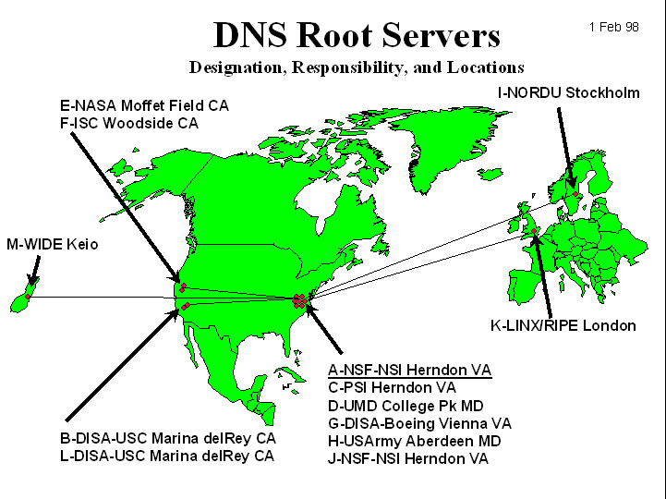
DNS Root Name Servers
Hierarchical service
Root name servers for top-level domains
Authoritative name servers for subdomains
Local name resolvers contact authoritative servers when they do not know a name

Slide 31
DNS Lookup Example
root & edu
DNS server
www.cs.stanford.edu
www.cs.stanford.edu
NS stanford.edu
stanford.edu
DNS server
Local DNS resolver
NS cs.stanford.edu
Client
A www=IPaddr
cs.stanford.edu
DNS server
DNS record types (partial list):
- NS: name server (points to other server)
- A: address record (contains IP address)
- MX: address in charge of handling email
- TXT: generic text (e.g. used to distribute site public keys (DKIM) )

Slide 32
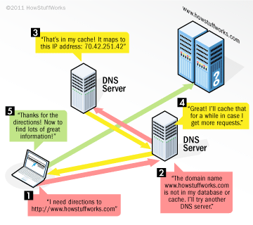
DNS Lookup Example
DNS

Slide 33
Caching
DNS responses are cached
Quick response for repeated translations
Useful for finding servers as well as addresses
NS records for domains
DNS negative queries are cached
Save time for nonexistent sites, e.g. misspelling
Cached data periodically times out
Lifetime (TTL) of data controlled by owner of data
TTL passed with every record

Slide 34
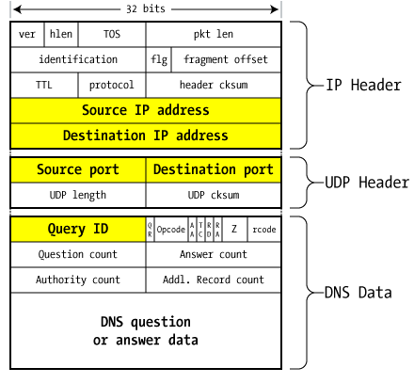
DNS Packet
Query ID:
16 bit random value
Links response to query
(from Steve Friedl)

Slide 35
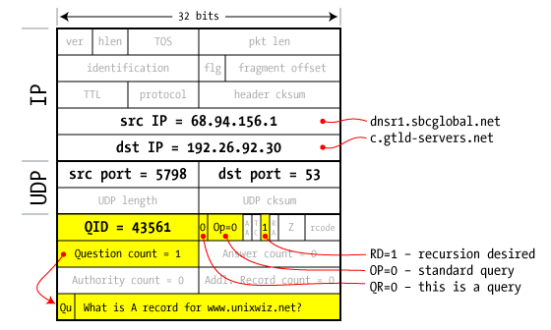
Resolver to NS request

Slide 36
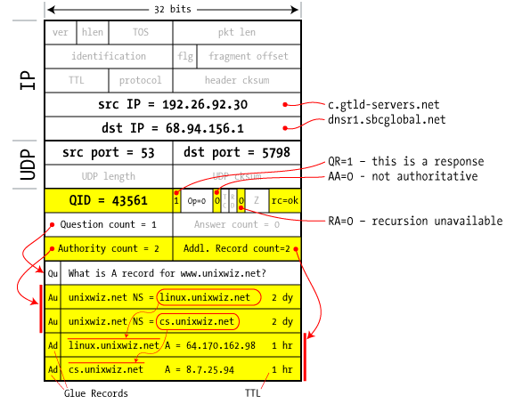
Response to resolver
Response contains IP addr of next NS server
(called “glue”)
Response ignored if unrecognized QueryID

Slide 37
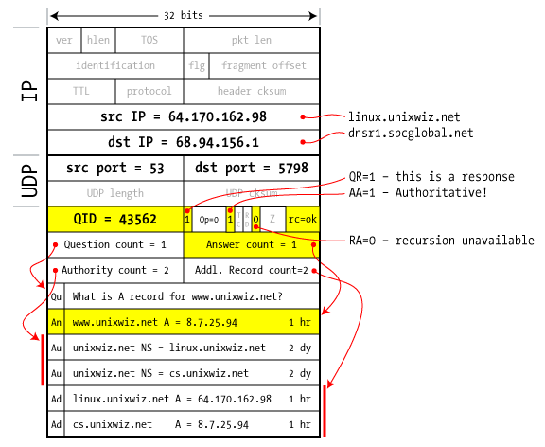
Authoritative response to resolver
bailiwick checking:
response is cached if it is within the same domain of query (i.e. a.com cannot set NS for b.com)
final answer

Slide 38
Basic DNS Vulnerabilities
Users/hosts trust the host-address mapping provided by DNS:
Used as basis for many security policies:
Browser same origin policy, URL address bar
Obvious problems
Interception of requests or compromise of DNS servers can result in incorrect or malicious responses
e.g.: malicious access point in a Cafe
Solution – authenticated requests/responses
Provided by DNSsec … but few use DNSsec

Slide 39
DNS cache poisoning (a la Kaminsky’08)
Victim machine visits attacker’s web site, downloads Javascript
Query:
a.bank.com
a.bank.com
QID=x₁
user
browser
local
DNS
resolver
ns.bank.com
IPaddr
256 responses:
Random QID y₁, y₂, …
NS bank.com=ns.bank.com
A ns.bank.com=attackerIP
attacker wins if ∃j: x₁ = y_{j}
response is cached and attacker owns bank.com
attacker

Slide 40
If at first you don’t succeed …
Victim machine visits attacker’s web site, downloads Javascript
Query:
b.bank.com
b.bank.com
QID=x₂
user
browser
local
DNS
resolver
ns.bank.com
IPaddr
256 responses:
Random QID y₁, y₂, …
NS bank.com=ns.bank.com
A ns.bank.com=attackerIP
attacker wins if ∃j: x₂ = y_{j}
response is cached and attacker owns bank.com
attacker
success after ≈ 256 tries (few minutes)
Notes:
Birthday paradox: success once x_{i} = y_{j} for some i,j .
Success probability after each try is 1/256 ⇒ needs 256 tries on average until success

Slide 41
Defenses
Increase Query ID size. How?
a. Randomize src port, additional 11 bits
Now attack takes several hours
b. Ask every DNS query twice:
Attacker has to guess QueryID correctly twice (32 bits)
Apparently DNS system cannot handle the load

Slide 42
DNS poisoning attacks in the wild
January 2005, the domain name for a large New York ISP, Panix, was hijacked to a site in Australia.
In November 2004, Google and Amazon users were sent to Med Network Inc., an online pharmacy
In March 2003, a group dubbed the "Freedom Cyber Force Militia" hijacked visitors to the Al-Jazeera Web site and presented them with the message "God Bless Our Troops"

Slide 43
DNS Rebinding Attack
[DWF’96, R’01]
<iframe src="http://www.evil.com">
DNS-SEC cannot
stop this attack
Firewall
www.evil.com?
ns.evil.com
DNS server
171.64.7.115 TTL = 0
192.168.0.100
www.evil.com
web server
corporate
web server
171.64.7.115
192.168.0.100
Read permitted: it’s the “same origin”

Slide 44
DNS Rebinding Defenses
Browser mitigation: DNS Pinning
Refuse to switch to a new IP
Interacts poorly with proxies, VPN, dynamic DNS, …
Not consistently implemented in any browser
Server-side defenses
Check Host header for unrecognized domains
Authenticate users with something other than IP
Firewall defenses
External names can’t resolve to internal addresses
Protects browsers inside the organization

Slide 45
Summary
Core protocols not designed for security
Eavesdropping, Packet injection, Route stealing, DNS poisoning
Patched over time to prevent basic attacks
(e.g. random TCP SN)
More secure variants exist (next lecture) :
IP -> IPsec
DNS -> DNSsec
BGP -> SBGP

