Slide 1
ENGI 301
LED Marble Maze Proposal
Vanessa Garlepp
26 September 2022

Slide 2
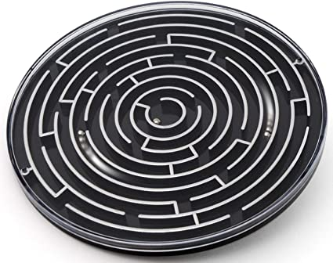
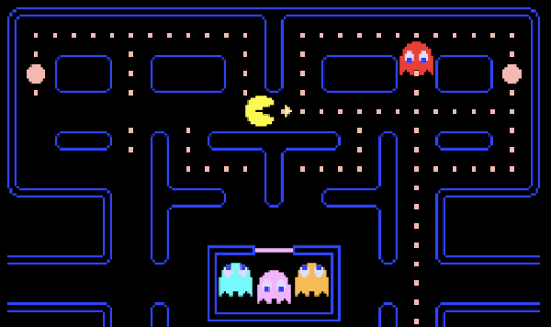
Background Information
Goal: utilize accelerometer (intersection with Capstone project)
Party favor marble maze games
Combine with extra features of Pac-Man
Inspiration:
Body Position Sensing project
LED Matrix graduation cap

Slide 3
System Block Diagram
MPU-6050
Accelerometer
/gyroscope
- logic: 1.8 V
- digital in/output
Power bank
- USB-A output
Pocketbeagle
USB-A converter
64x64 2 pitch LED screen
- 5 addressable pins
Switch

Slide 4
Power Block Diagram
MPU-6050
Accelerometer
/gyroscope
- 2.5-3.5 V
- 3.8 mA
3.3V
Power bank
- 12 W charge
Pocketbeagle
64x64 2 pitch LED screen
- supply: 5 V
5V

Slide 5
Components/Budget
Component | Need to Buy | Cost
Adafruit 64x64 RGB LED Matrix Panel - 2mm Pitch | Yes | $49.95
MPU-6050 Accelerometer/Gyroscope | Yes | $6.29
Pocketbeagle | No | -
Breadboard (generic) | No | -
Jumper wires (generic) | No | -
Switch (generic) | No | -
Power bank | Yes | $21.99
USB adaptor | Yes | $0.94
Total: |  | $79.17

