Slide 1
ENGI 301 PCB Project
Vanessa Garlepp
12/13/2022, 11:59pm

Slide 2
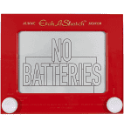
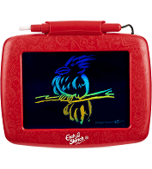
Background Information
Task: Create a PCB for an “Etch-a-Sketch”
Hardware:
SPI Display Screen
Two Potentiometers
Two Buttons (Reset the Game, Change Color)
Three LEDs (Red, Green, and Blue for Color)
USB Port (Expansion)

Slide 3
System Block Diagram – “Etch-a-Sketch”
5V
3.3V
PocketBeagle
USB Host
VCC
SPI Display
USB
SPI
SPI
VCC
USB
SPI
GPIO
GPIO
GPIO
GND
3.3V
GND
GND
1k
1.8V
Potentiometer
3.3V
GPIO
1k
AIN
GPIO
AGND
GPIO
1.8V
Potentiometer
GPIO
AIN
AGND
GPIO

Slide 4
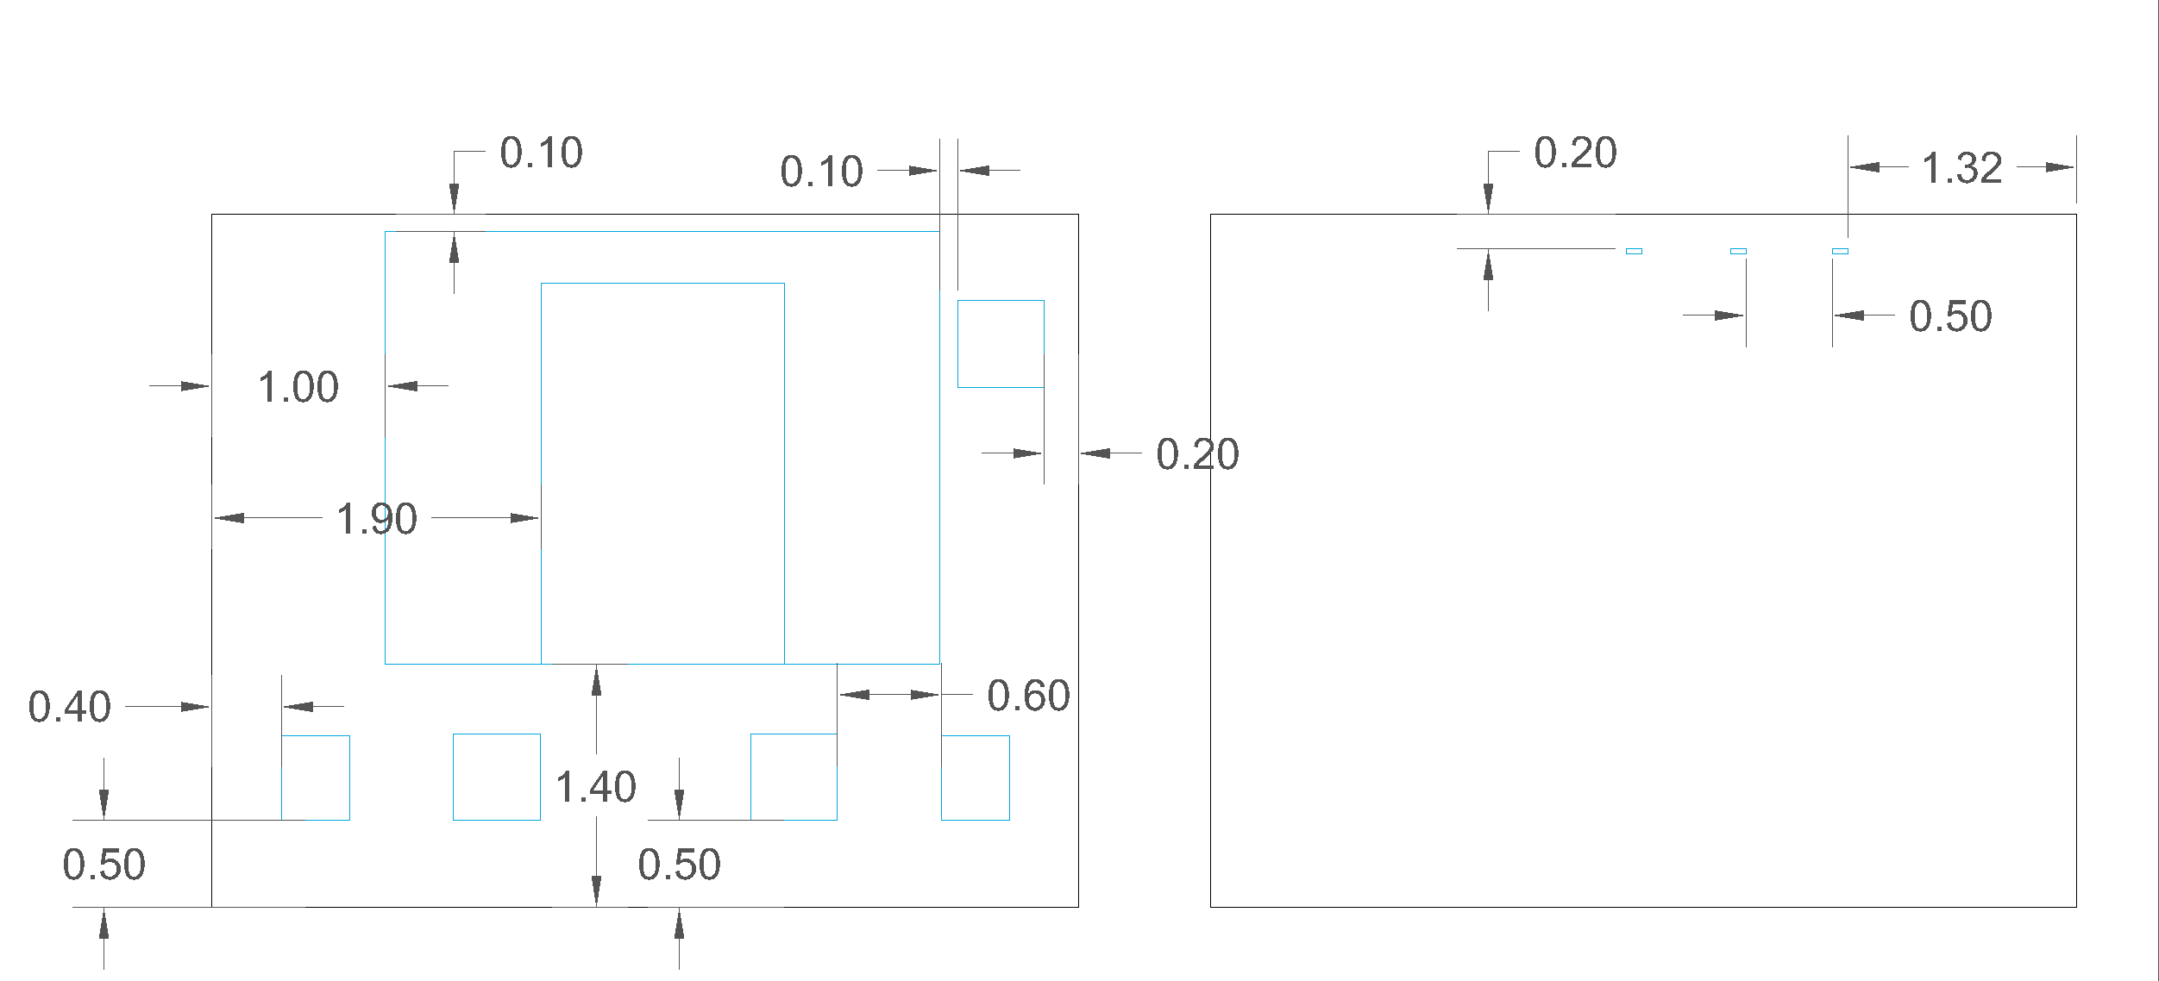
Mechanical Drawing
Units: inches
SPI Display
LED
LED
LED
USB
Host
Pocketbeagle
Pot
Button
Button
Pot
FRONT
BACK

