Slide 1
SOILS SFA | PROSSER TIME SERIES
MicroResp-linked expression resolves three seasonal programs
Targeted BRITE C pathways and BRITE D KOs: GAM review, temporal clustering, and storyboard synthesis
100% irrigation metatranscriptomes | Seven dates | July 2026
Notes:
[Sources]
Storyboard: SFA3-1-1_VGC_Storyboard_v2.docx
Analysis: Scripts/12_MicroResp_targeted_BRITE_C_D_GAM_and_clustering.R

Slide 2
MICRORESP-LINKED EXPRESSION
Filtering narrows the transcriptome to functions tied to assayed substrates
The explicit MicroResp-to-KEGG map was joined to previously fitted random-plot GAMs. All mapped, converged trajectories were clustered after within-feature z-scoring; targeted-set FDR identifies the strongest time-varying subset.
31
985
k = 3
BRITE C pathways mapped and clustered
BRITE D KOs clustered from 1,312 requested
automatic elbow at both annotation levels
Significant within the targeted set: 20 BRITE C pathways and 230 BRITE D KOs. Distance: 1 - Pearson correlation; linkage: Ward.D2.
Source: Results/MicroResp_targeted_BRITE_C_D/*_run_summary.csv
2
Notes:
[Sources]
Results/MicroResp_targeted_BRITE_C_D/MicroResp_BRITE_C_D_run_summary.csv
Data/MicroResp_all_BRITE_C_D_complete.csv
Scripts/12_MicroResp_targeted_BRITE_C_D_GAM_and_clustering.R

Slide 3
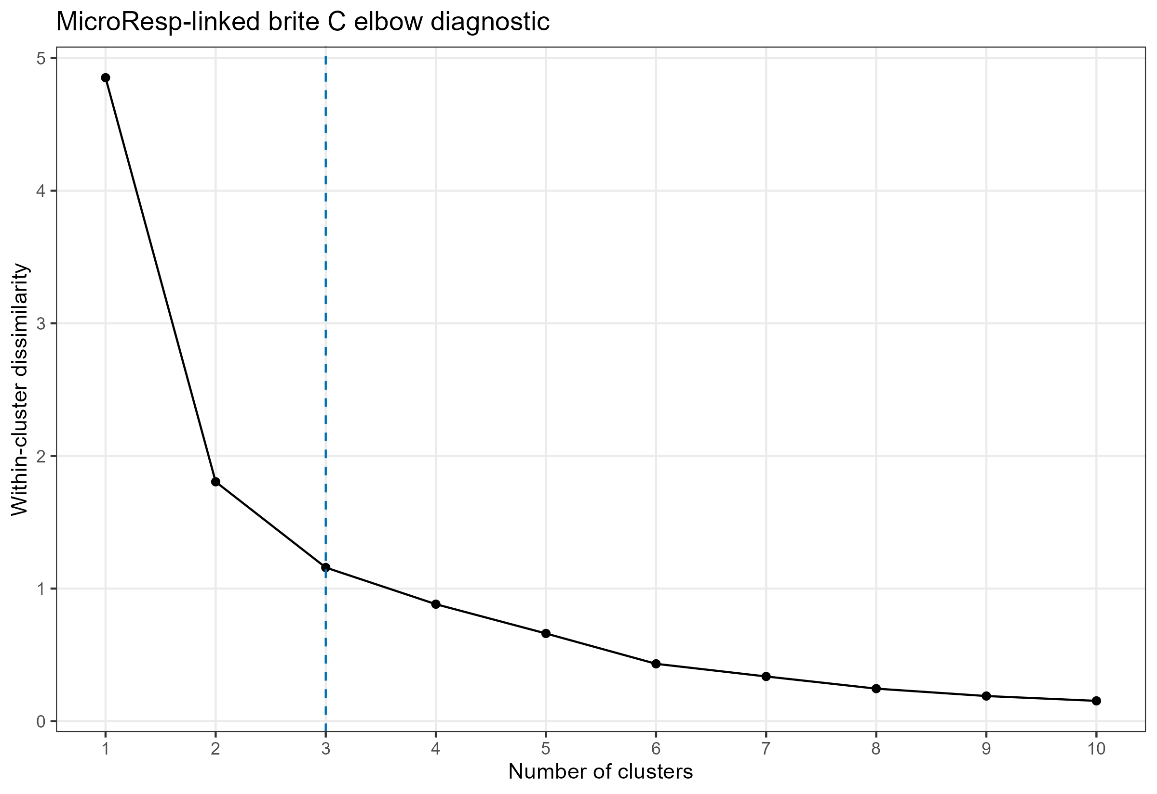
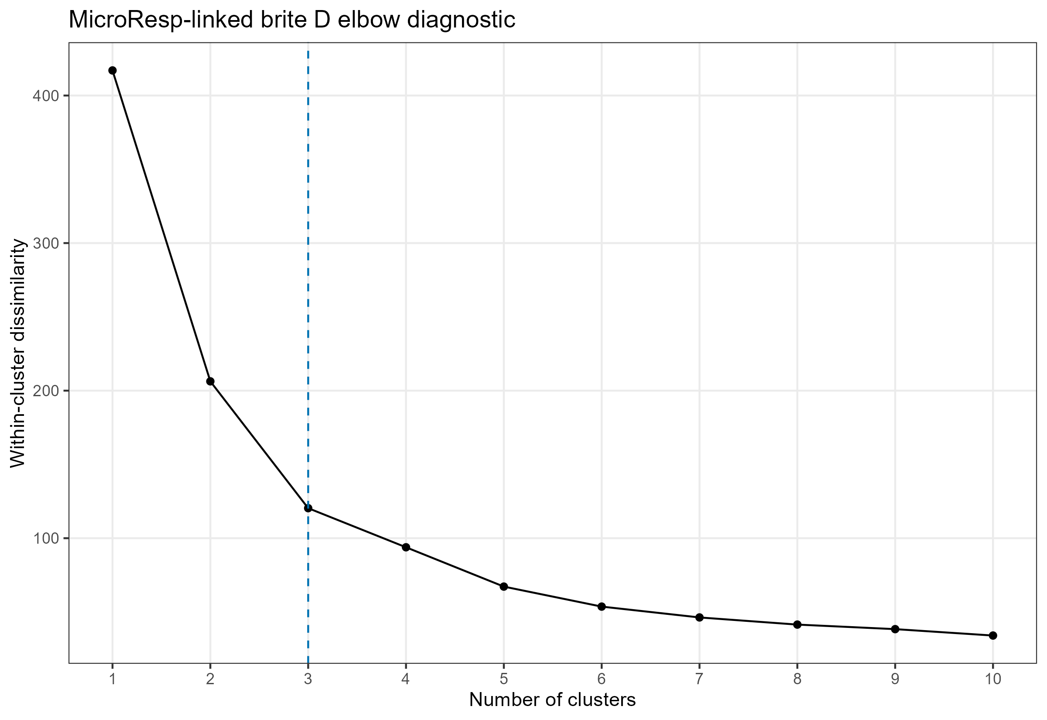
MICRORESP-LINKED EXPRESSION
Both functional resolutions support three temporal expression clusters
BRITE C
BRITE D
Within-cluster dissimilarity drops sharply through k = 3 at both levels. Higher k values continue to subdivide trajectories but add progressively smaller gains.
Source: MicroResp-targeted BRITE C/D elbow diagnostics; automatic selection, no manual override.
3
Notes:
[Sources]
Results/MicroResp_targeted_BRITE_C_D/brite_C_MicroResp_elbow_diagnostics.csv
Results/MicroResp_targeted_BRITE_C_D/brite_D_MicroResp_elbow_diagnostics.csv

Slide 4
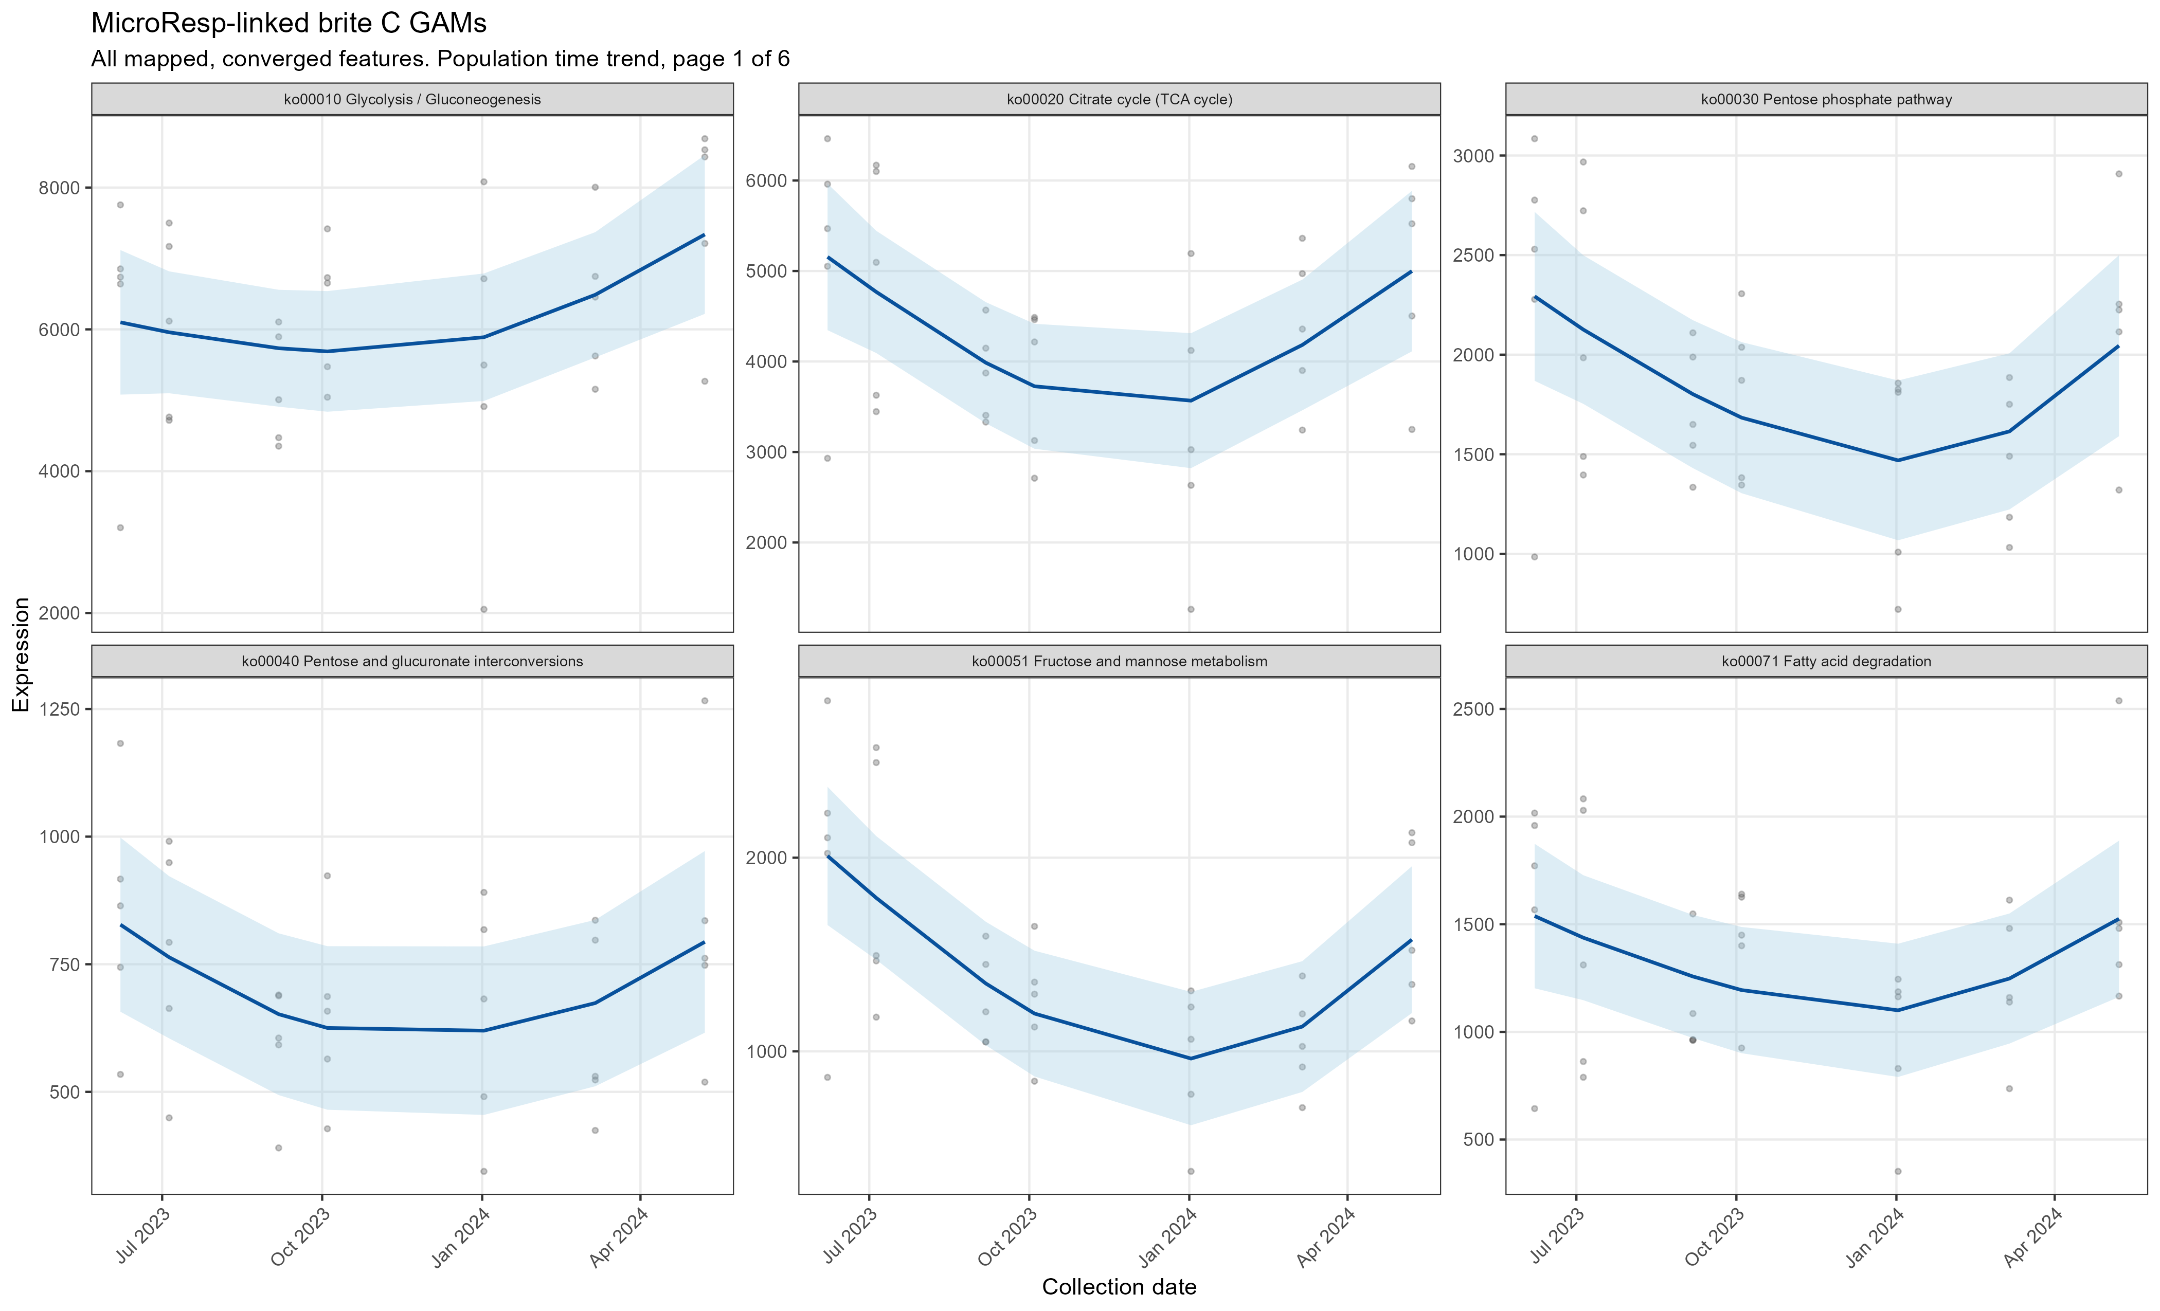
MICRORESP-LINKED BRITE C
Twenty of 31 mapped pathways show targeted-set temporal significance
Cluster 1 | 12 pathways: biosynthesis, glycan use, and aromatic degradation
Cluster 2 | 13 pathways: TCA, N cycling, amino-acid and fatty-acid metabolism
Cluster 3 | 6 pathways: glycolysis, pyruvate, lipid, butanoate functions
GAM evidence
The mapped pathway set contains broad, nonlinear time trends rather than a single synchronized response. Strong signals include arginine biosynthesis, N metabolism, amino-sugar metabolism, and aromatic-compound degradation.
Source: brite_C_MicroResp_GAM_statistics.csv and targeted GAM panels
4
Notes:
[Sources]
Results/MicroResp_targeted_BRITE_C_D/brite_C_MicroResp_GAM_statistics.csv
Figures/MicroResp_targeted_BRITE_C_D/brite_C/brite_C_targeted_GAMs_page_01.png

Slide 6
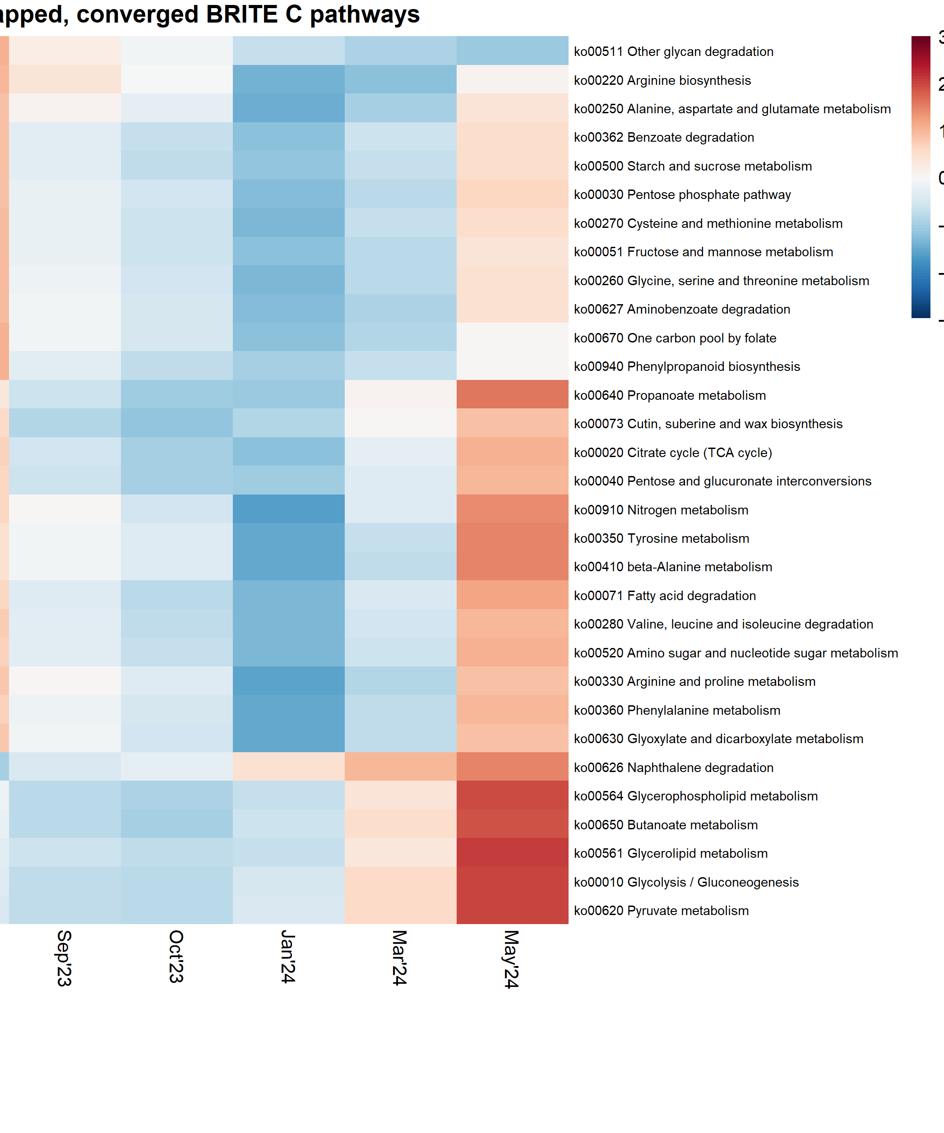
MICRORESP-LINKED BRITE C
Pathway clusters separate broad winter activity from shorter seasonal modes
Cluster 1 | 12 pathways
Pentose phosphate, glycan degradation, amino-acid biosynthesis, benzoate/aminobenzoate degradation, and folate-linked C1 metabolism.
Cluster 2 | 13 pathways
TCA and glyoxylate cycles, N metabolism, amino-sugar metabolism, fatty-acid degradation, and several amino-acid degradation routes.
Cluster 3 | 6 pathways
Glycolysis, pyruvate and butanoate metabolism, glycerolipid and glycerophospholipid metabolism, plus naphthalene degradation.
The heatmap includes every mapped, converged BRITE C pathway. Rows are z-scored, so color represents trajectory shape rather than absolute expression.
Source: brite_C_MicroResp_cluster_assignments.csv and brite_C_MicroResp_heatmap.png
5
Notes:
[Sources]
Results/MicroResp_targeted_BRITE_C_D/brite_C_MicroResp_cluster_assignments.csv
Figures/MicroResp_targeted_BRITE_C_D/brite_C/brite_C_MicroResp_heatmap.png

Slide 7
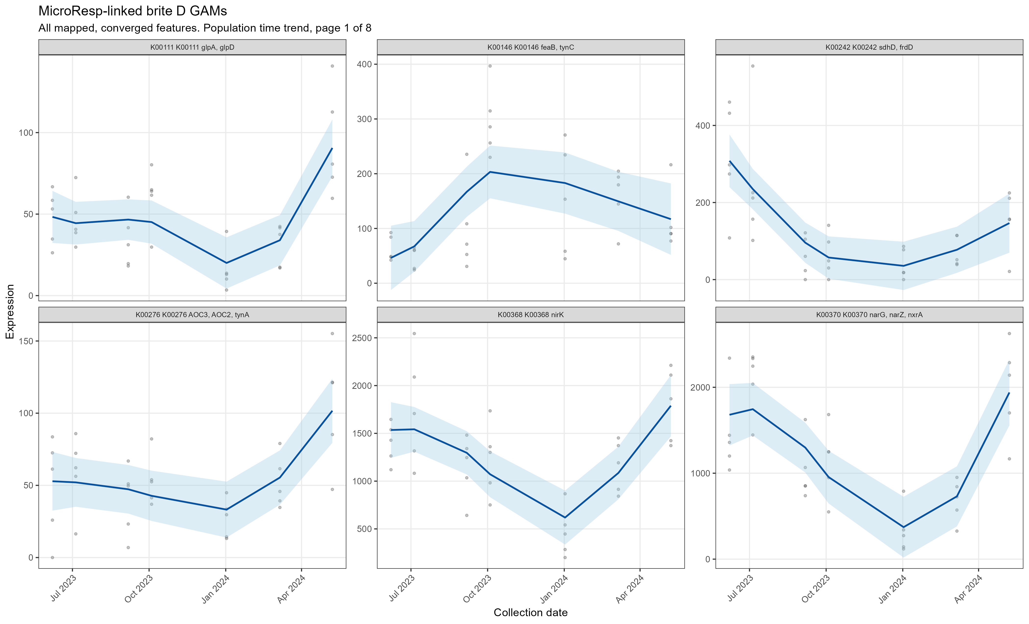
MICRORESP-LINKED BRITE D
KO-level GAMs reveal strong but heterogeneous seasonal expression
Cluster 1 | 477 KOs (48%): includes urease, polyamine, TCA, and aromatic-use genes
Cluster 2 | 245 KOs (25%): includes nitrate reduction and storage-carbon functions
Cluster 3 | 263 KOs (27%): includes sugar, amino-acid, and N-oxide functions
Resolution matters
Of 1,312 mapped KOs requested; 230 were temporally significant, 985 converged and were clustered within the targeted set. KO diversity shows that pathway-level averages can conceal opposing constituent trajectories.
Source: brite_D_MicroResp_GAM_statistics.csv and targeted GAM panels
6
Notes:
[Sources]
Results/MicroResp_targeted_BRITE_C_D/brite_D_MicroResp_GAM_statistics.csv
Figures/MicroResp_targeted_BRITE_C_D/brite_D/brite_D_targeted_GAMs_page_01.png

Slide 8
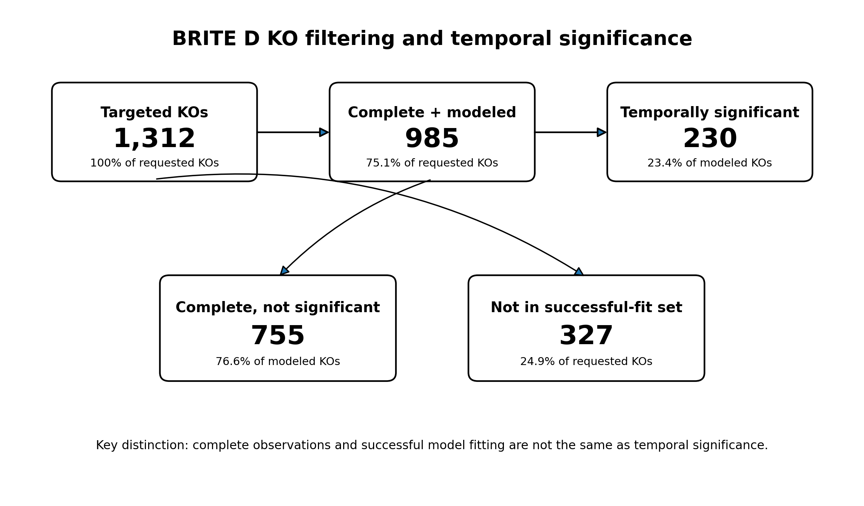

Slide 9
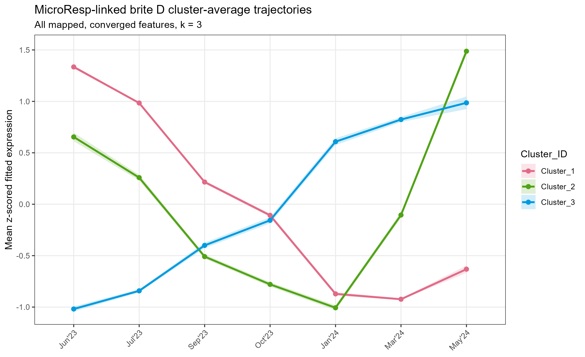
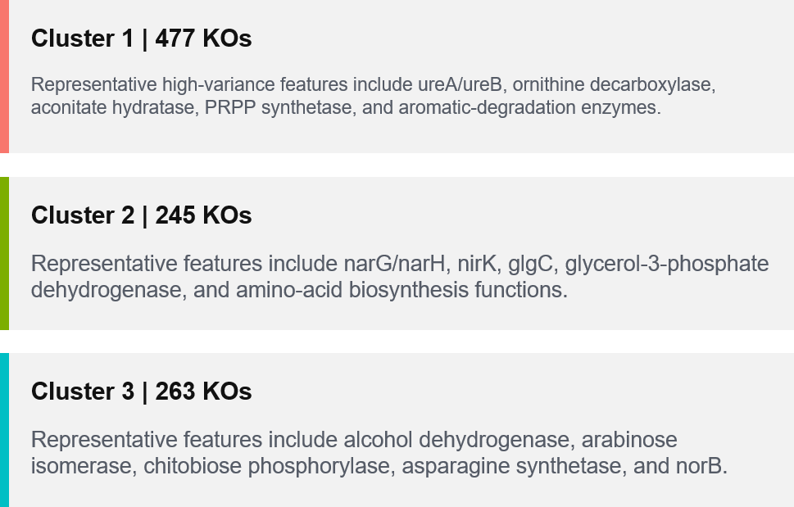

Slide 10
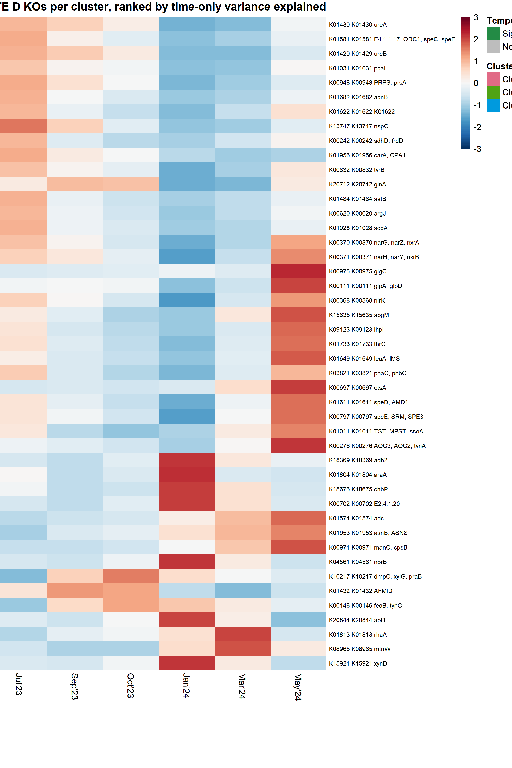
MICRORESP-LINKED BRITE D
The strongest KO trajectories connect C use with nitrogen and stress metabolism
Cluster 1 | 477 KOs
Representative high-variance features include ureA/ureB, ornithine decarboxylase, aconitate hydratase, PRPP synthetase, and aromatic-degradation enzymes.
Cluster 2 | 245 KOs
Representative features include narG/narH, nirK, glgC, glycerol-3-phosphate dehydrogenase, and amino-acid biosynthesis functions.
Cluster 3 | 263 KOs
Representative features include alcohol dehydrogenase, arabinose isomerase, chitobiose phosphorylase, asparagine synthetase, and norB.
For readability, the BRITE D heatmap shows the top 15 features per cluster ranked by time-only variance explained; all 985 converged KOs remain in the clustering.
Source: brite_D_MicroResp_heatmap_feature_selection.csv
7
Notes:
[Sources]
Results/MicroResp_targeted_BRITE_C_D/brite_D_MicroResp_heatmap_feature_selection.csv
Results/MicroResp_targeted_BRITE_C_D/brite_D_MicroResp_cluster_assignments.csv

Slide 11
STORYBOARD SYNTHESIS
Targeted expression partly supports the winter phenotype, not a one-to-one match
Storyboard claim
Targeted BRITE C
Targeted BRITE D
Broad winter/early-spring phenotype
Three modes; N, TCA, amino-sugar, and fatty-acid pathways represented
Three modes; nitrate, urease, C-use, amino-acid, and stress KOs represented
Sharp Sep-Oct fall pulse
No single dominant pathway cluster uniquely reproduces the pulse
No single dominant KO cluster uniquely reproduces the pulse
Cross-scale conclusion
Partial coordination across expressed pathways, consistent with the storyboard
Heterogeneity at KO resolution reinforces assay-specific variation
Interpretation: seasonal substrate-use capacity and expression overlap, but transient phenotypes may require denser sampling or remain assay-specific.
8
Notes:
[Sources]
SFA3-1-1_VGC_Storyboard_v2.docx
Results/MicroResp_targeted_BRITE_C_D/brite_C_MicroResp_cluster_assignments.csv
Results/MicroResp_targeted_BRITE_C_D/brite_D_MicroResp_cluster_assignments.csv

