Slide 1
SOILS SFA | PROSSER TIME SERIES
MEFISTO Factor 1 genes contain three seasonal expression programs
Factor 1 gene selection, BRITE aggregation, temporal GAMs, MicroResp overlap, and trajectory clustering
100% irrigation metatranscriptomes | Seven dates | July 2026
Notes:
[Sources]
Scripts/13_Factor1_expression_MicroResp_BRITE_C_D.R
SFA3-1-1_VGC_Storyboard_v2.docx

Slide 2
FACTOR 1 FOLLOW-ON ANALYSIS
The workflow asks which Factor 1 transcripts align with MicroResp-linked functions
MEFISTO Factor 1 features were filtered from the original expression matrix, annotated to KEGG, aggregated to BRITE C pathways and BRITE D KOs, modeled through time, intersected with the MicroResp map, and clustered by fitted trajectory shape.
770k
516
6,789
unique Factor 1 transcript features
unique BRITE C pathways represented
unique BRITE D KOs represented
GAM: Expression ~ s(time, k = 6) + s(Plot, random effect). Clustering: row z-score, 1 - Pearson correlation, Ward.D2.
Source: factor1_gene_summary.csv and run_manifest.csv
2
Notes:
[Sources]
Results/Factor1_BRITE_MicroResp/factor1_gene_summary.csv
Results/Factor1_BRITE_MicroResp/run_manifest.csv
Scripts/13_Factor1_expression_MicroResp_BRITE_C_D.R

Slide 3
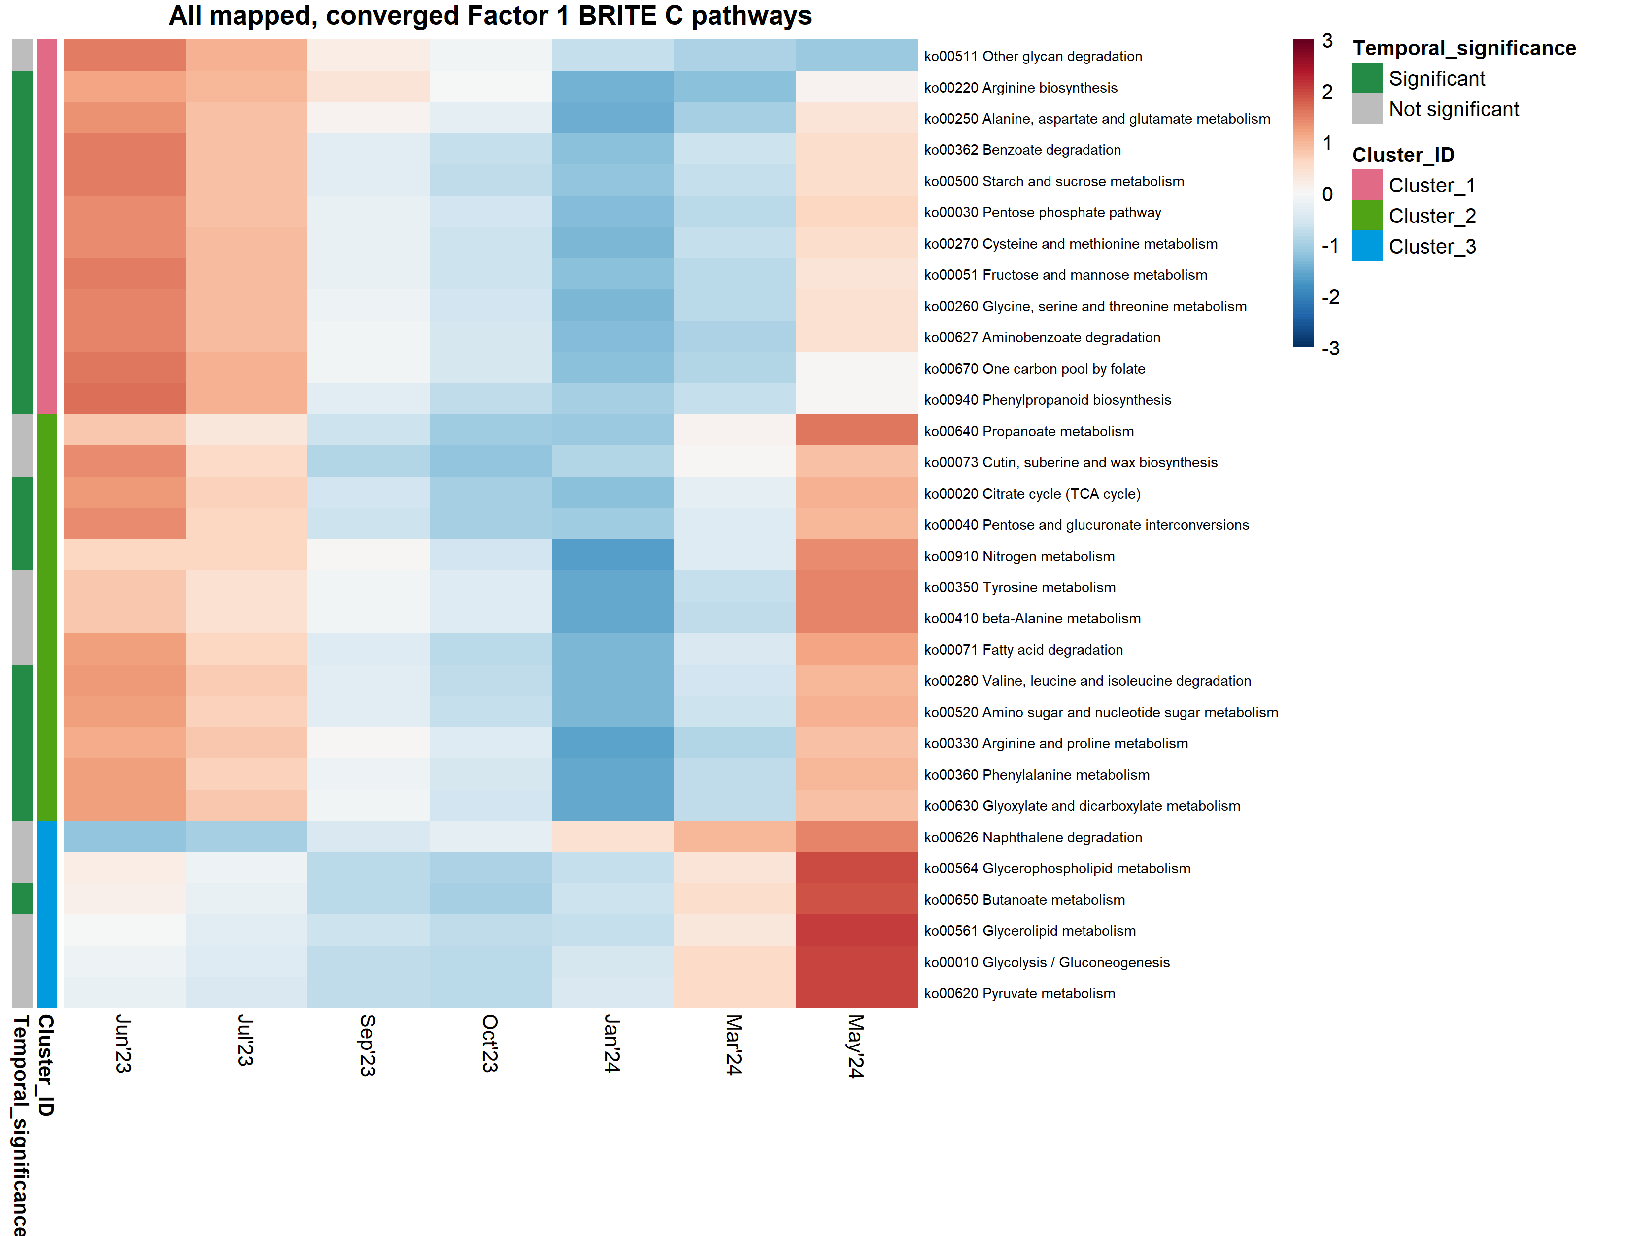
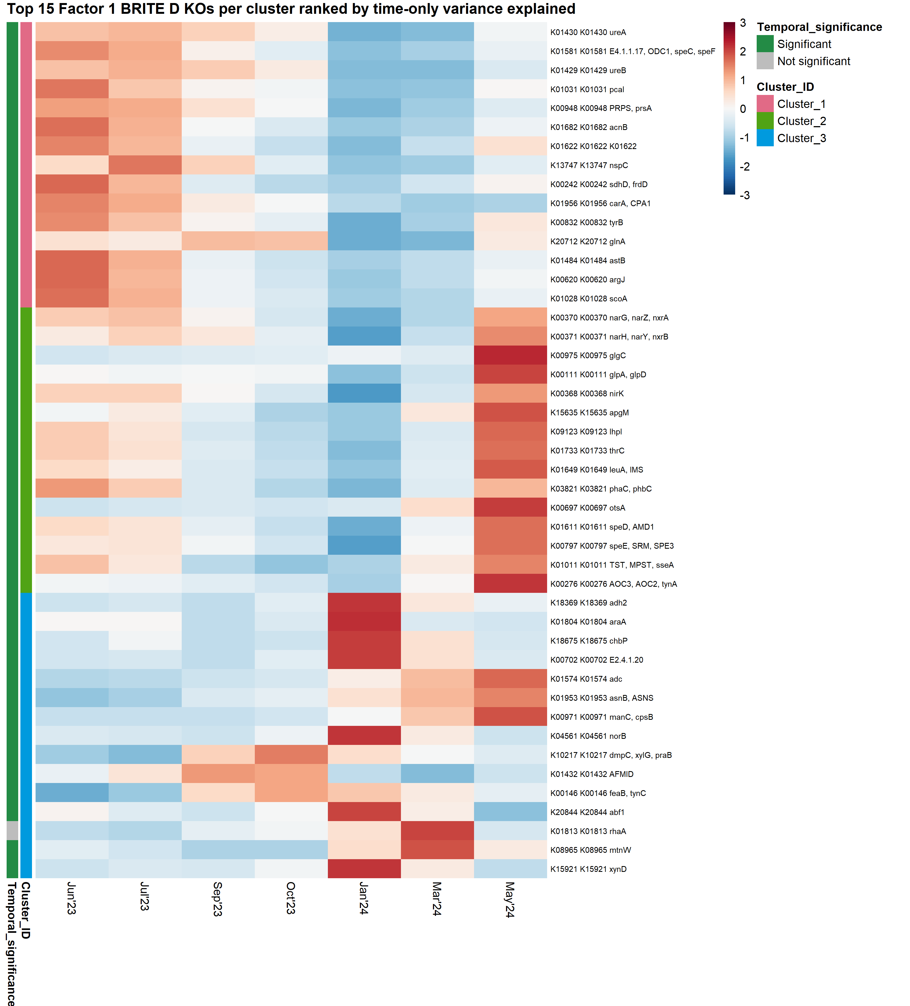
FACTOR 1 FUNCTIONAL BREADTH
Factor 1 genes span broad pathway- and KO-level functional space
BRITE C
BRITE D
The most gene-rich annotations include central metabolism, biosynthesis, transport, energy conservation, and information-processing functions.
Bars count Factor 1 genes per annotation; they do not show loading sign or temporal significance.
3
Notes:
[Sources]
Results/Factor1_BRITE_MicroResp/factor1_brite_C_summary.csv
Results/Factor1_BRITE_MicroResp/factor1_brite_D_summary.csv
Figures/Factor1_BRITE_MicroResp/factor1_brite_C_gene_counts.png
Figures/Factor1_BRITE_MicroResp/factor1_brite_D_gene_counts.png

Slide 4
MICRORESP OVERLAP AND CLUSTERING
The MicroResp-linked Factor 1 subset supports three expression clusters
BRITE C
BRITE D
MicroResp mapping matched 31/516 Factor 1 pathways and 1,113/6,789 Factor 1 KOs. After model matching, 31 pathways and 985 KOs were clustered; both elbows selected k = 3.
Target-set FDR significance: 20 BRITE C pathways and 230 BRITE D KOs.
5
Notes:
[Sources]
Results/Factor1_BRITE_MicroResp/factor1_microresp_overlap_summary.csv
Results/Factor1_BRITE_MicroResp/clustering/Factor1_MicroResp_clustering_run_summary.csv
Results/Factor1_BRITE_MicroResp/clustering/brite_C_Factor1_MicroResp_elbow_diagnostics.csv
Results/Factor1_BRITE_MicroResp/clustering/brite_D_Factor1_MicroResp_elbow_diagnostics.csv

Slide 5
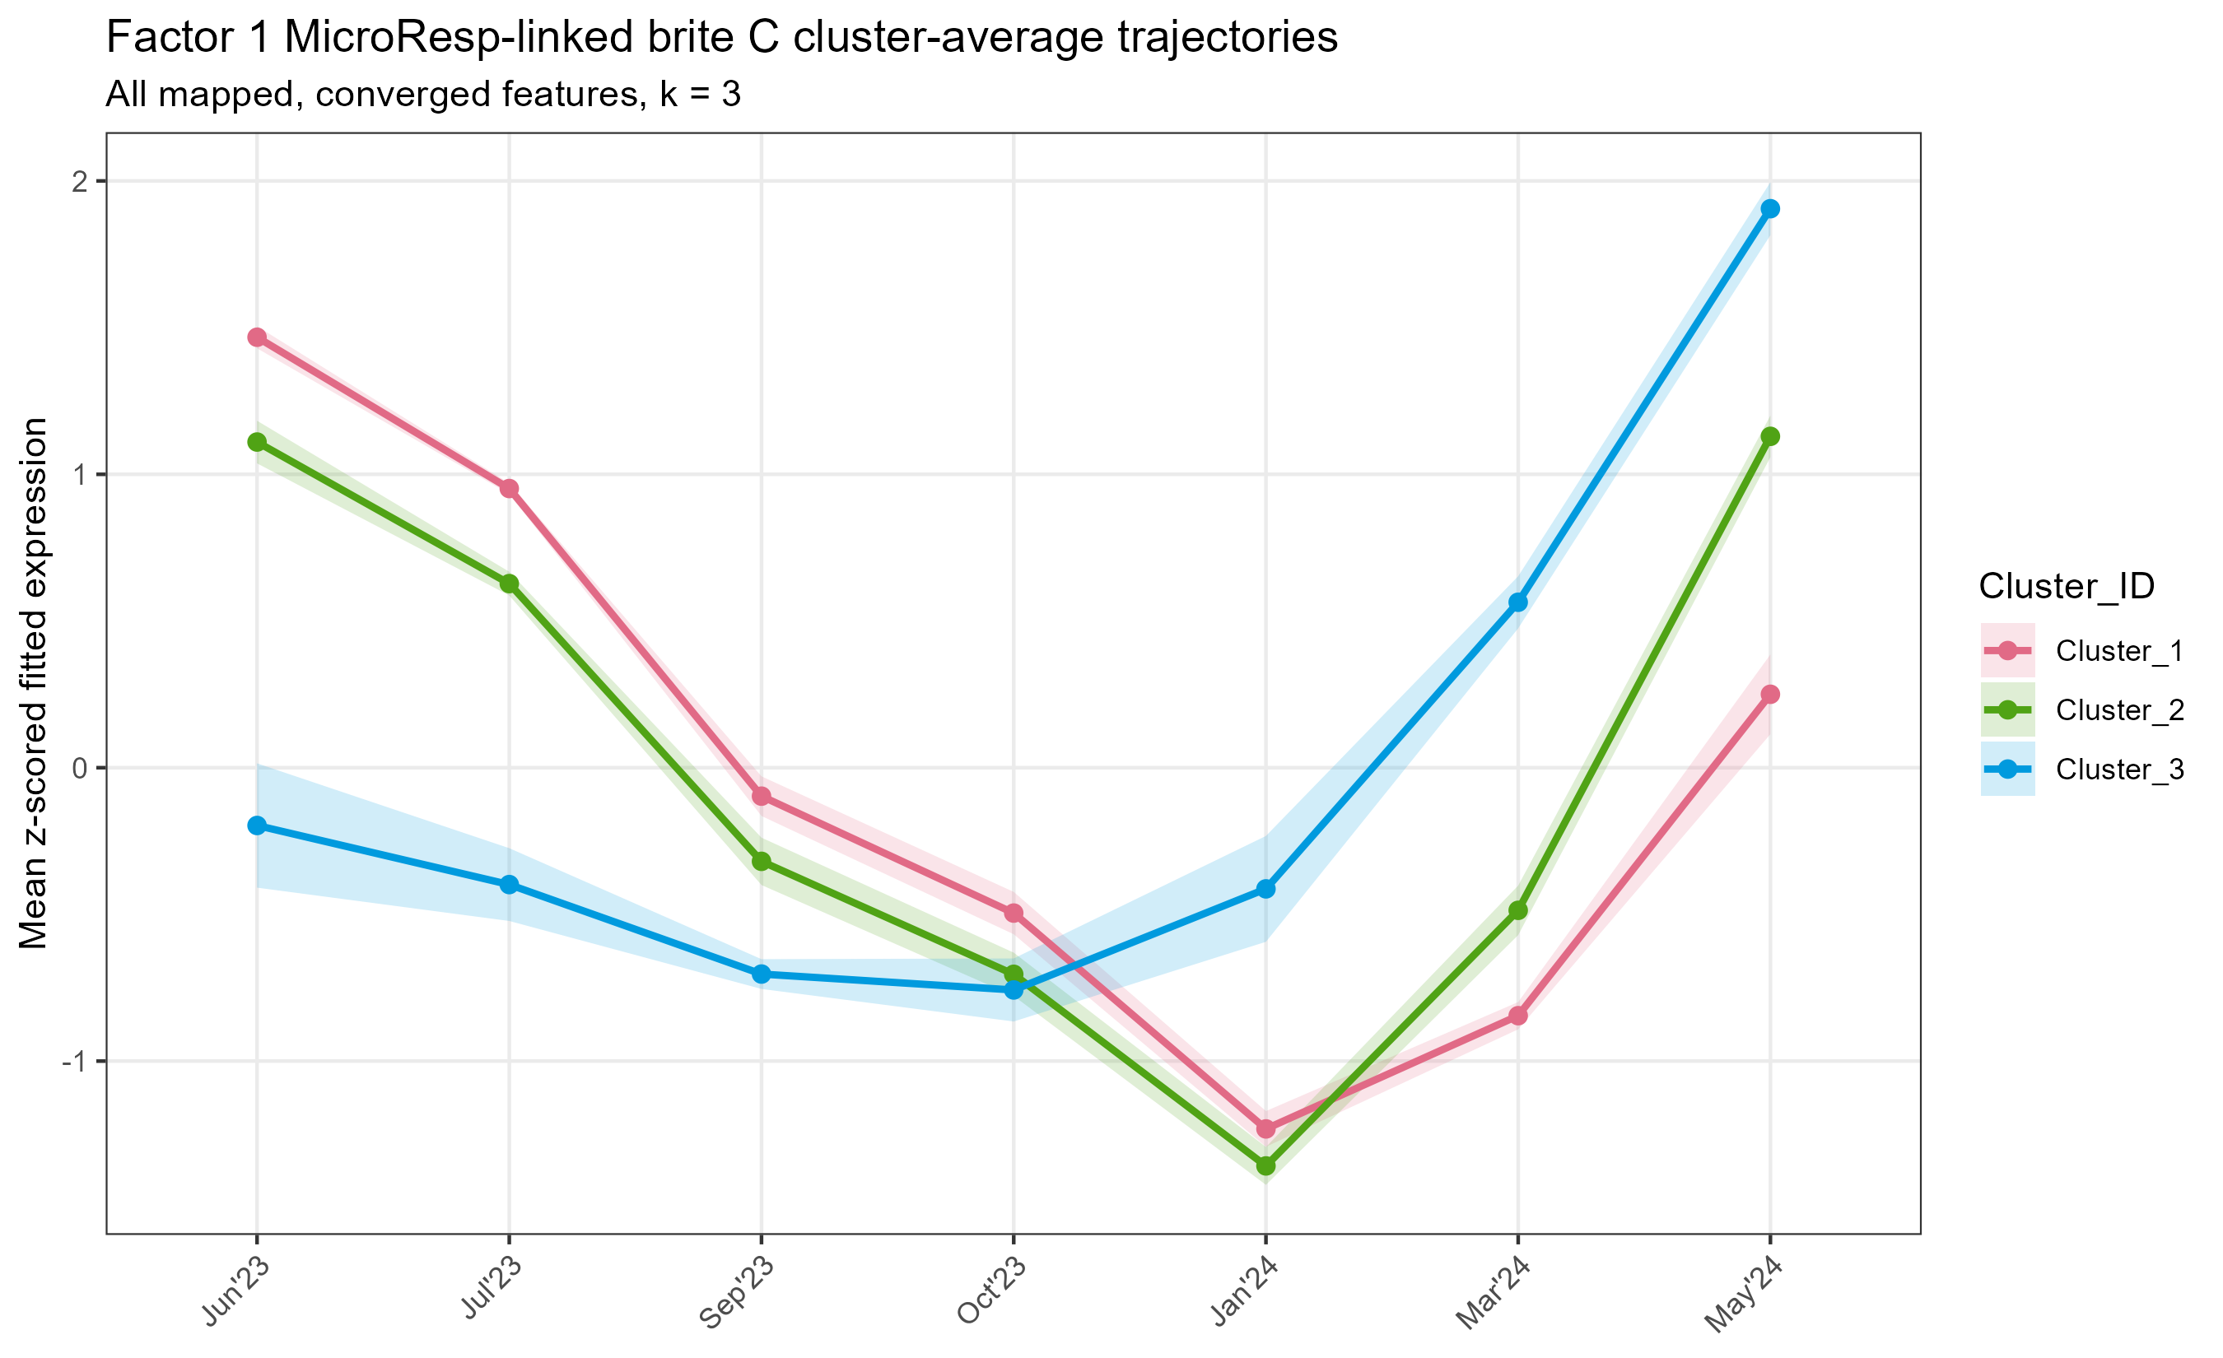
FACTOR 1 | BRITE C
Pathway clusters separate early-high, rebound, and late-activation modes
Cluster 1 | 12 pathways: highest in Jun-Jul, minimum in Jan
Cluster 2 | 13 pathways: early-high, Jan minimum, strong May rebound
Cluster 3 | 6 pathways: low through Oct, then rises to a May maximum
Connection to Factor 1
Cluster 3 most closely resembles the winter/early-spring activation described in the storyboard. Clusters 1 and 2 show that Factor 1 membership also contains early-season and rebound programs.
Source: brite_C Factor 1 cluster assignments and average trajectories
6
Notes:
[Sources]
Results/Factor1_BRITE_MicroResp/clustering/brite_C_Factor1_MicroResp_cluster_assignments.csv
Results/Factor1_BRITE_MicroResp/clustering/brite_C_Factor1_MicroResp_cluster_average_trajectories.csv

Slide 6
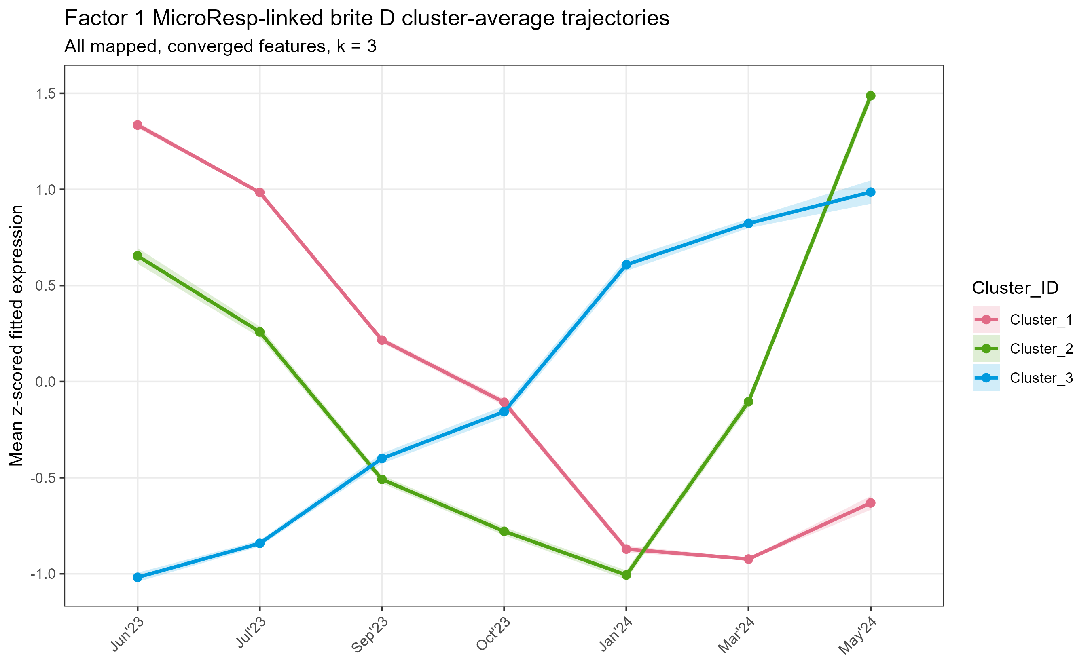
FACTOR 1 | BRITE D
KO-level clusters resolve a large sustained late-activation program
Cluster 1 | 477 KOs: highest in Jun-Jul, sustained decline afterward
Cluster 2 | 245 KOs: early-high, Jan minimum, strong May rebound
Cluster 3 | 263 KOs: low in summer, increases from Jan through May
Functional examples
Late/rebound groups include nitrate and nitrite reduction, storage-carbon, amino-acid, sugar-use, and N-oxide functions. Early-high genes include urease, polyamine, TCA, and aromatic-use functions.
Source: brite_D Factor 1 cluster assignments and average trajectories
7
Notes:
[Sources]
Results/Factor1_BRITE_MicroResp/clustering/brite_D_Factor1_MicroResp_cluster_assignments.csv
Results/Factor1_BRITE_MicroResp/clustering/brite_D_Factor1_MicroResp_cluster_average_trajectories.csv

Slide 7
STORYBOARD SYNTHESIS
Factor 1 supports partial coordination, with an important sign-specific caveat
The late-activation clusters support the storyboard's interpretation that part of the Factor 1 transcript signal tracks the winter/early-spring MicroResp phenotype. Other clusters reveal early-high and rebound programs within the same Factor 1 feature set.
Support
Caveat
Next
263 KOs and 6 pathways rise from winter toward May
This analysis combines positive and negative Factor 1 loadings
Repeat clustering separately by loading sign
Factor 1 membership is broader than the sign-specific reconstructed trajectory. Separating loading direction would provide the cleanest direct test of the storyboard's negative-weight winter signal.
Source: Factor 1 cluster outputs and manuscript storyboard
9
Notes:
[Sources]
SFA3-1-1_VGC_Storyboard_v2.docx
Data/factor1_all_omic_genes.csv
Results/Factor1_BRITE_MicroResp/clustering/Factor1_MicroResp_clustering_run_summary.csv
Scripts/13_Factor1_expression_MicroResp_BRITE_C_D.R

