Slide 1
SOILS SFA | PROSSER TIME SERIES
Temporal clustering of significant BRITE pathways and KOs
GAM-fitted metatranscriptomic trajectories after KEGG exclusion filtering
BRITE C and BRITE D analyzed separately | Seven sampling dates | July 2026

Slide 2
BRITE TEMPORAL CLUSTERING
Two functional resolutions reveal the same three timing modes
Only converged, FDR-significant GAM trajectories were clustered. Each feature was z-scored, so the analysis compares temporal shape rather than absolute expression.
155
995
k = 3
significant BRITE C pathways
significant BRITE D KOs
elbow-selected clusters at both levels
Inputs: GAM-fitted expression at Jun, Jul, Sep, Oct, Jan, Mar, and May. Distance: 1 − Pearson correlation. Linkage: Ward.D2.
Source: Results/BRITE_clustering_elbow/BRITE_clustering_run_summary.csv
2

Slide 3
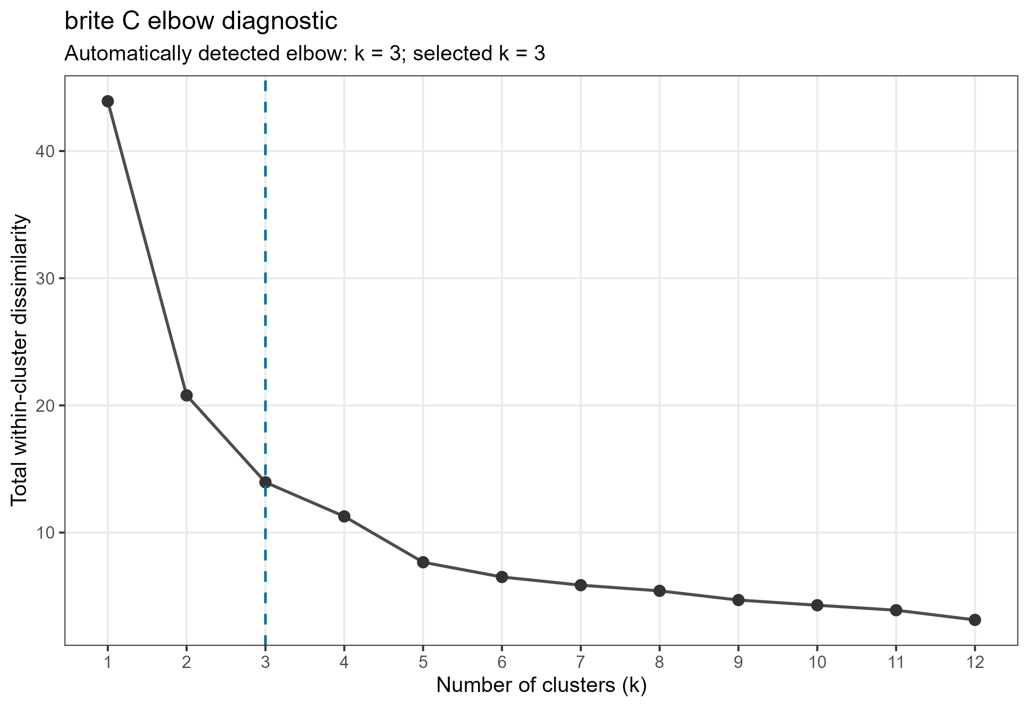
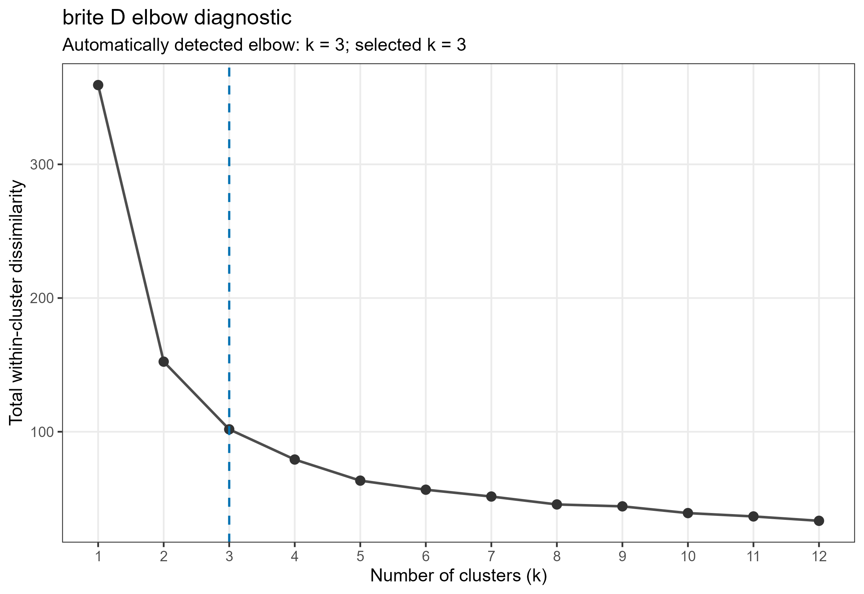
BRITE TEMPORAL CLUSTERING
Both annotation levels show a reproducible elbow at three clusters
BRITE C
BRITE D
Most of the reduction in within-cluster dissimilarity occurs by k = 3. Additional clusters provide progressively smaller gains and would subdivide the main temporal modes.
Source: elbow_diagnostics.csv for BRITE C and BRITE D. Automatic selection, no manual override.
3

Slide 4
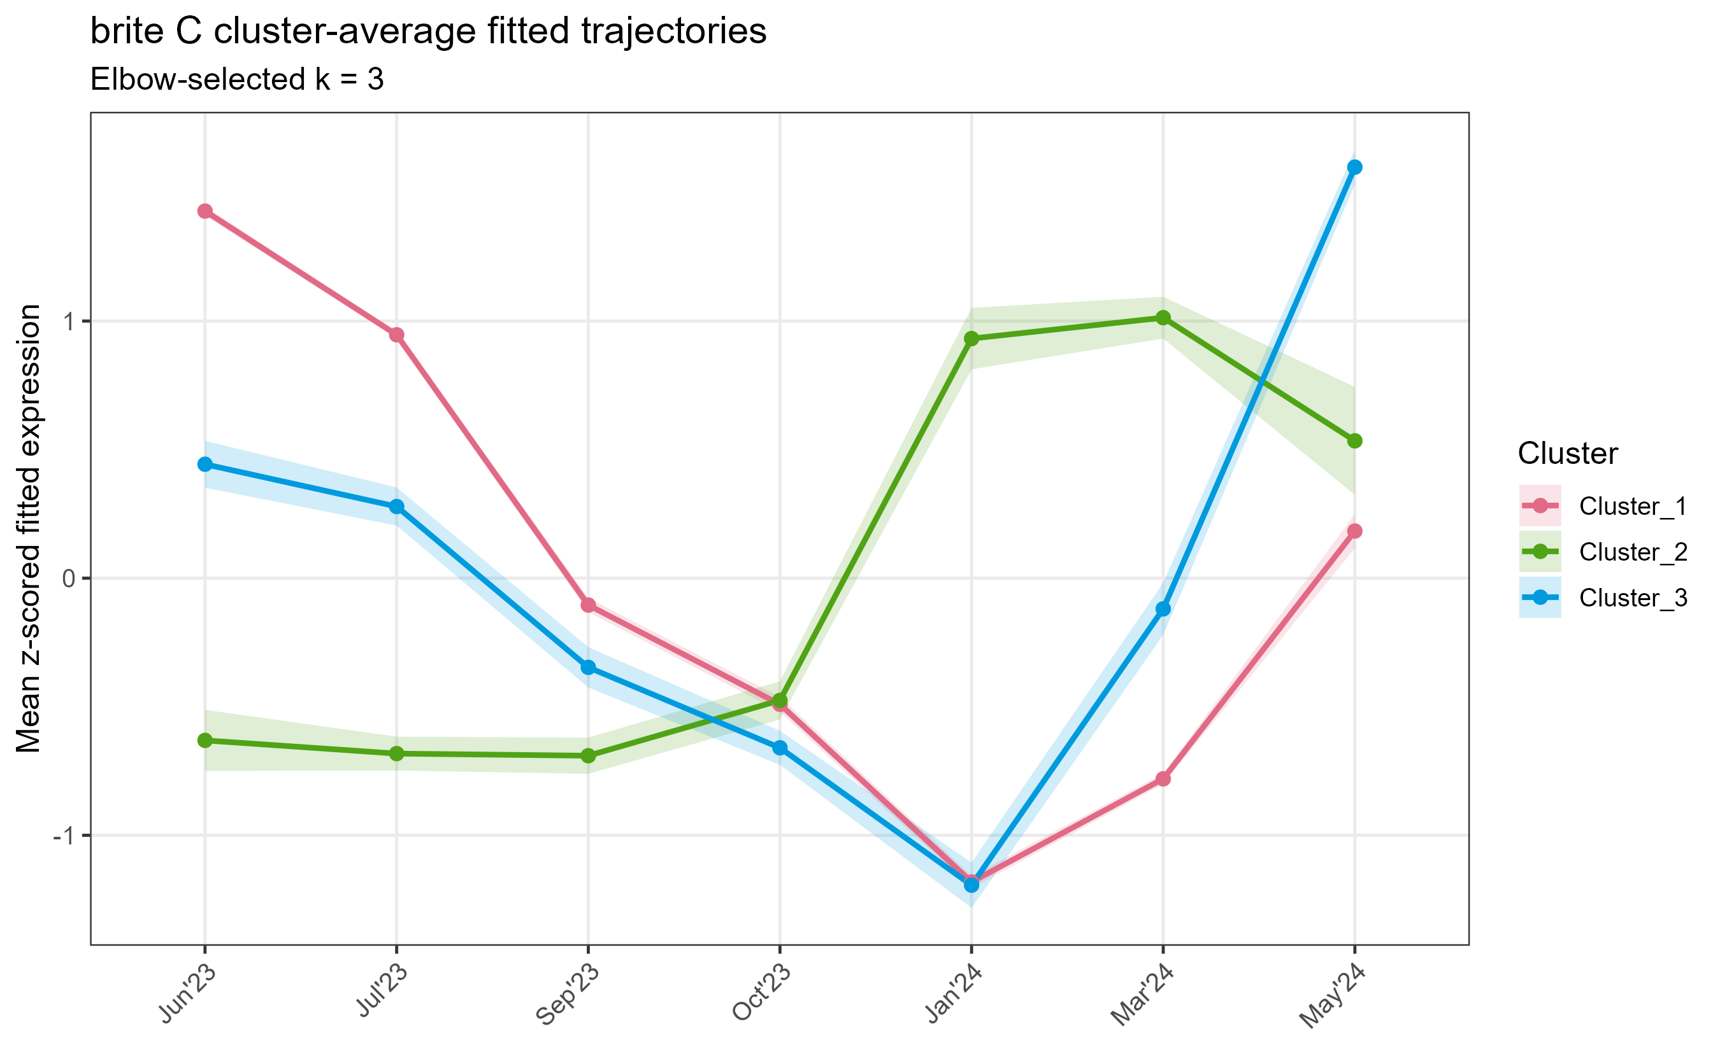
BRITE TEMPORAL CLUSTERING
BRITE C separates early activity, winter activation, and a May rebound
Cluster 1 | 104 pathways (67%): high in Jun–Jul, lowest in Jan
Cluster 2 | 25 pathways (16%): low through Oct, highest in Jan–Mar
Cluster 3 | 26 pathways (17%): declines to Jan, then peaks sharply in May
High-level meaning
Most significant pathways share an early-high trajectory, but one-third follow winter or late-spring activation patterns. The pathway-level response is therefore structured, not a single seasonal shift.
Source: brite_C/cluster_average_trajectories.csv and cluster_summary.csv
4

Slide 5
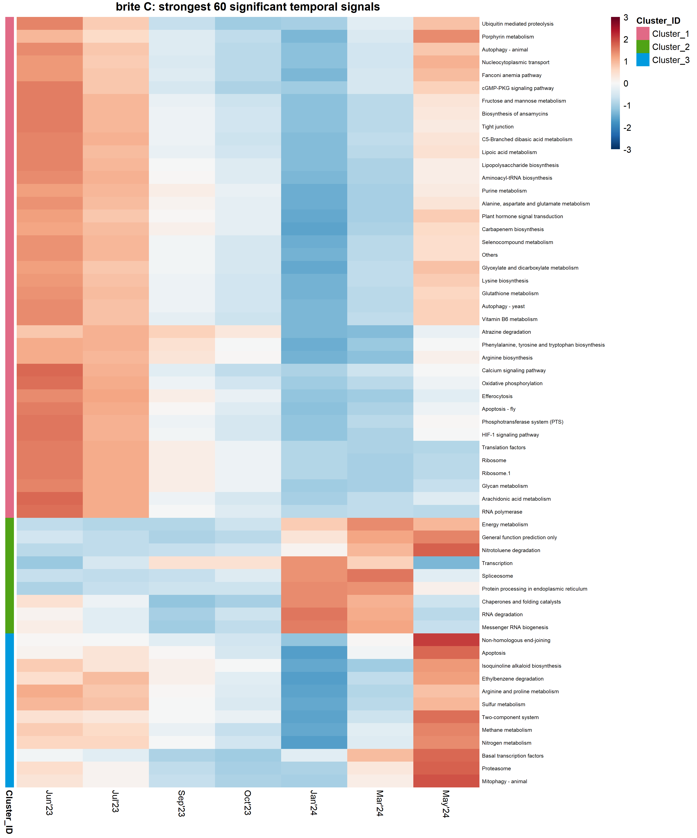
BRITE TEMPORAL CLUSTERING
Pathway identities suggest distinct functional programs across the year
Early-high group
Ribosome and translation, oxidative phosphorylation, arginine biosynthesis, glutathione metabolism, and lipopolysaccharide biosynthesis.
Winter-high group
Energy metabolism, transcription, RNA processing and degradation, chaperones, and protein processing.
May-rebound group
Nitrogen, methane, and sulfur metabolism, two-component signaling, proteasome activity, and arginine/proline metabolism.
Interpretation caution: KEGG pathway names such as apoptosis or animal signaling reflect orthology-based labels. They should not be treated as organism-specific functions without checking the contributing KOs and taxonomy.
Heatmap shows the 60 significant pathways with highest adjusted R²; it is not a complete functional enrichment analysis.
5

Slide 6
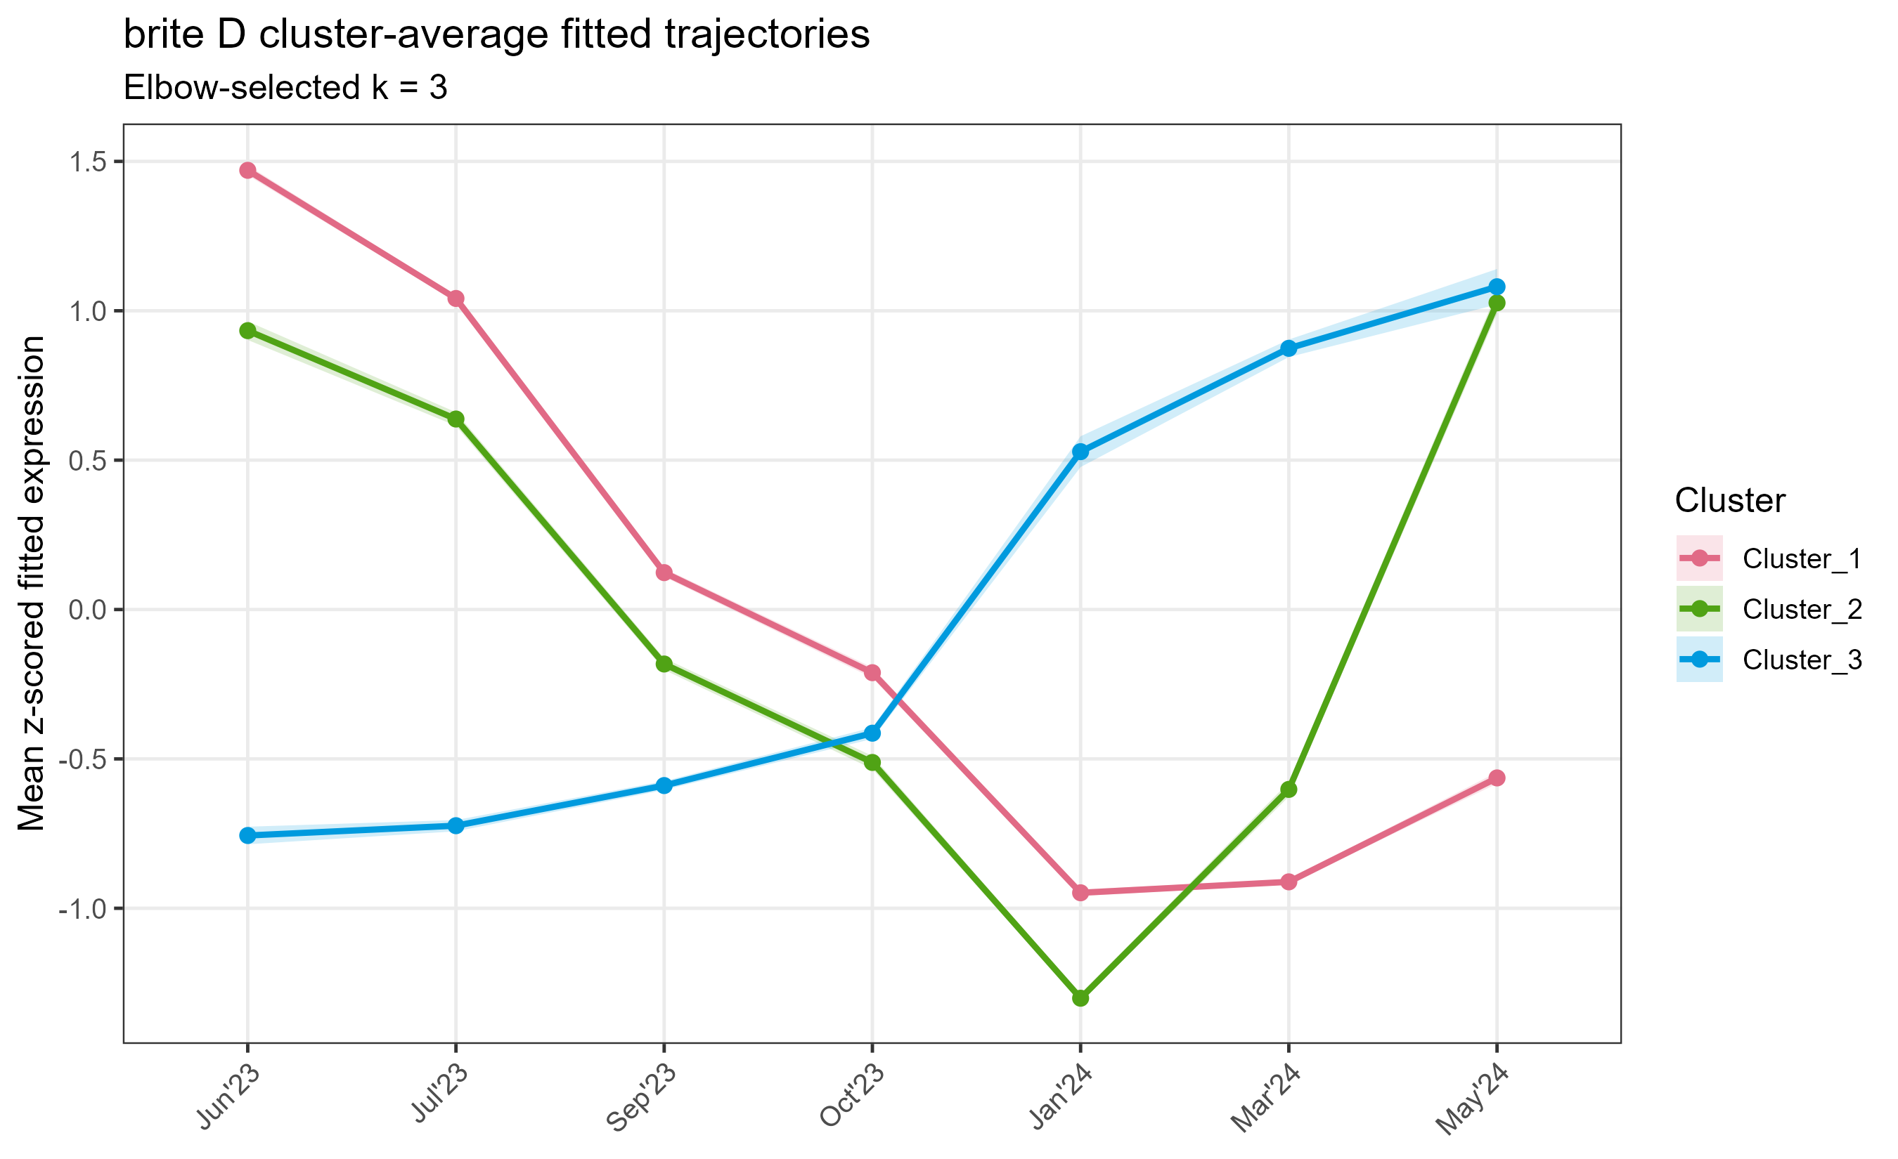
BRITE TEMPORAL CLUSTERING
KO-level clustering resolves a larger late-season activation group
Cluster 1 | 449 KOs (45%): high in Jun–Jul, sustained decline afterward
Cluster 2 | 299 KOs (30%): early-high, Jan minimum, strong May rebound
Cluster 3 | 247 KOs (25%): low through Oct, increases from Jan to May
High-level meaning
At finer resolution, 55% of significant KOs belong to rebound or late-activation trajectories. Aggregated pathways can therefore mask heterogeneous behavior among their constituent genes.
Source: brite_D/cluster_average_trajectories.csv and cluster_summary.csv
6

Slide 7
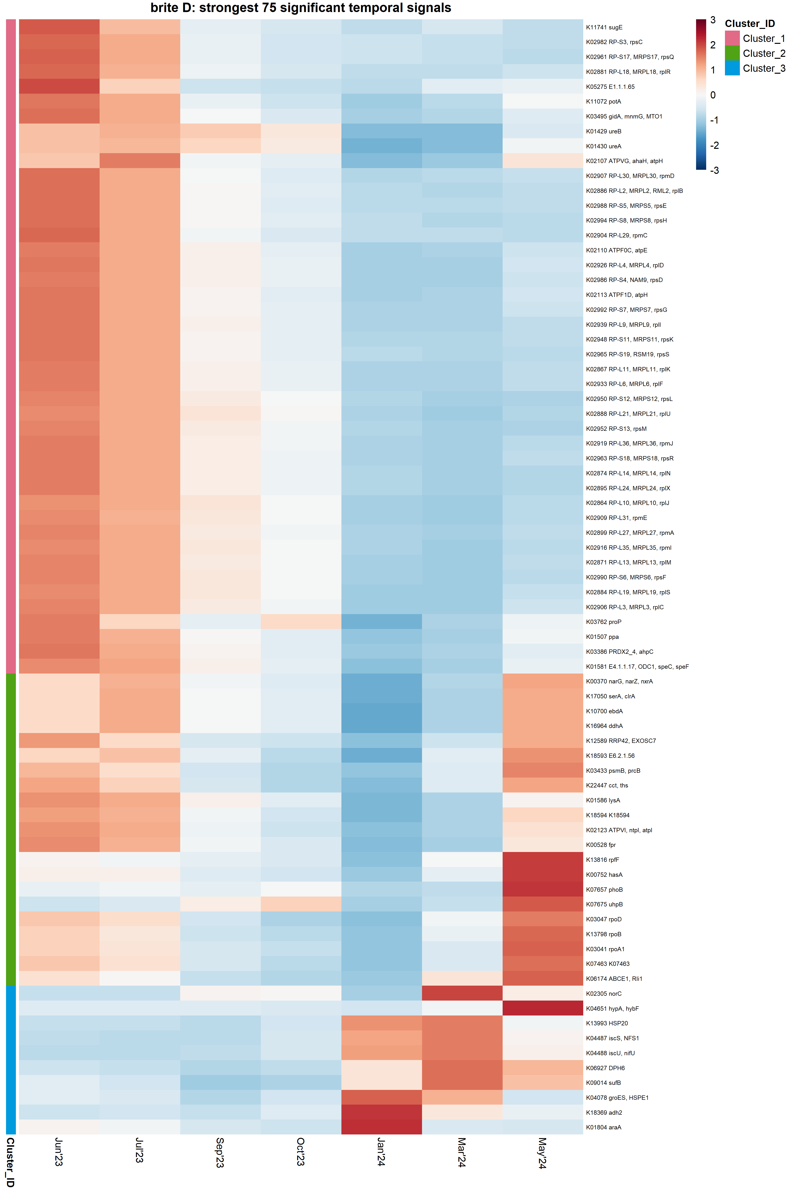
BRITE TEMPORAL CLUSTERING
The strongest KO signals span growth machinery, respiration, and stress response
Early-high group
Many ribosomal proteins, ATPase subunits, urease subunits, polyamine transport, and osmotic or oxidative stress proteins.
May-rebound group
Nitrate/nitrite and sulfur-related reductases, RNA polymerase components, proteasome and chaperonin functions, and phosphate response.
Late-activation group
Nitric oxide reductase, Fe–S cluster assembly proteins (Isc/Suf), HSP20 and GroES chaperones, and selected carbon-use genes.
These examples come from the top 75 features ranked primarily by adjusted R². They illustrate the strongest trajectories, not the proportional functional composition of each full cluster.
Source: brite_D/top_75_heatmap_features.csv
7

Slide 8
BRITE TEMPORAL CLUSTERING
BRITE C and D agree on timing modes, but not on their prevalence
Temporal mode
BRITE C pathways
BRITE D KOs
Early-high
104 | 67%
449 | 45%
Winter/late activation
25 | 16%
247 | 25%
Late-spring rebound
26 | 17%
299 | 30%
Percentages calculated from 155 BRITE C pathways and 995 BRITE D KOs.
8

Slide 9
Temporal pattern | MicroResp | Field transcripts | Interpretation
Winter/early-spring activation | Broad Cluster 2 winter peak | BRITE C winter-high cluster and BRITE D late-activation cluster | Strongest evidence for a seasonal phenotype expressed across scales
Spring rebound | Cluster 2 rebounds near June | BRITE C May-rebound pathways and BRITE D May-rebound KOs | Field transcription may accompany, or potentially precede, renewed substrate-use potential
Early-summer activity | Many MicroResp substrates are relatively low | Large BRITE C and D groups are highest in June–July | Field transcription and standardized substrate-use potential are decoupled during the growing season
Fall pulse | Clear MicroResp Cluster 1 peak in September–October | No comparably dominant BRITE trajectory | Fall potential may be transient, phenotype-specific, or poorly resolved by the transcript sampling
Notes:
Potential substrate-use phenotypes were partially reflected in field-expressed microbial functions. The broad winter/early-spring MicroResp phenotype corresponded with winter- and spring-active transcriptomic programs and was recovered as a shared MEFISTO factor. In contrast, the sharp fall organic-acid pulse was weakly represented in the field transcriptome. Field transcription also contained a strong early-summer program that was not apparent in MicroResp. Thus, laboratory substrate-use potential and field gene expression share seasonal structure but are not interchangeable measures of microbial function.

Slide 10
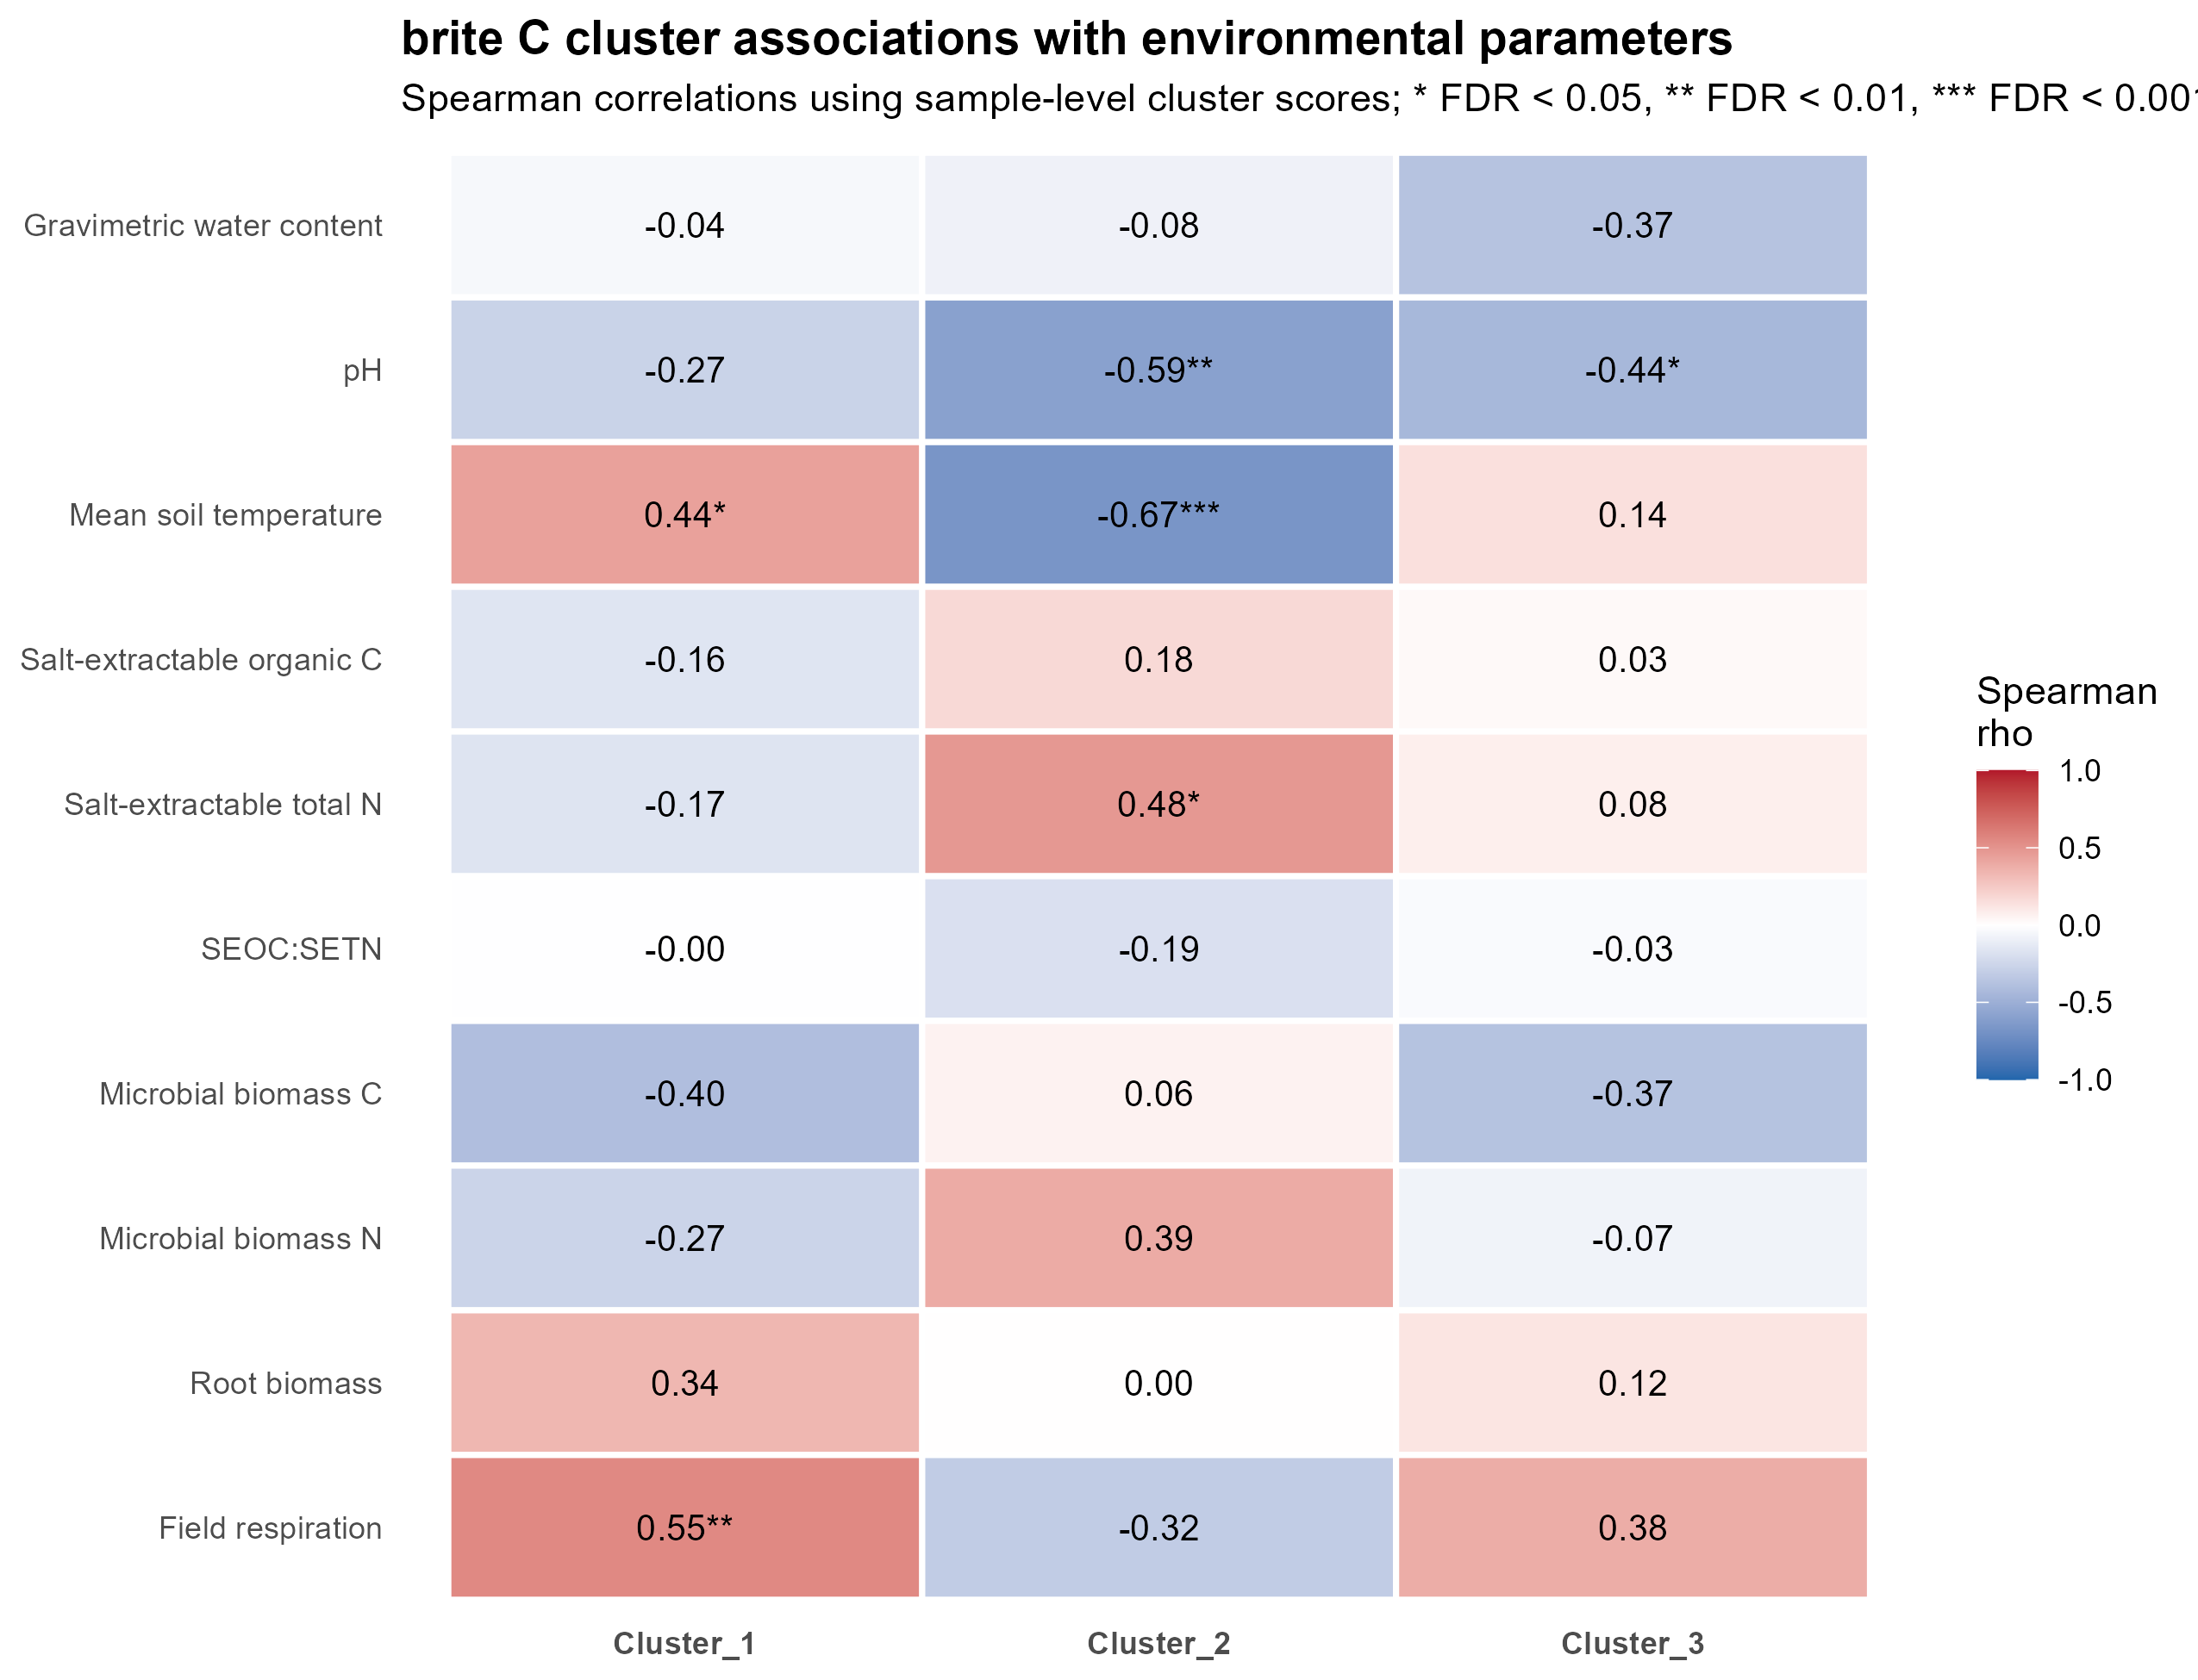

Slide 11
