Slide 1
SOILS SFA | PROSSER TIME SERIES
MicroResp-linked expression resolves three seasonal programs
Targeted BRITE C pathways and BRITE D KOs: GAM review, temporal clustering, and storyboard synthesis
100% irrigation metatranscriptomes | Seven dates | July 2026
Notes:
[Sources]
Storyboard: SFA3-1-1_VGC_Storyboard_v2.docx
Analysis: Scripts/12_MicroResp_targeted_BRITE_C_D_GAM_and_clustering.R

Slide 2
MICRORESP-LINKED EXPRESSION
Filtering narrows the transcriptome to functions tied to assayed substrates
The explicit MicroResp-to-KEGG map was joined to previously fitted random-plot GAMs. All mapped, converged trajectories were clustered after within-feature z-scoring; targeted-set FDR identifies the strongest time-varying subset.
31
985
k = 3
BRITE C pathways mapped and clustered
BRITE D KOs clustered from 1,312 requested
automatic elbow at both annotation levels
Significant within the targeted set: 20 BRITE C pathways and 230 BRITE D KOs. Distance: 1 - Pearson correlation; linkage: Ward.D2.
Source: Results/MicroResp_targeted_BRITE_C_D/*_run_summary.csv
2
Notes:
[Sources]
Results/MicroResp_targeted_BRITE_C_D/MicroResp_BRITE_C_D_run_summary.csv
Data/MicroResp_all_BRITE_C_D_complete.csv
Scripts/12_MicroResp_targeted_BRITE_C_D_GAM_and_clustering.R

Slide 3
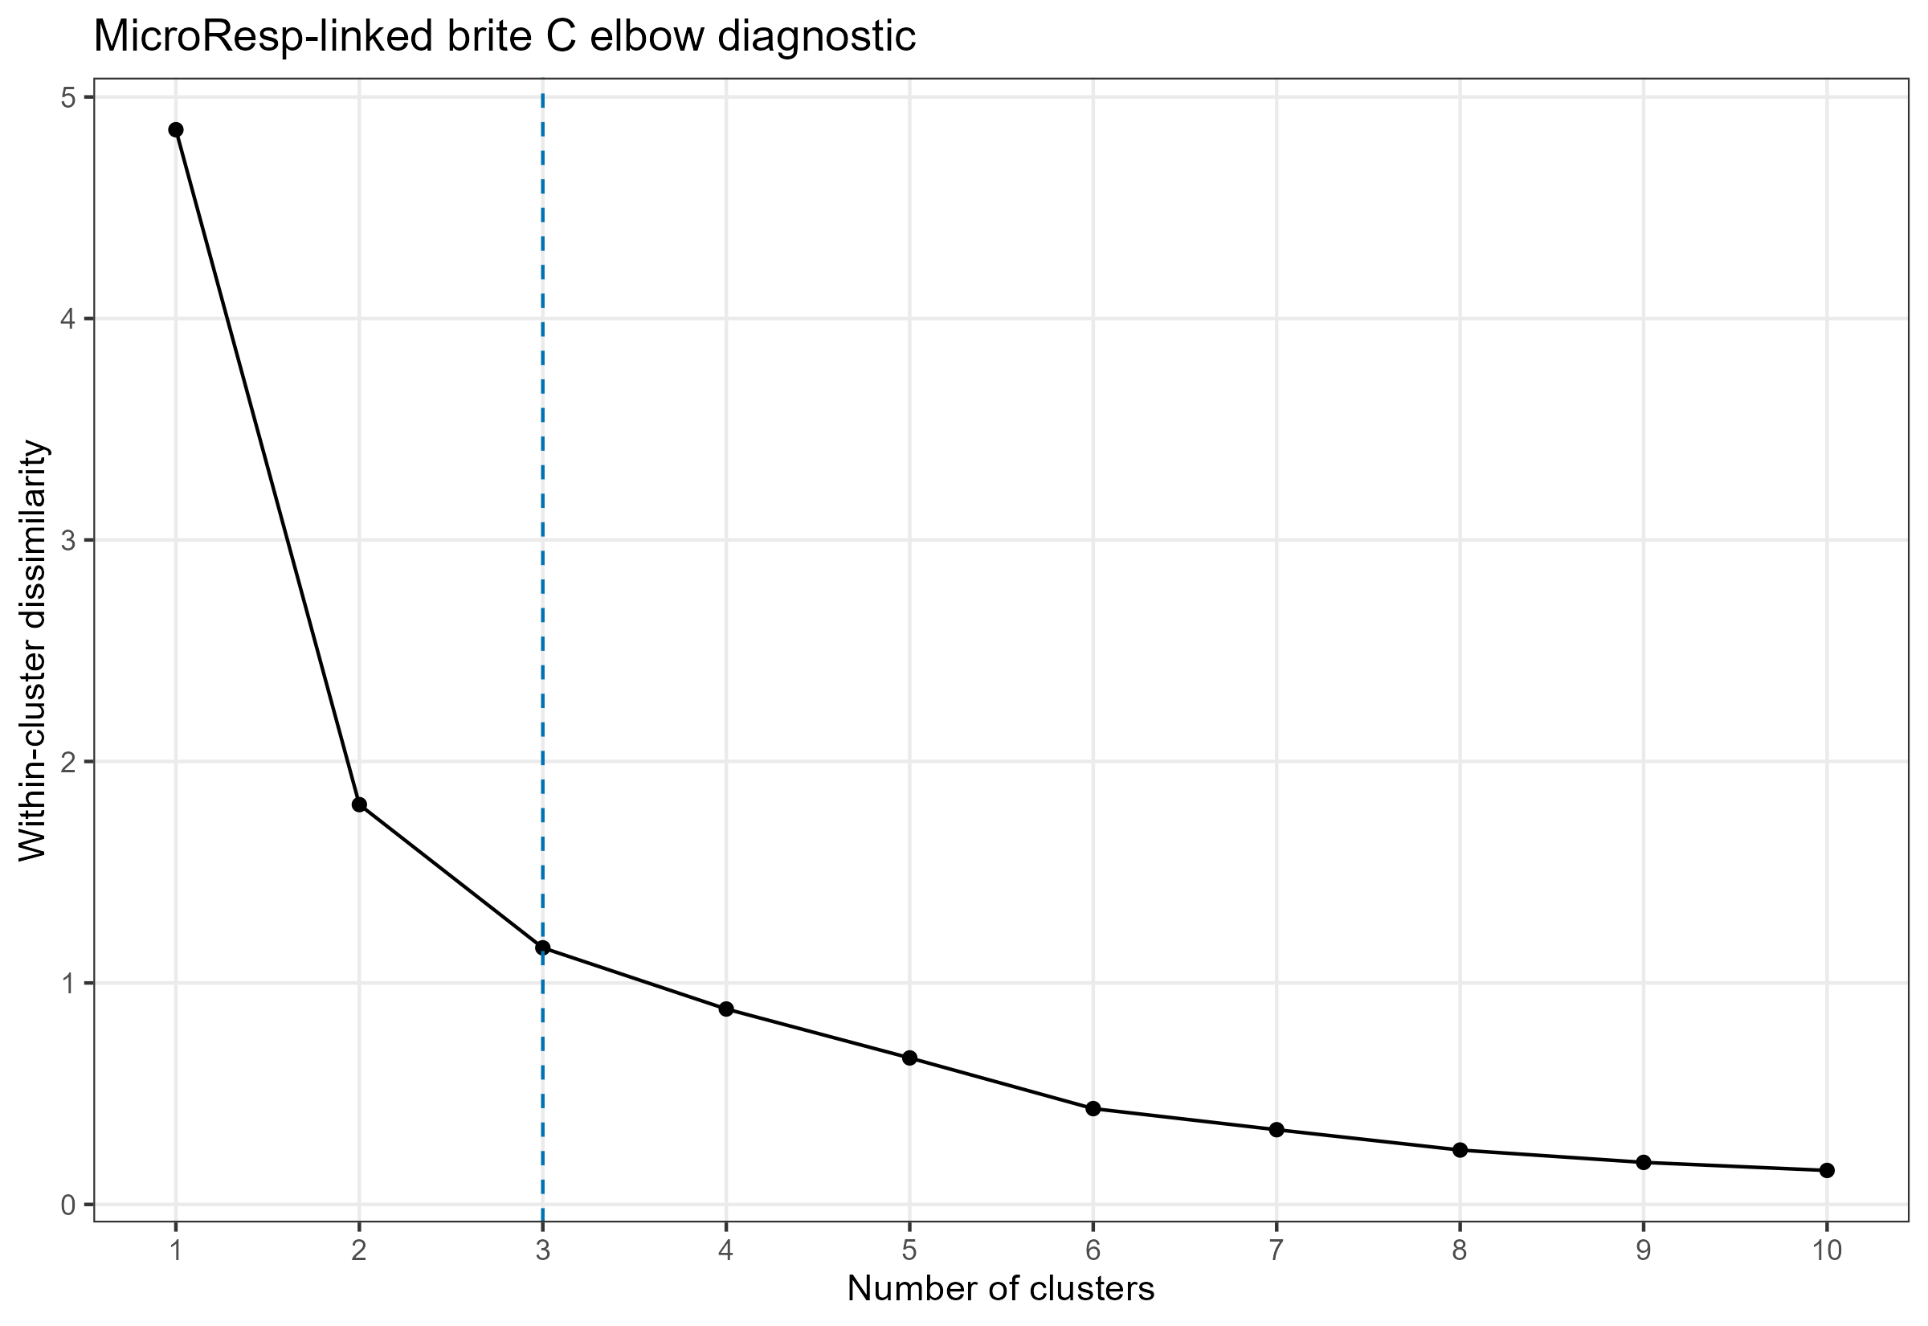
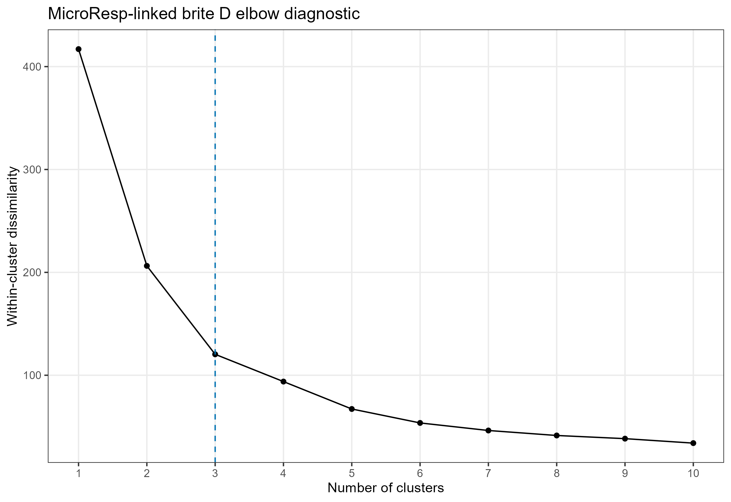
MICRORESP-LINKED EXPRESSION
Both functional resolutions support three temporal expression clusters
BRITE C
BRITE D
Within-cluster dissimilarity drops sharply through k = 3 at both levels. Higher k values continue to subdivide trajectories but add progressively smaller gains.
Source: MicroResp-targeted BRITE C/D elbow diagnostics; automatic selection, no manual override.
3
Notes:
[Sources]
Results/MicroResp_targeted_BRITE_C_D/brite_C_MicroResp_elbow_diagnostics.csv
Results/MicroResp_targeted_BRITE_C_D/brite_D_MicroResp_elbow_diagnostics.csv

Slide 4
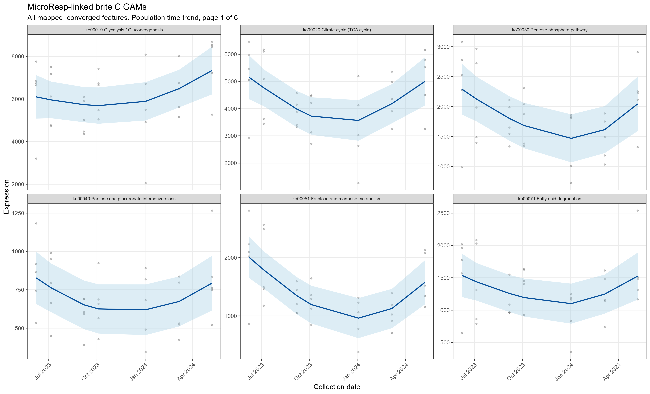
MICRORESP-LINKED BRITE C
Twenty of 31 mapped pathways show targeted-set temporal significance
Cluster 1 | 12 pathways: biosynthesis, glycan use, and aromatic degradation
Cluster 2 | 13 pathways: TCA, N cycling, amino-acid and fatty-acid metabolism
Cluster 3 | 6 pathways: glycolysis, pyruvate, lipid, butanoate functions
GAM evidence
The mapped pathway set contains broad, nonlinear time trends rather than a single synchronized response. Strong signals include arginine biosynthesis, N metabolism, amino-sugar metabolism, and aromatic-compound degradation.
Source: brite_C_MicroResp_GAM_statistics.csv and targeted GAM panels
4
Notes:
[Sources]
Results/MicroResp_targeted_BRITE_C_D/brite_C_MicroResp_GAM_statistics.csv
Figures/MicroResp_targeted_BRITE_C_D/brite_C/brite_C_targeted_GAMs_page_01.png

Slide 5
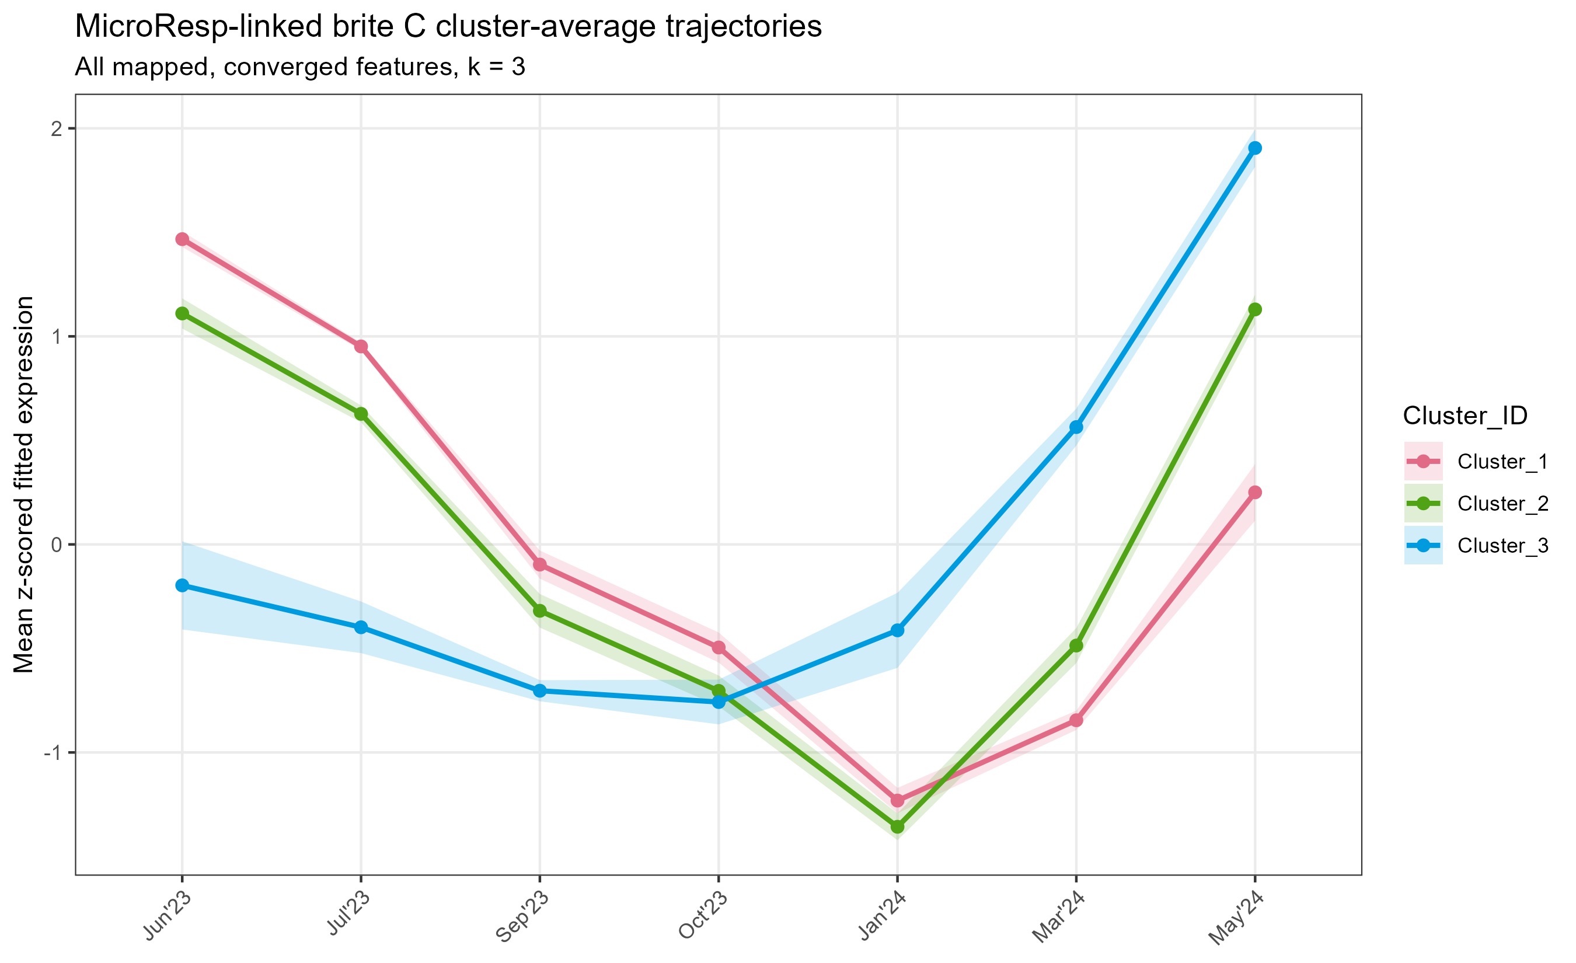
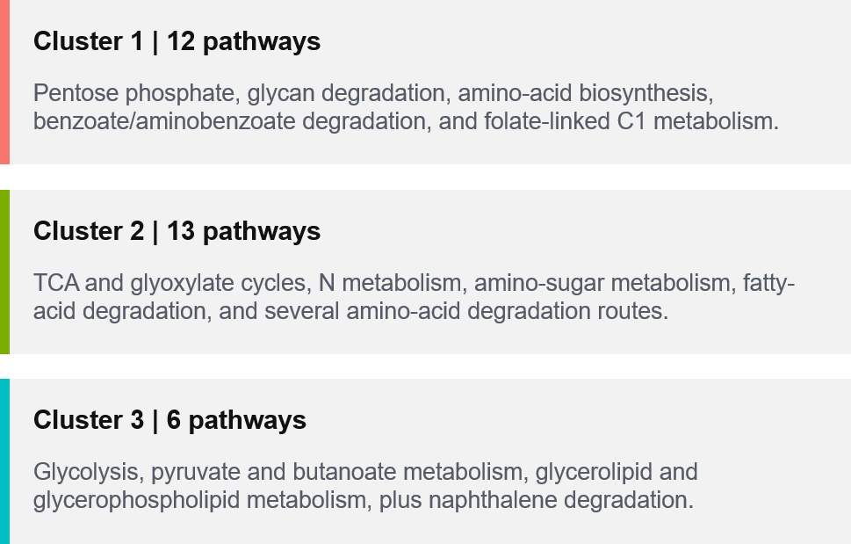

Slide 6
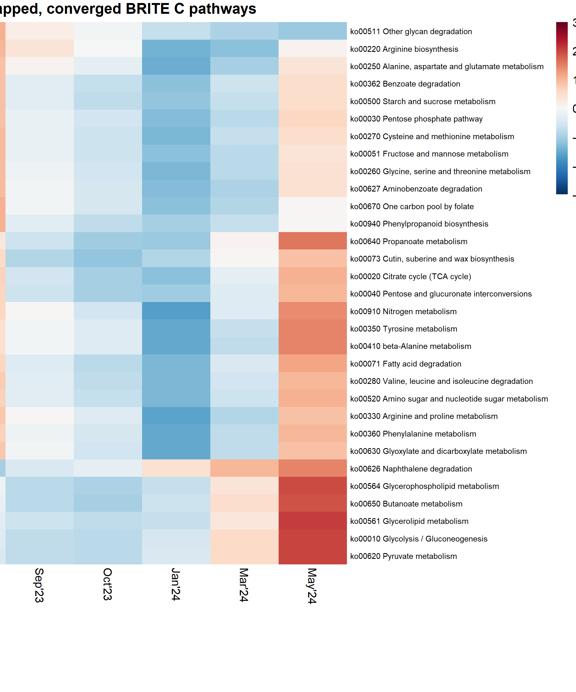
MICRORESP-LINKED BRITE C
Pathway clusters separate broad winter activity from shorter seasonal modes
Cluster 1 | 12 pathways
Pentose phosphate, glycan degradation, amino-acid biosynthesis, benzoate/aminobenzoate degradation, and folate-linked C1 metabolism.
Cluster 2 | 13 pathways
TCA and glyoxylate cycles, N metabolism, amino-sugar metabolism, fatty-acid degradation, and several amino-acid degradation routes.
Cluster 3 | 6 pathways
Glycolysis, pyruvate and butanoate metabolism, glycerolipid and glycerophospholipid metabolism, plus naphthalene degradation.
The heatmap includes every mapped, converged BRITE C pathway. Rows are z-scored, so color represents trajectory shape rather than absolute expression.
Source: brite_C_MicroResp_cluster_assignments.csv and brite_C_MicroResp_heatmap.png
5
Notes:
[Sources]
Results/MicroResp_targeted_BRITE_C_D/brite_C_MicroResp_cluster_assignments.csv
Figures/MicroResp_targeted_BRITE_C_D/brite_C/brite_C_MicroResp_heatmap.png

Slide 7
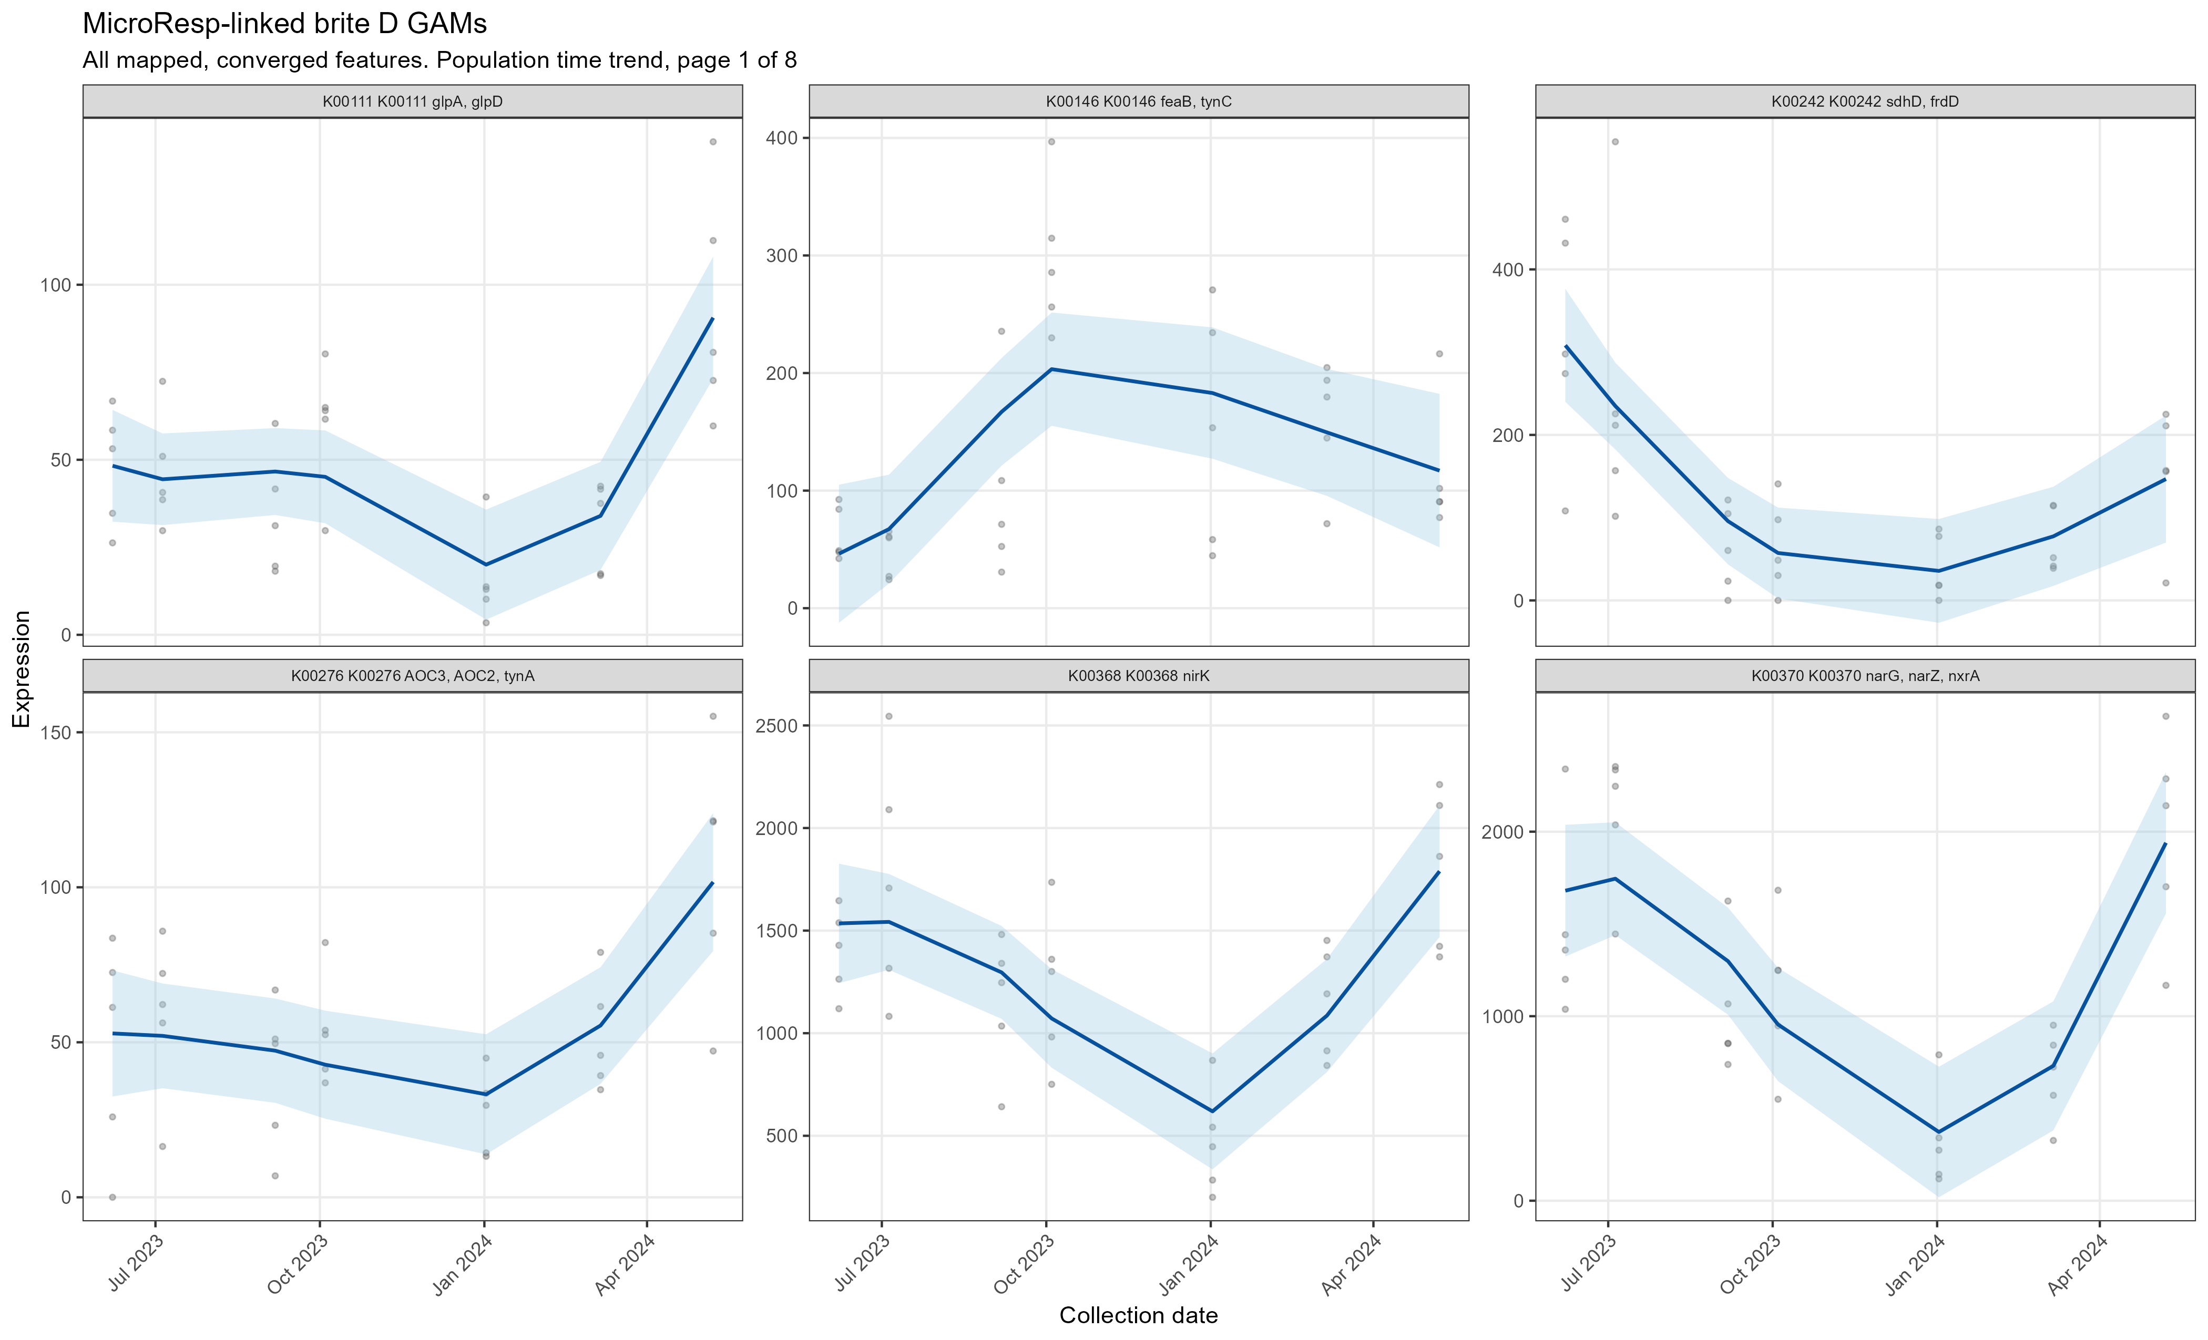
MICRORESP-LINKED BRITE D
KO-level GAMs reveal strong but heterogeneous seasonal expression
Cluster 1 | 477 KOs (48%): includes urease, polyamine, TCA, and aromatic-use genes
Cluster 2 | 245 KOs (25%): includes nitrate reduction and storage-carbon functions
Cluster 3 | 263 KOs (27%): includes sugar, amino-acid, and N-oxide functions
Resolution matters
Of 1,312 mapped KOs requested; 230 were temporally significant, 985 converged and were clustered within the targeted set. KO diversity shows that pathway-level averages can conceal opposing constituent trajectories.
Source: brite_D_MicroResp_GAM_statistics.csv and targeted GAM panels
6
Notes:
[Sources]
Results/MicroResp_targeted_BRITE_C_D/brite_D_MicroResp_GAM_statistics.csv
Figures/MicroResp_targeted_BRITE_C_D/brite_D/brite_D_targeted_GAMs_page_01.png

Slide 8
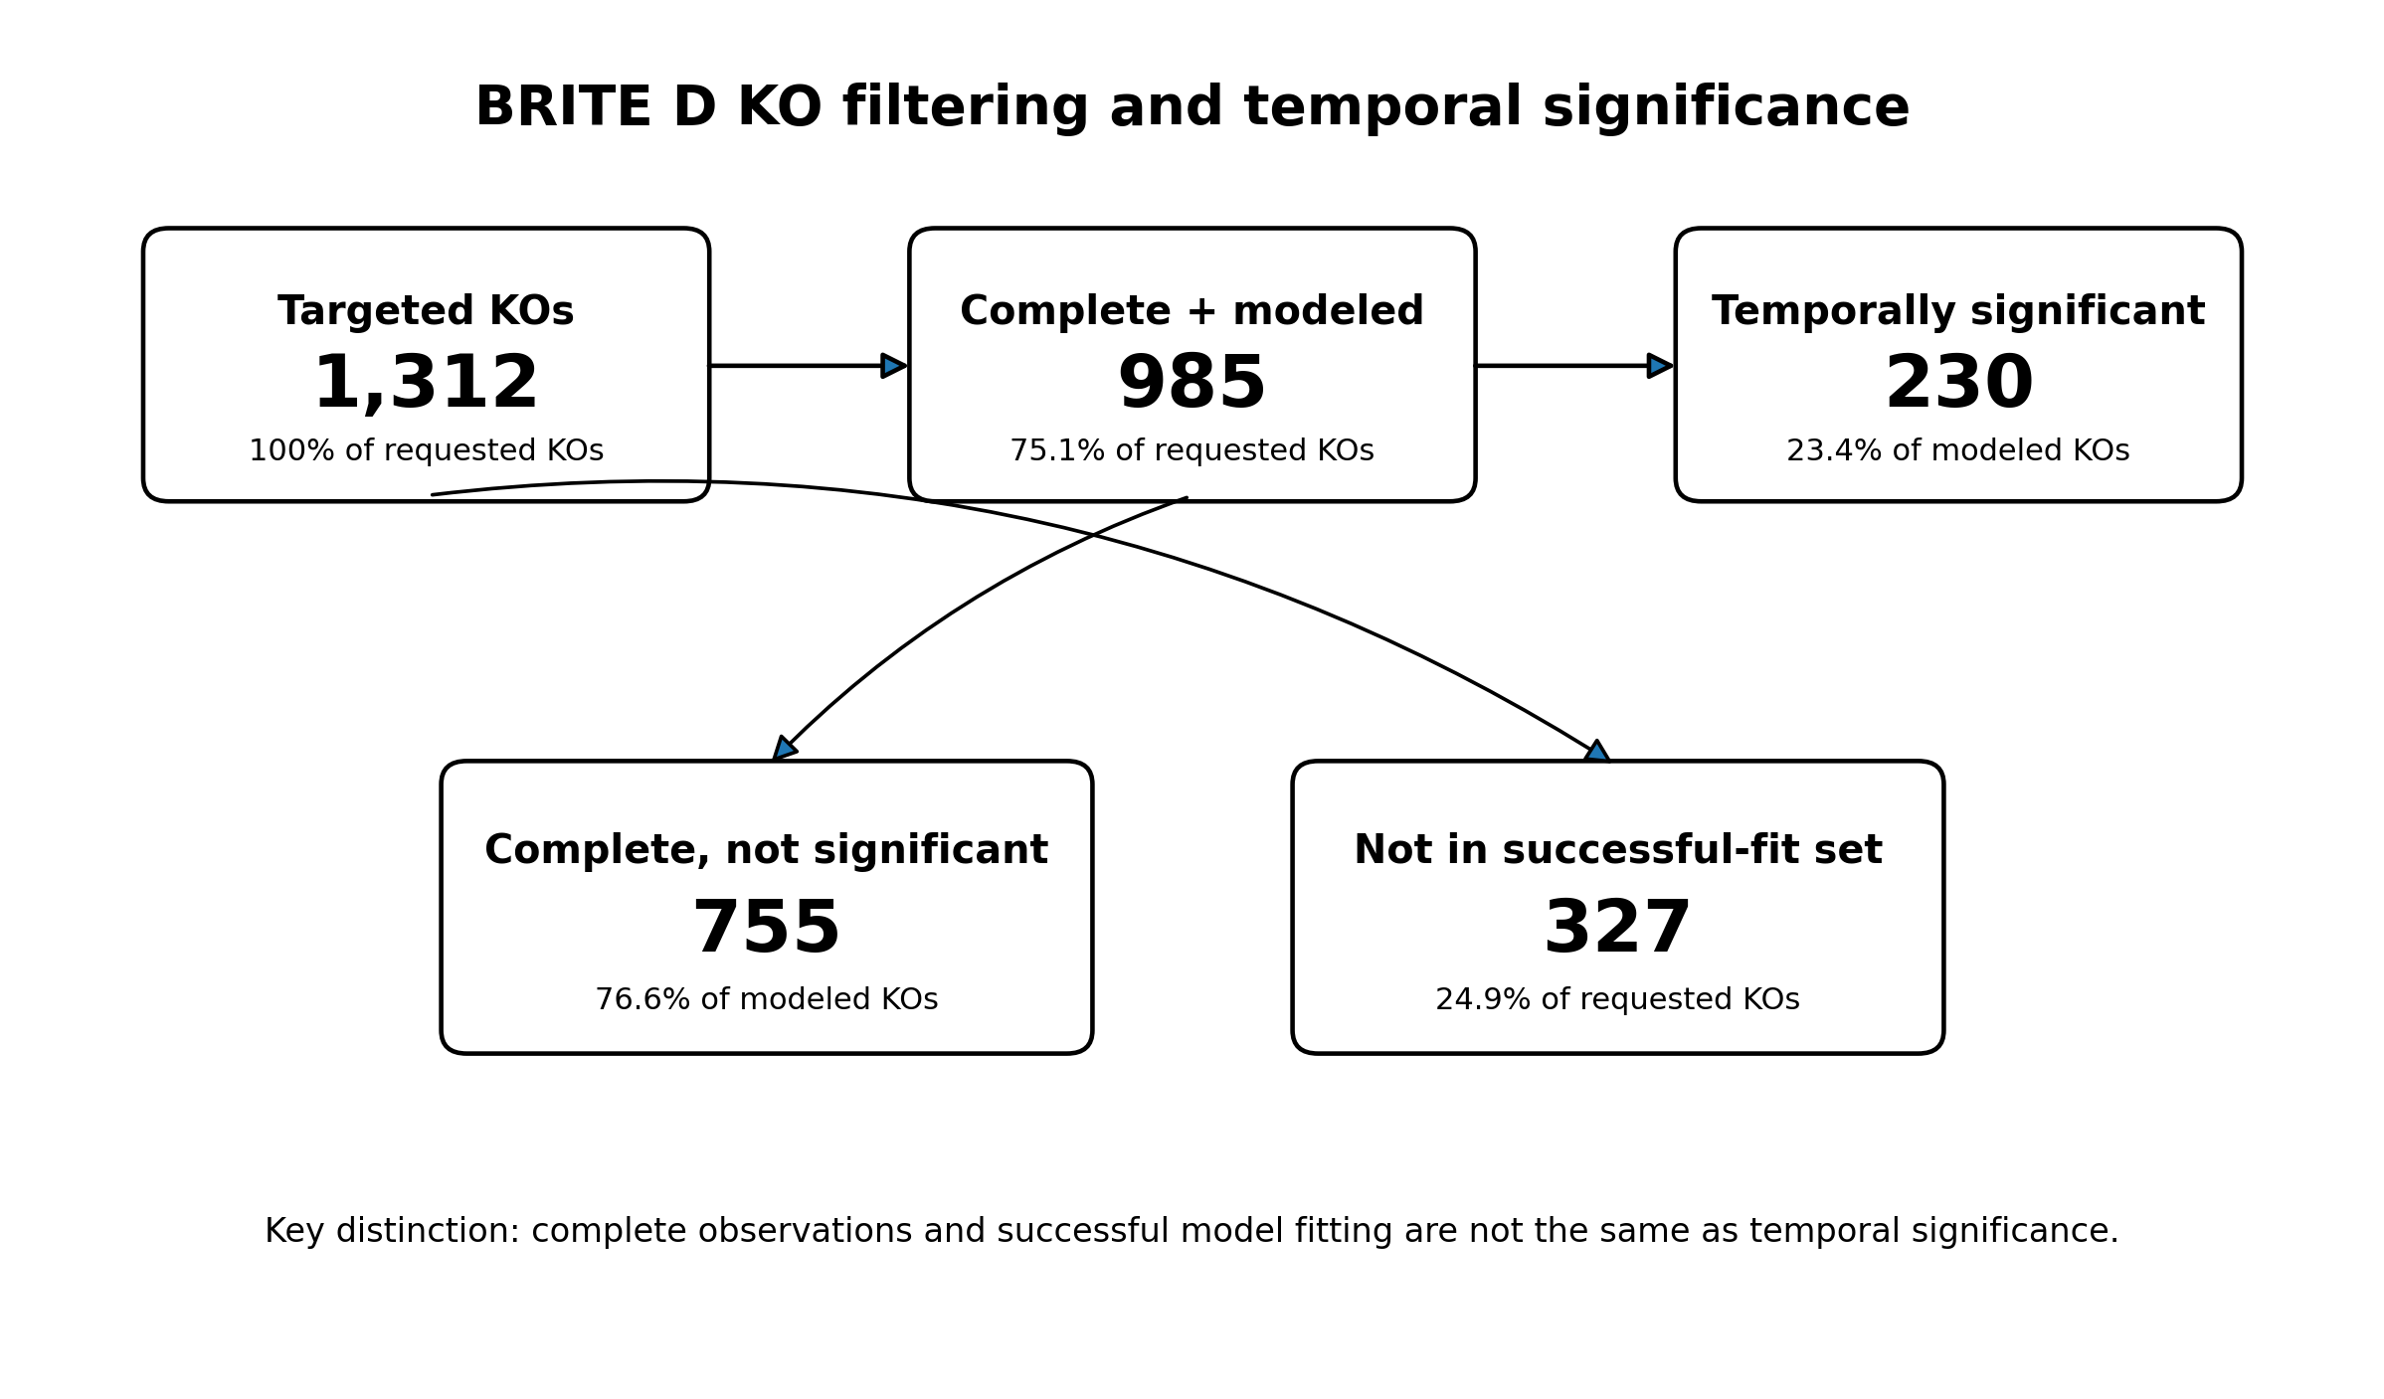

Slide 9
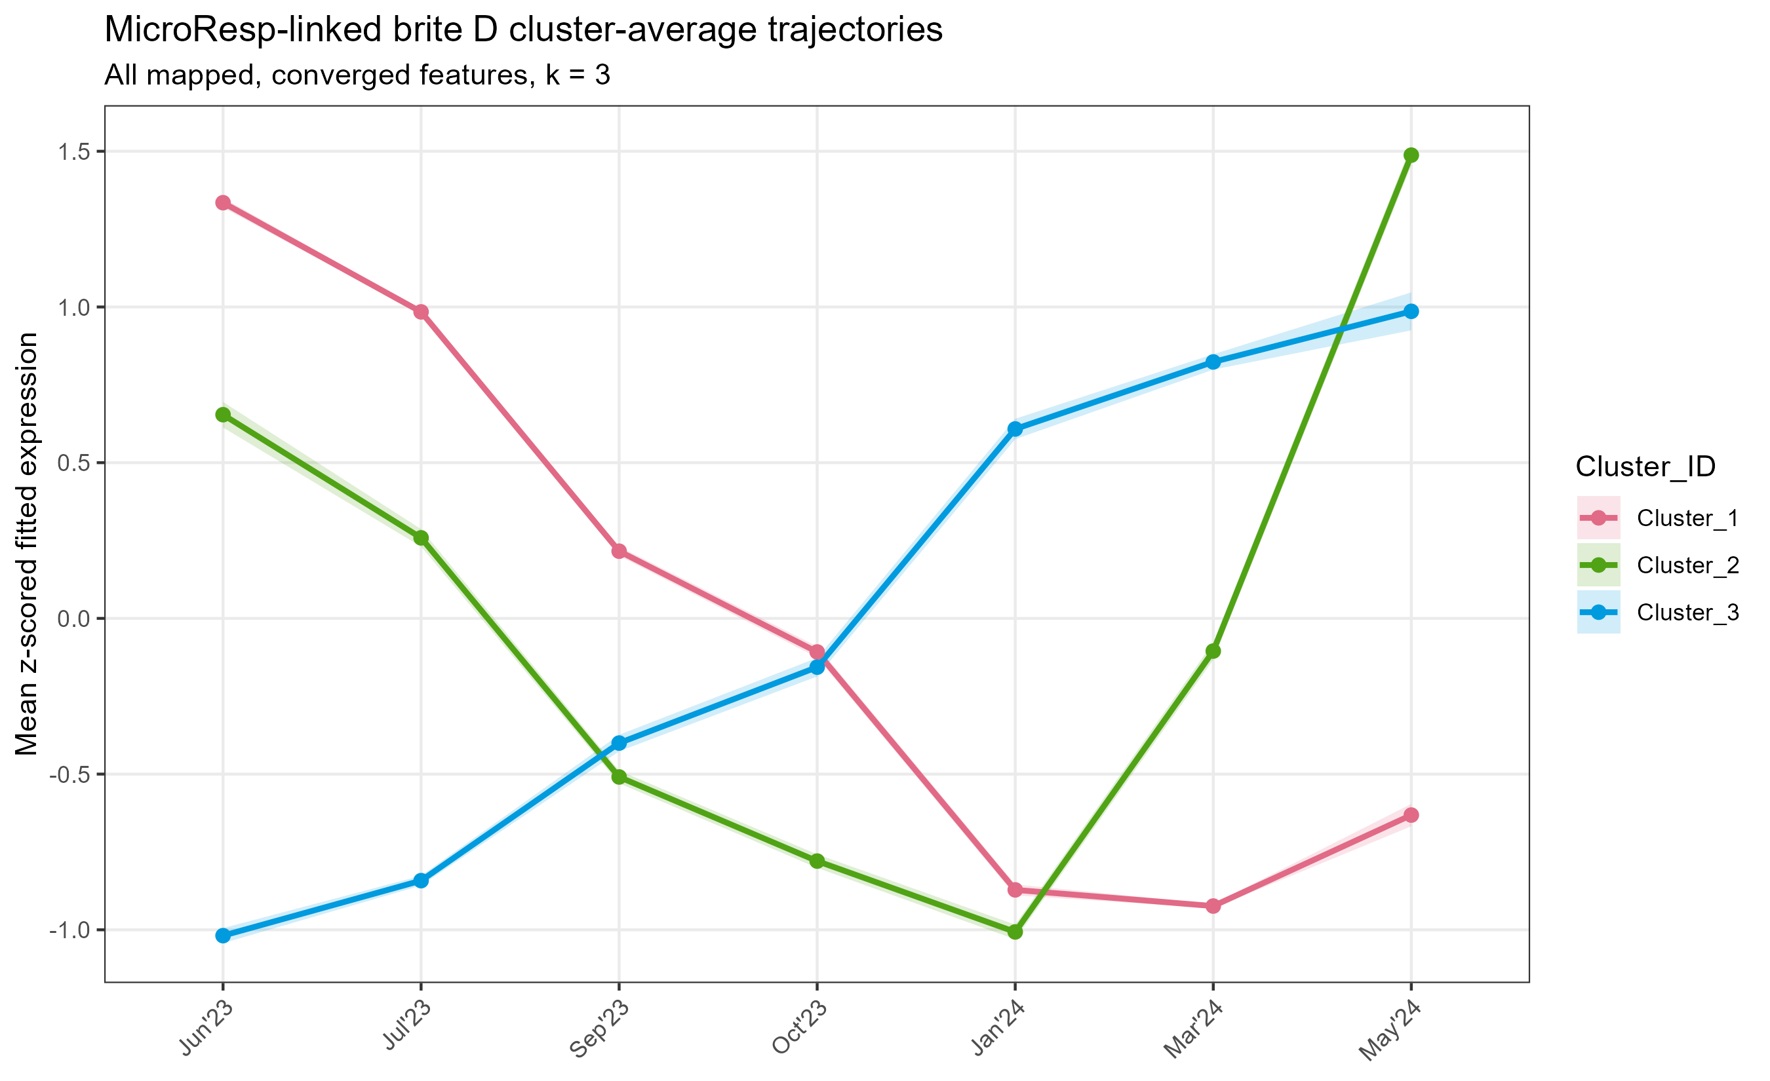
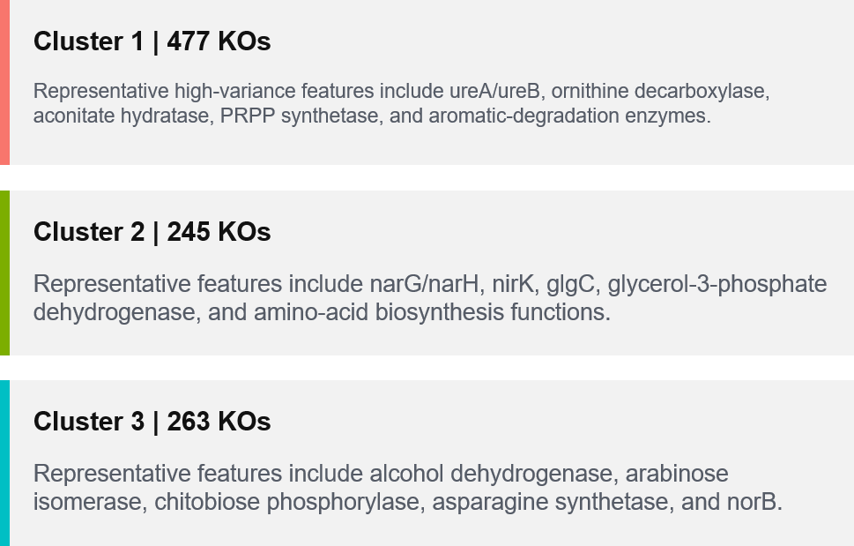

Slide 10
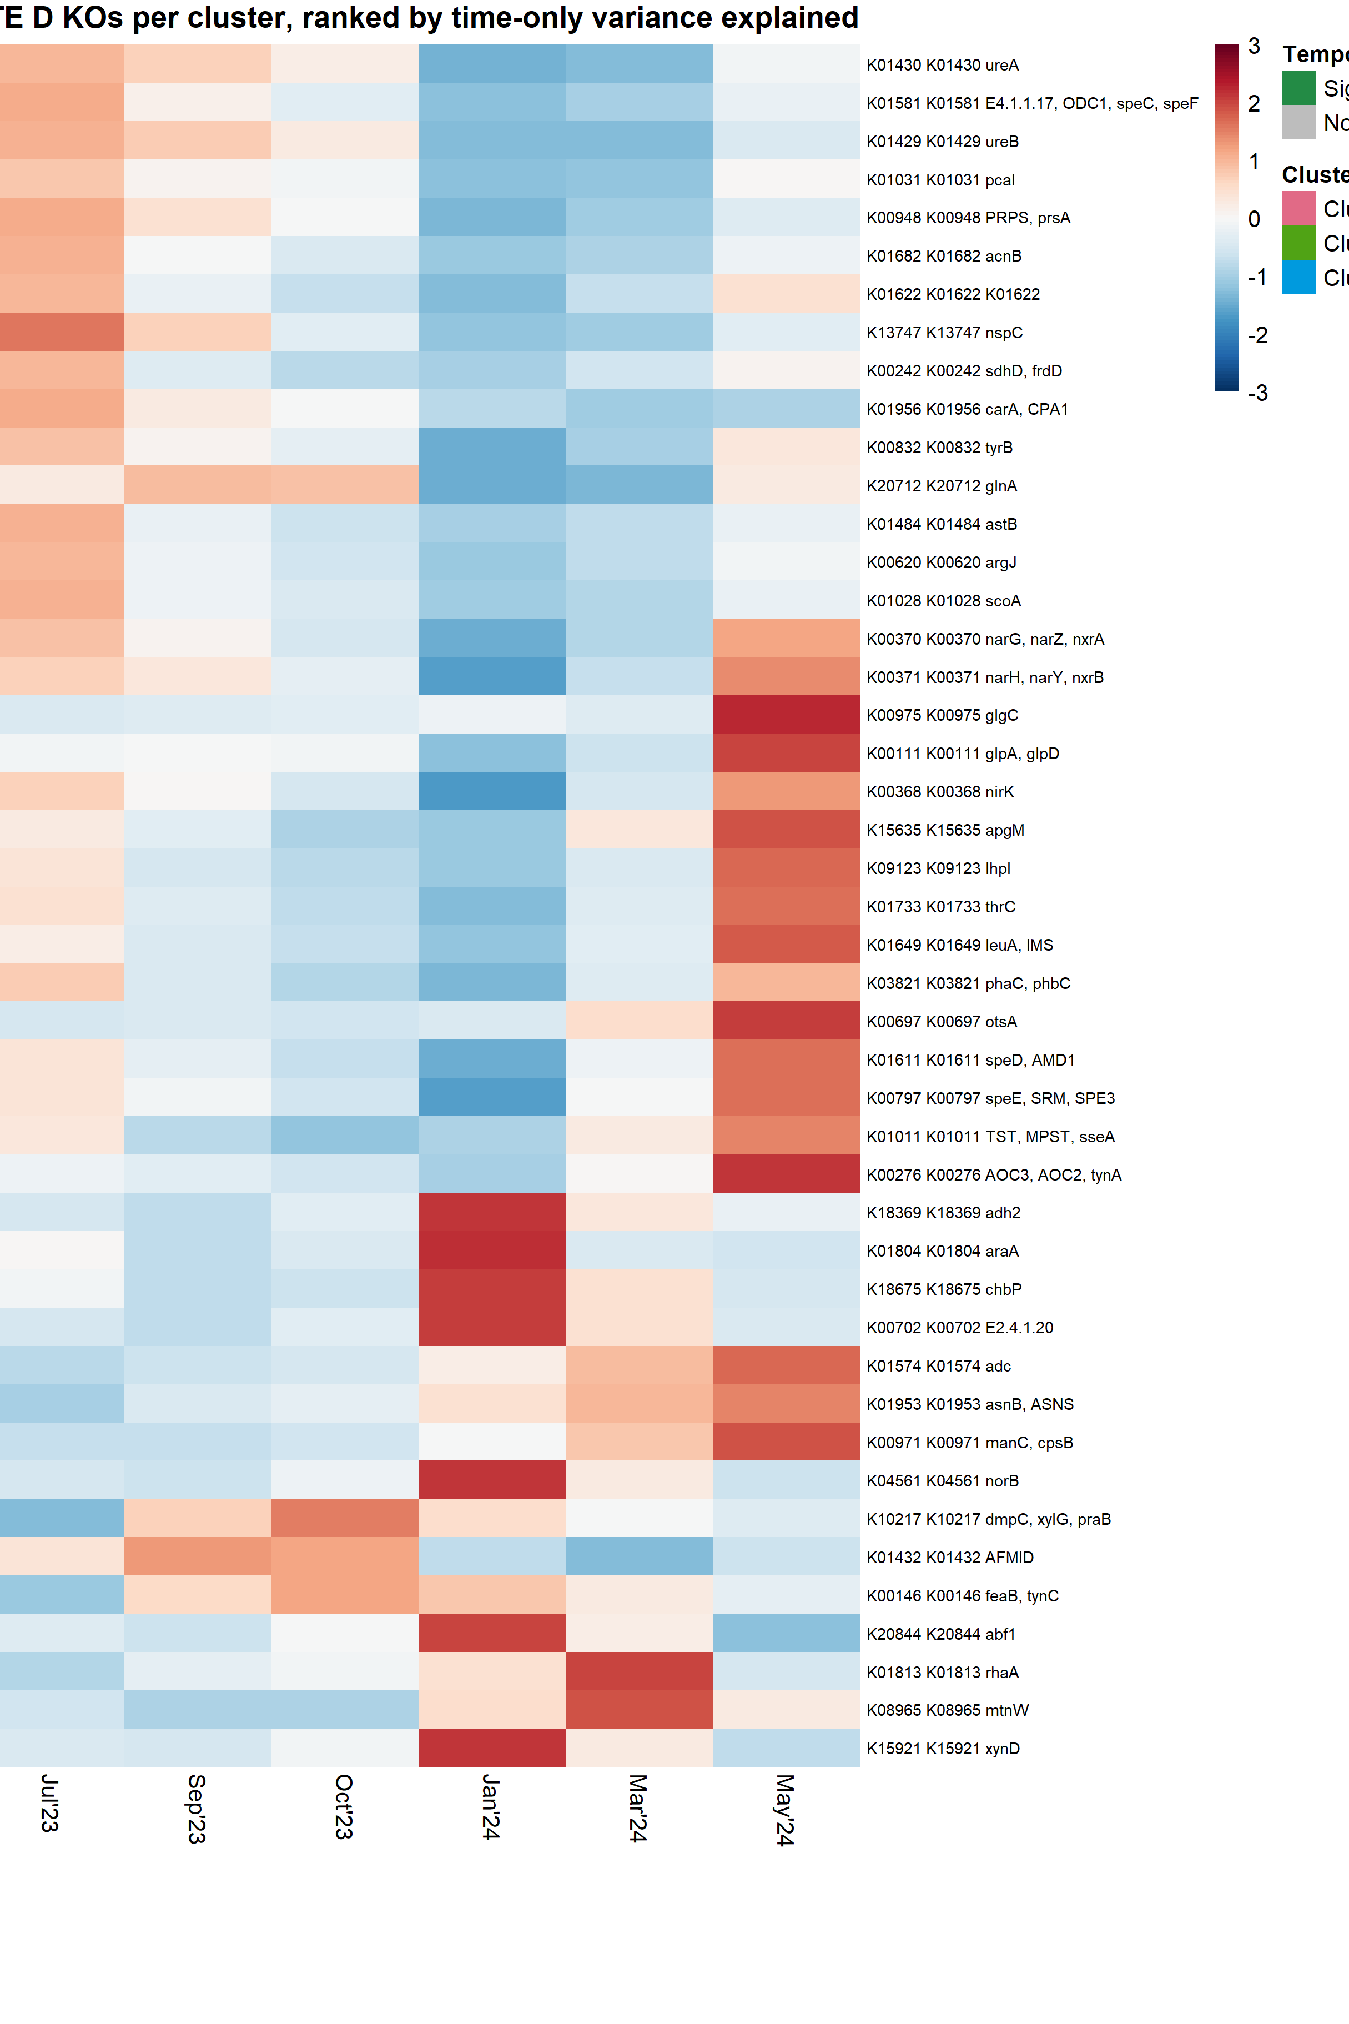
MICRORESP-LINKED BRITE D
The strongest KO trajectories connect C use with nitrogen and stress metabolism
Cluster 1 | 477 KOs
Representative high-variance features include ureA/ureB, ornithine decarboxylase, aconitate hydratase, PRPP synthetase, and aromatic-degradation enzymes.
Cluster 2 | 245 KOs
Representative features include narG/narH, nirK, glgC, glycerol-3-phosphate dehydrogenase, and amino-acid biosynthesis functions.
Cluster 3 | 263 KOs
Representative features include alcohol dehydrogenase, arabinose isomerase, chitobiose phosphorylase, asparagine synthetase, and norB.
For readability, the BRITE D heatmap shows the top 15 features per cluster ranked by time-only variance explained; all 985 converged KOs remain in the clustering.
Source: brite_D_MicroResp_heatmap_feature_selection.csv
7
Notes:
[Sources]
Results/MicroResp_targeted_BRITE_C_D/brite_D_MicroResp_heatmap_feature_selection.csv
Results/MicroResp_targeted_BRITE_C_D/brite_D_MicroResp_cluster_assignments.csv

Slide 11
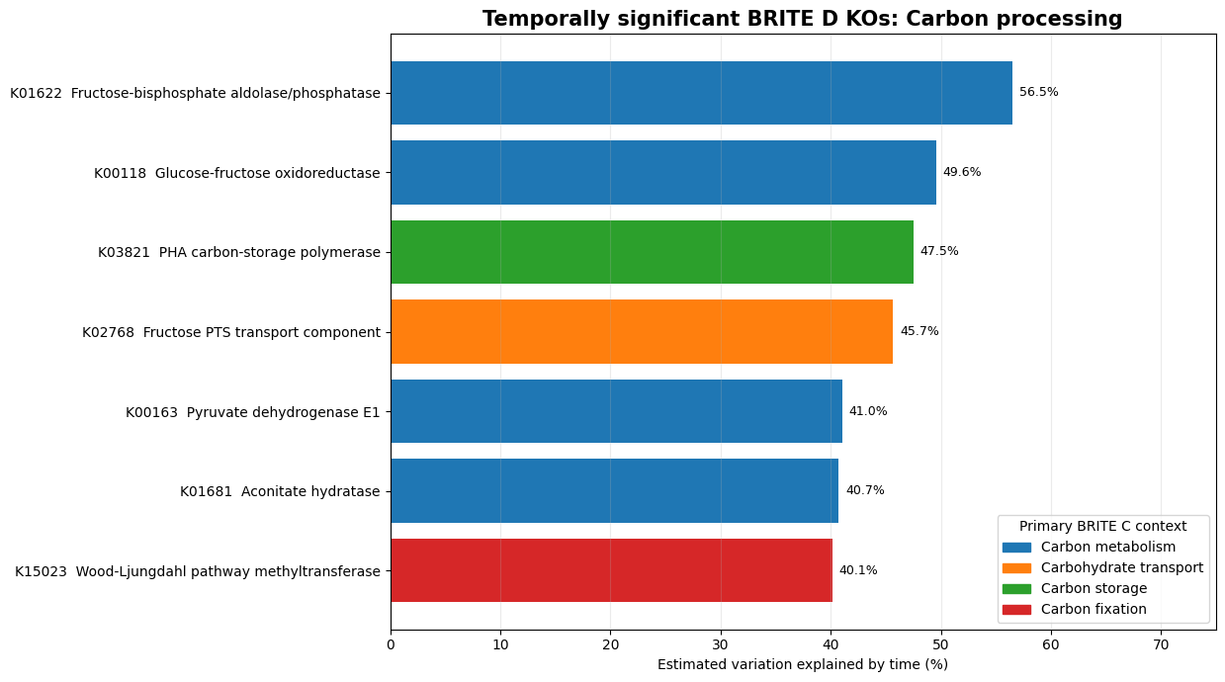
Notes:
Microbial function changed substantially through time, not only in general growth machinery but also in specific processes related to carbon use, nutrient acquisition, redox conditions, and stress response.
More specifically, the significant KOs suggest:
Changing carbon acquisition and allocation: fructose and polyol transport, central carbon metabolism, and carbon-storage polymer production varied through time.
Changing nitrogen cycling: urease showed one of the strongest temporal patterns, suggesting seasonal variation in urea use and ammonium generation.
Changing respiratory and redox strategies: selenate/chlorate reductase, fumarate-linked respiration, cytochrome formation, and a redox-sensing regulator all varied temporally.
Changing resource limitation: iron uptake and amino-acid transport genes suggest that nutrient demand or availability shifted across dates.
Changing stress and cell maintenance: transporters, cell-envelope synthesis, and protease activity indicate shifts in microbial physiological state.

Slide 12
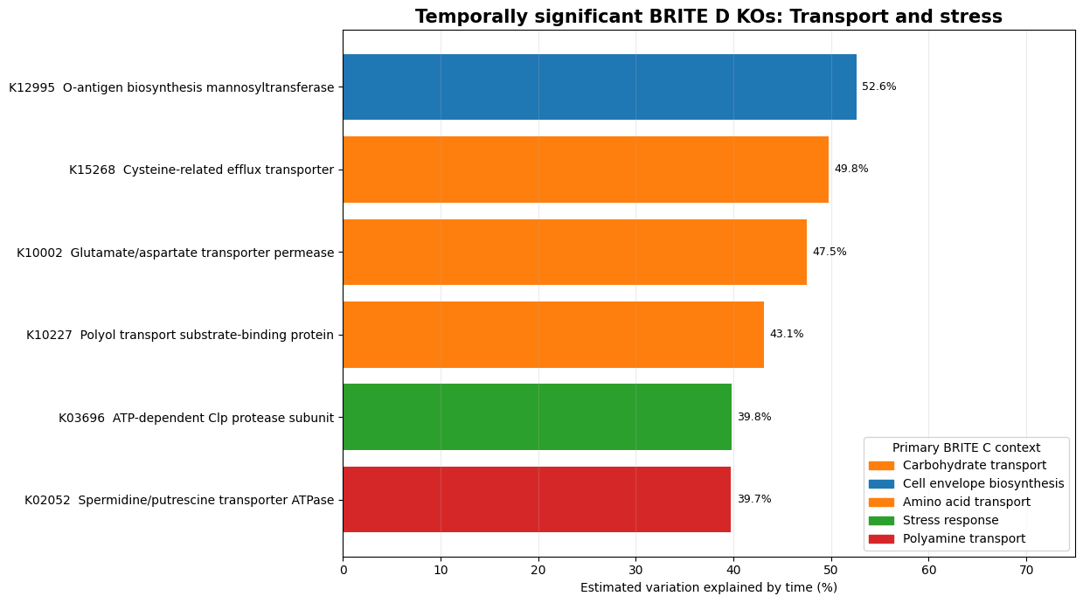

Slide 13
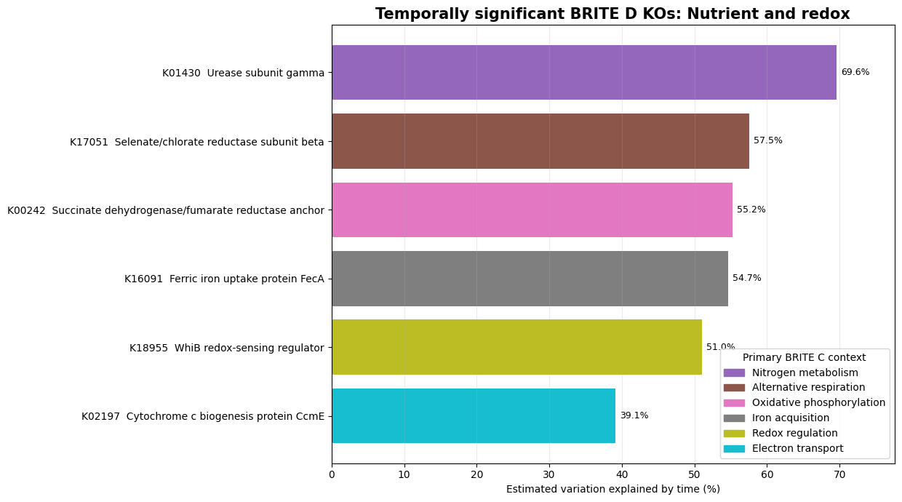

Slide 14
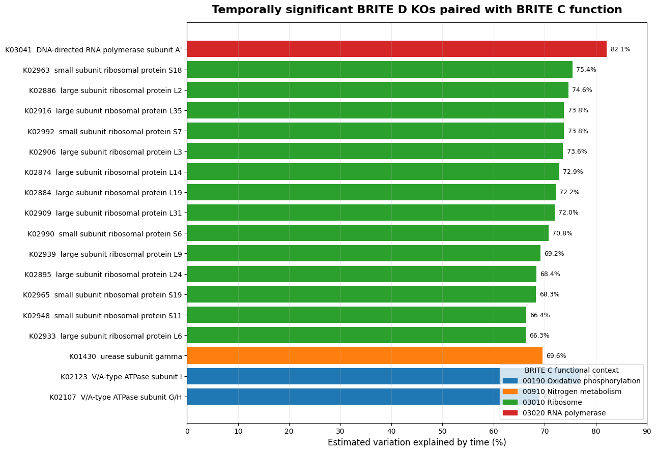

Slide 15
STORYBOARD SYNTHESIS
Targeted expression partly supports the winter phenotype, not a one-to-one match
Storyboard claim
Targeted BRITE C
Targeted BRITE D
Broad winter/early-spring phenotype
Three modes; N, TCA, amino-sugar, and fatty-acid pathways represented
Three modes; nitrate, urease, C-use, amino-acid, and stress KOs represented
Sharp Sep-Oct fall pulse
No single dominant pathway cluster uniquely reproduces the pulse
No single dominant KO cluster uniquely reproduces the pulse
Cross-scale conclusion
Partial coordination across expressed pathways, consistent with the storyboard
Heterogeneity at KO resolution reinforces assay-specific variation
Interpretation: seasonal substrate-use capacity and expression overlap, but transient phenotypes may require denser sampling or remain assay-specific.
8
Notes:
[Sources]
SFA3-1-1_VGC_Storyboard_v2.docx
Results/MicroResp_targeted_BRITE_C_D/brite_C_MicroResp_cluster_assignments.csv
Results/MicroResp_targeted_BRITE_C_D/brite_D_MicroResp_cluster_assignments.csv

