Slide 1
Weekly report
Xiao Qiqi Xu Ziyang Xu Da
09/26/2015

Slide 2
Preview
Test the datasete
CompCars & Car-196 directly using unmodified CNN algorithm (with CAFFE)
Find better datasets
Contact with CUHK and get CompCars Dataset

Slide 3
Train hierarchical models
Light(front tail distinguished)
Wheel
Logo

Slide 4
Use R-CNN to detect car parts
Detect → lights, vehicle-logo…
Classify parts
Add different weights to parts→score→higher accuracy

Slide 5
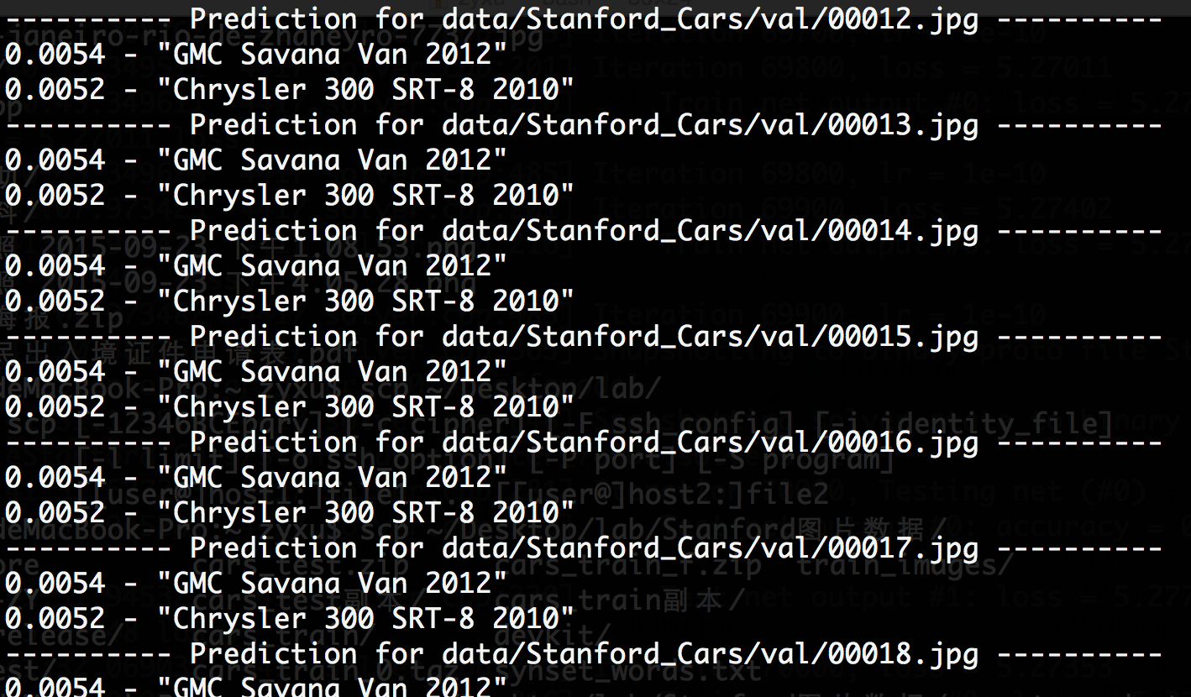
This week
Car-196
Change the structure and annotations for CAFFE
Accuracy:0%-3%
Bugs:
Do not converge
Same result while classifying
(different models, different images)

Slide 6
Import fast r-cnn to ceca-nv√
Run demo.py√
Crop images√

Slide 7
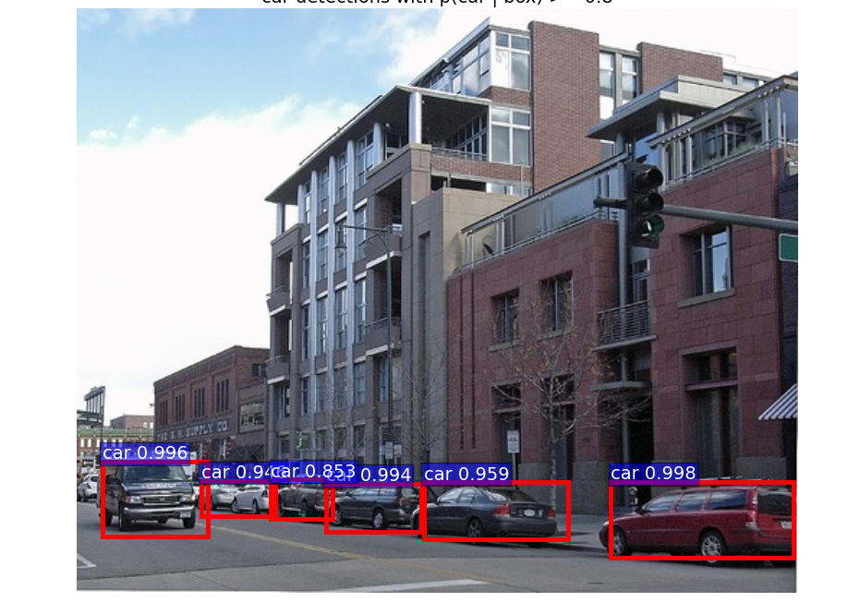
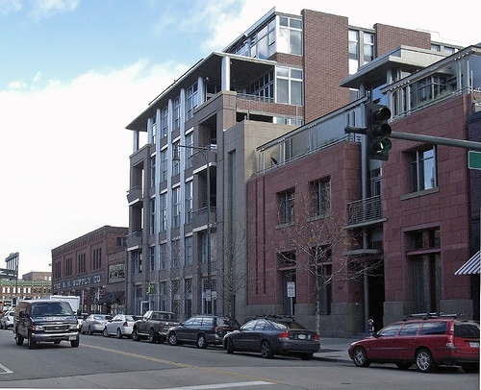


original
cpu
caffenet gpu
C version

Slide 8



Crop results
Picture with higher pixel
Crop larger images

Slide 9
Need to Do
Import matlab to server to train model
Transplant the whole project to AMD3

