Slide 1
weekly report
Qiqi Xiao
29/7/2015

Slide 2
cats&birds
cat30 o
cat31 x
cat32 o
cat33 o
cat34 o
cat35 o
cat36 o
cat37 o
cat38 o
cat39 o
9/10
Training scale:
30birds+30cats
Testing scale:
10birds+10cats
gpu:
real 21m26.281s
user 22m33.830s
sys 3m15.137s
cpu:
14.5h
speedup=40.8
bird30 x
bird31 o
bird32 o
bird33 x
bird34 o
bird35 x
bird36 o
bird37 o
bird38 o
bird39 o
7/10

Slide 3
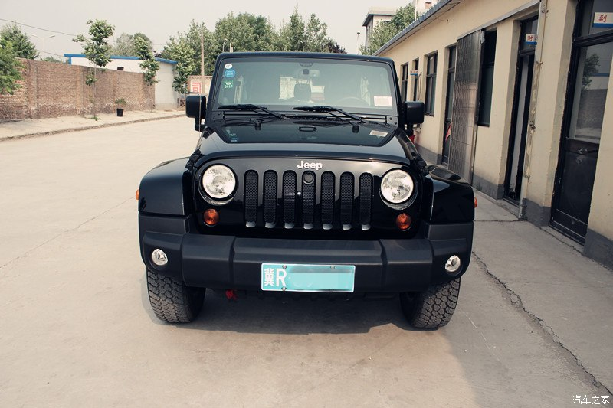
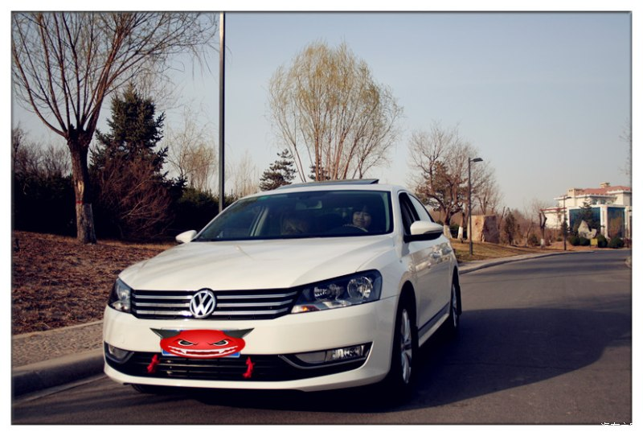
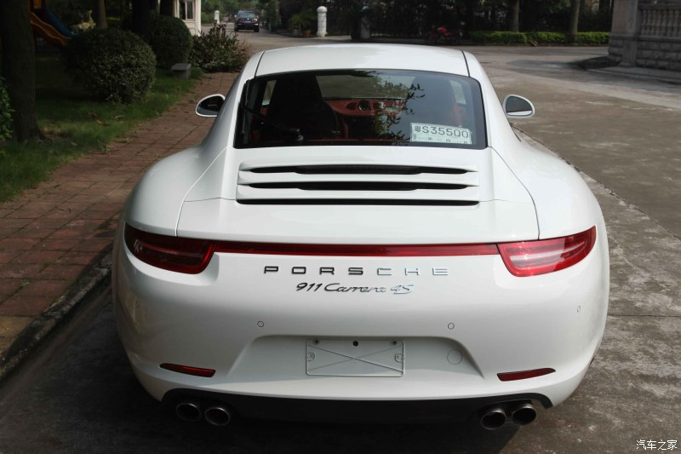
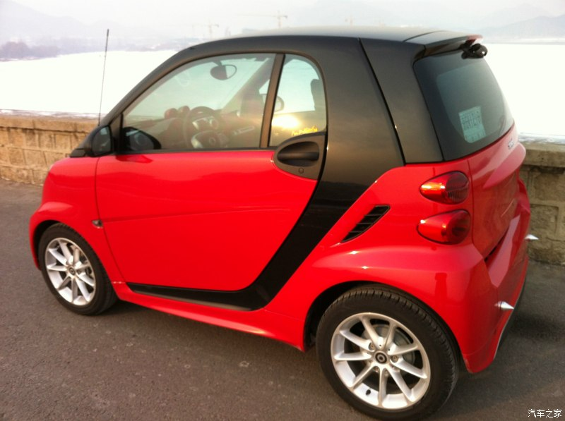
4 cars
JEEP
PASSAT
PORSCHE911
SMART

Slide 4
Training scale:
JEEP*279
PASSAT*287
PORSCHE911*598
SMART*337
Testing scale:
JEEP*20
PASSAT*20
PORSCHE911*20
SMART*20
Accurancy
JEEP: 20/20
PASSAT: 20/20
PORSCHE911: 20/20
SMART: 20/20
Test net output #0: accuracy = 0.95
Example:
./build/examples/cpp_classification/classification.bin car4_/deploy.prototxt car4_/_car4_iter_10000.caffemodel data/car4_/imagenet_mean.binaryproto data/car4_/synset_words.txt data/car4_/val/PORSCHE911-2.jpg
---------- Prediction for data/car4_/val/PORSCHE911-2.jpg ----------
0.7563 - "PORSCHE911"
0.2434 - "PASSAT"
0.0003 - "JEEP"
0.0000 - "SMART"
0.0003 - "JEEP"

Slide 5
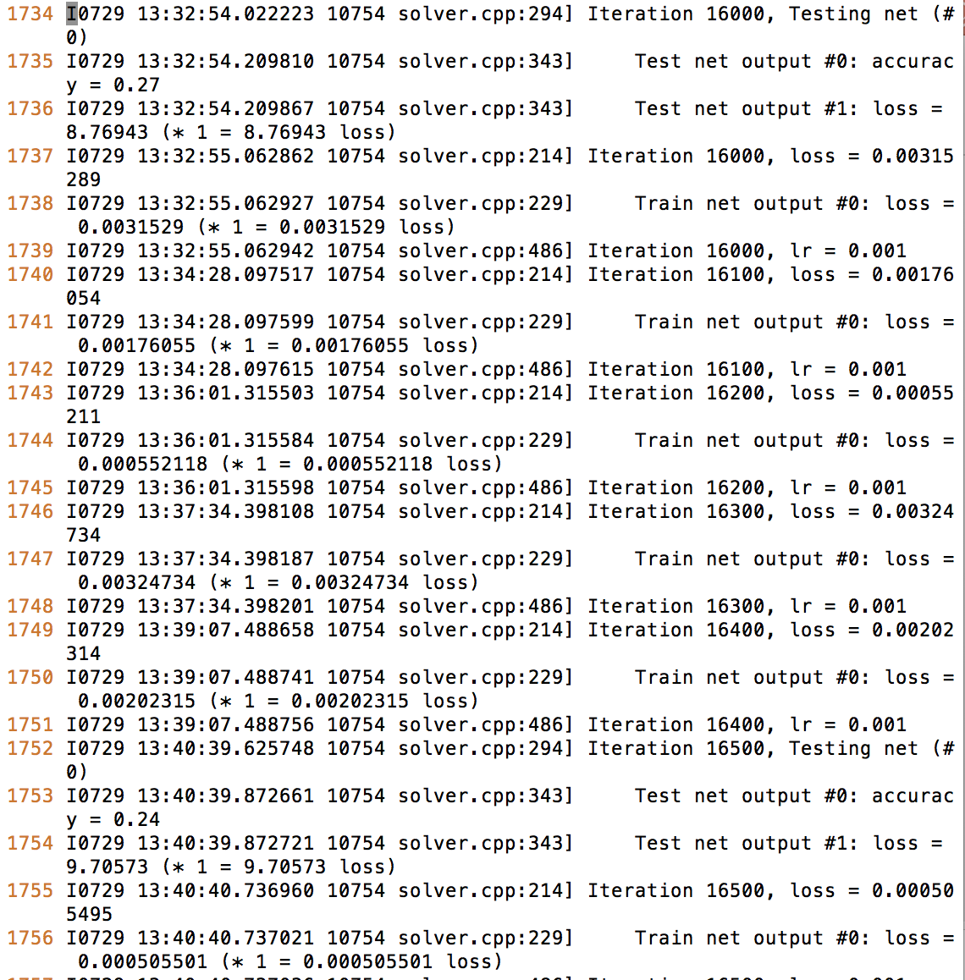
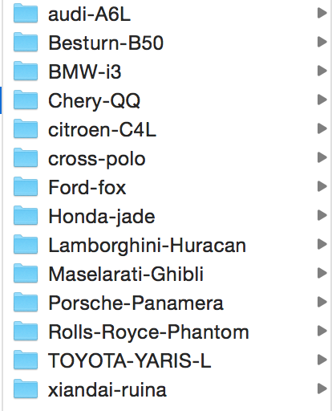

Slide 6
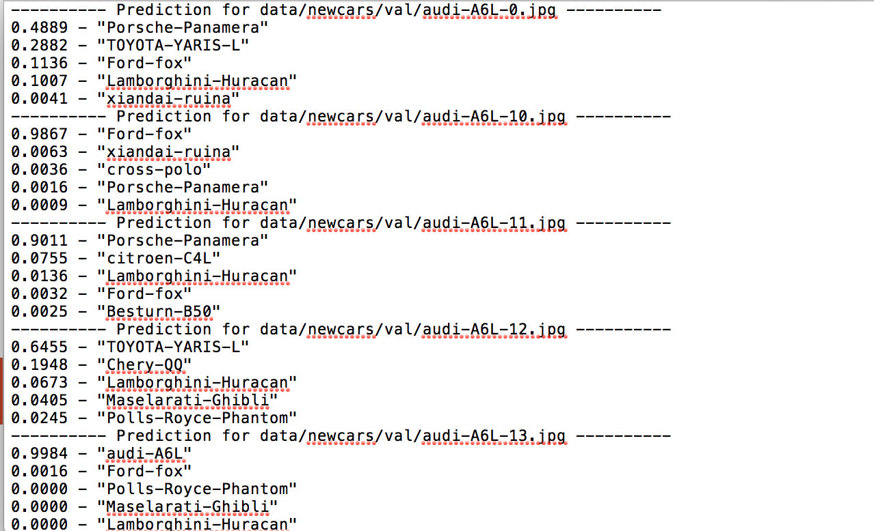
audi-A6L
Besturn-B50
BMW-i3
Chery-QQ
citroen-C4L
cross-polo
Ford-fox
Honda-jade
Lamborghini-Huracan
Maselarati-Ghibli
Porsche-Panamera
Polls-Royce-Phantom
TOYOTA-YARIS-L
xiandai-ruina
3/20
0/20
7/20
1/20
2/20
7/20
3/20
3/20
14/20
3/20
2/20
6/20
8/20
1/20
60/280=3/14
（写分类的代码 用来调试）

Slide 7
Problems
训练集大小
多分类的问题
直接convert图片消减特征？

Slide 8
1. 对图像进行预处理
找到车边缘 去除背景
分析和车本身相关的一些特征值（长、宽等）
对车进行预分类
2. 对数据的选择
差异大的已经验证可行了
可以先从差异小的两种车型进行对比
选取多个车型进行对比

