Slide 1
weekly report
Qiqi Xiao
6/8/2015

Slide 2
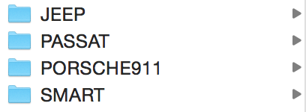
Last four kinds of cars
car4_0:
accurancy = 0.7
15/20
16/20
15/20
11/20
57/80
car4_1:
accurancy = 0.93
20/20
20/20
18/20
18/20
76/80
car4_2:
accurancy = 0.96
20/20
15/20
18/20
18/20
71/80
car4_3:
accurancy = 0.97
20/20
18/20
18/20
19/20
75/80

Slide 3
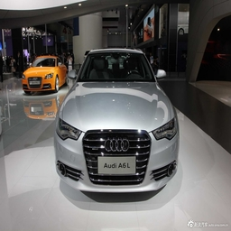
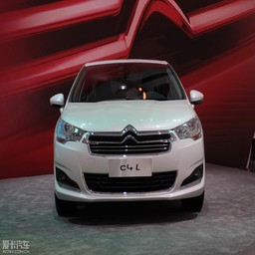
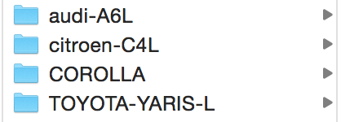
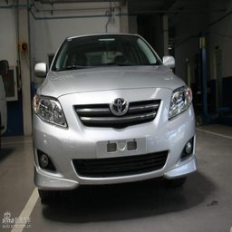
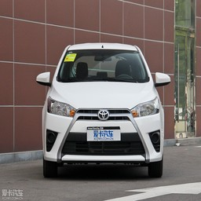
car4:
258*4
accuracy = 0.57
11/20
8/20
7/20
11/20
37/80

Slide 4
2 kinds of cars A6L&COROLLA
50*2
accurancy = 0.8
17/20
13/20
30/40
200*2
accurancy = 0.73
15/20
15/20
30/40

Slide 5
A6L 3511+50
COROLLA 3331+50
不收敛。。。Accuracy = 0.5
2000不收敛
1000不收敛
500收敛

