Slide 1
Predictive Inference Tools for Researchers
by Voyze G Harris III

Slide 2
Abstract
Motivation: the lack of suitable computing tools presents an obstacle to employment of Bayesian predictive inference in research
Purpose of this thesis: to address that problem by providing a set of software tools for some useful predictive models
Documentation and derivation of models
Creation of R functions for Bayesian predictive analysis
Primary Sources
Seymour Geisser’s Predictive Inference: An Introduction (1993)
Peter D. Hoff’s A First Course in Bayesian Statistical Methods (2009)

Slide 3
Why Predictive Inference?
A statistical model may be judged by the quality of the predictions it makes
Prediction is the main purpose of statistics
Bayesian predictive inference
Connects subjective and objective reality (Nate Silver)
Emphasizes concrete observed data over hypothetical parameters
Facilitates discrimination between competing statistical models
Improves scientific accuracy and reproducibility (Dean Billheimer)

Slide 4






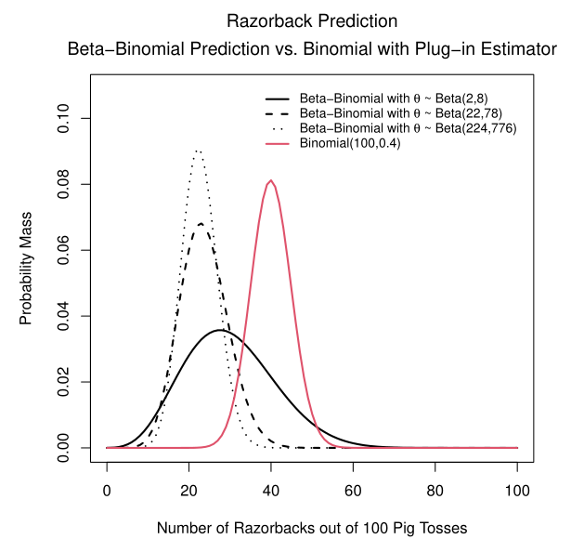


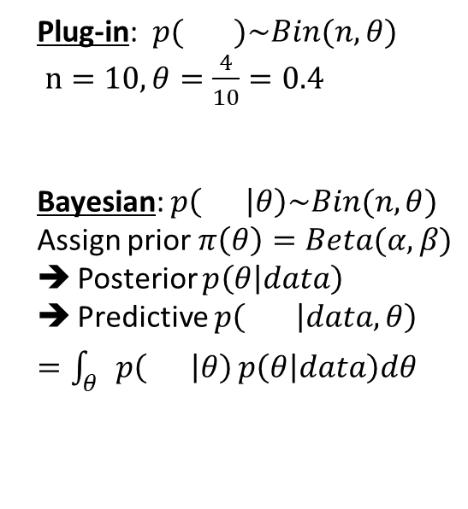
Illustration: Pass the Pigs®
Plug-in: $p( )\sim Bin(n, θ)$
$n=10, θ=\frac{4}{10}=0.4$
Bayesian: $p\left( | θ\right)\sim Bin(n,θ)$
Assign prior $π\left(θ\right)=Beta(α,β)$
Posterior $p\left(θ | data\right)$
Predictive $p\left( | data,θ\right)$
$=\int_{θ}{p\left( | θ\right)}p\left(θ | data\right)dθ$
Classic press-your-luck dice game where the “dice” are pigs!
Toss the pig dice and accumulate points (or lose everything) depending on how they land
Prediction problem: having just observed 4 razorbacks out of 10 tosses of a single pig, how many razorbacks will I see in the next 10 tosses?
Observations:
Noticeable location difference between the methods
Prior parameter selection affects variance
$$p\left( | data\right)= ?$$
Prior parameters selection reflects expectation from experience that the average number of Razorbacks should be near 22% of the tosses. Reference Duquesne University Pass the Pigs® experiment: see Journal of Statistics Education Volume 14, Number 3, 2006 (http://jse.amstat.org/v14n3/datasets.kern.html)

Slide 5
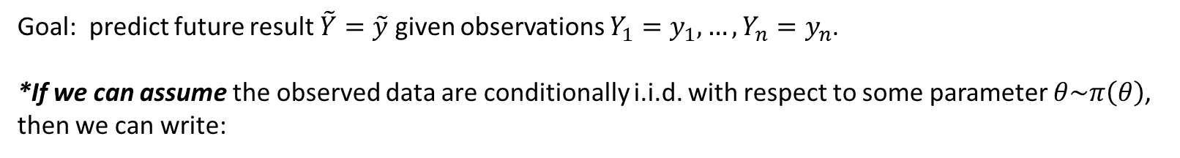
The Bayesian Parametric Prediction Format
Goal: predict future result $\tilde{Y}=\tilde{y}$ given observations $Y_{1}=y_{1},…,Y_{n}=y_{n}$.
*If we can assume the observed data are conditionally i.i.d. with respect to some parameter $θ\sim π\left(θ\right)$,
then we can write:
$$p\left(\tilde{Y}=\tilde{y} | Y_{1}=y_{1},…,Y_{n}=y_{n}\right)=\frac{p\left(\tilde{y},y_{1},…, y_{n}\right)}{p\left(y_{1},…, y_{n}\right)}=\frac{\int{p\left(\tilde{y},y_{1},…, y_{n} | θ\right)π\left(θ\right)dθ}}{p\left(y_{1},…, y_{n}\right)}=\int{p\left(\tilde{y} | θ\right)p\left(θ | y_{1},…, y_{n}\right)dθ}$$
*For this assumption, we need exchangeability.

Slide 6
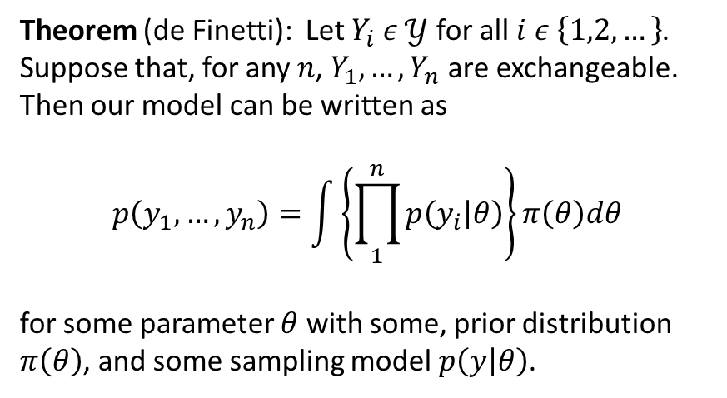
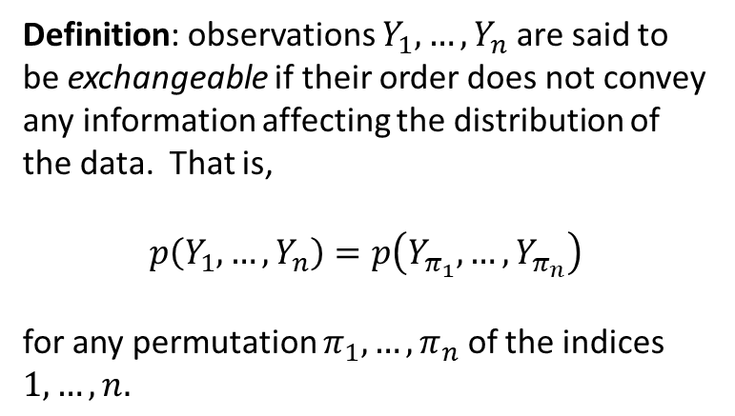
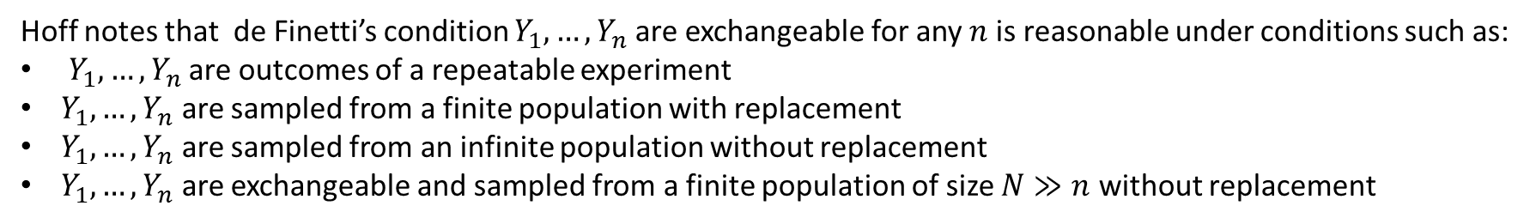
Exchangeability and de Finetti’s theorem
Definition: observations $Y_{1},…, Y_{n}$ are said to be exchangeable if their order does not convey any information affecting the distribution of the data. That is,
$$p\left(Y_{1},…, Y_{n}\right)=p\left(Y_{π_{1}},…, Y_{π_{n}}\right)$$
for any permutation $π_{1},…, π_{n}$ of the indices $1,…,n.$
Theorem (de Finetti): Let $Y_{i} ε 𝒴$ for all $i ε \left\{1,2,…\right\}$. Suppose that, for any $n$, $Y_{1},…, Y_{n}$ are exchangeable. Then our model can be written as
$$p\left(y_{1},…, y_{n}\right)=\int{\left\{\prod_{1}^{n}{p\left(y_{i} | θ\right)}\right\}}π\left(θ\right)dθ$$
for some parameter $θ$ with some, prior distribution $π\left(θ\right)$, and some sampling model $p\left(y | θ\right)$.
Hoff notes that de Finetti’s condition $Y_{1},…, Y_{n}$ are exchangeable for any $n$ is reasonable under conditions such as:
$Y_{1},…, Y_{n}$ are outcomes of a repeatable experiment
$Y_{1},…, Y_{n}$ are sampled from a finite population with replacement
$Y_{1},…, Y_{n}$ are sampled from an infinite population without replacement
$Y_{1},…, Y_{n}$ are exchangeable and sampled from a finite population of size $N≫n$ without replacement
We assume exchangeability of the data throughout this thesis.

Slide 7
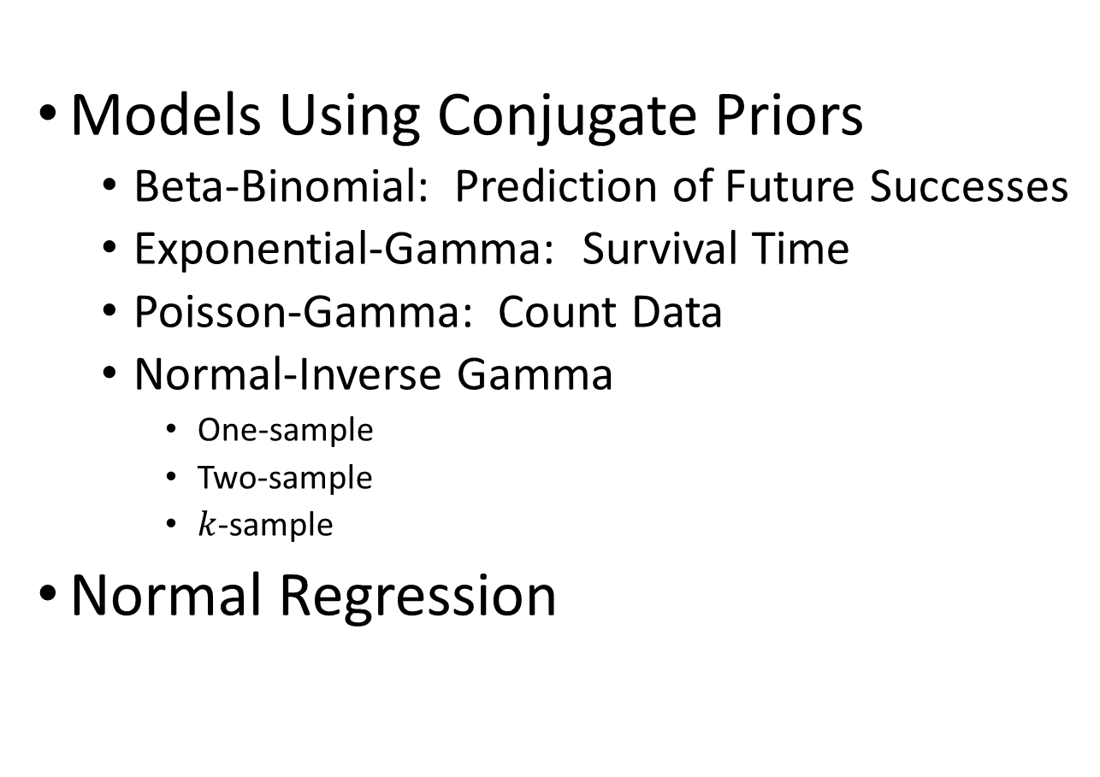
The Models
Should I get rid of the part after the colon?
Models Using Conjugate Priors
Beta-Binomial: Prediction of Future Successes
Exponential-Gamma: Survival Time
Poisson-Gamma: Count Data
Normal-Inverse Gamma
One-sample
Two-sample
$k$-sample
Normal Regression

Slide 8
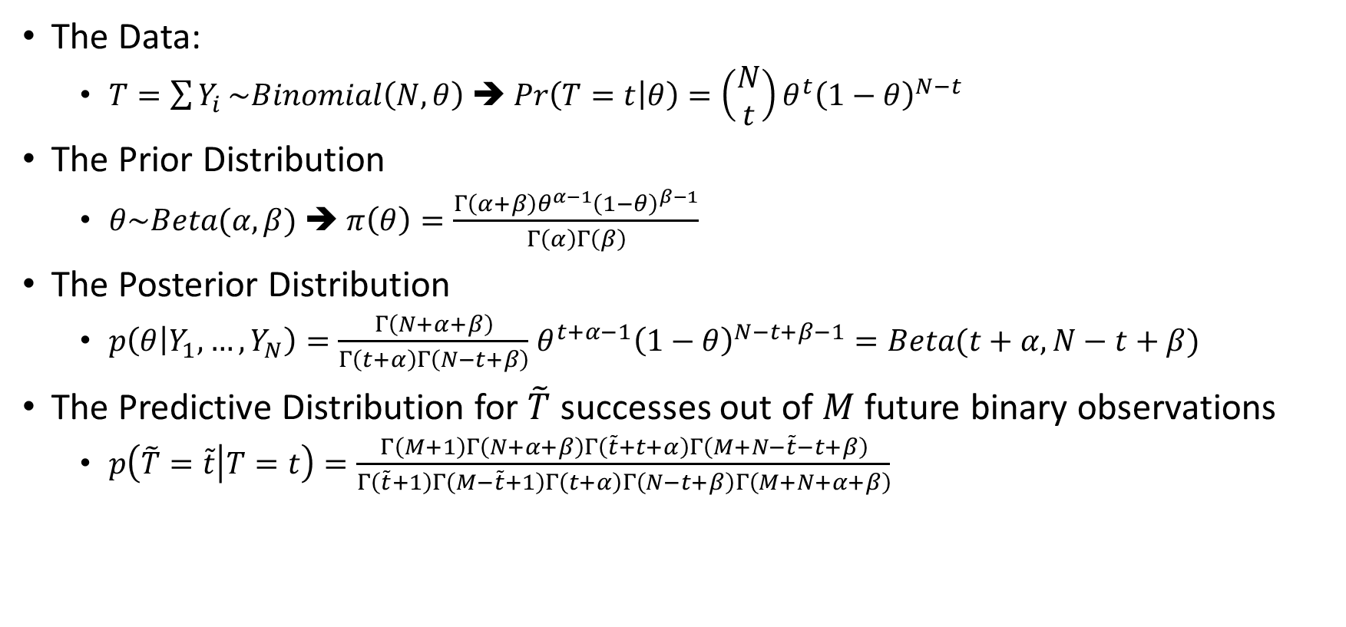
Prediction of Future Successes: Beta-Binomial Model
The Data:
$T=\sum{Y_{i}}\sim Binomial\left(N,θ\right)$ ➔ $Pr\left(T=t | θ\right)=\left(\begin{matrix}N \\ t\end{matrix}\right)θ^{t}{\left(1−θ\right)}^{N−t}$
The Prior Distribution
$θ\sim Beta(α,β)$ ➔ $π\left(θ\right)=\frac{Γ\left(α+β\right)θ^{α−1}{\left(1−θ\right)}^{β−1}}{Γ\left(α\right)Γ\left(β\right)}$
The Posterior Distribution
$p\left(θ | Y_{1},…, Y_{N}\right)=\frac{Γ\left(N+α+β\right)}{Γ\left(t+α\right)Γ\left(N−t+β\right)}$ $θ^{t+α−1}{\left(1−θ\right)}^{N−t+β−1}=Beta(t+α, N−t+β)$
The Predictive Distribution for $\tilde{T}$ successes out of $M$ future binary observations
$p\left(\tilde{T}=\tilde{t} | T=t\right)=\frac{Γ\left(M+1\right)Γ\left(N+α+β\right)Γ\left(\tilde{t}+t+α\right)Γ\left(M+N−\tilde{t}−t+β\right)}{Γ\left(\tilde{t}+1\right)Γ\left(M−\tilde{t}+1\right)Γ\left(t+α\right)Γ\left(N−t+β\right)Γ\left(M+N+α+β\right)}$

Slide 9
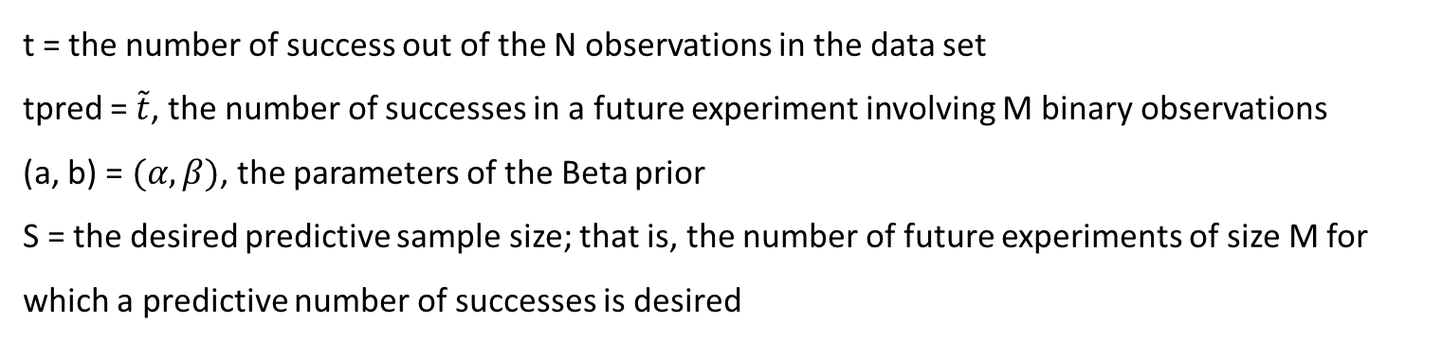
Beta-Binomial R functions:
Predictive distribution:$p\left(\tilde{T}=\tilde{t} | T=t\right)=\frac{Γ\left(M+1\right)Γ\left(N+α+β\right)Γ\left(\tilde{t}+t+α\right)Γ\left(M+N−\tilde{t}−t+β\right)}{Γ\left(\tilde{t}+1\right)Γ\left(M−\tilde{t}+1\right)Γ\left(t+α\right)Γ\left(N−t+β\right)Γ\left(M+N+α+β\right)}$
Type | Function | Implementation
Density | dpredBB(tpred,N,t,M,a,b) | Uses R function lgamma() for each factor then exponentiates.
Cumulative Probability | ppredBB(tpred,N,t,M,a,b) | Calls dpredBB() and returns the cumulative sum of that discrete set of results
Predictive Sampler | rpredBB(S,N,t,M,a,b) | Uses inverse transform method and output of ppredBB()
t = the number of success out of the N observations in the data set
tpred = $\tilde{t}$, the number of successes in a future experiment involving M binary observations
(a, b) = $(α,β)$, the parameters of the Beta prior
S = the desired predictive sample size; that is, the number of future experiments of size M for which a predictive number of successes is desired

Slide 10
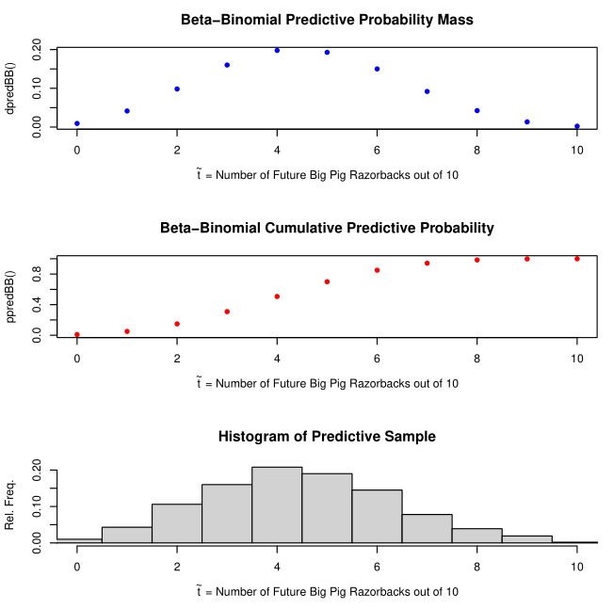
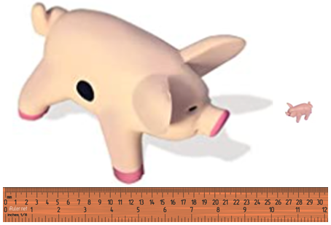
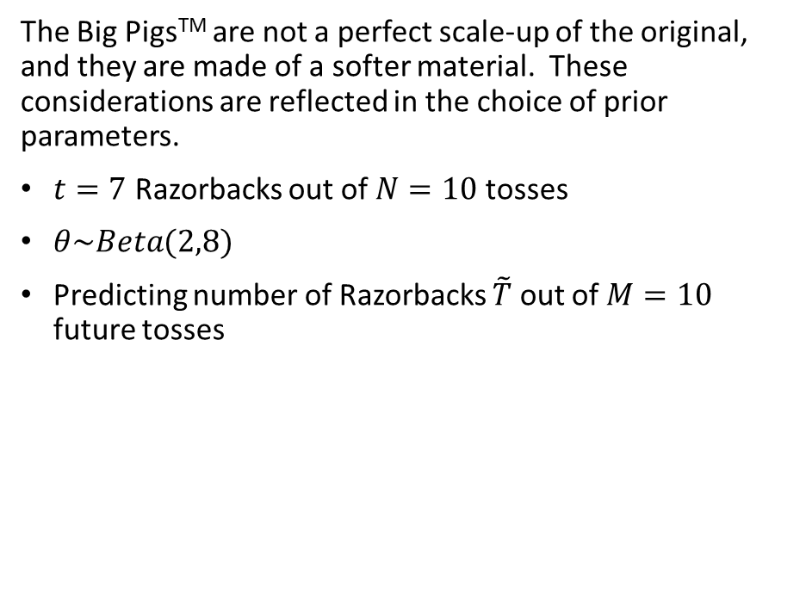
Beta-Binomial Example: Pass The Pigs®: Big PigsTM
The Big PigsTM are not a perfect scale-up of the original, and they are made of a softer material. These considerations are reflected in the choice of prior parameters.
$t=7$ Razorbacks out of $N=10$ tosses
$θ\sim Beta(2,8)$
Predicting number of Razorbacks $\tilde{T}$ out of $M=10$ future tosses

Slide 11
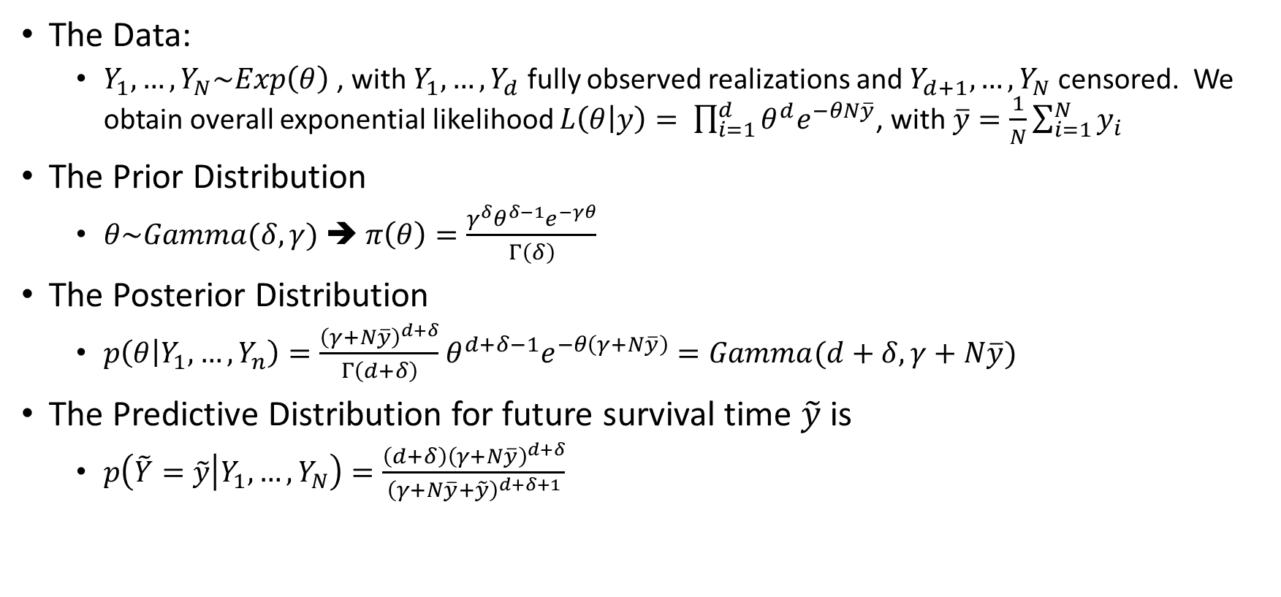
Survival Time: Exponential-Gamma Model
The Data:
$Y_{1},…, Y_{N}\sim Exp\left(θ\right)$ , with $Y_{1},…, Y_{d}$ fully observed realizations and $Y_{d+1},…, Y_{N}$ censored. We obtain overall exponential likelihood $L\left(θ | y\right)= \prod_{i=1}^{d}{θ^{d}e^{−θN\overline{y}}}$, with $\overline{y}=\frac{1}{N}\sum_{i=1}^{N}{y_{i}}$
The Prior Distribution
$θ\sim Gamma(δ,γ)$ ➔ $π\left(θ\right)=\frac{γ^{δ}θ^{δ−1}e^{−γθ}}{Γ\left(δ\right)}$
The Posterior Distribution
$p\left(θ | Y_{1},…, Y_{n}\right)=\frac{{\left(γ+N\overline{y}\right)}^{d+δ}}{Γ\left(d+δ\right)}$ $θ^{d+δ−1}e^{−θ\left(γ+N\overline{y}\right)}=Gamma(d+δ,γ+N\overline{y})$
The Predictive Distribution for future survival time $\tilde{y}$ is
$p\left(\tilde{Y}=\tilde{y} | Y_{1},…, Y_{N}\right)=\frac{\left(d+δ\right){\left(γ+N\overline{y}\right)}^{d+δ}}{{\left(γ+N\overline{y}+\tilde{y}\right)}^{d+δ+1}}$

Slide 12
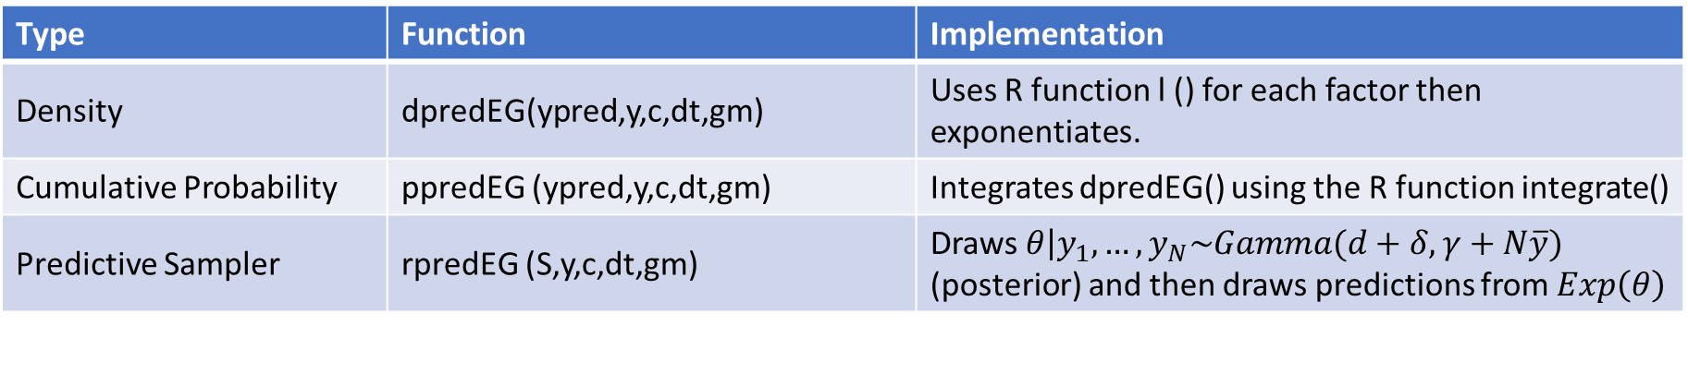
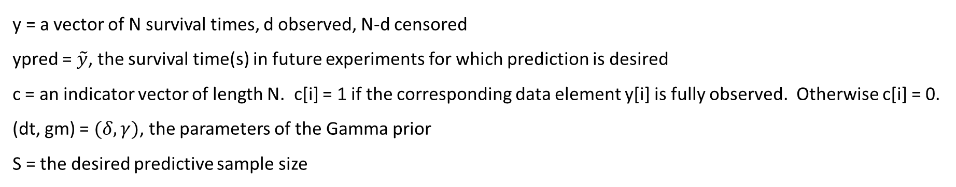
Exponential-Gamma R functions:
Predictive distribution:$p\left(\tilde{T}=\tilde{t} | T=t\right)=\frac{Γ\left(M+1\right)Γ\left(N+α+β\right)Γ\left(\tilde{t}+t+α\right)Γ\left(M+N−\tilde{t}−t+β\right)}{Γ\left(\tilde{t}+1\right)Γ\left(M−\tilde{t}+1\right)Γ\left(t+α\right)Γ\left(N−t+β\right)Γ\left(M+N+α+β\right)}$
Type | Function | Implementation
Density | dpredEG(ypred,y,c,dt,gm) | Uses R function l () for each factor then exponentiates.
Cumulative Probability | ppredEG (ypred,y,c,dt,gm) | Integrates dpredEG() using the R function integrate()
Predictive Sampler | rpredEG (S,y,c,dt,gm) | Draws $\left.θ\right|y_{1},…, y_{N}\sim Gamma(d+δ,γ+N\overline{y})$ (posterior) and then draws predictions from $Exp\left(θ\right)$
y = a vector of N survival times, d observed, N-d censored
ypred = $\tilde{y}$, the survival time(s) in future experiments for which prediction is desired
c = an indicator vector of length N. c[i] = 1 if the corresponding data element y[i] is fully observed. Otherwise c[i] = 0.
(dt, gm) = $(δ,γ)$, the parameters of the Gamma prior
S = the desired predictive sample size

Slide 13
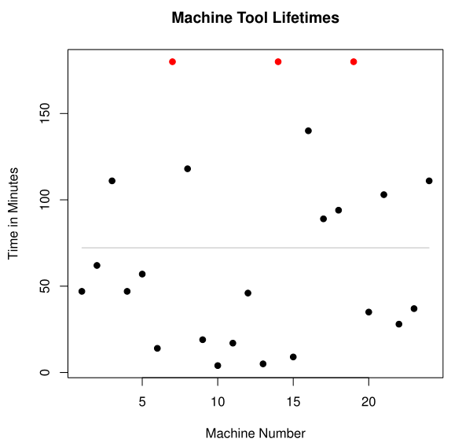
Exponential-Gamma Example: Machine Tool Lifetime (Aitchison & Dunsmore)
Data = lifetime in minutes of 24 machine tools of a particular type
Lifetimes range from 4 to 290 minutes, with mean 74.71 (gray horizontal line)
3 observations were censored at 180 minutes, and thus assigned to that time (shown in red on the plot)

Slide 14
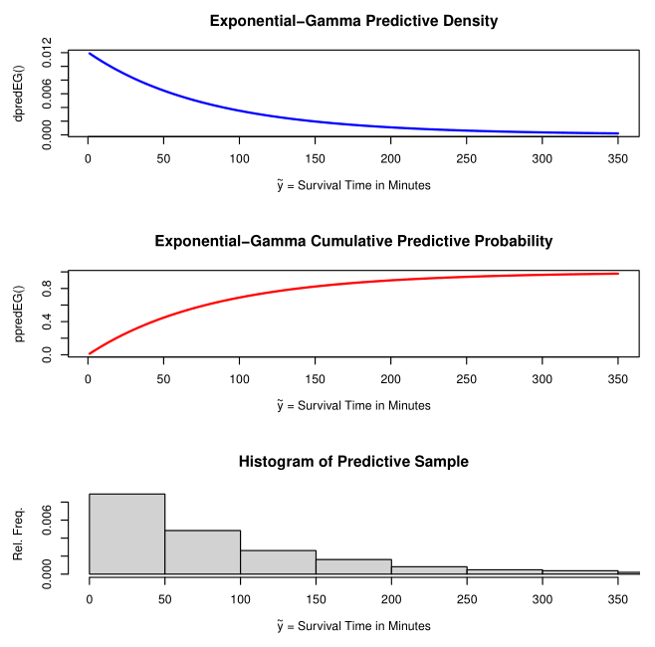
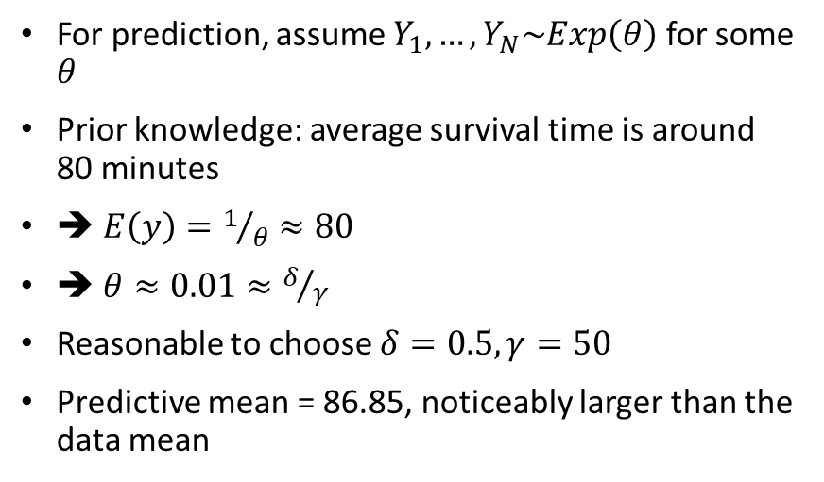
Exponential-Gamma Example, continued: Machine Tool Lifetime (Aitchison & Dunsmore)
For prediction, assume $Y_{1},…, Y_{N}\sim Exp\left(θ\right)$ for some $θ$
Prior knowledge: average survival time is around 80 minutes
➔ $E\left(y\right)=1/θ≈80$
➔ $θ≈0.01≈δ/γ$
Reasonable to choose $δ=0.5, γ=50$
Predictive mean = 86.85, noticeably larger than the data mean

Slide 15
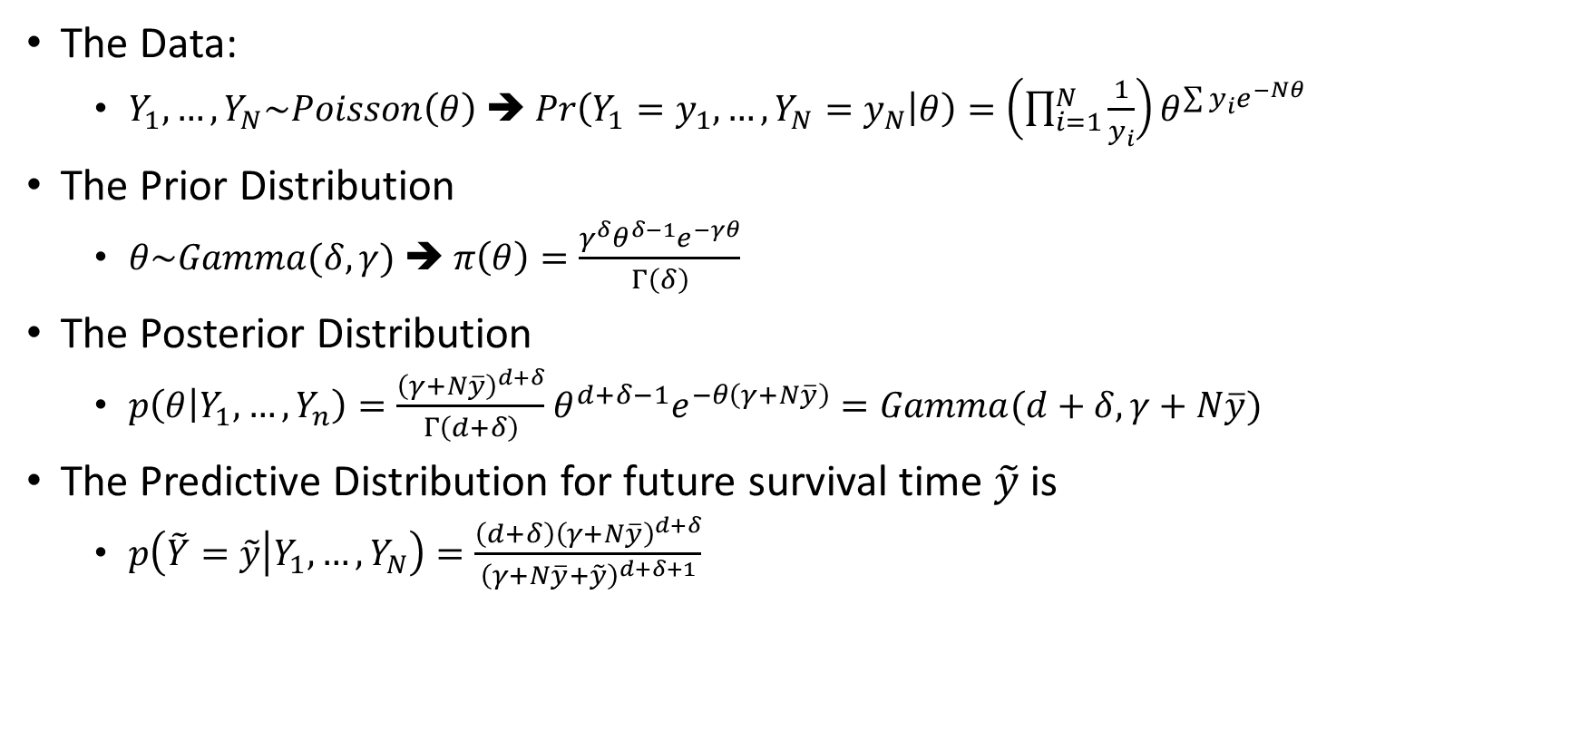
Count Data: Poisson-Gamma Model
The Data:
$Y_{1},…, Y_{N}\sim Poisson\left(θ\right)$ ➔ $Pr\left(Y_{1}=y_{1},…,Y_{N}=y_{N} | θ\right)=\left(\prod_{i=1}^{N}{\frac{1}{y_{i}}}\right)θ^{\sum{y_{i}e^{−Nθ}}}$
The Prior Distribution
$θ\sim Gamma(δ,γ)$ ➔ $π\left(θ\right)=\frac{γ^{δ}θ^{δ−1}e^{−γθ}}{Γ\left(δ\right)}$
The Posterior Distribution
$p\left(θ | Y_{1},…, Y_{n}\right)=\frac{{\left(γ+N\overline{y}\right)}^{d+δ}}{Γ\left(d+δ\right)}$ $θ^{d+δ−1}e^{−θ\left(γ+N\overline{y}\right)}=Gamma(d+δ,γ+N\overline{y})$
The Predictive Distribution for future survival time $\tilde{y}$ is
$p\left(\tilde{Y}=\tilde{y} | Y_{1},…, Y_{N}\right)=\frac{\left(d+δ\right){\left(γ+N\overline{y}\right)}^{d+δ}}{{\left(γ+N\overline{y}+\tilde{y}\right)}^{d+δ+1}}$

Slide 16
Poisson-Gamma Example: Large Hurricane Count

Slide 17
Normal-Inverse Gamma Model: 1-Sample

Slide 18
Normal-Inverse Gamma Example: Midge Wing Length (Hoff)

Slide 19
Normal-Inverse Gamma Model: 2-Sample

Slide 20
Normal-Inverse Gamma Example: Math Scores, Comparing Two Schools

Slide 21
Normal-Inverse Gamma Model: k-Sample

Slide 22
Normal-Inverse Gamma Example: Math Scores, Comparing 100 Schools

Slide 23
Normal Regression Model

Slide 24
Normal Regression Example: Oxygen Uptake

