Slide 1

Predictive Inference Tools for Researchers
by Gabe Harris

Slide 2
Why Predictive Inference?
A statistical model may be judged by the quality of the predictions it makes
Prediction is the main purpose of statistics
Bayesian predictive inference
Connects subjective and objective reality (Nate Silver)
Emphasizes concrete observed data over hypothetical parameters
Facilitates discrimination between competing statistical models
Improves scientific accuracy and reproducibility (Dean Billheimer)

Slide 3
Overview
Motivation: the lack of suitable computing tools presents an obstacle to employment of Bayesian predictive inference in research
Purpose of this thesis: to address that problem by providing a set of software tools for some useful predictive models
Documentation and derivation of models
Creation of R functions for Bayesian predictive analysis
Primary Sources
Seymour Geisser’s Predictive Inference: An Introduction (1993)
Peter D. Hoff’s A First Course in Bayesian Statistical Methods (2009)

Slide 4






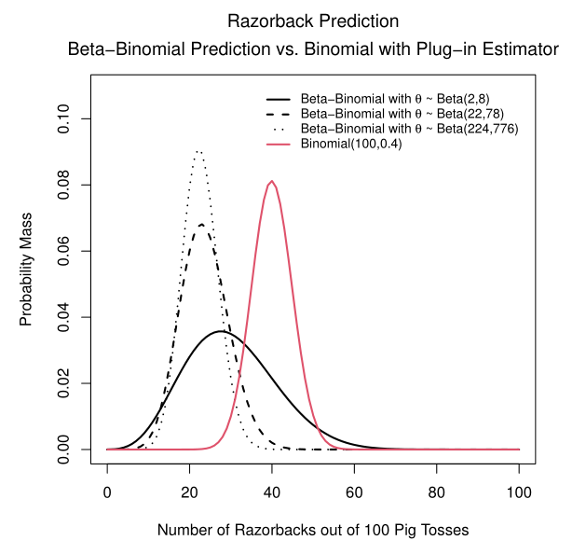


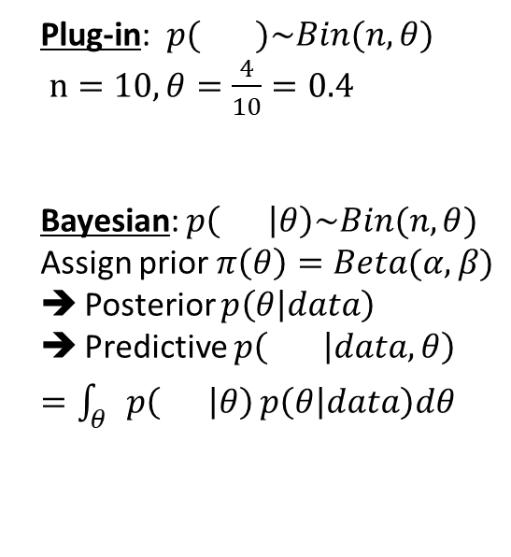
Illustration: Pass the Pigs®
Plug-in: $p( )\sim Bin(n, θ)$
$n=10, θ=\frac{4}{10}=0.4$
Bayesian: $p\left( | θ\right)\sim Bin(n,θ)$
Assign prior $π\left(θ\right)=Beta(α,β)$
Posterior $p\left(θ | data\right)$
Predictive $p\left( | data,θ\right)$
$=\int_{θ}{p\left( | θ\right)}p\left(θ | data\right)dθ$
Classic press-your-luck dice game where the “dice” are pigs!
Toss the pig dice and accumulate points (or lose everything) depending on how they land
Prediction problem: having just observed 4 razorbacks out of 10 tosses of a single pig, how many razorbacks will I see in the next 10 tosses?
Observations:
Noticeable location difference between the methods
Prior parameter selection affects variance
$$p\left( | data\right)= ?$$
Prior parameters selection reflects expectation from experience that the average number of Razorbacks should be near 22% of the tosses. Reference Duquesne University Pass the Pigs® experiment: see Journal of Statistics Education Volume 14, Number 3, 2006 (http://jse.amstat.org/v14n3/datasets.kern.html)

Slide 5
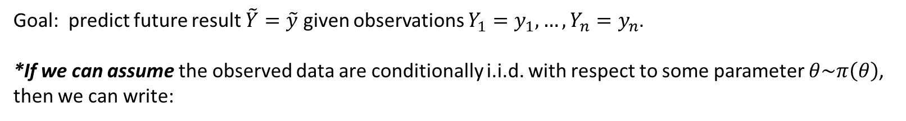
The Bayesian Parametric Prediction Format
Goal: predict future result $\tilde{Y}=\tilde{y}$ given observations $Y_{1}=y_{1},…,Y_{n}=y_{n}$.
*If we can assume the observed data are conditionally i.i.d. with respect to some parameter $θ\sim π\left(θ\right)$,
then we can write:
$$p\left(\tilde{Y}=\tilde{y} | Y_{1}=y_{1},…,Y_{n}=y_{n}\right)=\frac{p\left(\tilde{y},y_{1},…, y_{n}\right)}{p\left(y_{1},…, y_{n}\right)}=\frac{\int{p\left(\tilde{y},y_{1},…, y_{n} | θ\right)π\left(θ\right)dθ}}{p\left(y_{1},…, y_{n}\right)}=\int{p\left(\tilde{y} | θ\right)p\left(θ | y_{1},…, y_{n}\right)dθ}$$
*For this assumption, we need exchangeability.

Slide 6
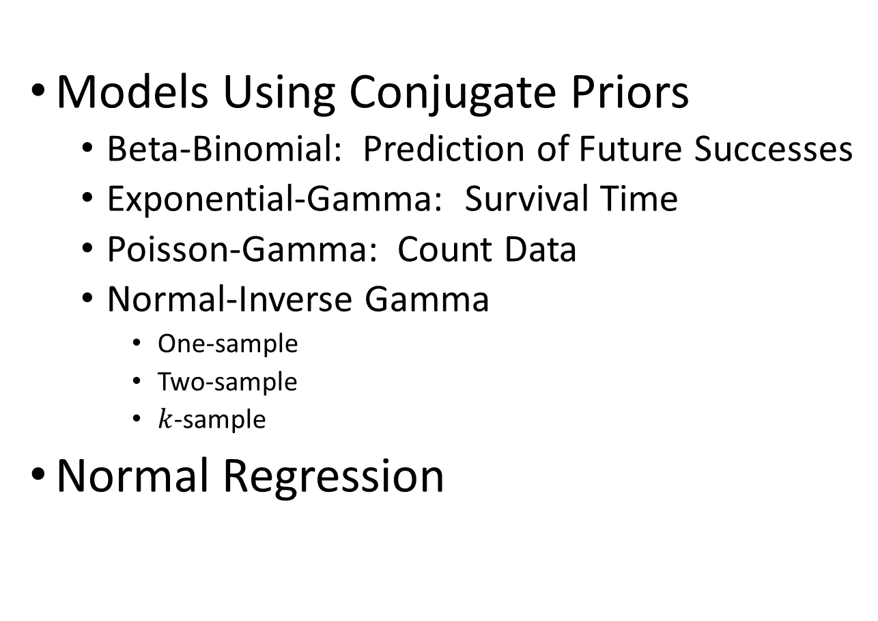
The Models
Models Using Conjugate Priors
Beta-Binomial: Prediction of Future Successes
Exponential-Gamma: Survival Time
Poisson-Gamma: Count Data
Normal-Inverse Gamma
One-sample
Two-sample
$k$-sample
Normal Regression

Slide 7
Beta-Binomial Model: Prediction of Future Successes

Slide 8
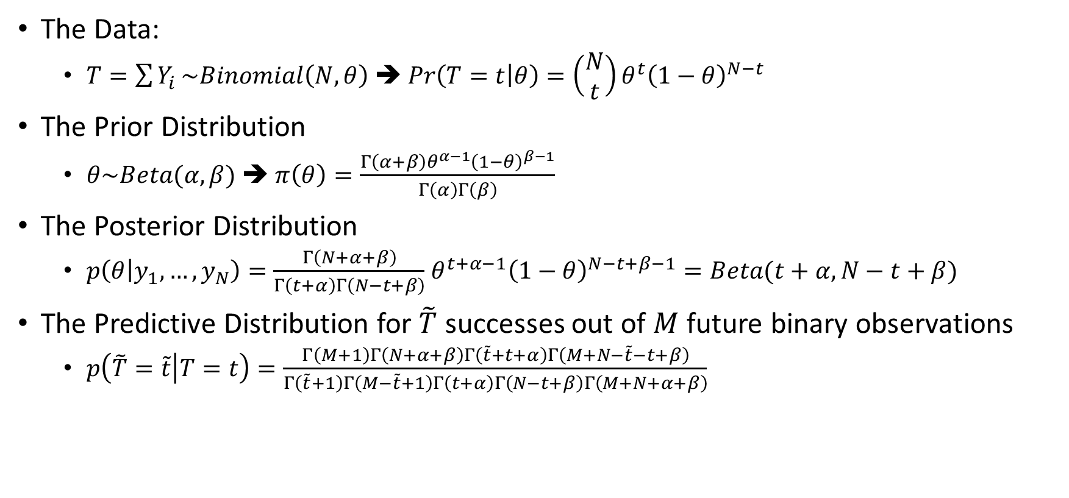
Beta-Binomial Model: Derivation
The Data:
$T=\sum{Y_{i}}\sim Binomial\left(N,θ\right)$ ➔ $Pr\left(T=t | θ\right)=\left(\begin{matrix}N \\ t\end{matrix}\right)θ^{t}{\left(1−θ\right)}^{N−t}$
The Prior Distribution
$θ\sim Beta(α,β)$ ➔ $π\left(θ\right)=\frac{Γ\left(α+β\right)θ^{α−1}{\left(1−θ\right)}^{β−1}}{Γ\left(α\right)Γ\left(β\right)}$
The Posterior Distribution
$p\left(θ | y_{1},…, y_{N}\right)=\frac{Γ\left(N+α+β\right)}{Γ\left(t+α\right)Γ\left(N−t+β\right)}$ $θ^{t+α−1}{\left(1−θ\right)}^{N−t+β−1}=Beta(t+α, N−t+β)$
The Predictive Distribution for $\tilde{T}$ successes out of $M$ future binary observations
$p\left(\tilde{T}=\tilde{t} | T=t\right)=\frac{Γ\left(M+1\right)Γ\left(N+α+β\right)Γ\left(\tilde{t}+t+α\right)Γ\left(M+N−\tilde{t}−t+β\right)}{Γ\left(\tilde{t}+1\right)Γ\left(M−\tilde{t}+1\right)Γ\left(t+α\right)Γ\left(N−t+β\right)Γ\left(M+N+α+β\right)}$

Slide 9
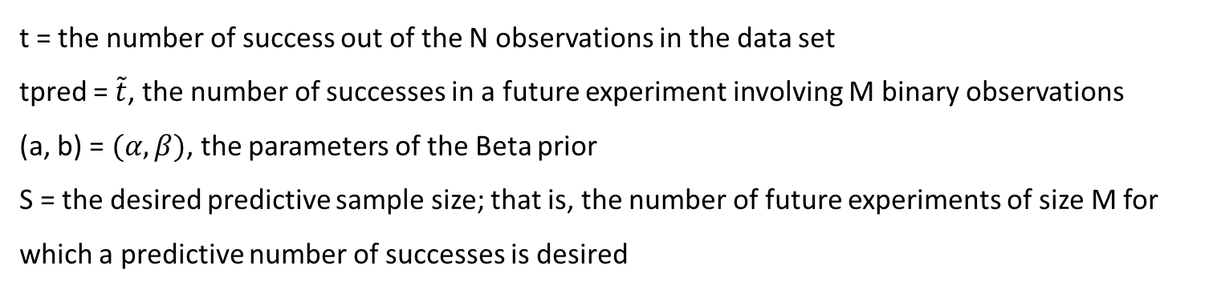
Beta-Binomial Model: R functions:
Predictive distribution:$p\left(\tilde{T}=\tilde{t} | T=t\right)=\frac{Γ\left(M+1\right)Γ\left(N+α+β\right)Γ\left(\tilde{t}+t+α\right)Γ\left(M+N−\tilde{t}−t+β\right)}{Γ\left(\tilde{t}+1\right)Γ\left(M−\tilde{t}+1\right)Γ\left(t+α\right)Γ\left(N−t+β\right)Γ\left(M+N+α+β\right)}$
Type | Function | Implementation
Density | dpredBB(tpred,N,t,M,a,b) | Uses R function lgamma() for each factor then exponentiates.
Cumulative Probability | ppredBB(tpred,N,t,M,a,b) | Calls dpredBB() and returns the cumulative sum of that discrete set of results
Predictive Sampler | rpredBB(S,N,t,M,a,b) | Uses inverse transform method and output of ppredBB()
t = the number of success out of the N observations in the data set
tpred = $\tilde{t}$, the number of successes in a future experiment involving M binary observations
(a, b) = $(α,β)$, the parameters of the Beta prior
S = the desired predictive sample size; that is, the number of future experiments of size M for which a predictive number of successes is desired
Notes:
Talk through this one in detail to orient audience.

Slide 10
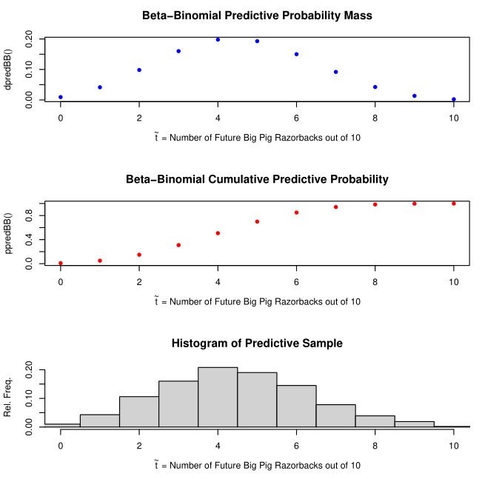
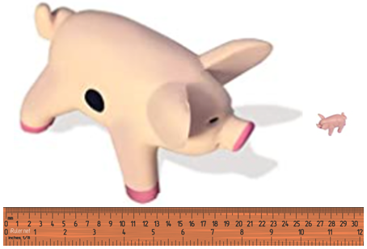
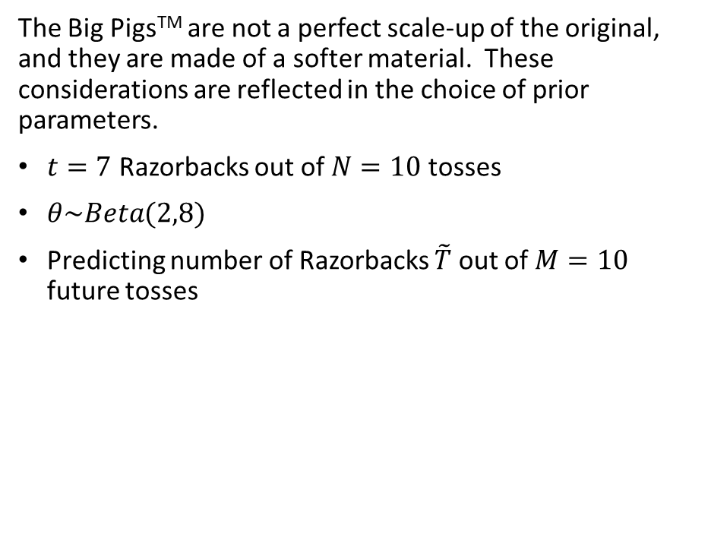
Beta-Binomial Example: Pass The Pigs®: Big PigsTM
The Big PigsTM are not a perfect scale-up of the original, and they are made of a softer material. These considerations are reflected in the choice of prior parameters.
$t=7$ Razorbacks out of $N=10$ tosses
$θ\sim Beta(2,8)$
Predicting number of Razorbacks $\tilde{T}$ out of $M=10$ future tosses

Slide 11
Exponential-Gamma Model: Time to Event (Allowing Censoring)

Slide 12
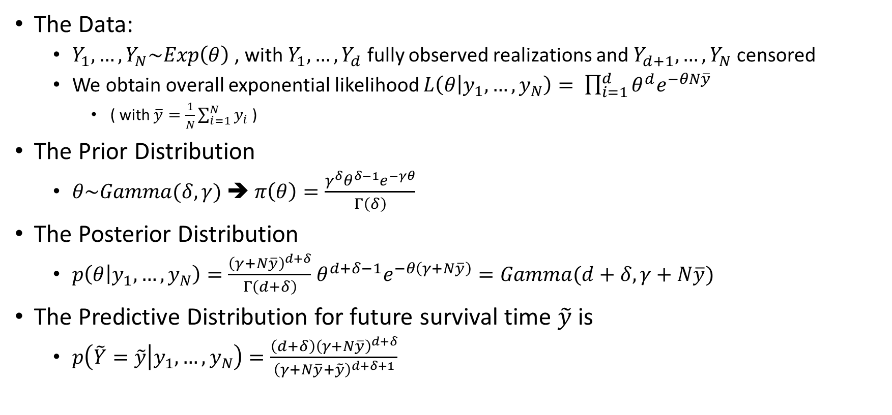
Exponential-Gamma Model: Derivation
The Data:
$Y_{1},…, Y_{N}\sim Exp\left(θ\right)$ , with $Y_{1},…, Y_{d}$ fully observed realizations and $Y_{d+1},…, Y_{N}$ censored
We obtain overall exponential likelihood $L\left(θ | y_{1},…, y_{N}\right)= \prod_{i=1}^{d}{θ^{d}e^{−θN\overline{y}}}$
( with $\overline{y}=\frac{1}{N}\sum_{i=1}^{N}{y_{i}}$ )
The Prior Distribution
$θ\sim Gamma(δ,γ)$ ➔ $π\left(θ\right)=\frac{γ^{δ}θ^{δ−1}e^{−γθ}}{Γ\left(δ\right)}$
The Posterior Distribution
$p\left(θ | y_{1},…, y_{N}\right)=\frac{{\left(γ+N\overline{y}\right)}^{d+δ}}{Γ\left(d+δ\right)}$ $θ^{d+δ−1}e^{−θ\left(γ+N\overline{y}\right)}=Gamma(d+δ,γ+N\overline{y})$
The Predictive Distribution for future survival time $\tilde{y}$ is
$p\left(\tilde{Y}=\tilde{y} | y_{1},…, y_{N}\right)=\frac{\left(d+δ\right){\left(γ+N\overline{y}\right)}^{d+δ}}{{\left(γ+N\overline{y}+\tilde{y}\right)}^{d+δ+1}}$

Slide 13
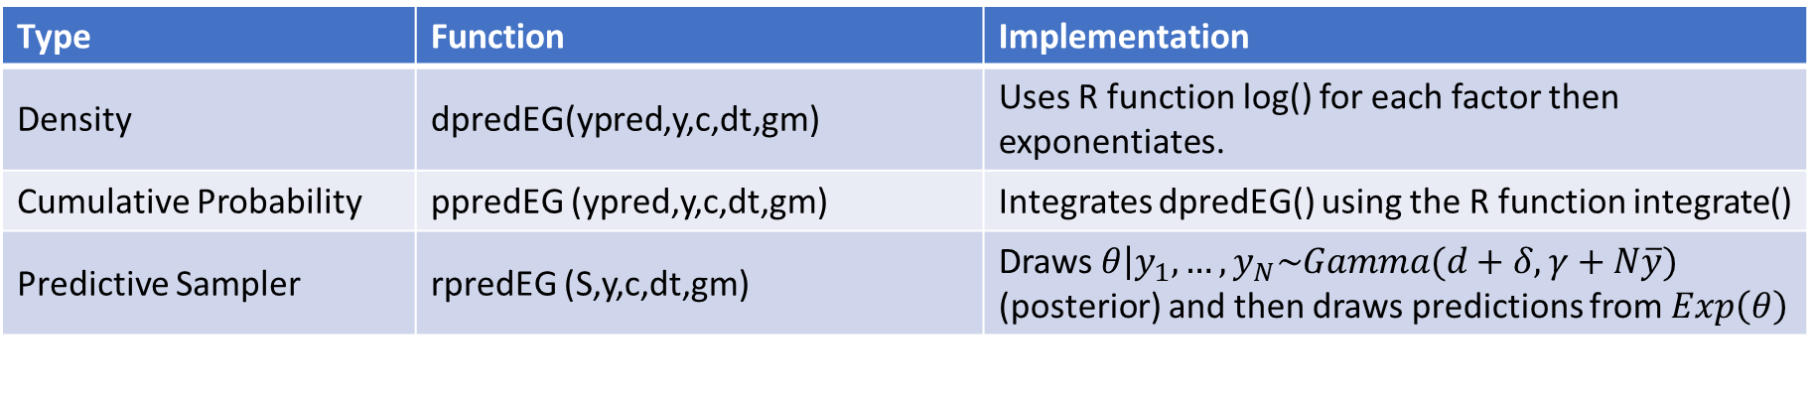
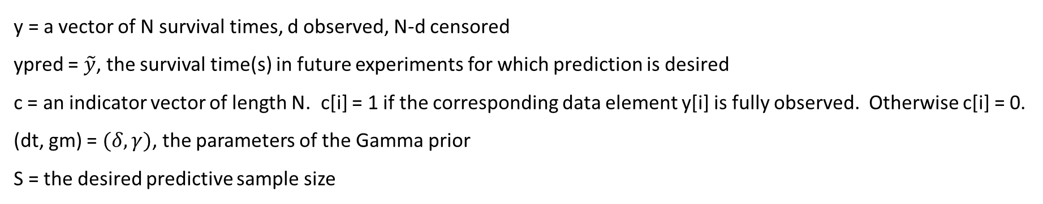
Exponential-Gamma Model: R functions
Predictive distribution: $p\left(\tilde{Y}=\tilde{y} | y_{1},…, y_{N}\right)=\frac{\left(d+δ\right){\left(γ+N\overline{y}\right)}^{d+δ}}{{\left(γ+N\overline{y}+\tilde{y}\right)}^{d+δ+1}}$
Type | Function | Implementation
Density | dpredEG(ypred,y,c,dt,gm) | Uses R function log() for each factor then exponentiates.
Cumulative Probability | ppredEG (ypred,y,c,dt,gm) | Integrates dpredEG() using the R function integrate()
Predictive Sampler | rpredEG (S,y,c,dt,gm) | Draws $\left.θ\right|y_{1},…, y_{N}\sim Gamma(d+δ,γ+N\overline{y})$ (posterior) and then draws predictions from $Exp\left(θ\right)$
y = a vector of N survival times, d observed, N-d censored
ypred = $\tilde{y}$, the survival time(s) in future experiments for which prediction is desired
c = an indicator vector of length N. c[i] = 1 if the corresponding data element y[i] is fully observed. Otherwise c[i] = 0.
(dt, gm) = $(δ,γ)$, the parameters of the Gamma prior
S = the desired predictive sample size

Slide 14
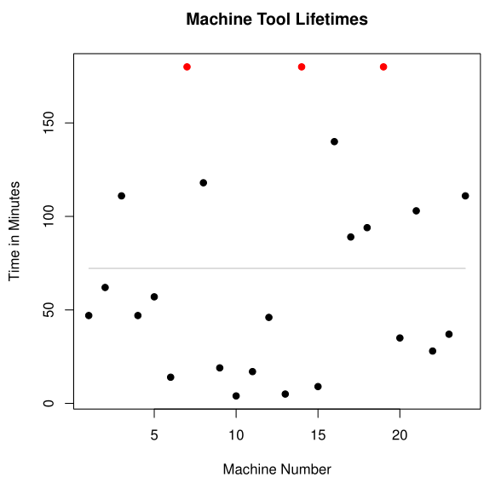
Exponential-Gamma Example: Machine Tool Lifetime
Data = lifetime in minutes of 24 machine tools of a particular type (taken from Statistical Prediction Analysis by Aitchison & Dunsmore)
Lifetimes range from 4 to 180 minutes, with mean 72.21 (gray horizontal line)
3 observations were censored at 180 minutes and are shown in red

Slide 15
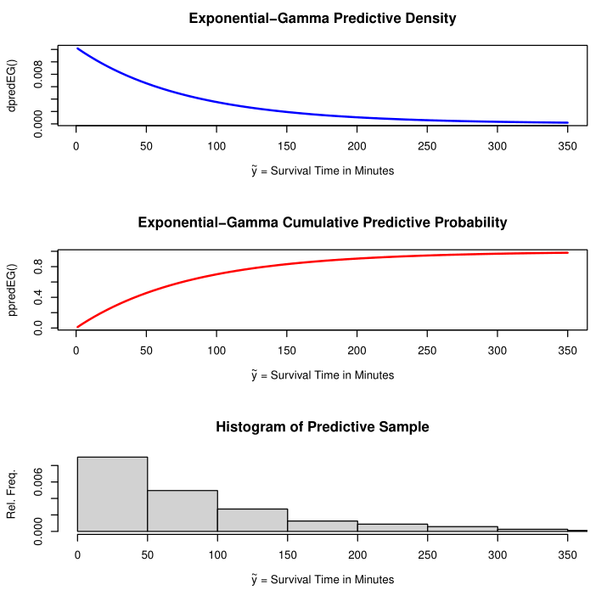
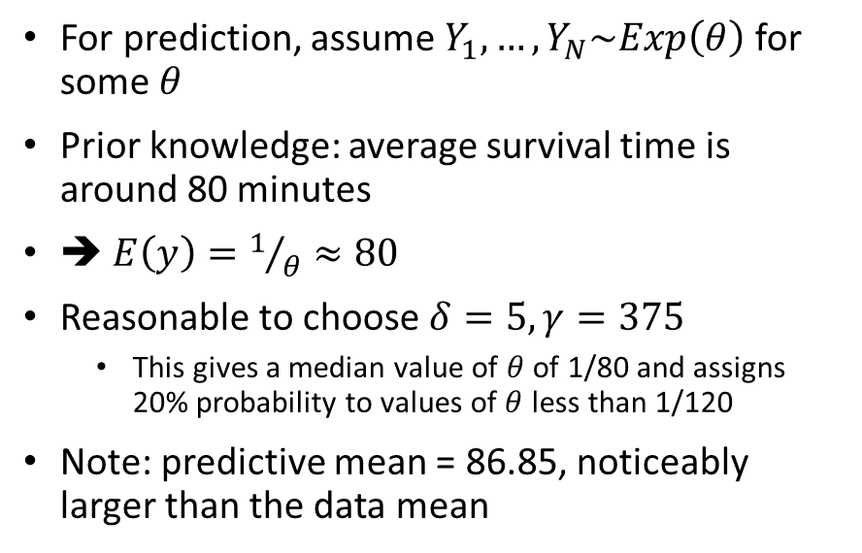
Exponential-Gamma Example, continued: Machine Tool Lifetime (Aitchison & Dunsmore)
For prediction, assume $Y_{1},…, Y_{N}\sim Exp\left(θ\right)$ for some $θ$
Prior knowledge: average survival time is around 80 minutes
➔ $E\left(y\right)=1/θ≈80$
Reasonable to choose $δ=5, γ=375$
This gives a median value of $θ$ of 1/80 and assigns 20% probability to values of $θ$ less than 1/120
Note: predictive mean = 86.85, noticeably larger than the data mean

Slide 16
Poisson-Gamma Model: Count Prediction

Slide 17
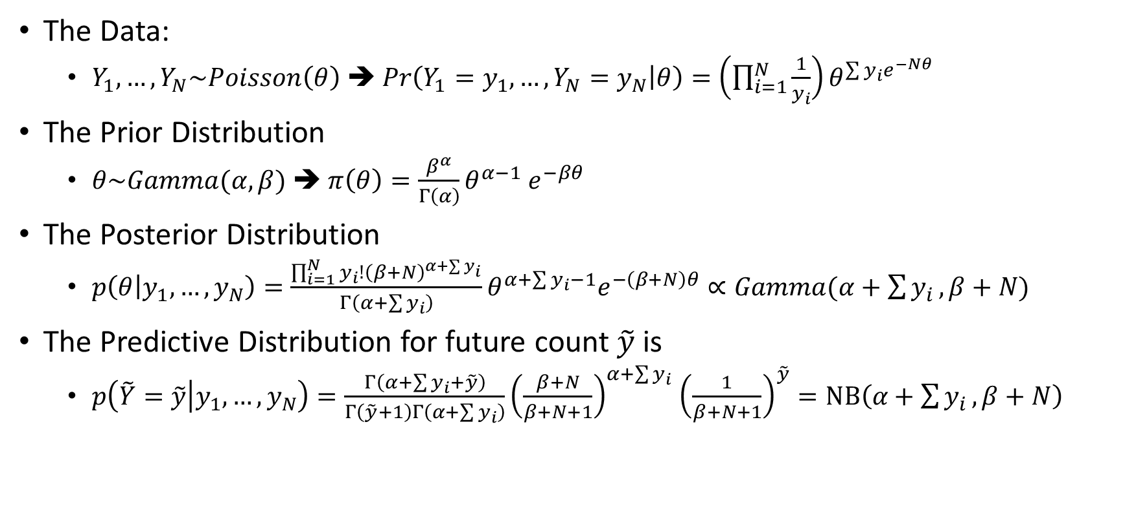
Poisson-Gamma Model: Derivation
The Data:
$Y_{1},…, Y_{N}\sim Poisson\left(θ\right)$ ➔ $Pr\left(Y_{1}=y_{1},…,Y_{N}=y_{N} | θ\right)=\left(\prod_{i=1}^{N}{\frac{1}{y_{i}}}\right)θ^{\sum{y_{i}e^{−Nθ}}}$
The Prior Distribution
$θ\sim Gamma(α,β)$ ➔ $π\left(θ\right)=\frac{β^{α}}{Γ\left(α\right)}θ^{α−1}$ $e^{−βθ}$
The Posterior Distribution
$p\left(θ | y_{1},…, y_{N}\right)=\frac{{\prod_{i=1}^{N}{y_{i}!}\left(β+N\right)}^{α+\sum{y_{i}}}}{Γ\left(α+\sum{y_{i}}\right)}θ^{α+\sum{y_{i}}−1}e^{−\left(β+N\right)θ}∝Gamma(α+\sum{y_{i}},β+N)$
The Predictive Distribution for future count $\tilde{y}$ is
$p\left(\tilde{Y}=\tilde{y} | y_{1},…, y_{N}\right)=\frac{Γ\left(α+\sum{y_{i}}+\tilde{y}\right)}{Γ\left(\tilde{y}+1\right)Γ\left(α+\sum{y_{i}}\right)}{\left(\frac{β+N}{β+N+1}\right)}^{α+\sum{y_{i}}}$ ${\left(\frac{1}{β+N+1}\right)}^{\tilde{y}}=NB\left(α+\sum{y_{i}},β+N\right)$

Slide 18
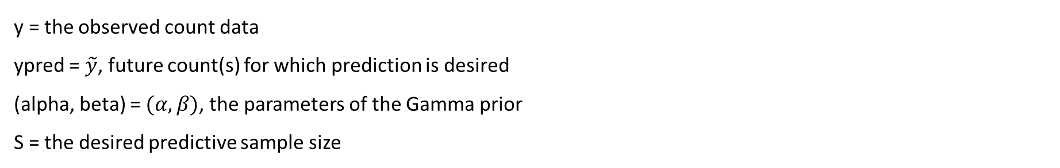
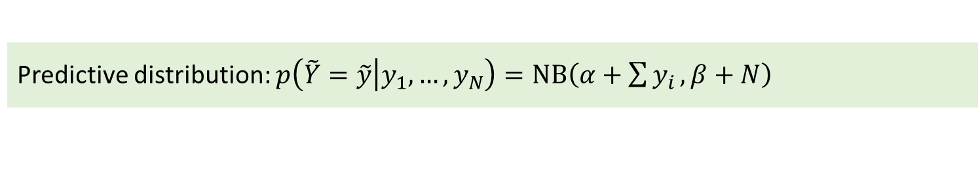
Poisson-Gamma Model: R functions
Predictive distribution: $p\left(\tilde{Y}=\tilde{y} | y_{1},…, y_{N}\right)=NB\left(α+\sum{y_{i}},β+N\right)$
Type | Function | Implementation
Density | dpredPG(ypred,y,alpha,beta) | Uses R function dnbinom()
Cumulative Probability | ppredPG (ypred,y,alpha,beta) | Returns a cumulative sum of the results of dpredPG()
Predictive Sampler | rpredPG (S,y,alpha,beta) | Establishes appropriate support, then employs the inverse transform method and output of ppredPG()
y = the observed count data
ypred = $\tilde{y}$, future count(s) for which prediction is desired
(alpha, beta) = $(α,β)$, the parameters of the Gamma prior
S = the desired predictive sample size

Slide 19
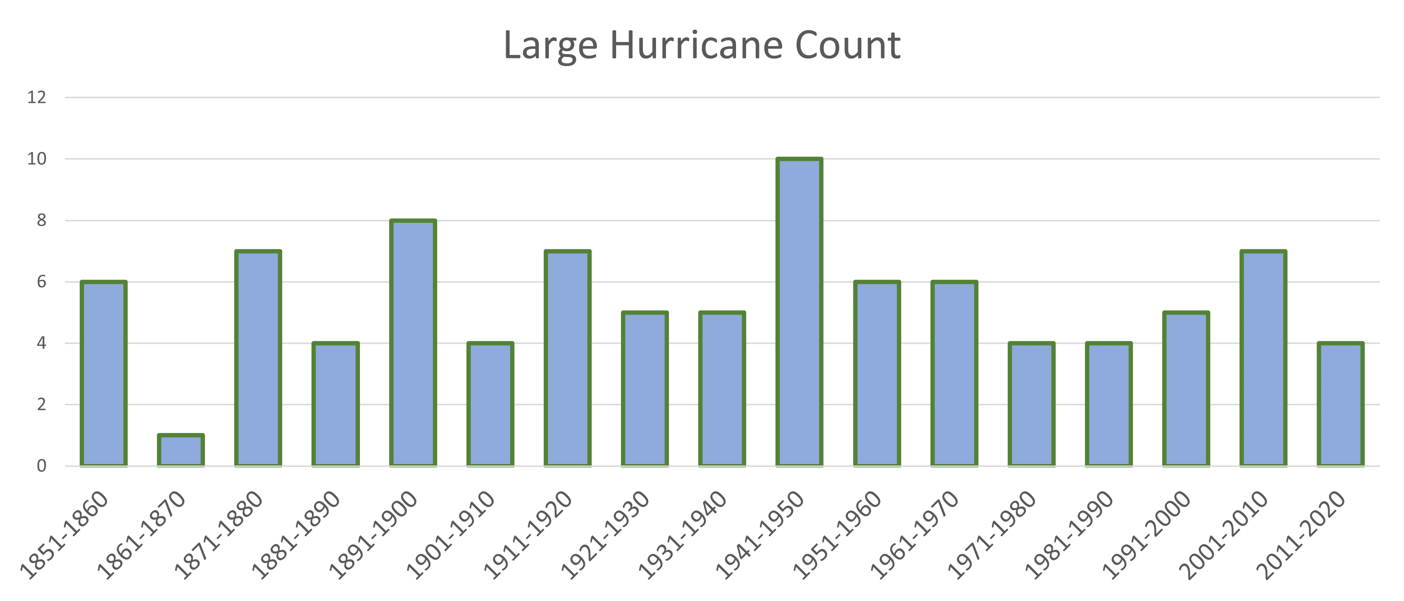
Poisson-Gamma Example: Large Hurricane Count
Data = number of large (category 3,4,5) hurricanes to make landfall each decade from 1851 through 2020 (National Hurricane Center): http://www.aoml.noaa.gov/hrd/hurdat/All_U.S._Hurricanes.html

Slide 20
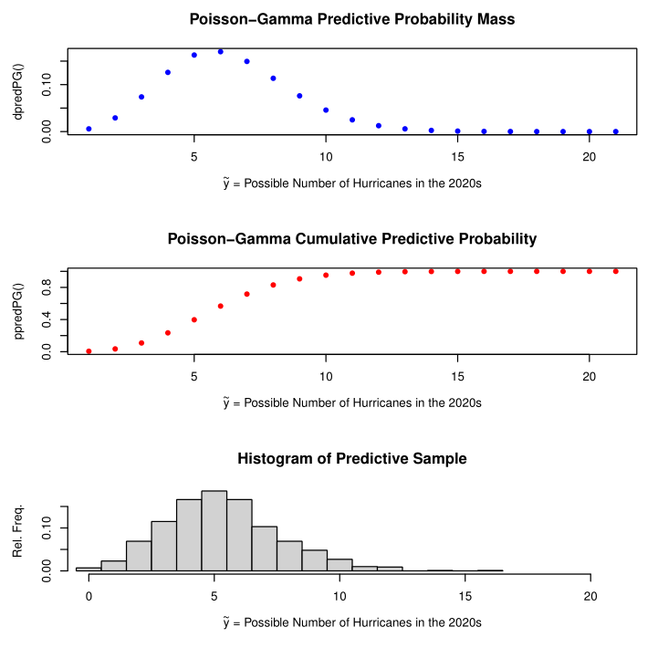
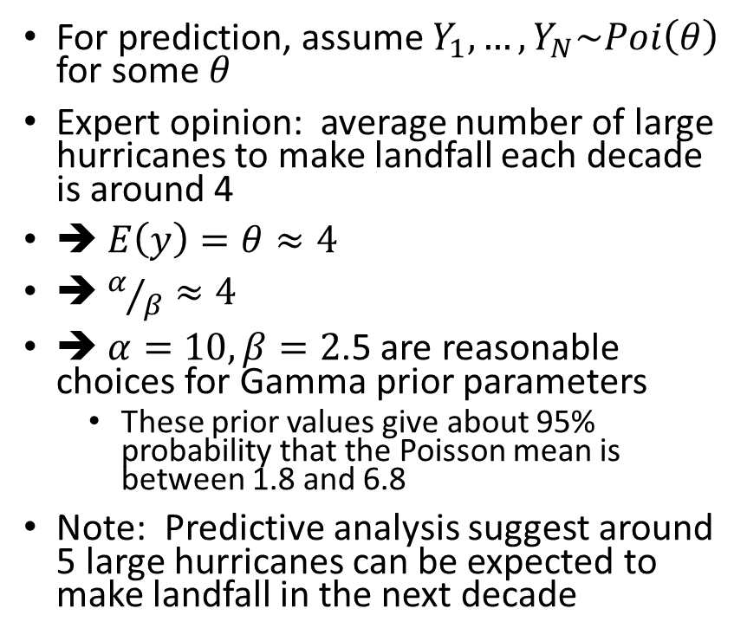
Poisson-Gamma Example: Large Hurricane Count
For prediction, assume $Y_{1},…, Y_{N}\sim Poi\left(θ\right)$ for some $θ$
Expert opinion: average number of large hurricanes to make landfall each decade is around 4
➔ $E\left(y\right)=θ≈4$
➔ $α/β≈4$
➔ $α=10, β=2$.5 are reasonable choices for Gamma prior parameters
These prior values give about 95% probability that the Poisson mean is between 1.8 and 6.8
Note: Predictive analysis suggest around 5 large hurricanes can be expected to make landfall in the next decade

Slide 21
Normal-Inverse Gamma Model: 1-Sample

Slide 22
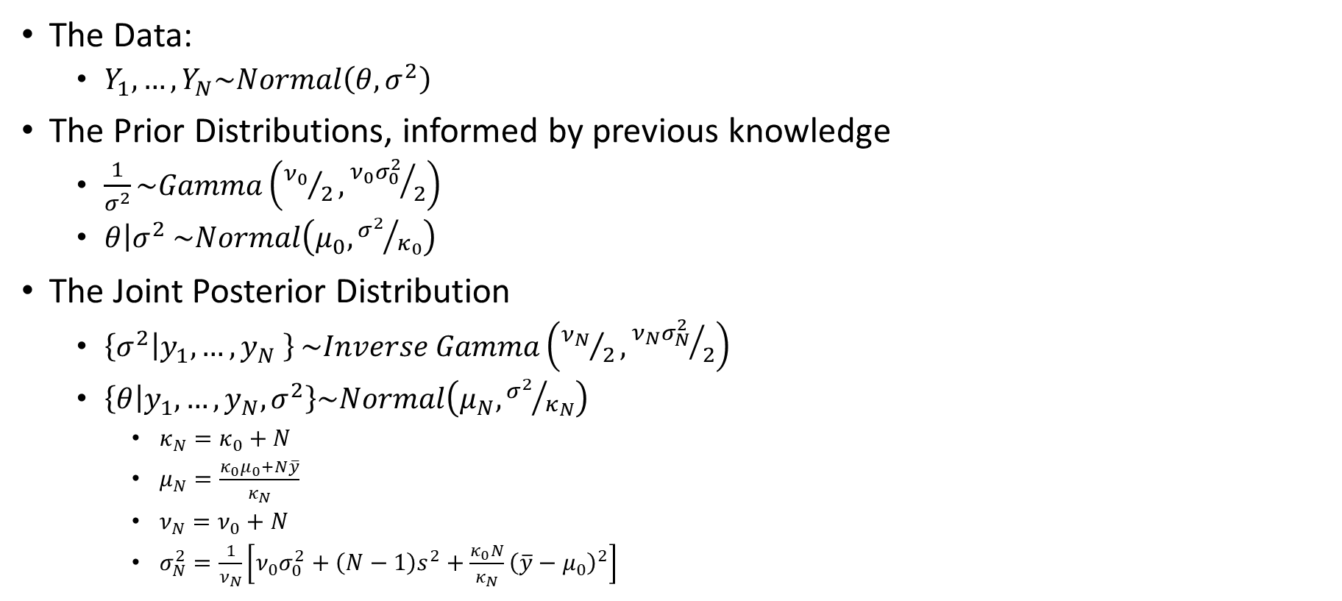
Normal-Inverse Gamma Model, 1-Sample: Derivation (with previous knowledge)
The Data:
$Y_{1},…, Y_{N}\sim Normal\left(θ,σ^{2}\right)$
The Prior Distributions, informed by previous knowledge
$\frac{1}{σ^{2}}\sim Gamma\left({ν_{0}}/2,{ν_{0}σ_{0}^{2}}/2\right)$
$\left.θ\right|σ^{2}$ $\sim Normal\left(μ_{0},{σ^{2}}/{κ_{0}}\right)$
The Joint Posterior Distribution
$\left\{\left.σ^{2}\right|y_{1},…, y_{N} \right\}$ $\sim Inverse Gamma\left({ν_{N}}/2,{ν_{N}σ_{N}^{2}}/2\right)$
$\left\{\left.θ\right|y_{1},…, y_{N},σ^{2}\right\}\sim Normal\left(μ_{N},{σ^{2}}/{κ_{N}}\right)$
$κ_{N}=$ $κ_{0}+N$
$μ_{N}=\frac{κ_{0}μ_{0}+N\overline{y}}{κ_{N}}$
$ν_{N}=$ $ν_{0}+N$
$σ_{N}^{2}=\frac{1}{ν_{N}}\left[ν_{0}σ_{0}^{2}+\left(N−1\right)s^{2}+\frac{κ_{0}N}{κ_{N}}{\left(\overline{y}−μ_{0}\right)}^{2}\right]$
Notes:
We can interpret $μ_{0}$ as the sample mean of $κ_{0}$ prior observations with variance $σ^{2}$, $ν_{0}$ as prior sample size with prior sample variance $σ_{0}^{2}$, and $ν_{0}σ_{0}^{2}$ and $ν_{N}σ_{N}^{2}$ as prior and posterior sums of squares, respectively (see Hoff p. 75)

Slide 23
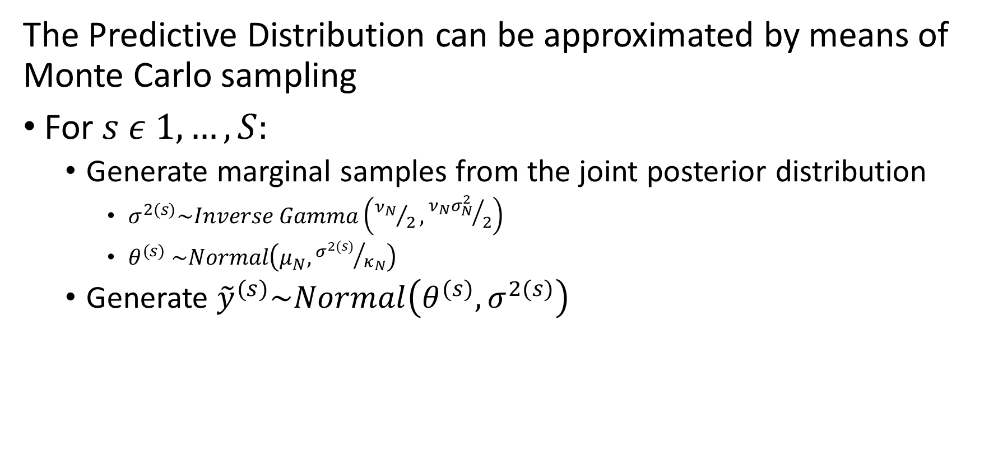
Normal-Inverse Gamma Model, 1-Sample: Derivation (with previous knowledge, continued)
The Predictive Distribution can be approximated by means of Monte Carlo sampling
For $s ε 1,…,S:$
Generate marginal samples from the joint posterior distribution
$σ^{2(s)}\sim Inverse Gamma\left({ν_{N}}/2,{ν_{N}σ_{N}^{2}}/2\right)$
$θ^{(s)}$ $\sim Normal\left(μ_{N},{σ^{2(s)}}/{κ_{N}}\right)$
Generate ${\tilde{y}}^{(s)}\sim Normal\left(θ^{(s)},σ^{2(s)}\right)$

Slide 24
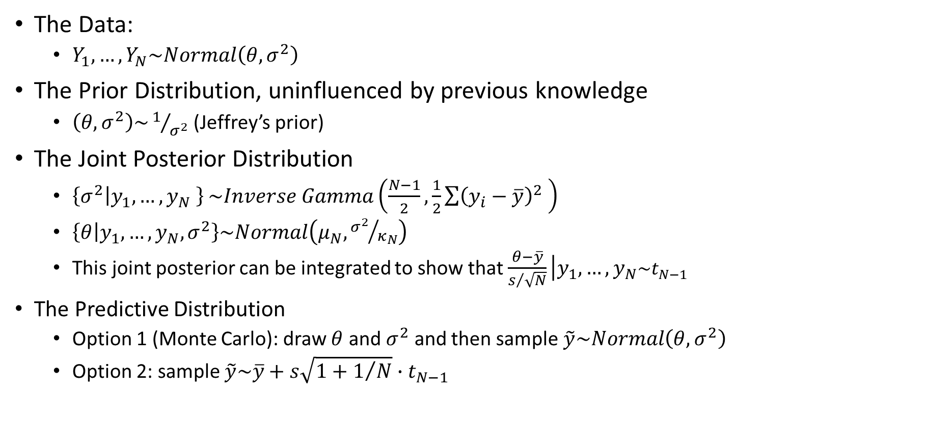
Normal-Inverse Gamma Model, 1-Sample: Derivation (without previous knowledge)
The Data:
$Y_{1},…, Y_{N}\sim Normal\left(θ,σ^{2}\right)$
The Prior Distribution, uninfluenced by previous knowledge
$\left(θ,σ^{2}\right)\sim 1/{σ^{2}}$ (Jeffrey’s prior)
The Joint Posterior Distribution
$\left\{\left.σ^{2}\right|y_{1},…, y_{N} \right\}$ $\sim Inverse Gamma\left(\frac{N−1}{2},\frac{1}{2}\sum{{\left(y_{i}−\overline{y}\right)}^{2}} \right)$
$\left\{\left.θ\right|y_{1},…, y_{N},σ^{2}\right\}\sim Normal\left(μ_{N},{σ^{2}}/{κ_{N}}\right)$
This joint posterior can be integrated to show that $\frac{θ−\overline{y}}{s/{\sqrt{N}}}\left|y_{1},…, y_{N}\right.\sim t_{N−1}$
The Predictive Distribution
Option 1 (Monte Carlo): draw $θ$ and $σ^{2}$ and then sample $\tilde{y}\sim Normal\left(θ,σ^{2}\right)$
Option 2: sample $\tilde{y}\sim \overline{y}+s\sqrt{1+1/N}∙t_{N−1}$

Slide 25
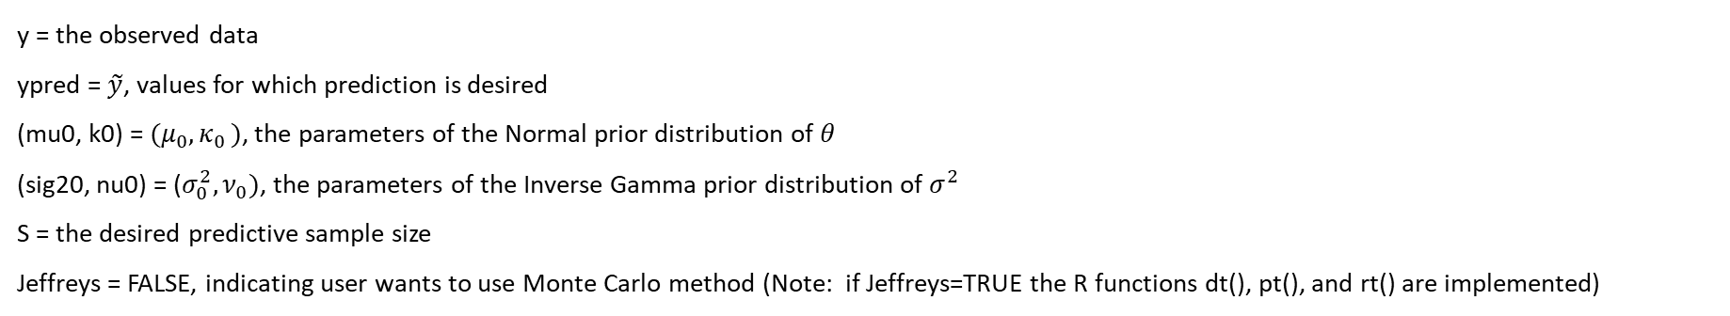
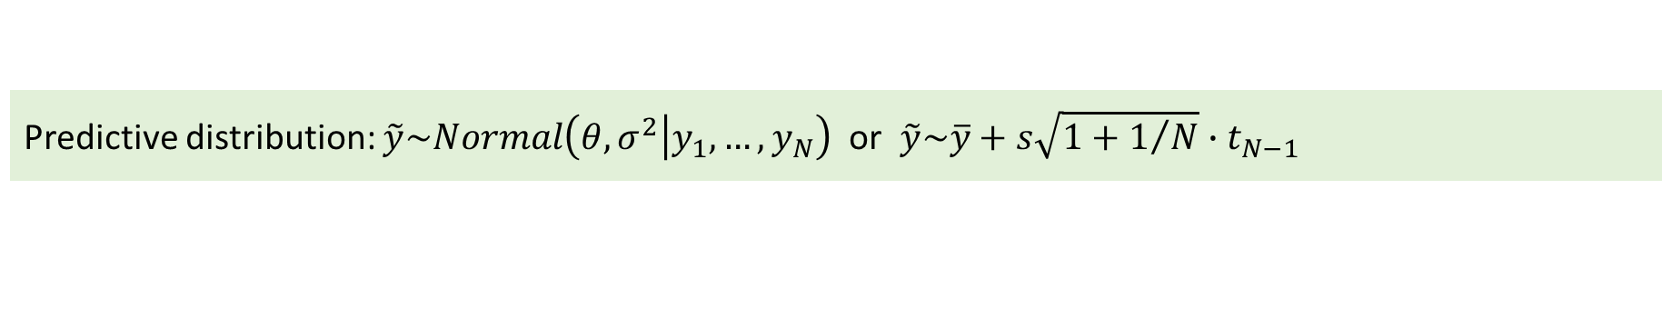
Normal-Inverse Gamma Model, 1-Sample: R functions (with previous knowledge)
Predictive distribution: $\tilde{y}\sim Normal\left(θ,σ^{2}\left|y_{1},…, y_{N}\right.\right)$ or $\tilde{y}\sim \overline{y}+s\sqrt{1+1/N}∙t_{N−1}$
Type | Function | Implementation
Density | dpredNormIG1(ypred,y,mu0,k0,sig20,nu0,S,Jeffreys) | Implements a kernel density estimation (KDE) method and the R function density()
Cumulative Probability | ppredNormIG1 (ypred,y,mu0,k0,sig20,nu0,S,Jeffreys) | Uses R function ecdf() with a predictive sample generated by rpredNormIG1()
Predictive Sampler | rpredNormIG1 (S,y,mu0,k0,sig20,nu0,Jeffreys) | Monte carlo sampling using R functions rgamma() and rnorm()
y = the observed data
ypred = $\tilde{y}$, values for which prediction is desired
(mu0, k0) = $(μ_{0}{,κ}_{0})$, the parameters of the Normal prior distribution of $θ$
(sig20, nu0) = ($σ_{0}^{2},ν_{0})$, the parameters of the Inverse Gamma prior distribution of $σ^{2}$
S = the desired predictive sample size
Jeffreys = FALSE, indicating user wants to use Monte Carlo method (Note: if Jeffreys=TRUE the R functions dt(), pt(), and rt() are implemented)

Slide 26
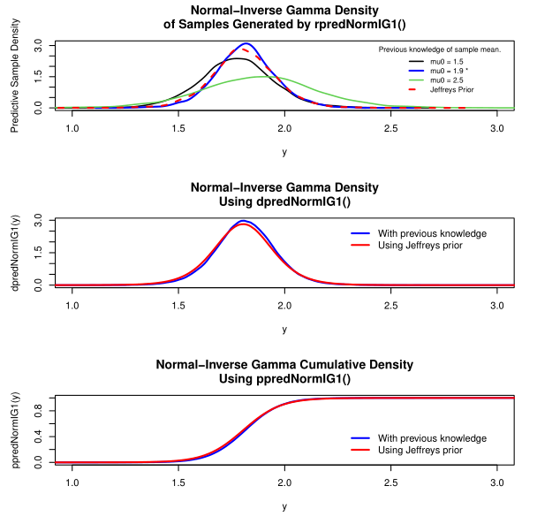
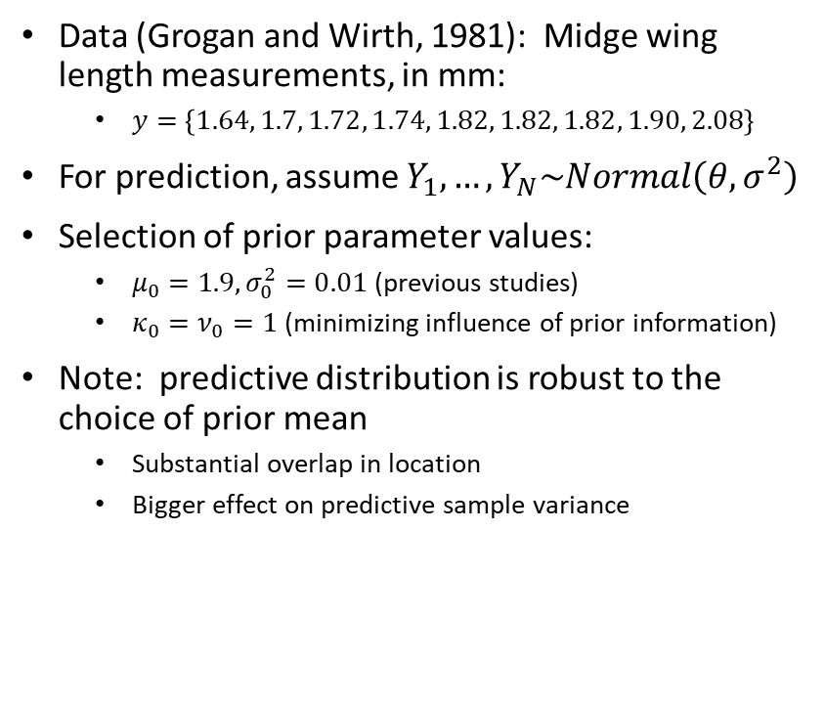
Normal-Inverse Gamma Example: Midge Wing Length (Hoff)
Data (Grogan and Wirth, 1981): Midge wing length measurements, in mm:
$y=\left\{1.64, 1.7, 1.72, 1.74, 1.82, 1.82, 1.82, 1.90, 2.08\right\}$
For prediction, assume $Y_{1},…, Y_{N}\sim Normal\left(θ,σ^{2}\right)$
Selection of prior parameter values:
$μ_{0}=1.9,σ_{0}^{2}=0.01$ (previous studies)
$κ_{0}=ν_{0}=1$ (minimizing influence of prior information)
Note: predictive distribution is robust to the choice of prior mean
Substantial overlap in location
Bigger effect on predictive sample variance

Slide 27
Normal-Inverse Gamma Model: k-Sample

Slide 28
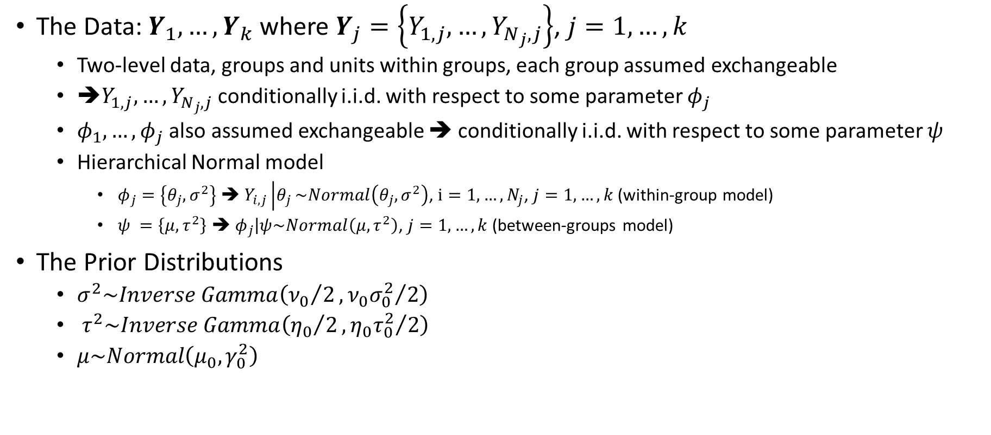
Normal-Inverse Gamma Model, k-Sample: Derivation (continued)
The Data: $Y_{1},…,Y_{k}$ where $Y_{j}=\left\{Y_{1,j},…, Y_{N_{j},j}\right\}$, $j=1,…,k$
Two-level data, groups and units within groups, each group assumed exchangeable
➔$Y_{1,j},…, Y_{N_{j},j}$ conditionally i.i.d. with respect to some parameter $φ_{j}$
${φ_{1},…,φ}_{j}$ also assumed exchangeable ➔ conditionally i.i.d. with respect to some parameter $ψ$
Hierarchical Normal model
$φ_{j}=\left\{θ_{j},σ^{2}\right\}$ ➔ $Y_{i,j}\left|θ_{j}\right.\sim Normal\left(θ_{j},σ^{2}\right)$, $i=1,…,N_{j}$, $j=1,…,k$ (within-group model)
$ψ =\left\{μ,τ^{2}\right\}$ ➔ $φ_{j}\left|ψ\right.\sim Normal\left(μ,τ^{2}\right)$, $j=1,…,k$ (between-groups model)
The Prior Distributions
$σ^{2}\sim Inverse Gamma\left({ν_{0}}/2, {ν_{0}σ_{0}^{2}}/2\right)$
$τ^{2}\sim Inverse Gamma\left({η_{0}}/2, {η_{0}τ_{0}^{2}}/2\right)$
$μ\sim Normal\left(μ_{0},γ_{0}^{2}\right)$
Notes:
Phi parameters have common variance

Slide 29
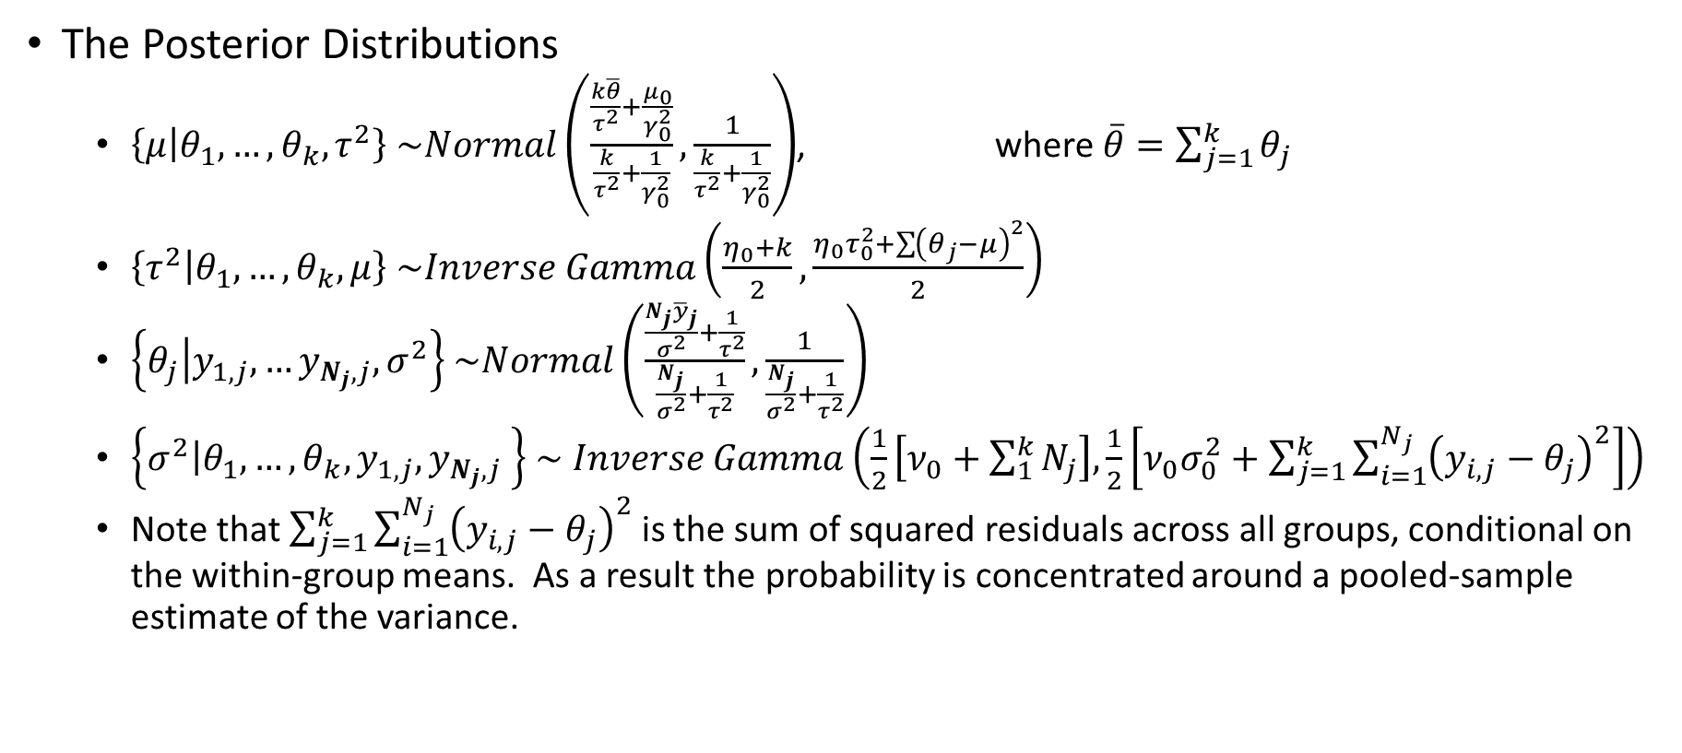
Normal-Inverse Gamma Model, k-Sample: Derivation (continued)
The Posterior Distributions
$\left\{\left.μ\right|θ_{1},…,θ_{k},τ^{2}\right\}$ $\sim Normal\left(\frac{\frac{k\overline{θ}}{τ^{2}}+\frac{μ_{0}}{γ_{0}^{2}}}{\frac{k}{τ^{2}}+\frac{1}{γ_{0}^{2}}},\frac{1}{\frac{k}{τ^{2}}+\frac{1}{γ_{0}^{2}}}\right)$, where $\overline{θ}=\sum_{j=1}^{k}{θ_{j}}$
$\left\{\left.τ^{2}\right|θ_{1},…,θ_{k},μ\right\}$ $\sim Inverse Gamma\left(\frac{η_{0}+k}{2},\frac{η_{0}τ_{0}^{2}+\sum{{\left(θ_{j}−μ\right)}^{2}}}{2}\right)$
$\left\{{\left.θ_{j}\right|y}_{1,j}, …y_{N_{j},j},σ^{2}\right\}$ $\sim Normal\left(\frac{\frac{N_{j}{\overline{y}}_{j}}{σ^{2}}+\frac{1}{τ^{2}}}{\frac{N_{j}}{σ^{2}}+\frac{1}{τ^{2}}},\frac{1}{\frac{N_{j}}{σ^{2}}+\frac{1}{τ^{2}}}\right)$
$\left\{{\left.σ^{2}\right|θ_{1},…,θ_{k},y}_{1,j}, y_{N_{j},j} \right\}$ $\sim$ $Inverse Gamma\left(\frac{1}{2}\left[ν_{0}+\sum_{1}^{k}{N_{j}}\right], \frac{1}{2}\left[ν_{0}σ_{0}^{2}+\sum_{j=1}^{k}{\sum_{i=1}^{N_{j}}{{\left(y_{i,j}−θ_{j}\right)}^{2}}}\right]\right)$
Note that $\sum_{j=1}^{k}{\sum_{i=1}^{N_{j}}{{\left(y_{i,j}−θ_{j}\right)}^{2}}}$ is the sum of squared residuals across all groups, conditional on the within-group means. As a result the probability is concentrated around a pooled-sample estimate of the variance.
Notes:
We have the usual

Slide 30
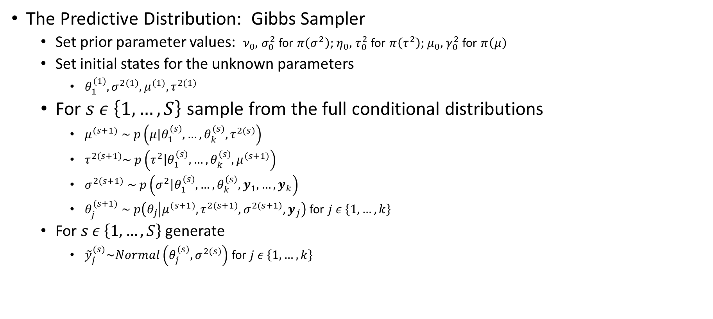
Normal-Inverse Gamma Model, k-Sample: Derivation (continued)
The Predictive Distribution: Gibbs Sampler
Set prior parameter values: $ν_{0},$ $σ_{0}^{2}$ for $π\left(σ^{2}\right)$; $η_{0},$ $τ_{0}^{2}$ for $π\left(τ^{2}\right)$; $μ_{0},$ $γ_{0}^{2}$ for $π\left(μ\right)$
Set initial states for the unknown parameters
$θ_{1}^{(1)},σ^{2(1)},μ^{(1)},τ^{2(1)}$
For $s ε \left\{1,…,S\right\}$ sample from the full conditional distributions
$μ^{(s+1)}$ $\sim p\left(\left.μ\right|θ_{1}^{(s)},…,{θ_{k}^{(s)},τ}^{2(s)}\right)$
$τ^{2(s+1)}\sim p\left(\left.τ^{2}\right|θ_{1}^{(s)},…,{θ_{k}^{(s)},μ}^{(s+1)}\right)$
$σ^{2(s+1)}$ $\sim p\left(\left.σ^{2}\right|θ_{1}^{(s)},…,θ_{k}^{\left(s\right)},y_{1},…,y_{k}\right)$
$θ_{j}^{(s+1)}$ $\sim p\left(\left.θ_{j}\right|{μ^{(s+1)},τ^{2(s+1)},σ^{2(s+1)},y}_{j}\right)$ for $j ε \left\{1,…,k\right\}$
For $s ε \left\{1,…,S\right\}$ generate
${\tilde{y}}_{j}^{(s)}\sim Normal\left(θ_{j}^{(s)},σ^{2(s)}\right)$ for $j ε \left\{1,…,k\right\}$

Slide 31
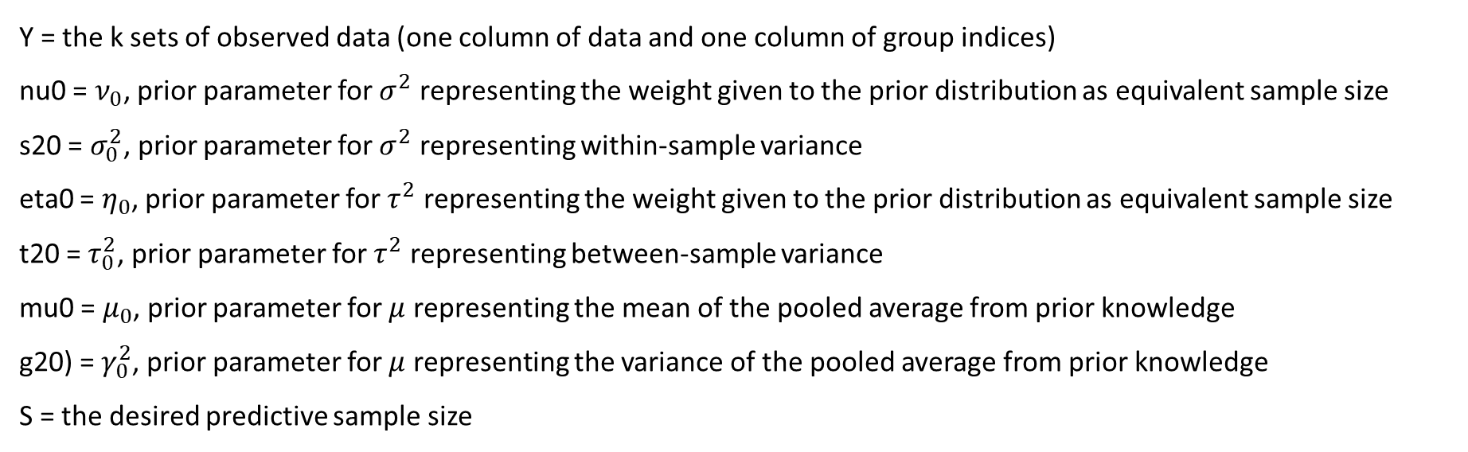
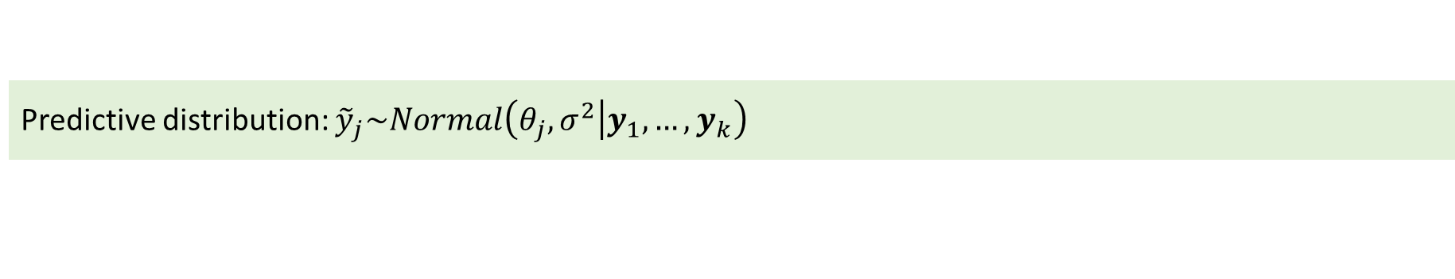
Normal-Inverse Gamma Model, 2-Sample: R function
Predictive distribution: ${\tilde{y}}_{j}\sim Normal\left(θ_{j},σ^{2}\left|y_{1},…, y_{k}\right.\right)$
Type | Function | Implementation
Predictive Sampler | rpredNormIGk(S,Y,nu0,s20,eta0,t20,mu0,g20) | Implements a Gibbs sampler
Y = the k sets of observed data (one column of data and one column of group indices)
nu0 = $ν_{0}$, prior parameter for $σ^{2}$ representing the weight given to the prior distribution as equivalent sample size
s20 = $σ_{0}^{2}$, prior parameter for $σ^{2}$ representing within-sample variance
eta0 = $η_{0}$, prior parameter for $τ^{2}$ representing the weight given to the prior distribution as equivalent sample size
t20 = $τ_{0}^{2}$, prior parameter for $τ^{2}$ representing between-sample variance
mu0 = $μ_{0}$, prior parameter for $μ$ representing the mean of the pooled average from prior knowledge
g20) = $γ_{0}^{2}$, prior parameter for $μ$ representing the variance of the pooled average from prior knowledge
S = the desired predictive sample size

Slide 32
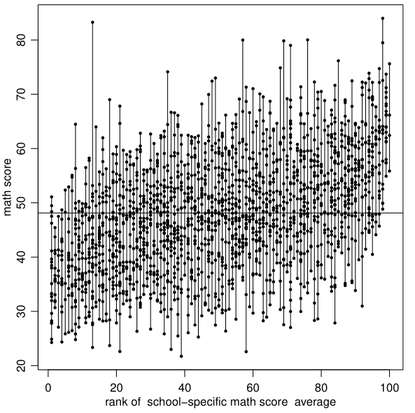
Normal-Inverse Gamma k-Sample Example: Math Scores, Comparing 100 Schools (Hoff)
Data: Math scores from 100 U.S. public high schools
Comparison of school averages:
Minimum individual school mean score: | School 5 | 36.58
Maximum individual school mean score: | School 67 | 65.02
Overall mean score (all schools): | -- | 48.13
Closest to overall mean: | School 92 | 48.18

Slide 33
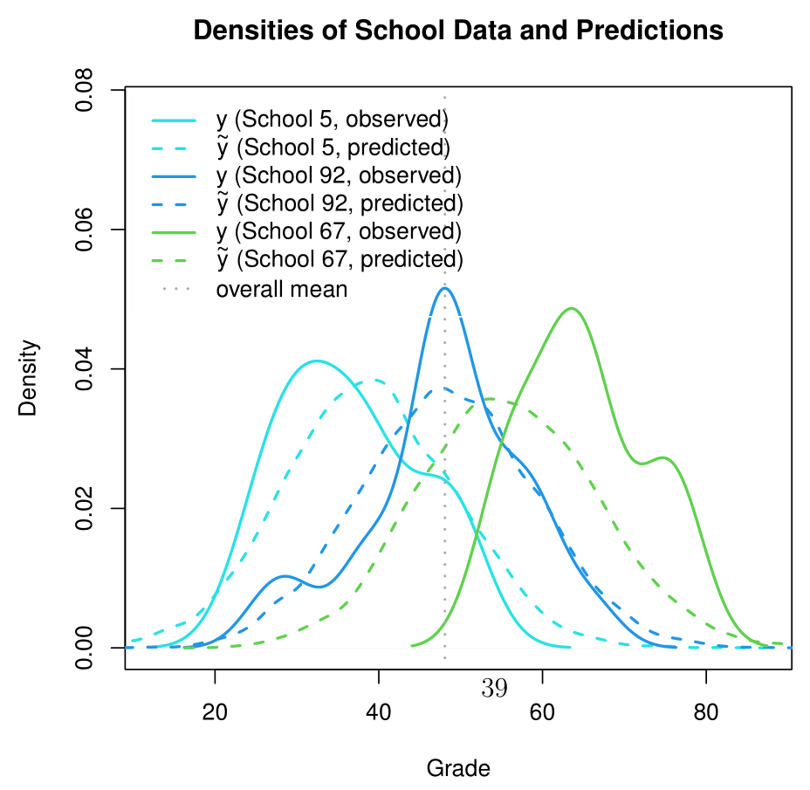
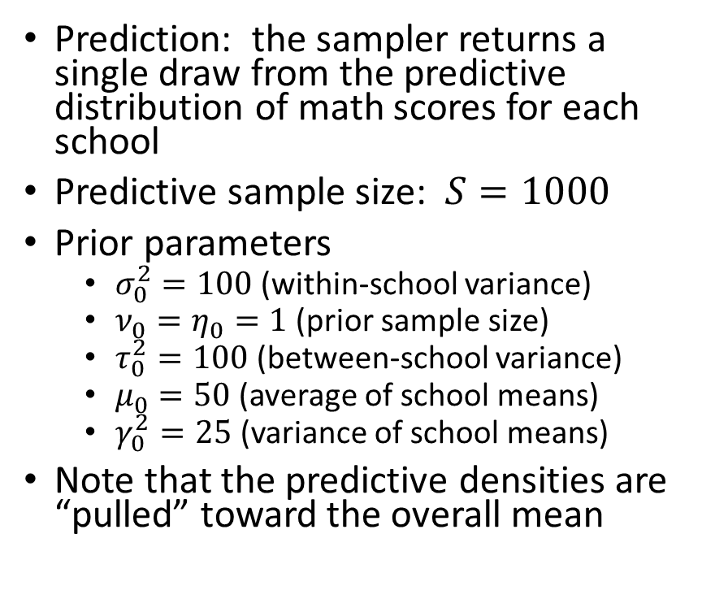
Normal-Inverse Gamma k-Sample Example: Math Scores, Comparing 100 Schools
Prediction: the sampler returns a single draw from the predictive distribution of math scores for each school
Predictive sample size: $S=1000$
Prior parameters
$σ_{0}^{2}=100$ (within-school variance)
$ν_{0}=η_{0}=1$ (prior sample size)
$τ_{0}^{2}=100$ (between-school variance)
$μ_{0}=50$ (average of school means)
$γ_{0}^{2}=25$ (variance of school means)
Note that the predictive densities are “pulled” toward the overall mean

Slide 34
Normal Regression Model

Slide 35
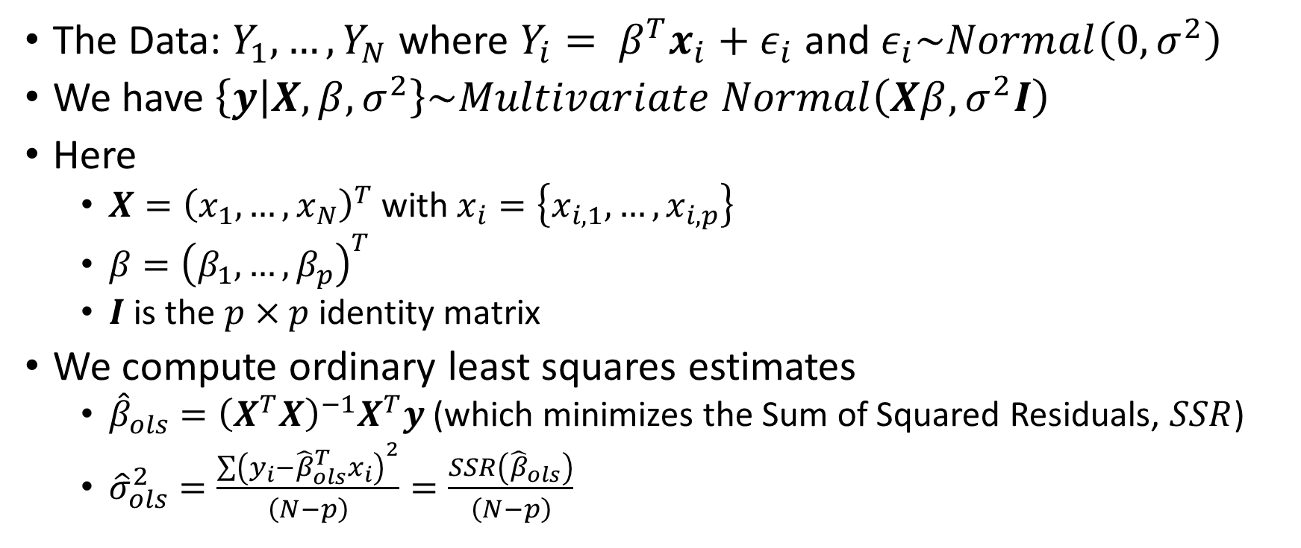
Normal Regression Model: Derivation
The Data: $Y_{1},…,Y_{N}$ where $Y_{i}= β^{T}x_{i}+ε_{i}$ and $ε_{i}\sim Normal\left(0,σ^{2}\right)$
We have $\left\{\left.y\right|X,β,σ^{2}\right\}\sim Multivariate Normal\left(Xβ,σ^{2}I\right)$
Here
$X={\left(x_{1},…,x_{N}\right)}^{T}$ with $x_{i}=\left\{x_{i,1},…,x_{i,p}\right\}$
$β={\left(β_{1},…,β_{p}\right)}^{T}$
$I$ is the $p×p$ identity matrix
We compute ordinary least squares estimates
${\hat{β}}_{ols}={\left(X^{T}X\right)}^{−1}X^{T}y$ (which minimizes the Sum of Squared Residuals, $SSR$)
${\hat{σ}}_{ols}^{2}=\frac{\sum{{\left(y_{i}−{\hat{β}}_{ols}^{T}x_{i}\right)}^{2}}}{\left(N−p\right)}=\frac{SSR\left({\hat{β}}_{ols}\right)}{\left(N−p\right)}$

Slide 36
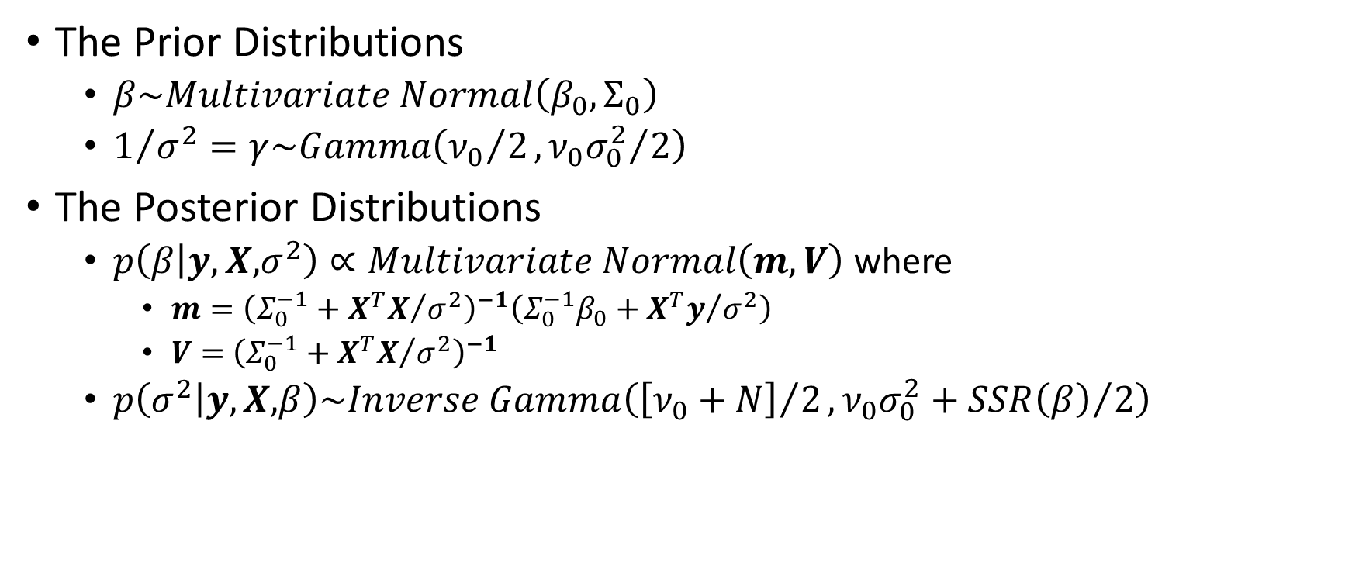
Normal Regression Model: Derivation (with prior information)
The Prior Distributions
$β\sim Multivariate Normal\left(β_{0},Σ_{0}\right)$
$1/{σ^{2}}=γ\sim Gamma\left({ν_{0}}/2, {ν_{0}σ_{0}^{2}}/2\right)$
The Posterior Distributions
$p\left(β\left|y,X,\right.σ^{2}\right)∝Multivariate Normal\left(m, V\right)$ where
$m={\left(Σ_{0}^{−1}+{X^{T}X}/{σ^{2}}\right)}^{−1}\left(Σ_{0}^{−1}β_{0}+{X^{T}y}/{σ^{2}}\right)$
$V=$ ${\left(Σ_{0}^{−1}+{X^{T}X}/{σ^{2}}\right)}^{−1}$
$p\left(σ^{2}\left|y,X,\right.β\right)\sim Inverse Gamma\left({\left[ν_{0}+N\right]}/2,{ν_{0}σ_{0}^{2}+SSR\left(β\right)}/2\right)$

Slide 37
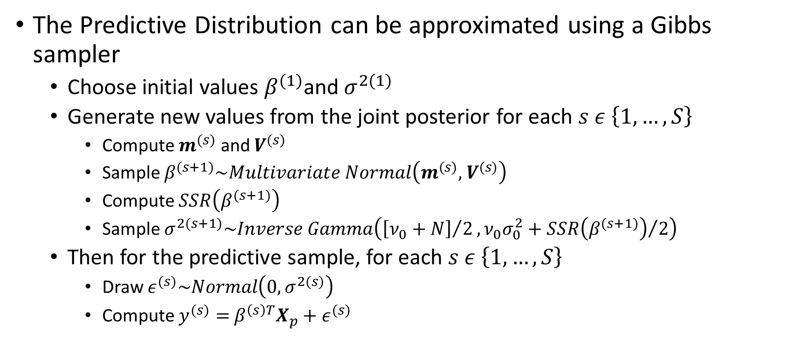
Normal Regression Model: Derivation (with prior information, continued)
The Predictive Distribution can be approximated using a Gibbs sampler
Choose initial values $β^{(1)}$and $σ^{2(1)}$
Generate new values from the joint posterior for each $s ε \left\{1,…,S\right\}$
Compute $m^{(s)}$ and $V^{(s)}$
Sample $β^{(s+1)}\sim Multivariate Normal\left(m^{(s)}\text{,} V^{(s)}\right)$
Compute $SSR\left(β^{(s+1)}\right)$
Sample $σ^{2(s+1)}\sim Inverse Gamma\left({\left[ν_{0}+N\right]}/2,{ν_{0}σ_{0}^{2}+SSR\left(β^{(s+1)}\right)}/2\right)$
Then for the predictive sample, for each $s ε \left\{1,…,S\right\}$
Draw $ε^{(s)}\sim Normal\left(0,σ^{2(s)}\right)$
Compute $y^{(s)}=$ $β^{\left(s\right)T}X_{p}+ε^{(s)}$

Slide 38
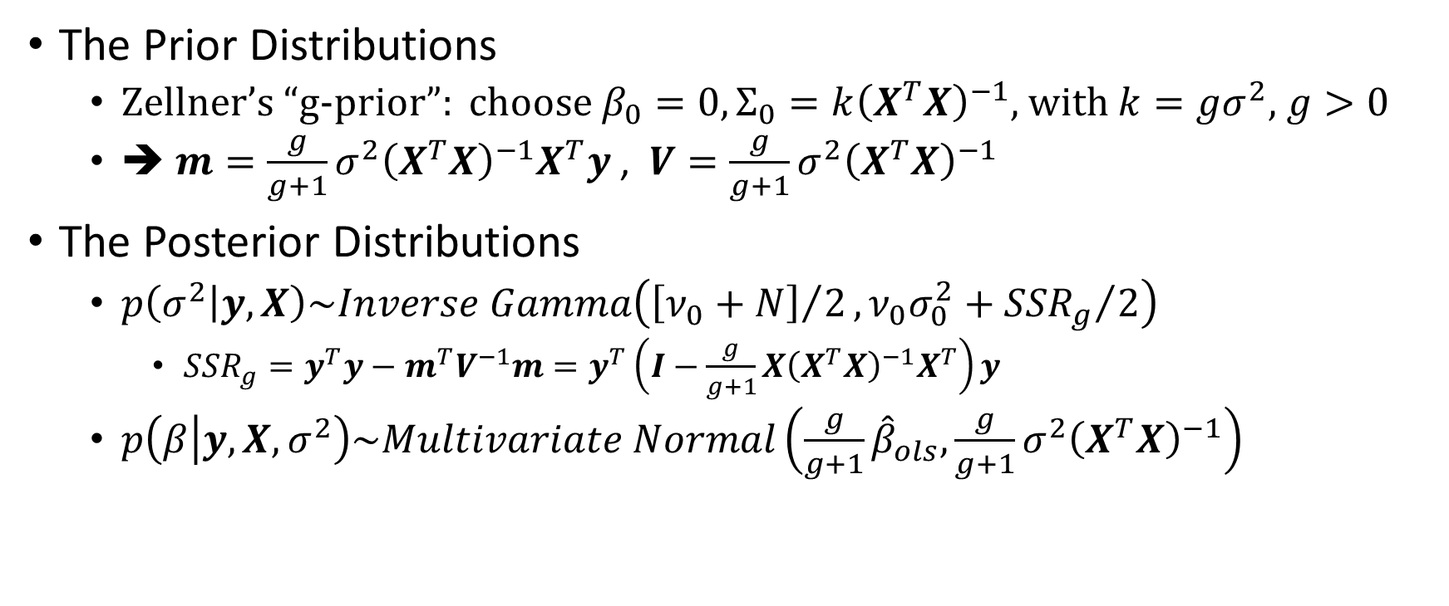
Normal Regression Model: Derivation (using Zellner’s “g-prior”)
The Prior Distributions
Zellner’s “g-prior”: choose $β_{0}=0, Σ_{0}=k{\left(X^{T}X\right)}^{−1}$, with $k=gσ^{2}$, $g>0$
➔ $m={\frac{g}{g+1}σ^{2}\left(X^{T}X\right)}^{−1}X^{T}y$ , $V={\frac{g}{g+1}σ^{2}\left(X^{T}X\right)}^{−1}$
The Posterior Distributions
$p\left(σ^{2}\left|y,X\right.\right)\sim Inverse Gamma\left({\left[ν_{0}+N\right]}/2,{ν_{0}σ_{0}^{2}+{SSR}_{g}}/2\right)$
${SSR}_{g}=y^{T}y−m^{T}V^{−1}m=y^{T}\left(I−\frac{g}{g+1}X{\left(X^{T}X\right)}^{−1}X^{T}\right)y$
$p\left(β\left|y,X,σ^{2}\right.\right)\sim Multivariate Normal\left(\frac{g}{g+1}{\hat{β}}_{ols},{\frac{g}{g+1}σ^{2}\left(X^{T}X\right)}^{−1}\right)$
Notes:
This satisfies a desired condition that the regression parameter estimation be invariant to changes in the scale of the regressors.
Note that this prior conditions on the observed X matrix.

Slide 39
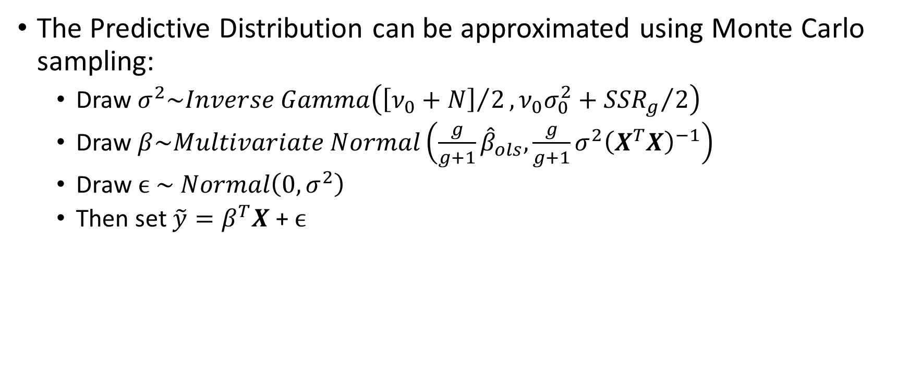
Normal Regression Model: Derivation (without prior information, continued)
The Predictive Distribution can be approximated using Monte Carlo sampling:
Draw $σ^{2}\sim Inverse Gamma\left({\left[ν_{0}+N\right]}/2,{ν_{0}σ_{0}^{2}+{SSR}_{g}}/2\right)$
Draw $β\sim Multivariate Normal\left(\frac{g}{g+1}{\hat{β}}_{ols},{\frac{g}{g+1}σ^{2}\left(X^{T}X\right)}^{−1}\right)$
$\text{Draw} ϵ \sim Normal\left(0,σ^{2}\right)$
Then set $\tilde{y}=β^{T}X$ + $ϵ$

Slide 40
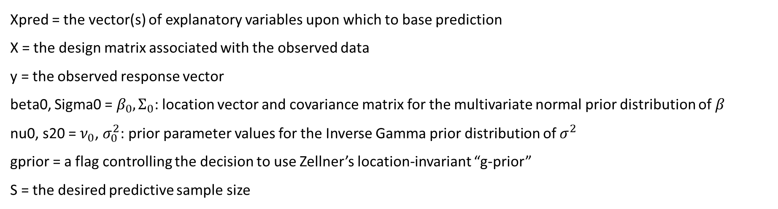
Normal-Inverse Gamma Model, 2-Sample: R function
Predictive distribution: $\tilde{y}=β^{T}X\text{ +} ϵ$
Type | Function | Implementation
Predictive Sampler | rpredNormReg(S,Xpred,X,y,beta0,Sigma0,nu0,s20,gprior) | Implements a Gibbs sampler (if gprior = 0) or Monte Carlo sampling (if gprior = 1)
Xpred = the vector(s) of explanatory variables upon which to base prediction
X = the design matrix associated with the observed data
y = the observed response vector
beta0, Sigma0 = $β_{0},Σ_{0}$: location vector and covariance matrix for the multivariate normal prior distribution of $β$
nu0, s20 = $ν_{0}$, $σ_{0}^{2}$: prior parameter values for the Inverse Gamma prior distribution of $σ^{2}$
gprior = a flag controlling the decision to use Zellner’s location-invariant “g-prior”
S = the desired predictive sample size

Slide 41
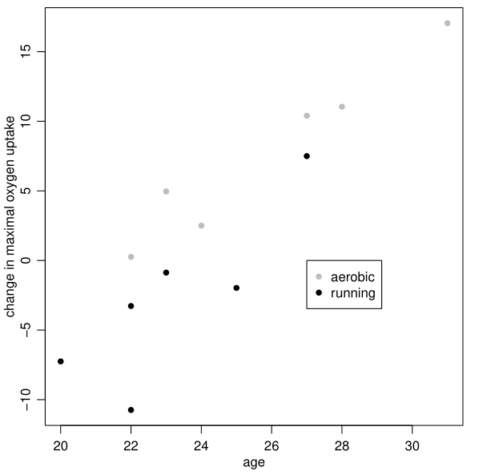
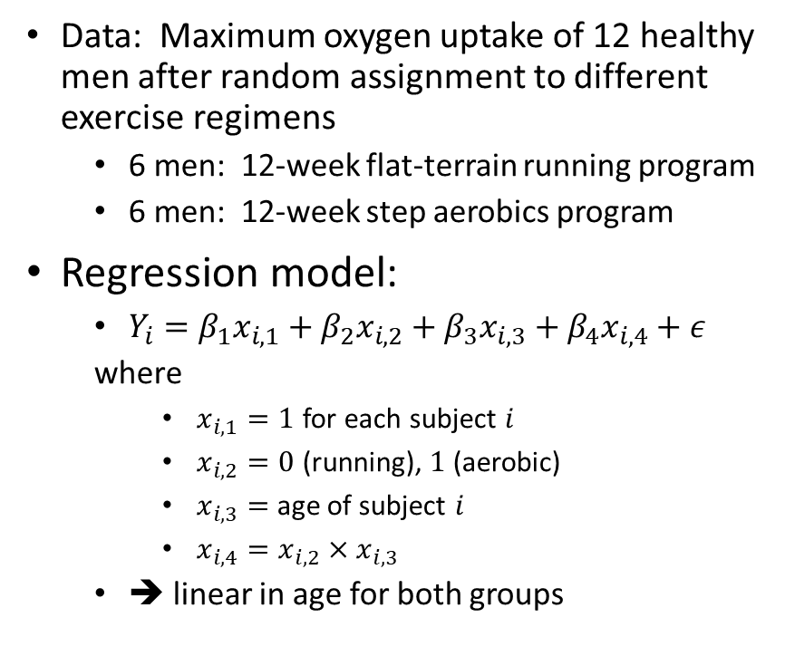
Normal Regression Example: Oxygen Uptake (Hoff)
Data: Maximum oxygen uptake of 12 healthy men after random assignment to different exercise regimens
6 men: 12-week flat-terrain running program
6 men: 12-week step aerobics program
Regression model:
$Y_{i}=β_{1}x_{i,1}+β_{2}x_{i,2}+β_{3}x_{i,3}+β_{4}x_{i,4}+ε$
where
$x_{i,1}=1$ for each subject $i$
$x_{i,2}=0$ (running), $1$ (aerobic)
$x_{i,3}=$ age of subject $i$
$x_{i,4}=x_{i,2}×x_{i,3}$
➔ linear in age for both groups

Slide 42
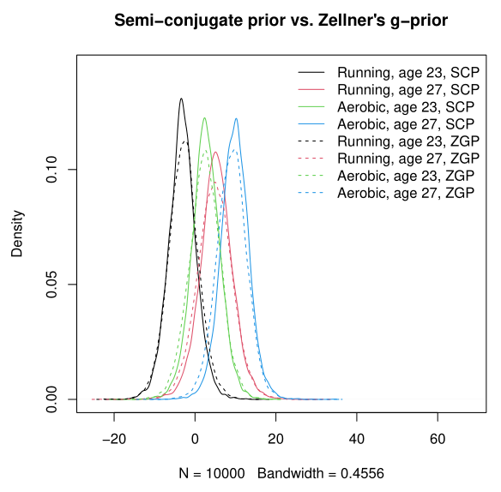
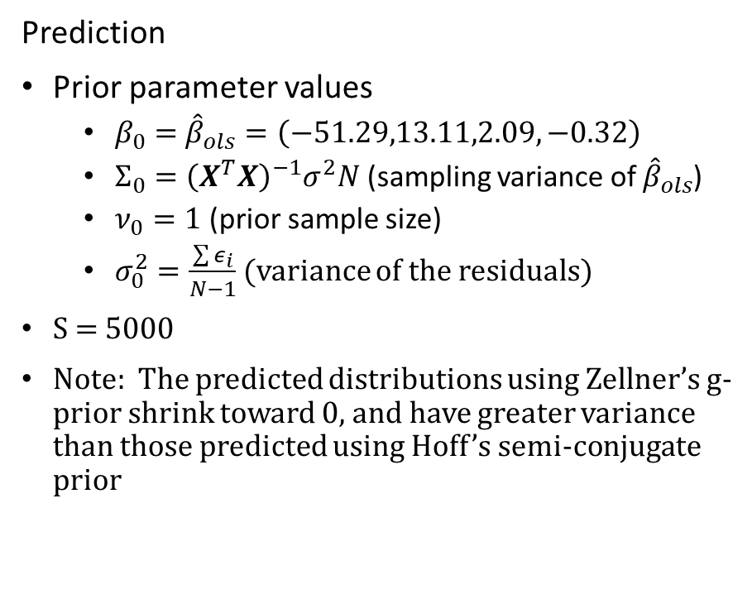
Normal Regression Example: Oxygen Uptake (Hoff)
Prediction
Prior parameter values
$β_{0}=$ ${\hat{β}}_{ols}=\left(−51.29,13.11,2.09,−0.32\right)$
$Σ_{0}={\left(X^{T}X\right)}^{−1}σ^{2}N$ (sampling variance of ${\hat{β}}_{ols}$)
$ν_{0}=1$ (prior sample size)
$σ_{0}^{2}=\frac{\sum{ε_{i}}}{N−1}$ (variance of the residuals)
S = 5000
Note: The predicted distributions using Zellner’s g-prior shrink toward 0, and have greater variance than those predicted using Hoff’s semi-conjugate prior

Slide 43
Conclusions
Predictive inference is important, but hampered by a lack of tools
I have developed a set of functions for some standard models to make prediction easier
These tools will be available on CRAN in a forthcoming R package

Slide 44
Backup

Slide 45
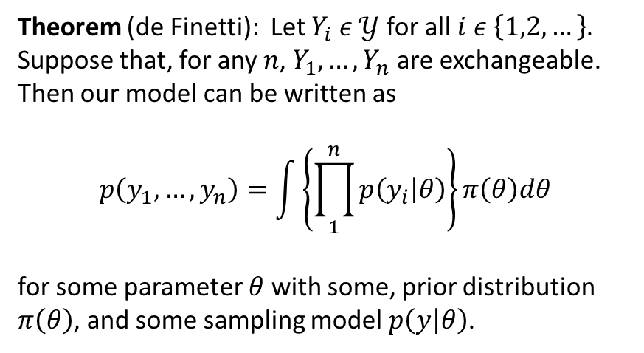
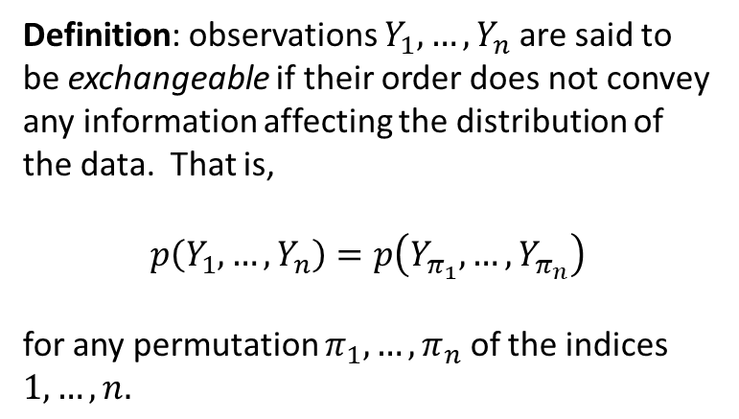
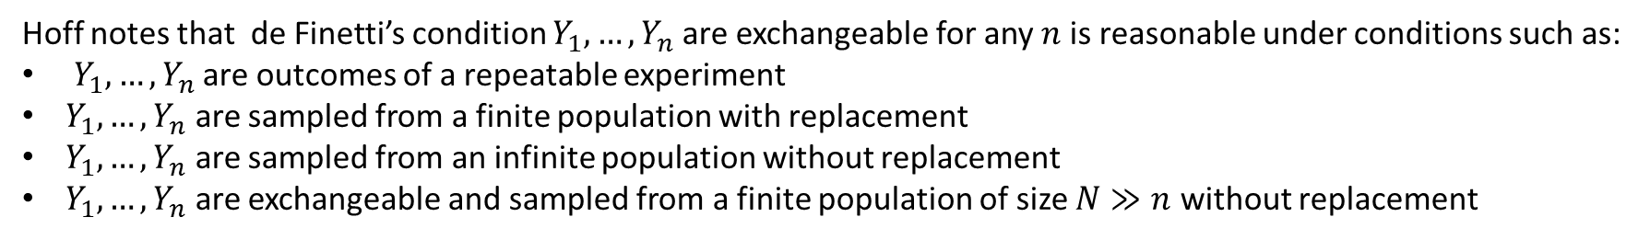
Exchangeability and de Finetti’s theorem
Backup Section
Definition: observations $Y_{1},…, Y_{n}$ are said to be exchangeable if their order does not convey any information affecting the distribution of the data. That is,
$$p\left(Y_{1},…, Y_{n}\right)=p\left(Y_{π_{1}},…, Y_{π_{n}}\right)$$
for any permutation $π_{1},…, π_{n}$ of the indices $1,…,n.$
Theorem (de Finetti): Let $Y_{i} ε 𝒴$ for all $i ε \left\{1,2,…\right\}$. Suppose that, for any $n$, $Y_{1},…, Y_{n}$ are exchangeable. Then our model can be written as
$$p\left(y_{1},…, y_{n}\right)=\int{\left\{\prod_{1}^{n}{p\left(y_{i} | θ\right)}\right\}}π\left(θ\right)dθ$$
for some parameter $θ$ with some, prior distribution $π\left(θ\right)$, and some sampling model $p\left(y | θ\right)$.
Hoff notes that de Finetti’s condition $Y_{1},…, Y_{n}$ are exchangeable for any $n$ is reasonable under conditions such as:
$Y_{1},…, Y_{n}$ are outcomes of a repeatable experiment
$Y_{1},…, Y_{n}$ are sampled from a finite population with replacement
$Y_{1},…, Y_{n}$ are sampled from an infinite population without replacement
$Y_{1},…, Y_{n}$ are exchangeable and sampled from a finite population of size $N≫n$ without replacement
We assume exchangeability of the data throughout this thesis.

Slide 46
Normal-Inverse Gamma Model: 2-Sample

Slide 47
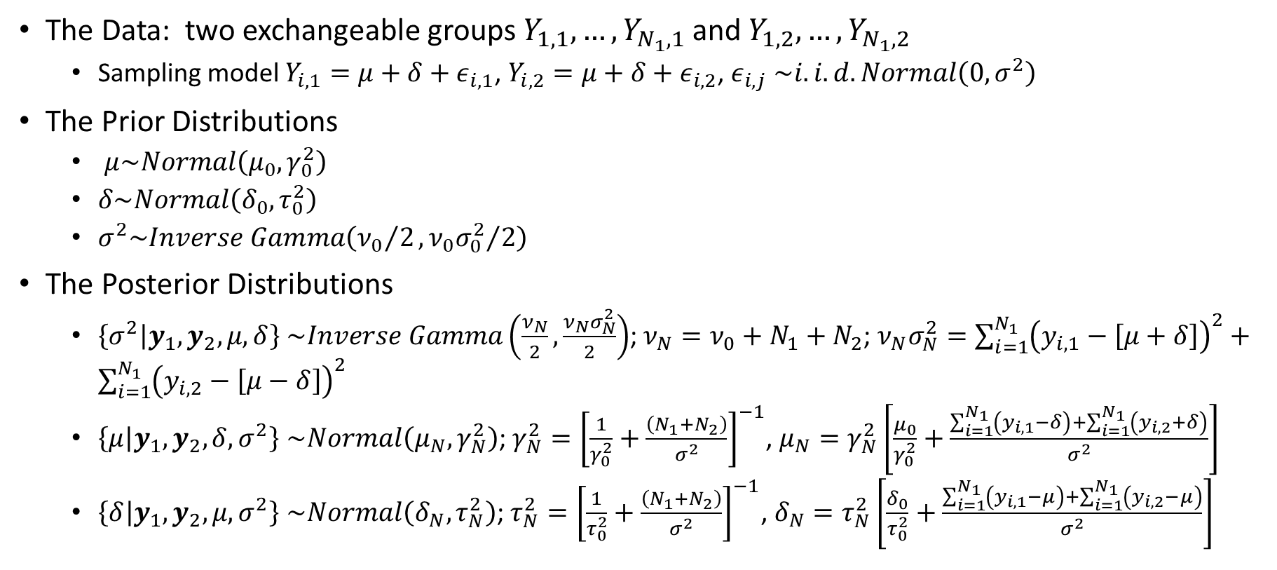
Normal-Inverse Gamma Model, 2-Sample: Derivation
The Data: two exchangeable groups $Y_{1,1},…, Y_{N_{1},1}$ and $Y_{1,2},…, Y_{N_{1},2}$
Sampling model $Y_{i,1}=μ+δ+ε_{i,1}$, $Y_{i,2}=μ+δ+ε_{i,2}$, $ε_{i,j}$ $\sim i.i.d. Normal\left(0,σ^{2}\right)$
The Prior Distributions
$μ\sim Normal\left(μ_{0},γ_{0}^{2}\right)$
$δ\sim Normal\left(δ_{0},τ_{0}^{2}\right)$
$σ^{2}\sim Inverse Gamma\left({ν_{0}}/2, {ν_{0}σ_{0}^{2}}/2\right)$
The Posterior Distributions
$\left\{{\left.σ^{2}\right|y}_{1}, y_{2},μ,δ\right\}$ $\sim Inverse Gamma\left(\frac{ν_{N}}{2},\frac{ν_{N}σ_{N}^{2}}{2}\right)$; $ν_{N}=ν_{0}+N_{1}+N_{2}$; $ν_{N}σ_{N}^{2}=\sum_{i=1}^{N_{1}}{{\left(y_{i,1}−\left[μ+δ\right]\right)}^{2}}+\sum_{i=1}^{N_{1}}{{\left(y_{i,2}−\left[μ−δ\right]\right)}^{2}}$
$\left\{\left.μ\right|y_{1}, y_{2},δ,σ^{2}\right\}$ $\sim Normal\left(μ_{N},γ_{N}^{2}\right)$; $γ_{N}^{2}={\left[\frac{1}{γ_{0}^{2}}+\frac{\left(N_{1}+N_{2}\right)}{σ^{2}}\right]}^{−1}$, $μ_{N}=γ_{N}^{2}\left[\frac{μ_{0}}{γ_{0}^{2}}+\frac{\sum_{i=1}^{N_{1}}{\left(y_{i,1}−δ\right)}+\sum_{i=1}^{N_{1}}{\left(y_{i,2}+δ\right)}}{σ^{2}}\right]$
$\left\{{\left.δ\right|y}_{1}, y_{2},μ,σ^{2}\right\}$ $\sim Normal\left(δ_{N},τ_{N}^{2}\right)$; $τ_{N}^{2}={\left[\frac{1}{τ_{0}^{2}}+\frac{\left(N_{1}+N_{2}\right)}{σ^{2}}\right]}^{−1}$, $δ_{N}=τ_{N}^{2}\left[\frac{δ_{0}}{τ_{0}^{2}}+\frac{\sum_{i=1}^{N_{1}}{\left(y_{i,1}−μ\right)}+\sum_{i=1}^{N_{1}}{\left(y_{i,2}−μ\right)}}{σ^{2}}\right]$

Slide 48

Normal-Inverse Gamma Model, 2-Sample: Derivation (continued)
The Predictive Distribution can be approximated by means of a Gibbs sampler, as follows.
Set initial values $μ=\frac{θ_{1}+θ_{2}}{2}$, $δ=\frac{θ_{1}−θ_{2}}{2}$
Note: letting $θ_{1}=μ+δ$, $θ_{2}=μ−δ$, we see that $δ={\left(θ_{1}−θ_{2}\right)}/2$ is half the population difference in means, and $μ={\left(θ_{1}−θ_{2}\right)}/2$ is the pooled average
Generate ${\left.σ^{2}\right|y}_{1}, y_{2},μ,δ \sim Inverse Gamma\left(\frac{ν_{N}}{2},\frac{ν_{N}σ_{N}^{2}}{2}\right)$
Generate updated $\left.μ\right|y_{1}, y_{2},δ,σ^{2} \sim Normal\left(μ_{N},γ_{N}^{2}\right)$
Generate updated ${\left.δ\right|y}_{1}, y_{2},μ,σ^{2 }\sim Normal\left(δ_{N},τ_{N}^{2}\right)$
Generate ${\tilde{y}}_{1}\sim Normal\left(μ+δ,σ^{2}\right)$ and ${\tilde{y}}_{2}\sim Normal\left(μ−δ,σ^{2}\right)$

Slide 49

Normal-Inverse Gamma Model, 2-Sample: R function
Predictive distribution: ${\tilde{y}}_{1}\sim Normal\left(μ+δ,σ^{2}\right),$ ${\tilde{y}}_{2}\sim Normal\left(μ−δ,σ^{2}\right)$
Type | Function | Implementation
Predictive Sampler | rpredNormIG2(S,y1,y2,mu0,g20,d0,t20,nu0,s20) | Implements a Gibbs sampler
y1, y2 = the two sets of observed data
(mu0, g20) = $(μ_{0},γ_{0}^{2})$, the prior mean and variance for $μ$
(d0, t20) = ($δ_{0},τ_{0}^{2})$, the prior mean and variance for $δ$
(nu0, s20) = ($ν_{0},σ_{0}^{2})$, prior parameters for the variance of the Normal data error terms
S = the desired predictive sample size

Slide 50


Normal-Inverse Gamma 2-Sample Example: Math Scores, Comparing Two Schools (Hoff)
Data: Math score samples from two public high schools
Exam designed to produce a nationwide mean of 50 and standard deviation of 10
${\overline{y}}_{1}=50.81$, ${\overline{y}}_{2}=46.15$
$σ_{1}=11.3, σ_{2}=9.1$
Standard t-test result ($p=0.087)$would have us treat the population means as equal

Slide 51


Normal-Inverse Gamma 2-Sample Example: Math Scores, Comparing Two Schools
For prediction, assume sampling model:
$Y_{i,1}=μ+δ+ε_{i,1}$
$Y_{i,2}=μ+δ+ε_{i,2}$
$ε_{i,j}$ $\sim i.i.d. Normal\left(0,σ^{2}\right)$
Prior parameters
$μ_{0}=50$
$σ_{0}^{2}=100$
$γ_{0}^{2}=625$
$ν_{0}=1$
$δ_{0}=0$
Note: shared variance but different means between the schools results in predictive densities with similar shapes but offset in location

Slide 52
Zellner

Slide 53
Gibbs Sampler

