Slide 1

Predictive Inference Tools for Researchers
by Gabe Harris
Notes:
Hello and welcome to my thesis defense. My presentation should take about ?? Minutes, after which there will be some time for questions. At 2pm the public part of the defense will be over, and everyone will be asked to leave accept for me and the members of my committee.
During the presentation, mute your audio. Thank you!
The title of my thesis is “Predictive Inference Tools for Researchers.”

Slide 2
Acknowledgements
This thesis is the culmination of an unusually long master’s program, which would not have been possible without the support of many people.
First I want to thank my thesis advisor, Dr. Dean Billheimer, for the many, many hours spent consulting, guiding, reading, and re-reading. Also my committee members, Dr. Edward Bedrick and Dr. Walter Piegorsch, whose classes I survived, and who always encouraged me.
I also owe my thanks to the University of Arizona, the Math Department, and specifically the Statistics and Data Science Graduate Interdisciplinary program, for offering this program and allowing me to participate.
Thank you to my employer, Raytheon, who encourages ongoing growth and education, and makes it possible by means of flexible work scheduling, and by funding. Thank you to my professional colleagues who rooted for me, especially John Rascon, Mitch Moffet, Kim Christianson, John Leach, Hahn Kim, Greg Paine, Dan Bentz, Ryan Ziegler, Ariel Boston, Chris Turner, Terrill Hurst, Al Mense, and Gary Garcia.
My dear friends Amy Duncan, Jenna Perryman, Dan Manship, Alex Swindle, and Danny Reckart showed me love and support I did not look for.
My parents and my sister always cheer for me.
My children challenge and inspire me, and they celebrate my every milestone with their smiling support and enthusiasm.
And finally, I don’t have words to express my deep gratitude to my wonderful wife, Trish, who has endured my long hours and late nights for several years, who wants me in her life, and whose constant words of loving affirmation and sweet affection are a gift I can never repay.
Notes:
I have so many people to acknowledge. I don’t want to abbreviate this, so I’ll just read through it.
[read it]
Now to the thesis.

Slide 3
Why Predictive Inference?
A statistical model may be judged by the quality of the predictions it makes
Prediction is the main purpose of statistics
Bayesian predictive inference
Connects subjective and objective reality (Nate Silver)
Emphasizes concrete observed data over hypothetical parameters
Facilitates discrimination between competing statistical models
Improves scientific accuracy and reproducibility (Dean Billheimer)
Notes:
A big idea underlying this thesis is that prediction is important, and moreover good predictions are desirable.
Indeed I’m persuaded that the pursuit of good predictions is the main point of statistics.
Bayesian predictive inference brings subjectivity into play while at the same time giving strong emphasis to concrete, objective data when making predictions.
Some of the resulting benefits include those listed here:
- better ability to compare statistical models
- improved scientific accuracy and reproducibility

Slide 4
Overview
Motivation: the lack of suitable computing tools presents an obstacle to employment of Bayesian predictive inference in research
Purpose of this thesis: to address that problem by providing a set of software tools for some useful predictive models
Documentation and derivation of models
Creation of R functions for Bayesian predictive analysis
Primary Sources
Seymour Geisser’s Predictive Inference: An Introduction (1993)
Peter D. Hoff’s A First Course in Bayesian Statistical Methods (2009)
Notes:
The motivation for the work I’ve done is the lack of suitable tools for Bayesian prediction.
So with this thesis I address that problem for several useful established models.
I will be presenting top-level derivations of the models and descriptions of the R functions I’ve created, illustrated with examples.
For the models and some of the examples I relied heavily on Seymour Geisser’s Predictive Inference: An Introduction and Peter Hoff’s A First Course in Bayesian Statistical Methods.

Slide 5






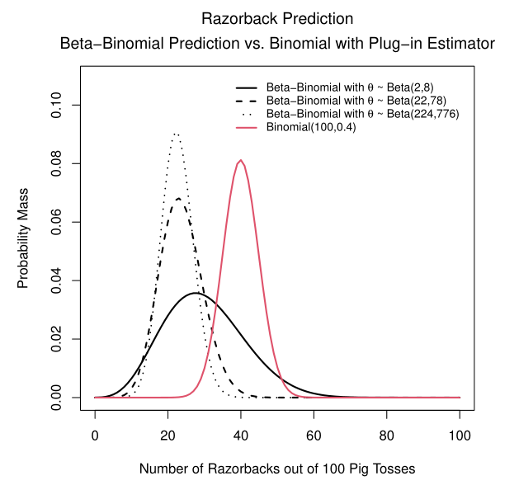

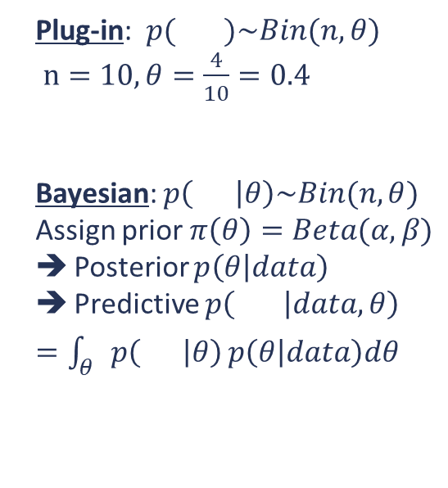

Illustration: Pass the Pigs®
Plug-in: $p( )\sim Bin(n, θ)$
$n=10, θ=\frac{4}{10}=0.4$
Bayesian: $p\left( | θ\right)\sim Bin(n,θ)$
Assign prior $π\left(θ\right)=Beta(α,β)$
Posterior $p\left(θ | data\right)$
Predictive $p\left( | data,θ\right)$
$=\int_{θ}{p\left( | θ\right)}p\left(θ | data\right)dθ$
Classic press-your-luck dice game where the “dice” are pigs!
Toss the pig dice and accumulate points (or lose everything) depending on how they land
Prediction problem: having just observed 4 razorbacks out of 10 tosses of a single pig, how many razorbacks will I see in the next 10 tosses?
Observations:
Noticeable location difference between the methods
Prior parameter selection affects variance
$$p\left( | data\right)= ?$$
Prior parameters selection reflects expectation from experience that the average number of Razorbacks should be near 22% of the tosses. Reference Duquesne University Pass the Pigs® experiment: see Journal of Statistics Education Volume 14, Number 3, 2006 (http://jse.amstat.org/v14n3/datasets.kern.html)
Notes:
An example to illustrate the potential difference between Bayesian prediction and the use of a plug-in estimator.
Pass the Pigs® is a game published in the late 1970’s involving dice that are actually little pig figurines. Players toss the pig dice and score points depending on how the pigs come to rest.
Some of the possible positions and associated scores are shown here at the top. For this example, we’re interested in the probability that a single pig will end up in the razorback position with all four legs in the air.
Suppose after 10 tosses of a single pig, 4 razorbacks have resulted. We could model this binomial data using the estimated parameter 4/10 and make a prediction based on that.
If we assign a Beta prior to the Binomial probability, harnessing the knowledge and experience of Pass the Pigs® experts, we may realize a different result.
In this case we have the benefit of an experiment performed at Duquesne University in which almost 12,000 pig tosses were undertaken, and end-state frequencies were computed. I used that information to inform my prior parameter selection.
The red curve is the plug-in binomial distribution. The black ones are predictive Beta-Binomial distributions. The differences between the three black curves result from selection of prior parameter values, which vary the amount of weight the predictive models give to the “expert” knowledge.

Slide 6

The Bayesian Parametric Prediction Format
Goal: predict future result $\tilde{Y}=\tilde{y}$ given observations $Y_{1}=y_{1},…,Y_{N}=y_{N}$.
*If we can assume the observed data are conditionally i.i.d. with respect to some parameter $θ\sim π\left(θ\right)$,
then we can write:
$$p\left(\tilde{Y}=\tilde{y} | Y_{1}=y_{1},…,Y_{N}=y_{N}\right)=\frac{p\left(\tilde{y},y_{1},…, y_{N}\right)}{p\left(y_{1},…, y_{N}\right)}=\frac{\int{p\left(\tilde{y},y_{1},…, y_{N} | θ\right)π\left(θ\right)dθ}}{p\left(y_{1},…, y_{N}\right)}=\int{p\left(\tilde{y} | θ\right)p\left(θ | y_{1},…, y_{N}\right)dθ}$$
*For this assumption, we need exchangeability.
Notes:
Throughout this presentation, a tilde surmounting a variable indicates a prediction.
Having observed data y1 through yN, we want to predict future y~.
The predictive models depend on the assumption that the data are exchangeable, which means essentially that the order in which they are labeled doesn’t matter in terms of their distribution. De Finnetti showed that exchangeability gives us conditional independence and identical distribution with respect to some parameter with a prior distribution.
If we have that, we can model the predictive distribution by multiplying the data distribution by the posterior distribution of the parameter, and then integrating out the parameter.

Slide 7


The Models
Models Using Conjugate Priors
Beta-Binomial: Prediction of Future Successes
Exponential-Gamma: Survival Time
Poisson-Gamma: Count Data
Normal-Inverse Gamma
One-sample
$k$-sample
Normal Regression

Slide 8
Beta-Binomial Model: Prediction of Future Successes

Slide 9

Beta-Binomial Model: Derivation
The Data:
$T=\sum{Y_{i}}\sim Binomial\left(N,θ\right)$ ➔ $Pr\left(T=t | θ\right)=\left(\begin{matrix}N \\ t\end{matrix}\right)θ^{t}{\left(1−θ\right)}^{N−t}$
The Prior Distribution
$θ\sim Beta(α,β)$ ➔ $π\left(θ\right)=\frac{Γ\left(α+β\right)θ^{α−1}{\left(1−θ\right)}^{β−1}}{Γ\left(α\right)Γ\left(β\right)}$
The Posterior Distribution
$p\left(θ | y_{1},…, y_{N}\right)=\frac{Γ\left(N+α+β\right)}{Γ\left(t+α\right)Γ\left(N−t+β\right)}$ $θ^{t+α−1}{\left(1−θ\right)}^{N−t+β−1}=Beta(t+α, N−t+β)$
The Predictive Distribution for $\tilde{T}$ successes out of $M$ future binary observations
$p\left(\tilde{T}=\tilde{t} | T=t\right)=\frac{Γ\left(M+1\right)Γ\left(N+α+β\right)Γ\left(\tilde{t}+t+α\right)Γ\left(M+N−\tilde{t}−t+β\right)}{Γ\left(\tilde{t}+1\right)Γ\left(M−\tilde{t}+1\right)Γ\left(t+α\right)Γ\left(N−t+β\right)Γ\left(M+N+α+β\right)}$
Notes:
The observed data T is the total number of successes out of N Bernoulli trials, so T has a binomial distribution
We assign to theta a prior Beta distribution.
The posterior distribution of theta is another Beta distribution,
…and the predictive distribution for T~ successes out of M future binary observations is this rather impressive rational combination of Gamma functions.

Slide 10
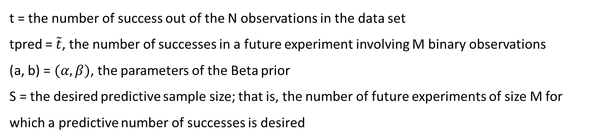
Beta-Binomial Model: R functions
Predictive distribution:$p\left(\tilde{T}=\tilde{t} | T=t\right)=\frac{Γ\left(M+1\right)Γ\left(N+α+β\right)Γ\left(\tilde{t}+t+α\right)Γ\left(M+N−\tilde{t}−t+β\right)}{Γ\left(\tilde{t}+1\right)Γ\left(M−\tilde{t}+1\right)Γ\left(t+α\right)Γ\left(N−t+β\right)Γ\left(M+N+α+β\right)}$
Type | Function | Implementation
Density | dpredBB(tpred,N,t,M,a,b) | Uses R function lgamma() for each factor then exponentiates.
Cumulative Probability | ppredBB(tpred,N,t,M,a,b) | Calls dpredBB() for 1,…,tpred and returns the cumulative sum of that discrete set of results
Predictive Sampler | rpredBB(S,N,t,M,a,b) | Uses inverse transform method and output of ppredBB()
t = the number of success out of the N observations in the data set
tpred = $\tilde{t}$, the number of successes in a future experiment involving M binary observations
(a, b) = $(α,β)$, the parameters of the Beta prior
S = the desired predictive sample size; that is, the number of future experiments of size M for which a predictive number of successes is desired
Notes:
The density function I created (in this case technically a mass function), dpredBB() uses the R function lgamma() for each factor in the predictive expression, then exponentiates for the result. This is done to avoid potential numerical problems arising from enormous products.
The probability function ppredBB() calls dpredBB() for each integer from 1 to the desired predicted value and returns the cumulative sum of that discrete set of results.
The predictive sampler rpredBB() uses the inverse transform method and the output of ppredBB() to generate a sample.
The user provides the observed data, the desired quantity for prediction, the number of observations in the future experiment, and the Beta Prior parameters.
IF ASKED: Inverse transform method:
Take a sample, u, from a uniform distribution
return the largest number x from the domain of the distribution P(X) such that P(-∞ <X<x) ≤ u

Slide 11
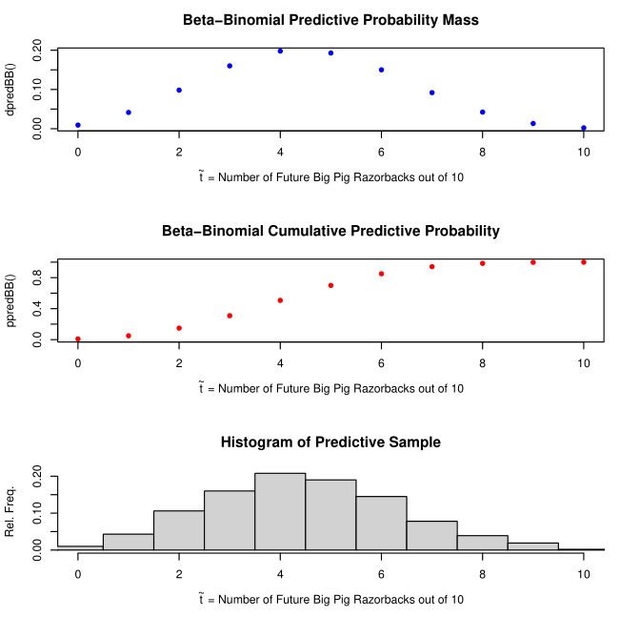
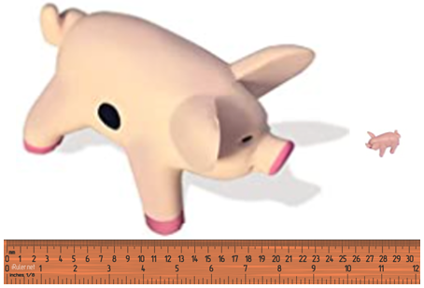
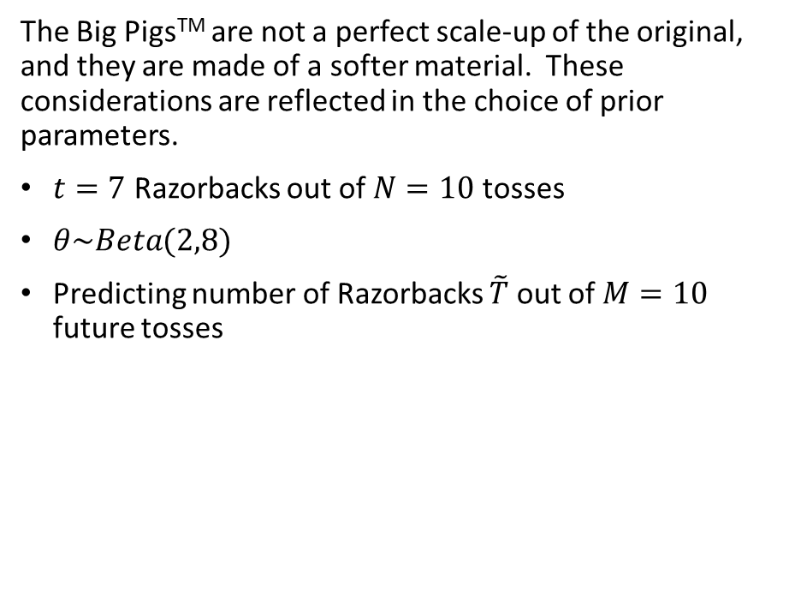
Beta-Binomial Example: Pass The Pigs®: Big Pigs™
The Big PigsTM are not a perfect scale-up of the original, and they are made of a softer material. These considerations are reflected in the choice of prior parameters.
$t=7$ Razorbacks out of $N=10$ tosses
$θ\sim Beta(2,8)$
Predicting number of Razorbacks $\tilde{T}$ out of $M=10$ future tosses
Notes:
Returning to the Pass the Pigs®, say we want to make a prediction but we’re playing with the Big Pigs™ variant. The picture shows the approximate size difference.
The bigger dice are not a perfect scale model of the originals, and they’re made out of a softer, cushiony material.
Supposed we’ve tossed the pigs 10 times resulting in 7 razorbacks. We choose prior parameters alpha=2 and beta=8, not giving too much weight to the prior knowledge
Plots of the predictive mass function and the cumulative probability, and a histogram of a predictive sample are shown to the right.
Our prediction looks like the expectation is somewhere around 4 razorbacks out of the next 10.

Slide 12
Exponential-Gamma Model: Time to Event (Allowing Censoring)

Slide 13


Exponential-Gamma Model: Derivation
The Data:
$Y_{1},…, Y_{N}\sim Exp\left(θ\right)$ , with $Y_{1},…, Y_{d}$ fully observed realizations and $Y_{d+1},…, Y_{N}$ censored
We obtain overall exponential likelihood $L\left(θ | y_{1},…, y_{N}\right)= \prod_{i=1}^{d}{θ^{d}e^{−θN\overline{y}}}$
( with $\overline{y}=\frac{1}{N}\sum_{i=1}^{N}{y_{i}}$ )
The Prior Distribution
$θ\sim Gamma(δ,γ)$ ➔ $π\left(θ\right)=\frac{γ^{δ}θ^{δ−1}e^{−γθ}}{Γ\left(δ\right)}$
The Posterior Distribution
$p\left(θ | y_{1},…, y_{N}\right)=\frac{{\left(γ+N\overline{y}\right)}^{d+δ}}{Γ\left(d+δ\right)}$ $θ^{d+δ−1}e^{−θ\left(γ+N\overline{y}\right)}=Gamma(d+δ,γ+N\overline{y})$
The Predictive Distribution for future survival time $\tilde{y}$ is
$p\left(\tilde{Y}=\tilde{y} | y_{1},…, y_{N}\right)=\frac{\left(d+δ\right){\left(γ+N\overline{y}\right)}^{d+δ}}{{\left(γ+N\overline{y}+\tilde{y}\right)}^{d+δ+1}}$
Notes:
The data are assumed to be distributed exponentially. We’re observing time to an event, and allowing for censoring. All that means is that we have a time window for observation, so if the event doesn’t occur within the window, we censor that event and assign the full window length to its time.
In this case we assume the first d observations are fully realized, and the rest are censored.
We assign a Gamma prior to the Exponential parameter, which yields a Gamma posterior distribution.
The predictive distribution is a closed form, shown here.

Slide 14
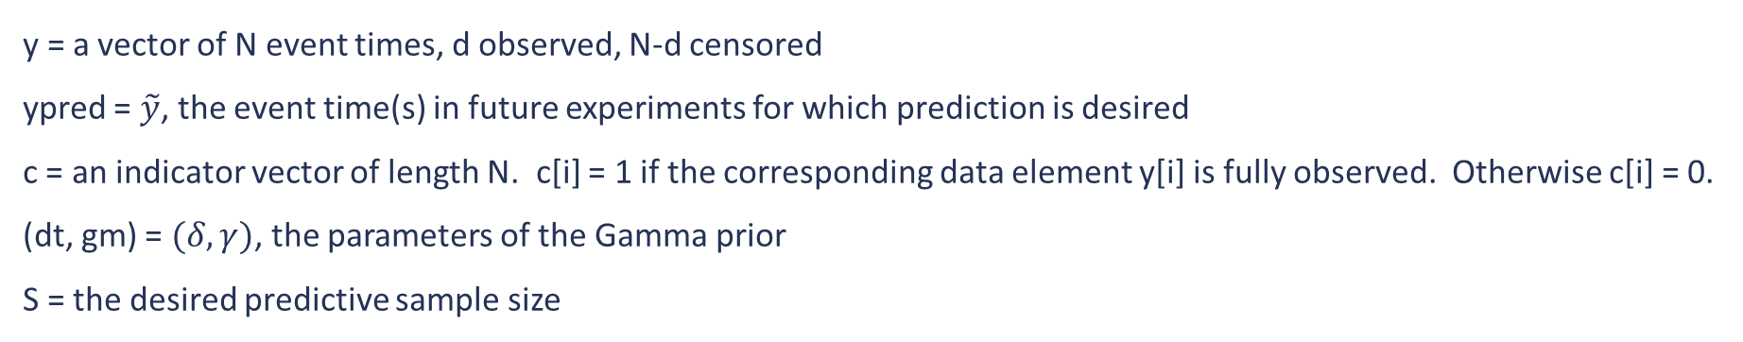
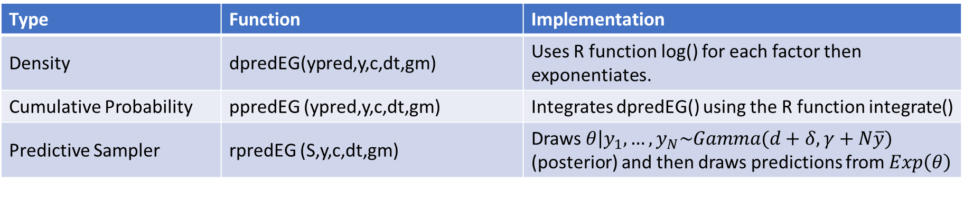
Exponential-Gamma Model: R functions
Predictive distribution: $p\left(\tilde{Y}=\tilde{y} | y_{1},…, y_{N}\right)=\frac{\left(d+δ\right){\left(γ+N\overline{y}\right)}^{d+δ}}{{\left(γ+N\overline{y}+\tilde{y}\right)}^{d+δ+1}}$
Type | Function | Implementation
Density | dpredEG(ypred,y,c,dt,gm) | Uses R function log() for each factor then exponentiates.
Cumulative Probability | ppredEG (ypred,y,c,dt,gm) | Integrates dpredEG() using the R function integrate()
Predictive Sampler | rpredEG (S,y,c,dt,gm) | Draws $\left.θ\right|y_{1},…, y_{N}\sim Gamma(d+δ,γ+N\overline{y})$ (posterior) and then draws predictions from $Exp\left(θ\right)$
y = a vector of N event times, d observed, N-d censored
ypred = $\tilde{y}$, the event time(s) in future experiments for which prediction is desired
c = an indicator vector of length N. c[i] = 1 if the corresponding data element y[i] is fully observed. Otherwise c[i] = 0.
(dt, gm) = $(δ,γ)$, the parameters of the Gamma prior
S = the desired predictive sample size
Notes:
The density function dpredEG() applies the R function log() to each factor and then exponentiates, again avoiding numerical issues.
The probability function ppredEG() integrates dpredEG() using the R function integrate().
The predictive sampler rpredEG() draws theta from the posterior and then draws predictions from the exponential distribution with the drawn theta as its parameter.
The user supplies the data, the desired event time for predictions, and the Gamma prior parameters.

Slide 15
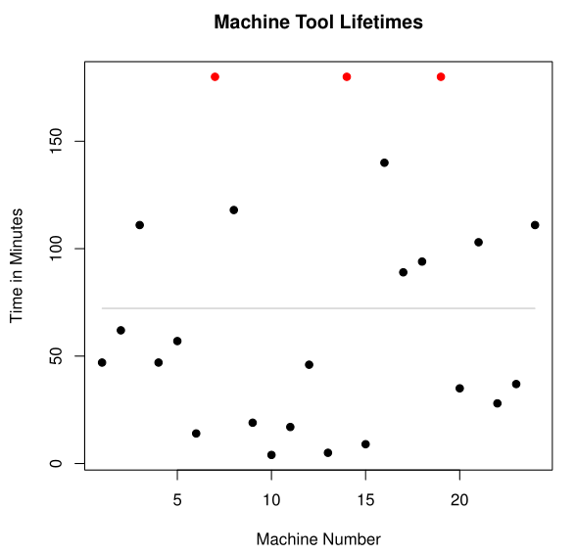
Exponential-Gamma Example: Machine Tool Lifetime
Data = lifetime in minutes of 24 machine tools of a particular type (taken from Statistical Prediction Analysis by Aitchison & Dunsmore)
Lifetimes range from 4 to 180 minutes, with mean 72.21 (gray horizontal line)
3 observations were censored at 180 minutes and are shown in red
Notes:
The data for this example was taken from Statistical Predictioin Analysis by Aitchison & Dunsmore.
It consists of machine tool lifetimes in minutes for 24 tools of a particular type.
The lifetimes ranged from 4 to 180 minutes, with a mean of 72.21.
3 observations were censored at the end of the experiment window, and are shown on the plot in red.

Slide 16
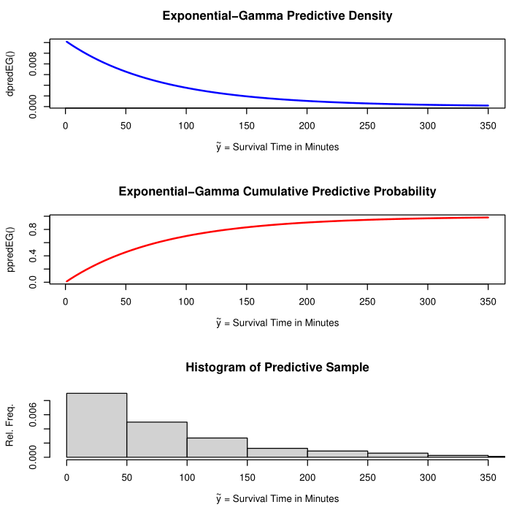
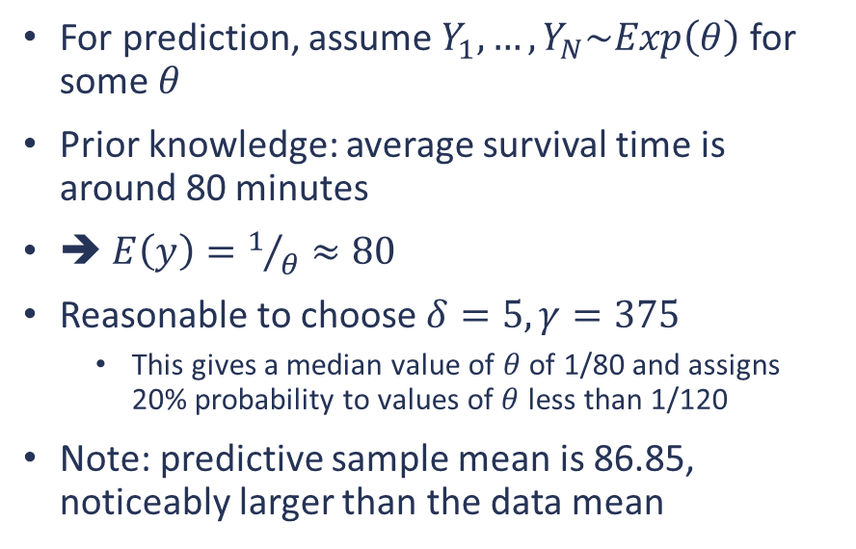
Exponential-Gamma Example, continued: Machine Tool Lifetime (Aitchison & Dunsmore)
For prediction, assume $Y_{1},…, Y_{N}\sim Exp\left(θ\right)$ for some $θ$
Prior knowledge: average survival time is around 80 minutes
➔ $E\left(y\right)=1/θ≈80$
Reasonable to choose $δ=5, γ=375$
This gives a median value of $θ$ of 1/80 and assigns 20% probability to values of $θ$ less than 1/120
Note: predictive sample mean is 86.85, noticeably larger than the data mean
Notes:
Suppose we have prior knowledge from an expert that says average survival time for these tools is around 80 minutes.
For the exponentially distributed data that means the parameter theta is 1/80.
After some consideration, prior parameters delta = 5 and gamma = 375 were chosen, because
- this gives a median value of 1/80 to the exponential parameter theta, and
- this gives only 20% probability to values of theta less than 1/120
The predictive density and cumulative probability curves, along with a histogram of a predictive sample, are shown here.
The mean of the predictive sample is 86.85, a bit larger than the data mean and the expert’s suggestion.

Slide 17
Poisson-Gamma Model: Count Prediction

Slide 18

Poisson-Gamma Model: Derivation
The Data:
$Y_{1},…, Y_{N}\sim Poisson\left(θ\right)$ ➔ $Pr\left(Y_{1}=y_{1},…,Y_{N}=y_{N} | θ\right)=\left(\prod_{i=1}^{N}{\frac{1}{y_{i}}}\right)θ^{\sum{y_{i}e^{−Nθ}}}$
The Prior Distribution
$θ\sim Gamma(α,β)$ ➔ $π\left(θ\right)=\frac{β^{α}}{Γ\left(α\right)}θ^{α−1}$ $e^{−βθ}$
The Posterior Distribution
$p\left(θ | y_{1},…, y_{N}\right)=\frac{{\prod_{i=1}^{N}{y_{i}!}\left(β+N\right)}^{α+\sum{y_{i}}}}{Γ\left(α+\sum{y_{i}}\right)}θ^{α+\sum{y_{i}}−1}e^{−\left(β+N\right)θ}∝Gamma(α+\sum{y_{i}},β+N)$
The Predictive Distribution for future count $\tilde{y}$ is
$p\left(\tilde{Y}=\tilde{y} | y_{1},…, y_{N}\right)=\frac{Γ\left(α+\sum{y_{i}}+\tilde{y}\right)}{Γ\left(\tilde{y}+1\right)Γ\left(α+\sum{y_{i}}\right)}{\left(\frac{β+N}{β+N+1}\right)}^{α+\sum{y_{i}}}$ ${\left(\frac{1}{β+N+1}\right)}^{\tilde{y}}=NB\left(α+\sum{y_{i}},β+N\right)$
Notes:
We have Poisson data (a list of counts), and a Gamma prior on the parameter, theta.
The posterior is a Gamma distribution.
The predictive distribution is negative binomial.

Slide 19
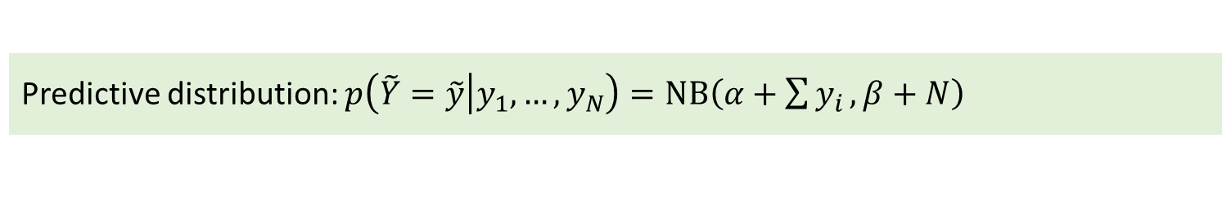
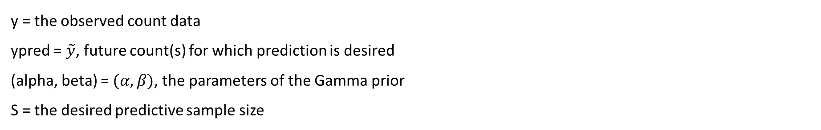
Poisson-Gamma Model: R functions
Predictive distribution: $p\left(\tilde{Y}=\tilde{y} | y_{1},…, y_{N}\right)=NB\left(α+\sum{y_{i}},β+N\right)$
Type | Function | Implementation
Density | dpredPG(ypred,y,alpha,beta) | Uses R function dnbinom()
Cumulative Probability | ppredPG (ypred,y,alpha,beta) | Returns a cumulative sum of the results of dpredPG() for the sequence 0,…,ypred
Predictive Sampler | rpredPG (S,y,alpha,beta) | Establishes appropriate support, then employs the inverse transform method and output of ppredPG()
y = the observed count data
ypred = $\tilde{y}$, future count(s) for which prediction is desired
(alpha, beta) = $(α,β)$, the parameters of the Gamma prior
S = the desired predictive sample size
Notes:
For the mass function dpredPG(), the negative binomial predictive distribution enables the straightforward use of the R function dnbinom().
The probability function ppredPG() returns a cumulative sum of the results of dpredPG() for the sequence 0,…,ypred
The predictive sampler uses a bisection method to establish an appropriate upper end to the negative binomial support, and then employs the inverse transform method.
The user supplies the observed data, the desired prediction count values, and the parameters of the Gamma prior.

Slide 20
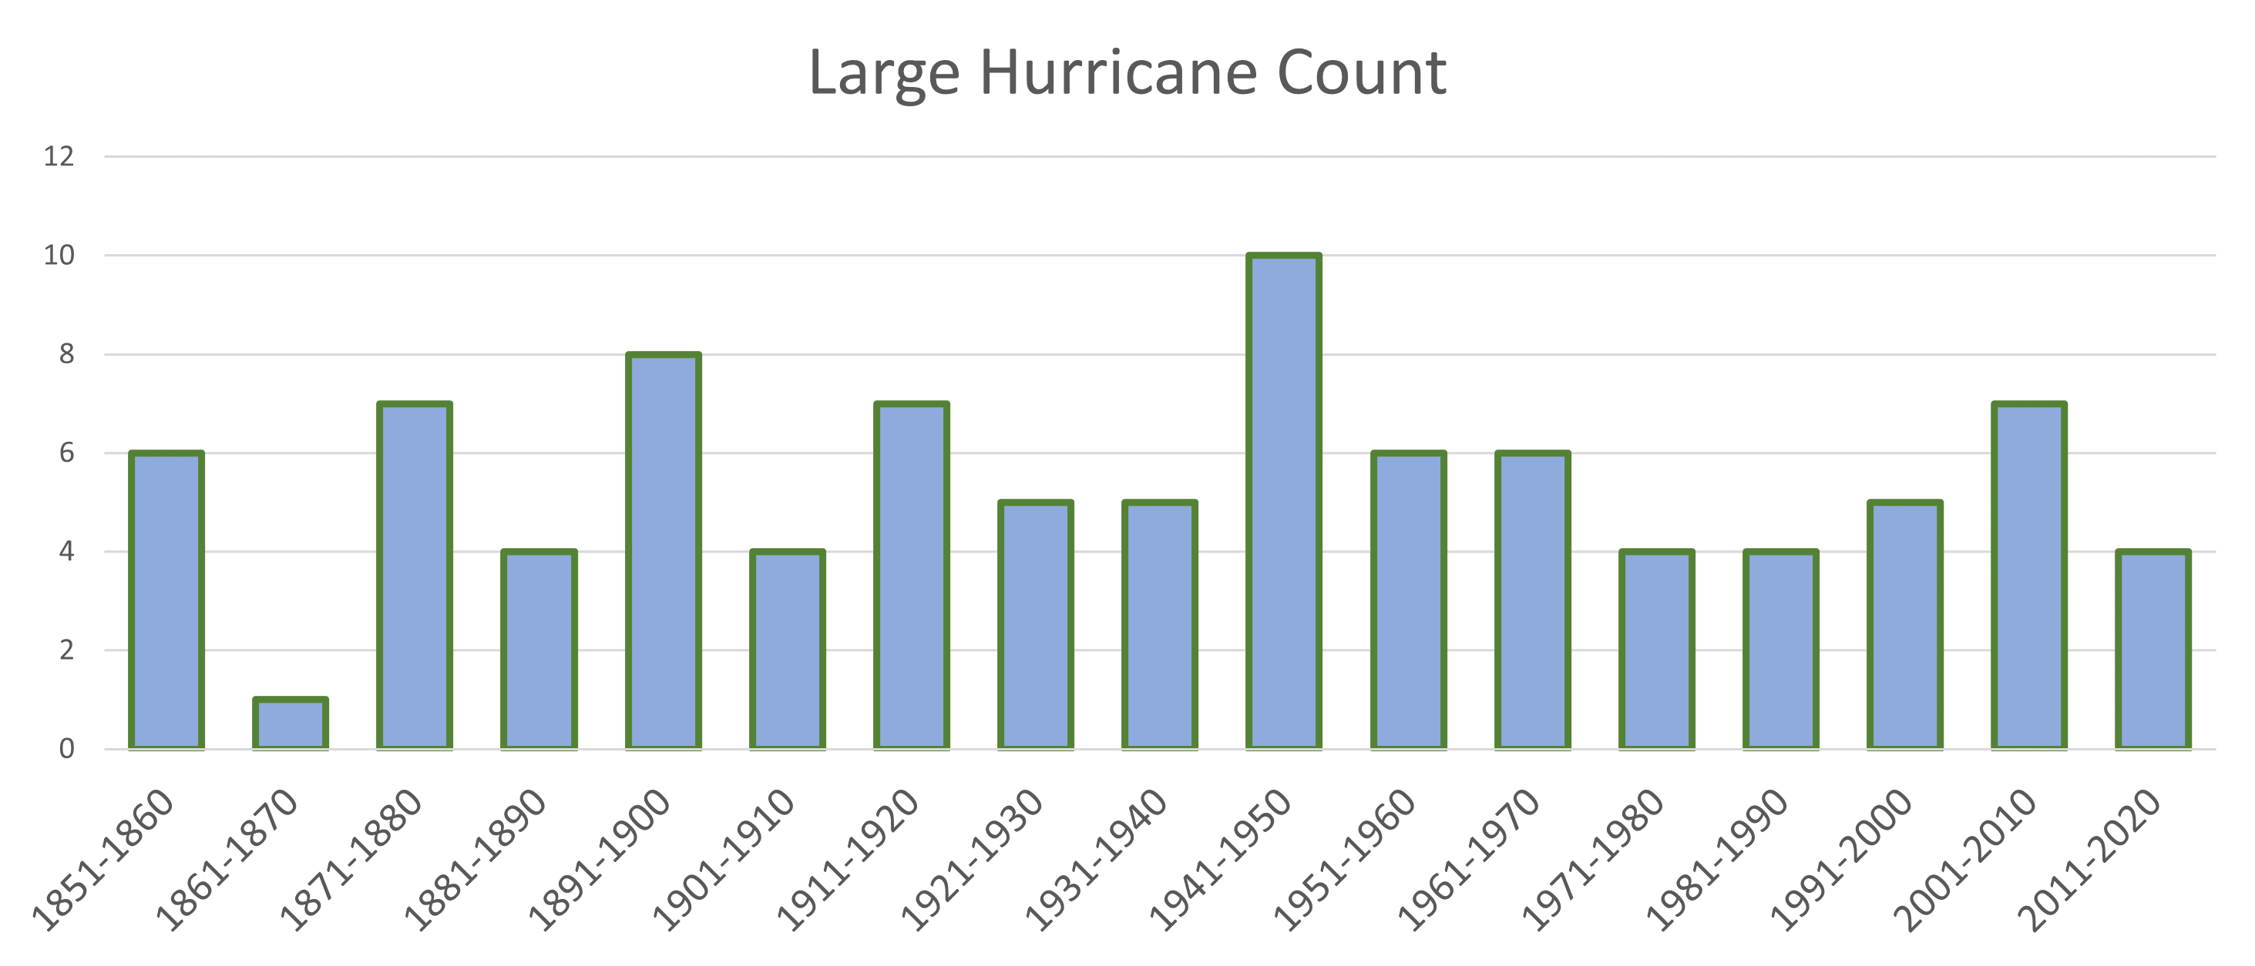
Poisson-Gamma Example: Large Hurricane Count
Data = number of large (category 3,4,5) hurricanes to make landfall each decade from 1851 through 2020 (National Hurricane Center): http://www.aoml.noaa.gov/hrd/hurdat/All_U.S._Hurricanes.html
Notes:
Each bar here represents the number of large hurricanes to make landfall in the United States each decade since 1851, as reported by the National Hurricane Center.
A “large hurricane” here means category 3, 4, or 5.

Slide 21
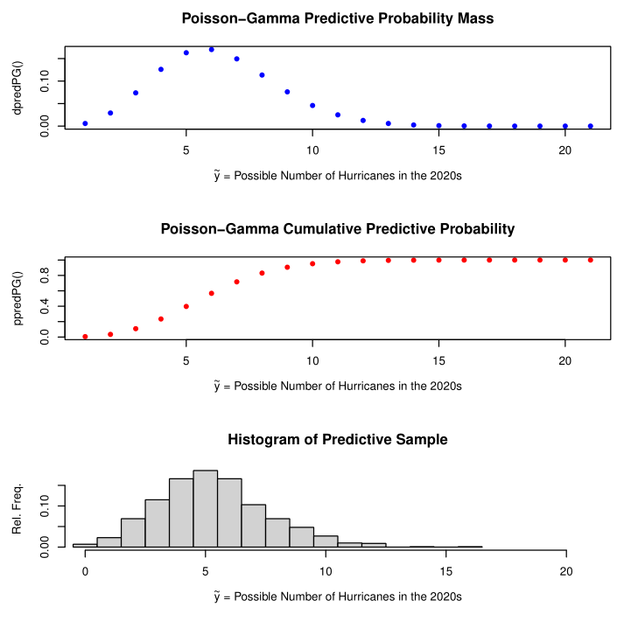
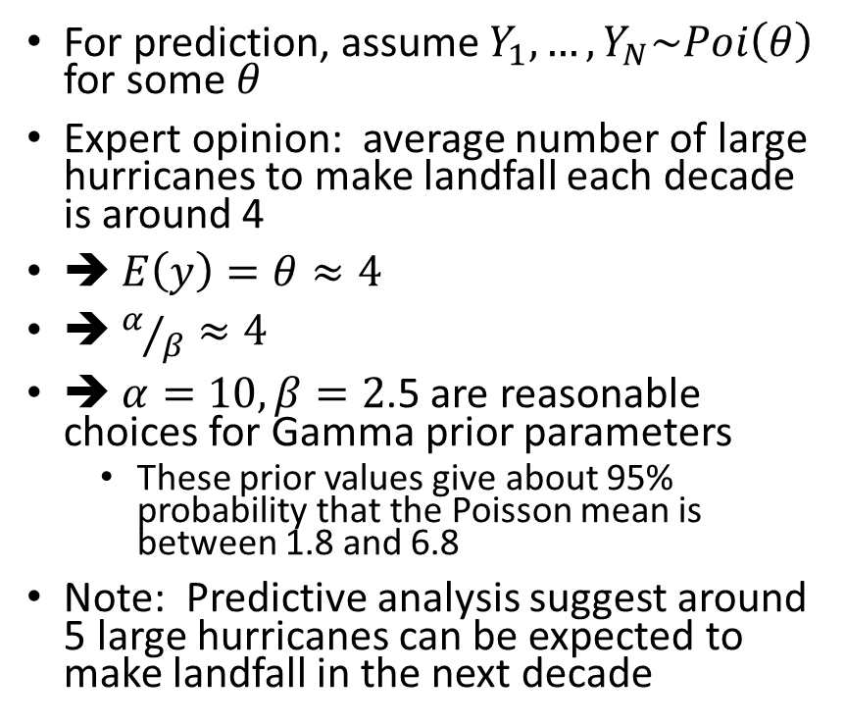
Poisson-Gamma Example: Large Hurricane Count
For prediction, assume $Y_{1},…, Y_{N}\sim Poi\left(θ\right)$ for some $θ$
Expert opinion: average number of large hurricanes to make landfall each decade is around 4
➔ $E\left(y\right)=θ≈4$
➔ $α/β≈4$
➔ $α=10, β=2$.5 are reasonable choices for Gamma prior parameters
These prior values give about 95% probability that the Poisson mean is between 1.8 and 6.8
Note: Predictive analysis suggest around 5 large hurricanes can be expected to make landfall in the next decade
Notes:
Suppose we want to predict the number of large hurricanes we can expect to make landfall in a future decade?
Suppose further a hurricane expert has told us the average should be about 4.
Choosing alpha = 10 and beta = 2.5 for the Gamma prior, our predictive analysis suggests we might see more like 5 such events in the 2020s.

Slide 22
Normal-Inverse Gamma Model: 1-Sample

Slide 23


Normal-Inverse Gamma Model, 1-Sample: Derivation (with previous knowledge)
The Data:
$Y_{1},…, Y_{N}\sim Normal\left(θ,σ^{2}\right)$
The Prior Distributions, informed by previous knowledge
$\frac{1}{σ^{2}}\sim Gamma\left({ν_{0}}/2,{ν_{0}σ_{0}^{2}}/2\right)$
$\left.θ\right|σ^{2}$ $\sim Normal\left(μ_{0},{σ^{2}}/{κ_{0}}\right)$
The Joint Posterior Distribution
$\left\{\left.σ^{2}\right|y_{1},…, y_{N} \right\}$ $\sim Inverse Gamma\left({ν_{N}}/2,{ν_{N}σ_{N}^{2}}/2\right)$
$\left\{\left.θ\right|y_{1},…, y_{N},σ^{2}\right\}\sim Normal\left(μ_{N},{σ^{2}}/{κ_{N}}\right)$
$κ_{N}=$ $κ_{0}+N$
$μ_{N}=\frac{κ_{0}μ_{0}+N\overline{y}}{κ_{N}}$
$ν_{N}=$ $ν_{0}+N$
$σ_{N}^{2}=\frac{1}{ν_{N}}\left[ν_{0}σ_{0}^{2}+\left(N−1\right)s^{2}+\frac{κ_{0}N}{κ_{N}}{\left(\overline{y}−μ_{0}\right)}^{2}\right]$
Notes:
We present two different options for Normal, depending on whether we want to rely on previous knowledge. First, we’ll assume we have previous knowledge on which to formulate a prior.
For Normal data we need to supply priors to two parameters: we have Normal prior for the mean and an Inverse Gamma prior for the variance.
The Joint Posterior consists of a Normal conditional distribution for the mean and an Inverse Gamma conditional for the variance.
(reciprocal of variance is precision)

Slide 24


Normal-Inverse Gamma Model, 1-Sample: Derivation (with previous knowledge, continued)
The Predictive Distribution can be approximated by means of Monte Carlo sampling
For $s ε 1,…,S:$
Generate marginal samples from the joint posterior distribution
$σ^{2(s)}\sim Inverse Gamma\left({ν_{N}}/2,{ν_{N}σ_{N}^{2}}/2\right)$
$θ^{(s)}$ $\sim Normal\left(μ_{N},{σ^{2(s)}}/{κ_{N}}\right)$
Generate ${\tilde{y}}^{(s)}\sim Normal\left(θ^{(s)},σ^{2(s)}\right)$
Here we have:
$κ_{N}$= $κ_{0}+N$
$$μ_{N}=\frac{κ_{0}μ_{0}+N\overline{y}}{κ_{N}}$$
$$ν_{N}=ν_{0}+N$$
$$σ_{N}^{2}=\frac{1}{ν_{N}}\left[ν_{0}σ_{0}^{2}+\left(N−1\right)s^{2}+\frac{κ_{0}N}{κ_{N}}{\left(\overline{y}−μ_{0}\right)}^{2}\right]$$
Notes:
For the prediction, we approximate the distribution using Monte Carlo sampling on the joint posterior.
First sample a variance, then sample a mean.
Then draw y~ from the Normal predictive distribution having those drawn parameter values.

Slide 25

Normal-Inverse Gamma Model, 1-Sample: Derivation (without previous knowledge)
The Data:
$Y_{1},…, Y_{N}\sim Normal\left(θ,σ^{2}\right)$
The Prior Distribution, uninfluenced by previous knowledge
$\left(θ,σ^{2}\right)\sim 1/{σ^{2}}$ (Jeffrey’s prior)
The Joint Posterior Distribution
$\left\{\left.σ^{2}\right|y_{1},…, y_{N} \right\}$ $\sim Inverse Gamma\left(\frac{N−1}{2},\frac{1}{2}\sum{{\left(y_{i}−\overline{y}\right)}^{2}} \right)$
$\left\{\left.θ\right|y_{1},…, y_{N},σ^{2}\right\}\sim Normal\left(μ_{N},{σ^{2}}/{κ_{N}}\right)$
This joint posterior can be integrated to show that $\frac{θ−\overline{y}}{s/{\sqrt{N}}}\left|y_{1},…, y_{N}\right.\sim t_{N−1}$
The Predictive Distribution
Sample $\tilde{y}\sim \overline{y}+s\sqrt{1+1/N}∙t_{N−1}$
Notes:
I we don’t want our prediction to be informed by previous information, we can assign a so-called non-informative prior to the parameters. In this case, we’ll use “Jeffrey’s prior”, 1/the variance, (which is not, as it happens, a probability density).
The resulting conditionals are Normal for the mean and Inverse Gamma for the variance.
Integrating the joint posterior has the happy result of yielding a t-distribution for prediction.

Slide 26
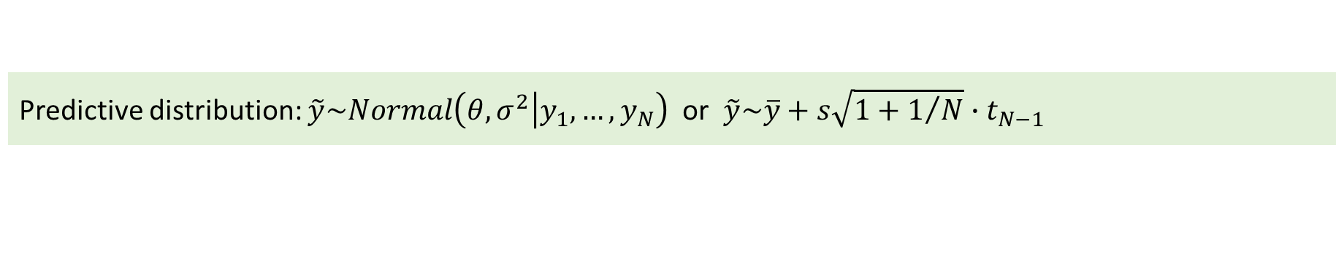
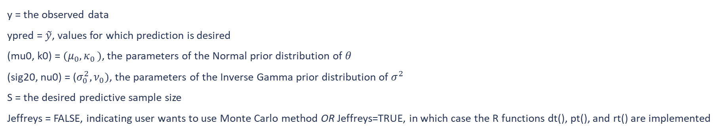
Normal-Inverse Gamma Model, 1-Sample: R functions
Predictive distribution: $\tilde{y}\sim Normal\left(θ,σ^{2}\left|y_{1},…, y_{N}\right.\right)$ or $\tilde{y}\sim \overline{y}+s\sqrt{1+1/N}∙t_{N−1}$
Type | Function | Implementation
Density | dpredNormIG1(ypred,y,mu0,k0,sig20,nu0,S,Jeffreys) | Implements a kernel density estimation (KDE) method and the R function density() or dt()
Cumulative Probability | ppredNormIG1 (ypred,y,mu0,k0,sig20,nu0,S,Jeffreys) | Uses R function ecdf() with a predictive sample generated by rpredNormIG1() or pt()
Predictive Sampler | rpredNormIG1 (S,y,mu0,k0,sig20,nu0,Jeffreys) | Monte carlo sampling using R functions rgamma() and rnorm() or rt()
y = the observed data
ypred = $\tilde{y}$, values for which prediction is desired
(mu0, k0) = $(μ_{0}{,κ}_{0})$, the parameters of the Normal prior distribution of $θ$
(sig20, nu0) = ($σ_{0}^{2},ν_{0})$, the parameters of the Inverse Gamma prior distribution of $σ^{2}$
S = the desired predictive sample size
Jeffreys = FALSE, indicating user wants to use Monte Carlo method OR Jeffreys=TRUE, in which case the R functions dt(), pt(), and rt() are implemented
Notes:
If using Jeffrey’s prior, the functions simply implement the basic R functions dt(), pt(), and rt() for the t-distribution.
If using informative priors, the density function dpreNormIG1() implements a kernel density estimator and the R function density(),
…the probability function ppredNormIG1() uses the empirical CDF R function ecdf() with a predictive sample generated by rpredNormIG1(), and
…the predictive sampler rpredNormIG1() implements Monte Carlo sampling as described on the previous page, using the R functions rgamma() and rnorm()
The user supplies the data, the values for desired prediction, the prior parameter values, and a 1 or 0 for Jeffrey’s.
IF ASKED: Kernel Density Estimation is a non-parametric way implementing data smoothing, to estimate the probability density function of a random variable based on a finite data sample. See Wikipedia.
IF ASKED: An Empirical CDF is an estimate of the cumulative density function of a data set based on the data. See Wikipedia.

Slide 27
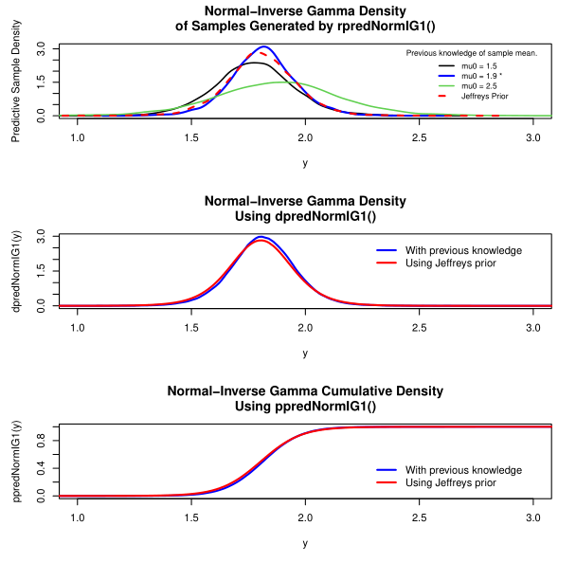
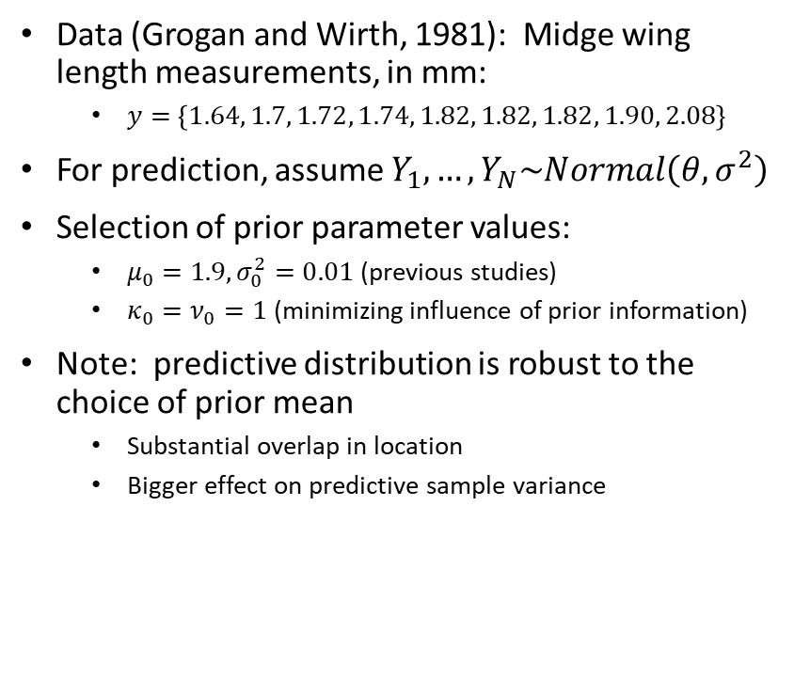
Normal-Inverse Gamma 1-Sample Example: Midge Wing Length (Hoff)
Data (Grogan and Wirth, 1981): Midge wing length measurements, in mm:
$y=\left\{1.64, 1.7, 1.72, 1.74, 1.82, 1.82, 1.82, 1.90, 2.08\right\}$
For prediction, assume $Y_{1},…, Y_{N}\sim Normal\left(θ,σ^{2}\right)$
Selection of prior parameter values:
$μ_{0}=1.9,σ_{0}^{2}=0.01$ (previous studies)
$κ_{0}=ν_{0}=1$ (minimizing influence of prior information)
Note: predictive distribution is robust to the choice of prior mean
Substantial overlap in location
Bigger effect on predictive sample variance
Notes:
Hoff presents this example using recorded midge wing lengths (in millimeters) from Grogan and Wirth.
Choosing prior parameter values based on previous studies, we have mu0 = 1.9mm (mean wing length) and sig_0^2 = 0.01 (variance). The kappa0 and nu0 values of 1 minimize the influence of the prior information. (if asked—they can be thought of as reflecting the sample size of the prior information).
The red dashed curve on the top plot is the predictive density resulting from Jeffrey’s prior.
The other three curves correspond to various choices of m0, comparing the expert knowledge (1.9mm) to choices above and below the whole range of the observed data. Notice the predictive model is robust to the choice of prior, with substantial overlap in location.

Slide 28
Normal-Inverse Gamma Model: k-Sample

Slide 29

Normal-Inverse Gamma Model, k-Sample: Derivation
The Data: $Y_{1},…,Y_{k}$ where $Y_{j}=\left\{Y_{1,j},…, Y_{N_{j},j}\right\}$, $j=1,…,k$
Two-level data, groups and units within groups, each group assumed exchangeable
➔$Y_{1,j},…, Y_{N_{j},j}$ conditionally i.i.d. with respect to some parameter $φ_{j}$
${φ_{1},…,φ}_{j}$ also assumed exchangeable ➔ conditionally i.i.d. with respect to some parameter $ψ$
Hierarchical Normal model
$φ_{j}=\left\{θ_{j},σ^{2}\right\}$ ➔ $Y_{i,j}\left|θ_{j}\right.\sim Normal\left(θ_{j},σ^{2}\right)$, $i=1,…,N_{j}$, $j=1,…,k$ (within-group model)
$ψ =\left\{μ,τ^{2}\right\}$ ➔ $θ_{j}\left|ψ\right.\sim Normal\left(μ,τ^{2}\right)$, $j=1,…,k$ (between-groups model)
The Prior Distributions
$σ^{2}\sim Inverse Gamma\left({ν_{0}}/2, {ν_{0}σ_{0}^{2}}/2\right)$
$τ^{2}\sim Inverse Gamma\left({η_{0}}/2, {η_{0}τ_{0}^{2}}/2\right)$
$μ\sim Normal\left(μ_{0},γ_{0}^{2}\right)$
Notes:
We have two-level data setting up a Hierarchical Normal model.
Note the data (the Yj’s) are exchangeable, and also their parameters (the phi’s) are also exchangeable.
The data is normal, with all the groups having different means, but sharing the same variance. This is the within-groups model.
The group means are conditionally independent with respect to a shared mean and variance. This is the between groups model.
The priors are Normal for the between-groups mean, and Inverse Gamma for the variances.

Slide 30

Normal-Inverse Gamma Model, k-Sample: Derivation (continued)
The Joint Posterior Distribution
$\left\{\left.μ\right|θ_{1},…,θ_{k},τ^{2}\right\}$ $\sim Normal\left(\frac{\frac{k\overline{θ}}{τ^{2}}+\frac{μ_{0}}{γ_{0}^{2}}}{\frac{k}{τ^{2}}+\frac{1}{γ_{0}^{2}}},\frac{1}{\frac{k}{τ^{2}}+\frac{1}{γ_{0}^{2}}}\right)$, where $\overline{θ}=\sum_{j=1}^{k}{θ_{j}}$
$\left\{\left.τ^{2}\right|θ_{1},…,θ_{k},μ\right\}$ $\sim Inverse Gamma\left(\frac{η_{0}+k}{2},\frac{η_{0}τ_{0}^{2}+\sum{{\left(θ_{j}−μ\right)}^{2}}}{2}\right)$
$\left\{{\left.θ_{j}\right|y}_{1,j}, …y_{N_{j},j},σ^{2}\right\}$ $\sim Normal\left(\frac{\frac{N_{j}{\overline{y}}_{j}}{σ^{2}}+\frac{1}{τ^{2}}}{\frac{N_{j}}{σ^{2}}+\frac{1}{τ^{2}}},\frac{1}{\frac{N_{j}}{σ^{2}}+\frac{1}{τ^{2}}}\right)$
$\left\{{\left.σ^{2}\right|θ_{1},…,θ_{k},y}_{1,j}, y_{N_{j},j} \right\}$ $\sim$ $Inverse Gamma\left(\frac{1}{2}\left[ν_{0}+\sum_{1}^{k}{N_{j}}\right], \frac{1}{2}\left[ν_{0}σ_{0}^{2}+\sum_{j=1}^{k}{\sum_{i=1}^{N_{j}}{{\left(y_{i,j}−θ_{j}\right)}^{2}}}\right]\right)$
Note that $\sum_{j=1}^{k}{\sum_{i=1}^{N_{j}}{{\left(y_{i,j}−θ_{j}\right)}^{2}}}$ is the sum of squared residuals across all groups, conditional on the within-group means. As a result the probability is concentrated around a pooled-sample estimate of the variance.
Notes:
The conditional distributions for the means are Normal (both within and between-groups),
…and the for the variances they are Inverse Gamma.

Slide 31

Normal-Inverse Gamma Model, k-Sample: Derivation (continued)
The Predictive Distribution: Gibbs Sampler
Set prior parameter values: $ν_{0},$ $σ_{0}^{2}$ for $π\left(σ^{2}\right)$; $η_{0},$ $τ_{0}^{2}$ for $π\left(τ^{2}\right)$; $μ_{0},$ $γ_{0}^{2}$ for $π\left(μ\right)$
Set initial states for the unknown parameters
$θ_{1}^{(1)},σ^{2(1)},μ^{(1)},τ^{2(1)}$
For $s ε \left\{1,…,S\right\}$ sample from the full conditional distributions
$μ^{(s+1)}$ $\sim p\left(\left.μ\right|θ_{1}^{(s)},…,{θ_{k}^{(s)},τ}^{2(s)}\right)$
$τ^{2(s+1)}\sim p\left(\left.τ^{2}\right|θ_{1}^{(s)},…,{θ_{k}^{(s)},μ}^{(s+1)}\right)$
$σ^{2(s+1)}$ $\sim p\left(\left.σ^{2}\right|θ_{1}^{(s)},…,θ_{k}^{\left(s\right)},y_{1},…,y_{k}\right)$
$θ_{j}^{(s+1)}$ $\sim p\left(\left.θ_{j}\right|{μ^{(s+1)},τ^{2(s+1)},σ^{2(s+1)},y}_{j}\right)$ for $j ε \left\{1,…,k\right\}$
For $s ε \left\{1,…,S\right\}$ generate
${\tilde{y}}_{j}^{(s)}\sim Normal\left(θ_{j}^{(s)},σ^{2(s)}\right)$ for $j ε \left\{1,…,k\right\}$
Notes:
Prediction is accomplished in this case by means of a Gibbs sampler.
First set prior parameter values.
Then set initial states for the unknown parameters [IF ASKED: theta<-ybar, sigma2<-mean(sv), mu<-mean(theta), tau2<-var(theta)]
Then sample from the full conditional distributions, in thish order.
Finally, generate a sample from the Normal predictive distribution using the sampled mean and variance.

Slide 32
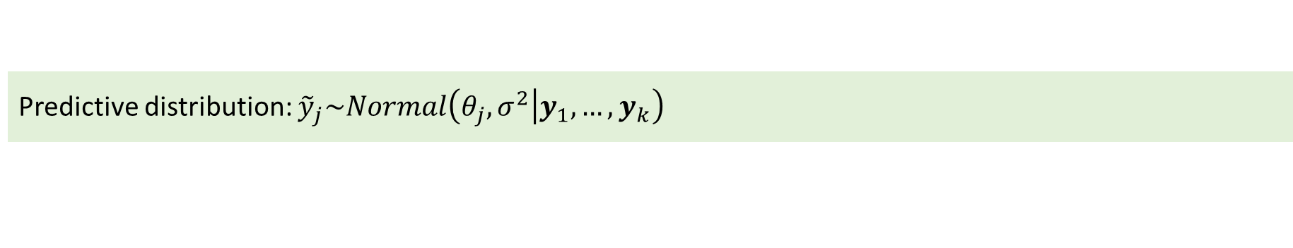
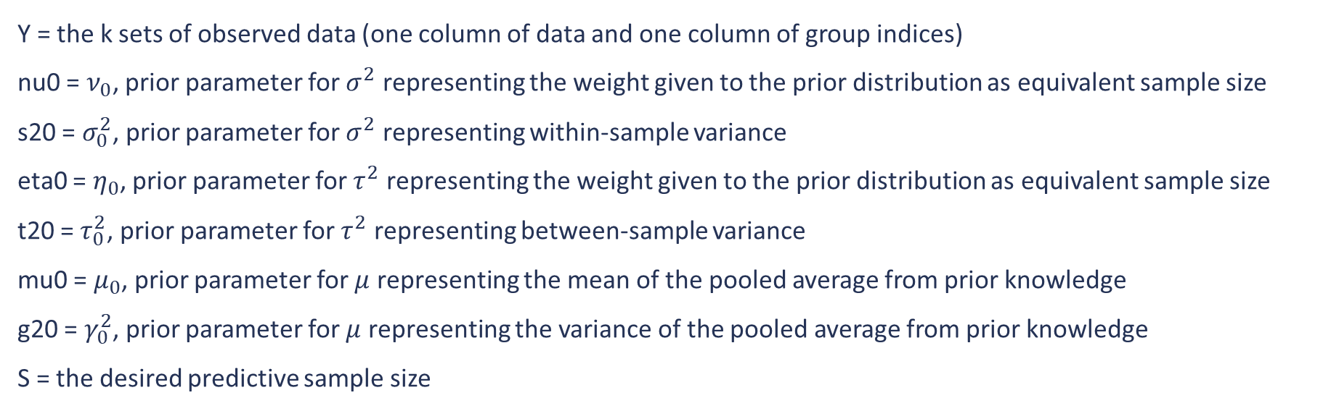
Normal-Inverse Gamma Model, 2-Sample: R function
Predictive distribution: ${\tilde{y}}_{j}\sim Normal\left(θ_{j},σ^{2}\left|y_{1},…, y_{k}\right.\right)$
Type | Function | Implementation
Predictive Sampler | rpredNormIGk(S,Y,nu0,s20,eta0,t20,mu0,g20) | Implements a Gibbs sampler
Y = the k sets of observed data (one column of data and one column of group indices)
nu0 = $ν_{0}$, prior parameter for $σ^{2}$ representing the weight given to the prior distribution as equivalent sample size
s20 = $σ_{0}^{2}$, prior parameter for $σ^{2}$ representing within-sample variance
eta0 = $η_{0}$, prior parameter for $τ^{2}$ representing the weight given to the prior distribution as equivalent sample size
t20 = $τ_{0}^{2}$, prior parameter for $τ^{2}$ representing between-sample variance
mu0 = $μ_{0}$, prior parameter for $μ$ representing the mean of the pooled average from prior knowledge
g20 = $γ_{0}^{2}$, prior parameter for $μ$ representing the variance of the pooled average from prior knowledge
S = the desired predictive sample size
Notes:
The predictive sampler, rpredNormIGk() implements a Gibbs sampler, as described.
The user supplies the prior parameter values.

Slide 33
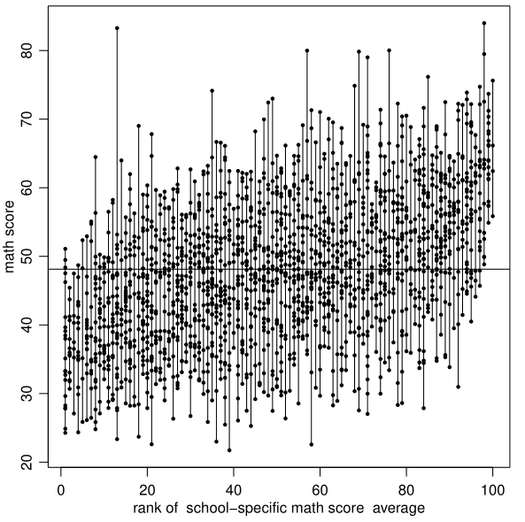
Normal-Inverse Gamma k-Sample Example: Math Scores, Comparing 100 Schools (Hoff)
Data: Math scores from 100 U.S. public high schools
Comparison of school averages:
Minimum individual school mean score: | School 5 | 36.58
Maximum individual school mean score: | School 67 | 65.02
Overall mean score (all schools): | -- | 48.13
Closest to overall mean: | School 92 | 48.18
Notes:
The Data in this example consists of math scores from 100 public US high schools, resulting from a test that was intended to produce a mean of 50 and a standard deviation of 10 points.
The vertical segments on the plot show the range of scores for each school. The segments are arranged from left to right in order of ascending mean.
The grand mean of all the scores is 48.18. The minimum and maximum school means, and the closest to the grand mean, are shown in the table.
Predictions are made for these schools on the next slide.

Slide 34
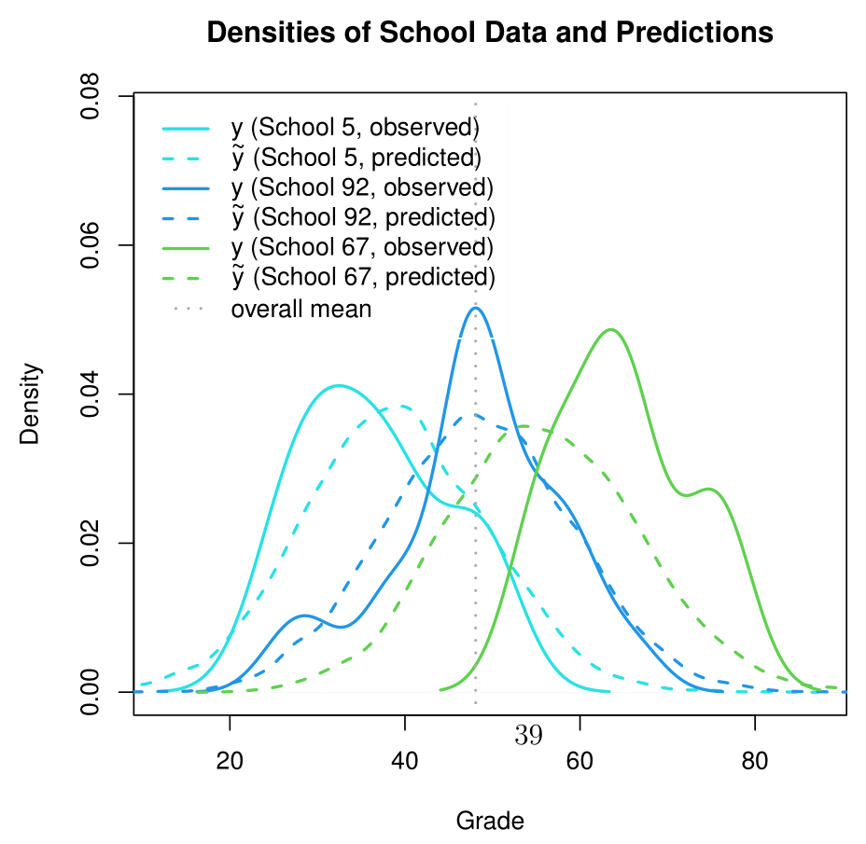
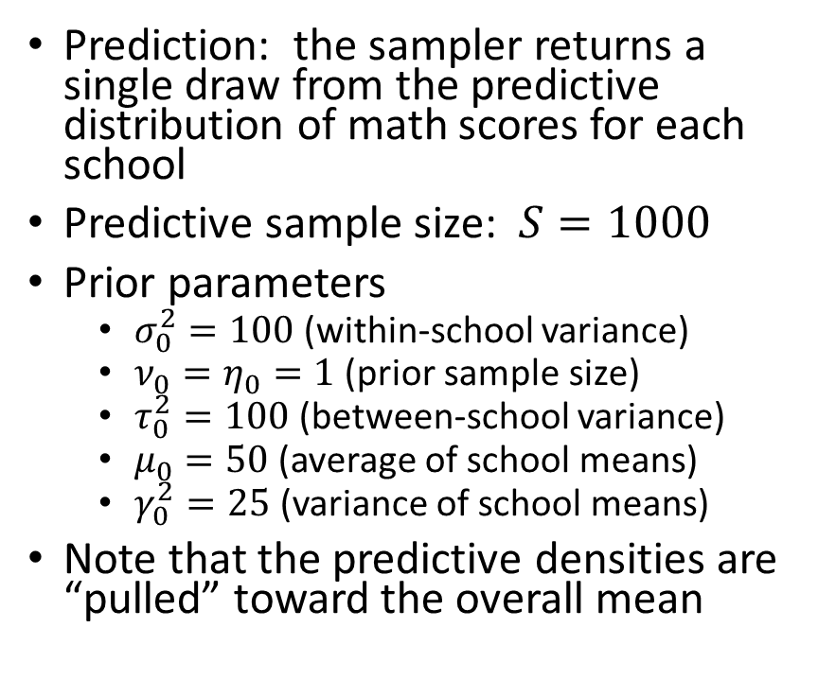
Normal-Inverse Gamma k-Sample Example: Math Scores, Comparing 100 Schools
Prediction: the sampler returns a single draw from the predictive distribution of math scores for each school
Predictive sample size: $S=1000$
Prior parameters
$σ_{0}^{2}=100$ (within-school variance)
$ν_{0}=η_{0}=1$ (prior sample size)
$τ_{0}^{2}=100$ (between-school variance)
$μ_{0}=50$ (average of school means)
$γ_{0}^{2}=25$ (variance of school means)
Note that the predictive densities are “pulled” toward the overall mean
Notes:
The predictive sampler returns a single draw from the predictive distribution of math scores for each school.
The prior parameter values reflect the test design.
The plot shows estimated data densities (in solid curves) and predictive densities (in dashed curves) for the three schools from the table on the previous slide.
The dotted vertical gray line indicates the grand mean math score.
Note that the predictive densities are “pulled” toward the overall mean, reflecting the shared mean of the prior on the group means.

Slide 35
Normal Regression Model

Slide 36

Normal Regression Model: Derivation
The Data: $Y_{1},…,Y_{N}$ where $Y_{i}= β^{T}x_{i}+ε_{i}$ and $ε_{i}\sim Normal\left(0,σ^{2}\right)$
We have $\left\{\left.y\right|X,β,σ^{2}\right\}\sim Multivariate Normal\left(Xβ,σ^{2}I\right)$
Here
$X={\left(x_{1},…,x_{N}\right)}^{T}$ with $x_{i}=\left\{x_{i,1},…,x_{i,p}\right\}$
$β={\left(β_{1},…,β_{p}\right)}^{T}$
$I$ is the $p×p$ identity matrix
We compute ordinary least squares estimates
${\hat{β}}_{ols}={\left(X^{T}X\right)}^{−1}X^{T}y$ (which minimizes the Sum of Squared Residuals, $SSR$)
${\hat{σ}}_{ols}^{2}=\frac{\sum{{\left(y_{i}−{\hat{β}}_{ols}^{T}x_{i}\right)}^{2}}}{\left(N−p\right)}=\frac{SSR\left({\hat{β}}_{ols}\right)}{\left(N−p\right)}$
Notes:
We have a standard Normal regression setup, with Multivariate Normal data,
design matrix,
coefficients,
and least squares estimates.
[IF ASKED: residuals are the differences between the data values and the regression line values. The coefficients beta^hat_ols minimize these differences giving us our regression line.]

Slide 37

Normal Regression Model: Derivation (with prior information)
The Prior Distributions
$β\sim Multivariate Normal\left(β_{0},Σ_{0}\right)$
$1/{σ^{2}}=γ\sim Gamma\left({ν_{0}}/2, {ν_{0}σ_{0}^{2}}/2\right)$
The Joint Posterior Distribution
$p\left(β\left|y,X,\right.σ^{2}\right)∝Multivariate Normal\left(m, V\right)$ where
$m={\left(Σ_{0}^{−1}+{X^{T}X}/{σ^{2}}\right)}^{−1}\left(Σ_{0}^{−1}β_{0}+{X^{T}y}/{σ^{2}}\right)$
$V=$ ${\left(Σ_{0}^{−1}+{X^{T}X}/{σ^{2}}\right)}^{−1}$
$p\left(σ^{2}\left|y,X,\right.β\right)\sim Inverse Gamma\left({\left[ν_{0}+N\right]}/2,{ν_{0}σ_{0}^{2}+SSR\left(β\right)}/2\right)$
Notes:
We can assign a prior Multivariate Normal distribution to beta (the coefficient vector)
…and an inverse gamma distribution to the variance.
The beta posterior is Normal,
…and the variance posterior is again Inverse Gamma.

Slide 38

Normal Regression Model: Derivation (with prior information, continued)
The Predictive Distribution can be approximated using a Gibbs sampler
Choose initial values $β^{(1)}$and $σ^{2(1)}$
Generate new values from the joint posterior for each $s ε \left\{1,…,S\right\}$
Compute $m^{(s)}$ and $V^{(s)}$
Sample $β^{(s+1)}\sim Multivariate Normal\left(m^{(s)}\text{,} V^{(s)}\right)$
Compute $SSR\left(β^{(s+1)}\right)$
Sample $σ^{2(s+1)}\sim Inverse Gamma\left({\left[ν_{0}+N\right]}/2,{ν_{0}σ_{0}^{2}+SSR\left(β^{(s+1)}\right)}/2\right)$
Then for the predictive sample, for each $s ε \left\{1,…,S\right\}$
Draw $ε^{(s)}\sim Normal\left(0,σ^{2(s)}\right)$
Compute ${\tilde{y}}^{(s)}=$ $β^{\left(s\right)T}X+ε^{(s)}$
Notes:
The Predictive Distribution is approximated with a Gibbs Sampler: First choose initial values for beta and sigma^2.
Generate new values for m and V from the joint posterior and sample a beta using these values.
Compute the sum of squared residuals at the generated beta. Then sample a sigma^2 value using the beta and SSR.
For the predictive sample, draw an error term from the normal distribution centered at 0 and generated variance.
Then compute y~

Slide 39

Normal Regression Model: Derivation (using Zellner’s “g-prior”)
The Prior Distributions
Zellner’s “g-prior”: choose $β_{0}=0, Σ_{0}=k{\left(X^{T}X\right)}^{−1}$, with $k=gσ^{2}$, $g>0$
➔ $m={\frac{g}{g+1}σ^{2}\left(X^{T}X\right)}^{−1}X^{T}y$ , $V={\frac{g}{g+1}σ^{2}\left(X^{T}X\right)}^{−1}$
The Joint Posterior Distribution
$p\left(σ^{2}\left|y,X\right.\right)\sim Inverse Gamma\left({\left[ν_{0}+N\right]}/2,{ν_{0}σ_{0}^{2}+{SSR}_{g}}/2\right)$
${SSR}_{g}=y^{T}y−m^{T}V^{−1}m=y^{T}\left(I−\frac{g}{g+1}X{\left(X^{T}X\right)}^{−1}X^{T}\right)y$
$p\left(β\left|y,X,σ^{2}\right.\right)\sim Multivariate Normal\left(\frac{g}{g+1}{\hat{β}}_{ols},{\frac{g}{g+1}σ^{2}\left(X^{T}X\right)}^{−1}\right)$
Notes:
A “default and weakly informative” prior is offered by Zellner, limiting the needed prior parameter specification.
Set the initial coefficients vector and variance-covariance matrix to these values, and the expressions of M and V reduce to the ones shown here.
The posterior for the variance is this Inverse Gamma, and
…the posterior for the coefficients is this Multivariate Normal

Slide 40

Normal Regression Model: Derivation (without prior information, continued)
The Predictive Distribution can be approximated using Monte Carlo sampling:
Draw $σ^{2}\sim Inverse Gamma\left({\left[ν_{0}+N\right]}/2,{ν_{0}σ_{0}^{2}+{SSR}_{g}}/2\right)$
Draw $β\sim Multivariate Normal\left(\frac{g}{g+1}{\hat{β}}_{ols},{\frac{g}{g+1}σ^{2}\left(X^{T}X\right)}^{−1}\right)$
$\text{Draw} ϵ \sim Normal\left(0,σ^{2}\right)$
Then set $\tilde{y}=β^{T}X$ + $ϵ$
Notes:
The predictive distribution can be approximated using Monte Carlo sampling:
Draw sigma^2
Draw Beta
Draw the error term.
Compute y~

Slide 41
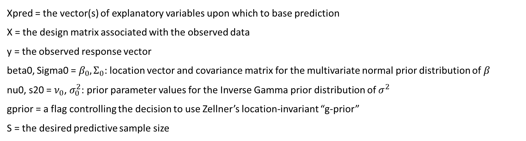
Normal-Inverse Gamma Model, 2-Sample: R function
Predictive distribution: $\tilde{y}=β^{T}X\text{ +} ϵ$
Type | Function | Implementation
Predictive Sampler | rpredNormReg(S,Xpred,X,y,beta0,Sigma0,nu0,s20,gprior) | Implements a Gibbs sampler (if gprior = 0) or Monte Carlo sampling (if gprior = 1)
Xpred = the vector(s) of explanatory variables upon which to base prediction
X = the design matrix associated with the observed data
y = the observed response vector
beta0, Sigma0 = $β_{0},Σ_{0}$: location vector and covariance matrix for the multivariate normal prior distribution of $β$
nu0, s20 = $ν_{0}$, $σ_{0}^{2}$: prior parameter values for the Inverse Gamma prior distribution of $σ^{2}$
gprior = a flag controlling the decision to use Zellner’s location-invariant “g-prior”
S = the desired predictive sample size
Notes:
The predictive sampler rpredNormReg() implements a Gibbs sampler, OR simple Monte Carlo if the gprior flag is set to 1.
The user provides the data, the value(s) for which prediction is desired, the prior parameter values, and a 1 or 0 for the flag “gprior” depending on which method is desired.

Slide 42
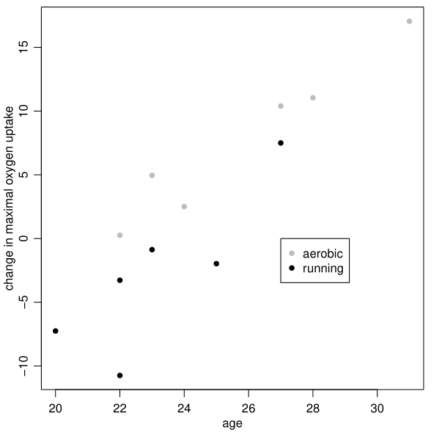
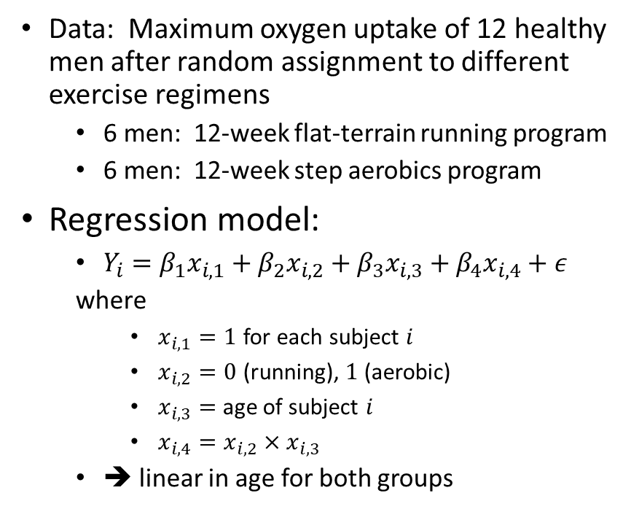
Normal Regression Example: Oxygen Uptake (Hoff)
Data: Maximum oxygen uptake of 12 healthy men after random assignment to different exercise regimens
6 men: 12-week flat-terrain running program
6 men: 12-week step aerobics program
Regression model:
$Y_{i}=β_{1}x_{i,1}+β_{2}x_{i,2}+β_{3}x_{i,3}+β_{4}x_{i,4}+ε$
where
$x_{i,1}=1$ for each subject $i$
$x_{i,2}=0$ (running), $1$ (aerobic)
$x_{i,3}=$ age of subject $i$
$x_{i,4}=x_{i,2}×x_{i,3}$
➔ linear in age for both groups
Notes:
This example is also from Hoff.
12 men were assigned to exercise programs, randomly split: 6 to a running program and 6 to a step-aerobics program, each for 12 weeks.
At the beginning and end of the program, oxygen uptake was measured for each of the subjects.
Hoff’s regression model incorporates age, and accounts for exercise program.
A plot of the change in oxygen uptake versus age is shown here.

Slide 43
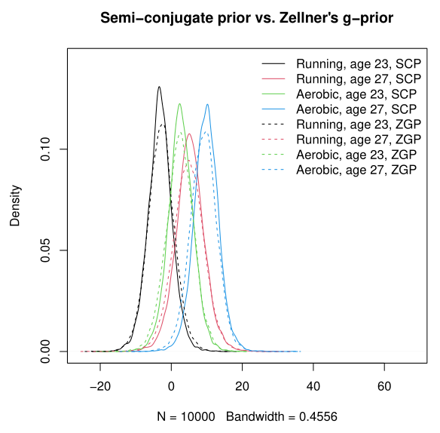
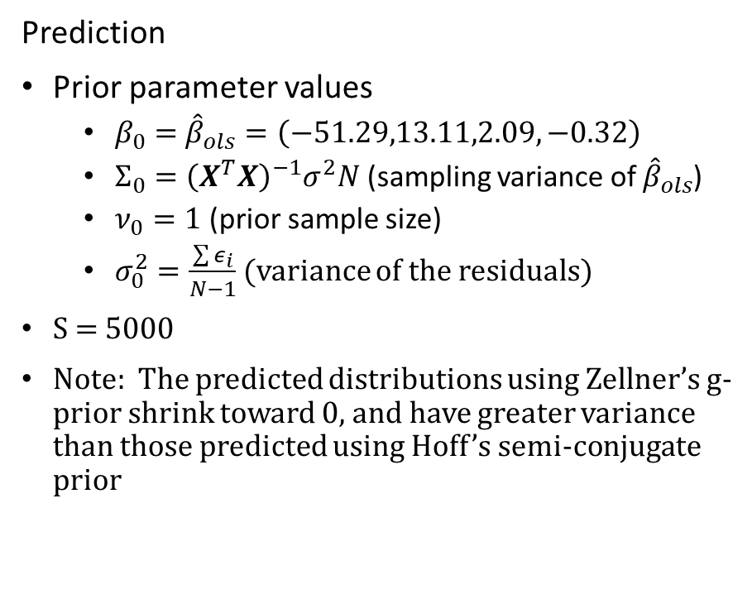
Normal Regression Example: Oxygen Uptake (Hoff)
Prediction
Prior parameter values
$β_{0}=$ ${\hat{β}}_{ols}=\left(−51.29,13.11,2.09,−0.32\right)$
$Σ_{0}={\left(X^{T}X\right)}^{−1}σ^{2}N$ (sampling variance of ${\hat{β}}_{ols}$)
$ν_{0}=1$ (prior sample size)
$σ_{0}^{2}=\frac{\sum{ε_{i}}}{N−1}$ (variance of the residuals)
S = 5000
Note: The predicted distributions using Zellner’s g-prior shrink toward 0, and have greater variance than those predicted using Hoff’s semi-conjugate prior
Notes:
Hoff uses the ordinary least squares estimator for the initial beta0 value, and its sampling variance for Sigma0.
nu0 = 1, which Hoff refers to as prior sample size, and sigma_0^2 is set to the variance of the residuals.
The plot shows predictive distributions for future subjects of ages 23 and 27, for both exercise programs.
Solid curves represent Hoff’s semi-conjugate priors using previous knowledge.
Dashed curves represent predictive distributions based on Zellner’s g-prior.
Note that Zellner’s g-prior distributions shrink toward 0, and have greater variance than those predicted using Hoff’s semi-conjugate prior.

Slide 44
Conclusions
Predictive inference is important, but hampered by a lack of tools
I have developed a set of functions for some standard models to make prediction easier
These tools will be available on the Comprehensive R Archive Network (CRAN) in a forthcoming R package

Slide 45
Backup

Slide 46
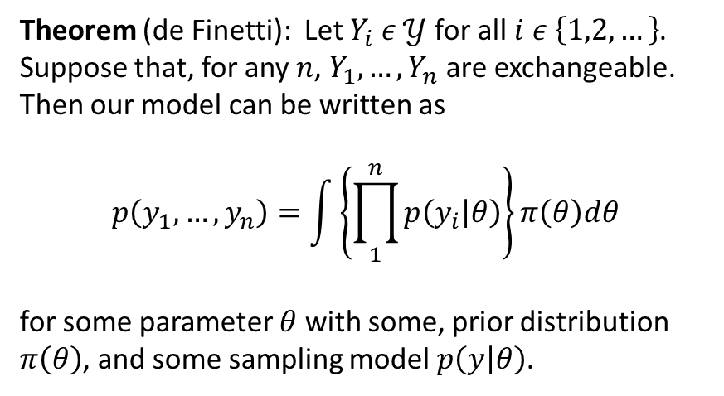
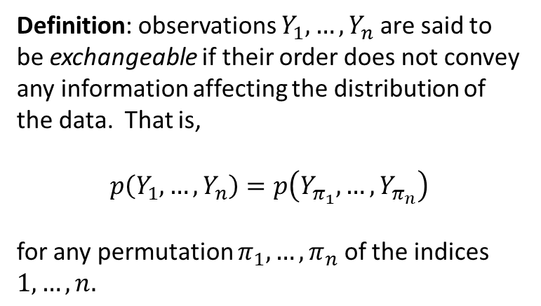
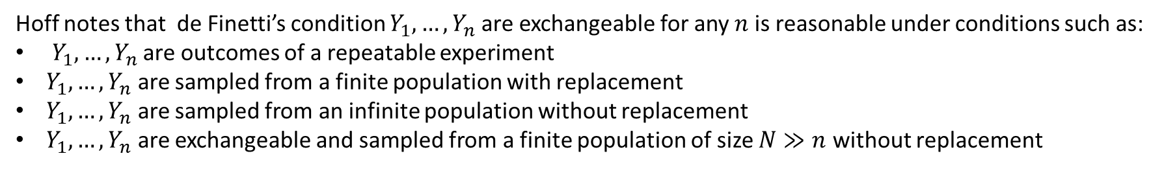
Exchangeability and de Finetti’s theorem
Backup Section
Definition: observations $Y_{1},…, Y_{n}$ are said to be exchangeable if their order does not convey any information affecting the distribution of the data. That is,
$$p\left(Y_{1},…, Y_{n}\right)=p\left(Y_{π_{1}},…, Y_{π_{n}}\right)$$
for any permutation $π_{1},…, π_{n}$ of the indices $1,…,n.$
Theorem (de Finetti): Let $Y_{i} ε 𝒴$ for all $i ε \left\{1,2,…\right\}$. Suppose that, for any $n$, $Y_{1},…, Y_{n}$ are exchangeable. Then our model can be written as
$$p\left(y_{1},…, y_{n}\right)=\int{\left\{\prod_{1}^{n}{p\left(y_{i} | θ\right)}\right\}}π\left(θ\right)dθ$$
for some parameter $θ$ with some, prior distribution $π\left(θ\right)$, and some sampling model $p\left(y | θ\right)$.
Hoff notes that de Finetti’s condition $Y_{1},…, Y_{n}$ are exchangeable for any $n$ is reasonable under conditions such as:
$Y_{1},…, Y_{n}$ are outcomes of a repeatable experiment
$Y_{1},…, Y_{n}$ are sampled from a finite population with replacement
$Y_{1},…, Y_{n}$ are sampled from an infinite population without replacement
$Y_{1},…, Y_{n}$ are exchangeable and sampled from a finite population of size $N≫n$ without replacement
We assume exchangeability of the data throughout this thesis.

Slide 47
Normal-Inverse Gamma Model: 2-Sample

Slide 48

Normal-Inverse Gamma Model, 2-Sample: Derivation
The Data: two exchangeable groups $Y_{1,1},…, Y_{N_{1},1}$ and $Y_{1,2},…, Y_{N_{1},2}$
Sampling model $Y_{i,1}=μ+δ+ε_{i,1}$, $Y_{i,2}=μ+δ+ε_{i,2}$, $ε_{i,j}$ $\sim i.i.d. Normal\left(0,σ^{2}\right)$
The Prior Distributions
$μ\sim Normal\left(μ_{0},γ_{0}^{2}\right)$
$δ\sim Normal\left(δ_{0},τ_{0}^{2}\right)$
$σ^{2}\sim Inverse Gamma\left({ν_{0}}/2, {ν_{0}σ_{0}^{2}}/2\right)$
The Joint Posterior Distribution
$\left\{{\left.σ^{2}\right|y}_{1}, y_{2},μ,δ\right\}$ $\sim Inverse Gamma\left(\frac{ν_{N}}{2},\frac{ν_{N}σ_{N}^{2}}{2}\right)$; $ν_{N}=ν_{0}+N_{1}+N_{2}$; $ν_{N}σ_{N}^{2}=\sum_{i=1}^{N_{1}}{{\left(y_{i,1}−\left[μ+δ\right]\right)}^{2}}+\sum_{i=1}^{N_{1}}{{\left(y_{i,2}−\left[μ−δ\right]\right)}^{2}}$
$\left\{\left.μ\right|y_{1}, y_{2},δ,σ^{2}\right\}$ $\sim Normal\left(μ_{N},γ_{N}^{2}\right)$; $γ_{N}^{2}={\left[\frac{1}{γ_{0}^{2}}+\frac{\left(N_{1}+N_{2}\right)}{σ^{2}}\right]}^{−1}$, $μ_{N}=γ_{N}^{2}\left[\frac{μ_{0}}{γ_{0}^{2}}+\frac{\sum_{i=1}^{N_{1}}{\left(y_{i,1}−δ\right)}+\sum_{i=1}^{N_{1}}{\left(y_{i,2}+δ\right)}}{σ^{2}}\right]$
$\left\{{\left.δ\right|y}_{1}, y_{2},μ,σ^{2}\right\}$ $\sim Normal\left(δ_{N},τ_{N}^{2}\right)$; $τ_{N}^{2}={\left[\frac{1}{τ_{0}^{2}}+\frac{\left(N_{1}+N_{2}\right)}{σ^{2}}\right]}^{−1}$, $δ_{N}=τ_{N}^{2}\left[\frac{δ_{0}}{τ_{0}^{2}}+\frac{\sum_{i=1}^{N_{1}}{\left(y_{i,1}−μ\right)}+\sum_{i=1}^{N_{1}}{\left(y_{i,2}−μ\right)}}{σ^{2}}\right]$

Slide 49

Normal-Inverse Gamma Model, 2-Sample: Derivation (continued)
The Predictive Distribution can be approximated by means of a Gibbs sampler, as follows.
Set initial values $μ=\frac{θ_{1}+θ_{2}}{2}$, $δ=\frac{θ_{1}−θ_{2}}{2}$
Note: letting $θ_{1}=μ+δ$, $θ_{2}=μ−δ$, we see that $δ={\left(θ_{1}−θ_{2}\right)}/2$ is half the population difference in means, and $μ={\left(θ_{1}−θ_{2}\right)}/2$ is the pooled average
Generate ${\left.σ^{2}\right|y}_{1}, y_{2},μ,δ \sim Inverse Gamma\left(\frac{ν_{N}}{2},\frac{ν_{N}σ_{N}^{2}}{2}\right)$
Generate updated $\left.μ\right|y_{1}, y_{2},δ,σ^{2} \sim Normal\left(μ_{N},γ_{N}^{2}\right)$
Generate updated ${\left.δ\right|y}_{1}, y_{2},μ,σ^{2 }\sim Normal\left(δ_{N},τ_{N}^{2}\right)$
Generate ${\tilde{y}}_{1}\sim Normal\left(μ+δ,σ^{2}\right)$ and ${\tilde{y}}_{2}\sim Normal\left(μ−δ,σ^{2}\right)$

Slide 50
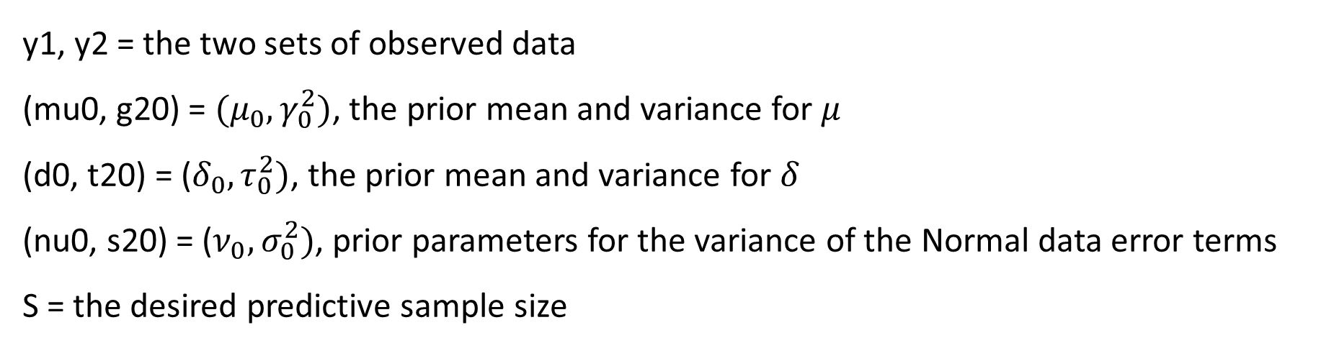
Normal-Inverse Gamma Model, 2-Sample: R function
Predictive distribution: ${\tilde{y}}_{1}\sim Normal\left(μ+δ,σ^{2}\right),$ ${\tilde{y}}_{2}\sim Normal\left(μ−δ,σ^{2}\right)$
Type | Function | Implementation
Predictive Sampler | rpredNormIG2(S,y1,y2,mu0,g20,d0,t20,nu0,s20) | Implements a Gibbs sampler
y1, y2 = the two sets of observed data
(mu0, g20) = $(μ_{0},γ_{0}^{2})$, the prior mean and variance for $μ$
(d0, t20) = ($δ_{0},τ_{0}^{2})$, the prior mean and variance for $δ$
(nu0, s20) = ($ν_{0},σ_{0}^{2})$, prior parameters for the variance of the Normal data error terms
S = the desired predictive sample size

Slide 51
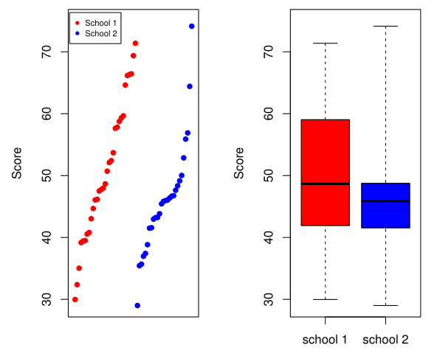
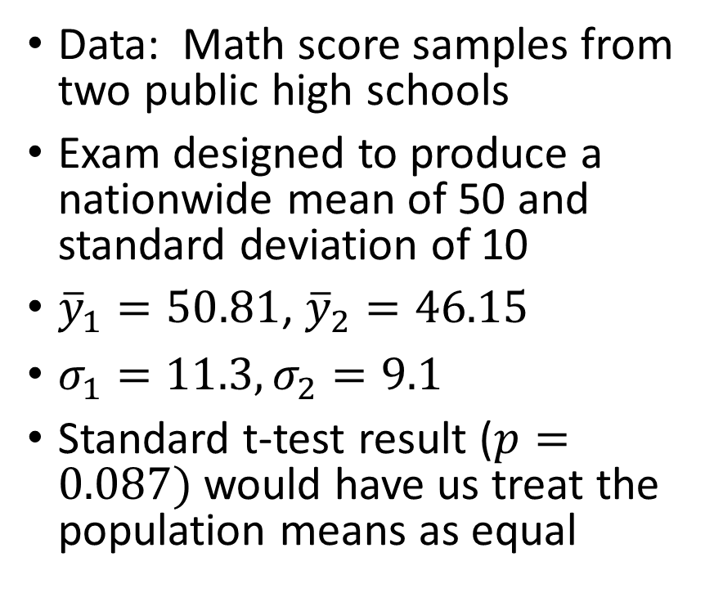
Normal-Inverse Gamma 2-Sample Example: Math Scores, Comparing Two Schools (Hoff)
Data: Math score samples from two public high schools
Exam designed to produce a nationwide mean of 50 and standard deviation of 10
${\overline{y}}_{1}=50.81$, ${\overline{y}}_{2}=46.15$
$σ_{1}=11.3, σ_{2}=9.1$
Standard t-test result ($p=0.087)$would have us treat the population means as equal

Slide 52
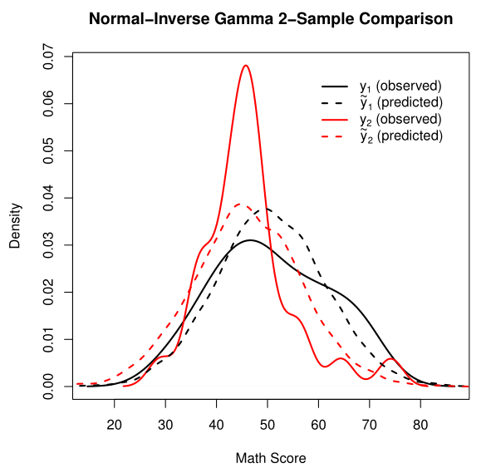
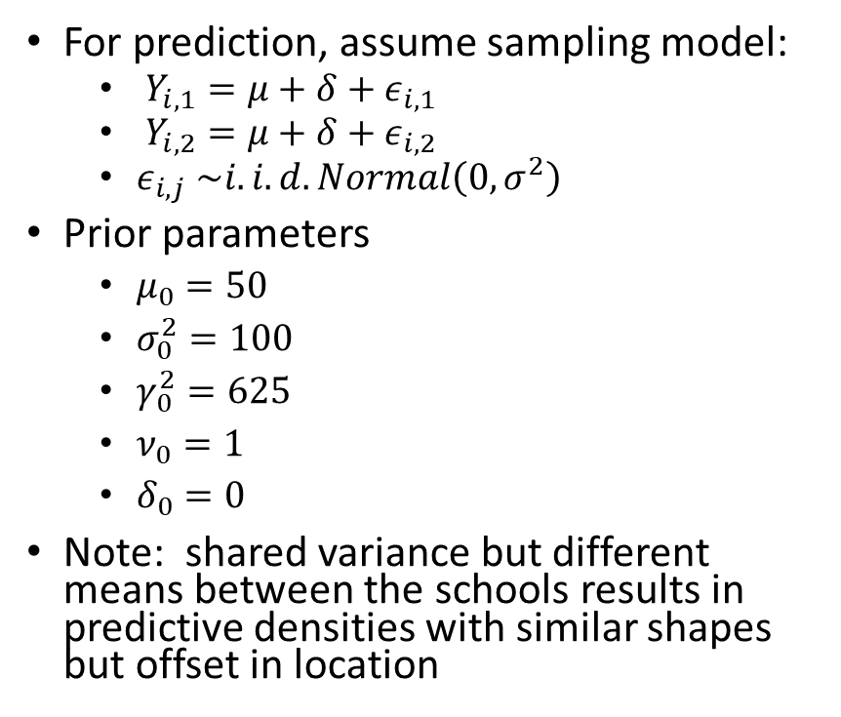
Normal-Inverse Gamma 2-Sample Example: Math Scores, Comparing Two Schools
For prediction, assume sampling model:
$Y_{i,1}=μ+δ+ε_{i,1}$
$Y_{i,2}=μ+δ+ε_{i,2}$
$ε_{i,j}$ $\sim i.i.d. Normal\left(0,σ^{2}\right)$
Prior parameters
$μ_{0}=50$
$σ_{0}^{2}=100$
$γ_{0}^{2}=625$
$ν_{0}=1$
$δ_{0}=0$
Note: shared variance but different means between the schools results in predictive densities with similar shapes but offset in location

Slide 53
Zellner

Slide 54
Gibbs Sampler

