Slide 1
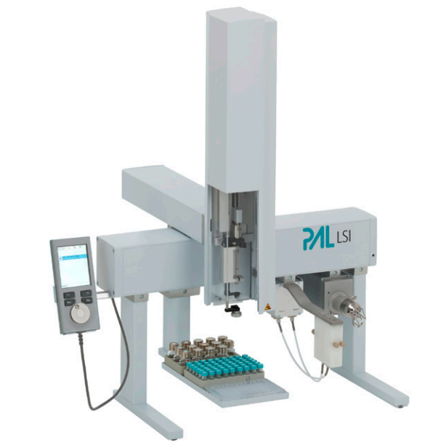
Dry carrier
g
Micropump
Vaporiser
Cavity
Tubing
?
Connection
PAL Needle
Sample

