Slide 1
Handwritten Character Recognition
CVML - 2024
Team Members:
1.Manab Behera
2.V.G.Krishna Aditya
3.Sukanya Choudhury
4.Siba Prasad Sahu
5.Deepak Nayak

Slide 2
Project Objective
OBJECTIVE : Aims to tackle the challenge of handwriting recognition using advanced techniques in computer vision and machine learning
The primary objective of this project is to develop an efficient and accurate system for recognizing hand written characters , digits , and symbols .By leveraging the power of convolutional Neural Network(CNN) and support vector machines(SVMs) .
The goal is to create a solution that can reliably and efficiently process handwritten inputs , paving the way for numerous applications in fields such as document processing ,digital archiving and human computer interaction.

Slide 3
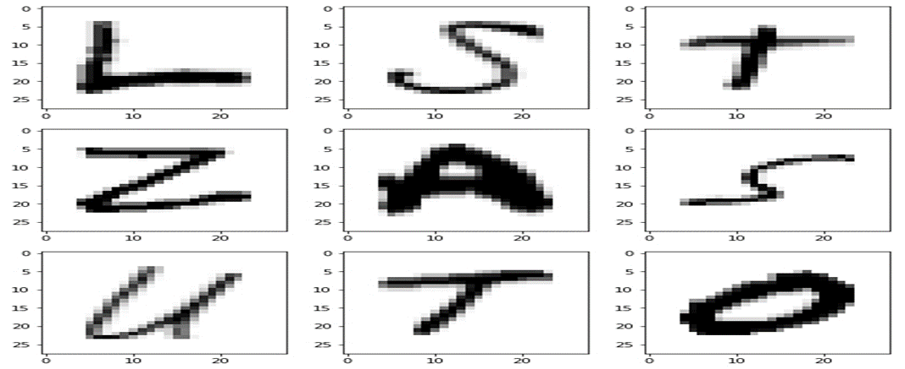
Sample Dataset
For handwritten character recognition we have taken handwritten images of digits , alphabets and special characters from the source (https://www.kaggle.com/datasets/nibinv23/iam-handwriting-word-database)

Slide 4
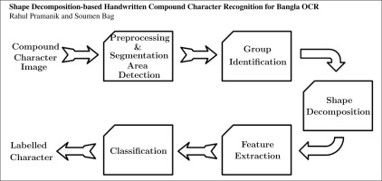
CNN Architecture for Handwritting recognition
DATA Collection and Preprocessing
The project will begin with the collection of and preprocessing of a diverse data set of handwritten samples . This crucial step will involve techniques such as image segmentation ,normalization ,and feature extraction to prepare the data for model training.

Slide 5
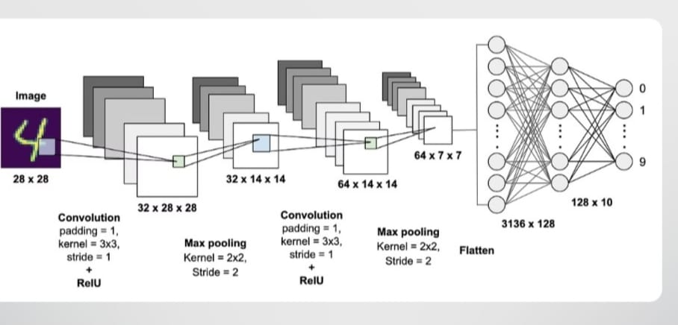
CNN Architecture for Handwritting recognition
CNN Model Design
The team will design a tailored Convolutional Neural Network architecture that can effectively capture the unique characteristics of hand written patterns. The network will consist of multiple convolutional ,polling , and fully connected layers,optimized to achieve high accuracy in character and digit recognition.c

Slide 6
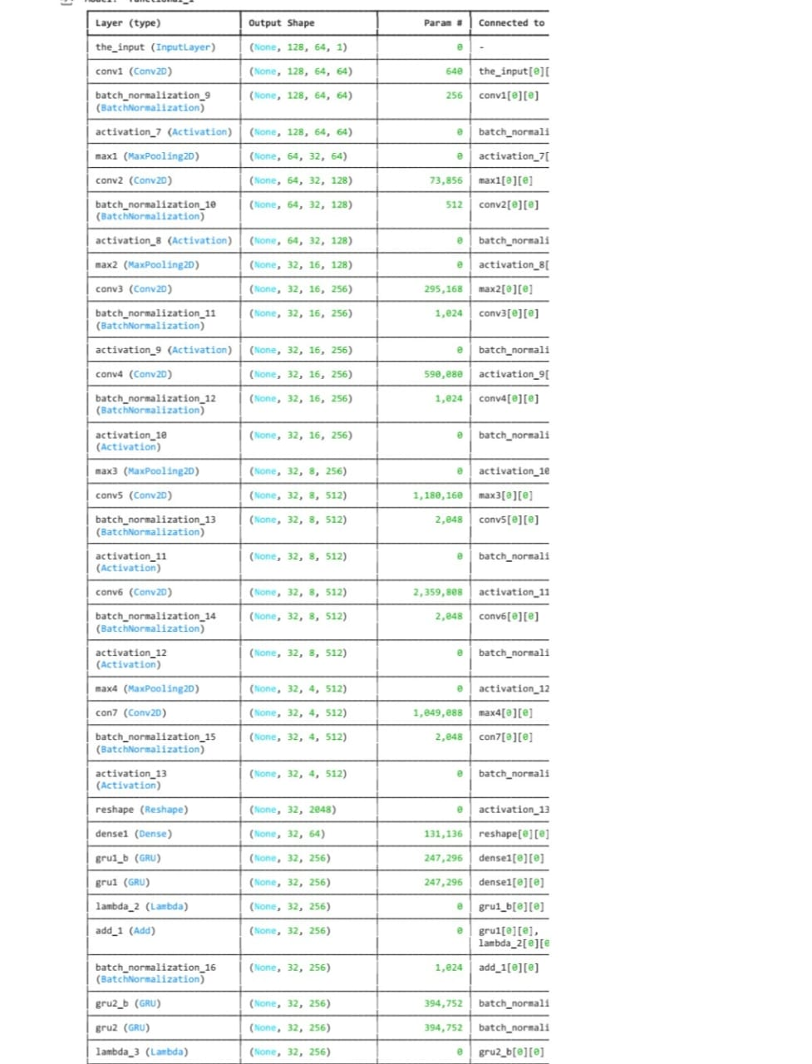
CNN Architecture for Handwritting recognition

Slide 7
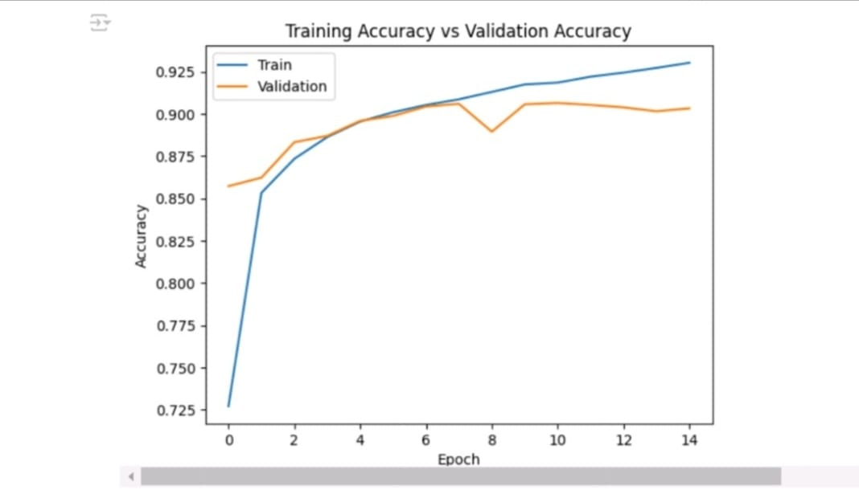
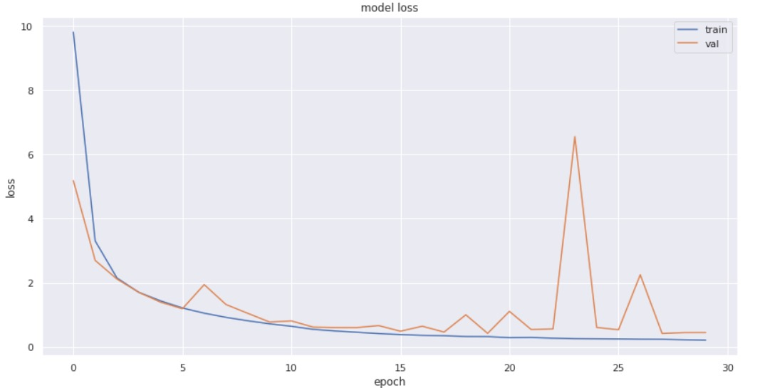
CNN Architecture for Handwritten Recognition
Training and Evaluation
The CNN model will undergo rigorous training on the prepared dataset, using techniques such as data augmentation and regularization to enhance its performance. The team will evaluate the model’s accuracy , precision , recall using appropriate metrics to ensure its effectiveness in real world scenarios.

Slide 8
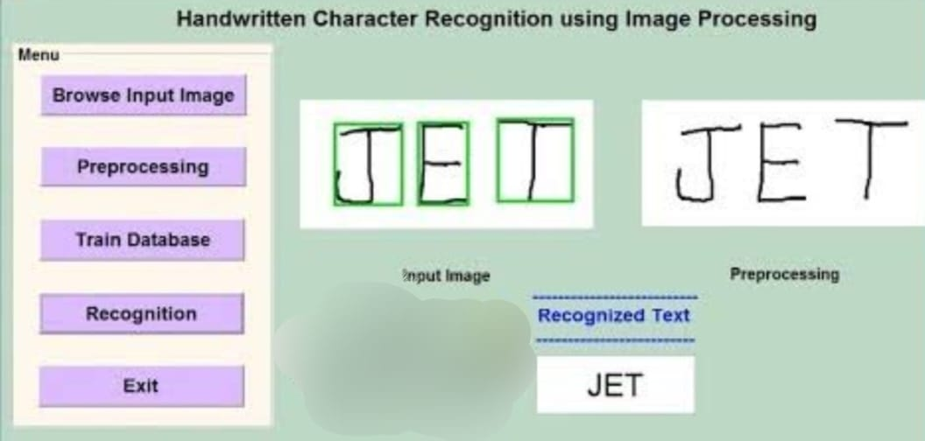
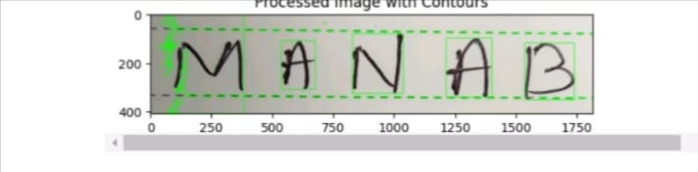
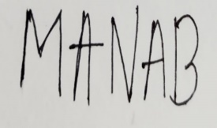
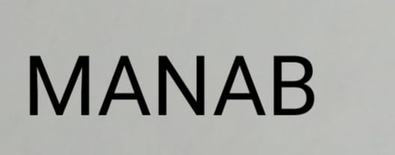
Result Analysis
After dataset collection and preprocessing the model was introduced towards training of handwritten digits , characters , special characters and others by giving approx. 30 epochs to it.as result to this the model was trained with an accuracy of approx. 94% under training dataset.
With 94% accuracy when the model was introduced for testing of user’s
Handwritting ,the model is able to detect the characters present in the text with some noises.That may be due to training with 94% accuracy.

Slide 9
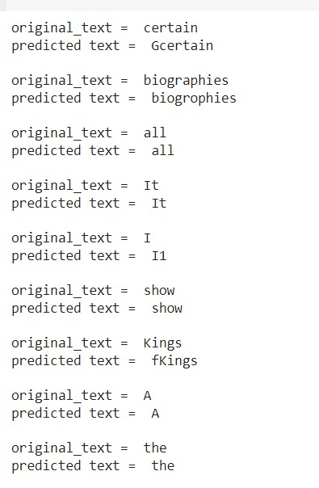
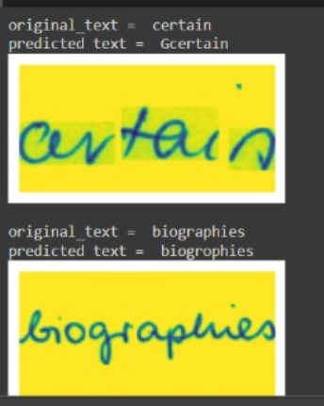
Result Analysis
Similarly, here are some other predicted outputs for their respected inputs!

Slide 10
Thank You

