Slide 1
FINAL PROJECT: Portfolio

Slide 2
Concept
… a portfolio site!
So I’m in the process of applying to a couple of different schools to transfer into for the Fall of 2016; I’d like to attend an art school with an animation program
I thought that including a link to my portfolio online would be a nice addition to the applications.

Slide 3
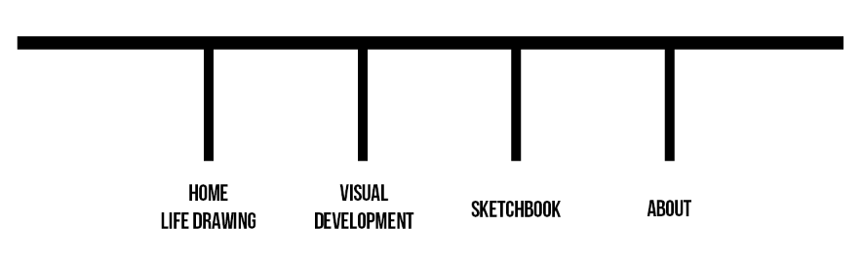
Sitemap
Currently, I plan on having four pages (although I’m considering a landing page if I have the time)
Divided content based on what the applications are looking for; most of what I have to submit is life drawing, but also some visual development (like character design, storyboards, other digital arts), and a sketchbook

Slide 4
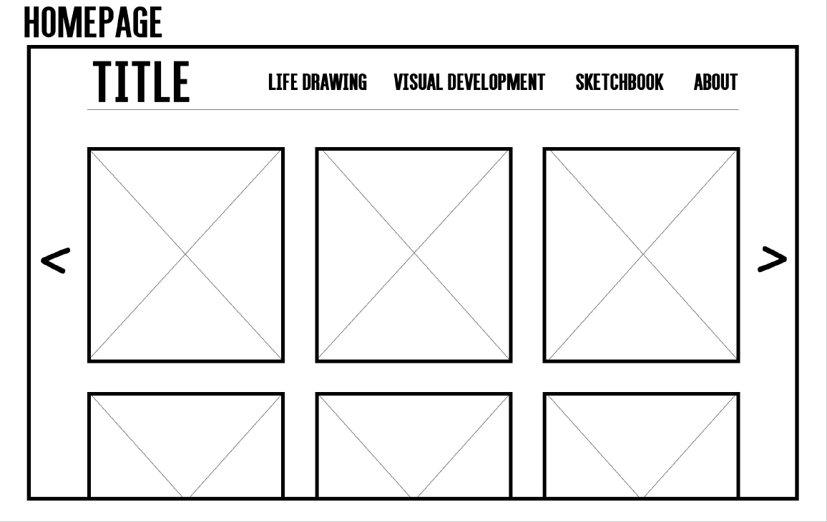
Wireframes
Notes:
The pages with content all have the same layout.
Wanted something basic

Slide 5
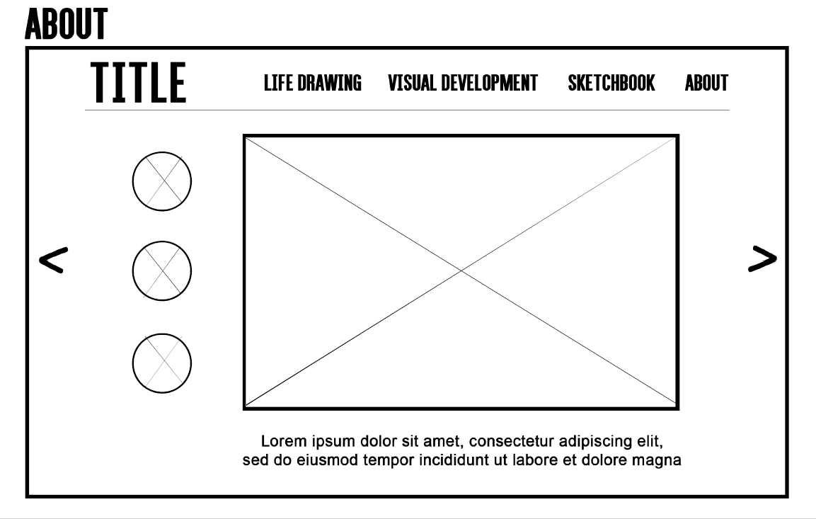

Slide 6
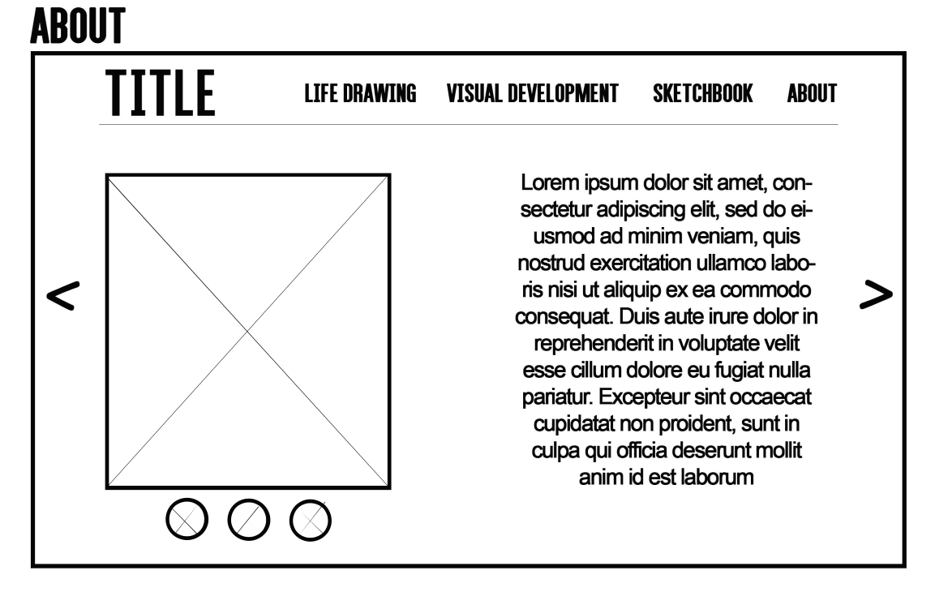

Slide 7
#aesthetic
Wanted something pretty basic that wouldn’t stand out, so the site itself wouldn’t compete with the content
Wanted the other images to be kind of cartoony to contrast the minimalism of the rest of the site (still playing with designs though)
COLORS:
White (#ffffff) – background
Dark grey (#62626) – header/ footer text
Blue (#00c5f7) – main color for favicon, logo, social media buttons
FONTS:
Helvetica – links in navigation
Futura Pt – text

Slide 8
Process
For the midterm, I had my first attempts at the Life Drawing and Visual Development pages up
Was still messing with the navigation bar
Took a while to get Lightbox working
Since then, I’ve:
Squished everything (which fixed some of the problems I was having with the page layouts – too much space -- but now there’s a lot of white space on the sides instead?)
the Sketchbook page
Began coding About page
Moved the CSS and JavaScript from the HTML into their own files
Fixed the padding in the navigation bar align it with the rest of the page
Added a span in between the links
Made the padding 35px so that they’d take up more horizontal space without changing the font size
Changed the width of the div from 80% to 95%?
Notes:
- Added "letter-spacing" in the CSS of "#nav" (3px) so that the links would take up more space without making the font bigger
- Added a span ("navspace") in between the links in the HTML and made the padding 35px in the CSS, so that they'd take up more horizontal space
- Changed the "width" in "#nav" from 80% to 95%, and I have no idea why it worked but it did?

Slide 9
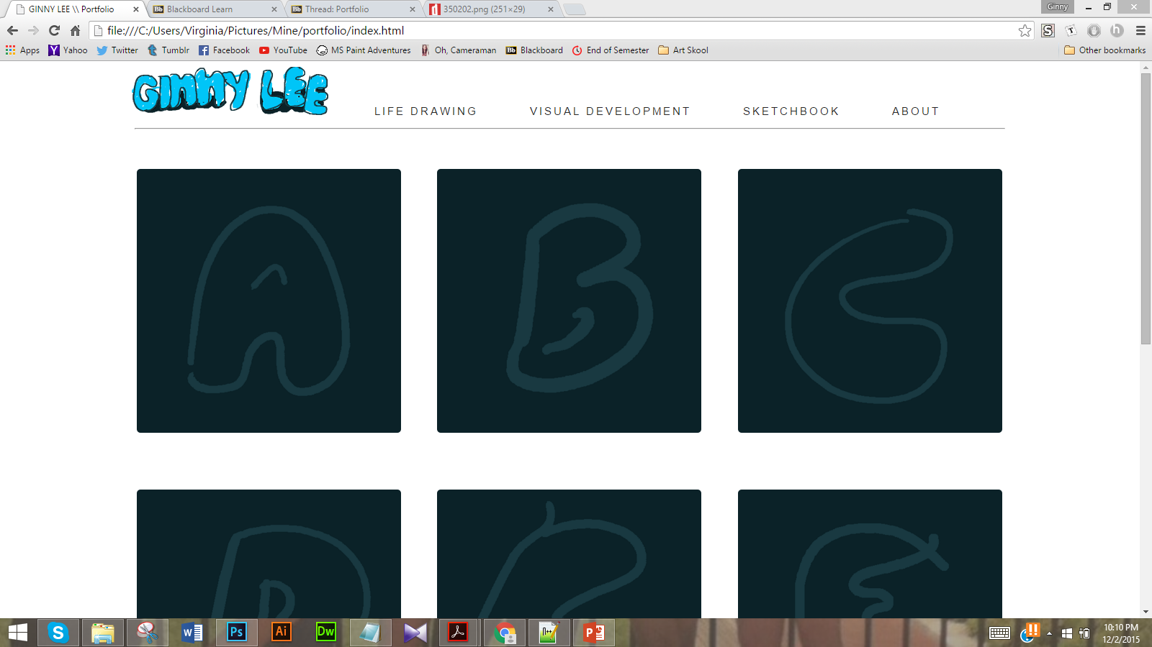

Slide 10
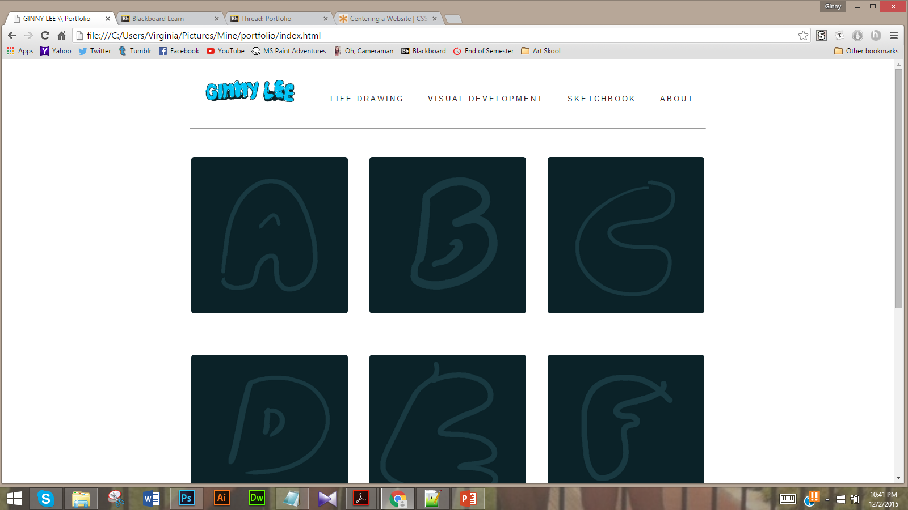

Slide 11
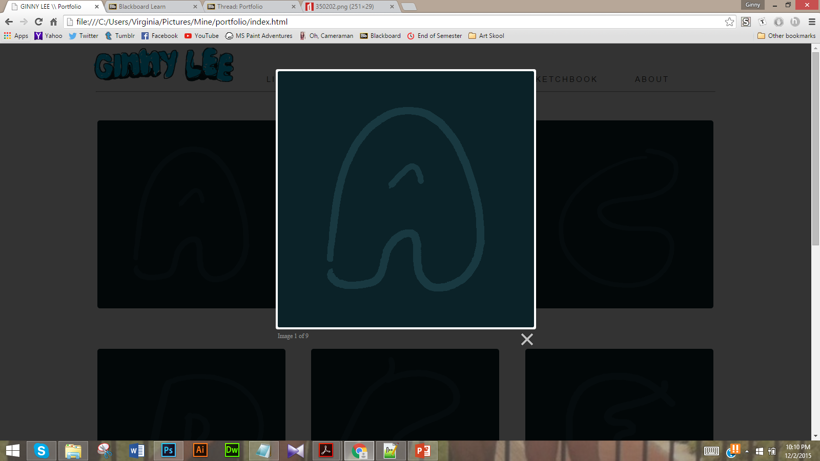

Slide 12
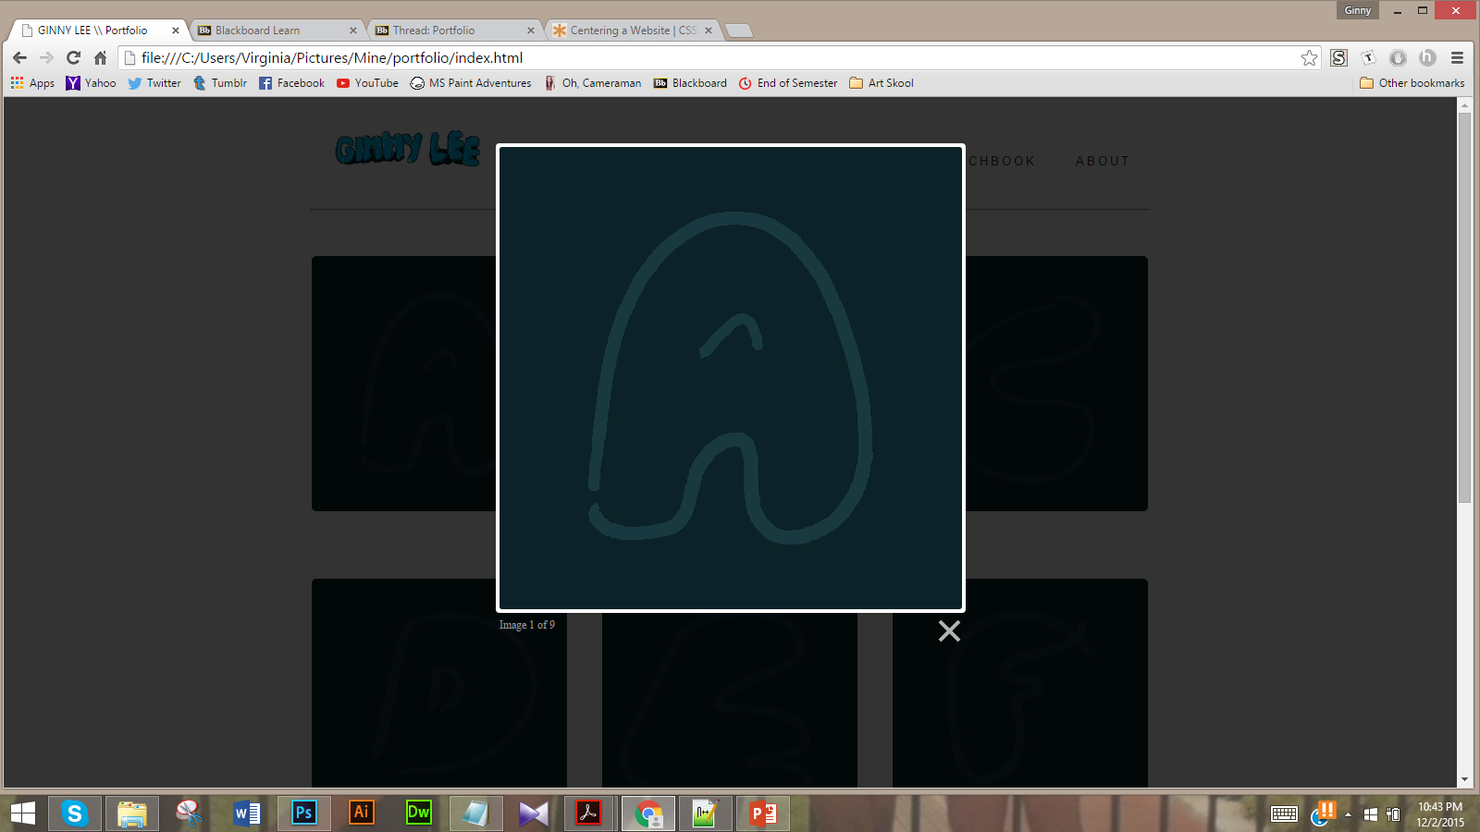

Slide 13
TO DO (12/2/2015):
Upload content
Finish coding About page
Upload to GitHub
Figure out why the navigation bar is further right on the about page than on the other pages (the code for this is the same across the board so? Why is this even happening?)
Replace logo with somethin’ better
Add social media buttons, favicon, etcetera
Page responsiveness (mostly just the navigation)
Landing page (optional) -- background would be a gif

