Slide 1
Towards Prediction of Query Execution Time
Handling Scan Operators
Vishal Goel
14 Nov 2019

Slide 2
Why Predict Query Execution Time?
To tell when the user should come to get the results of a query
To pick the query plan with the least cost (Query Optimisation)
To schedule queries in a workload
To pick the right environment for query execution by predicting time on all available environments
1

Slide 3

How do DBMSs predict query execution time?
Cardinality Estimation Model: Estimates number of output tuples at each operator
Cost Model: Estimates time that will be spent in each operator
Cardinality estimation model
Query
Query
Plan
+ Predicted Execution Time
of the plan
Cost model = f(cardinality, system config, ..)
PostgreSQL’s Cost Model
Cost of each operator $\left(Co\right)=nTc$
$$c=\left[cs, cr, ct, ci, co\right]T, n=\left[ns, nr, nt, ni, no\right]T$$
where
$cs$: I/O cost to sequentially access a page
$cr:$I/O cost to randomly access a page
$ct$: CPU cost to process a relation tuple
$ci$: CPU cost to process an index tuple
$co$: CPU cost to perform an operation like hash and aggregation
2

Slide 4

Evidence of Bad Cost Modeling (PostgreSQL)
Tuning* cost parameters fixed the predictions!
IMDB database
SELECT *
FROM title t,
movie_keyword mk
WHERE t.id = mk.movie_id AND
mk.keyword_id = 335
Estimated time: 4 sec
Actual time: 81 sec
Merge Join
PostgreSQL
Index scan
$σ$(Bitmap heap scan)
t
mk
SELECT *
FROM title t,
cast_info ci,
movie_keyword mk
WHERE t.id = mk.movie_id AND
t.id = ci.movie_id AND
mk.keyword_id = 47
Estimated time: 8 sec
Actual time: 3 min
Wu-tuned PostgreSQL
Bad prediction of execution time can affect
query optimisation!
A MUCH BETTER PLAN AVAILABLE!!
Estimated time : 19 sec
Actual time : 26 sec
NOTE: Estimated cardinalities are close to actual cardinalities
*Wu et al. “Prediction of Query Execution Time: Are Optimiser Cost Models Really Unusable?” ICDE 2013
3

Slide 5

Scan Operators
4

Slide 6
Why Is Predicting Scan Operators Important?
Ran around 20 random queries in
Join Order Benchmark (JOB)
over IMDB Database (8 GB)
Ran around 10 random queries in
TPC-DS
Benchmark (100 GB)
96% of the total time
spent in scan
88% of the total scan time
spent in index scan
43% of the total time
spent in scan
48% of the total scan time
spent in index scan
NOTE: Above experiments are cold-cache, done in isolated environment and on hard-disk resident databases
5

Slide 7
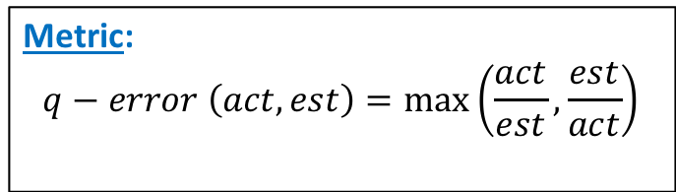
Sequential Scan
SELECT *
FROM Relation R
WHERE v₁ ≤ A ≤ v₂
Execution: Read pages of R sequentially.
Performance on IMDB database (Full table scans): Mean q-error of 1.1
Metric:
$$q−error \left(act,est\right)=\max\left(\frac{act}{est},\frac{est}{act}\right)$$
NOTE: Above experiments are cold-cache, done in isolated environment and on hard-disk resident databases with perfect cardinality estimates.
6

Slide 8
Index Scan
SELECT *
FROM Relation R
WHERE v₁ ≤ A ≤ v₂
Types of filter predicates: Range(v₁ ≤ A ≤ v₂) and Equality (A = v₁)
Types of Indexes: B+ Tree, Hash, Bitmap, etc.
Types of B+ Tree indexes: Clustered and Non-Clustered
Execution in PostgreSQL:
Read #index_height pages (from root to first leaf page).
Read relation pages corresponding to first leaf (in ascending order of the attribute value).
Read next index leaf page.
Repeat steps 2 and 3 till last tuple of v₂.
Uncertainties affecting execution time of index scan:
Data Layout – Affects time taken between reading two consecutive page requests
Caching of pages in memory – Affects number of pages to read from disk
7

Slide 9

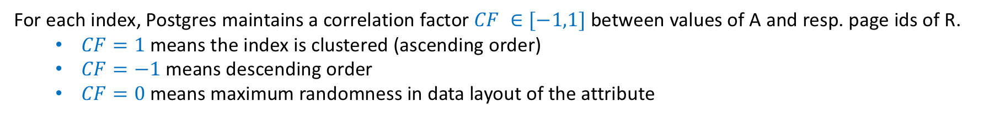
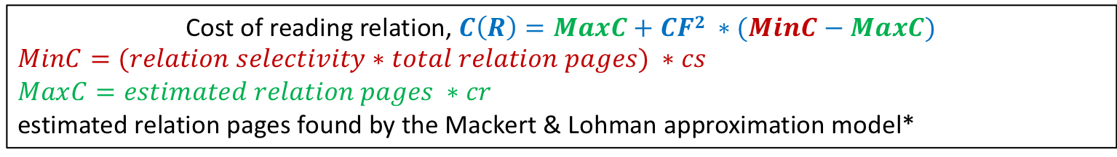
PostgreSQL’s Cost Model of Index Scan
SELECT *
FROM Relation R
WHERE v₁ ≤ A ≤ v₂
For each index, Postgres maintains a correlation factor $CF ∈[−1,1]$ between values of A and resp. page ids of R.
$CF=1$means the index is clustered (ascending order)
$CF=−1$means descending order
$CF=0$means maximum randomness in data layout of the attribute
Cost of reading relation, $C\left(R\right)=MaxC+CF2 ∗(MinC−MaxC)$
$$MinC=(relation selectivity∗total relation pages) ∗cs$$
$$MaxC=estimated relation pages ∗cr$$
estimated relation pages found by the Mackert & Lohman approximation model*
Cost of reading index, $C\left(I\right)=(relation selectivity ∗total index pages) ∗cr$
Total Cost , $TC=C\left(R\right)+C(I)$
NOTE: CPU cost (of processing index tuples and relation tuples) and cost of reading #index_height pages has been omitted.
*Mackert and Lohman. “Index Scans Using a Finite LRU Buffer: A Validated I/O Model”, TODS 1989
8

Slide 10
Limitations in PostgreSQL’s Cost Model
Experimental Setup
cast_info relation (movie_id attribute) from IMDB database
CF ≈ 0 (table: cast_info)
CF = 1 (table: cast_info_sorted)
CF = -1 (table: cast_info_sorted_desc)
Static data layouts
Isolated Environment
Large enough memory to avoid spilling
Cardinality estimates good enough so that maximum error in Postgres’ predictions is of 1 sec
All tables have size 6.4 GB
All indexes have size 776 MB
9

Slide 11
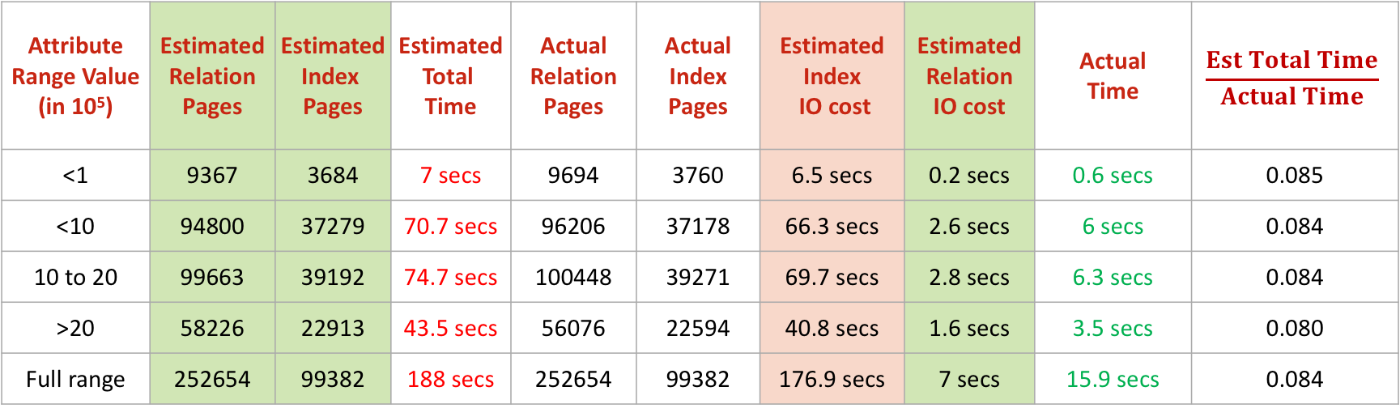
Limitations in PostgreSQL’s Cost Model
Errors due to global parameter (cr)
Estimated correctly
Estimated correctly
Over-estimated
CF = 1
Attribute Range Value (in 10⁵) | Estimated Relation Pages | Estimated Index Pages | Estimated Total Time | Actual Relation Pages | Actual Index Pages | Estimated Index IO cost | Estimated Relation IO cost | Actual Time | $$\frac{Est Total Time}{Actual Time}$$
<1 | 9367 | 3684 | 7 secs | 9694 | 3760 | 6.5 secs | 0.2 secs | 0.6 secs | 0.085
<10 | 94800 | 37279 | 70.7 secs | 96206 | 37178 | 66.3 secs | 2.6 secs | 6 secs | 0.084
10 to 20 | 99663 | 39192 | 74.7 secs | 100448 | 39271 | 69.7 secs | 2.8 secs | 6.3 secs | 0.084
>20 | 58226 | 22913 | 43.5 secs | 56076 | 22594 | 40.8 secs | 1.6 secs | 3.5 secs | 0.080
Full range | 252654 | 99382 | 188 secs | 252654 | 99382 | 176.9 secs | 7 secs | 15.9 secs | 0.084
Global cr value = 1.7 Ideal cr value for this data layout = 0.082
10

Slide 12
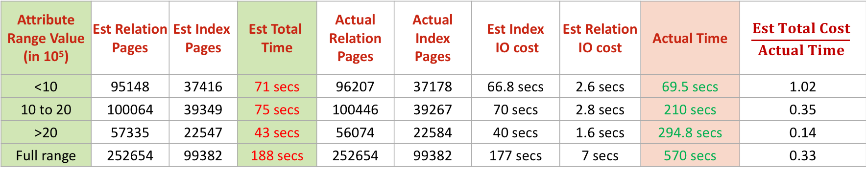
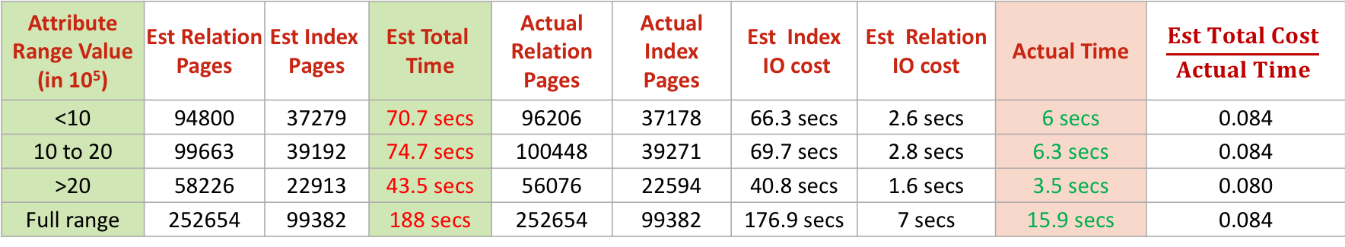
Limitations in PostgreSQL’s Cost Model
Errors due to neglecting sign of CF
CF = 1
Attribute Range Value (in 10⁵) | Est Relation Pages | Est Index Pages | Est Total Time | Actual Relation Pages | Actual Index Pages | Est Index IO cost | Est Relation IO cost | Actual Time | $$\frac{Est Total Cost}{Actual Time}$$
<10 | 94800 | 37279 | 70.7 secs | 96206 | 37178 | 66.3 secs | 2.6 secs | 6 secs | 0.084
10 to 20 | 99663 | 39192 | 74.7 secs | 100448 | 39271 | 69.7 secs | 2.8 secs | 6.3 secs | 0.084
>20 | 58226 | 22913 | 43.5 secs | 56076 | 22594 | 40.8 secs | 1.6 secs | 3.5 secs | 0.080
Full range | 252654 | 99382 | 188 secs | 252654 | 99382 | 176.9 secs | 7 secs | 15.9 secs | 0.084
Same predicates
Same estimated cost
Widely
different times
CF = -1
Attribute Range Value (in 10⁵) | Est Relation Pages | Est Index Pages | Est Total Time | Actual Relation Pages | Actual Index Pages | Est Index IO cost | Est Relation IO cost | Actual Time | $$\frac{Est Total Cost}{Actual Time}$$
<10 | 95148 | 37416 | 71 secs | 96207 | 37178 | 66.8 secs | 2.6 secs | 69.5 secs | 1.02
10 to 20 | 100064 | 39349 | 75 secs | 100446 | 39267 | 70 secs | 2.8 secs | 210 secs | 0.35
>20 | 57335 | 22547 | 43 secs | 56074 | 22584 | 40 secs | 1.6 secs | 294.8 secs | 0.14
Full range | 252654 | 99382 | 188 secs | 252654 | 99382 | 177 secs | 7 secs | 570 secs | 0.33
11

Slide 13
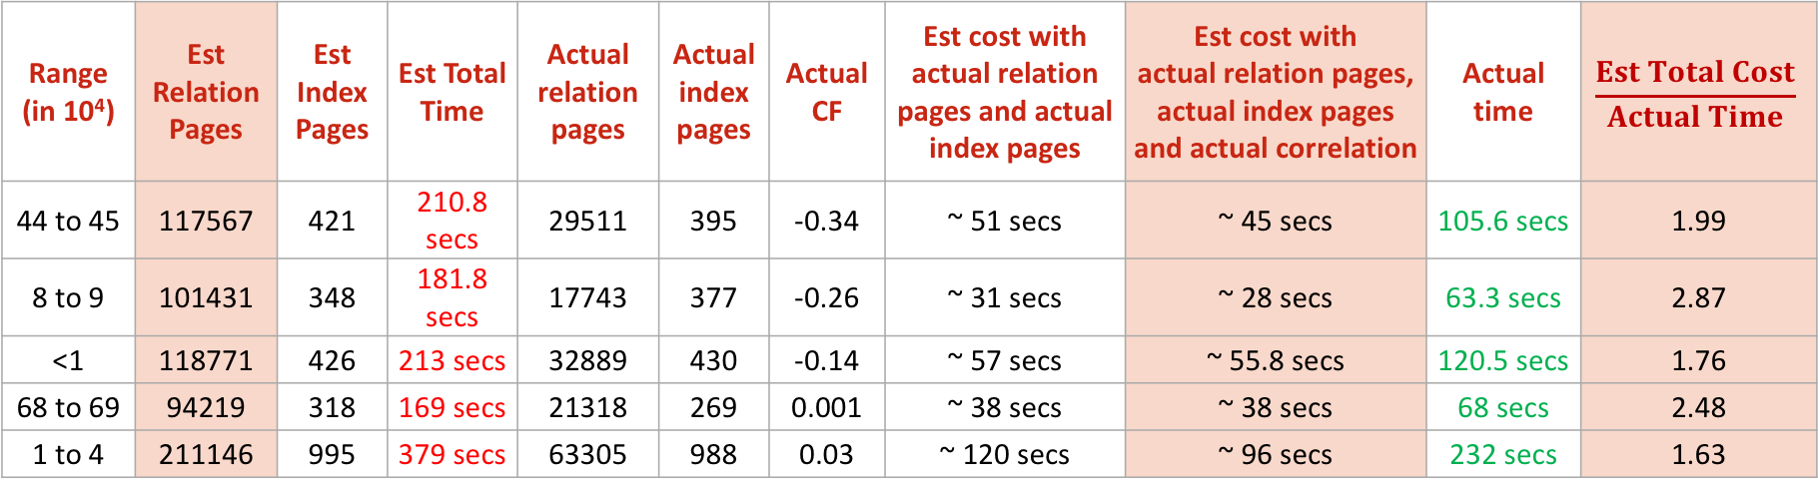
Limitations in PostgreSQL’s Cost Model
Errors due to M&L Formula and Model Design
Over-estimated
No magic number
Still not correct
CF = 0
Range (in 10⁴) | Est Relation Pages | Est Index Pages | Est Total Time | Actual relation pages | Actual index pages | Actual CF | Est cost with actual relation pages and actual index pages | Est cost with actual relation pages, actual index pages and actual correlation | Actual time | $$\frac{Est Total Cost}{Actual Time}$$
44 to 45 | 117567 | 421 | 210.8 secs | 29511 | 395 | -0.34 | ~ 51 secs | ~ 45 secs | 105.6 secs | 1.99
8 to 9 | 101431 | 348 | 181.8 secs | 17743 | 377 | -0.26 | ~ 31 secs | ~ 28 secs | 63.3 secs | 2.87
<1 | 118771 | 426 | 213 secs | 32889 | 430 | -0.14 | ~ 57 secs | ~ 55.8 secs | 120.5 secs | 1.76
68 to 69 | 94219 | 318 | 169 secs | 21318 | 269 | 0.001 | ~ 38 secs | ~ 38 secs | 68 secs | 2.48
1 to 4 | 211146 | 995 | 379 secs | 63305 | 988 | 0.03 | ~ 120 secs | ~ 96 secs | 232 secs | 1.63
12

Slide 14
New Cost Model for Index Scan
No assumptions on data layout and no global parameters
Technique: Run a few training queries for each index and fit a piecewise linear approximation curve
Queries of type:
Training on queries with cardinalities in arithmetic progression
Testing on randomly selected queries
SELECT * FROM R WHERE 1 ≤ A ≤ v₂
13

Slide 15
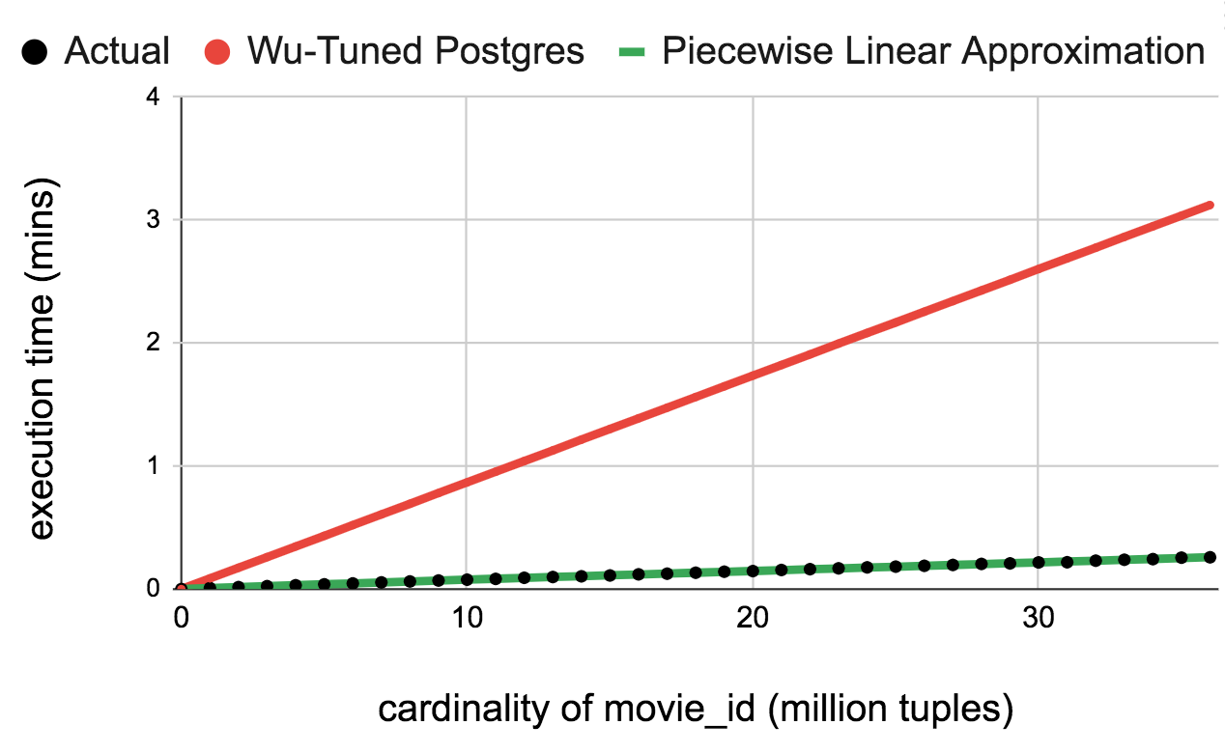
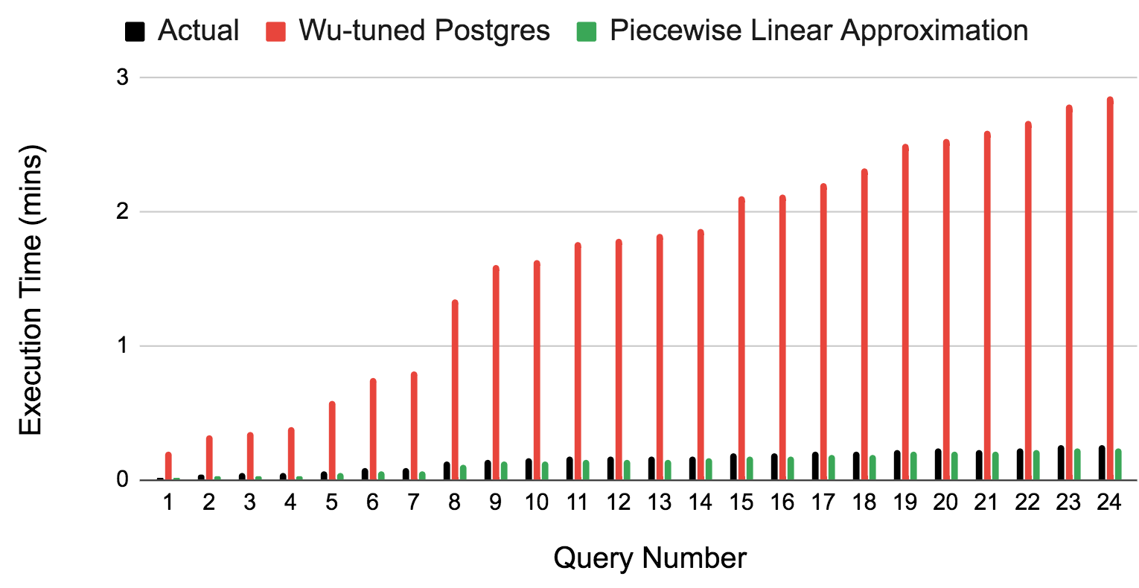
Experiments
SELECT *
FROM cast_info_sorted
WHERE 1 ≤ movie_id ≤ v₂
Training
CF = 1
Over-estimation
Mean Q-error (Wu-Tuned Postgres) : 9.8
Mean Q-error (Piecewise) : 1.2
Predictions
Note : Storage space is O(#lines) and prediction time is O(#lines)
14

Slide 16
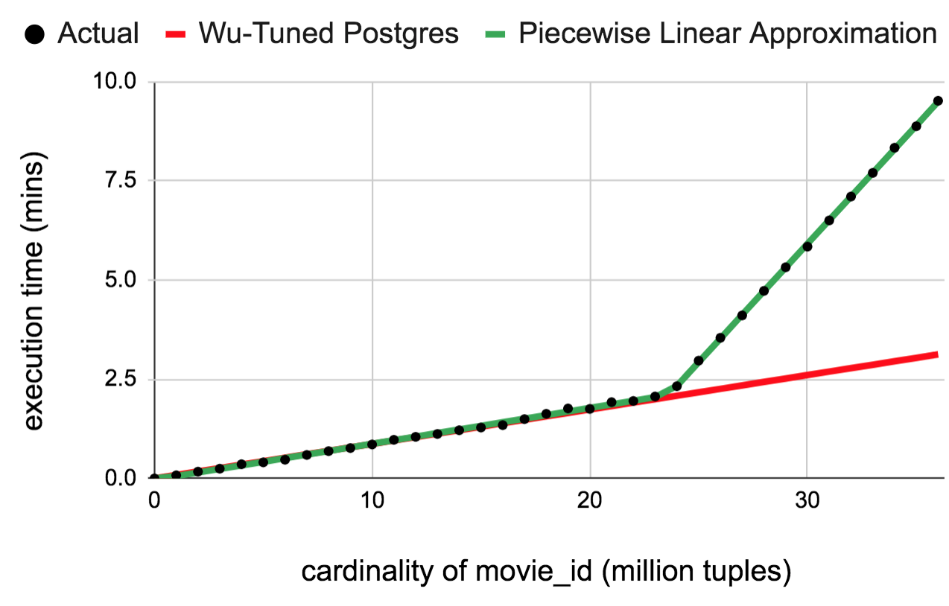
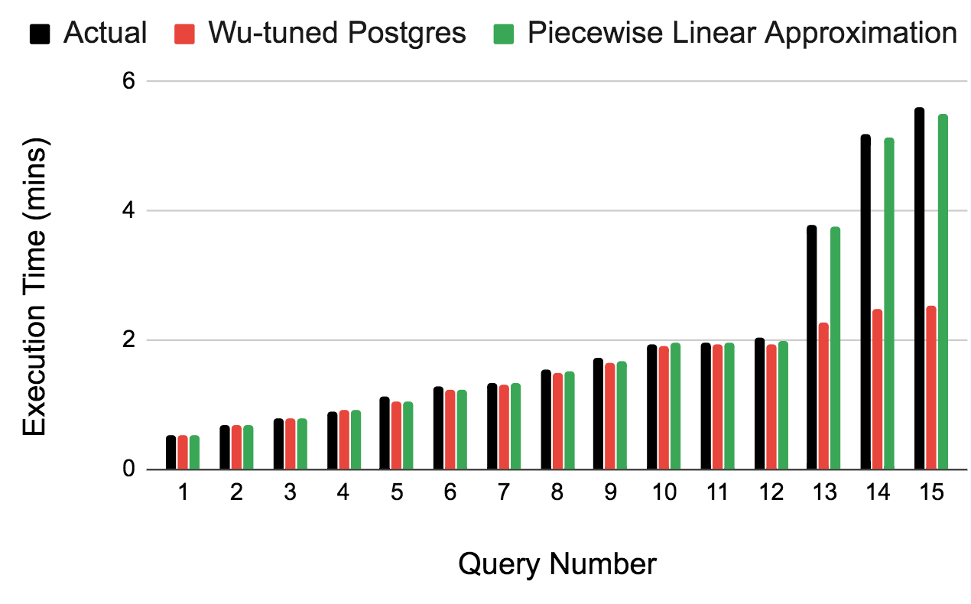
Experiments
SELECT *
FROM cast_info_sorted_desc
WHERE 1 ≤ movie_id ≤ v₂
Training
CF = -1
Mean Q-error (Wu-Tuned Postgres) : 1.21
Mean Q-error (Piecewise) : 1.02
Predictions
Under-estimation
Note : Storage space is O(#lines) and prediction time is O(#lines)
15

Slide 17
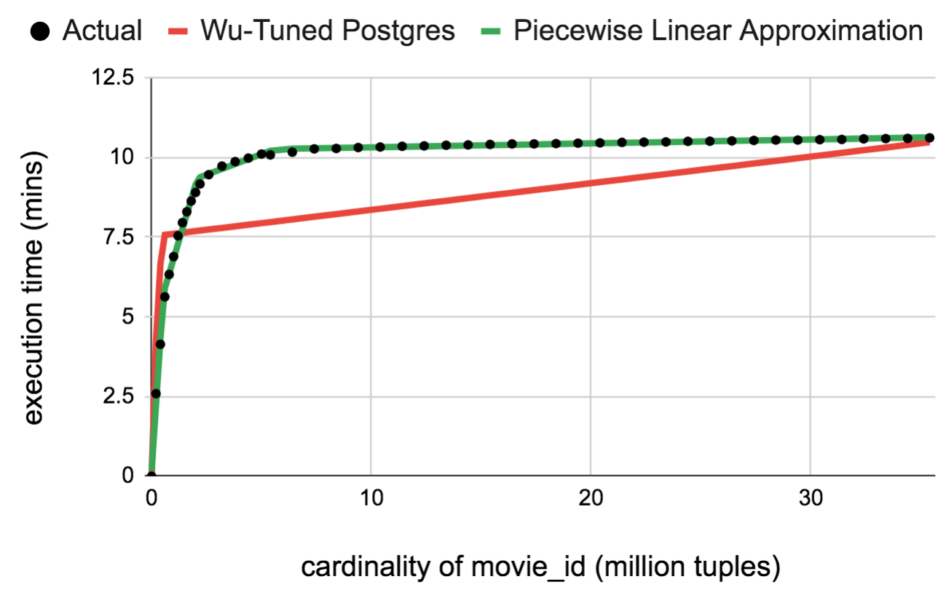
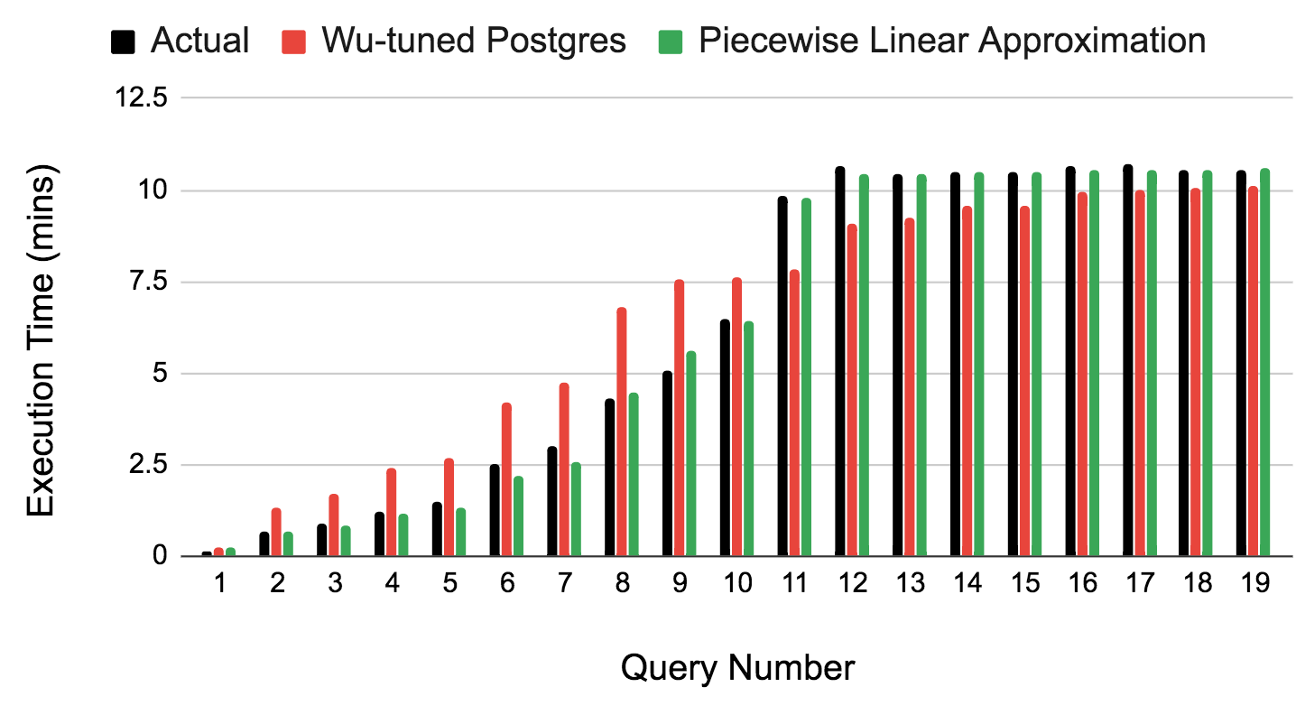
Experiments
SELECT *
FROM cast_info
WHERE 1 ≤ movie_id ≤ v₂
Training
CF = 0
Mean Q-error (Wu-Tuned Postgres) : 1.36
Mean Q-error (Piecewise) : 1.04
Predictions
Under-estimation
Over-estimation
Note : Storage space is O(#lines) and prediction time is O(#lines)
16

Slide 18
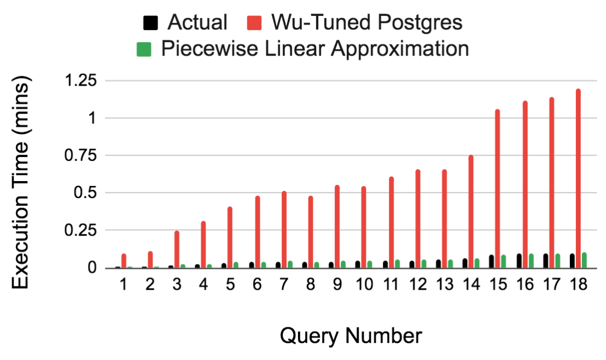
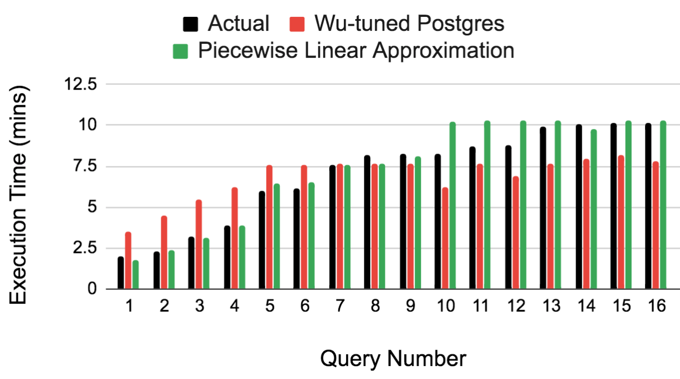
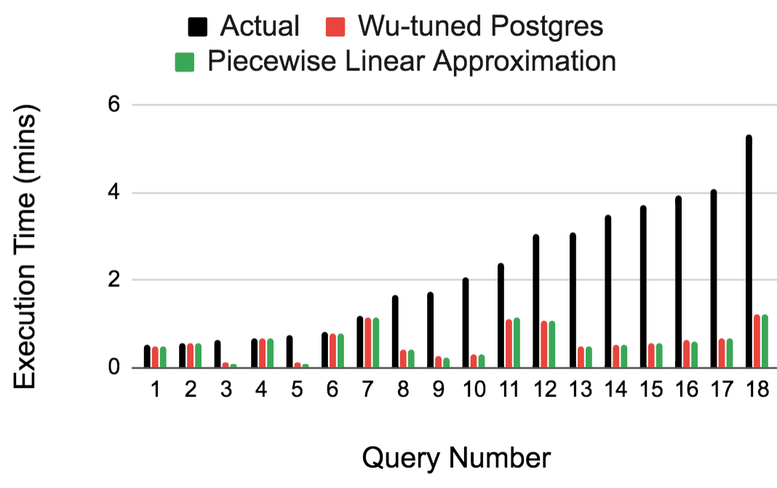
What about other queries?
SELECT *
FROM Relation R
WHERE v₁ ≤ A ≤ v₂
Used the previous models to predict these type of queries
CF = 1
CF = 0
Cost Model
cannot be
data-layout agnostic
Mean Q-error(Wu-Tuned Postgres) : 12.2
Mean Q-error(Piecewise) : 1.1
CF = -1
Mean Q-error(Wu-Tuned Postgres) : 1.46
Mean Q-error(Piecewise) : 1.15
1.04
Mean Q-error(Wu-Tuned Postgres) : 3.79
Mean Q-error(Piecewise) : 5.04
1.02
17

Slide 19
Conclusions
PostgreSQL does not predict execution time for index scan very well.
It is possible to build a better cost model without any assumptions on data layout by doing pre-processing.
Future
To handle the whole spectrum of range queries
To handle equality predicates
To handle bitmap heap scan operator and internal node operators like join and aggregate
To handle spilling (i.e. limited memory buffer size constraint)
18

Slide 20

Thank You

Slide 21
Related Work
Machine Learning [Black Box Approach]
As an attempt to capture uncertainties, the world turned to machine learning. e.g.
PQR: Predicting Query Execution Times for Autonomous Workload Management, ICAC 2008, Chetan Gupta et al.
Predicting multiple metrics for queries: Better decisions enabled by machine learning, ICDE 2009, Archana Ganapathi et al.
Learning-based query performance modelling and prediction, ICDE 2012, Mert Akdere et al.
Robust Estimation of Resource Consumption for SQL Queries using Statistical Techniques, VLDB 2012, Jiexing Li et al.
Statistical Tuning [White Box Approach]
After a flow of ML-based papers, Wu attempted tuning the Postgres’ cost model itself using a set of calibrated queries to give a simple set of linear equations (with cost coefficients as variables)
Predicting query execution time: Are optimizer cost models really unusable?, ICDE 2013, Wu et al.
Uncertainty Aware Query Execution Time Prediction, VLDB 2014, Wu et al.

Slide 22
Appendix

Slide 23

Example (PostgreSQL)
SELECT *
FROM title t,
movie_keyword mk
WHERE t.id = mk.movie_id AND
mk.keyword_id = 335
Est: 72262
Act: 72496
Merge Join
Est: 72262
Act: 72496
Wu’s model*
[tunes the cost parameters by running a set of calibrating queries]
Plan execution time
correctly estimated
Index scan
$σ$(Bitmap heap scan)
Est: 2528312
Act: 2525632
Est: 4523930
Act: 4523930
t
mk
Estimated time: 4 sec
Actual time: 81 sec
NOTE: Estimated cardinalities are close to actual cardinalities
*Wu et al. “Prediction of Query Execution Time: Are Optimiser Cost Models Really Unusable?” ICDE 2013
4/23

Slide 24

Example(Wu-Tuned PostgreSQL)
SELECT *
FROM title t,
cast_info ci,
movie_keyword mk
WHERE t.id = mk.movie_id AND
t.id = ci.movie_id AND
mk.keyword_id = 47
Estimated time: 8 sec
Actual time: 3 min
Est: 135783
Act: 120410
Est: 9470
Act: 9060
Nested Loop Join
Est: 9470
Act: 9060
Hash Join
Index scan
Est: 34*9470
Act: 11*9060
$σ$(Seq scan)
Seq scan
ci
Est: 4523930
Act: 4523930
Est: 2528312
Act: 2528312
mk
t
NOTE: Estimated cardinalities are close to actual cardinalities
5/23

Slide 25


Effect on Query Optimisation
SELECT *
FROM title t,
cast_info ci,
movie_keyword mk
WHERE t.id = mk.movie_id AND
t.id = ci.movie_id AND
mk.keyword_id = 47
Estimated time: 8 sec
Actual time: 3 min
Est: 135783
Act: 120410
A MUCH BETTER PLAN!!
Estimated time : 19 sec
Actual time : 26 sec
Est: 135783
Act: 120410
Est: 9470
Act: 9060
Hash Join
Est: 9470
Act: 9060
Nested Loop Join
Seq scan
Hash Join
Est: 9470
Act: 9060
Hash Join
Index scan
Est: 9470
Act: 9060
Est: 34*9470
Act: 11*9060
Est: 36251624
Act: 36244344
$σ$(Seq scan)
Seq scan
Est: 4523930
Act: 4523930
Est: 2528312
Act: 2528312
ci
ci
$σ$(Seq scan)
Seq scan
mk
t
Est: 4523930
Act: 4523930
Est: 2528312
Act: 2528312
mk
t
NOTE: Estimated cardinalities are close to actual cardinalities
6/23

Slide 26
Query | Index Scan Time (secs) | Total Scan Time (secs) | Total Time (secs)
1 | 0 | 0.8 | 0.8
2 | 1.3 | 1.3 | 1.3
3 | 2.8 | 3 | 3.2
4 | 6.9 | 7.2 | 7.8
5 | 8.7 | 8.7 | 8.8
6 | 10.1 | 10.1 | 10.1
7 | 8.7 | 11.2 | 11.3
8 | 1.5 | 8.2 | 14.5
9 | 14.9 | 14.9 | 14.9
10 | 16.3 | 16.9 | 17.3
11 | 21.5 | 22.4 | 22.5
12 | 24.6 | 24.9 | 24.9
13 | 31.6 | 31.8 | 32.7
14 | 38.8 | 38.8 | 38.8
15 | 285.2 | 285.8 | 286.2
16 | 582.1 | 583 | 583.3
17 | 804.7 | 804.9 | 808.1
18 | 841.3 | 841.3 | 844.1
Query | Index Scan Time (secs) | Total Scan Time (secs) | Total Time (secs)
1 | 0.127 | 2.8 | 25
2 | 49.5 | 0 | 49.5
3 | 0.08 | 73.08 | 91
4 | 0.64 | 178.64 | 213
5 | 0.64 | 180 | 213
6 | 0.64 | 179.2 | 213
7 | 0.06 | 175.06 | 214
8 | 0.5 | 167.5 | 214
9 | 7.75 | 7.75 | 427
10 | 407.9 | 0 | 591.6
Scan Importance (IMDB 7 GB)
Scan Importance (TPC-DS 100 GB)

Slide 27

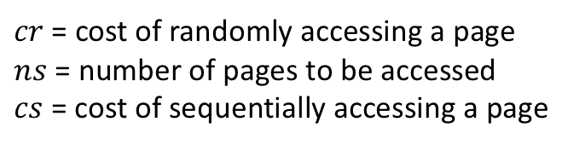
$cr$ = cost of randomly accessing a page
$ns$ = number of pages to be accessed
$cs$ = cost of sequentially accessing a page
Estimated Cost (PostgreSQL): $cr+\left(ns−1\right)∗cs$
Table | Actual Time (secs) | Estimated Time (secs)
aka_name | 0.4 | 0.3
aka_title | 0.2 | 0.2
cast_info | 9.1 | 8.7
char_name | 1.4 | 1.1
movie_companies | 0.6 | 0.6
movie_keyword | 0.9 | 0.8
Sequential Scan Performance of PostgreSQL

