Slide 1
Characterisation of SPEC CPU 2017 Benchmarks using Roofline Model Technique
Prathyush P.V. and Vishal Goel

Slide 2
Motivation
Executing benchmark workloads helps compare two systems based on their performance and identify potential optimizations possible in both software or hardware of the system.
SPEC CPU2006 has been one of the most widely used benchmark suites. However, it was replaced with the new SPEC CPU2017 suite, released in June 2017.
SPEC benchmarks are known to potentially take several days or weeks to run using simulators. Thus, it is imperative to characterise the workloads and only work on the useful subset of the suite.

Slide 3
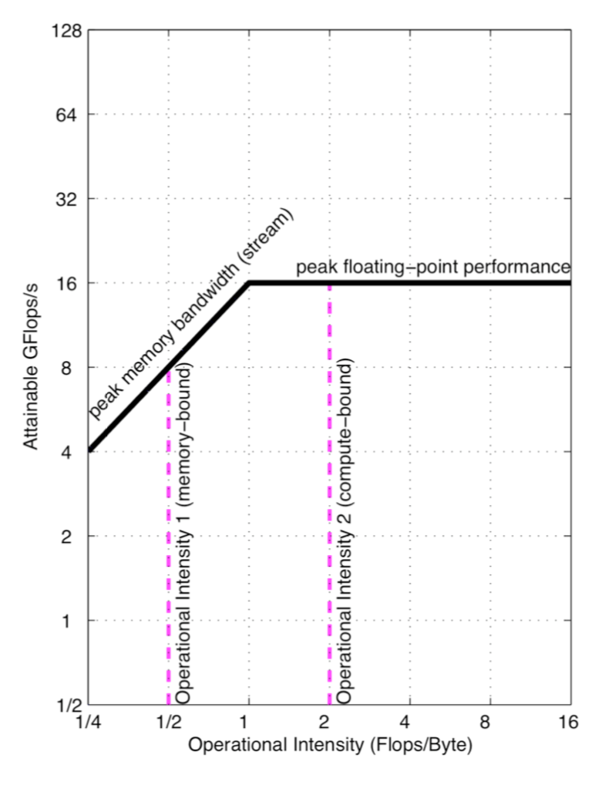
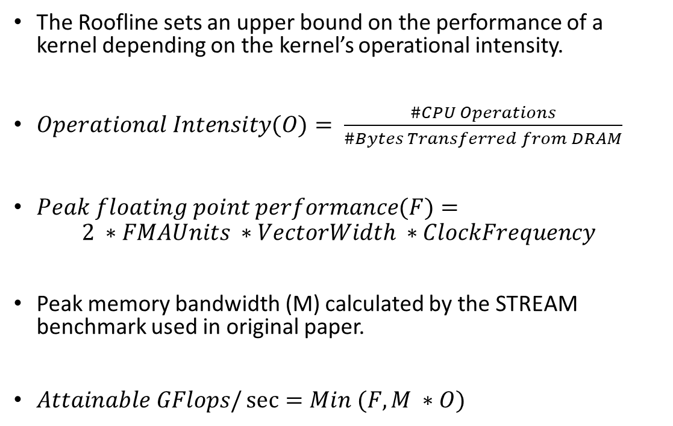
Roofline Model Technique
The Roofline sets an upper bound on the performance of a kernel depending on the kernel’s operational intensity.
$Operational Intensity(O)= \frac{\#CPU Operations}{\#Bytes Transferred from DRAM}$
$Peak floating point performance(F)=$
$$2 ∗FMAUnits ∗VectorWidth ∗ClockFrequency$$
Peak memory bandwidth (M) calculated by the STREAM benchmark used in original paper.
$Attainable GFlops/\sec{=Min (F,M ∗O)}$
S. Williams, A. Waterman, and D. Patterson,
“Roofline: An Insightful Visual Performance Model for Multicore Architectures”,
Communications of the ACM, April 2009

Slide 4
Experimental Setup
Intel Core i7-8700 processor with 4GHz clock frequency and 32GB DRAM
Peak Floating-Point Performance = 64 GFlops/sec
Peak memory bandwidth = 22.1 GB/sec
SPEC CPU 2017 Benchmark has 10 SPECfp benchmarks and 10 SPECint benchmarks.

Slide 5
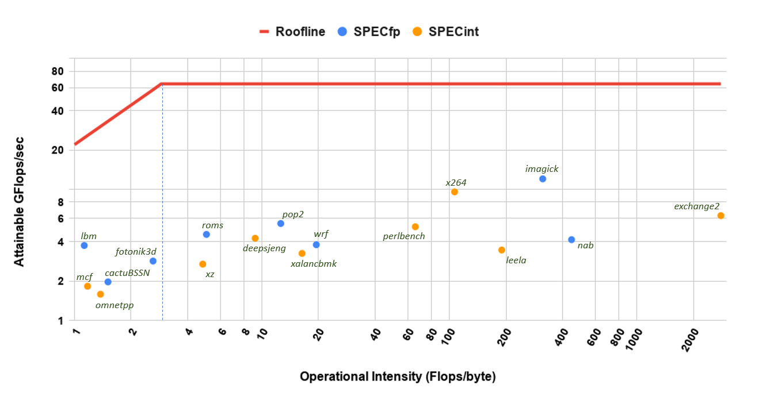
Roofline Model for SPEC CPU 2017

Slide 6
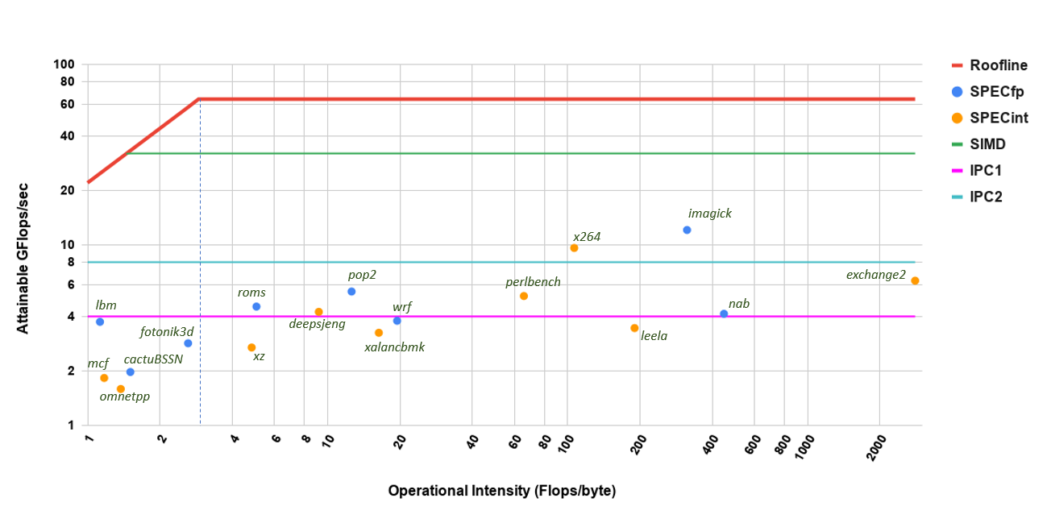
Roofline Model for SPEC CPU 2017

Slide 7
Execution Behaviour of the Benchmarks

Slide 8
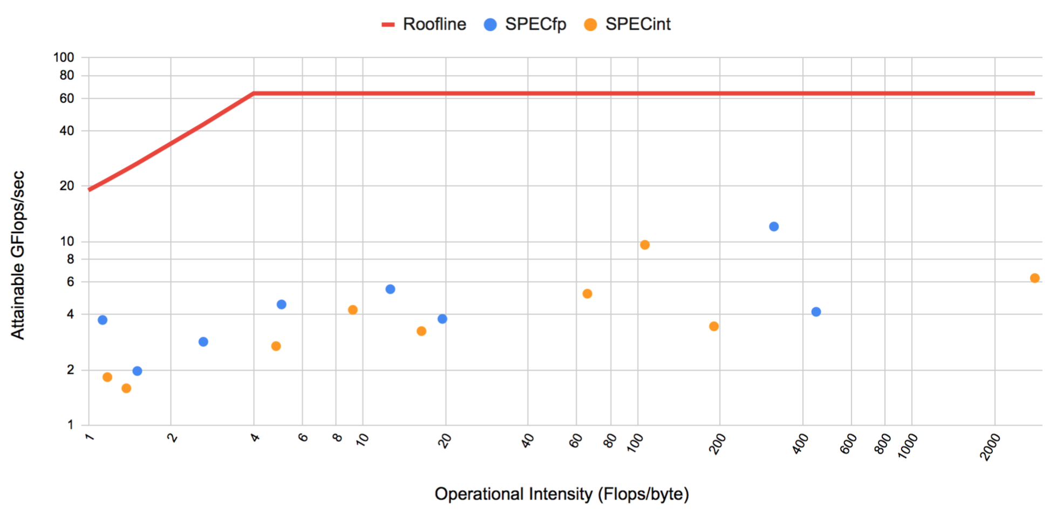
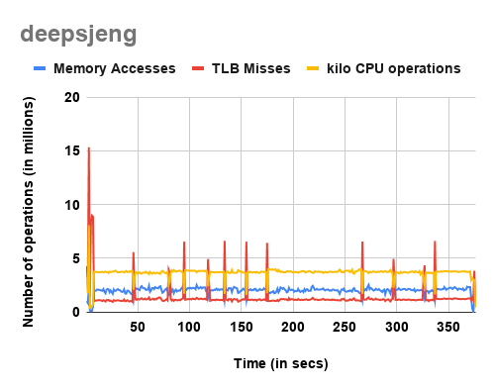
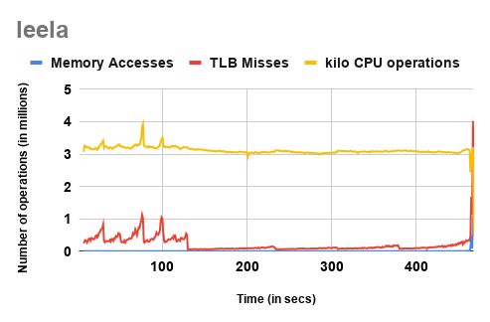
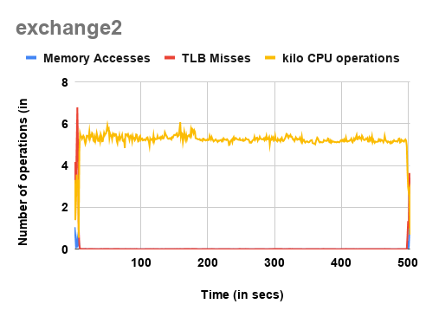
AI Benchmarks
exchange2
deepsjeng
leela
[Chess]
[Go]
[Sudoku Generator]
Highly recursive alpha beta tree search algorithm to find out next chess move
Algorithm does better with more data storage
12 games in the input
Monte-Carlo tree search algorithm
For each move, it simulates game until the end
Given a trivial sudoku, it generates harder sudokus.
Not much memory bandwidth requirement
High Operational Intensity

Slide 9
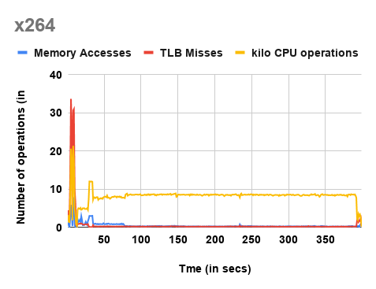
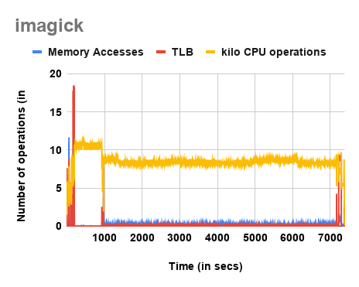
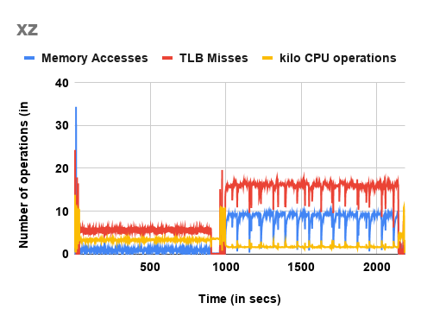
Media and Compression Benchmarks
x264
imagick
xz
[Image Manipulation]
[Video Compression]
[Data Compression]
Initial loading of data causes spike in memory accesses in all benchmarks.
High CPU usage and low bandwidth requirement -> IPC > 2
Decompresses and compresses two different data inputs
Compression factor of 4 and 8 respectively.
High TLB misses -> Speedup of 16% with transparent huge pages enabled

Slide 10
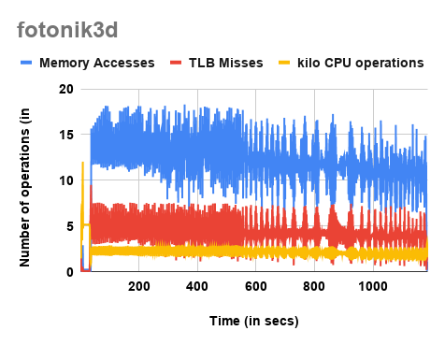
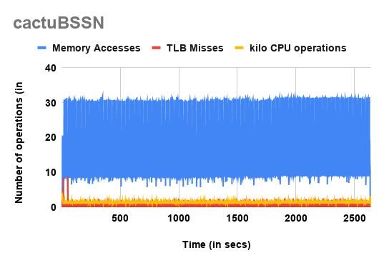
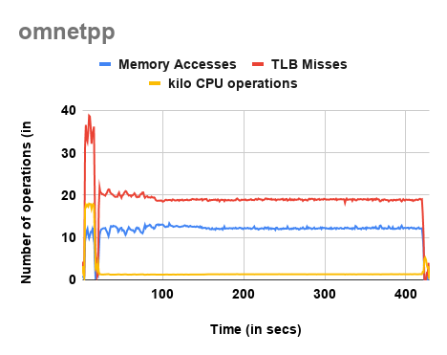
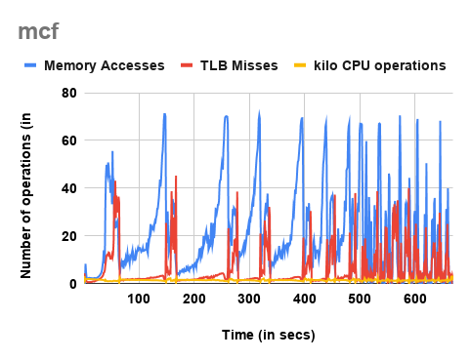
Memory Bandwidth Intensive Benchmarks
General Relativity: Solves equations in simulated vacuum flat space-time
Simulation of a large 10 gigabit Ethernet network
Simplex Algorithm for Route Planning
Computational
Electromagnetics
In mcf, the time of successive iterations of Simplex keeps reducing as it approaches convergence.
fotonik3d, omnetpp and mcf experience high TLB misses -> speedup of 5%, 8% and 3% resp. with transparent huge paging enabled.

Slide 11
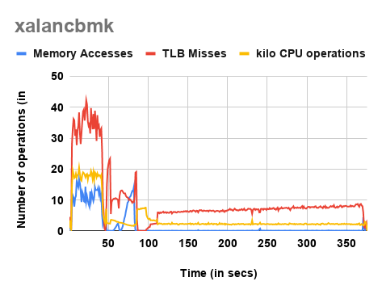
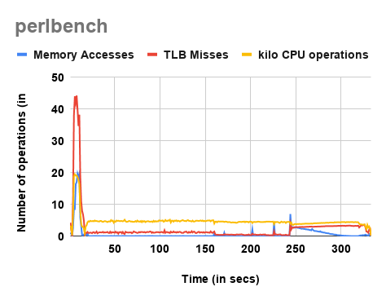
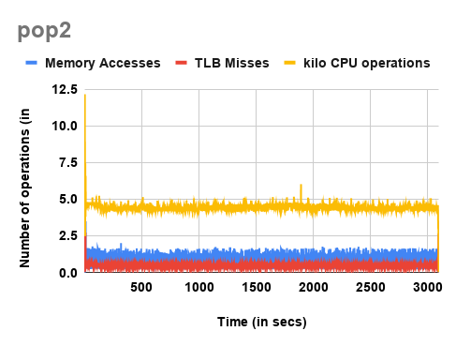
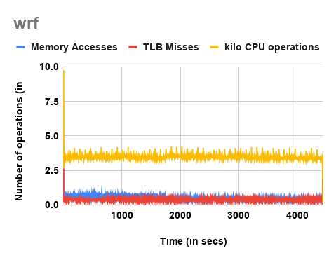
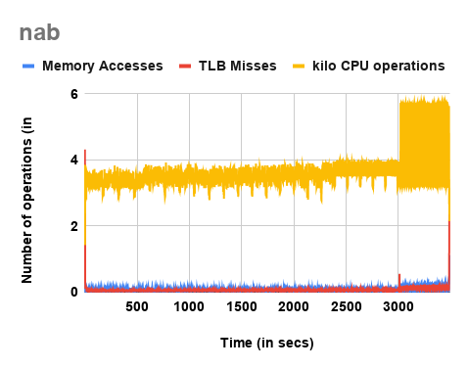
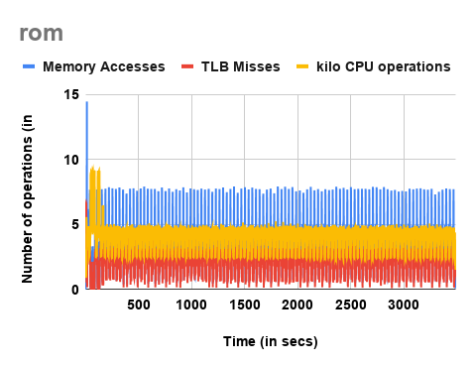
Other Benchmarks
[XML to HTML Conversion]
[Perl Interpreter]
[Wide Scale Ocean Modeling]
[Weather Forecasting]
[Molecular Dynamics]
[Regional Ocean Modeling]

Slide 12
Vectorisation of SPEC Benchmarks
By default, all the benchmarks in SPEC17 are compiled with flag -fno-tree-loop-vectorize which prevents compiler from vectorizing any loops. The number of vector instructions executed for most of the benchmarks are 0 or less than 100.
Used -ftree-vectorize to see if any benchmark can be vectorized. Almost all the loops in the all benchmarks are not vectorized by gcc or clang. Thus, no effect on performance.
Also all the benchmarks achieved performance less than 12 Gflops/sec whereas our system has a peak performance of 64 Gflops/sec, which can only be obtained with a significant amount of SIMD operations in the benchmarks.
We ran a hand-optimized matrix multiplication code and it attained a performance of 47 Gflops/sec.

Slide 13
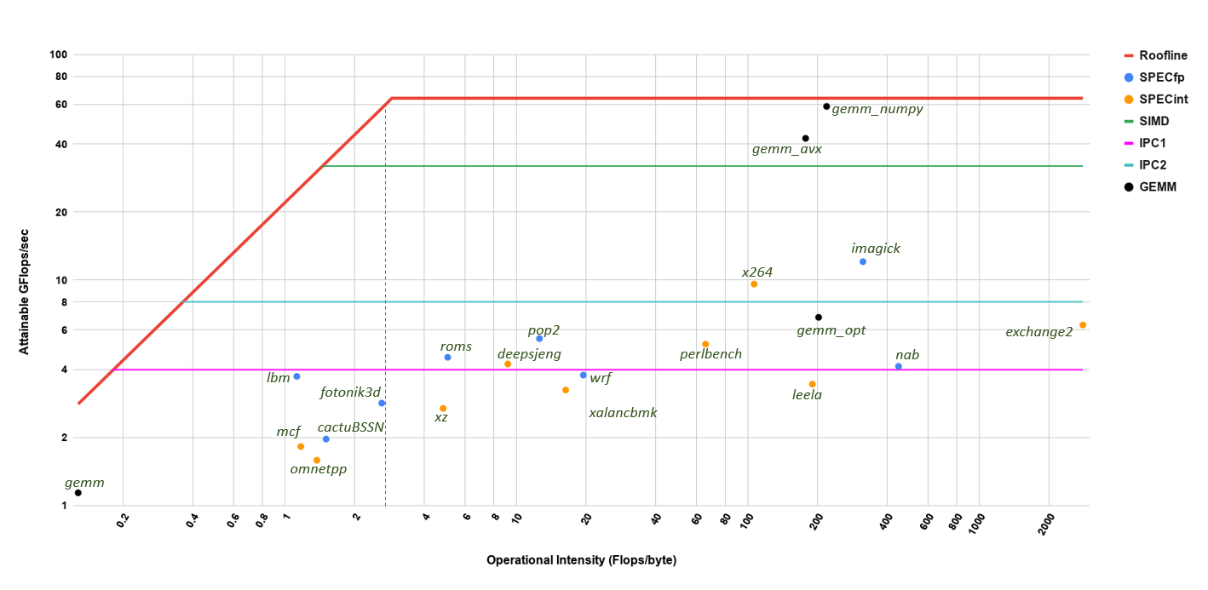

Slide 14
Future
Understand phase executions of benchmarks more closely
Cache-Aware Roofline Modeling for SPEC CPU 17 Benchmarks
Effect of TLB misses on memory bandwidth

Slide 15
Thank You

