Slide 1
Project Demo Presentation
James Young

Slide 2
Implementation of Real-World Modern Football Tactics in RoboCup Soccer Simulator

Slide 3
Design
The new tactical implementations were chosen because of their increasing relevance to the modern game of football, as well as how applicable they would be to the simulated game after analysis and observations
The new ideas include updated formations, new player behaviour and an xG model implemented from scratch.

Slide 4

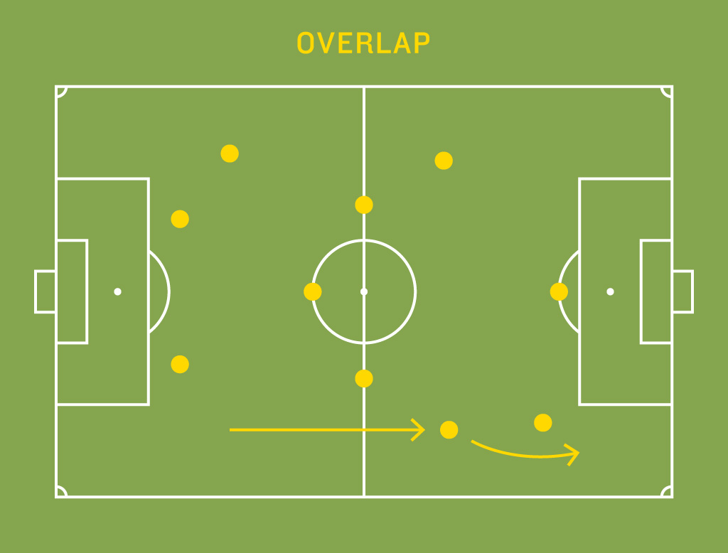
New Role: Overlapping Full-Back
The overlapping full-back is a classic tactical idea in football, dating back to the legendary Brazilian winning sides of the 1950s and 60s
The Fundamental Idea is to encourage your full-backs, who are typically in a defensive role to engage in a more attacking role, allowing the wingers to come inside and to add numerical advantage to the attack

Slide 5
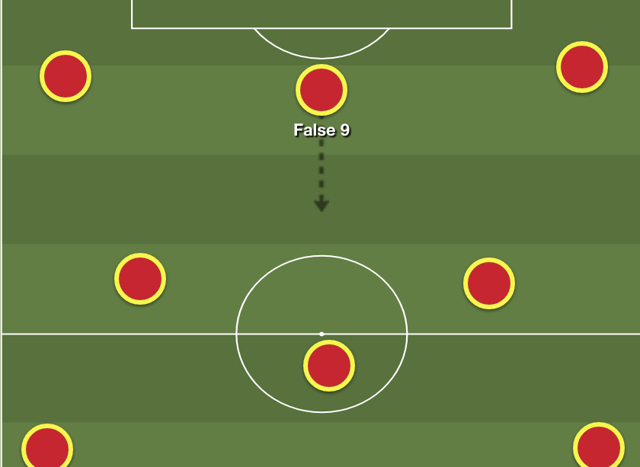
New Role: False 9
The false 9 is a newer idea within football, most famously utilised by the World Cup winning team of Spain in 2012, but also popularised by Pep Guardiola’s great Barcelona side between 2008 and 2012.
It involves playing without a traditional striker, instead encouraging them to drop into midfield to enable a numerical advantage

Slide 6
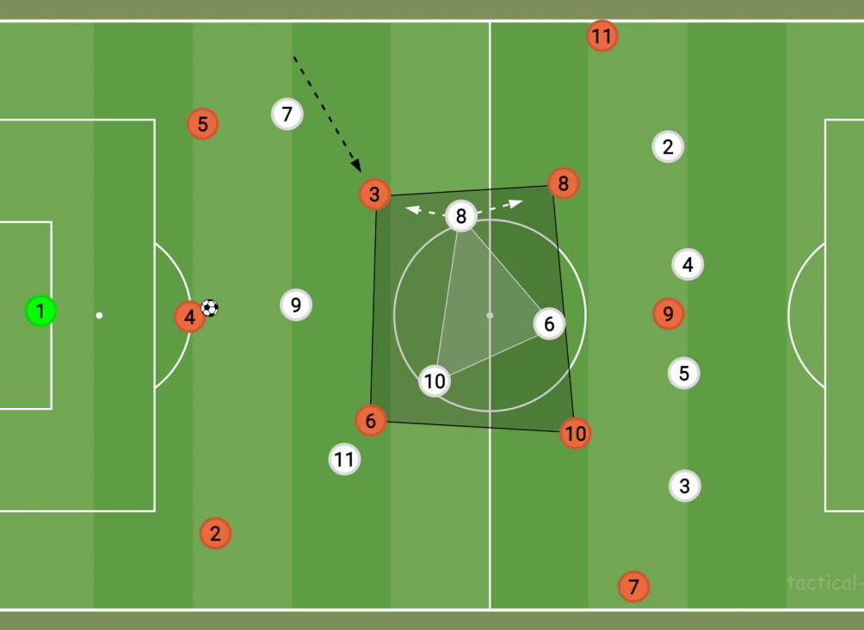
New Role: Inverted Full-Back
The Inverted Full-Back is a much more modern take on the full-back, and is the opposite idea of the Overlapping Full-Back
Instead of pushing up high and wide to create numbers out wide, the full-back tucks inside to midfield next to the defensive midfielder, creating a “box midfield” to create a numerical advantage in midfield while in possession, as well as a more solid position should you lose the ball
Involves pairing the full-back with the defensive midfielder, and converting the right back to a centre back, making it a back 3 in possession

Slide 7
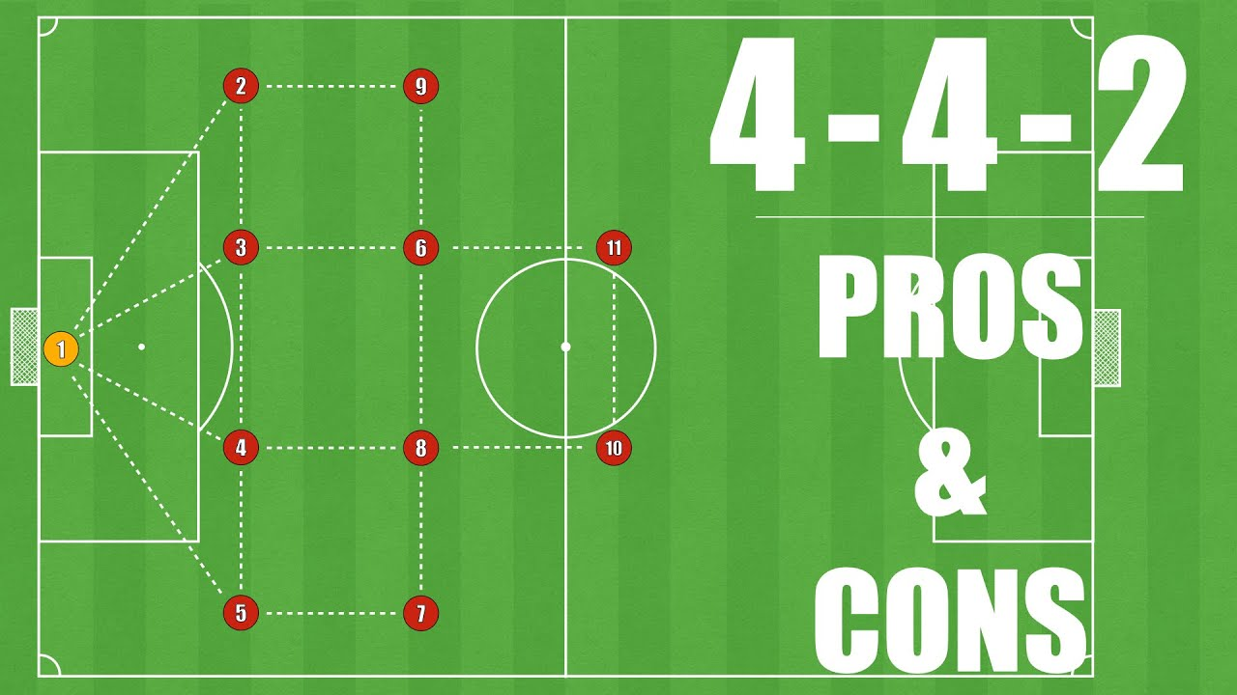
Updated Formations - 4-4-2 Out of Possession (OOP)
The 4-4-2 is known as a more rigid and tactically solid formation compared to the more popular 4-3-3.
It sacrifices a player in midfield in an attempt to cover the pitch with players in a more even spread
This works well when not in possession of the ball as it makes the team harder to break down compared to the 4-3-3, as less players are left up front

Slide 8
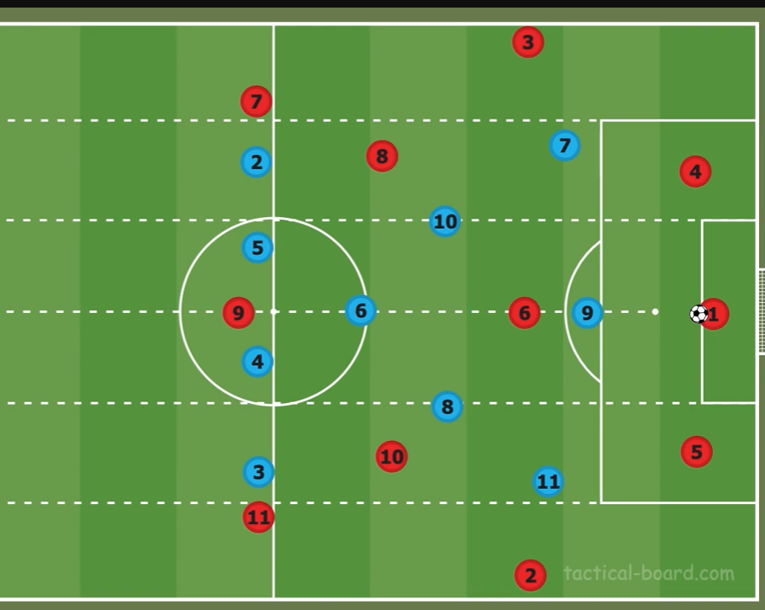
Updated Formations – 4-3-3 High Press
The High Press is a different out of possession tactic, designed to pressure the opposition high up the pitch.
It attempts to win the ball back much closer to the opposition goal, preventing them ever getting closer to your won goal and making it easy to start an immediate quick attack of your own

Slide 9

xG Modelling
xG stands for “Expected Goals”
Gives each shot a probability of being a goal (between 0 and 1) based on factors such as:
Distance to goal
Shot angle
Body part used
Defensive pressure
Used in this project for measuring team performance and influencing shot taking decision making

Slide 10
System Demo

Slide 11
Recorded Matches

Slide 12
Tactical Changes
Times when its being used
Link to match
Key moment from match
Explain how this works and how it benefits the team
Fullbacks x2, false 9, OOP structure x2

Slide 13
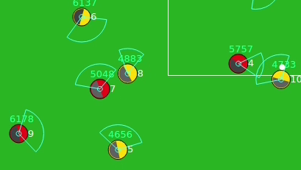
Overlapping Full-back
Deployed in losing situations, asking defenders to be more attacking and take risks
Link to match (0.45)
Full-Back (no. 5) joins the attack, giving a numerical advantage and leading to winger having more space and creating a chance

Slide 14
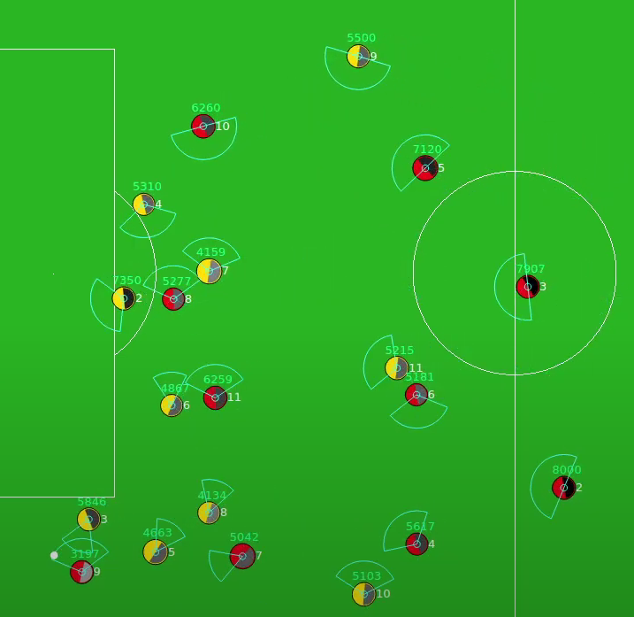
Inverted Full-back
Starting tactic, implemented for drawing situations
Link to match (0.29)
Full-Back (no. 4) joins the midfield, giving a numerical advantage and leading to box midfield for best ball progression

Slide 15
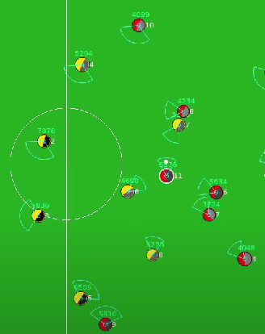
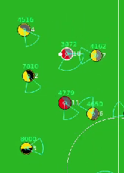
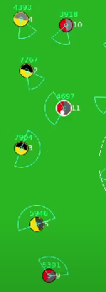
Key Moment - False 9
Deployed in winning situations, allows for more control of the midfield and able to consolidate leads
Link to match (7.55)
1) False 9 picks ball up deep in midfield
3) False 9 picks the ball up deeper, allowing him to dribble and go on to score
2) False 9 moves wide to play next to the winger
Orange circle highlights where normal striker would be compared to false 9

Slide 16
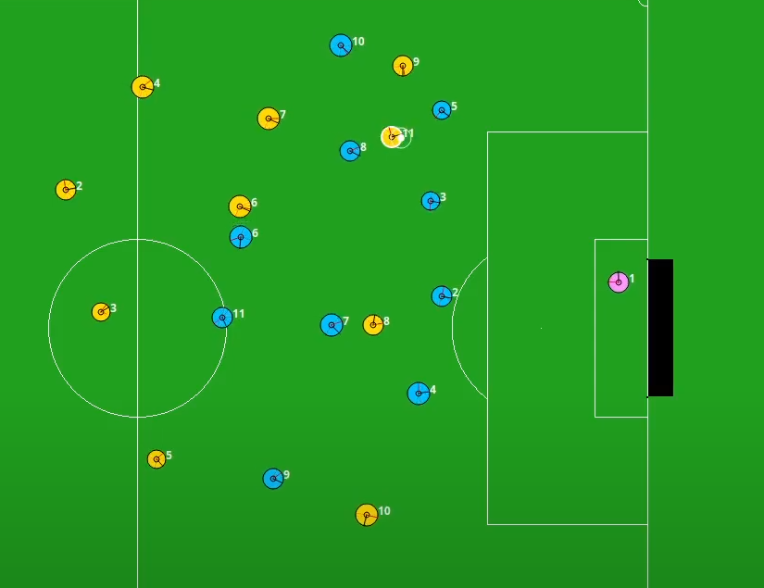
4-4-2 Structure OOP
Defensive Structure used when winning – aiming to hold onto a lead
Link to match (2.50)
Compact Shape
Covers pitch most efficiently with 10 players
Prevents a goal in this situation

Slide 17
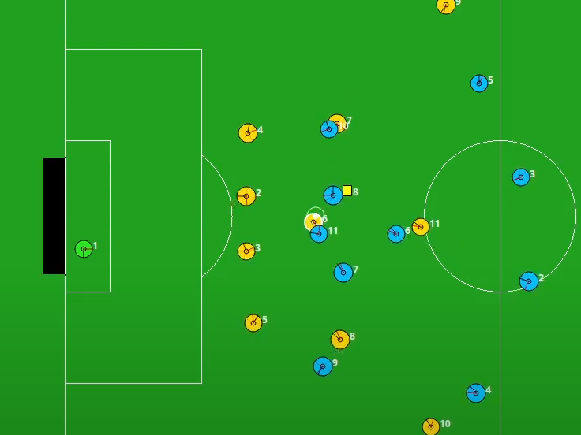
4-3-3 High Press OOP
Defensive Structure used when drawing or behind – aim to put pressure on opponent and force mistakes
Link to match (3.30)
Aggressive Tactic
Able to create chances close to opposition goal
Wins ball back here

