Slide 1
Business Insights:
Capstone Project – 2
By
Gowri v

Slide 2
Customer Analysis
Visuals:
1. Doughnut Chart: Female vs Male Customers.
- Gender split is nearly equal.
2. Card Visual: Total Customers.
- 1.06M Total Customers.
3. Bar Chart: Customer Location by Continent.
- Majority customers from North America.
4. Map Visual: Geographical Insights.
- North America leads.

Slide 3
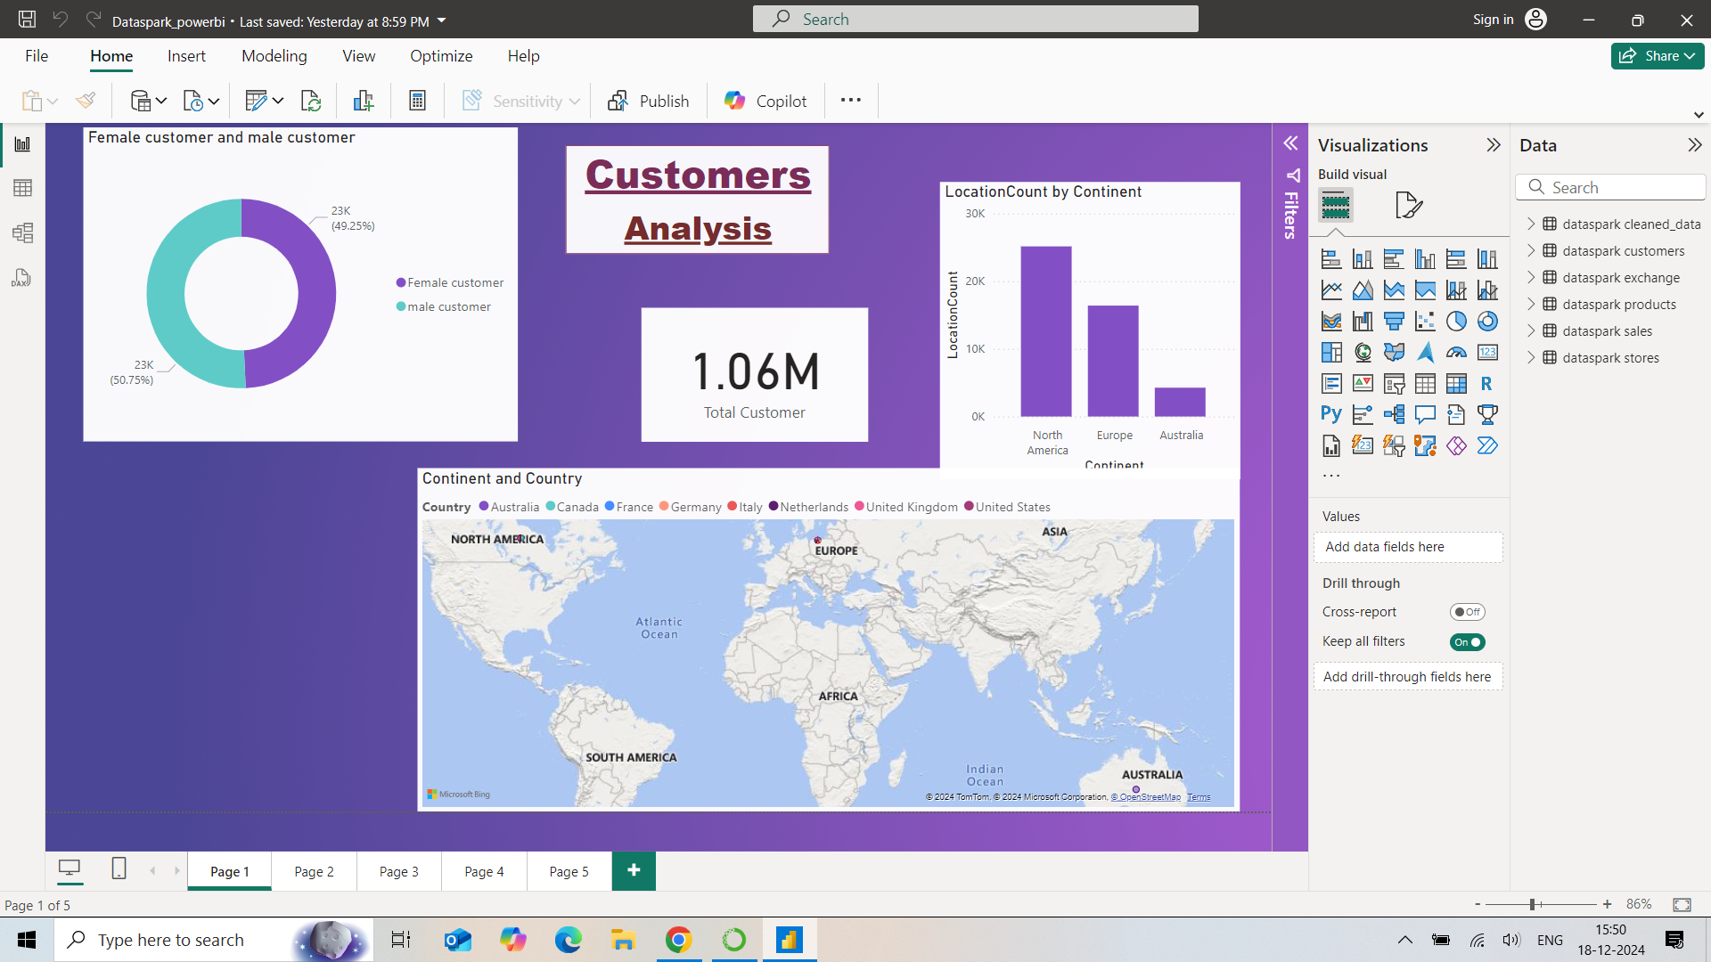

Slide 4
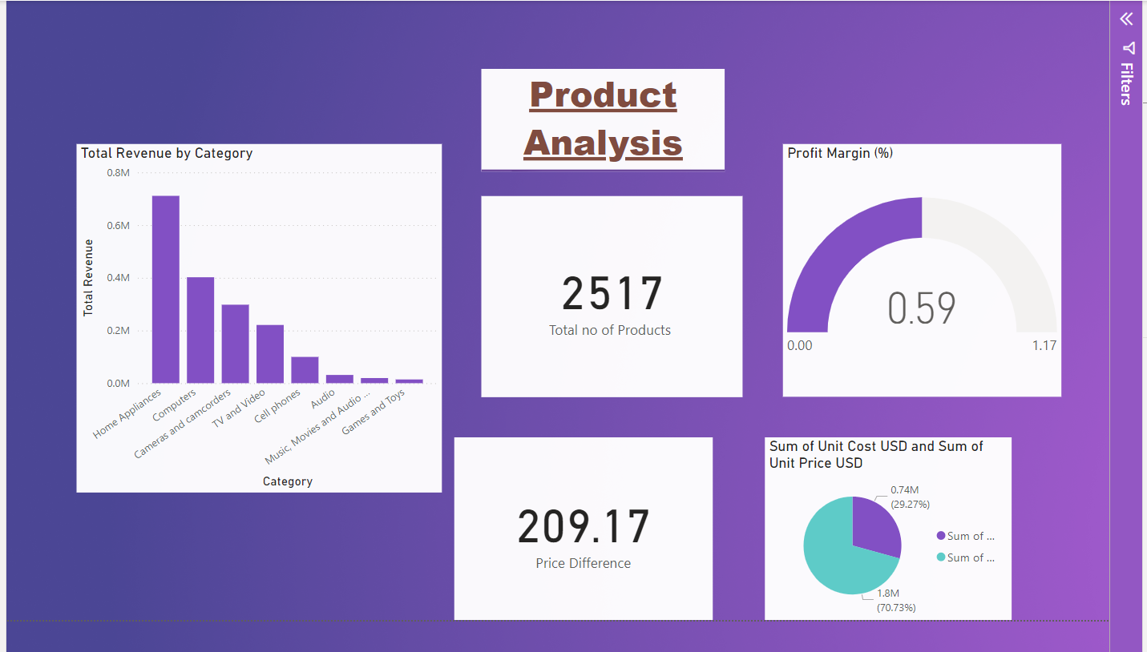
Product Analysis
Visuals:
1. Bar Chart: Total Quantity and Product Count.
- Shows product count vs total quantity sold.
2. Card Visual: Average of Product Key.
- Displays the average product key.
-Total Profit: 195.98M USD
3. Pie Chart: Profit vs Sales Breakdown.
- Proportion of revenue vs profit.
-Major sales come from USD with a sum of 202,602.

Slide 5
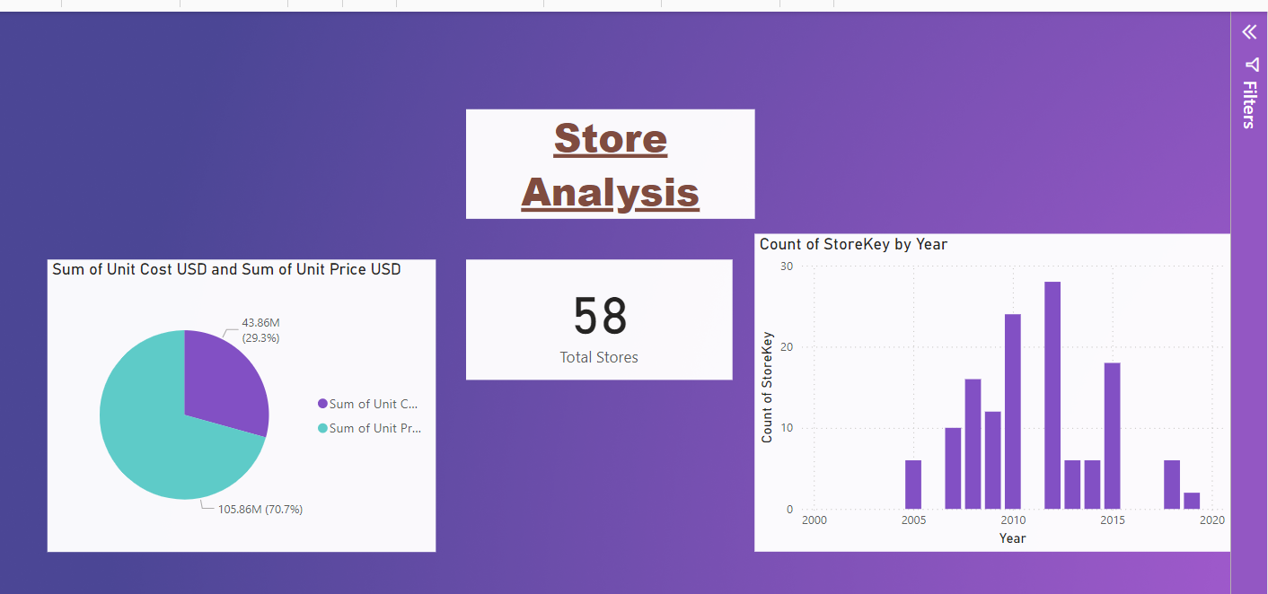
Store Analysis
Visuals:
1. Pie Chart: Sum of Unit Cost USD and Unit Price USD.
- 70.7% sales from price, 29.3% from costs.
2. Card Visual: Total Stores.
- Displays 58 stores.
3. Bar Chart: Count of StoreKey by Year.
- Store growth peaked in 2010–2012.

Slide 6
Sales Analysis
Visuals
1. Bar Chart: Total Quantity and Count of Product Key.
- Total quantity is twice as high as the count of product keys.
2. Card Visual: Average of Product Key.
- The average product key is 1.13.
3. Pie Chart: Total Profit and Sales Breakdown.
- 36.94% in profit and 63.06% in sales.
4. Table: Currency Code and Sum of Exchange.
- Total exchange amount is 374,486.81.

Slide 7
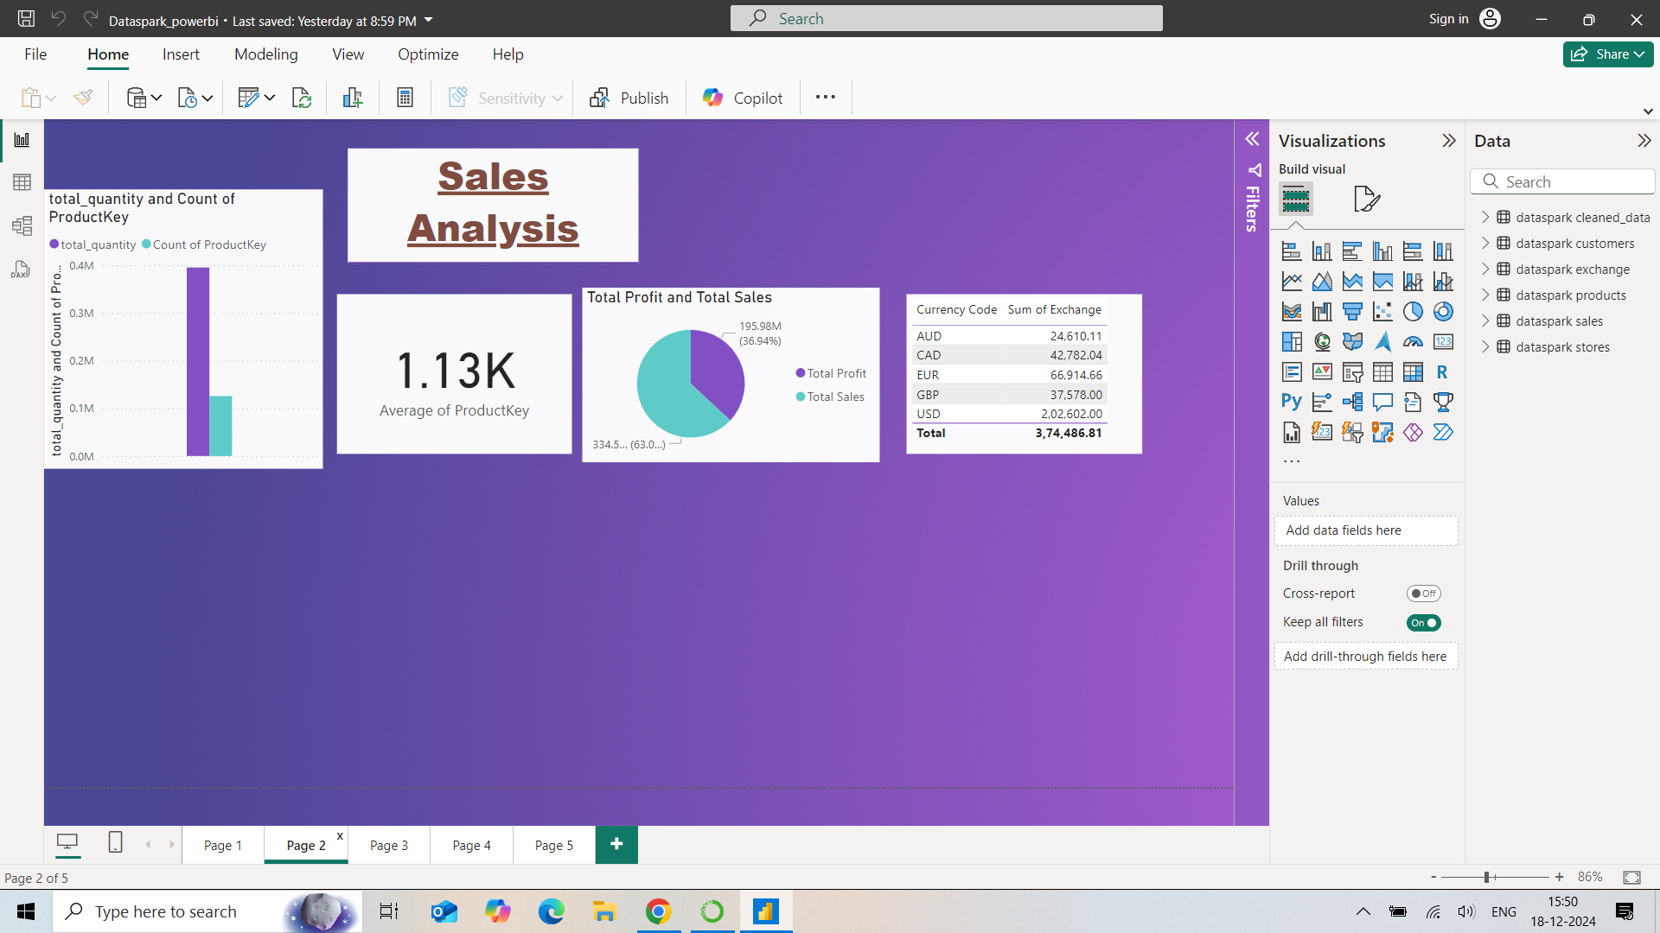

Slide 8
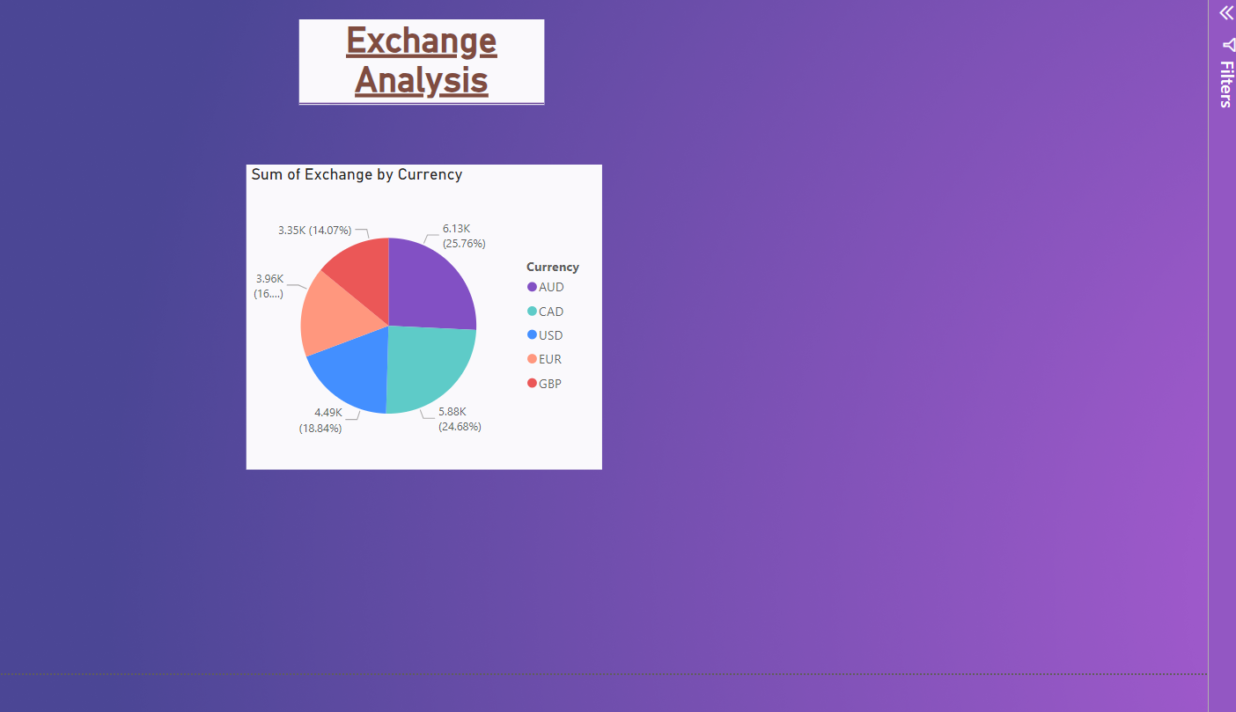
Exchange Analysis
Visuals:
1. Table: Currency Exchange Summary.
- Detailed data on exchange amounts by currency.
2. Pie Chart: Sum of Exchange by Currency.
- USD: 24.68%, CAD: 18.84%, GBP, EUR, AUD moderate.

Slide 9
Overall Business Summary
1. Customer Analysis: North America leads with most customers.
2. Product Analysis: Major sales driven by USD.
3. Store Analysis: Store count peaked between 2010-2012.
4. Exchange Analysis: USD dominates currency exchanges.
5. Sales Analysis: Total quantity is significantly higher than the product key count, with sales contributing 63.06% of revenue and 36.94% as profit.
6. Total Metrics: 1.06M customers, 58 stores, 195.98M profit.
Explanation:
The key insights highlight major findings across customers, products, stores, sales, and currency exchange. These metrics provide a clear view of business performance.

Slide 10
Thank you!!!

