Slide 1
Hospital Readmission
Risk Prediction
V.G.PRAKUL
23BCE1548
Explainable machine learning for recorded early readmission
among hospital encounters involving patients with diabetes
A complete workflow from historical data to a Streamlit application
Educational demonstration using UCI data from 1999–2008
Notes:
TIME 0:00–0:45, 45 seconds
Good morning. My project is Hospital Readmission Risk Prediction Using Explainable Machine Learning. The goal is to estimate whether a hospital encounter involving a patient with diabetes will be followed by a recorded readmission before 30 days. I developed the complete workflow, beginning with understanding the data and ending with a published Streamlit application. Along the way, I compared models, evaluated their probability estimates and explained individual predictions. The main finding is that previous hospital utilization contains useful predictive information. However, the model also produces a substantial false-positive workload. This is therefore an educational project, and clinical use would require further validation.
Sources
https://github.com/vgprakul/hospital-readmission-prediction
https://prakul-readmission-explorer.streamlit.app/
UCI dataset https://doi.org/10.24432/C5230J

Slide 2
Dataset and the main challenges
101,766
99,319
11.38%
original encounters
eligible encounters
early readmission
Challenge | How the project handles it
Repeated patients | Keep every patient in one partition
Missing and coded values | Median imputation and explicit categories
Class imbalance | Evaluate precision, recall and average precision
Cohort definition | Exclude death, hospice and unclear discharges
Target: <30 days = 1 Later or no recorded readmission = 0
Source: UCI Diabetes 130-US Hospitals, 1999–2008
2 / 8
Notes:
TIME 0:45–2:15, 90 seconds
The original UCI dataset contains 101,766 encounters from 71,518 patients. An encounter is one hospitalization, so a patient can have several records. The outcome has three labels: less than 30 days, more than 30 days and no recorded readmission. I mapped the first to one and the other two to zero. Prediction takes place at discharge. Excluding death-coded discharges, hospice and unclear completed discharges gives 99,319 encounters from 69,980 patients. About 11.38 percent have the positive outcome.
The first challenge is repeated patients. A random row split could place the same patient in training and testing and inflate performance. I used patient-grouped splitting instead. The second challenge is missing information. Weight is missing in around 97 percent of training encounters. A question mark denotes missingness, but the literal lab category None indicates no result recorded. Numerical missing values receive median imputation and categorical missingness remains explicit. Integer admission codes are categories. Third, class imbalance makes accuracy misleading: always predicting zero would achieve nearly 89 percent accuracy while finding no positives. Historical data and incomplete cross-hospital follow-up also constrain generalization.
Sources
https://github.com/vgprakul/hospital-readmission-prediction/blob/main/scripts/create_cohort_splits.py
https://github.com/vgprakul/hospital-readmission-prediction/blob/main/reports/model_comparison/training_feature_audit.csv
https://doi.org/10.24432/C5230J

Slide 3
Previous utilization shows the clearest gradient
Emergency visits
10.68% with no visits
28.74% with 4+ visits
Other EDA findings
Age varies non-linearly
Stay length and medication
count show uneven increases
Descriptive associations across 99,319 eligible encounters. Repeated encounters remain included.
These patterns do not establish causal effects.
3 / 8
Notes:
TIME 2:15–3:30, 75 seconds
The strongest descriptive pattern appears in previous inpatient utilization. Readmission increases from 8.59 percent with no inpatient visits during the preceding year to 40.48 percent with six or more. The upper category pools sparse counts. It contains 1,176 encounters from 483 people, illustrating why encounters and patients must be distinguished. Emergency utilization shows a similar gradient, rising from 10.68 percent with no prior emergency visits to 28.74 percent with four or more.
The other plots are less consistent. Age does not show a simple increasing relationship. Longer stays generally have higher rates up to about eight to ten days, followed by variation. Medication count also rises across several groups before declining in the highest category. These patterns may reflect severity, recurring care needs and other factors. They do not show that earlier visits, medication use or longer hospitalization cause readmission. The full-cohort EDA charts were produced after final evaluation and did not feed back into model or threshold tuning.
Sources
https://github.com/vgprakul/hospital-readmission-prediction/blob/main/reports/eda/readmission_by_previous_inpatient_visits.csv
https://github.com/vgprakul/hospital-readmission-prediction/blob/main/reports/eda/readmission_by_previous_emergency_visits.csv
https://github.com/vgprakul/hospital-readmission-prediction/tree/main/reports/eda

Slide 4
Model training and selection
Patient separation
Train 69,651 encounters
Validation 14,806
Test 14,862
One consistent pipeline
Engineer features, impute missing values,
encode categories and fit the model.
Compare candidates using the same
three patient-grouped training folds.
Selected: histogram gradient boosting
Sigmoid calibration slightly worsened validation Brier score and log loss. Original probabilities retained.
4 / 8
Notes:
TIME 3:30–5:00, 90 seconds
I allocated approximately 70, 15 and 15 percent of unique patients to training, validation and testing. Because patients have different encounter counts, the encounter totals differ from these exact percentages. IDs are grouping metadata and do not enter the model. I first established dummy and logistic-regression baselines, including a class-weighted logistic model. Then I compared engineered logistic regression, Random Forest and histogram gradient boosting.
Feature engineering adds total previous visits and active or changed diabetes medication counts. It replaces detailed diagnoses with broad groups. All transformations are inside a scikit-learn pipeline, and each training fold learns its own imputation, scaling and encoding. Three-fold StratifiedGroupKFold keeps each patient within one fold while attempting similar outcome proportions. Gradient boosting had the highest mean average precision, 0.2321, compared with 0.2183 for Random Forest and 0.2150 for logistic regression. Boosting builds trees sequentially to improve predictions. The histogram implementation makes training efficient by binning numerical values. These were fixed configurations rather than an extensive search. A training-only sigmoid calibration candidate slightly worsened both validation Brier score and log loss, so I retained original probabilities.
Sources
https://github.com/vgprakul/hospital-readmission-prediction/blob/main/scripts/compare_models.py
https://github.com/vgprakul/hospital-readmission-prediction/blob/main/scripts/calibrate_and_audit.py
https://github.com/vgprakul/hospital-readmission-prediction/blob/main/src/features.py

Slide 5
Final results and the alert workload
0.671
69.58%
15.89%
ROC-AUC
Recall
Precision
Actual outcome | Below threshold | Above threshold
No early readmission | 6,992 true negatives | 6,190 false positives
Early readmission | 511 missed outcomes | 1,169 detected outcomes
49.52% of test encounters flagged
14,862 test encounters AP 0.229 Brier score 0.09536
Threshold 0.0974 targeted 70% validation recall. Model and threshold froze before test evaluation.
5 / 8
Notes:
TIME 5:00–6:25, 85 seconds
I selected the highest threshold achieving at least 70 percent recall on validation data. The threshold was approximately 0.0974, equivalent to a score of 9.74 percent. This is an illustrative recall objective, not a clinically established cutoff. The model and threshold were frozen before the final test scoring pass.
On 14,862 test encounters from 10,497 patients, ROC-AUC was 0.671 and average precision was 0.229. ROC-AUC describes ranking, not classification accuracy. The model detected 1,169 of 1,680 early readmissions, giving 69.58 percent recall, while missing 511. However, there were 6,190 false positives. Precision was therefore only 15.89 percent, and almost half the test encounters were flagged. In everyday terms, it catches around seven out of ten recorded early readmissions, but only about sixteen out of every hundred flags correspond to a positive outcome. This workload is the key practical limitation. A hospital would need to assess intervention capacity, costs and benefits before using such a rule. No threshold adjustment followed the test results.
Sources
https://github.com/vgprakul/hospital-readmission-prediction/blob/main/reports/final_test/test_metrics.json
https://github.com/vgprakul/hospital-readmission-prediction/blob/main/scripts/calibrate_and_audit.py

Slide 6
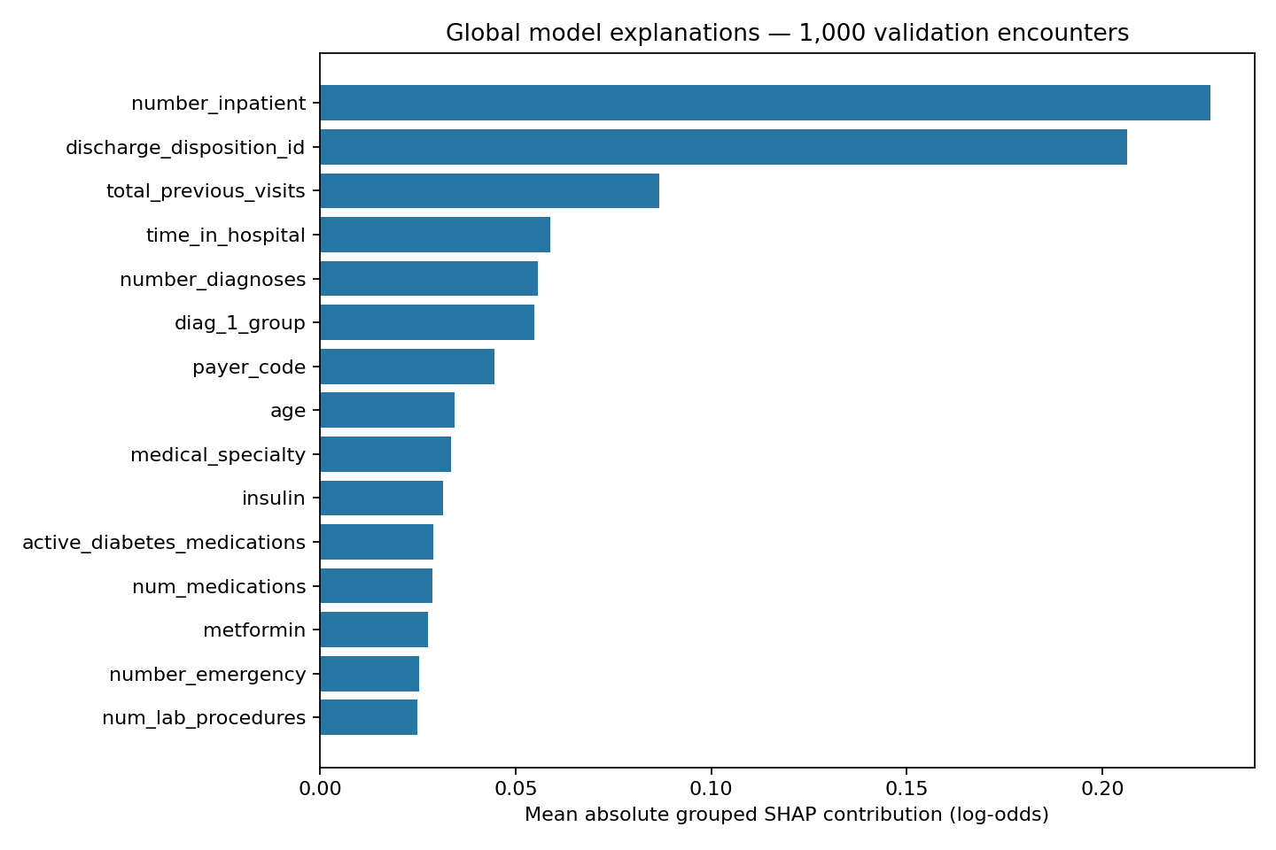
The app serves a frozen model and explains its score
1 Readmission predictor
Load a training example or edit the inputs.
Submit to receive a probability and threshold flag.
2 Prediction explanation
Tree SHAP shows each feature’s contribution.
The contributions reconstruct the model score.
3 Model performance
Inspect saved test metrics, curves and subgroups.
The app does not retrain during prediction.
Previous inpatient visits and discharge
destination lead global model attribution.
Open the live application
6 / 8
Notes:
TIME 6:25–8:00, 95 seconds including a short demo
I will now demonstrate the app. Open the Readmission predictor page and load an existing training example to save time. The examples come from training data and contain no patient identifiers. The user can edit all 47 model inputs. When I submit, the app validates numerical ranges and categorical choices, constructs a DataFrame in the required column order and calls the saved preprocessing and model pipeline. The result shows an estimated probability and whether it crosses the frozen threshold.
Next, open Prediction explanation. Tree SHAP attributes the score to individual features relative to a baseline. Positive contributions push the model score upward and negative contributions push it downward. Contributions use log-odds rather than percentage points. Correlated predictors can share attribution. These explanations describe a model calculation and must not become causal or treatment claims. The implementation checks that the contributions reconstruct the probability. The global chart uses 1,000 validation encounters and highlights inpatient history and discharge destination. Finally, open Model performance to show saved test metrics and the confusion matrix. The application loads a fixed model and does not retrain on submitted encounters. If the network is unavailable, explain these same three pages from this slide.
Sources
https://prakul-readmission-explorer.streamlit.app/
https://github.com/vgprakul/hospital-readmission-prediction/blob/main/app/app.py
https://github.com/vgprakul/hospital-readmission-prediction/blob/main/app/runtime.py
https://github.com/vgprakul/hospital-readmission-prediction/blob/main/reports/explainability/global_shap_importance.png

Slide 7
Key code and deployment decisions
Patient grouping protects the evaluation
splitter = GroupShuffleSplit(test_size=0.30, random_state=42)
train_idx, held_idx = next(
splitter.split(cohort, groups=cohort.patient_nbr)
)
The app reuses the saved pipeline and threshold
frame = make_frame(values, policy, schema)
probability = float(model.predict_proba(frame)[0, 1])
flagged = probability >= policy['threshold']
Engineering checks
Pinned dependencies, SHA-256 integrity checks and input tests
Path normalization supports Linux hosting of Windows-created artifacts
7 / 8
Notes:
TIME 8:00–9:15, 75 seconds
There are two important code ideas here. First, GroupShuffleSplit receives patient_nbr through the groups argument. That groups all records for a patient in the same partition. The held-out patient group is then divided equally into validation and testing. Assertions verify there is no overlap. Second, the app creates validated inputs, calls predict_proba on the complete saved pipeline and compares the probability with the saved operating threshold. The omitted surrounding code handles artifact loading and error checking.
This avoids manually reimplementing training transformations in the app. I use joblib to load the trusted model, cache the loaded resources and verify SHA-256 checksums for the model and feature source. I also pinned runtime dependencies and checked input handling, prediction consistency and SHAP reconstruction. A concrete deployment issue was that model metadata stored Windows path separators, while Streamlit hosting uses Linux. The loader normalizes separators before loading. The runtime package can serve predictions without the raw dataset. The displayed excerpts preserve the core logic but are not complete standalone programs.
Sources
https://github.com/vgprakul/hospital-readmission-prediction/blob/main/scripts/create_cohort_splits.py
https://github.com/vgprakul/hospital-readmission-prediction/blob/main/app/runtime.py
https://github.com/vgprakul/hospital-readmission-prediction/blob/main/scripts/check_streamlit_app.py

Slide 8
Conclusion and next steps
The completed project
Future improvements
A reproducible workflow with patient separation
and a published, explainable application.
Useful ranking signal, with a large
false-positive workload.
Validate on newer independent hospital data
Improve clinical context and outcome follow-up
Choose thresholds around intervention capacity
Assess subgroup reliability and prospective use
Educational demonstration. Clinical use requires further validation.
Live Streamlit app
GitHub source and documentation
8 / 8
Notes:
TIME 9:15–10:00, 45 seconds
To conclude, this project demonstrates a complete machine-learning workflow with explicit cohort rules, patient separation, consistent preprocessing, model comparison, threshold selection and a published application. Previous utilization provides useful predictive signal, and histogram gradient boosting performed best among the fixed engineered candidates. The biggest practical limitation is the number of false positives at the chosen recall objective. The dataset is historical and the evaluation remains internal. Future work should evaluate the locked model on newer independent hospital data, improve follow-up and clinical context, and select thresholds around real intervention capacity. Prospective assessment and subgroup reliability analysis are essential before considering clinical use. The application and source code are linked here. Thank you, and I welcome your questions.
Sources
https://prakul-readmission-explorer.streamlit.app/
https://github.com/vgprakul/hospital-readmission-prediction
https://doi.org/10.24432/C5230J

