Slide 1



05 - 09
PHARMAA
PRESENTATION
2025 June
Pharmacy medicine Management

Slide 2
Technologies:
Backend
Frontend
  Spring Web (Spring MVC) – for REST APIs
  Embedded Tomcat Server – to run the application
  HTML – page structure
  CSS – styling
  JavaScript – API communication (Fetch API)
Tool
  Spring Tool Suite (STS)
  vs code

Slide 3
What and Why :
What :
Why :
Pharmacy Management System is a Java Spring Boot web application used to manage medicine details such as name, price, quantity, expiry date, and company.
It helps pharmacies to efficiently manage medicines, track expiry dates, and maintain accurate inventory records with reduced manual effort.

Slide 4
Frontend (HTML / JavaScript)
↓
Controller Layer
↓
Service Layer
↓
Model Layer

Slide 5
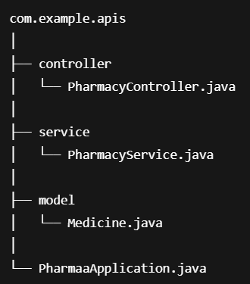

Slide 6
Package Description
Controller :
  Handles HTTP requests
  Communicates with frontend
Service :
  Contains business logic
  Processes data
Model :
  Represents data structure

Slide 7
Model.Medicine.java
Fields:
  id
  name
  price
  quantity
  expiryDate
  company

Slide 8
service.PharmacyService.java
Responsibilities:
  Add medicine
  Auto‑generate unique ID
  Merge quantity for same medicine
  Identify expired medicines

Slide 9
Controller.PharmacyController.java
APIs Provided:
  View all medicines
  Add medicine
  Delete medicine
  View expired medicines

Slide 10
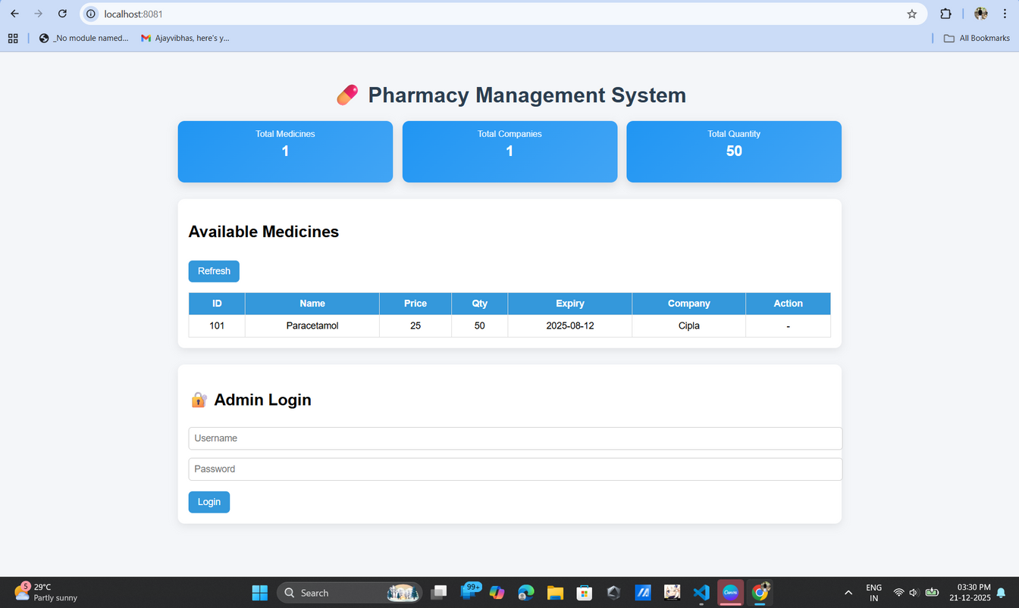
Home Page
This page is the main Pharmacy Management System dashboard. It shows total medicines, total companies, and total quantity at the top, a table of available medicines in the middle, and an admin login panel at the bottom for secure access to management actions.
  Admin login required
  Add medicine
  Delete medicine
  Logout functionality
  Normal users have view‑only access

Slide 11
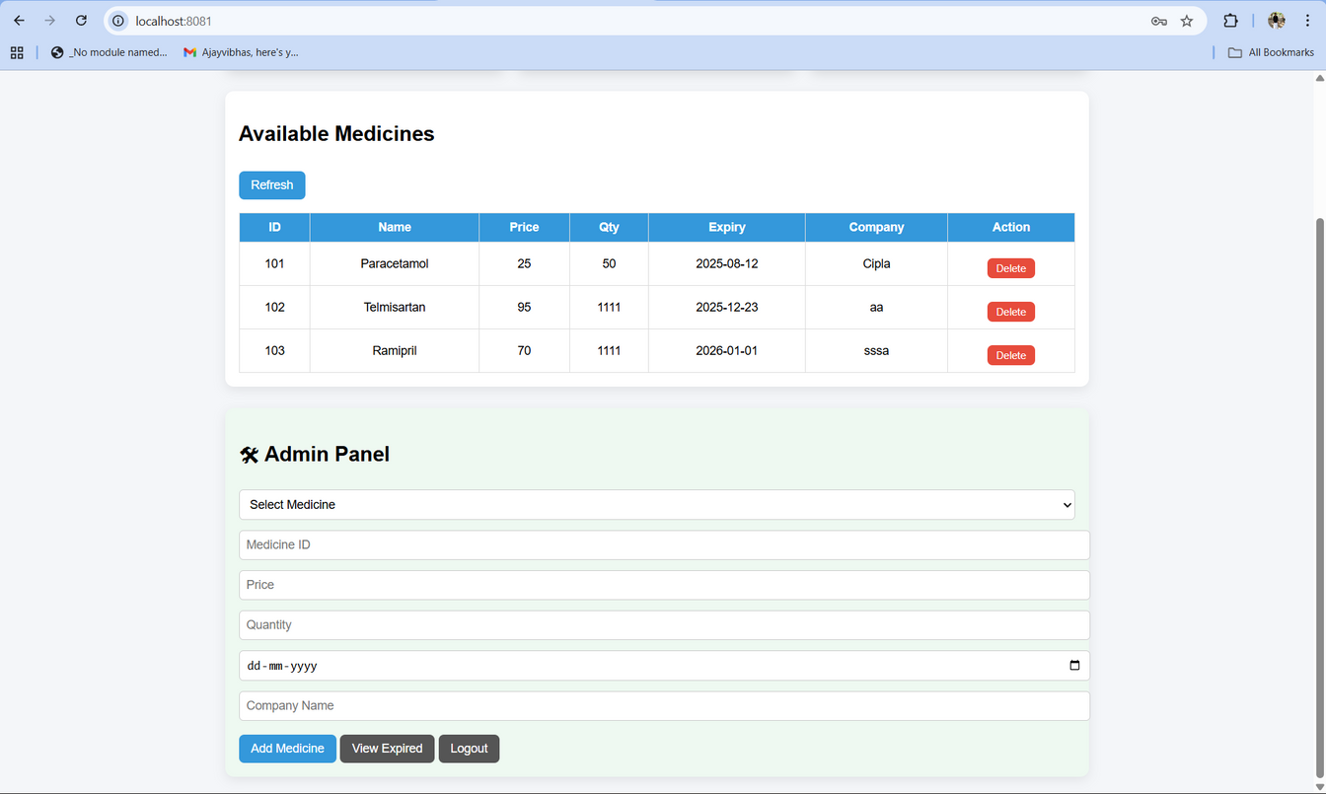
Login:
Admin login required:
  Auto‑generated medicine ID
  Expiry date validation
  Quantity merging
  Admin login & logout
  View expired medicines
After Login with unique id user can able to add / remove
/ view expired iteams

Slide 12
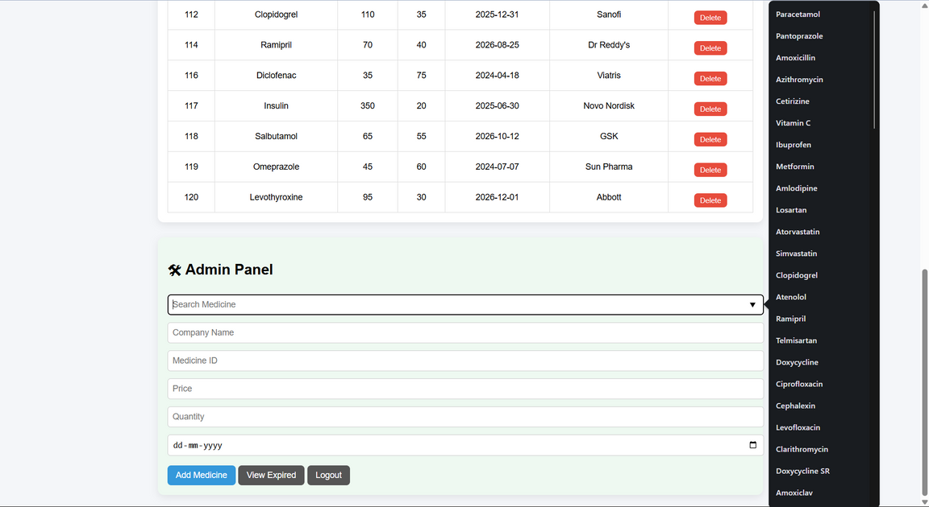
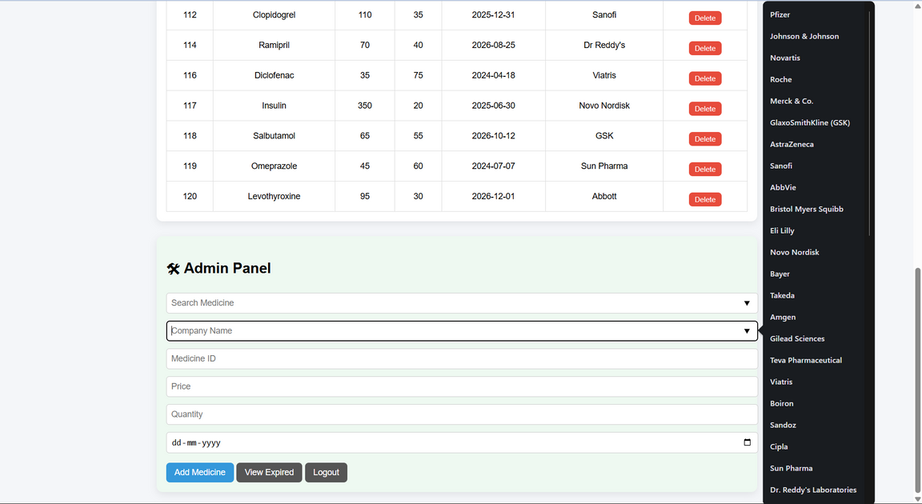
Add :
Admin can Add item by selecting medicine or search it
/ manual entery

Slide 13
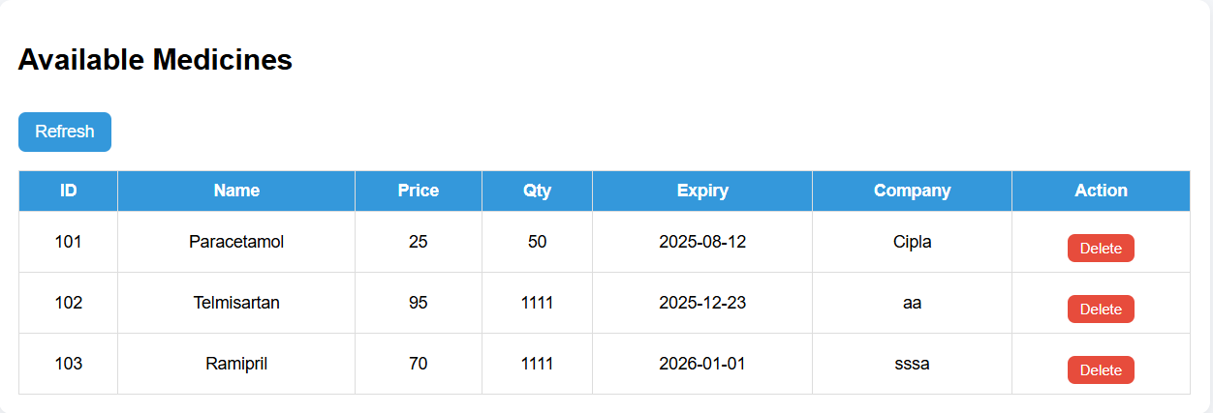
Remove:
Delete button to delete the iteam in the
data base

Slide 14
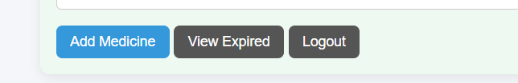
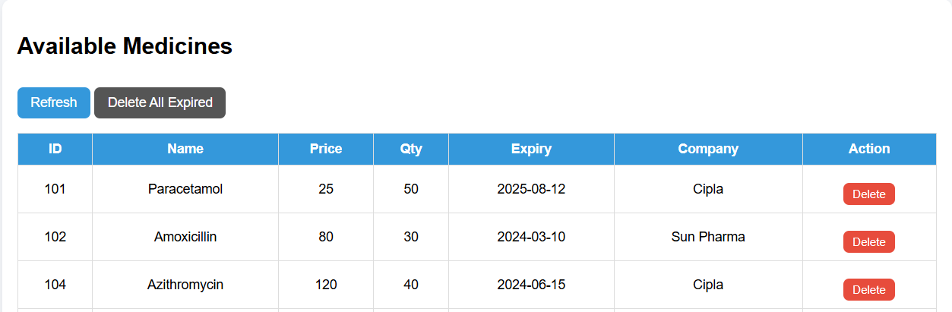
view expired :
By selecting view expired button admin can view the expired medicines
by selecting delete all it delete entire expired items

Slide 15
Logout :
by logout it take to main page

Slide 16
code and class:
  run
  admin
  add
  expired
  pharmacy
  remove
  view

Slide 17
view and run code in spring tool or in vs code:

