Slide 1

Going Virtual with Java 21 and Project Loom
Victor Grazi – Bank of NY
July 2024
Notes:
Java 21 was released late last year, and with it came one of the most important features since the release of Java 8.
That is virtual threads.
Traditionally thread creation and execution is resource intensive. Virtual threads can eliminate much of the overhead, especially in modern applications, as we will see

Slide 2






Thread Creation – Loom Style!

Slide 3
Notes:
There are two kinds of threads now, platform and virtual. You use a new builder pattern to construct them

Slide 4
How Platform Threads Work
Assigned by the JVM, thread scheduler maps them to OS threads.
Once a platform thread is assigned, it stays with the OS thread for its full life.
Expensive – Startup time, context switching, and stack memory.
Limited number of threads per application.
For blocking calls, platform thread is blocked for the life of the thread.
Notes:
Platform threads are assigned by the JVM, the thread scheduler maps them to OS threads.
Once a platform thread is assigned, it stays with the operating system thread for its full life
Platform threads are expensive – There are a few milliseconds of Startup time, and time for context switching. Also assigned stack memory for each thread
There is always a Limit to the number of threads you can have per application, so you want to use thread pooling
When a blocking call such as I/O or sleep is invoked, the platform thread is blocked for the life of the thread

Slide 5

How Virtual Threads Work
Virtual threads have no more overhead than other objects.
Thread scheduler mounts it to a platform thread (aka “carrier thread”.)
Parks and unmounted at blocking methods, and carrier can be reassigned to other virtual threads.
When blocking method completes or socket returns the bytes, virtual thread is mounted to a new carrier.
Most value is from:
I/O bound threads
sleep (but not wait) operations.
Notes:
Virtual threads are no more expensive to create than any other object
When created, thread scheduler mounts it to a platform thread (also called a “carrier thread”)
Parks at blocking methods such as sleep() or I/O, platform thread is unmounted and can be assigned to other virtual threads.
When blocking method completes or socket returns the bytes, virtual thread is mounted to a new carrier
Most value is from:
I/O bound threads, such as HTTP calls or DB calls, which is really beneficial in current microservices based architectures
sleep (but not wait) operations. We will see why not wait in a minute

Slide 6
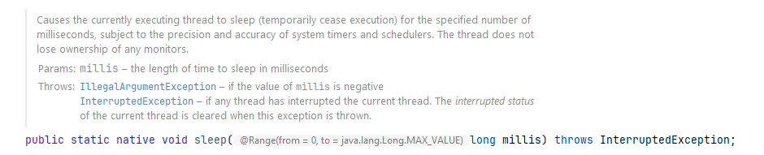
Blocking methods have been re-engineered…
Pre-Java 21

Slide 7
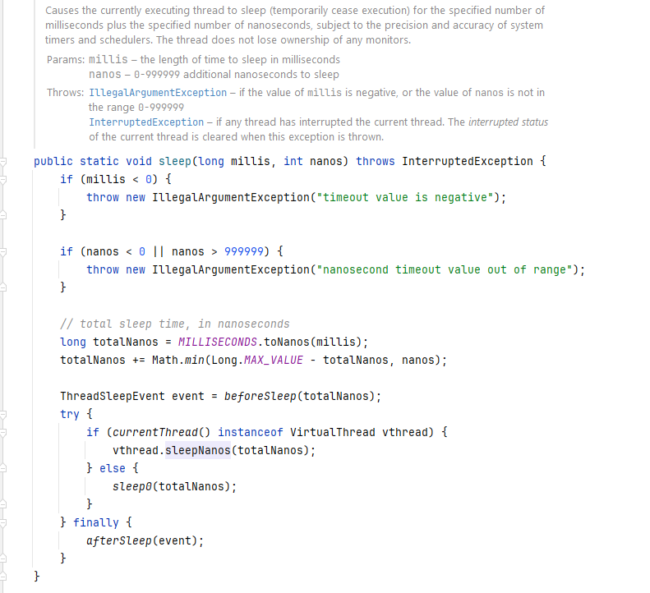
…Blocking methods have been re-engineered…
Java 21

Slide 8
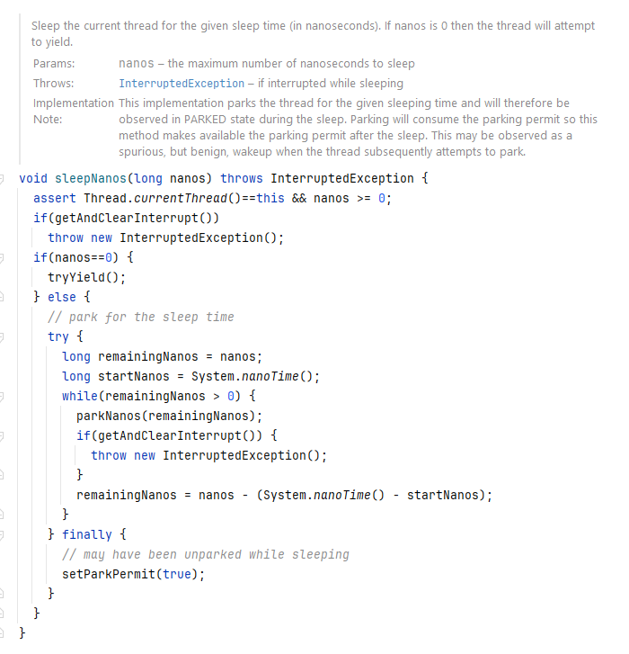
…Blocking methods have been re-engineered…
Java 21

Slide 9

Pinned Threads
Pinned threads - virtual threads that remain mounted to their carrier.
When a virtual thread enters a synchronized block, it will remain “pinned” to its carrier.
ReentrantLock has been re-engineered to work with virtual threads.
Notes:
One caveat with virtual threads –what would happen if the carrier enters a synchronized block, and you have multiple virtual threads on that carrier? Because of this, when a virtual thread enters a synchronized block, it will remain with its carrier. This is not an error condition, it just inhibits the desired action.
These are known as Pinned threads, which are virtual threads that will not be unmounted from their carrier
As a workaround, use ReentrantLock, which has been re-engineered to work with virtual threads, so if you are migrating to virtual threads, you want to change your synchronized blocks to use ReentrantLock instead

Slide 10
Virtual Threads - In Summary
No thread overhead for creation.
Very scalable, high concurrency.
Greatest benefit is for I/O bound processing.
Careful when using synchronized.

Slide 11



