Slide 1
Unit Testing
Vedran Grbavac
Hrvoje Dumančić
TVVS

Slide 2
Summary
Test Driven Development
Unit testing
Unit test class functions
Advantages and disadvantages
Unit testing frameworks
Conclusion
References

Slide 3
Test driven development
Development process that is focused on testing
Every function is tested before incorporation into the main software
Tests are written first to fully understand the task requirements
Results in better and cleaner code

Slide 4
Unit testing
White box type of testing done on small amount of code
1
Used to test the code in regards to the defined specifications and requirements
2
Methods, classes and interfaces is the most common code to be tested
3

Slide 5
Unit test class functions Four distinct methods in test classes:
setUpClass
called once before the class is instantiated
can be used to setup dependencies needed for testing
setUp
called before every test method
way to avoid duplicate code
avoid instantiating unused objects before they are called to save memory and other
tearDown
called after every test method is finished
used to destroy objects and free up memory
tearDownClass
called once after all the tests have finished
last method to be executed

Slide 6
Unit test advantages
Every unit test is done independently of other code
Early in the development cycle
Developers first write tests
they understand the requirements better
they have a better understanding of the possible problems and difficult scenarios
Great way to understand dependencies in the project and remove unnecessary ones
Tests can be udes as project documentation
The development time is quicker
discovering the location of the error is easier than with other types of testing
less time and money spent on fixing the possible errors later

Slide 7
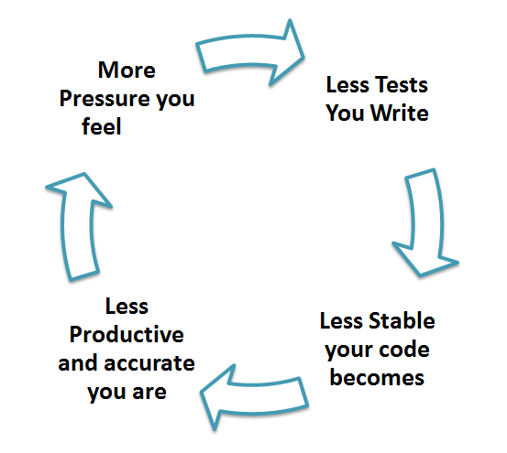
Unit test advantages
Every unit test is done independently of other code
Early in the development cycle
Developers first write tests
they understand the requirements better
they have a better understanding of the possible problems and difficult scenarios
Great way to understand dependencies in the project and remove unnecessary ones
Tests can be udes as project documentation
The development time is quicker
discovering the location of the error is easier than with other types of testing
less time and money spent on fixing the possible errors later

Slide 8
Unit test disadvantages
Only trivial scenarios are tested
larger problems can go unnoticed
only small and isolated scenarios are tested
Difficulty of setting up real test scenarios
various branches of the problems need to be tested
It is recommended to do unit testing with some other testing tehniques

Slide 9
Java testing frameworks
Junit | Spock | TestNG
De facto standard library for Unit test | Reports on variables when "AssertEqual" fails | Flexible test configuration
Supported out of the box by all major IDEs | Better exception syntax | Powerful and easy to use
Bunch of extensions available for various purposes | Support for data-driven tests | Support lot test types
Has great Ant integration | IDE might not support Spock well
Free | Syntax is very different from others
Simple

Slide 10
C# testing frameworks
MSTest | NUnit | xUnit.NET
Ships with the Visual Studio | Good Interoperability, but not with Microsoft softwares | Excellent extensibility
Easy to get started | Fast testing running | Authors are very commit and responsive
See code coverage without installing any other tools | Test annotations allowing easy specification of multiple inputs to give test | Lack of documentation
 | Doesn’t integrate in Visual Studio | More complex to learn
Interoperability(just with Microsoft software, not third party) | Need to install extra tools to work with
Performance

Slide 11
PHP testing frameworks
StoryPlayer | SeleniumHQ | PHPUnit | SimpleTest
Open source | Cross Browser Testing with its compatibility | Confine to every part of the program for unit testing | It tests every part
Simple and easy to test and debug the code | Supports different Testing Frameworks | Most widely used across the organization for unit testing | Easy to understand and find bugs if unit testing is done
Used for cross-browser testing | Useful for Comprehensive Testing | Test various types of controllers without extending | Execution will be fast
Install via Composer | Used with TDD | Tests results are customized | Mocking is complicated
If no knowledge of PHP, then it takes time to understand the test cases developed in PHP | Easy to Integrate with a different programming language | Different and multiple types of test reports are created | Can’t say that every part of the system will work correctly
Without the installation of a composer, it will not work | Only limited browsers are supported | It cannot run directly with a web browser
 | Difficulty in searching Locators | It is less functional
 | You cannot write manual scripts | For API testing it is not good for use
 | Performance is slow

Slide 12
JavaScript testing frameworks
Unit.js | QUnit | Jasmin | Karma | Mocha
Open source | Free | Behavior-driven development framework | Open source | Runs on Node.js and in the browser
Compatible with other JavaScript Testing frameworks | Used both for client-side and server-side | Can test both synchronous and asynchronous JavaScript Code | Easy workflow control Running on the command line | Performs asynchronous Testing in a simpler way
Provides full documented API of assertion list | Supports Node Longterm Support Schedule | Doesn’t require DOM | Can run the test on real devices with easy debugging | Provides accuracy and flexibility in reporting
 |  | Easy syntax | Remote control | Provides tremendous support of rich features
 |  | Does not have test runner |  | Does not include assertion and test double utilities
 |  | Unfriendly error log

Slide 13
Conclusion
Unit testing is the foundation of Test driven development where developers test the written code to see if it works with the task descriptions and requirements ( white-box )
It is a great way for programmers to understand the difficulties of the software so they coud write the code in a better and simpler format
Unit testing alone is not sufficient because it focuses on small pieces of code and needs to be done in conjuction with another testing tehnique
By doing unit tests we make sure our functions, classes and interfaces are well made so we don’t run into some troubles later on in the develpment cycle and thus not cause any time or money problems in the future

Slide 14
Let’s do SOME WORK

Slide 16
Exercise 1:
Open IDE which you have previously installed
Click on File → New Project… and then select Java Application, click “Next” and enter some name for project and after click “Finish”
Add following libraries to project → Hamcrest 1.3, JUnit 4.12, JUnit 5.3.1
Copy and paste class from GitHub into your project
Right click on Calculator.java then select “Tools → Create/Update Tests” and just click on “OK” button
Put “@Ignore” in front of every method except first one (“public void testAddition()”)
Change variables (x, y, expResult) into something that will return true value
Run test with a shortcut (Shift + F6) or right click on file and then select “Run file”
Now you done first test in JUnit, play with it and try to figure out what else it can do

Slide 17
Exercise 2:
Open the project from GitHub repository and run all test written. Some tests failed? Try to figure out why did tests failed and fix them so tests in the end pass. Tip: you will need to correct some code.

Slide 18
Exercise 3:
Check the method for checking the prime number, is it wrong? Why does it return that the test is passed?

Slide 19
Thank you for your time! any questions?

Slide 20
References
https://www.guru99.com/unit-testing-guide.html
https://blog.idrsolutions.com/2015/02/8-useful-java-testing-tools-frameworks-programmers-developers-coders/
https://javarevisited.blogspot.com/2018/01/10-unit-testing-and-integration-tools-for-java-programmers.html
https://stackify.com/unit-test-frameworks-csharp/
https://www.softwaretestinghelp.com/php-testing-framework-tools/https://www.slant.co/topics/1489/~best-javascript-unit-testing-tools
https://www.slant.co/topics/1489/~best-javascript-unit-testing-tools
https://www.guru99.com/javascript-unit-testing-frameworks.html

