Slide 1


Too Much ACID, Not Enough Reality
A guided tour of what your SELECT thinks happened
Vinicius Grippa | Marcelo Altmann
Lead Database Engineer | Senior Software Engineer
01
Notes:
35 min slot. Content runs to 30:42, Q&A from there.
Technical evidence from original slide:
Diluted ACID
What your SELECT actually returns · MySQL BRConf 2026
Vinicius Grippa · Lead Database Engineer · Behaviour verified against MySQL 9.7 LTS, commit 845d525d49c · Bench on MySQL 8.4
Brand assets and palette: https://readyset.io/ ; glyphs: https://readyset.io/icons/sprite-bulk.svg

Slide 2

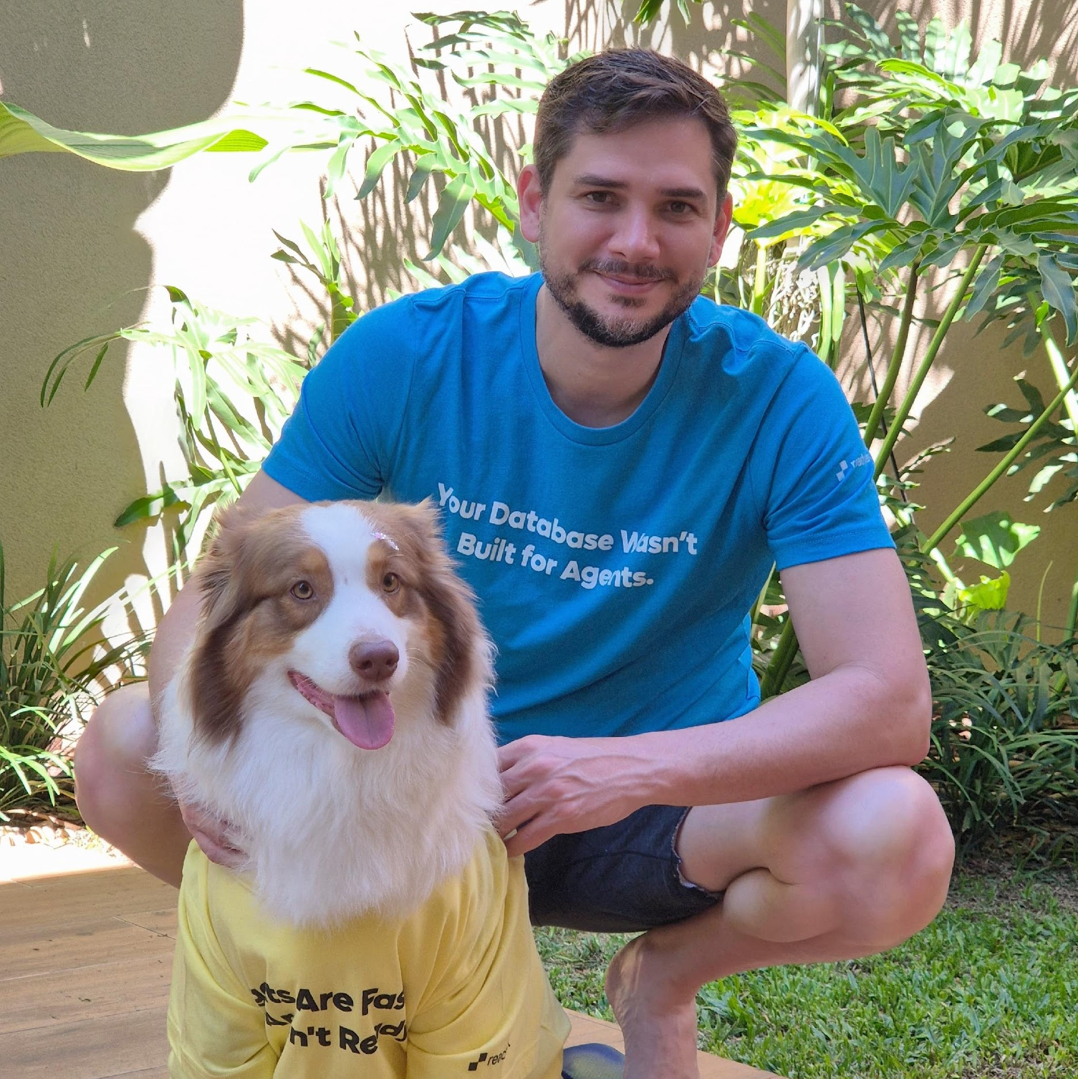


About Me
SELECT * FROM person WHERE name LIKE ‘Vini’;
Lead Database Engineer at Readyset
Ex-Percona working with MySQL and MongoDB
Co-author of the book Learning MySQL
Organizer of the MySQL community in Brazil (MUG)
02

Slide 3

About Me
SELECT SQL_NO_CACHE * FROM person WHERE name LIKE 'Marcelo';
Software Engineer at Readyset
Ex-Percona working on Percona Xtrabackup for MySQL
Oracle ACE Pro
MySQL Rockstar
MySQL Code Contributor
Rust MySQL Driver Contributor
Apache Datafusion SQLParser Contributor
— and the most important item on the résumé
Marcelo Altmann
bpftrace Contributor
Senior Software Engineer
* I fixed a typo in the README 😄
@ readyset
03

Slide 4
Three questions for the test
01 MySQL source
How old is the answer when it arrives?
02 Replica
How much extra delay does replication add?
03 Readyset
What changes when Readyset maintains the result?
Same workload, three destinations. Results from recorded experiments.
04
Notes:
Technical detail retained from original presentation:
Original slide 3:
Three questions, answered with numbers
How far behind is your read already, measured against the source itself?
What does a replica add on top of that?
What changes when the read stops executing the query at all?
Method: every behaviour claim carries a file.cc:line from the MySQL source. Every number carries the result file it came from. Where a measurement was wrong, the correction is in the deck.
Brand: https://readyset.io/

Slide 5

What 4-letter word defines how database transactions behave?
05
Notes:
Technical evidence from original slide:
01
ACID
What each letter guarantees in InnoDB, and where the guarantee ends
Brand assets and palette: https://readyset.io/ ; glyphs: https://readyset.io/icons/sprite-bulk.svg

Slide 6
A
PRAY
Pray to work. Pay the sacrifice to the gods.
B
YOLO
Real devs test in production
C
Forgot the WHERE clause
F*CK
D
Atomicity, Consistency, Isolation, Durability (boring, but correct)
ACID
06
Notes:
Explain each property using the same transfer example. Atomicity: debit Alice and credit Bob in one transaction; if the operation cannot complete, roll back the transaction. A statement error does not necessarily roll back the entire MySQL transaction automatically. Consistency: the transaction must preserve valid state and obey declared constraints; application-only business rules require application logic. Isolation: controls concurrent visibility and locking. Serial execution is the ideal of SERIALIZABLE, not a blanket promise of every isolation level. Durability: a successful durable commit survives a crash or power loss, subject to log flush settings and storage guarantees. Replication and backups are separate concerns.
Original introduction retained for the presenter:
Three questions, answered with numbers
How far behind is your read already, measured against the source itself?
What does a replica add on top of that?
What changes when the read stops executing the query at all?
Method: every behaviour claim carries a file.cc:line from the MySQL source. Every number carries the result file it came from. Where a measurement was wrong, the correction is in the deck.
Brand assets: https://readyset.io/

Slide 7
ACID
What each letter guarantees in InnoDB, and where
the guarantee ends
07
Notes:
Technical evidence from original slide:
01
ACID
What each letter guarantees in InnoDB, and where the guarantee ends
Brand assets and palette: https://readyset.io/ ; glyphs: https://readyset.io/icons/sprite-bulk.svg

Slide 8
ACID: four promises of a transaction
Example: transfer 100 from Alice to Bob.
A
Atomicity
Debit and credit are one unit. Commit both, or roll
back both.
All or nothing
C
Consistency
The transaction must obey declared rules and
constraints.
Valid state to valid state
I
Isolation
Controls what transactions see and change.
Guarantees depend on the isolation level.
Concurrent work, controlled
D
Durability
After a successful commit, changes survive a crash or
power loss with durable settings.
Committed means saved
08
Notes:
Explain each property using the same transfer example. Atomicity: debit Alice and credit Bob in one transaction; if the operation cannot complete, roll back the transaction. A statement error does not necessarily roll back the entire MySQL transaction automatically. Consistency: the transaction must preserve valid state and obey declared constraints; application-only business rules require application logic. Isolation: controls concurrent visibility and locking. Serial execution is the ideal of SERIALIZABLE, not a blanket promise of every isolation level. Durability: a successful durable commit survives a crash or power loss, subject to log flush settings and storage guarantees. Replication and backups are separate concerns.
Original introduction retained for the presenter:
Three questions, answered with numbers
How far behind is your read already, measured against the source itself?
What does a replica add on top of that?
What changes when the read stops executing the query at all?
Method: every behaviour claim carries a file.cc:line from the MySQL source. Every number carries the result file it came from. Where a measurement was wrong, the correction is in the deck.
Brand assets: https://readyset.io/

Slide 9
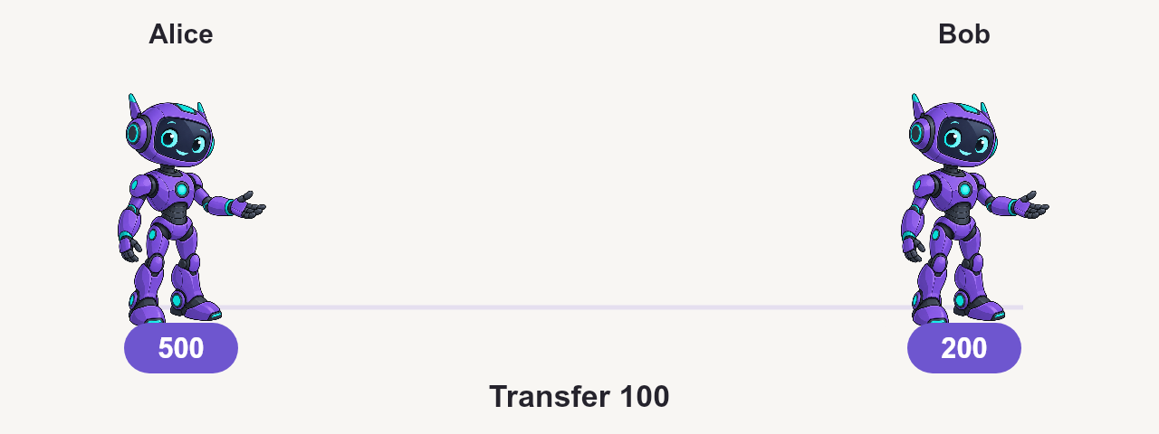
Atomicity
Click the scene to play • Hover for playback controls
09
Notes:
Illustrative transfer. A statement error alone does not necessarily roll back a whole MySQL transaction. The application rolls back when the transfer cannot complete. Undo supports rollback.
Technical detail retained from original presentation:
Original slide 5:
ACID, letter by letter, with the mechanism behind it
A · Atomicity — the undo log. Rollback walks the same version chain a consistent read does (trx0roll.cc:708-712).
C · Consistency — only what is declared: NOT NULL, CHECK, FOREIGN KEY (row0ins.cc:1412-1416). Nothing about freshness.
I · Isolation — the read view and the lock manager (row0sel.cc:4833-4842 and :5226).
D · Durability — redo log plus binary log (trx0trx.cc:1735-1750).
Default isolation level is REPEATABLE READ (sys_vars.cc:5058-5062).
Original slide 6:
The undo log serves both A and I
row_sel_build_prev_vers_for_mysql() calls row_vers_build_for_consistent_read(), and returns DB_MISSING_HISTORY when the version it needs is gone (row0sel.cc:5336-5344, row0vers.cc:1249-1252).
Same structure, two jobs: undoing a transaction, and reconstructing the past for a reader.
Operational consequence: History list length grows because rollback and consistent read compete for the same chain.
Brand: https://readyset.io/

Slide 10
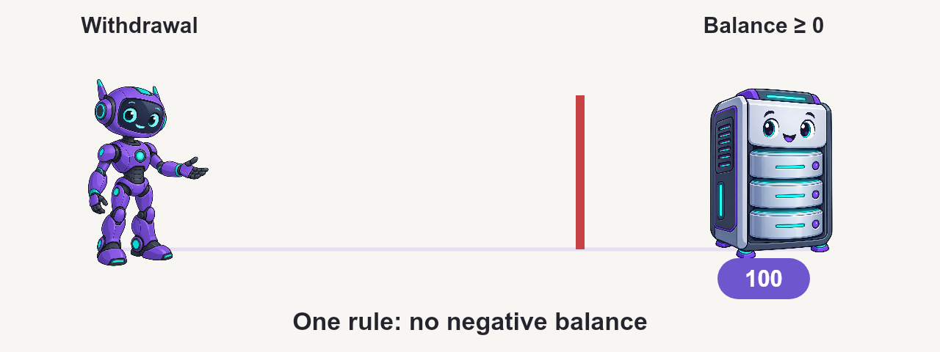
Consistency
Click the scene to play • Hover for playback controls
10
Notes:
Illustrative declared CHECK(balance >= 0). Database constraints do not implement every business rule. FK checks can take shared locks. Freshness is a separate concern.
Technical detail retained from original presentation:
Original slide 5:
ACID, letter by letter, with the mechanism behind it
A · Atomicity — the undo log. Rollback walks the same version chain a consistent read does (trx0roll.cc:708-712).
C · Consistency — only what is declared: NOT NULL, CHECK, FOREIGN KEY (row0ins.cc:1412-1416). Nothing about freshness.
I · Isolation — the read view and the lock manager (row0sel.cc:4833-4842 and :5226).
D · Durability — redo log plus binary log (trx0trx.cc:1735-1750).
Default isolation level is REPEATABLE READ (sys_vars.cc:5058-5062).
Original slide 7:
C is only what you declared. D costs an fsync.
Consistency
NOT NULL, CHECK, FOREIGN KEY
FK checks take shared locks inside your own transaction (row0ins.cc:1412-1415)
Out of scope: any rule that lives only in the application
Out of scope: recency. C never promised you a fresh row.
Durability
flush, sync, then commit in the engine (binlog.cc:7961, :8031, :8106)
With innodb_flush_method=nosync, the value 1 writes without fsync (trx0trx.cc:1727-1742)
Group commit amortizes the fsync pair per group, not per commit
9.7 note: innodb_log_file_size is gone; WL#16484 replaced hardware_concurrency()
Brand: https://readyset.io/

Slide 11
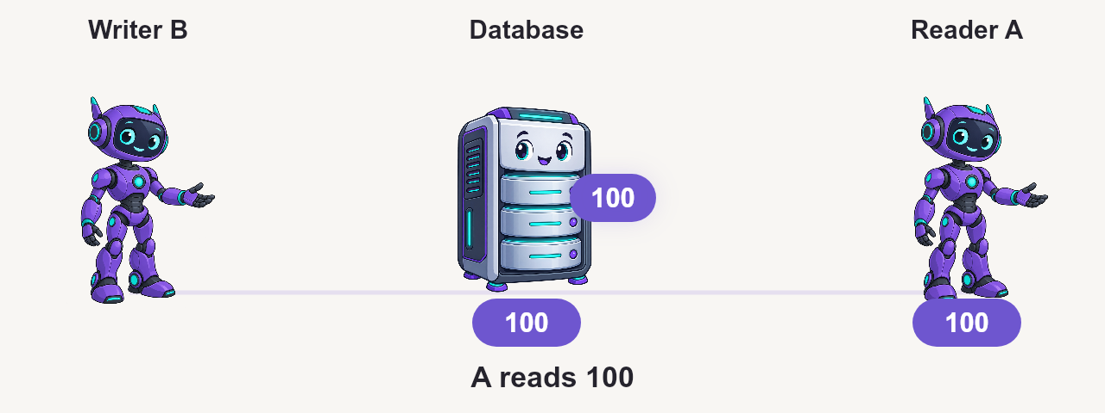
Isolation
Click the scene to play • Hover for playback controls
11
Notes:
Concurrent transactions need rules for visibility and locking. Serial execution is the ideal of SERIALIZABLE, not a blanket guarantee of all isolation levels.
Technical detail retained from original presentation:
Original slide 5:
ACID, letter by letter, with the mechanism behind it
A · Atomicity — the undo log. Rollback walks the same version chain a consistent read does (trx0roll.cc:708-712).
C · Consistency — only what is declared: NOT NULL, CHECK, FOREIGN KEY (row0ins.cc:1412-1416). Nothing about freshness.
I · Isolation — the read view and the lock manager (row0sel.cc:4833-4842 and :5226).
D · Durability — redo log plus binary log (trx0trx.cc:1735-1750).
Default isolation level is REPEATABLE READ (sys_vars.cc:5058-5062).
Original slide 10:
02
Isolation levels
What each level does with the read view
Original slide 11:
The four levels, in InnoDB's own words
From trx0trx.h:676-699, pasted without cuts.
The READ UNCOMMITTED comment ends with '; otherwise like level 2'. That clause matters: it is what ties RU to the gap-lock behaviour of READ COMMITTED (trx0trx.h:1113-1124, skip_gap_locks()).
The SERIALIZABLE comment mentions neither read view nor gap lock.
The levels are numbered 0 to 3 in the source, and that number becomes a numeric guard on the next slide.
Brand: https://readyset.io/

Slide 12
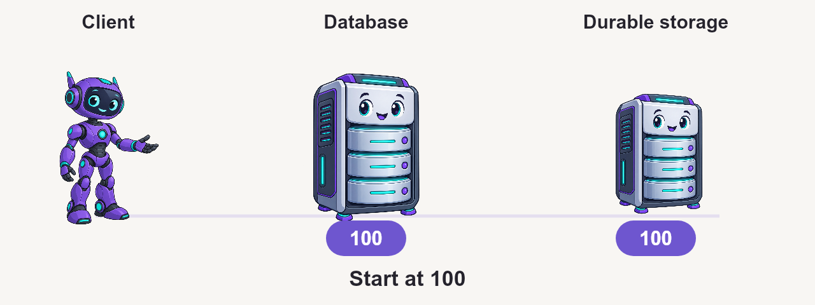
Durability
Click the scene to play • Hover for playback controls
12
Notes:
Durability depends on log flushing settings and storage guarantees. InnoDB redo and binary log coordination support durable commit. Group commit shares sync cost. Replication and backups address different failure modes.
Technical detail retained from original presentation:
Original slide 5:
ACID, letter by letter, with the mechanism behind it
A · Atomicity — the undo log. Rollback walks the same version chain a consistent read does (trx0roll.cc:708-712).
C · Consistency — only what is declared: NOT NULL, CHECK, FOREIGN KEY (row0ins.cc:1412-1416). Nothing about freshness.
I · Isolation — the read view and the lock manager (row0sel.cc:4833-4842 and :5226).
D · Durability — redo log plus binary log (trx0trx.cc:1735-1750).
Default isolation level is REPEATABLE READ (sys_vars.cc:5058-5062).
Original slide 7:
C is only what you declared. D costs an fsync.
Consistency
NOT NULL, CHECK, FOREIGN KEY
FK checks take shared locks inside your own transaction (row0ins.cc:1412-1415)
Out of scope: any rule that lives only in the application
Out of scope: recency. C never promised you a fresh row.
Durability
flush, sync, then commit in the engine (binlog.cc:7961, :8031, :8106)
With innodb_flush_method=nosync, the value 1 writes without fsync (trx0trx.cc:1727-1742)
Group commit amortizes the fsync pair per group, not per commit
9.7 note: innodb_log_file_size is gone; WL#16484 replaced hardware_concurrency()
Brand: https://readyset.io/

Slide 13
One history, two uses
Current row
Undo history
Older history
version 3
version 2
version 1
ROLLBACK
SNAPSHOT READ
Undo your changes
Reconstruct an older version
Long-lived snapshots can keep history from being purged.
13
Notes:
Technical detail retained from original presentation:
Original slide 6:
The undo log serves both A and I
row_sel_build_prev_vers_for_mysql() calls row_vers_build_for_consistent_read(), and returns DB_MISSING_HISTORY when the version it needs is gone (row0sel.cc:5336-5344, row0vers.cc:1249-1252).
Same structure, two jobs: undoing a transaction, and reconstructing the past for a reader.
Operational consequence: History list length grows because rollback and consistent read compete for the same chain.
Brand: https://readyset.io/

Slide 14
Autocommit still means a transaction
Autocommit
statement 1 COMMIT
statement 2 COMMIT
Explicit transaction
BEGIN statement 1 statement 2 COMMIT
Grouping statements changes the lifetime of the transaction and its snapshot.
14
Notes:
Technical detail retained from original presentation:
Original slide 8:
ACID is a property of the transaction
There are two scopes, STMT and SESSION (handler.cc:1273-1275, :1706-1714). Under autocommit the statement commits implicitly in external_lock(F_UNLCK) (ha_innodb.cc:19142-19148).
So every statement runs inside a transaction, even in autocommit. The audience question is fair: what is the difference then?
Under REPEATABLE READ, visibility is identical. What differs is which scope is durable, and what SERIALIZABLE does to your SELECT.
Brand: https://readyset.io/

Slide 15

Isolation levels
What each level does with the read view
15
Notes:
Technical evidence from original slide:
02
Isolation levels
What each level does with the read view
Brand assets and palette: https://readyset.io/ ; glyphs: https://readyset.io/icons/sprite-bulk.svg

Slide 16
Read Uncommitted
Click the scene to play • Hover for playback controls
16
Notes:
A may read data B later rolls back.
Illustrative timeline, not a benchmark. A and B are separate sessions. B begins a transaction before UPDATE. A uses an explicit transaction. * means uncommitted. https://dev.mysql.com/doc/refman/8.4/en/innodb-transaction-isolation-levels.html
Technical detail retained from original presentation:
Original slide 11:
The four levels, in InnoDB's own words
From trx0trx.h:676-699, pasted without cuts.
The READ UNCOMMITTED comment ends with '; otherwise like level 2'. That clause matters: it is what ties RU to the gap-lock behaviour of READ COMMITTED (trx0trx.h:1113-1124, skip_gap_locks()).
The SERIALIZABLE comment mentions neither read view nor gap lock.
The levels are numbered 0 to 3 in the source, and that number becomes a numeric guard on the next slide.
Original slide 12:
Where the read view is born, and who closes it
Born: row0sel.cc:4818-4842, in start-of-statement preparation, before the cursor opens at :4856. trx0trx.cc:2291-2305 opens a view only if none is active.
Closed: two sites, both guarded by isolation_level <= TRX_ISO_READ_COMMITTED (ha_innodb.cc:19749 and :19156).
Under pure autocommit the second one does not fire: it sits in the else branch of thd_test_options(OPTION_NOT_AUTOCOMMIT|OPTION_BEGIN). The implicit commit closes the view instead.
Under REPEATABLE READ neither fires. The view lives until COMMIT, and the undo history is pinned with it.
Original slide 13:
READ UNCOMMITTED: the view is assigned and never consulted
row0sel.cc:5322-5330 is an empty branch with the comment: 'Do nothing: we let a non-locking SELECT read the latest version of the record'.
The read view is still assigned under RU. There is no isolation guard at :4838, and :4824-4831 aborts if it is missing. What never happens is the lookup.
Compare with ha_innodb.cc:10968, where InnoDB writes an explicit guard when it really does want to skip the view.
This one line explains the lab result three blocks from now.
Original slide 14:
SERIALIZABLE has three conditions, not one
ha_innodb.cc:19072-19076 promotes a non-locking SELECT to LOCK_S only when all three hold. The comment at trx0trx.h:696-698 promises the conversion with no caveat at all.
The third condition is thd_test_options(thd, OPTION_NOT_AUTOCOMMIT | OPTION_BEGIN). That is true inside BEGIN, and also with @@autocommit=0 and no BEGIN at all.
So SERIALIZABLE in plain autocommit takes no record locks. Measured: performance_schema.data_locks returns zero rows of LOCK_TYPE='RECORD'. Inside BEGIN: RECORD S and RECORD S,GAP.
Original slide 15:
The anomalies InnoDB actually has
Consistent read
RR: one view for the whole transaction
RC: a new view per statement
RU: reads the current version, no view lookup
No phantom reads in RR, because of MVCC
Locking read
Never consults the read view (row0sel.cc:5226)
So one transaction can have a SELECT that misses a row and a SELECT FOR UPDATE that sees it
Once touched, the row carries your own trx id (read0types.h:167)
Exact match on a full UNIQUE key becomes LOCK_REC_NOT_GAP (row0sel.cc:4618-4627)
Brand: https://readyset.io/

Slide 17
Read Committed
Click the scene to play • Hover for playback controls
17
Notes:
Each new SELECT gets a new snapshot. A running SELECT keeps its view.
Illustrative timeline, not a benchmark. A and B are separate sessions. B begins a transaction before UPDATE. A uses an explicit transaction. * means uncommitted. https://dev.mysql.com/doc/refman/8.4/en/innodb-transaction-isolation-levels.html
Technical detail retained from original presentation:
Original slide 11:
The four levels, in InnoDB's own words
From trx0trx.h:676-699, pasted without cuts.
The READ UNCOMMITTED comment ends with '; otherwise like level 2'. That clause matters: it is what ties RU to the gap-lock behaviour of READ COMMITTED (trx0trx.h:1113-1124, skip_gap_locks()).
The SERIALIZABLE comment mentions neither read view nor gap lock.
The levels are numbered 0 to 3 in the source, and that number becomes a numeric guard on the next slide.
Original slide 12:
Where the read view is born, and who closes it
Born: row0sel.cc:4818-4842, in start-of-statement preparation, before the cursor opens at :4856. trx0trx.cc:2291-2305 opens a view only if none is active.
Closed: two sites, both guarded by isolation_level <= TRX_ISO_READ_COMMITTED (ha_innodb.cc:19749 and :19156).
Under pure autocommit the second one does not fire: it sits in the else branch of thd_test_options(OPTION_NOT_AUTOCOMMIT|OPTION_BEGIN). The implicit commit closes the view instead.
Under REPEATABLE READ neither fires. The view lives until COMMIT, and the undo history is pinned with it.
Original slide 13:
READ UNCOMMITTED: the view is assigned and never consulted
row0sel.cc:5322-5330 is an empty branch with the comment: 'Do nothing: we let a non-locking SELECT read the latest version of the record'.
The read view is still assigned under RU. There is no isolation guard at :4838, and :4824-4831 aborts if it is missing. What never happens is the lookup.
Compare with ha_innodb.cc:10968, where InnoDB writes an explicit guard when it really does want to skip the view.
This one line explains the lab result three blocks from now.
Original slide 14:
SERIALIZABLE has three conditions, not one
ha_innodb.cc:19072-19076 promotes a non-locking SELECT to LOCK_S only when all three hold. The comment at trx0trx.h:696-698 promises the conversion with no caveat at all.
The third condition is thd_test_options(thd, OPTION_NOT_AUTOCOMMIT | OPTION_BEGIN). That is true inside BEGIN, and also with @@autocommit=0 and no BEGIN at all.
So SERIALIZABLE in plain autocommit takes no record locks. Measured: performance_schema.data_locks returns zero rows of LOCK_TYPE='RECORD'. Inside BEGIN: RECORD S and RECORD S,GAP.
Original slide 15:
The anomalies InnoDB actually has
Consistent read
RR: one view for the whole transaction
RC: a new view per statement
RU: reads the current version, no view lookup
No phantom reads in RR, because of MVCC
Locking read
Never consults the read view (row0sel.cc:5226)
So one transaction can have a SELECT that misses a row and a SELECT FOR UPDATE that sees it
Once touched, the row carries your own trx id (read0types.h:167)
Exact match on a full UNIQUE key becomes LOCK_REC_NOT_GAP (row0sel.cc:4618-4627)
Brand: https://readyset.io/

Slide 18
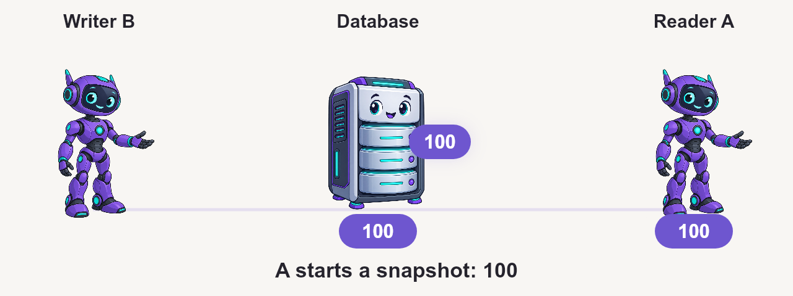
Repeatable Read
Click the scene to play • Hover for playback controls
18
Notes:
A’s first consistent read creates the snapshot. A makes no writes.
Illustrative timeline, not a benchmark. A and B are separate sessions. B begins a transaction before UPDATE. A uses an explicit transaction. * means uncommitted. https://dev.mysql.com/doc/refman/8.4/en/innodb-transaction-isolation-levels.html
Technical detail retained from original presentation:
Original slide 11:
The four levels, in InnoDB's own words
From trx0trx.h:676-699, pasted without cuts.
The READ UNCOMMITTED comment ends with '; otherwise like level 2'. That clause matters: it is what ties RU to the gap-lock behaviour of READ COMMITTED (trx0trx.h:1113-1124, skip_gap_locks()).
The SERIALIZABLE comment mentions neither read view nor gap lock.
The levels are numbered 0 to 3 in the source, and that number becomes a numeric guard on the next slide.
Original slide 12:
Where the read view is born, and who closes it
Born: row0sel.cc:4818-4842, in start-of-statement preparation, before the cursor opens at :4856. trx0trx.cc:2291-2305 opens a view only if none is active.
Closed: two sites, both guarded by isolation_level <= TRX_ISO_READ_COMMITTED (ha_innodb.cc:19749 and :19156).
Under pure autocommit the second one does not fire: it sits in the else branch of thd_test_options(OPTION_NOT_AUTOCOMMIT|OPTION_BEGIN). The implicit commit closes the view instead.
Under REPEATABLE READ neither fires. The view lives until COMMIT, and the undo history is pinned with it.
Original slide 13:
READ UNCOMMITTED: the view is assigned and never consulted
row0sel.cc:5322-5330 is an empty branch with the comment: 'Do nothing: we let a non-locking SELECT read the latest version of the record'.
The read view is still assigned under RU. There is no isolation guard at :4838, and :4824-4831 aborts if it is missing. What never happens is the lookup.
Compare with ha_innodb.cc:10968, where InnoDB writes an explicit guard when it really does want to skip the view.
This one line explains the lab result three blocks from now.
Original slide 14:
SERIALIZABLE has three conditions, not one
ha_innodb.cc:19072-19076 promotes a non-locking SELECT to LOCK_S only when all three hold. The comment at trx0trx.h:696-698 promises the conversion with no caveat at all.
The third condition is thd_test_options(thd, OPTION_NOT_AUTOCOMMIT | OPTION_BEGIN). That is true inside BEGIN, and also with @@autocommit=0 and no BEGIN at all.
So SERIALIZABLE in plain autocommit takes no record locks. Measured: performance_schema.data_locks returns zero rows of LOCK_TYPE='RECORD'. Inside BEGIN: RECORD S and RECORD S,GAP.
Original slide 15:
The anomalies InnoDB actually has
Consistent read
RR: one view for the whole transaction
RC: a new view per statement
RU: reads the current version, no view lookup
No phantom reads in RR, because of MVCC
Locking read
Never consults the read view (row0sel.cc:5226)
So one transaction can have a SELECT that misses a row and a SELECT FOR UPDATE that sees it
Once touched, the row carries your own trx id (read0types.h:167)
Exact match on a full UNIQUE key becomes LOCK_REC_NOT_GAP (row0sel.cc:4618-4627)
Brand: https://readyset.io/

Slide 19

Serializable
Click the scene to play • Hover for playback controls
19
Notes:
A uses BEGIN and reads an existing row by primary key. In plain autocommit, SELECT can use a nonlocking consistent read.
Illustrative timeline, not a benchmark. A and B are separate sessions. B begins a transaction before UPDATE. A uses an explicit transaction. * means uncommitted. https://dev.mysql.com/doc/refman/8.4/en/innodb-transaction-isolation-levels.html
Technical detail retained from original presentation:
Original slide 11:
The four levels, in InnoDB's own words
From trx0trx.h:676-699, pasted without cuts.
The READ UNCOMMITTED comment ends with '; otherwise like level 2'. That clause matters: it is what ties RU to the gap-lock behaviour of READ COMMITTED (trx0trx.h:1113-1124, skip_gap_locks()).
The SERIALIZABLE comment mentions neither read view nor gap lock.
The levels are numbered 0 to 3 in the source, and that number becomes a numeric guard on the next slide.
Original slide 12:
Where the read view is born, and who closes it
Born: row0sel.cc:4818-4842, in start-of-statement preparation, before the cursor opens at :4856. trx0trx.cc:2291-2305 opens a view only if none is active.
Closed: two sites, both guarded by isolation_level <= TRX_ISO_READ_COMMITTED (ha_innodb.cc:19749 and :19156).
Under pure autocommit the second one does not fire: it sits in the else branch of thd_test_options(OPTION_NOT_AUTOCOMMIT|OPTION_BEGIN). The implicit commit closes the view instead.
Under REPEATABLE READ neither fires. The view lives until COMMIT, and the undo history is pinned with it.
Original slide 13:
READ UNCOMMITTED: the view is assigned and never consulted
row0sel.cc:5322-5330 is an empty branch with the comment: 'Do nothing: we let a non-locking SELECT read the latest version of the record'.
The read view is still assigned under RU. There is no isolation guard at :4838, and :4824-4831 aborts if it is missing. What never happens is the lookup.
Compare with ha_innodb.cc:10968, where InnoDB writes an explicit guard when it really does want to skip the view.
This one line explains the lab result three blocks from now.
Original slide 14:
SERIALIZABLE has three conditions, not one
ha_innodb.cc:19072-19076 promotes a non-locking SELECT to LOCK_S only when all three hold. The comment at trx0trx.h:696-698 promises the conversion with no caveat at all.
The third condition is thd_test_options(thd, OPTION_NOT_AUTOCOMMIT | OPTION_BEGIN). That is true inside BEGIN, and also with @@autocommit=0 and no BEGIN at all.
So SERIALIZABLE in plain autocommit takes no record locks. Measured: performance_schema.data_locks returns zero rows of LOCK_TYPE='RECORD'. Inside BEGIN: RECORD S and RECORD S,GAP.
Original slide 15:
The anomalies InnoDB actually has
Consistent read
RR: one view for the whole transaction
RC: a new view per statement
RU: reads the current version, no view lookup
No phantom reads in RR, because of MVCC
Locking read
Never consults the read view (row0sel.cc:5226)
So one transaction can have a SELECT that misses a row and a SELECT FOR UPDATE that sees it
Once touched, the row carries your own trx id (read0types.h:167)
Exact match on a full UNIQUE key becomes LOCK_REC_NOT_GAP (row0sel.cc:4618-4627)
Brand: https://readyset.io/

Slide 20
Replica apply and replica reads
Row-based applier
Your reader
READ COMMITTED
its own isolation
Temporary, per transaction
Controls what your SELECT sees
MySQL 8.4.11 test: ROW → RC; STATEMENT → RR (replica default).
20
Notes:
Verified on MySQL Community Server 8.4.11, source and replica, with GTIDs enabled, InnoDB, four parallel workers and REPEATABLE READ defaults. This slide describes fully row-based transactions in that configuration; it is not an unconditional claim that every replication applier always uses READ COMMITTED.
Live test: source sessions at READ UNCOMMITTED, READ COMMITTED, REPEATABLE READ and SERIALIZABLE each produced an active row-based applier transaction at READ COMMITTED. With binlog_format=STATEMENT, both REPEATABLE READ and SERIALIZABLE source sessions produced an active applier transaction at the replica session default, REPEATABLE READ. Returning to ROW produced READ COMMITTED again on the same worker. The applier session variable remained REPEATABLE-READ even during the active READ COMMITTED transaction.
Method: a replica SELECT ... FOR SHARE held a lock on a dedicated test row. After committing the source update, the test joined information_schema.innodb_trx to performance_schema.threads and replication_applier_status_by_worker, and matched the APPLYING_TRANSACTION GTID to that exact source commit. TRX_ISOLATION_LEVEL measured the active InnoDB transaction, not just its session default. The lock was released by ROLLBACK after each sample. All seven updates reached the replica; both values ended at 7, workers had zero errors, and the dedicated test schema was removed.
Code proof, tag mysql-8.4.11, commit 99960bf74fa919347e4f4e3ca47672f333d6e91f:
https://github.com/mysql/mysql-server/blob/mysql-8.4.11/sql/log_event.cc#L13565-L13594
Gtid_log_event::do_apply_event checks that the transaction cannot contain statement-based changes, that the current applier isolation is above READ COMMITTED, and that the GTID is not being skipped. Only then does set_tx_isolation(... ISO_READ_COMMITTED, true) apply a one-shot override. Its reason is to avoid unnecessary InnoDB gap locking.
https://github.com/mysql/mysql-server/blob/mysql-8.4.11/sql/log_event.cc#L6209-L6232
Xid_log_event::do_commit restores transaction characteristics.
https://github.com/mysql/mysql-server/blob/mysql-8.4.11/sql/transaction.cc#L72-L80
trans_reset_one_shot_chistics restores the session isolation default.
Boundaries: row events apply source-produced row changes; they do not rerun the source transaction's reads or copy its snapshot. Replica application-client SELECTs use their own transaction isolation. MIXED must be reasoned about using actual events, not only its configuration label. The condition does not raise an applier already at READ UNCOMMITTED. This test did not exercise that configuration, XA, Group Replication or other MySQL versions. No universal statement about all replication implementations is implied.
Brand: https://readyset.io/

Slide 21

Readyset
21
Notes:
Technical evidence from original slide:
03
The lab
What was measured, with which ruler, and where the ruler failed
Brand assets and palette: https://readyset.io/ ; glyphs: https://readyset.io/icons/sprite-bulk.svg

Slide 22

the alternative · readyset
A decade of research. One problem.
origin
paper — OSDI '18
A decade of MIT research behind it
Noria: dynamic, partially stateful data-flow for high performance web applications
The Noria paper (OSDI '18) describes the partial dataflow model Readyset is built on — from MIT PDOS, a systems group focused on parallel and distributed data.
Jon Gjengset - MIT PDOS · 2018
mission
“There are only two hard things in Computer Science:
cache invalidation and naming things.”
— Phil Karlton
Readyset solves the first. You're on your own for the second.
two modes
pdos.csail.mit.edu/papers/noria:osdi18.pdf
Shallow Caching
Deep Caching
TTL-based result cache. Lightweight setup, broad coverage.
Incremental dataflow via CDC/IVM — always consistent.
open source
github.com/readysettech/readyset
22

Slide 23
Shallow Caching
23
Notes:
Technical evidence from original slide:
03
The lab
What was measured, with which ruler, and where the ruler failed
Brand assets and palette: https://readyset.io/ ; glyphs: https://readyset.io/icons/sprite-bulk.svg

Slide 24
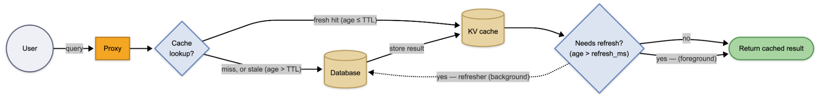
shallow caching · flow per request
How a query moves through Readyset
TTL-based result cache · asynchronous background refresh · the user always sees sub-ms
Proxy intercepts the query · KV cache stores the result set · refresher updates the entry in the background, off the user's path
outcome
Stale entry → the user gets the cached value immediately while Readyset refreshes it in the background. No stampede, no tail latency.
24

Slide 25
— shallow cache · what the application stops doing
Traditional: the application is the cache.
Readyset: SQL is the cache.
Authorization verdict per row
Stampede coalesces upstream
TTL sliding from access
Refresh pre-expiry, off-path
Dynamic refresh per key
Eviction cost-aware LFU
Admission freq × cost
Semantic Aware keys - RLS , Charset, Collation, ...
25
Notes:
Eight responsibilities — one bullet each. All eight are moves that take a "the application must handle this" decision out of the application layer and put it into the SQL/cache layer, where Readyset owns it. Authorization → verdict per row. Stampede → coalesce upstream. Refresh → pre-expiry, off-path. TTL → sliding from access. Eviction → cost-aware LFU. Row-Level Security → per-tenant keys. Dynamic refresh → per key, when upstream data changes.
The cost-aware story for memory: Readyset's shallow cache uses cost-aware admission AND eviction. Every cached result records two numbers — its size in bytes and how long the query took to run upstream. Size decides how much of the memory budget the entry uses; upstream execution time is its "cost". When the cache is full, a new result is only admitted if its request frequency multiplied by its cost beats that of the entries it would push out — so a result asked for rarely but slow to recompute can outrank one asked for often but cheap to recompute.
The next four slides expand one of these bullets at a time — freshness, traffic control, memory and cost, correctness — which is where the bullets lead.

Slide 26
Deep Caching
26
Notes:
Technical evidence from original slide:
03
The lab
What was measured, with which ruler, and where the ruler failed
Brand assets and palette: https://readyset.io/ ; glyphs: https://readyset.io/icons/sprite-bulk.svg

Slide 27
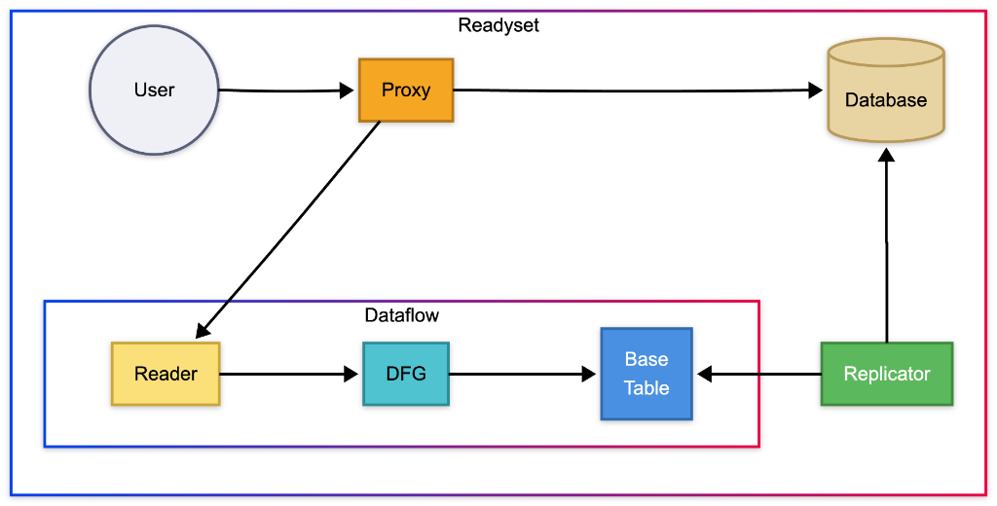
deep caching · architecture
The database notifies. Readyset keeps up.
initial snapshot · continuous CDC · incremental dataflow — no recompute when nothing changed
components
What makes up Deep
01.
Snapshot
An initial copy of the tables that will be cached — hydrates the Base Tables of the dataflow.
02.
Replication / CDC
Keeps the tables current and streams deltas into the dataflow.
03.
Proxy
Speaks the PostgreSQL wire protocol — routes reads to Readyset or to the upstream.
04.
Dataflow // heart of the system
Incremental graph: Base Table → DFG → Reader. It recomputes only what changed. Details in the next slides.
reads → served by the Reader · writes → flow straight to the Database · Replicator feeds the Dataflow
27

Slide 28
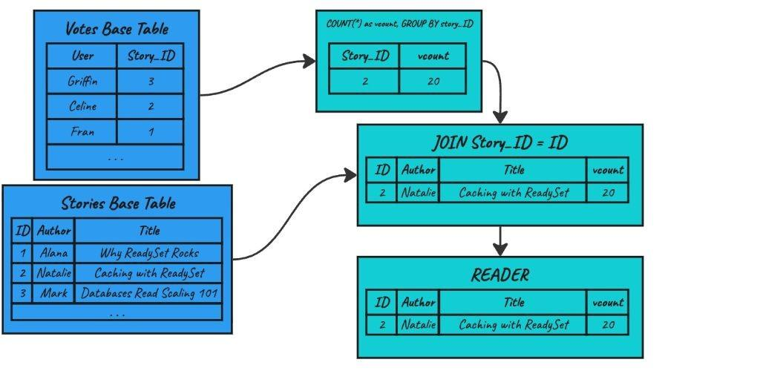
dataflow · overview
Every SQL operator becomes a node in the graph
example query
SELECT s.id, s.author, s.title, COUNT(v.*) AS vcount
FROM stories s JOIN votes v ON v.story_id = s.id WHERE s.id = ? GROUP BY s.id;
28

Slide 29
dataflow · step 1/3
Partial materialization
building the graph
The operator graph materializes only what was queried.
Base Tables. In-memory copies of PostgreSQL tables — hydrated by the initial Snapshot and updated by the Replicator.
Intermediate operators. The query parser becomes a graph: GROUP BY, JOIN, FILTER, COUNT — each one a node.
Reader. The terminal node — stores the final result set handed to the client, keyed for lookup.
Partial materialization. Each node holds only the rows actually queried — no eager materialization of whole views.
29

Slide 30
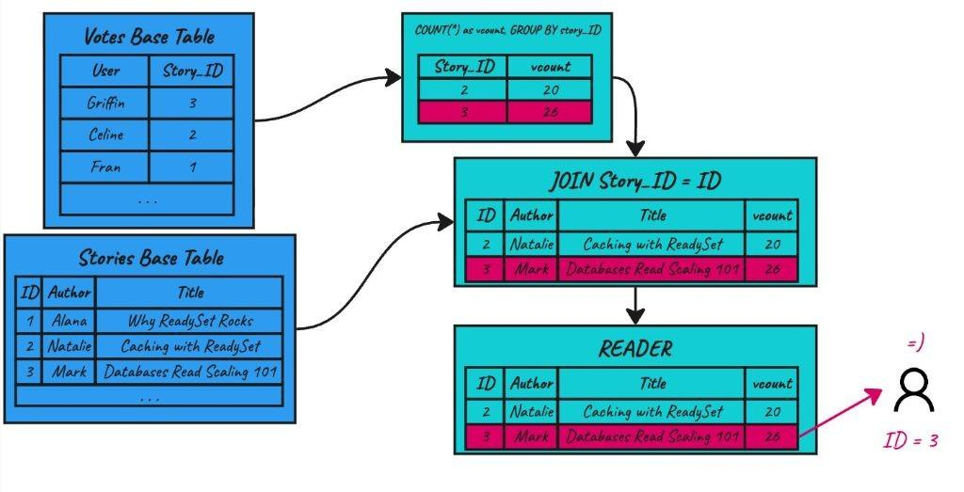
dataflow · step 2/3
Cache miss — compute on demand
a new key arrives
A user requests id = 3 — but it isn't materialized yet.
Miss at the Reader. The key id=3 isn't available in the materialized result.
Upquery. The Reader fires a reverse query — walks up the graph asking only for the rows relevant to story_id=3.
On-demand computation. Base Tables filter and return only what's needed → the aggregator recomputes vcount=26 → the JOIN completes with the stories row.
A new row is materialized. The Reader now holds id=2 and id=3 — future requests for those keys hit instantly.
No manual coalescing. Readyset guarantees that concurrent misses for the same key collapse to a single upquery.
30

Slide 31
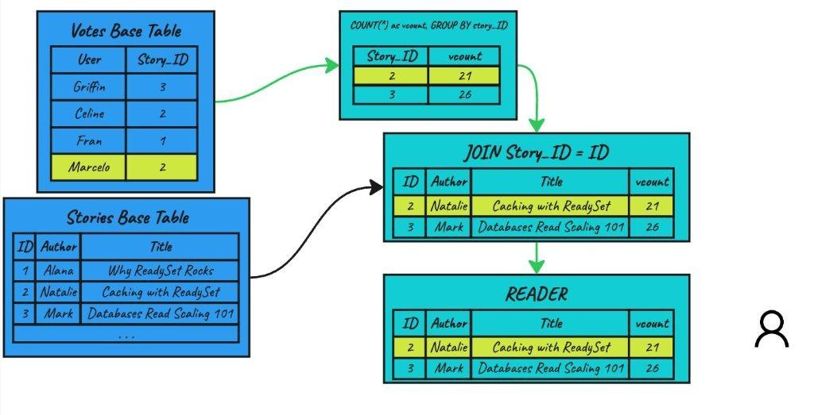
dataflow · step 3/3
Incremental view maintenance
a write arrives — what now?
A new vote from Marcelo on story 2. The delta propagates.
CDC delivers the delta. The Replicator captures the INSERT on votes and feeds the Base Table.
Incremental propagation. The aggregator receives the delta and increments: vcount 20 → 21. It does not recompute the COUNT over every vote — only the cached value is adjusted.
JOIN refreshed. The new vcount=21 reaches the JOIN node, which replaces the row for id=2.
Reader converges. The id=2 entry in the final result set is swapped atomically — the next read already sees 21.
Cost = O(delta). Work scales with what changed — not with table size.
No TTL. Consistency is bound to real changes in the data.
31

Slide 32
THE FRESHNESS LAB
“Read from the source.
It is always fresh.”
Is it still fresh when the answer arrives?
32
Notes:
Lab focus: challenge the absolute claim that selecting from the source always guarantees a fresh answer. Freshness here means recency relative to commits when the answer reaches the client, not transactional consistency. Source: https://dev.mysql.com/doc/refman/8.4/en/innodb-consistent-read.html
Lab evidence: Readyset-Lab-Comparison.json. Query: SELECT side, COUNT(*) AS n, SUM(amount) AS s FROM ledger GROUP BY side
Warm reads. Source and replica each start a fresh explicit RR read-only transaction per query. Deep cache autocommit; route checked after every read. One monotonic client clock; freshness counts acknowledged commits absent at response, not exact replication delay. Single writer, two rows/commit; baseline and final counts verified. Random target order, same Docker host. Writes remain in lab ledger under batch_id 1790213058572

Slide 33

The source is current. Your snapshot may not be.
Snapshot at 0 s
→
The query keeps this view
New commits stay outside it
Source keeps changing
REPEATABLE READ · ordinary consistent SELECT · writes continue during execution
33
Notes:
A plain consistent SELECT in InnoDB REPEATABLE READ sees its read view, not changes committed after that read view was established. The example assumes a fresh read-only transaction and a snapshot established at the start of the illustrated query. An existing RR snapshot could be older still. Locking reads are outside this example. https://dev.mysql.com/doc/refman/8.4/en/innodb-consistent-read.html
Lab evidence: Readyset-Lab-Comparison.json. Query: SELECT side, COUNT(*) AS n, SUM(amount) AS s FROM ledger GROUP BY side
Warm reads. Source and replica each start a fresh explicit RR read-only transaction per query. Deep cache autocommit; route checked after every read. One monotonic client clock; freshness counts acknowledged commits absent at response, not exact replication delay. Single writer, two rows/commit; baseline and final counts verified. Random target order, same Docker host. Writes remain in lab ledger under batch_id 1790213058572

Slide 34
10 seconds. 30 seconds. One minute.
Snapshot at 0 s → answer arrives later
10 seconds
10 s old
30 seconds
30 s old
1 minute
60 s old
Illustration: age of the snapshot at response arrival, while new commits keep happening.
34
Notes:
Illustrative durations, NOT benchmark results. For each separate scenario the snapshot is established at t=0 and the answer arrives at t=T. The snapshot is then T seconds old; this is snapshot age, not the age of every row. Newer commits during execution are not in the result. An idle database would not create missing changes merely because time passes. Query time need not equal snapshot age if view establishment happens later or an older RR snapshot is reused. https://dev.mysql.com/doc/refman/8.4/en/innodb-consistent-read.html
Lab evidence: Readyset-Lab-Comparison.json. Query: SELECT side, COUNT(*) AS n, SUM(amount) AS s FROM ledger GROUP BY side
Warm reads. Source and replica each start a fresh explicit RR read-only transaction per query. Deep cache autocommit; route checked after every read. One monotonic client clock; freshness counts acknowledged commits absent at response, not exact replication delay. Single writer, two rows/commit; baseline and final counts verified. Random target order, same Docker host. Writes remain in lab ledger under batch_id 1790213058572

Slide 35
READYSET / DEEP CACHE
Keep the answer updated.
Read it quickly.
Source changes → maintained result → lookup
35
Notes:
Readyset deep caching only. Shallow caching and replica comparison are outside the main lab. A warm supported query reuses an incrementally maintained result, with asynchronous source changes. https://readyset.io/docs/concepts/deep-caching
Lab evidence: Readyset-Lab-Comparison.json. Query: SELECT side, COUNT(*) AS n, SUM(amount) AS s FROM ledger GROUP BY side
Warm reads. Source and replica each start a fresh explicit RR read-only transaction per query. Deep cache autocommit; route checked after every read. One monotonic client clock; freshness counts acknowledged commits absent at response, not exact replication delay. Single writer, two rows/commit; baseline and final counts verified. Random target order, same Docker host. Writes remain in lab ledger under batch_id 1790213058572

Slide 36
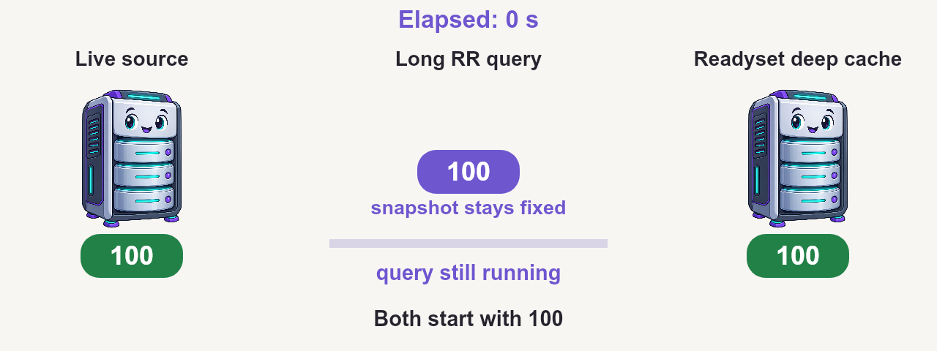
Watch the snapshot fall behind
Illustration · time compressed · cache lookup at the end · click scene to play
36
Notes:
ILLUSTRATION, not a timed database run. Animation compresses one minute into 18 seconds. Starting value 100; source commits ten-unit increments every ten simulated seconds. Illustrative propagation delay is 0.8 simulated seconds. The source RR read holds the initial snapshot and returns 100 after 60 simulated seconds. A warm deep-cache lookup performed near that completion can return 150, newer than 100 but behind the latest source value 160. This does not claim that a cache request issued at t=0 returns future data. The comparison shows a later lookup versus an already-running query. For requests issued at the same time, judge freshness at each response arrival; the cache can return sooner with less stale data at its own response time. https://dev.mysql.com/doc/refman/8.4/en/innodb-consistent-read.html https://readyset.io/docs/concepts/deep-caching
Lab evidence: Readyset-Lab-Comparison.json. Query: SELECT side, COUNT(*) AS n, SUM(amount) AS s FROM ledger GROUP BY side
Warm reads. Source and replica each start a fresh explicit RR read-only transaction per query. Deep cache autocommit; route checked after every read. One monotonic client clock; freshness counts acknowledged commits absent at response, not exact replication delay. Single writer, two rows/commit; baseline and final counts verified. Random target order, same Docker host. Writes remain in lab ledger under batch_id 1790213058572

Slide 37
Reading the source does not guarantee freshness
Ask how old the answer is
when it reaches you.
Deep cache can return sooner with newer data.
It can win when update delay + lookup time < the long query’s snapshot age.
37
Notes:
The falsified claim is unconditional freshness at response time. A source consistent read can return a snapshot that aged during execution, even though the server has newer commits. A warm deep cache can be both faster and fresher at response time when propagation plus lookup delay is smaller than the age of the source query snapshot. This does not imply linearizable reads, source transaction snapshot equivalence, or that Readyset is always fresher. The 10/30/60-second timeline scenarios are illustrative, not extrapolated benchmark results. https://dev.mysql.com/doc/refman/8.4/en/innodb-consistent-read.html https://readyset.io/docs/concepts/deep-caching
Lab evidence: Readyset-Lab-Comparison.json. Query: SELECT side, COUNT(*) AS n, SUM(amount) AS s FROM ledger GROUP BY side
Warm reads. Source and replica each start a fresh explicit RR read-only transaction per query. Deep cache autocommit; route checked after every read. One monotonic client clock; freshness counts acknowledged commits absent at response, not exact replication delay. Single writer, two rows/commit; baseline and final counts verified. Random target order, same Docker host. Writes remain in lab ledger under batch_id 1790213058572

Slide 38
4.3 Million QPS Paper
38
Notes:
Technical evidence from original slide:
03
The lab
What was measured, with which ruler, and where the ruler failed
Brand assets and palette: https://readyset.io/ ; glyphs: https://readyset.io/icons/sprite-bulk.svg

Slide 39
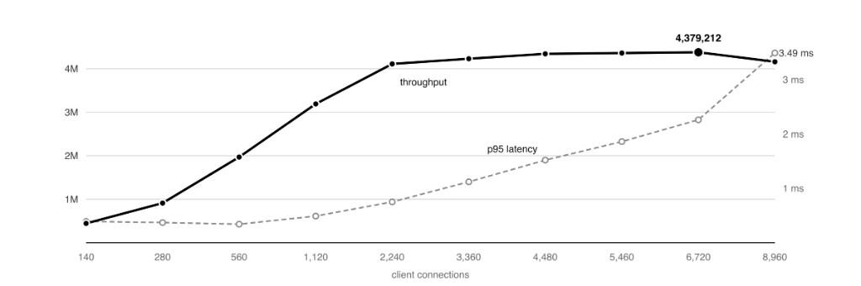
— benchmark · readyset in isolation
4,379,212 queries per second. From a single node.
Measured 14 August 2026 · MySQL wire protocol · deep cache · 1 M-row table · 10 K hot keys · serving from Readyset only.
peak throughput
4.38M
queries / second, served from cache with zero misses across 2.9 B requests.
p95 latency at peak
2.26ms
3.49 ms at 8,960 connections, after the machine has saturated.
where the cycles go
kernel networking 56.3%
Readyset userspace 42.8%
cache read path itself ~7%
39
Notes:
This is Readyset in isolation. Same machine, same day, same workload: one primary-key point lookup against 10,000 hot keys in a 1,000,000-row MySQL table, served over the MySQL wire protocol from a fully pre-built deep cache. Every request was a cache hit; the database was not in the path.
Throughput climbs linearly through 560 connections, then plateaus near 4 million queries per second. Peak is 4,379,212 at 6,720 connections at 2.26 ms p95. Past peak, additional concurrency reduces throughput and pushes tail latency out — that's queueing once the machine is saturated, which is expected.
The most useful number on this slide is the cycle breakdown. At peak the cache read path itself is roughly seven percent of all cycles on the machine. Kernel networking is fifty-six. Readyset is not the bottleneck — it has been removed as a bottleneck. Anything left to optimize is in the kernel or the protocol.

Slide 40
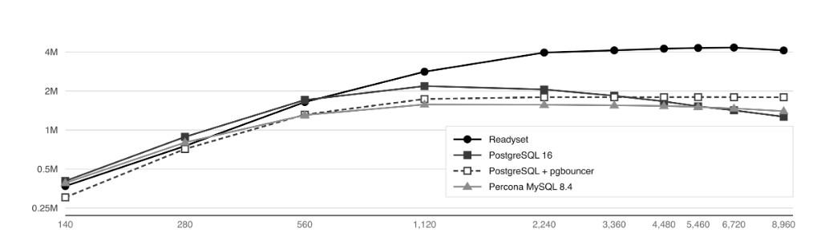
— benchmark · same workload, same hardware
Readyset vs. PostgreSQL vs. MySQL.
AMD EPYC 9454, 48 cores / 96 threads, 251 GiB RAM, 10 GbE · same 1 M-row / 10 K-key workload, served by 35 client machines on the same day.
SOURCE · Readyset Engineering · Measuring the Maximum Query Throughput of a Single Readyset Node · Table 3.
01 · Readyset
02 · PostgreSQL 16
03 · PostgreSQL + pgbouncer
04 · Percona MySQL 8.4
4.38 M peak QPS
2.18 M peak QPS
1.80 M peak QPS
1.57 M peak QPS
mode: deep cache, query logging off
shards: 24 runtime shards
workload: point lookup, MySQL wire
max_connections: 10,000
shared_buffers: 8 GiB
model: one backend / conn · JIT & parallel off
mode: transaction pool · 6 instances
prepared: max_prepared_statements 200
pool: default_pool_size 5 → fixed 1,050 conns
thread handling: pool-of-threads
thread_pool_size: 96
buffer_pool: 8 GiB · conns multiplexed
40
Notes:
Same workload, same machine, same fleet of thirty-five client generators, run within a single day. Four configurations total.
Readyset peaks at 4.33 million queries per second. PostgreSQL 16, run directly, peaks at 2.18 million — about half. Putting pgbouncer in transaction-pooling mode in front of the same Postgres peaks at 1.80 million; the pooler caps concurrency. Percona MySQL 8.4 peaks at 1.57 million.
The chart is log-scaled, so the visual gap between the curves understates the runtime gap. On a linear scale the Readyset line sits at the top while the three databases cluster in a band below. All four ran on the same AMD EPYC 9454 with 251 GiB of RAM and a 10 GbE NIC. The 1 M-row working set fits easily in any buffer configuration — the comparison is not about whether the data fits. It is about what each engine does per round trip, and Readyset does not do a round trip on the cache read path.

Slide 41
Thank you.
Questions?
readyset.io
vinicius@readyset.io
marcelo@readyset.io
41
Notes:
Technical evidence from original slide:
Thank you.
Questions?
readyset.io
vinicius@readyset.io
Bench, harness and every result file are in the talk repository
Brand assets and palette: https://readyset.io/ ; glyphs: https://readyset.io/icons/sprite-bulk.svg

