Slide 1


Too Much ACID, Not Enough Reality
A PostgreSQL tour of what your SELECT thinks happened
Vinicius Grippa
Lead Database Engineer
01
Notes:
PostgreSQL edition. The talk distinguishes transaction guarantees from the age of an answer at response arrival. PostgreSQL 18 is the semantic reference. Readyset product behavior depends on the deployed release.

Slide 2

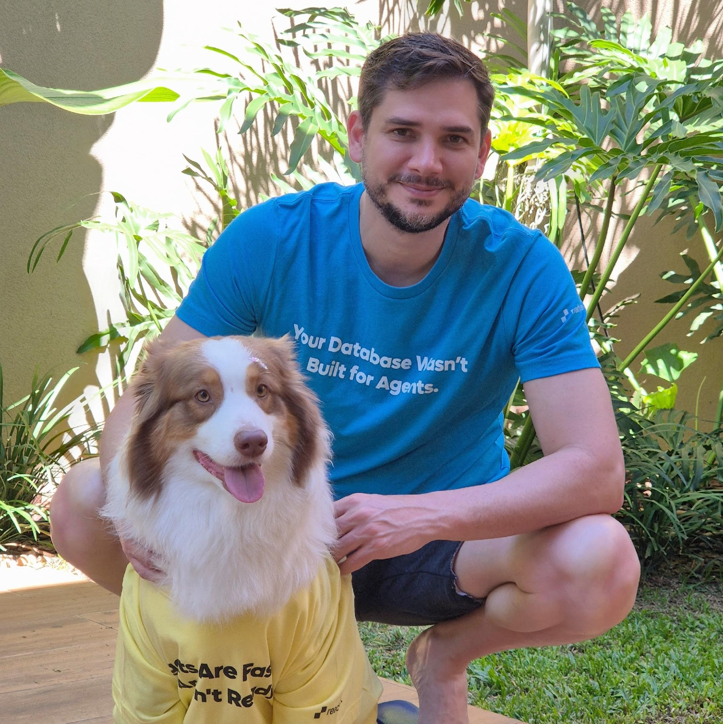
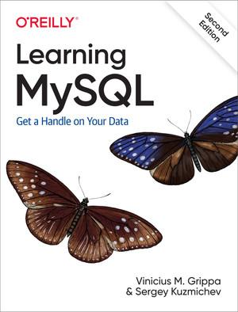
About Me
SELECT * FROM person WHERE name LIKE 'Vini';
Lead Database Engineer at Readyset
Previously at Percona, working across database technologies
Co-author of the book Learning MySQL
Organizer of the MySQL community in Brazil (MUG)
02
Notes:
The book title and community affiliation are historical facts, not database names to substitute for a new audience. Learning MySQL, second edition, by Vinicius M. Grippa and Sergey Kuzmichev. https://www.oreilly.com/library/view/learning-mysql-2nd/9781492085911/
https://www.odbms.org/2026/01/on-brazils-mysql-landscape-qa-with-vinicius-grippa/

Slide 3
Three questions about freshness
01 PostgreSQL
How old is the answer when it arrives?
02 Replica
How much extra delay does replication add?
03 Readyset
What changes when Readyset maintains the result?
PostgreSQL semantics, illustrated timelines, and a published cache benchmark
03
Notes:
The timelines illustrate semantics rather than a measured three-destination PostgreSQL experiment. The later throughput benchmark is a separate published experiment. It does not measure freshness. https://www.postgresql.org/docs/18/transaction-iso.html

Slide 4

What 4-letter word defines how database transactions behave?
04
Notes:
Audience question introducing the ACID properties of PostgreSQL transactions.

Slide 5
A
PRAY
Pray to work. Pay the sacrifice to the gods.
B
YOLO
Real devs test in production
C
Forgot the WHERE clause
F*CK
D
Atomicity, Consistency, Isolation, Durability (boring, but correct)
ACID
05
Notes:
Audience quiz. ACID means Atomicity, Consistency, Isolation, and Durability. The following slides explain PostgreSQL behavior using transaction timelines. Illustrations are not benchmark measurements.

Slide 6
ACID
What each letter guarantees in PostgreSQL, and where the guarantee ends
06
Notes:
PostgreSQL uses tuple versions and transaction visibility for MVCC, WAL for crash recovery, and locks plus Serializable Snapshot Isolation for concurrency control. https://www.postgresql.org/docs/18/transaction-iso.html
https://www.postgresql.org/docs/18/runtime-config-wal.html

Slide 7
ACID: four promises of a transaction
Example: transfer 100 from Alice to Bob.
A
Atomicity
Debit and credit are one unit. Commit both, or roll
back both.
All or nothing
C
Consistency
The transaction must obey declared rules and
constraints.
Valid state to valid state
I
Isolation
Controls what transactions see and change.
Guarantees depend on the isolation level.
Concurrent work, controlled
D
Durability
After a successful commit, changes survive a crash or
power loss with durable settings.
Committed means saved
07
Notes:
Atomicity applies to transactional changes. Sequence increments are a notable exception: nextval is not rolled back. Consistency covers declared constraints, while applications must encode other invariants. Isolation varies with the level. Durable commit assumes logged tables, appropriate WAL settings, and reliable storage. https://www.postgresql.org/docs/18/transaction-iso.html
https://www.postgresql.org/docs/18/runtime-config-wal.html

Slide 8
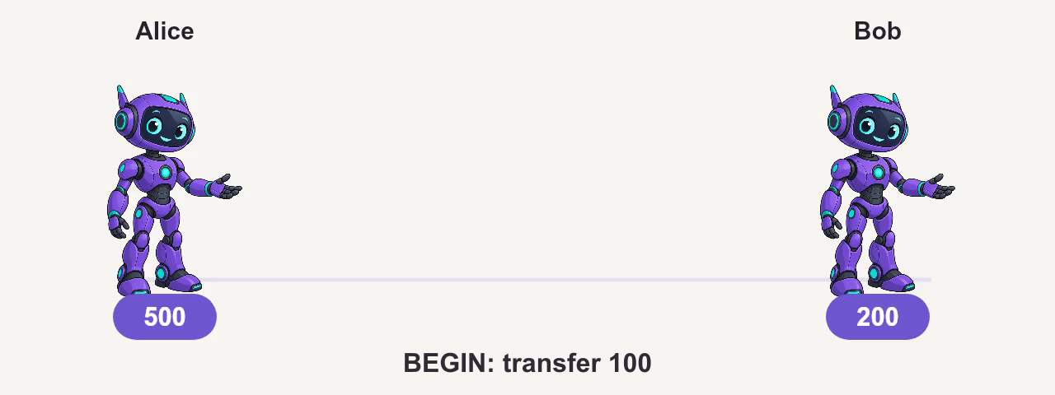
Atomicity: commit
08
Notes:
Continuous embedded animation. It starts automatically in Slide Show and contains deliberate pauses. Hover over the movie to pause or replay. The slide itself does not advance automatically.
Successful transfer only. Alice starts at 500 and Bob at 200. BEGIN, debit Alice by 100, and credit Bob by 100. The transaction has pending balances of 400 and 300. COMMIT makes the complete transfer durable and visible to eligible new snapshots. There is no rollback in this scenario. An already-running SELECT or a Repeatable Read snapshot may continue to see older committed values.
Character artwork adapted from the supplied presentation.
Sources and artwork:
https://www.postgresql.org/docs/18/tutorial-transactions.html
https://www.postgresql.org/docs/18/routine-vacuuming.html
https://www.postgresql.org/media/img/about/press/elephant.png
https://wiki.postgresql.org/wiki/Logo
https://www.postgresql.org/docs/18/transaction-iso.html

Slide 9
Atomicity: rollback
09
Notes:
Continuous embedded animation. It starts automatically in Slide Show and contains deliberate pauses. Hover over the movie to pause or replay. The slide itself does not advance automatically.
Independent failed transfer. Alice starts at 500 and Bob at 200. BEGIN, then debit Alice by 100 inside the transaction. The attempted credit fails. ROLLBACK discards the pending debit, leaving the committed balances at 500 and 200. No retry or commit follows. This illustrates all-or-nothing handling of the transfer, not a rollback phase within a successful commit.
Character artwork adapted from the supplied presentation.
Sources and artwork:
https://www.postgresql.org/docs/18/tutorial-transactions.html
https://www.postgresql.org/docs/18/routine-vacuuming.html
https://www.postgresql.org/media/img/about/press/elephant.png
https://wiki.postgresql.org/wiki/Logo
https://www.postgresql.org/docs/18/transaction-iso.html

Slide 10
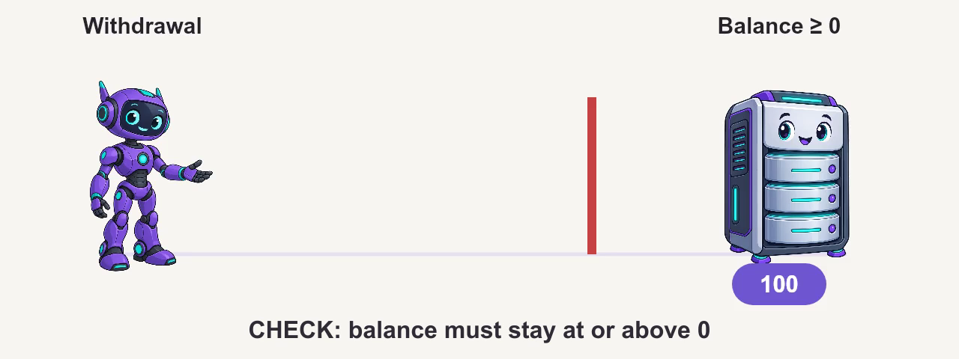
Consistency
10
Notes:
Continuous embedded animation. It starts automatically in Slide Show and contains deliberate pauses. Hover over the movie to pause or replay. The slide itself does not advance automatically.
One invalid withdrawal only. The account begins at 100 and the application attempts to withdraw 150, which would produce -50. CHECK (balance >= 0) rejects that row value. The final committed balance remains 100. The explicit transaction must be rolled back after the error. There is no successful retry in this movie; recovery with a savepoint is outside the example.
Character artwork adapted from the supplied presentation.
Sources and artwork:
https://www.postgresql.org/docs/18/ddl-constraints.html
https://www.postgresql.org/docs/18/tutorial-transactions.html
https://www.postgresql.org/media/img/about/press/elephant.png
https://wiki.postgresql.org/wiki/Logo

Slide 11
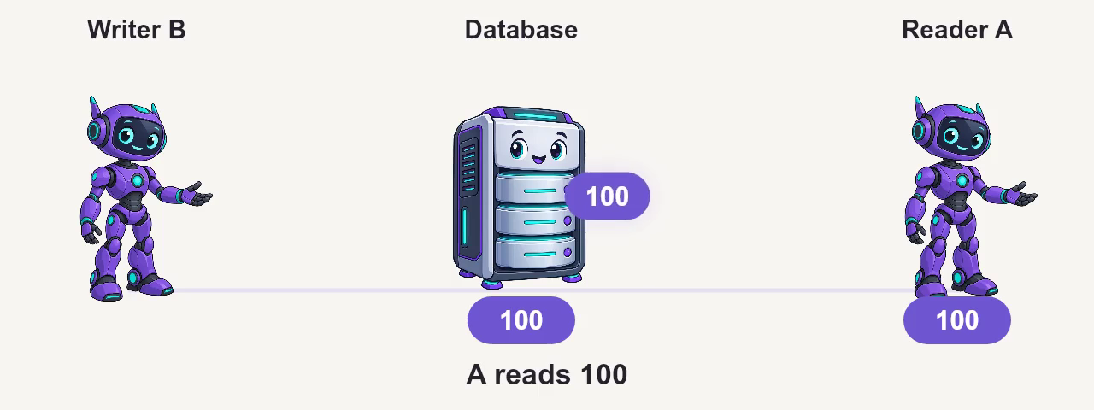
Isolation
11
Notes:
Continuous embedded animation. It starts automatically in Slide Show and contains deliberate pauses. Hover over the movie to pause or replay. The slide itself does not advance automatically.
Ordinary SELECTs in Read Committed, using two sessions. Reader A reads 100. Writer B changes the balance to 200 but has not committed, so A cannot see that pending value and still reads 100. B then commits. A's next SELECT takes a fresh statement snapshot and reads 200. A can remain in one transaction throughout. PostgreSQL uses Read Committed by default.
Character artwork adapted from the supplied presentation.
Sources and artwork:
https://www.postgresql.org/docs/18/transaction-iso.html
https://www.postgresql.org/media/img/about/press/elephant.png
https://wiki.postgresql.org/wiki/Logo

Slide 12
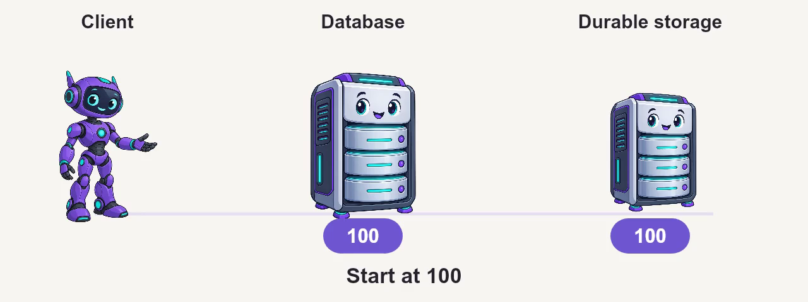
Durability
12
Notes:
Continuous embedded animation. It starts automatically in Slide Show and contains deliberate pauses. Hover over the movie to pause or replay. The slide itself does not advance automatically.
The initial balance is 100 and the transaction changes it to 200. The client requests COMMIT. With fsync=on and synchronous_commit=on, PostgreSQL makes the required local WAL durable before acknowledging COMMIT. Data pages may be written later. The server then crashes; restart and WAL recovery restore the committed value 200. Storage must honor flushes. Synchronous standby configuration can add a remote wait.
Character artwork adapted from the supplied presentation.
Sources and artwork:
https://www.postgresql.org/docs/18/runtime-config-wal.html
https://www.postgresql.org/media/img/about/press/elephant.png
https://wiki.postgresql.org/wiki/Logo

Slide 13
MVCC: tuple versions and VACUUM
Current tuple
Older tuple
Older tuple
version 3
version 2
version 1
ROLLBACK
SNAPSHOT READ
Aborted changes stay invisible
Choose a visible tuple version
Long snapshots delay cleanup. VACUUM reclaims versions no snapshot needs.
13
Notes:
PostgreSQL stores row versions in heap tuples. Tuple xmin/xmax and transaction status determine visibility. ROLLBACK marks the transaction aborted, so its versions are not visible as committed rows. VACUUM removes versions no active snapshot needs. The arrows group version history conceptually; they do not imply an InnoDB undo chain or a guaranteed physical tuple layout. Long transactions can delay cleanup and increase bloat. https://www.postgresql.org/docs/18/routine-vacuuming.html
https://www.postgresql.org/docs/18/ddl-system-columns.html

Slide 14
Autocommit still means a transaction
Autocommit
statement 1 COMMIT
statement 2 COMMIT
Explicit transaction
BEGIN statement 1 statement 2 COMMIT
READ COMMITTED: a snapshot per statement. REPEATABLE READ: one per transaction.
14
Notes:
With client autocommit enabled, individual statements run in implicit transactions. BEGIN groups statements into one transaction. Under READ COMMITTED, each statement still gets a fresh snapshot. Under REPEATABLE READ and SERIALIZABLE, the first non-transaction-control statement establishes the transaction snapshot. Own prior writes remain visible. https://www.postgresql.org/docs/18/transaction-iso.html
https://www.postgresql.org/docs/18/tutorial-transactions.html

Slide 15

Isolation levels
Statement snapshots, transaction snapshots, and serialization failures
15
Notes:
PostgreSQL accepts four SQL isolation names but offers three behaviors. READ UNCOMMITTED maps to READ COMMITTED. REPEATABLE READ prevents phantom reads but permits serialization anomalies. SERIALIZABLE adds SSI conflict detection. https://www.postgresql.org/docs/18/transaction-iso.html

Slide 16
Read Uncommitted behaves like Read Committed
16
Notes:
Continuous embedded animation. It starts automatically in Slide Show and contains deliberate pauses. Hover over the movie to pause or replay. The slide itself does not advance automatically.
Reader A requests READ UNCOMMITTED and reads 100. PostgreSQL implements this level as Read Committed. Writer B's pending update to 200 remains invisible to A, which still reads 100. After B commits, A's next SELECT takes a new statement snapshot and reads 200. No dirty read occurs.
Character artwork adapted from the supplied presentation.
Sources and artwork:
https://www.postgresql.org/docs/18/transaction-iso.html
https://www.postgresql.org/media/img/about/press/elephant.png
https://wiki.postgresql.org/wiki/Logo

Slide 17
Read Committed: PostgreSQL’s default
17
Notes:
Continuous embedded animation. It starts automatically in Slide Show and contains deliberate pauses. Hover over the movie to pause or replay. The slide itself does not advance automatically.
Ordinary SELECTs in Read Committed, using two sessions. Reader A reads 100. Writer B changes the balance to 200 but has not committed, so A cannot see that pending value and still reads 100. B then commits. A's next SELECT takes a fresh statement snapshot and reads 200. A can remain in one transaction throughout. PostgreSQL uses Read Committed by default.
Character artwork adapted from the supplied presentation.
Sources and artwork:
https://www.postgresql.org/docs/18/transaction-iso.html
https://www.postgresql.org/media/img/about/press/elephant.png
https://wiki.postgresql.org/wiki/Logo

Slide 18
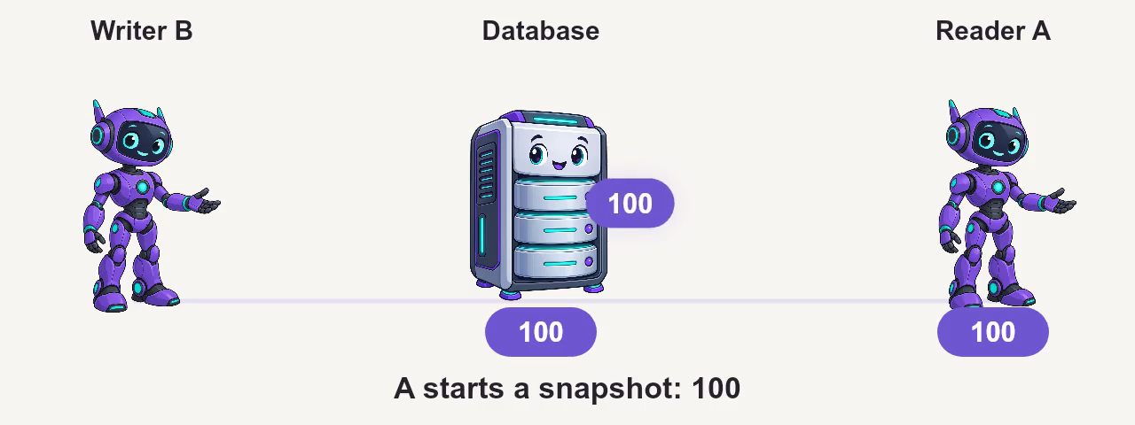
Repeatable Read: a stable snapshot
18
Notes:
Continuous embedded animation. It starts automatically in Slide Show and contains deliberate pauses. Hover over the movie to pause or replay. The slide itself does not advance automatically.
Ordinary SELECTs in Repeatable Read. A's first non-transaction-control statement establishes its snapshot and reads 100. B updates the balance to 200 and commits. A's subsequent SELECT still reads 100 from the same transaction snapshot. The movie ends with that stable snapshot; it does not show A starting a new transaction. Concurrent row updates and write-skew cases have additional rules.
Character artwork adapted from the supplied presentation.
Sources and artwork:
https://www.postgresql.org/docs/18/transaction-iso.html
https://www.postgresql.org/media/img/about/press/elephant.png
https://wiki.postgresql.org/wiki/Logo

Slide 19
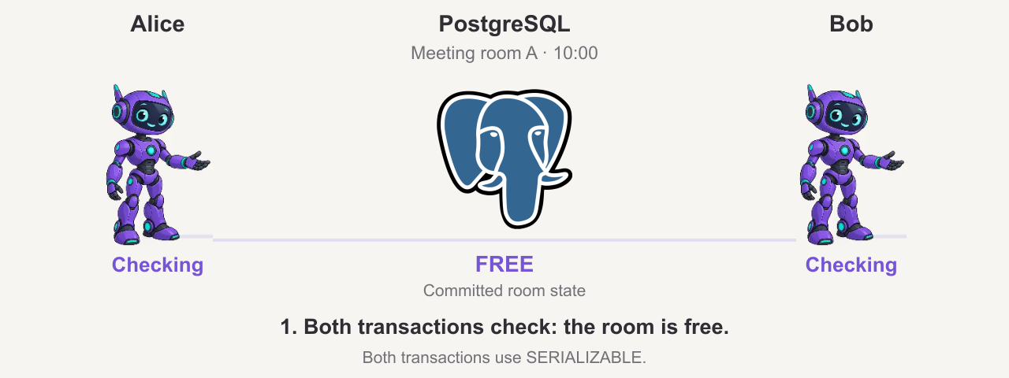
Serializable: two bookings, one room
Local PostgreSQL 18.3 test. Animation timing is illustrative.
19
Notes:
PostgreSQL 18.3 local test, 16 October 2026. Two SERIALIZABLE transactions try to book Meeting room A at 10:00.
1. Alice and Bob both SELECT availability and see no booking.
2. Both INSERT a separate pending booking row for the same room and slot.
3. Alice COMMIT succeeds.
4. Bob COMMIT fails with SQLSTATE 40001: could not serialize access due to read/write dependencies among transactions.
5. Bob retries the WHOLE transaction, including the availability SELECT. It now finds Alice's booking and does not INSERT.
Only Alice's booking remains. In the control run with REPEATABLE READ, both transactions committed and two booking rows remained.
The database display is COMMITTED room state; pending requests are not confirmations. SERIALIZABLE detects the dependency conflict; ordinary availability SELECTs do not block these inserts. The aborted transaction and error point can vary under another schedule.
Teaching schema: primary key on id only, with no UNIQUE(room,slot) or exclusion constraint, so this example isolates SSI rather than a unique-key conflict. For actual fixed slots, a UNIQUE constraint can enforce room/slot uniqueness; ranges may need an exclusion constraint. Both participating transactions here use SERIALIZABLE and implement the availability check.
The animation reproduces the observed sequence; its 32-second playback is not measured database latency.
Local evidence: 20261016_PostgreSQL_SnapshotReplica_Tests.zip (results.json and executable test_replication.py).
Sources:
https://www.postgresql.org/docs/18/transaction-iso.html#XACT-SERIALIZABLE
https://www.postgresql.org/docs/18/ddl-constraints.html
Character artwork reused from the supplied presentation. PostgreSQL elephant:
https://www.postgresql.org/media/img/about/press/elephant.png

Slide 20
Physical standby: WAL replay and read snapshots
Recovery process
Read-only client
WAL replay
RC or RR snapshot
Visibility advances after commit replay
A long snapshot can conflict with recovery
Replay lag and snapshot age both matter.
20
Notes:
This slide describes physical hot standby, not logical subscription apply. The recovery process replays WAL; it does not run the source SQL under a client isolation level. A replayed commit becomes visible to eligible new standby snapshots. Long queries can conflict with WAL cleanup or DDL replay. max_standby_streaming_delay bounds recovery waiting; queries may be canceled. hot_standby_feedback reduces cleanup conflicts but can increase primary bloat and cannot prevent every conflict. SERIALIZABLE is unavailable during hot standby. remote_apply can wait for a selected synchronous standby to replay a commit, but cannot refresh an existing reader snapshot or every replica. https://www.postgresql.org/docs/18/hot-standby.html
https://www.postgresql.org/docs/18/runtime-config-wal.html

Slide 21

Readyset
21
Notes:
Section transition. Readyset caching modes and PostgreSQL integration follow.

Slide 22

the alternative · readyset
A decade of research. One problem.
origin
paper — OSDI '18
A decade of MIT research behind it
Noria: dynamic, partially stateful data-flow for high performance web applications
The Noria paper (OSDI '18) describes the partial dataflow model Readyset is built on — from MIT PDOS, a systems group focused on parallel and distributed data.
Jon Gjengset - MIT PDOS · 2018
mission
“There are only two hard things in Computer Science:
cache invalidation and naming things.”
— Phil Karlton
Readyset solves the first. You're on your own for the second.
two modes
pdos.csail.mit.edu/papers/noria:osdi18.pdf
Shallow Caching
Deep Caching
TTL-based result cache. Lightweight setup, broad coverage.
Incremental dataflow via CDC/IVM. Eventual consistency.
open source
github.com/readysettech/readyset
22
Notes:
Deep caching maintains supported results incrementally and is eventually consistent with the source. It does not provide a blanket always-consistent or latest-commit guarantee. https://readyset.io/docs/concepts/deep-caching
https://www.usenix.org/conference/osdi18/presentation/gjengset

Slide 23
Shallow Caching
23
Notes:
Section transition. Readyset caching modes and PostgreSQL integration follow.

Slide 24
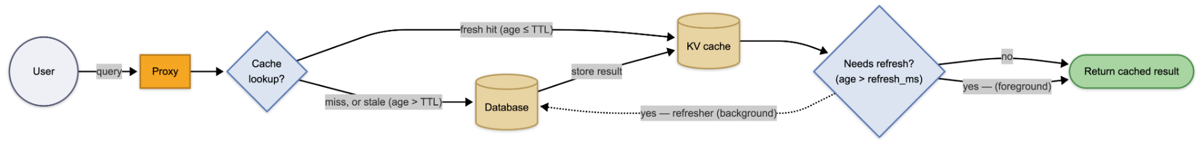
shallow caching · flow per request
How a query moves through Readyset
TTL-based results with background refresh for eligible entries
Proxy routes queries. Cache stores results. Misses and refreshes query PostgreSQL.
outcome
A refresh can serve the existing result while a background query runs. Cold or expired entries can wait for upstream.
24
Notes:
For eligible ordinary shallow entries, background refresh may return the existing result to the triggering request. Misses and expiration can require upstream work, so neither sub-millisecond latency nor zero tail latency is guaranteed. RLS-scoped caches refresh in-session on a miss rather than through background workers. The diagram depicts the ordinary eligible-entry flow. https://readyset.io/docs/concepts/shallow-caching
https://readyset.io/docs/concepts/shallow-caching/row-level-security

Slide 25
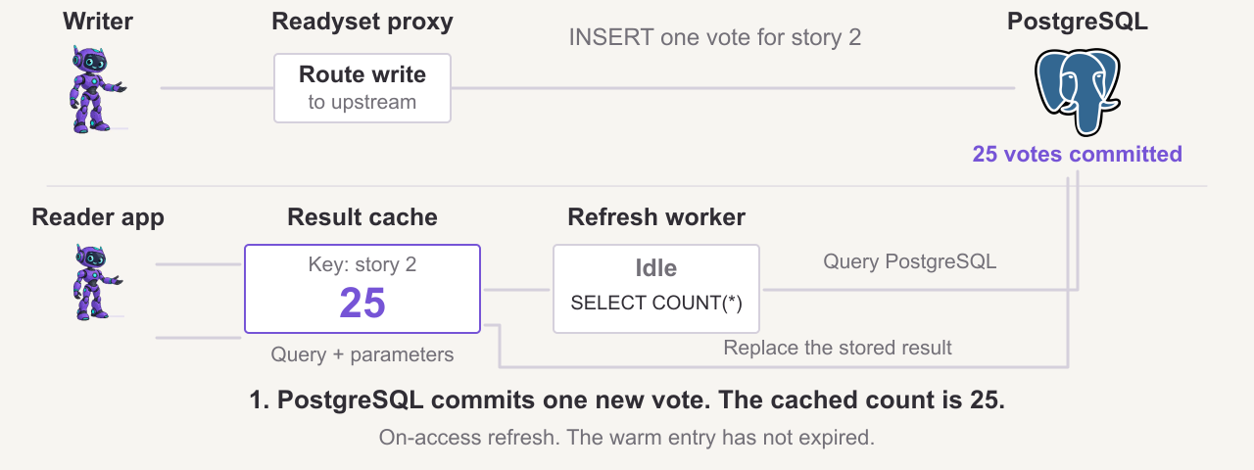
Shallow cache: refresh after a write
Warm key: story 2. Conceptual simulation. Timing is illustrative.
25
Notes:
Conceptual simulation of a warm shallow cache. Query: SELECT story_id, COUNT(*) AS votes FROM votes WHERE story_id = $1 GROUP BY story_id; parameter $1 = 2. The cached result starts as (2,25).
A writer inserts (voter_id=88, story_id=2) and commits in PostgreSQL. The database count becomes 26, but this write does not directly refresh the shallow entry.
A different reader session accesses the unexpired entry after its refresh interval. Readyset queues a background refresh and serves the existing 25. The worker reruns the query on PostgreSQL, replaces the stored result with (2,26), and a later read receives 26.
Assumptions: on-access refresh, an ordinary non-RLS query, available refresh capacity, successful refresh, no additional writes or eviction. The proxy is implicit in the lower read path. The display isolates this key and omits connection management.
TTL expiration and refresh eligibility are distinct. A cold or expired entry can wait for upstream. Scheduled refresh is another supported strategy. Failed or delayed refresh can extend staleness.
Sources:
https://readyset.io/docs/concepts/shallow-caching
https://github.com/readysettech/readyset/blob/43859f170ac41362e92cfcc376f1ab9a45f44c08/readyset-shallow/src/cache.rs#L971-L1004
https://github.com/readysettech/readyset/blob/43859f170ac41362e92cfcc376f1ab9a45f44c08/readyset-adapter/src/backend/shallow.rs#L343-L360
https://github.com/readysettech/readyset/blob/43859f170ac41362e92cfcc376f1ab9a45f44c08/readyset-adapter/src/shallow_refresh_pool.rs#L410-L441
Character artwork reused from the supplied deck. PostgreSQL logo: https://www.postgresql.org/media/img/about/press/elephant.png

Slide 26
shallow caching · PostgreSQL behavior and boundaries
Shallow caching in PostgreSQL applications
Access control: ordinary cached results are shared
Coalescing: concurrent misses can share upstream work
TTL: entry lifetime follows last access
Refresh: eligible entries refresh in the background
RLS: supported policies partition keys by session state
RLS refresh: in-session on a miss, not in the background
Policy changes: catalog polling adds a staleness window
Deep caching does not support RLS-protected tables
26
Notes:
Readyset ordinary shallow caches do not implement general upstream per-user GRANT enforcement. Supported PostgreSQL RLS policies partition entries by session inputs. Unsupported policies fall back to upstream. RLS entries skip background refresh. Policy polling has a separate staleness window, and failed polling can prolong stale policy state. Deep caches do not support RLS-protected tables. Verify the deployed release and access model. https://readyset.io/docs/concepts/shallow-caching/row-level-security
https://readyset.io/docs/concepts/shallow-caching

Slide 27
Deep Caching
27
Notes:
Section transition. Readyset caching modes and PostgreSQL integration follow.

Slide 28
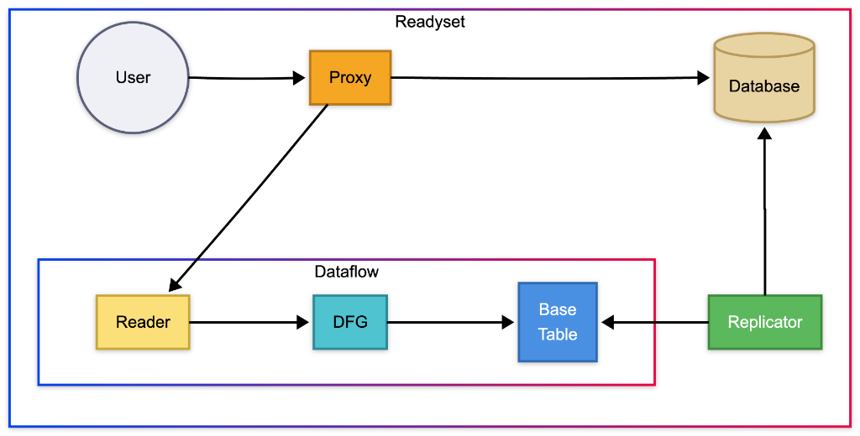
deep caching · architecture
The database notifies. Readyset keeps up.
Initial snapshot, logical replication, and incremental maintenance
components
What makes up Deep
01.
Snapshot
An initial copy of the tables that will be cached — hydrates the Base Tables of the dataflow.
02.
Replication / CDC
Streams PostgreSQL changes through a logical replication slot.
03.
Proxy
Speaks the PostgreSQL wire protocol. Routes cached reads or proxies upstream.
04.
Dataflow // heart of the system
Incremental graph: Base Table → DFG → Reader. It recomputes only what changed. Details in the next slides.
reads → served by the Reader · writes → flow straight to the Database · Replicator feeds the Dataflow
28
Notes:
For PostgreSQL deep caching, Readyset takes a snapshot and follows logical replication. It is not a physical standby. wal_level=logical and suitable replication permissions/configuration are required. Monitor replication slot WAL retention and CDC lag. Uncached or unsupported queries route upstream. https://readyset.io/docs/cache/connect/postgres
https://readyset.io/docs/concepts/deep-caching

Slide 29
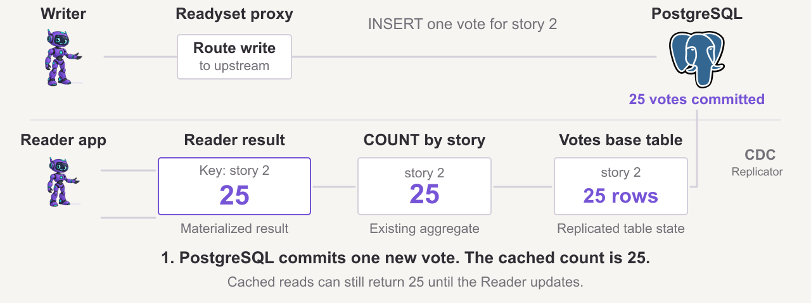
Deep cache: propagate a write
Warm key: story 2. Conceptual simulation. Timing is illustrative.
29
Notes:
Conceptual simulation of an existing deep cache with story 2 materialized. Query: SELECT story_id, COUNT(*) AS votes FROM votes WHERE story_id = $1 GROUP BY story_id; parameter $1 = 2. Initial snapshot and warm-up are already complete.
The writer inserts (voter_id=88, story_id=2) and commits in PostgreSQL. Its count becomes 26 while the Reader can still hold (2,25).
Logical replication delivers the change through the Replicator to the votes base table. COUNT applies a positive record to the existing group: 25 + 1 = 26. The changed result propagates to the Reader. A later cached lookup for key 2 returns (2,26).
The diagram simplifies the physical graph and shows one successful INSERT. The base-table row count shown is only for story 2. Other groups are unaffected. The proxy is implicit in the lower read path. Deletes subtract and updates can produce negative and positive records. This is incremental maintenance, with asynchronous propagation, rather than a periodic full SQL refresh.
Cold or evicted keys can require replay/upquery work, covered in the following slides. This warm-key example is not a read-your-writes guarantee or a measured latency comparison.
Sources:
https://readyset.io/docs/concepts/deep-caching
https://github.com/readysettech/readyset/blob/43859f170ac41362e92cfcc376f1ab9a45f44c08/replicators/src/postgres_connector/connector.rs#L1084-L1120
https://github.com/readysettech/readyset/blob/43859f170ac41362e92cfcc376f1ab9a45f44c08/replicators/src/postgres_connector/connector.rs#L1174-L1192
https://github.com/readysettech/readyset/blob/43859f170ac41362e92cfcc376f1ab9a45f44c08/readyset-dataflow/src/ops/grouped/aggregate.rs#L235-L249
Character artwork reused from the supplied deck. PostgreSQL logo: https://www.postgresql.org/media/img/about/press/elephant.png

Slide 30
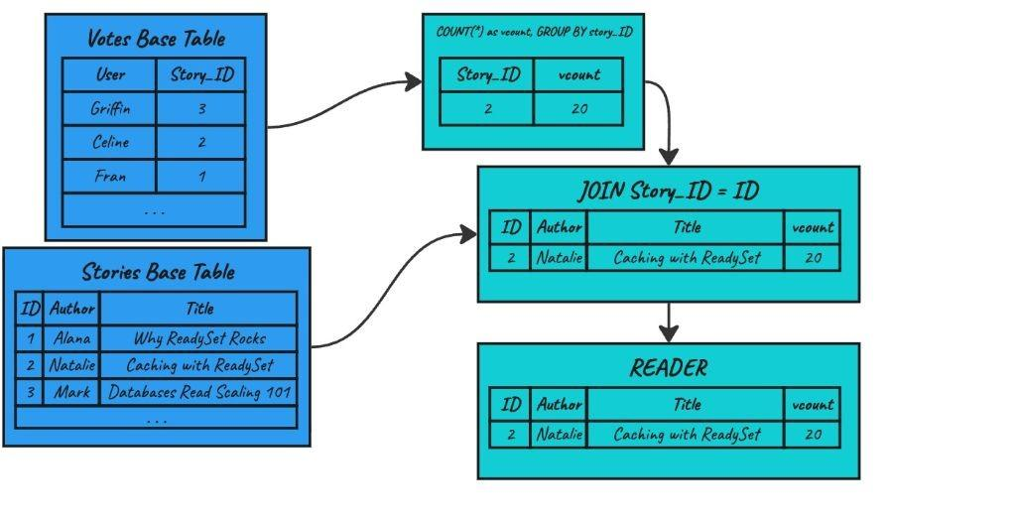
dataflow · overview
Supported SQL operators become dataflow nodes
example query
SELECT s.id, s.author, s.title, COUNT(*) AS vcount
FROM stories s JOIN votes v ON v.story_id = s.id WHERE s.id = $1 GROUP BY s.id, s.author, s.title;
30
Notes:
PostgreSQL prepared-statement parameters use $1. COUNT(*) counts joined vote rows. Explicit GROUP BY s.id, s.author, s.title avoids reliance on functional-dependency inference. The sample query was prepared and executed against local PostgreSQL 18.3 tables. This checks PostgreSQL syntax, not support by every Readyset release. https://readyset.io/docs/concepts/deep-caching

Slide 31
dataflow · step 1/3
Partial materialization
building the graph
The graph maintains results as data changes.
Base Tables. In-memory copies of PostgreSQL tables — hydrated by the initial Snapshot and updated by the Replicator.
Intermediate operators. The query parser becomes a graph: GROUP BY, JOIN, FILTER, COUNT — each one a node.
Reader. The terminal node — stores the final result set handed to the client, keyed for lookup.
Partial materialization. Intermediate results can be demand-driven. Base tables still retain replicated state.
31
Notes:
Partial materialization applies to demand-driven state within the graph. Do not infer that every base-table copy contains only keys the application queried. Memory use also includes replicated base state and operator state. https://readyset.io/docs/concepts/deep-caching

Slide 32
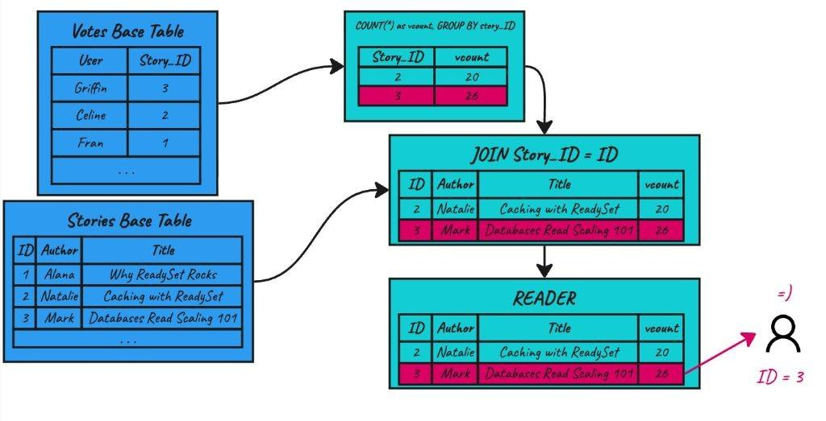
dataflow · step 2/3
Cache miss — compute on demand
a new key arrives
A user requests id = 3 — but it isn't materialized yet.
Miss at the Reader. The key id=3 isn't available in the materialized result.
Upquery. The Reader fires a reverse query — walks up the graph asking only for the rows relevant to story_id=3.
On-demand computation. Base Tables filter and return only what's needed → the aggregator recomputes vcount=26 → the JOIN completes with the stories row.
A new result is materialized. The Reader now holds id=2 and id=3 for subsequent lookups.
Concurrent misses. Upqueries can share work. Cold lookups still pay computation and scheduling costs.
32
Notes:
A cold result requires upstream graph work and may have higher latency. Warm hits avoid recomputing the supported result. Eviction can make a later request cold again. https://readyset.io/docs/concepts/deep-caching

Slide 33
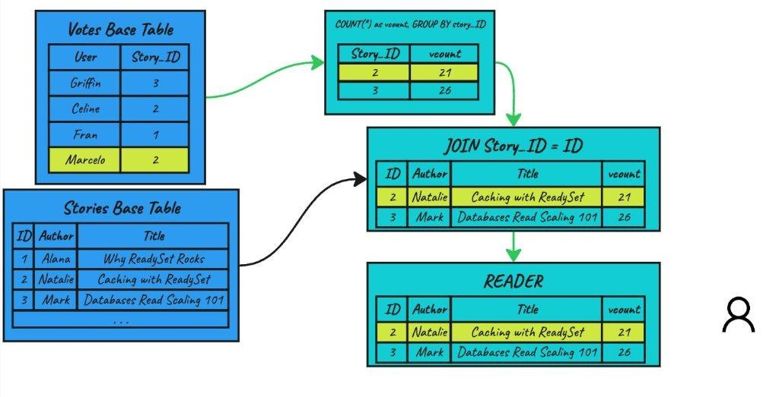
dataflow · step 3/3
Incremental view maintenance
a write arrives — what now?
A new vote from Marcelo on story 2. The delta propagates.
CDC delivers the delta. The Replicator captures the INSERT on votes and feeds the Base Table.
Incremental propagation. The aggregator receives the delta and increments: vcount 20 → 21. It does not recompute the COUNT over every vote — only the cached value is adjusted.
JOIN refreshed. The new vcount=21 reaches the JOIN node, which replaces the row for id=2.
Reader converges. After the delta reaches the Reader, a lookup for id=2 sees vcount=21.
Update cost depends on affected state, operator work, and join fan-out.
No TTL for deep caches. Freshness still depends on CDC and dataflow lag.
33
Notes:
Incremental work depends on affected rows, operator state, and join fan-out, not only the number of input deltas. The Reader returns the new count after propagation reaches it. The animation does not claim every reader across different queries shares a PostgreSQL transaction snapshot. https://readyset.io/docs/concepts/deep-caching

Slide 34
THE FRESHNESS LAB
“Read from the source.
It is always fresh.”
Is it still fresh when the answer arrives?
34
Notes:
The next slides distinguish a fresh source from the age of a query snapshot at response arrival. An illustrative timeline is not a benchmark. https://www.postgresql.org/docs/18/transaction-iso.html

Slide 35

A running SELECT keeps an earlier snapshot
Snapshot at 0 s
→
The query keeps this view
New commits stay outside it
Source keeps changing
READ COMMITTED too: an ordinary SELECT keeps its statement snapshot while writes continue
35
Notes:
An ordinary long-running SELECT under READ COMMITTED keeps its statement snapshot, even while concurrent transactions commit. REPEATABLE READ can use an even older transaction snapshot. This is about snapshot age, not a claim that every row changes or that every returned value is stale. https://www.postgresql.org/docs/18/transaction-iso.html

Slide 36
10 seconds. 30 seconds. One minute.
Snapshot at 0 s → answer arrives later
10 seconds
10 s old
30 seconds
30 s old
1 minute
60 s old
Illustration: age of the snapshot at response arrival, while new commits keep happening.
36
Notes:
Illustration only: snapshot age is response time minus snapshot acquisition time. The snapshot age does not measure a particular row’s last change, replica replay lag, or a bounded application staleness guarantee.

Slide 37
READYSET / DEEP CACHE
Keep the answer updated.
Read it quickly.
Source changes → maintained result → lookup
37
Notes:
Deep cache freshness depends on snapshot completion, replication lag, dataflow propagation, and the time to serve a lookup. Writes stay on the database path. https://readyset.io/docs/concepts/deep-caching

Slide 38
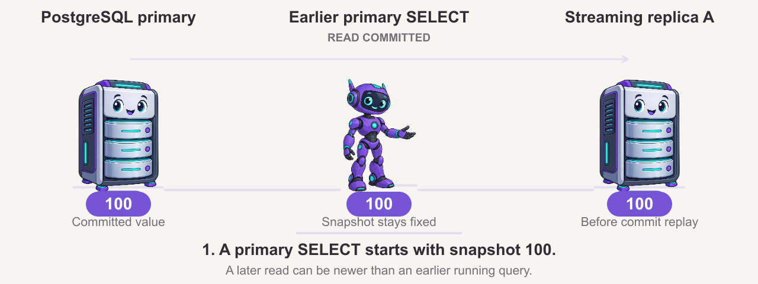
Watch the snapshot fall behind
Local PostgreSQL 18.3 test. Animation timing is illustrative.
38
Notes:
PostgreSQL 18.3 local verification, 16 October 2026: one primary and two asynchronous physical streaming replicas. Default READ COMMITTED, fsync=on, synchronous_commit=on, and no synchronous standby requirement.
1. Start an ordinary primary SELECT with snapshot value 100. A materialized CTE plus pg_sleep(5) keeps that statement open; pg_stat_activity confirms PgSleep and a snapshot before the writer runs.
2. Another session updates the value to 200 and COMMIT succeeds.
3. Wait until replica A's replay LSN reaches the primary's post-commit WAL flush LSN. A NEW SELECT on replica A returns 200 while the earlier primary SELECT is still running. A new primary SELECT also returns 200.
4. The earlier primary SELECT completes with 100. Its next READ COMMITTED statement returns 200. The schedule passed three times.
Replica B control: confirmed replay was actually paused before COMMIT; a new SELECT returned 100. After replay resumed and reached the same WAL boundary, a new SELECT returned 200. A replica is not inherently fresher than the primary.
Additional checks: a long-running SELECT on replica A also retained its earlier snapshot after replay caught up. REPEATABLE READ retained the first snapshot across statements on primary and both replicas; a new transaction saw replayed commits. READ COMMITTED refreshed on the next statement. A separate DROP TABLE replay conflict cancelled a standby SELECT with 40001 at a 1-second max_standby_streaming_delay.
This is a controlled semantic test, not a query-speed or replication-latency benchmark. Sleep is deliberate. Animation timing is illustrative. No Readyset server was tested and no Readyset freshness or performance measurement is claimed.
Local evidence: 20261016_PostgreSQL_SnapshotReplica_Tests.zip (results.json and executable test_replication.py).
Sources:
https://www.postgresql.org/docs/18/transaction-iso.html
https://www.postgresql.org/docs/18/hot-standby.html
https://www.postgresql.org/docs/18/functions-admin.html#FUNCTIONS-RECOVERY-CONTROL
Character artwork reused from the supplied presentation.

Slide 39
Snapshot age and response time
How old is the visible state
when the answer reaches you?
Deep caching can return sooner with newer applied data.
Compare CDC lag + dataflow lag + lookup time with the query’s snapshot age.
39
Notes:
Compare the age of the applied state at response arrival, not query latency alone. A fast cache can return a newer result than a long snapshot query when its update delay plus lookup latency is smaller than that query snapshot age. A cache can also lose this comparison. Applications needing read-your-writes or stronger transaction guarantees must verify routing and consistency mechanisms. https://readyset.io/docs/concepts/deep-caching

Slide 40
A published 4.3 million QPS benchmark
40
Notes:
Published throughput experiment, not a PostgreSQL freshness benchmark. The peak Readyset measurement used the MySQL binary protocol. https://cms.readyset.io/files/uploads/71635221-6fa9-4b43-818e-e8374433dfc1.pdf

Slide 41
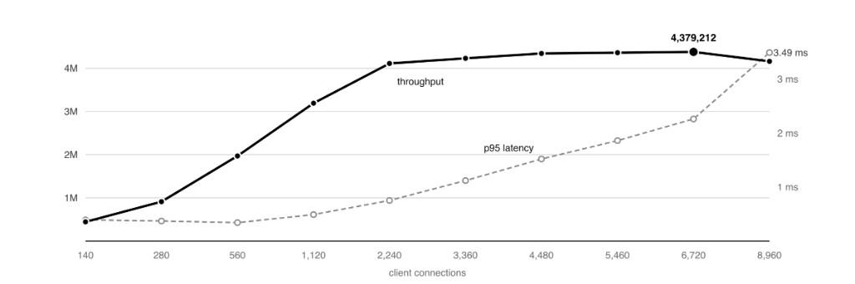
— benchmark · readyset in isolation
4,379,212 queries per second. From a single node.
14 August 2026 · MySQL protocol · fully cached reads · 1 M rows · 10 K hot keys · Table 1
peak throughput
4.38M
queries / second on the isolated cache-hit serving path.
p95 latency at peak
2.26ms
3.49 ms at 8,960 connections, beyond the throughput peak.
where the cycles go
kernel networking 56.3%
Readyset userspace 42.8%
cache read path itself ~7%
41
Notes:
Table 1: 4,379,212 QPS at 6,720 connections, 2.26 ms p95. MySQL binary protocol, prepared point lookups, 100% cache hits. This isolates Readyset serving and excludes miss cost, live replication catch-up, write throughput, and general SQL execution. CPU percentages share a denominator: the cache read path is a subset of Readyset userspace, not an extra category to add. Measured 14 August 2026. https://cms.readyset.io/files/uploads/71635221-6fa9-4b43-818e-e8374433dfc1.pdf

Slide 42
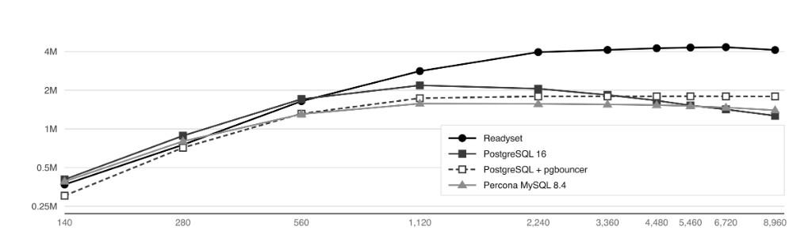
benchmark · same server and lookup workload
Readyset, PostgreSQL, and MySQL
Same server and lookup workload. Protocols differ. This measures cached read throughput, not freshness.
Readyset Engineering · Maximum Query Throughput · Table 3 (separate comparison run)
01 · Readyset
02 · PostgreSQL 16
03 · PostgreSQL + pgbouncer
04 · Percona MySQL 8.4
4.33 M peak QPS
2.18 M peak QPS
1.80 M peak QPS
1.57 M peak QPS
Deep cache, query logging off
24 runtime shards
MySQL binary protocol
max_connections: 10,000
shared_buffers: 8 GiB
model: one backend / conn · JIT & parallel off
Transaction pool: 6 instances per generator
Prepared statements: 200
Database connections: about 1,050
thread handling: pool-of-threads
thread_pool_size: 96
buffer_pool: 8 GiB · conns multiplexed
42
Notes:
Use Table 3 for the comparison: Readyset 4,332,492 QPS; PostgreSQL 16 2,181,981; PostgreSQL plus PgBouncer 1,797,759; Percona MySQL 8.4 1,573,565. The Readyset Table 3 run differs from Table 1 (4,379,212). The paper identifies MySQL binary protocol on the Readyset serving path, so these are not all PostgreSQL-wire measurements. Retain Percona MySQL as the actual comparison system. PgBouncer ran six instances per generator, not six total, and exposed about 1,050 database connections. Its plateau does not establish that the pooler itself saturated: database CPU was near 99%. This point-lookup workload does not measure transaction equivalence, freshness, or end-to-end application gains. https://cms.readyset.io/files/uploads/71635221-6fa9-4b43-818e-e8374433dfc1.pdf

Slide 43
Thank you.
Questions?
readyset.io
vinicius@readyset.io
43
Notes:
Technical evidence from original slide:
Thank you.
Questions?
readyset.io
vinicius@readyset.io
Bench, harness and every result file are in the talk repository
Brand assets and palette: https://readyset.io/ ; glyphs: https://readyset.io/icons/sprite-bulk.svg

