Slide 1
A STUDY OF GOSSIP ALGORITHMS FOR Internet-Scale Cardinality Estimation of Distributed XML Data
Vasil G. Slavov
Computer Science & Electrical Engineering
University of Missouri-Kansas City
June 22nd 2012
Acknowledgements
National Science Foundation (IIS-1115871)

Slide 2
Thesis Committee
Praveen R. Rao, Ph.D., Committee Chair
Yugyung Lee, Ph.D.
Deep Medhi, Ph.D.

Slide 3
Overview
Introduction
Background
Thesis objectives
Design
VanillaXGossip
XGossip
Implementation
Performance evaluation
Amazon Elastic Compute Cloud (EC2)
Conclusions

Slide 4
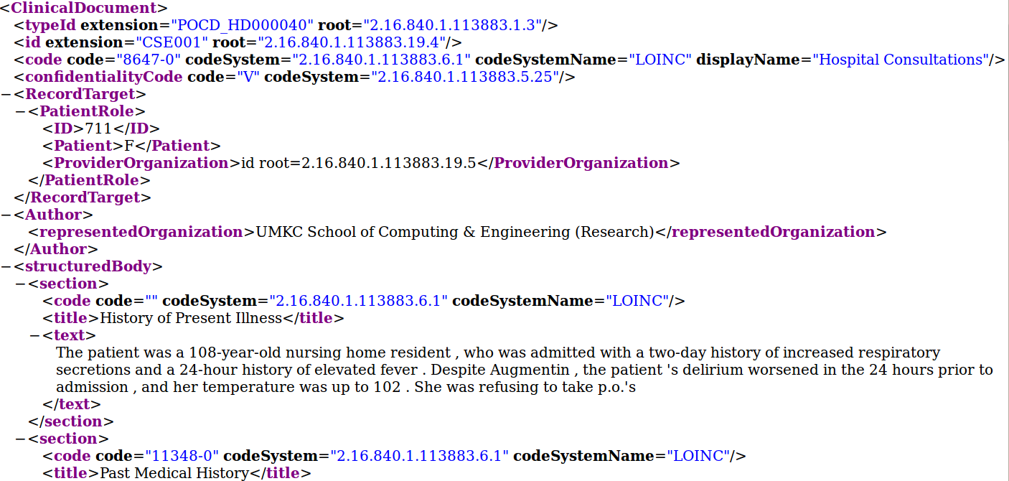
Introduction
XML and XPath – W3C standards
XPath
Notes:
the standard data model for information representation and interchange on the Internet
can be represented as an ordered, labeled tree

Slide 5
The Story So Far…
Chord [SIGCOMM ‘01],
CAN [SIGCOMM ‘01],
Pastry [Middleware ‘01],
Tapestry [JSAC ‘04],
Kademlia [IPTPS ‘02]
Dynamo [SOSP ‘07],
Cassandra [SIGMOD ‘08],
Voldemort [ICDE ‘11],
…
Galanis et.al. [VLDB ‘03],
XPeer [P2P&DB ‘04],
XP2P [WIDM ‘04],
Garces et al. [ICDCS ‘04], Skobeltsyn et.al. [ODBASE‘05], KadoP [ICDE ‘08],
XTreeNet [VLDB ‘08],
psiX [TKDE ‘09, ICDE ‘09],
...
Peer-to-peer
Computing (Distributed Hash Tables)
XML/XPath/ XQuery
Gossip (or epidemic) algorithms
XML ∩ P2P ∩ Gossip
Demers et. al. [PODC ‘87],
Karp et. al. [FOCS ’00],
Kempe et.al. [FOCS ‘03],
Berger et.al. [SODA ’05],
Ganesh et. al. [INFOCOMM ‘ 05],
Boyd et. al. [INFOCOMM ’05],
Jelasity et. al. [TOCS ‘05],
Kashyap et. al. [PODS ‘06],
Georgiou et. al. [PODC ‘08],
Mosk-Aoyama et. al. [TOIT ’08], …
Notes:
The peer-to-peer (P2P) computing model has been very successful in the last decade

Slide 6
XML ∩ P2P = ?
Large-scale sharing of biomedical and clinical data
Scalable clinical data sharing systems via a P2P architecture [Stead and Lin, 2009]
HL7 version 3 standard; XML based; semantic interoperability; can model discharge summaries, lab reports, …
The Cancer Biomedical Informatics Grid (caBIG): a real world data sharing platform

Slide 7
The Problem: XPath Cardinality Estimation
Compute the number of documents in the network that contain a match for the expression /Gene//goAcc
Useful for query optimization
Desired properties
Scalability
Decentralization
Fault-tolerance
Efficient usage of bandwidth
Provable guarantee on the quality of the estimate
Notes:
Given an XPath expression (or query) q, estimate the total number of XML documents in the network that contain a match for q with provable guarantee on the quality of the estimate.
Though the above estimate does not provide the size of the result set of an XPath query
To select a particular join ordering, to determine if sufficient number of samples available to conduct a study

Slide 8
Gossip Algorithms
Communication, computation, and information spreading
Attractive in large-scale, distributed systems
Real world examples: Amazon S3, Dynamo, Cassandra
Gossip algorithms
Information exchange
Aggregate computation
Synchronous
Asynchronous
Synchronous
Asynchronous
Can further classify based on the topology of the network
Notes:
Satisfy requirements on previous slide

Slide 9
Push-Sum Protocol
By Kempe, Dobra, and Gehrke [FOCS ‘03]
Each peer wishes to know the average
Each peer maintains a (sum, weight) pair during gossip
In round @ t = 0: send (f₁,1) to itself
In any round @ t > 0: add up sums & weights, send (s1, s2)/2, (w2, w2)/2 to itself and to random peer
Convergence (n peers)
Rounds: O(log(n) + log(1/ε) + log(1/δ))
Messages: n messages per round
Proof is based on the property of “mass conservation”
Notes:
the estimate of the average is the ratio of the sum and the weight (s_t/w_t)
Epsilon: accuracy
Delta: confidence
mass conservation: the average of all sums st,i is always the correct average, and the sum of all weights wt,i is always n

Slide 10
Thesis Objectives
Implementing gossip in an Internet-scale environment
Conducting a comprehensive evaluation
Analyzing the experimental results
Notes:
The goal of the performance evaluation is to find if the results we obtain are consistent with the theoretical analysis of VanillaXGossip and XGossip.

Slide 11
Design of VanillaXGossip
Builds on Push-Sum
XML documents are mapped to their signatures
psiX [Rao et.al. TKDE ‘09, ICDE ‘09]
XML doc. → data signature; XPath query → query signature
T
p₁
s₁ | (2,1)
s₂ | (1,1)
┴ | (0,1)
p₄
p₂
s₁
s₂
s₁
p₃
Each peer creates a sorted tuple list
Notes:
Divisibility test: If Q is a subgraph of T, then sig(Q,S) divides sig(T,S)

Slide 12
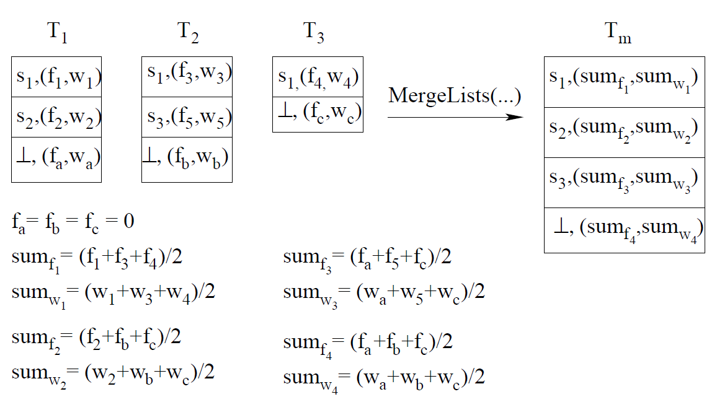
Merging Phase
Suppose a peer receives 3 tuple lists during a gossip round
T_{m} → randomly selected peer

Slide 13
VanillaXGossip
Special multiset ┴
Placeholder for signatures not yet known to a peer during a gossip round
Preserves the property of “mass conservation”
Convergence
Rounds: O(log(n) + log(1/ε) + log(1/δ))
Problem ☹
A peer will end up with all the distinct signatures
More memory, more bandwidth
Notes:
With at least prob. 1 – Delta, there is a round t_i = O(…) such that in all the following rounds (t > t_i), the relative error of the estimate of avg freq is at most Epsilon
Epsilon: accuracy
Delta: confidence

Slide 14
XGossip
Idea
Divide-and-conquer approach using Locality Sensitive Hashing (LSH)
A subset of peers are responsible for gossiping a subset of distinct signatures
Benefits ☺
Less memory, less bandwidth, faster convergence

Slide 15
Locality Sensitive Hashing (LSH)
Introduced by Indyk and Motwani [STOC ‘98]
Applications
Web clustering, computer vision, computational biology, etc.
Idea
Use many hash functions
Probability of collision is higher for inputs that are more similar
LSH on sets using Jaccard index [WWW ‘02, WWW ‘05]
P[h(s₁) = h(s₂)] = |s₁ ∩ s₂|/|s₁ U s₂|
h() → min-hashing
Notes:
we can map similar items to the same buckets with high probability by hashing the input items
the probability that the output hash values of two different sets is equal, is equivalent to the Jaccard index of the sets

Slide 16
LSH on Sets
Suppose p = |s₁ ∩ s₂|/|s₁ U s₂|
Pick k x ℓ random linear hash functions
s₁
1
2
….
k
s₂
1
2
….
k
Output of ℓ hash functions
Can pick k and ℓ s.t.
High probability if similarity ≥ p
Low probability if similarity < p
P[at least one pair of yellow and green is identical] = 1 - (1 - p^{ℓ})^{k}

Slide 17
XGossip (1/2)
Define k teams for a signature s
LSH(s) → {h₁, …, h_{k}}
Each team has id h_{i}, 1≤ i ≤ k; ∆ denotes team size
α = 1 - (1 - p^{ℓ})^{k}
h_{i}
Cardinality estimation: more likely to find all the required signatures in the same team
Only peers of a team exchange messages during gossip
Similar signatures are gossiped by a team → high probability
Signature s is gossiped by k teams
∆= 4
denotes a peer
Notes:
If two signatures have a similarity p, there is at least one team which gossips both signatures with probability 1 – (1 – p^l)^k
α is the probability that there is at least one team that gossips two given signatures
We fixed the LSH parameter l at 10 so that α = 0 when two signatures have similarity less than 0.5

Slide 18
XGossip (2/2)
Initialization and execution phases
Convergence
Rounds: O(log(∆) + log(1/ε) + log(1/δ))
Bandwidth reduction
Compress signatures when sending a gossip message

Slide 19
VanillaXGossip: Cardinality Estimation
Suppose a peer wants to compute card(/Gene//goAcc)
Tuple list T @ the peer
Signature | (sum,weight)
s_{i} | (f_{i},w_{i})
Sum the frequency estimates of signatures that are supersets of the query signature; multiply by n
Notes:
the divisibility test is equivalent to testing the superset relationship between a document and a query signature

Slide 20
XGossip: Cardinality Estimation
Suppose a peer wants to compute card(/Gene//goAcc)
Apply LSH on the query signature → k teams
T @ p₁
T @ p₂
T @ p_{k}
……….
Merge the frequency estimates of signatures that are supersets of the query signature; multiply by ∆

Slide 21
Implementation
Built on top of the Chord DHT [SIGCOMM ‘01]
Use Chord for routing (key-value pairs)
4 processes per peer: Chord (lsd, syncd, adbd), Gossip (gpsi)
Communicate over UNIX sockets
Read signatures from files, store in main memory
Implemented in C++
Data structures from STL
typedef std::map<std::vector<POLY>, std::vector<double>, CompareSig> mapType;
typedef std::map<chordID, std::vector<int> > teamid2totalT;
SFSlite asynchronous library
Challenges
Notes:
respond to events through callbacks
2 Datasets (message size)
Multiple data structures
Async programming lib
Distributed environment: managing, debugging
Large amounts of data

Slide 22
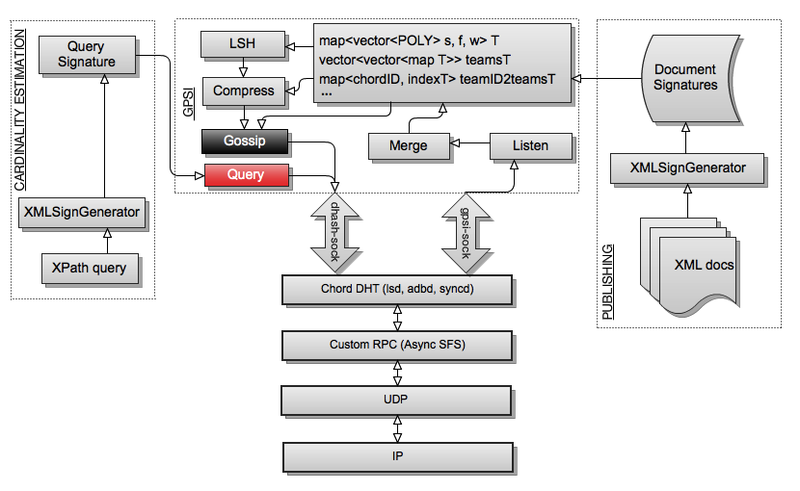
System Architecture

Slide 23
Performance Evaluation
Datasets
Generated by the IBM Synthetic XML generator using well-known DTDs (Treebank, DBLP, etc.)
Uniformly distributed among all peers
Dataset | # of DTDs | Avg # of docs per DTD | Total # of docs | Avg. document signature size
D1 | 11 | 190,809 | 2,098,900 | 114 bytes
D2 | 13 | 192,223 | 2,498,900 | 127 bytes

Slide 24
Performance Evaluation
Query sets
XPath queries generated by YFilter [TODS ‘03]
A total of 753 queries
2 query approaches
LSH(XPath sig)
LSH(proxy sig)
Query subsets based on p_{min} value
Query Set | Value of p_{min} | # of queries
Q₀ | [0, 0.5) | 101
Q₁ | [0.5, 1] | 652
Q₂ | [0.6, 1] | 356
Q₃ | [0.7, 1] | 300
Q₄ | [0.8, 1] | 277
Q₅ | [0.9, 1] | 26
Notes:
minimum similarity between a proxy signature and a signature in R (set of distinct document signatures that are divisible by a query signature (or result set of a query))

Slide 25
Network Setup and Distribution of Documents
Amazon EC2
20 medium instances (2 cores, 1.7GB memory)
US East availability zone
Peers use local clock
120s long rounds
Variables
team size (Δ): 8, 16
LSH parameter k: 4, 8
LSH parameter l: 10 (fixed): α = 0, when p < 0.5
compression
# of peers: 500, 1000, 2000
Total # of peers in the network (n) | # of peers per EC2 instance | # of peers picked per DTD (z)
500 | 25 | 250
1000 | 50 | 500
2000 | 100 | 1000
Notes:
α is the probability that there is at least one team that gossips two given signatures
We fixed the LSH parameter l at 10 so that α = 0 when two signatures have similarity less than 0.5
1 - (1 - p^{ℓ})^{k}

Slide 26

Evaluation Metrics
Convergence speed of the frequency of signatures
Mean absolute relative error (MARE) of the frequency estimate of the document signatures
Where
M: tuple list size
f_{i}: true signature frequency
ef_{i}: estimated signature frequency
VanillaXGossip: freq / weight * n
XGossip: freq / weight * Δ
Accuracy of cardinality estimation
MARE of the cardinality estimate of the queries
Bandwidth consumption during gossip
Amount of data transmitted per round by all peers

Slide 27


XGossip in the Cloud
m peers
m peers
m peers
m peers
m peers
m peers
Amazon EC2
Card(/Gene//goAcc)

Slide 28
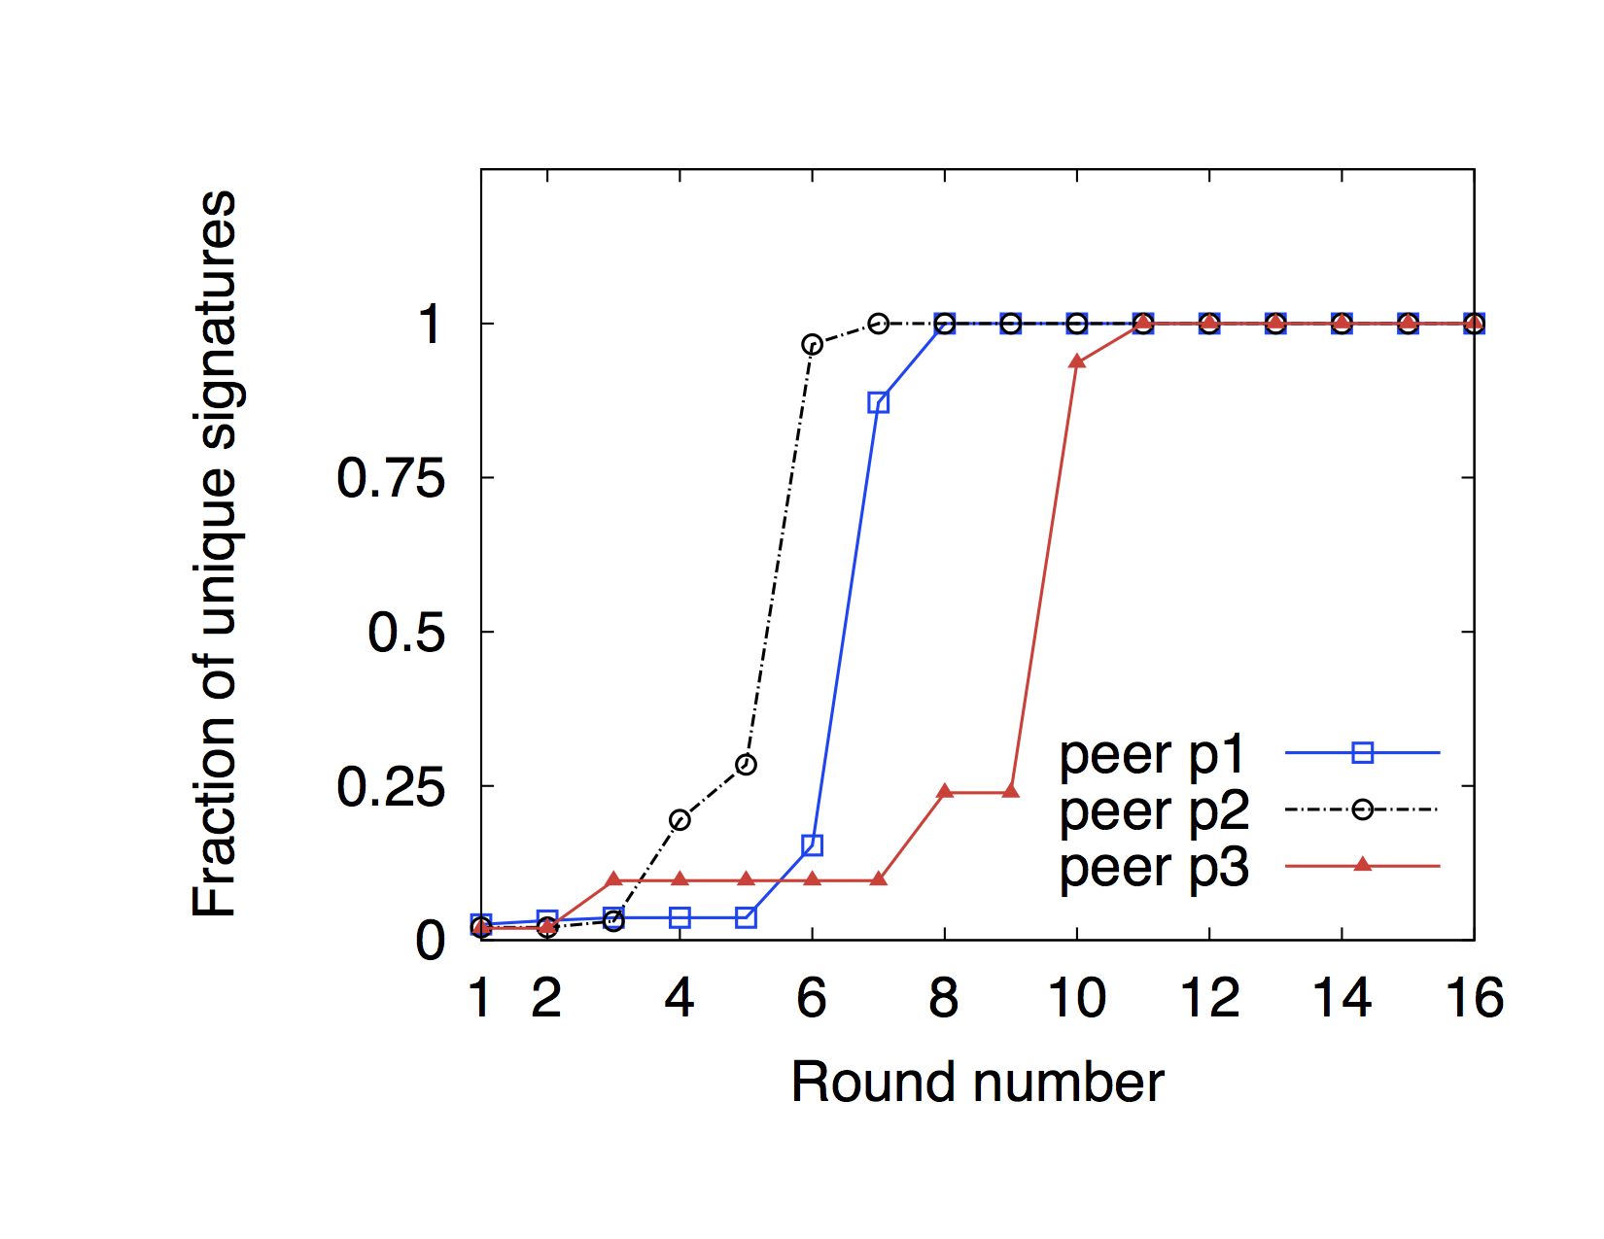
Diffusion Speed of Signatures
VanillaXGossip

Slide 29
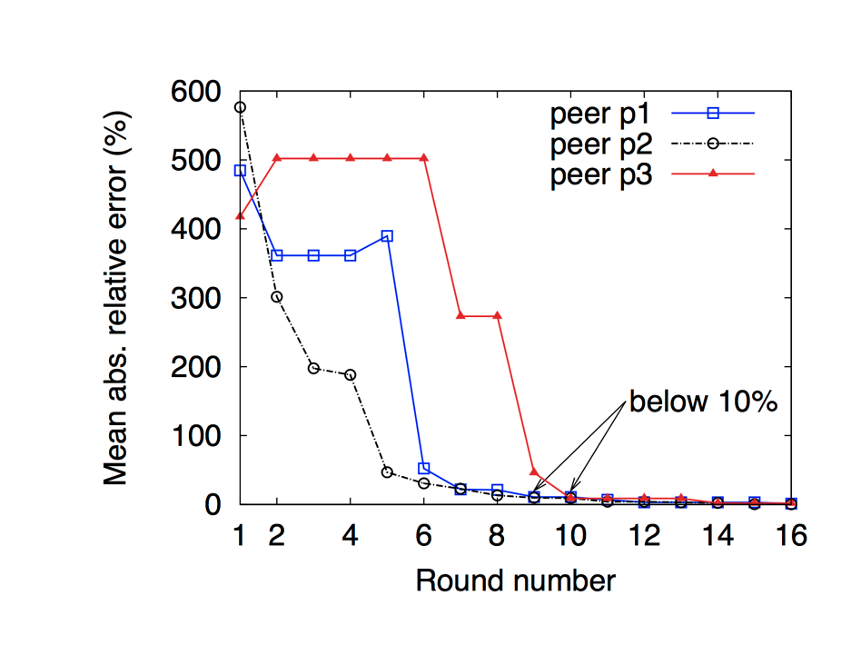
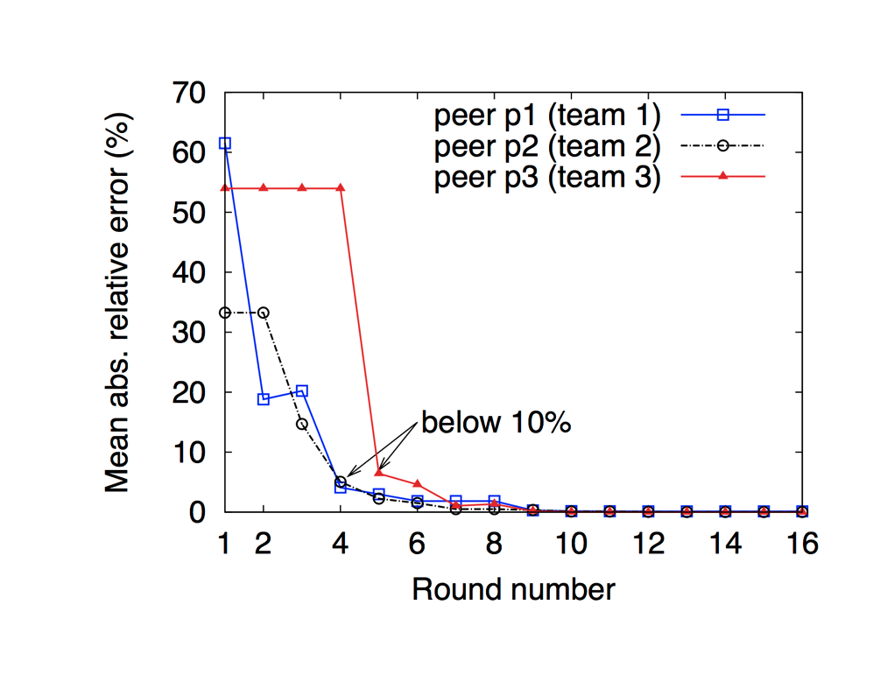
Convergence of Frequencies of Signatures
VanillaXGossip
XGossip
Dataset D₁, n = 1000
Dataset D₁, n = 1000
Δ = 8, k = 8, l = 10

Slide 30
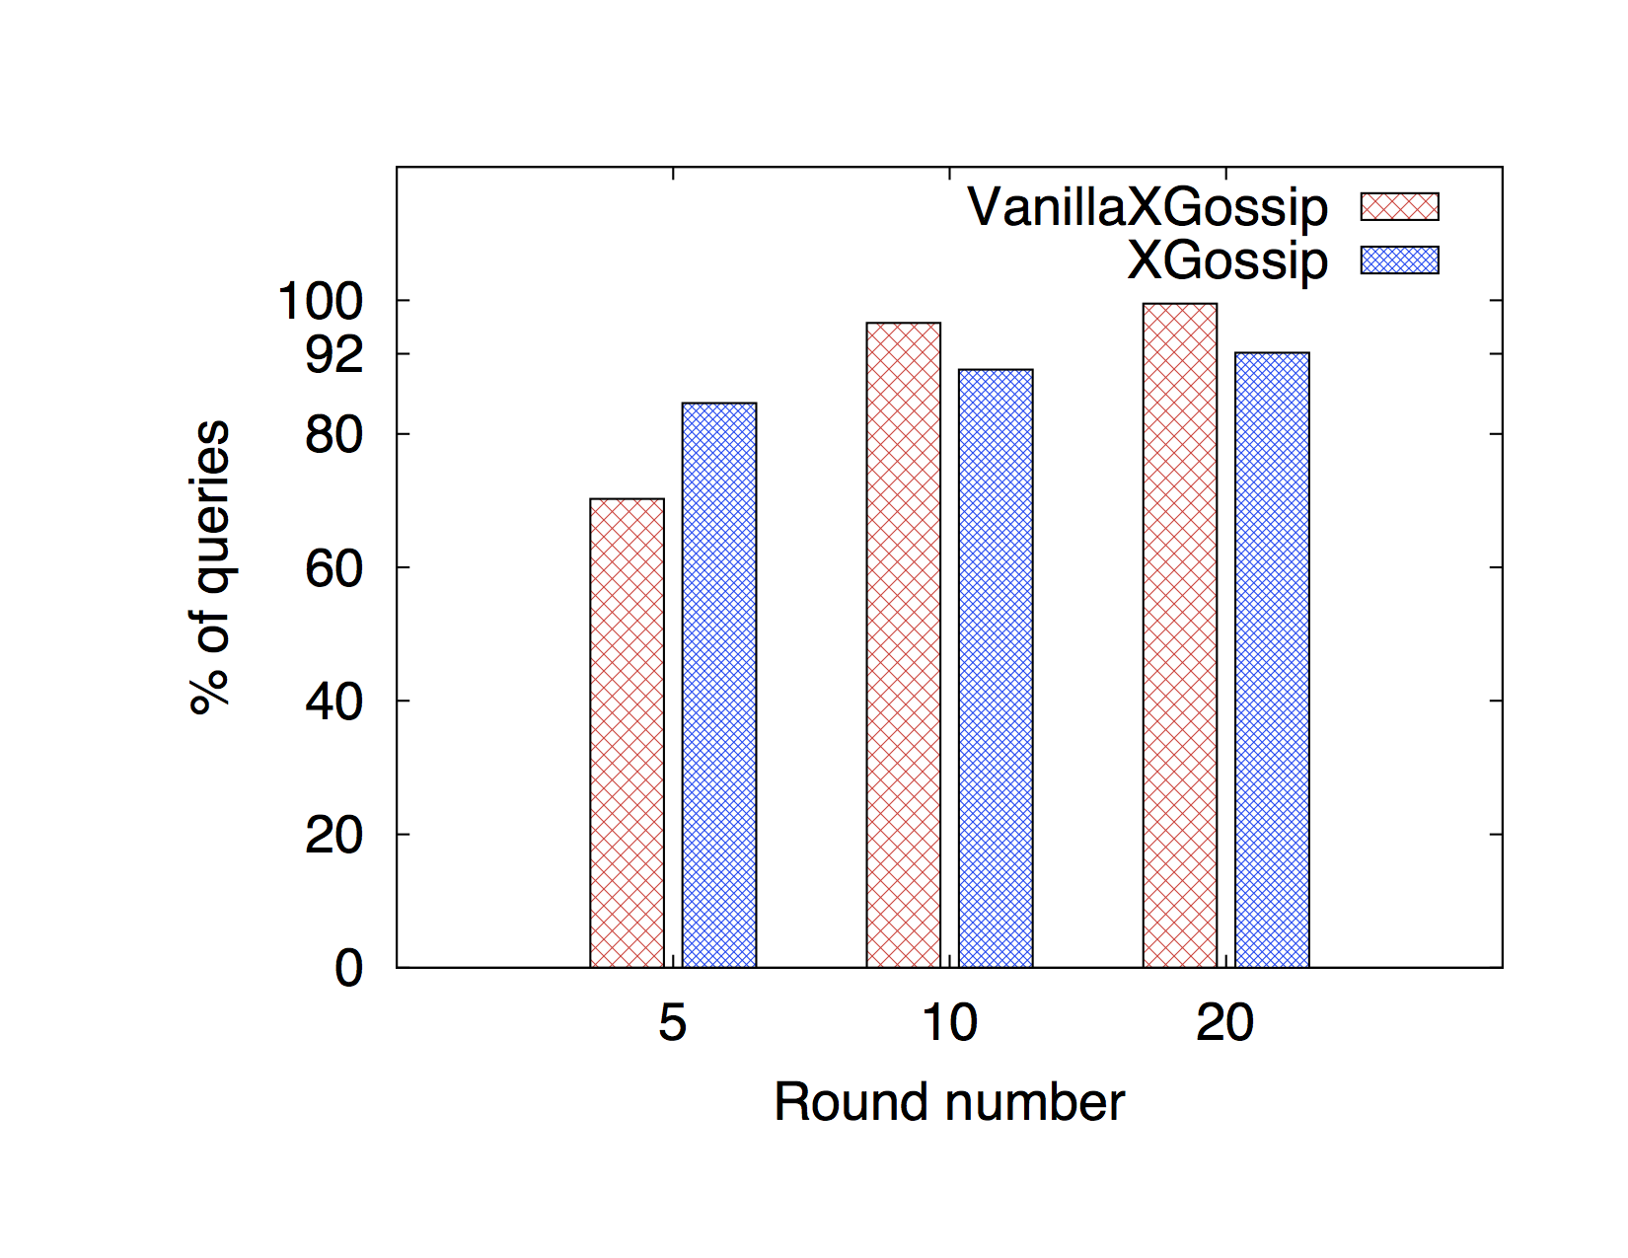
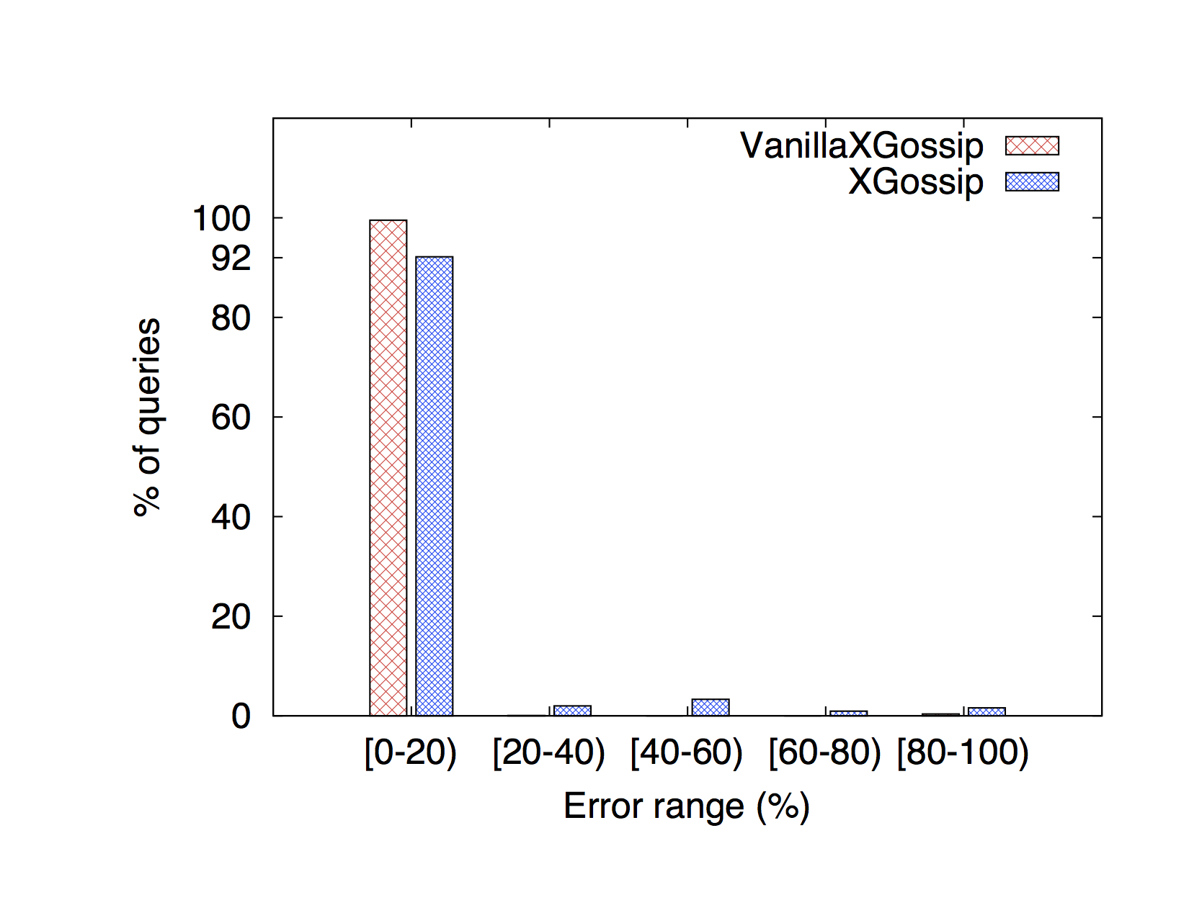
Accuracy of Cardinality Estimation (1/6)
VanillaXGossip vs. XGossip
At different rounds
After 20 rounds
Relative error below 20%
n = 1000, Δ = 8, k = 8, l = 10

Slide 31
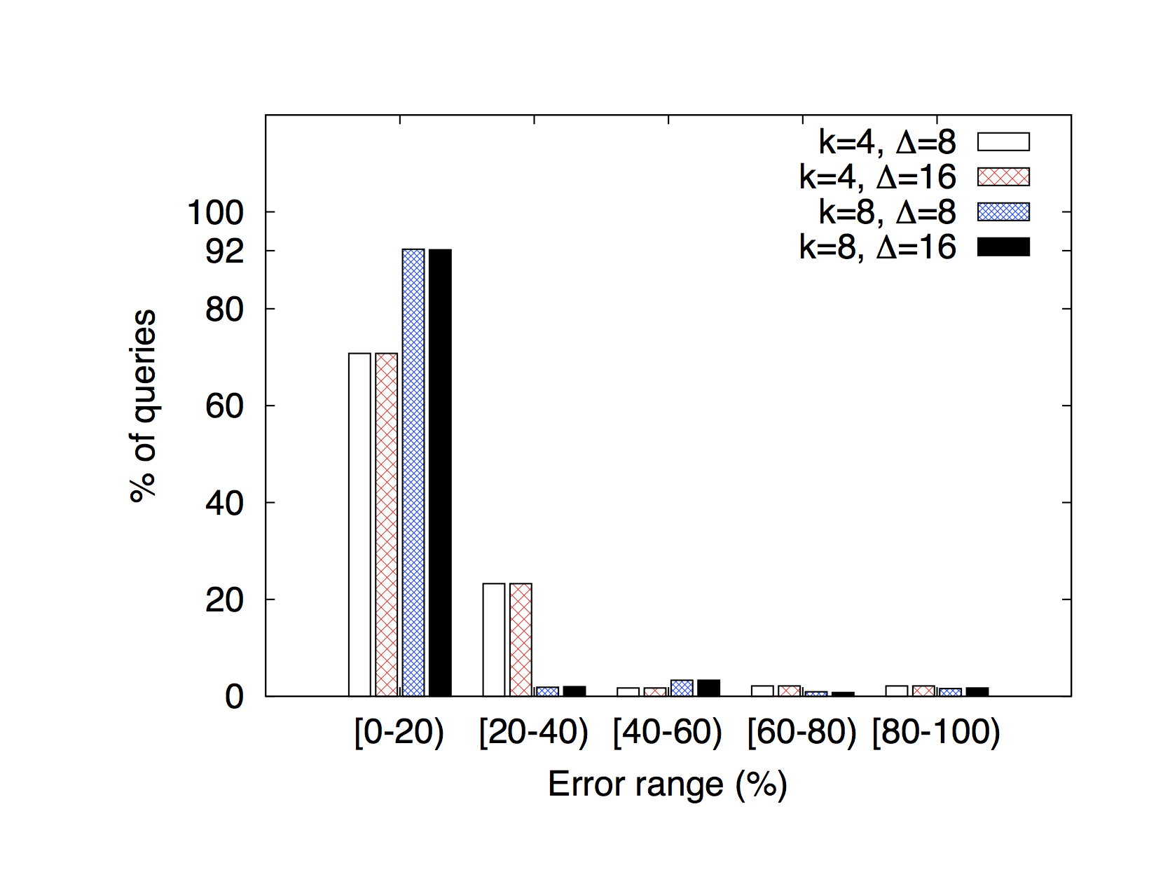
Accuracy of Cardinality Estimation (2/6)
XGossip: LSH and team size
After 30 rounds, n = 1000, l = 10

Slide 32
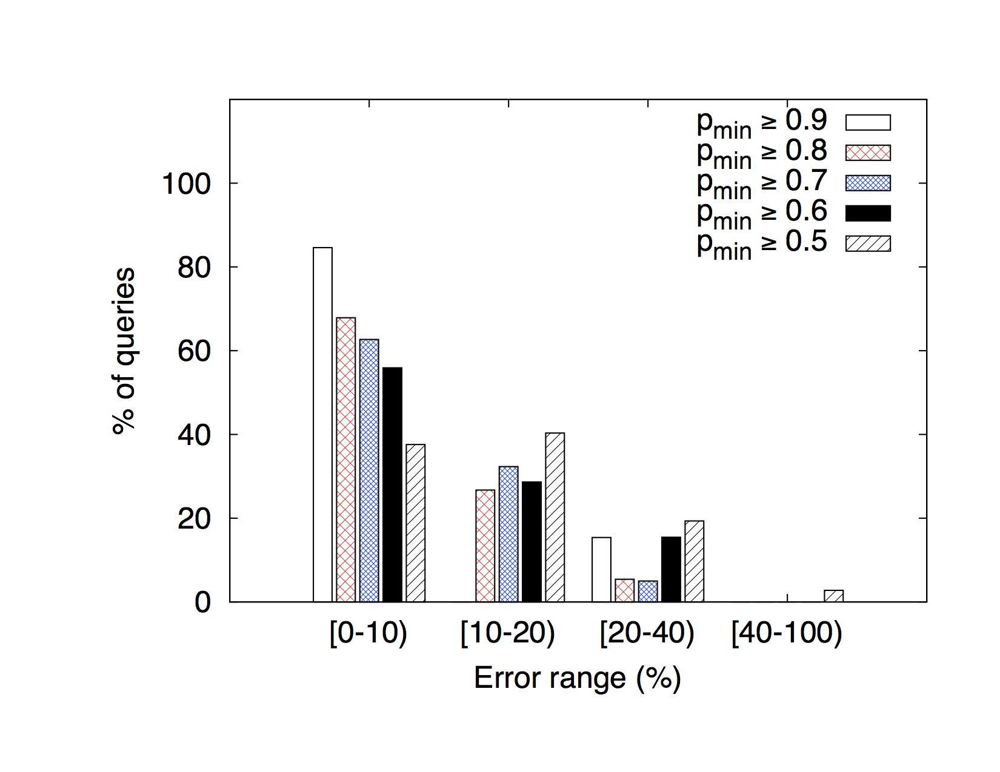
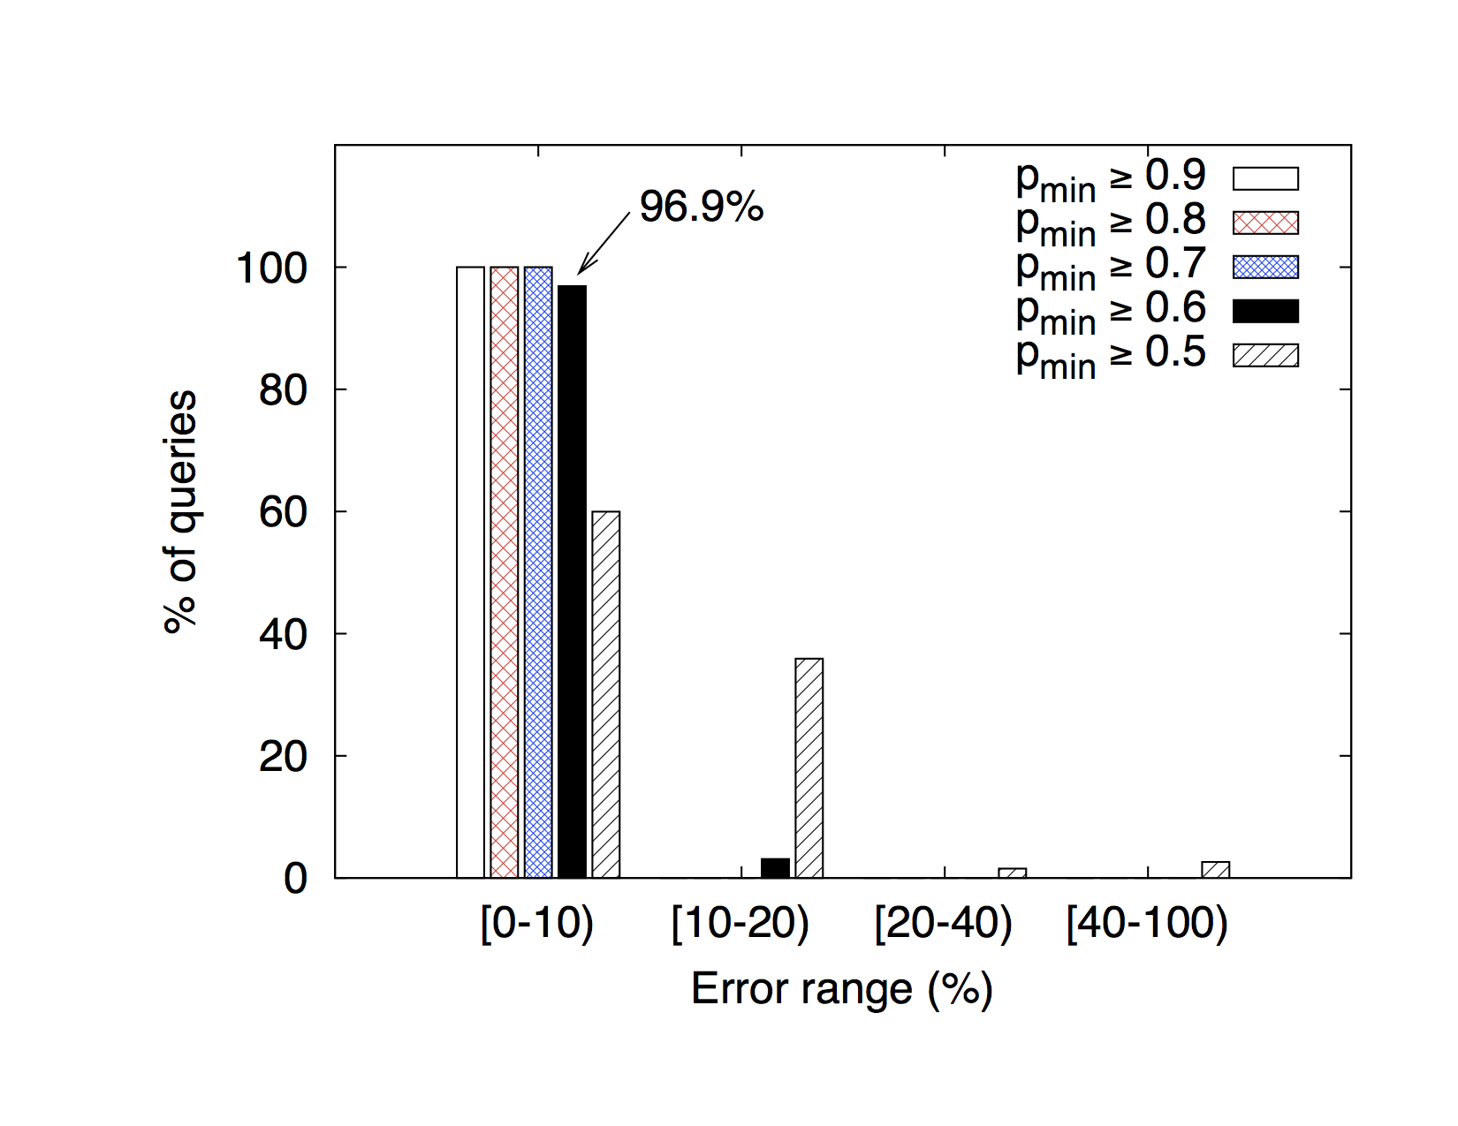
Accuracy of Cardinality Estimation (3/6)
XGossip
Δ = 8, k = 4
Δ = 8, k = 8
n = 1000, after 30 rounds
Δ = 16, k = 4 is almost identical
n = 1000, after 30 rounds
Δ = 16, k = 8 is almost identical

Slide 33
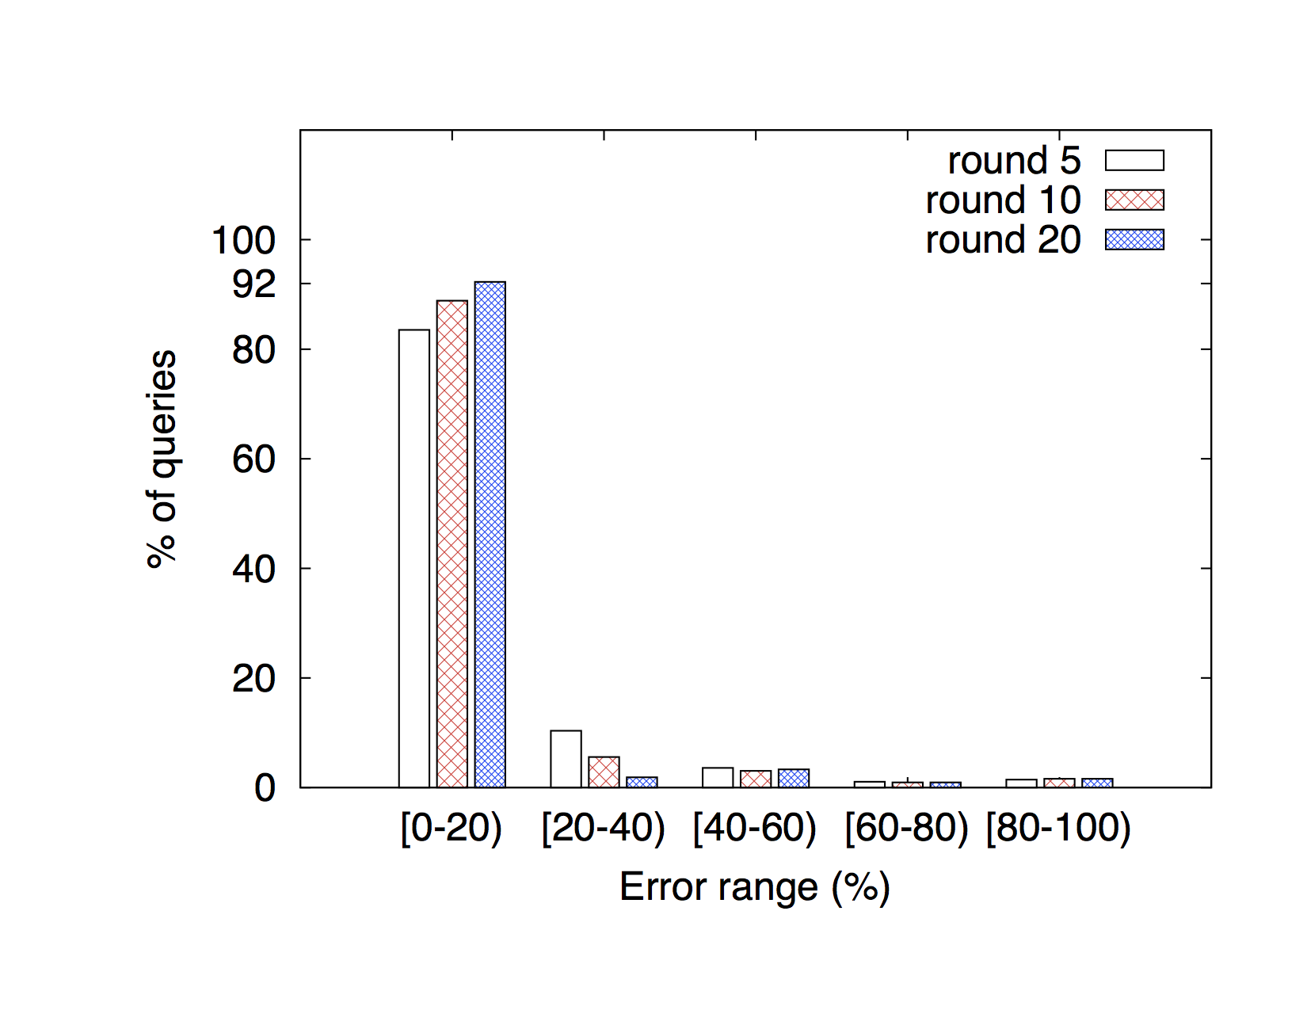
Accuracy of Cardinality Estimation (4/6)
XGossip: increasing # of rounds
n = 1000, Δ = 8, k = 8, l = 10

Slide 34
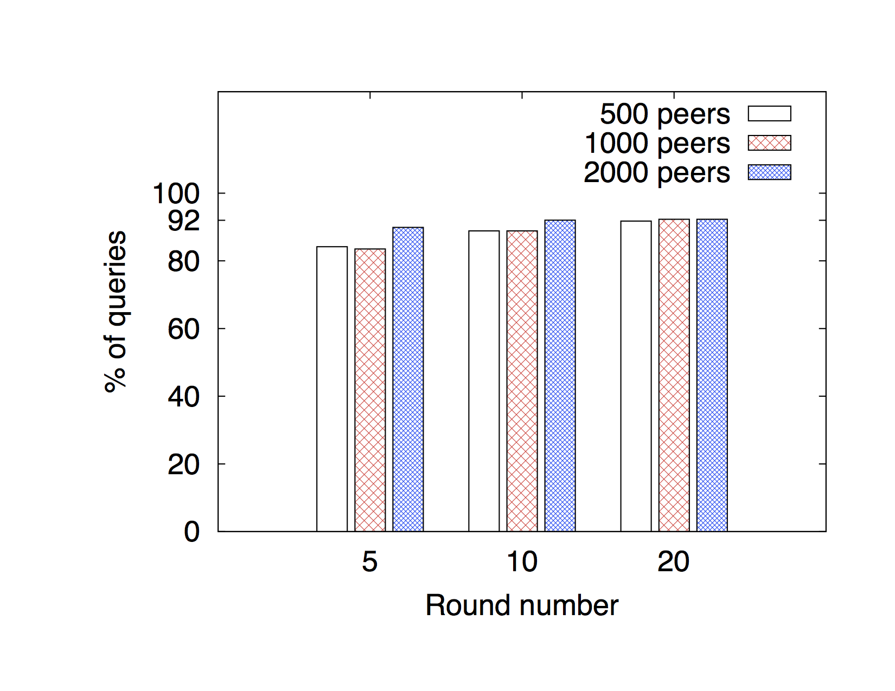
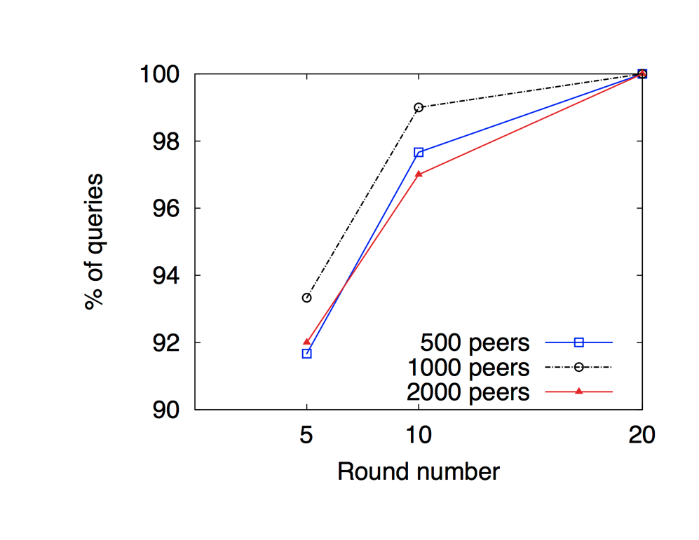
Accuracy of Cardinality Estimation (5/6)
XGossip
Varying # of peers
Varying # of peers
(query set Q₃: [0.7, 1])
Relative error below 20%
Δ = 8, k = 8, l = 10
Relative error below 10%
n = 1000, Δ = 8, k = 8, l = 10

Slide 35
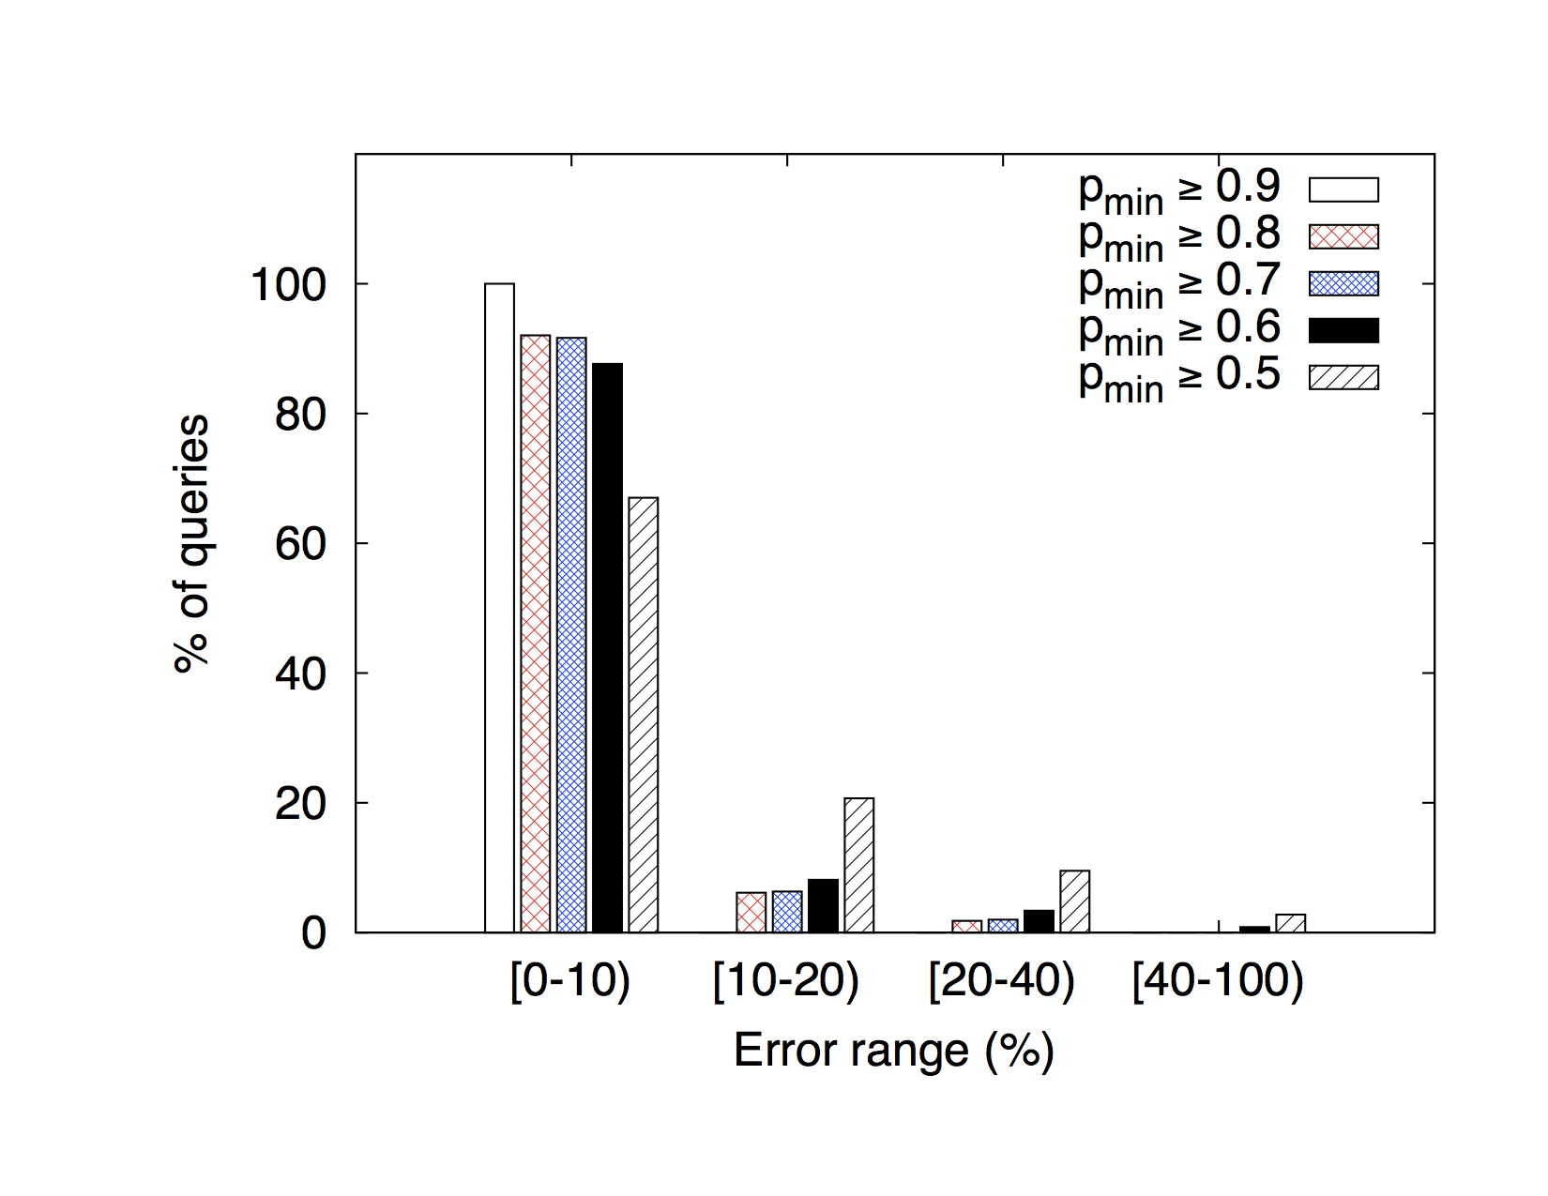
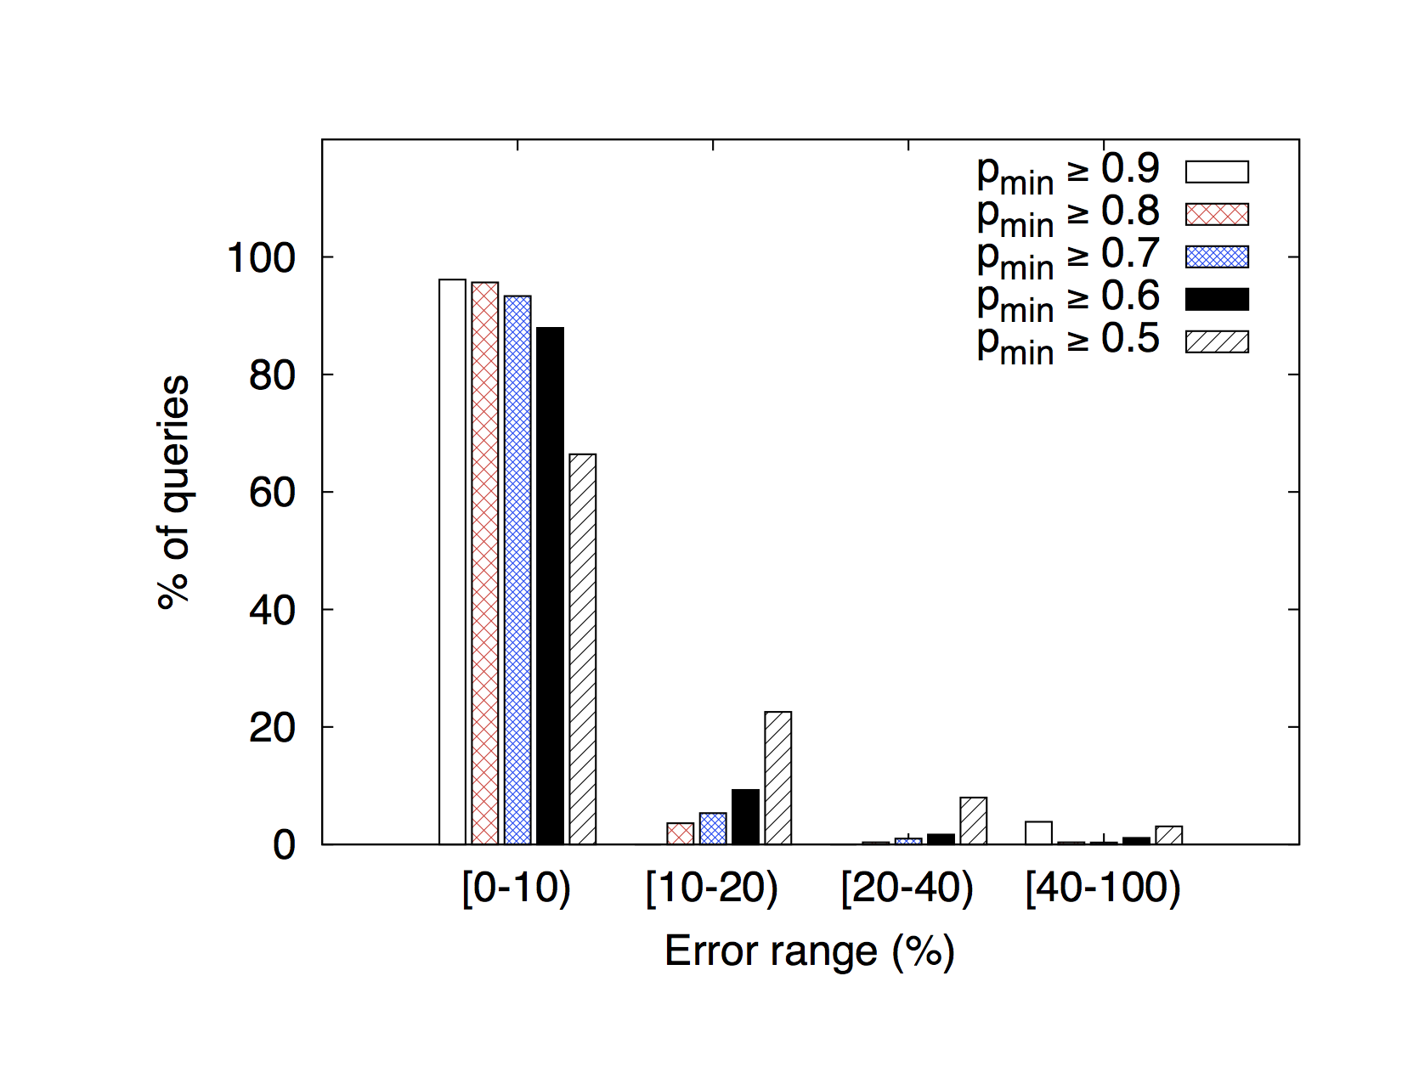
Accuracy of Cardinality Estimation (6/6)
XGossip
500 peers
1000 peers
After 5 rounds
Δ = 8, k = 8, l = 10

Slide 36
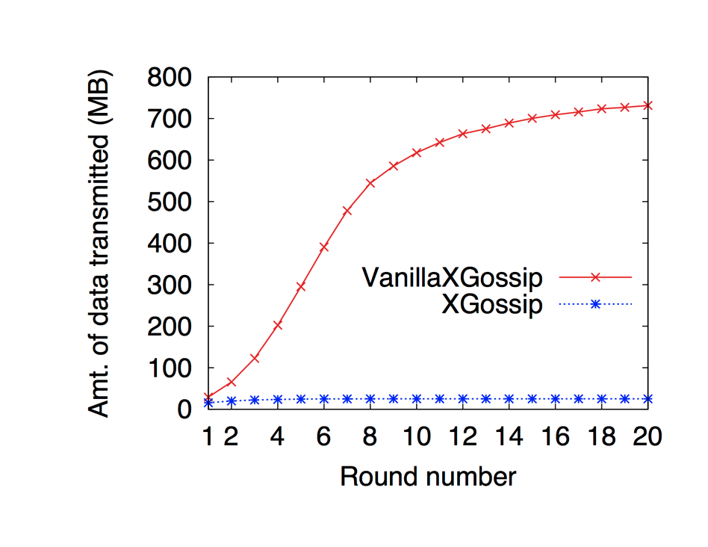
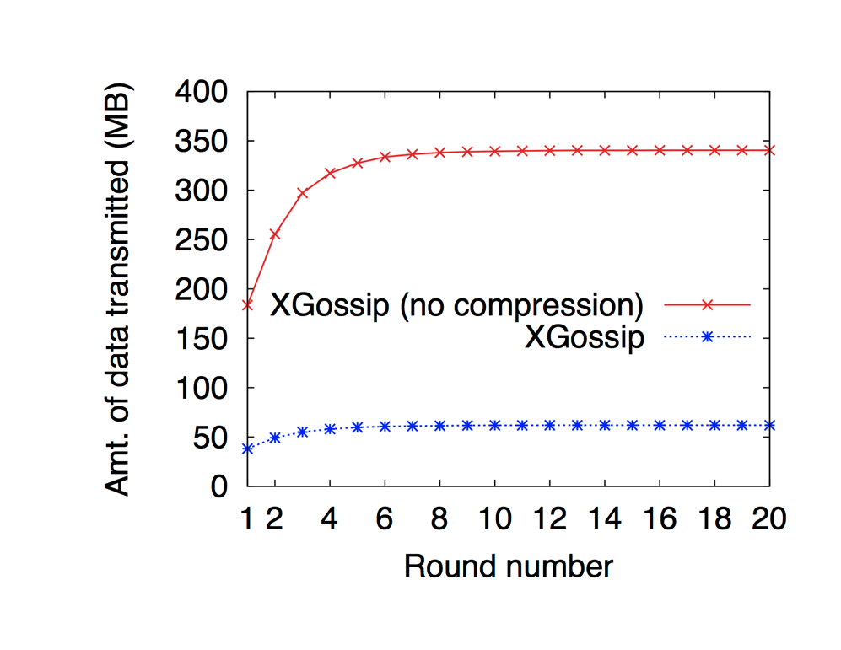
Bandwidth Consumption (1/2)
VanillaXGossip vs. XGossip
(Dataset D₁)
XGossip compression
(Dataset D₂)
VanillaXGossip: 10,309 MB
XGossip: 484 MB
XGossip (no compression): 9,874.2 MB
XGossip: 1,805.9 MB

Slide 37
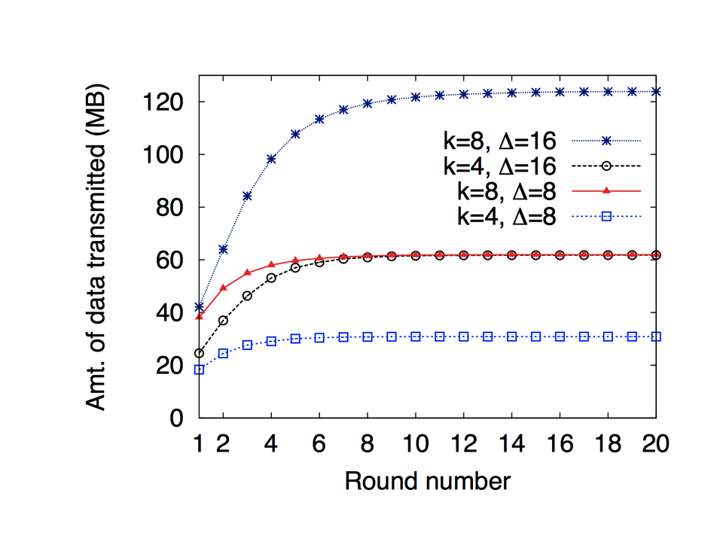
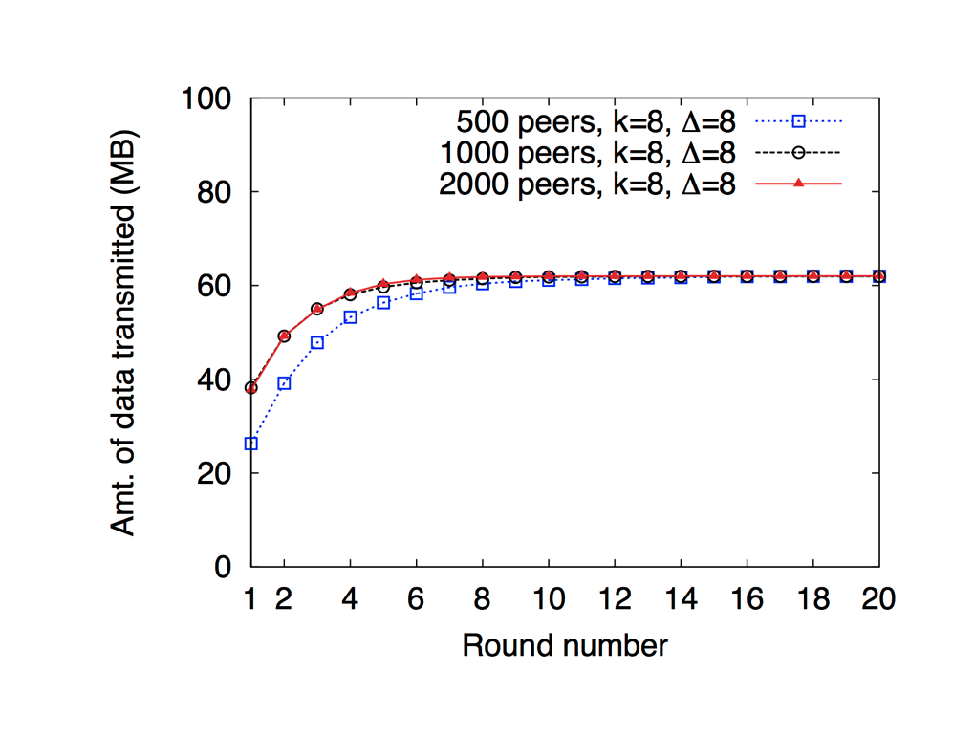
Bandwidth Consumption (2/2)
XGossip
Different values of k and Δ
Varying the # of peers
n = 1000
l = 10

Slide 38
Performance Analysis: Results Summary
LSH: tune k and l
Compression works
XGossip scales, VanillaXGossip does not
XGossip converges faster than VanillaXGossip
XGossip transmits less data than VanillaXGossip
# of peers | Avg. # of teams/peer | Avg. # of sigs/peer | Avg. # of sigs/team | Avg. msg size/peer (bytes) | Total # of msgs
500 | 88.40 | 4,024.25 | 45.52 | 1,160.18 | 440,240
1000 | 44.82 | 2,040.81 | 45.52 | 1,265.64 | 440,240
2000 | 23.09 | 1051.20 | 45.52 | 1,244.91 | 441,750

Slide 39
Conclusion
Thesis objectives
Implementing gossip in an Internet-scale environment
Conducting a comprehensive evaluation
Analyzing the experimental results
The results we obtained were consistent with the theoretical analysis of VanillaXGossip and XGossip.

Slide 40
Questions?
References
Vasil G. Slavov, Praveen R. Rao - Towards Internet-Scale Cardinality Estimation of XPath Queries over Distributed XML Data. Proceedings of 6th International Workshop on Networking Meets Databases (NetDB 2011), Athens, Greece.
Praveen Rao and Vasil Slavov - Towards Internet-Scale Cardinality Estimation of XPath Queries over Distributed XML Data. University of Missouri-Kansas City, Kansas City, MO 64110, Tech. Rep. TR-DB-2011-01, Jun. 2011, http://r.faculty.umkc.edu/raopr/TR-DB-2011-01.pdf.
Acknowledgements
National Science Foundation (IIS-1115871), 2011-2014

