Slide 1
ML STAR PV RCA
Finding Similar STARs using Machine Learning
Yun-Xiang Hong
2019/08/21

Slide 2
Problem
Given a Verdi STAR, is it possible to find similar STARs automatically?
Input: 9001341639 - [Intel-CCD] fsdbreport utility slowdown when scope contains wild card character
Output: 9001231034- fsdbreport to report signals under 1 level hierarchy takes long time
SPS0312062- fsdbreport utility takes too long to run

Slide 3
Automated Keyword Extraction plus STAR Matching using Foresight
Apply Natural Language Processing (NLP) Techniques to extract keywords/phrases from STAR title and description and then use the existing ML-based tool Foresight to searching for similar STARs
keyword
keyword
keyphrase
Input: 9001341639 - [Intel-CCD] fsdbreport utility slowdown when scope contains wild card character
keyword
keyphrase
Output: 9001231034- fsdbreport to report signals under 1 level hierarchy takes long time
But does the tool really know “slowdown” and “takes long time” are semantically similar?

Slide 4
Word2Vec and Doc2Vec
Refer to [1], [2]
The purpose of Word2Vec model is to turn words into the numerical form: a set of vectors.
Words that appear in a similar context will be mapped to a proximate vector space.
Doc2Vec is an extension of Word2Vec.
California
cold
The weather in ________ was ____ yesterday.
California
hot
California
The weather in ________ was ____ yesterday.
Taiwan
hot
Taiwan
The weather in ________ will be ____ tomorrow.
hot
cold
Notes:
Word2vec does not capture similarity based on antonyms and synonyms. Word2vec would give a higher similarity if the two words have the similar context. Eg The weather in California was _____ . The blank could be filled by both hot and cold hence the similarity would be higher. This concept is called Paradigmatic relations.
https://datascience.stackexchange.com/questions/12872/how-can-i-get-a-measure-of-the-semantic-similarity-of-words
king - man + woman is queen; but why?
https://p.migdal.pl/2017/01/06/king-man-woman-queen-why.html

Slide 5
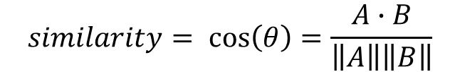

How to measure the similarity between vectors?
Cosine Similarity is a measure of similarity between two vectors that measures the cosine of the angle between them.
A
$$similarity= \cos\left(θ\right)=\frac{A∙B}{\left\|A\right\|\left\|B\right\|}$$
$$θ$$
B
Notes:
If the two vectors A and B overlap, the value of cosine theta will be close to 1.
That means the two words or the two stars are very similar.

Slide 6
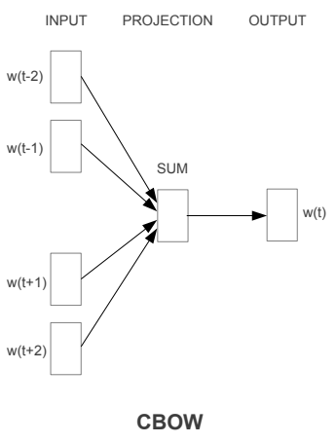
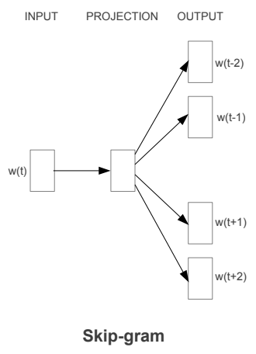
Word2Vec
Two primary models Continuous Bag-of-words (CBOW) and Skip-gram. [1], [2]

Slide 7
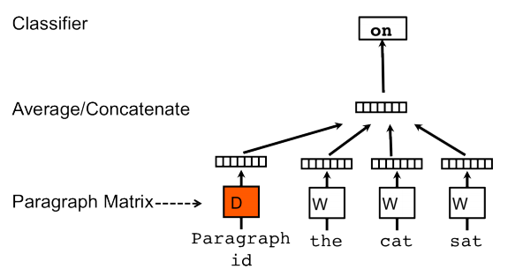
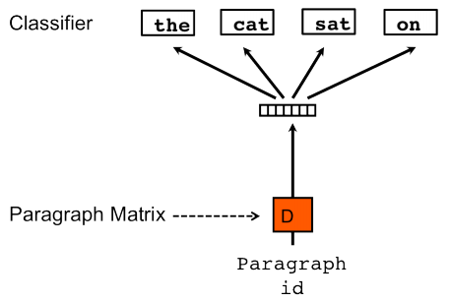
Doc2Vec
Same concept as Word2Vec. Refer to [1], [2]
PV-DM (Paragraph Vector: A distributed memory model)
DBOW (Distributed bag of words)

Slide 8
Word2Vec Example
Word2Vec data generation (Skip-gram, window size = 2). Refer to [3]
“king brave man”
“queen beautiful woman”
Word | Word One Hot Encoding | Neighbor | Neighbor One Hot Encoding
king | [1,0,0,0,0,0] | brave | [0,1,0,0,0,0]
king | [1,0,0,0,0,0] | man | [0,0,1,0,0,0]
brave | [0,1,0,0,0,0] | king | [1,0,0,0,0,0]
brave | [0,1,0,0,0,0] | man | [0,0,1,0,0,0]
man | [0,0,1,0,0,0] | king | [1,0,0,0,0,0]
man | [0,0,1,0,0,0] | brave | [0,1,0,0,0,0]
queen | [0,0,0,1,0,0] | beautiful | [0,0,0,0,1,0]
queen | [0,0,0,1,0,0] | woman | [0,0,0,1,0,0]
beautiful | [0,0,0,0,1,0] | queen | [0,0,0,1,0,0]
beautiful | [0,0,0,0,1,0] | woman | [0,0,0,1,0,0]
woman | [0,0,0,0,0,1] | queen | [0,0,0,1,0,0]
woman | [0,0,0,0,0,1] | beautiful | [0,0,0,0,1,0]
Notes:
Window Size就是詞的上下文的範圍
Words使用One Hot Encoding編碼後做為Input
Neighbor則是做為訓練的Target

Slide 9
Word2Vec Example (cont’d)
Architecture of Neural Network
Word2Vec Training
Input
Hidden (linear neuron)
Output (softmax)
target
king
1
0.1
0
0
0.7
0
0
w1
0.2
1
man
0
w2
0
0
0
0
0
0
0
0
Cross entropy
Notes:
Word2Vec的神經網絡，Input的大小是詞的總數，Output是一組預測的機率
例如0.7代表[0,1,0,0,0,0]是King這個詞的Neighbor的機率
Cross-entropy是Output和Target的差距，loss function最小化cross-entropy

Slide 10
Word2Vec Example (cont’d)
Hidden layer is Word2Vec
Input
Hidden (linear neuron)
Unique word | Embedding
king | [1, 1]
brave | [1, 2]
man | [1, 3]
queen | [5, 5]
beautiful | [5, 6]
woman | [5, 7]
w1
w2

Slide 11
Word2Vec Example (cont’d)
Because input is one hot encoding, hidden layer works as lookup table
Input
Hidden (linear neuron)
[
[0, 1, 0, 0, 0, 0]
]
[
[1, 1],
[1, 2],
[1, 3],
[5, 5],
[5, 6],
[5, 7],
]
Unique word | Embedding
king | [1, 1]
brave | [1, 2]
man | [1, 3]
queen | [5, 5]
beautiful | [5, 6]
woman | [5, 7]
X
brave

Slide 12
Gensim’s implementation of Word2Vec
The vector representation of word ‘fsdb’ (vector size = 100)
In : model.wv['fsdb']
Out :
array([-0.7608707 , -0.37955657, -2.906462 , -0.4375401 , 2.9660382 ,
-2.212919 , -0.17721225, -2.799212 , 3.1365337 , -0.7779334 ,
-1.0907131 , 1.1342388 , 2.9037385 , 3.1998987 , -1.1057326 ,
0.94891804, 0.48081526, -2.351937 , 2.482524 , -2.7476246 ,
1.0401441 , -2.7474709 , 1.5914077 , 0.67026883, -2.0357964 ,
2.041526 , -4.0117555 , 3.8831751 , 3.1612527 , -3.879688 ,
0.11474969, 2.0962286 , 0.12048002, 0.2621428 , 6.175813 ,
-0.9551771 , -0.5700842 , -2.0331128 , 0.7125781 , -0.8323695 ,
3.3345644 , 1.11578 , -1.1692951 , 0.7249089 , -2.3685577 ,
2.3396358 , -2.6008384 , -0.02779628, -1.7126689 , 2.7914572 ,
3.9941664 , -0.45404038, 0.5232506 , 2.0982604 , -2.4638731 ,
0.8933134 , 3.1713908 , 2.0564964 , 0.282349 , 2.6566098 ,
1.8931702 , -0.50672835, 0.8720573 , -1.1741017 , -0.72306216,
0.7969488 , 3.960106 , -1.2399791 , -4.073105 , 1.1256508 ,
-3.3342583 , 1.8391644 , 2.6477509 , -0.68003875, -1.8259329 ,
1.5829676 , 2.0152254 , 3.5909948 , 0.6332451 , 1.1891974 ,
2.4187531 , 1.6626383 , -0.3663267 , -0.6903361 , 0.96285826,
-4.6692357 , 3.0729911 , -2.3578944 , 1.3086629 , -3.5949953 ,
-2.703109 , -2.3404891 , 1.6670519 , 5.3346653 , 4.964245 ,
-1.1311473 , 0.6438249 , -0.82584167, -0.9369347 , -1.9242805 ],
dtype=float32)
Notes:
Word2vec does not capture similarity based on antonyms and synonyms. Word2vec would give a higher similarity if the two words have the similar context. Eg The weather in California was _____ . The blank could be filled by both hot and cold hence the similarity would be higher. This concept is called Paradigmatic relations.
https://datascience.stackexchange.com/questions/12872/how-can-i-get-a-measure-of-the-semantic-similarity-of-words

Slide 13
Gensim’s implementation of Word2Vec
Get the similar words
In :model.wv.most_similar('fsdb')
Out :
[(vf, 0.8820921182632446),
(vcd, 0.8650792241096497),
(virtual_file, 0.8470926284790039),
(fsdbextract, 0.8359571695327759),
(fsdbs, 0.835952877998352),
(zwd, 0.8335732221603394),
(fsdb_vcd, 0.8121148347854614),
(ztdb, 0.8093371391296387),
(slvf, 0.8057438135147095),
(vf_file, 0.8041646480560303)]
In :model.wv.most_similar('slowdown')
Out :
[(slowness, 0.860400915145874),
(memory_consumption, 0.8502603769302368),
(take_hour, 0.8479933142662048),
(customer_complain, 0.8442140817642212),
(take_hr, 0.8385006189346313),
(consumption, 0.8356343507766724),
(nvidia, 0.8337755799293518),
(take_time, 0.8309735655784607),
(debug_session, 0.8293709754943848),
(cmem, 0.8263660669326782)]

Slide 14
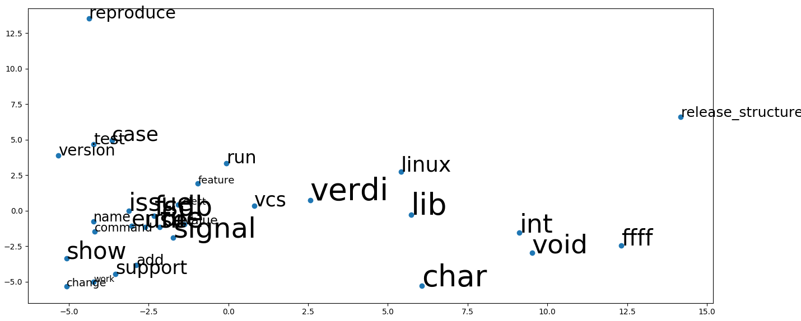
The 30 most frequent words in Verdi STARs
1 | verdi | 16 | release_structure
2 | file | 17 | name
3 | char | 18 | reproduce
4 | signal | 19 | version
5 | use | 20 | add
6 | issue | 21 | select
7 | fsdb | 22 | test
8 | show | 23 | description
9 | vcs | 24 | change
10 | void | 25 | user
11 | int | 26 | value
12 | support | 27 | work
13 | error | 28 | need
14 | run | 29 | get
15 | case | 30 | find

Slide 15
Usage
% cp /slowfs/vgpv6/yunxiang/ML/sim_star_org_0716/* .
% module load ml/1.0
% python train_doc2vec.py
It will take 0.5 to 2 hours to train based on the parameter setting of doc2vec
% python get_similar_star.py income_star_ids.log
Require a STAR IDs file as input (each STAR IDs should be on a separate line in the file)
Report ‘report_star_rca.xlsx’ will be generated

Slide 16
Get the similar STARs through Doc2Vec model
Given a Verdi STAR ID, we should be able to find similar STARs from all Verdi STARs
The task can be broken down into the steps below:
Query STARs
(as training data)
Query STARs
(for incoming analysis)
Preprocess text
Preprocess text
Build phrases
Load the model
Infer vector and get most similar STARs
Train Doc2Vec
Save the model
Output results as .xlsx
train_doc2vec.py
get_similar_star.py

Slide 17
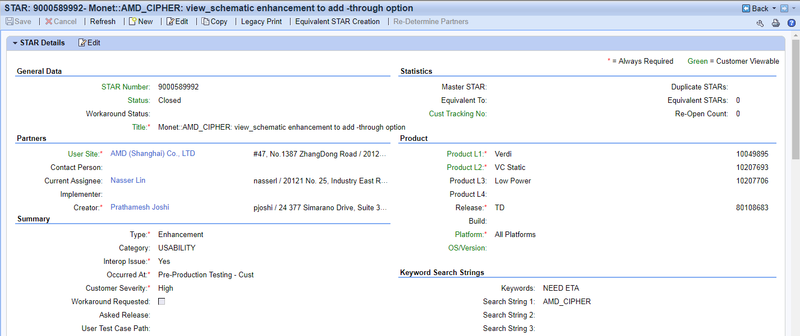
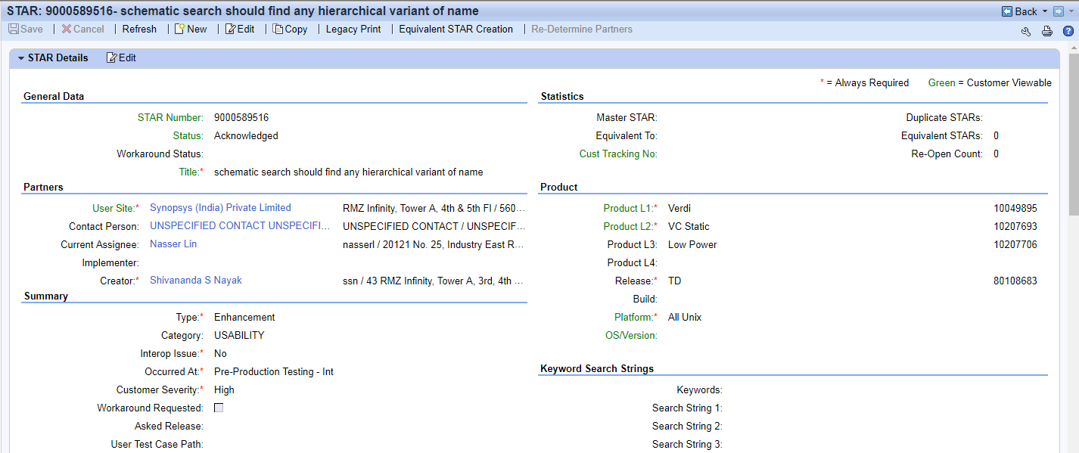
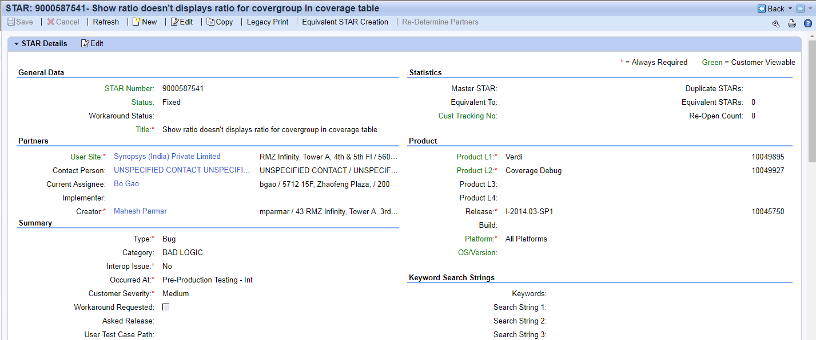
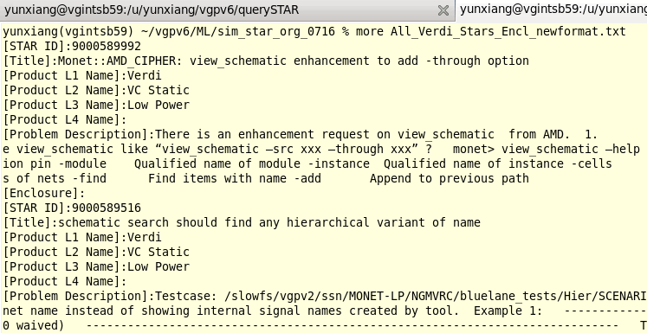
Get the similar STARs through Doc2Vec model
Query STARs
(as training data)
Preprocess text
Build phrases
Step 1: query all verdi stars using /u/regress/INFRA_HOME/bin/mq_star.pl
Train Doc2Vec
Save the model
train_doc2vec.py

Slide 18
Get the similar STARs through Doc2Vec model
Query STARs
(as training data)
Preprocess text
Build phrases
Step 2-1: tokenize(split) the sentences into words
We use Gensim’s simple_preprocess to convert the document into a list of lowercase
words and remove the punctuation marks and numbers
Train Doc2Vec
Save the model
train_doc2vec.py
In : [INTEL-VPG-GT] [17.12]- small issue with npiFsdbFreqDuty This issue is happened in Intel python script, which reads from a database and sets all the needed env vars. However, when it gives the full path to the location of npiFsdbFreqDuty the tool exits without doing nothing unless we have added $VERDI_HOME/bin to $PATH. Please see description below: The script invokes a subroutine called play_verdi_tcl where they do my $Novas_Bin = "novas"; … system("$Novas_Bin -play $tmp_tcl -batch"); So unless $PATH contains $VERDI_HOME/bin then novas utility won't run. The user has workaround and expects the fix in 19.06. The user needs the ETA for the enhancement
Out : ['intel', 'vpg', 'gt', 'small', 'issue', 'with', 'npifsdbfreqduty', 'this', 'issue', 'is', 'happened', 'in', 'intel', 'python', 'script', 'which', 'reads', 'from', 'database', 'and', 'sets', 'all', 'the', 'needed', 'env', 'vars', 'however', 'when', 'it', 'gives', 'the', 'full', 'path', 'to', 'the', 'location', 'of', 'npifsdbfreqduty', 'the', 'tool', 'exits', 'without', 'doing', 'nothing', 'unless', 'we', 'have', 'added', 'verdi_home', 'bin', 'to', 'path', 'please', 'see', 'description', 'below', 'the', 'script', 'invokes', 'subroutine', 'called', 'play_verdi_tcl', 'where', 'they', 'do', 'my', 'novas_bin', 'novas', 'system', 'novas_bin', 'play', 'tmp_tcl', 'batch', 'so', 'unless', 'path', 'contains', 'verdi_home', 'bin', 'then', 'novas', 'utility', 'won', 'run', 'the', 'user', 'has', 'workaround', 'and', 'expects', 'the', 'fix', 'in', 'the', 'user', 'needs', 'the', 'eta', 'for', 'the', 'enhancement']
Notes:
https://radimrehurek.com/gensim/utils.html
gensim.utils.simple_preprocess(doc, deacc=False, min_len=2, max_len=15)
Convert a document into a list of lowercase tokens, ignoring tokens that are too short or too long.
Uses tokenize() internally.
Parameters: doc (str) – Input document.
deacc (bool, optional) – Remove accent marks from tokens using deaccent()?
min_len (int, optional) – Minimum length of token (inclusive). Shorter tokens are discarded.
max_len (int, optional) – Maximum length of token in result (inclusive). Longer tokens are discarded.
Returns:Tokens extracted from doc.
Return type:list of str

Slide 19
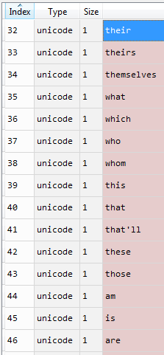
Get the similar STARs through Doc2Vec model
Query STARs
(as training data)
Preprocess text
Build phrases
Step 2-2: remove stop words
This is one of the important step in NLP. The stop words are common words that carry
less important meaning than keywords.
Train Doc2Vec
Save the model
train_doc2vec.py
In : ['intel', 'vpg', 'gt', 'small', 'issue', 'with', 'npifsdbfreqduty', 'this', 'issue', 'is', 'happened', 'in', 'intel', 'python', 'script', 'which', 'reads', 'from', 'database', 'and', 'sets', 'all', 'the', 'needed', 'env', 'vars', 'however', 'when', 'it', 'gives', 'the', 'full', 'path', 'to', 'the', 'location', 'of', 'npifsdbfreqduty', 'the', 'tool', 'exits', 'without', 'doing', 'nothing', 'unless', 'we', 'have', 'added', 'verdi_home', 'bin', 'to', 'path', 'please', 'see', 'description', 'below', 'the', 'script', 'invokes', 'subroutine', 'called', 'play_verdi_tcl', 'where', 'they', 'do', 'my', 'novas_bin', 'novas', 'system', 'novas_bin', 'play', 'tmp_tcl', 'batch', 'so', 'unless', 'path', 'contains', 'verdi_home', 'bin', 'then', 'novas', 'utility', 'won', 'run', 'the', 'user', 'has', 'workaround', 'and', 'expects', 'the', 'fix', 'in', 'the', 'user', 'needs', 'the', 'eta', 'for', 'the', 'enhancement']
Out : ['intel', 'vpg', 'gt', 'small', 'issue', 'npifsdbfreqduty', 'issue', 'happened', 'intel', 'python', 'script', 'reads', 'database', 'sets', 'needed', 'env', 'vars', 'however', 'gives', 'full', 'path', 'location', 'npifsdbfreqduty', 'tool', 'exits', 'without', 'nothing', 'unless', 'added', 'verdi_home', 'bin', 'path', 'please', 'see', 'description', 'script', 'invokes', 'subroutine', 'called', 'play_verdi_tcl', 'novas_bin', 'novas', 'system', 'novas_bin', 'play', 'tmp_tcl', 'batch', 'unless', 'path', 'contains', 'verdi_home', 'bin', 'novas', 'utility', 'run', 'user', 'workaround', 'expects', 'fix', 'user', 'needs', 'eta', 'enhancement']

Slide 20
Get the similar STARs through Doc2Vec model
Query STARs
(as training data)
Preprocess text
Build phrases
Step 2-3: word lemmatization
The example below setups lemmatization for Nouns, Verbs and Adjectives.
Train Doc2Vec
Save the model
train_doc2vec.py
In : ['intel', 'vpg', 'gt', 'small', 'issue', 'npifsdbfreqduty', 'issue', 'happened', 'intel', 'python', 'script', 'reads', 'database', 'sets', 'needed', 'env', 'vars', 'however', 'gives', 'full', 'path', 'location', 'npifsdbfreqduty', 'tool', 'exits', 'without', 'nothing', 'unless', 'added', 'verdi_home', 'bin', 'path', 'please', 'see', 'description', 'script', 'invokes', 'subroutine', 'called', 'play_verdi_tcl', 'novas_bin', 'novas', 'system', 'novas_bin', 'play', 'tmp_tcl', 'batch', 'unless', 'path', 'contains', 'verdi_home', 'bin', 'novas', 'utility', 'run', 'user', 'workaround', 'expects', 'fix', 'user', 'needs', 'eta', 'enhancement']
Out : ['intel', 'vpg', 'gt', 'small', 'issue', 'npifsdbfreqduty’, 'issue', 'happen', 'intel', 'python', 'script', 'read', 'database', 'set', 'need', 'env', 'var', 'however', 'give', 'full', 'path', 'location', 'npifsdbfreqduty', 'tool', 'exit', 'without', 'nothing', 'unless', 'add', 'verdi_home', 'bin', 'path', 'please', 'see', 'description', 'script', 'invoke', 'subroutine', 'call', 'play_verdi_tcl', 'novas_bin', 'nova', 'system', 'novas_bin', 'play', 'tmp_tcl', 'batch', 'unless', 'path', 'contain', 'verdi_home', 'bin', 'nova', 'utility', 'win', 'run', 'user', 'workaround', 'expect', 'fix', 'user', 'need', 'eta', 'enhancement']

Slide 21
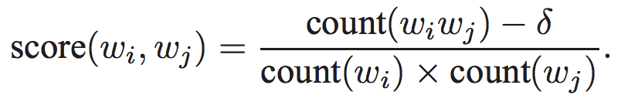
Get the similar STARs through Doc2Vec model
Query STARs
(as training data)
Preprocess text
Build phrases
Step 3: detect common phrases
Train Doc2Vec
Save the model
train_doc2vec.py
In : ['intel', 'vpg', 'gt', 'small', 'issue', 'npifsdbfreqduty’, 'issue', 'happen', 'intel', 'python', 'script', 'read', 'database', 'set', 'need', 'env', 'var', 'however', 'give', 'full', 'path', 'location', 'npifsdbfreqduty', 'tool', 'exit', 'without', 'nothing', 'unless', 'add', 'verdi_home', 'bin', 'path', 'please', 'see', 'description', 'script', 'invoke', 'subroutine', 'call', 'play_verdi_tcl', 'novas_bin', 'nova', 'system', 'novas_bin', 'play', 'tmp_tcl', 'batch', 'unless', 'path', 'contain', 'verdi_home', 'bin', 'novas', 'utility', 'win', 'run', 'user', 'workaround', 'expect', 'fix', 'user’,
'need', 'eta', 'enhancement']
Out : ['intel_vpg_gt', 'small', 'issue', 'npifsdbfreqduty’, 'issue', 'happen', 'intel', 'python', 'script', 'read', 'database', 'set', 'need', 'env_var', 'however', 'give', 'full_path', 'location', 'npifsdbfreqduty', 'tool', 'exit', 'without', 'nothing', 'unless', 'add', 'verdi_home_bin', 'path', 'please_see', 'description', 'script', 'invoke', 'subroutine_call', 'play_verdi_tcl', 'novas_bin', 'nova', 'system', 'novas_bin', 'play', 'tmp_tcl', 'batch', 'unless', 'path', 'contain', 'verdi_home_bin', 'novas', 'utility', 'win', 'run', 'user', 'workaround', 'expect', 'fix', 'user', 'need_eta', 'enhancement']

Slide 22
Get the similar STARs through Doc2Vec model
Query STARs
(as training data)
Preprocess text
Build phrases
Step 4: tagging documents and training Doc2Vec
snippet of code
Train Doc2Vec
Save the model
# Create the tagged document needed for Doc2Vec
def create_tagged_document2(index2key, list_of_list_of_words):
for i, list_of_words in enumerate(list_of_list_of_words):
yield gensim.models.doc2vec.TaggedDocument(list_of_words, [index2key[i]])
train_data = list(create_tagged_document2(index2key,trigram[bigram[stars_data_processed]]))
# Init the Doc2Vec model
model_doc2vec = gensim.models.doc2vec.Doc2Vec(vector_size=100, min_count=2, epochs=40)
# Build the Vocabulary
model_doc2vec.build_vocab(train_data)
# Train the Doc2Vec model
model_doc2vec.train(train_data, total_examples=model_doc2vec.corpus_count, epochs=model_doc2vec.epochs)
train_doc2vec.py
https://radimrehurek.com/gensim/models/doc2vec.html

Slide 23
Get the similar STARs through Doc2Vec model
Query STARs
(as training data)
Preprocess text
Build phrases
Step 5: save Doc2Vec model
Step 6~7: query incoming stars and preprocess text the same way as step 1~2
Step 8: load Doc2Vec model
Train Doc2Vec
model_doc2vec.save('doc2vec_0716’)
Save the model
train_doc2vec.py
Query STARs
(for incoming analysis)
model_doc2vec = Doc2Vec.load('doc2vec_0716')
Preprocess text
Load the model
Infer vector and get most similar STARs
Output results as .xlsx
get_similar_star.py

Slide 24
Get the similar STARs through Doc2Vec model
Step 9: infer vector for the income star and get the most similar stars
In : model_doc2vec.docvecs[‘9001341639’]
or new_vector = model_doc2vec.infer_vector(new_star.words)
Out :
[ 6.04996532e-02 9.17110443e-01 1.42640388e+00 1.47512376e-01
2.42325532e-05 -6.69282794e-01 3.05849344e-01 2.96403676e-01
-2.31290236e-01 2.80926049e-01 -6.24684274e-01 -8.23133349e-01
-6.36173129e-01 -2.09046118e-02 -1.25258401e-01 -4.68335629e-01
4.22685206e-01 -3.27804983e-02 1.24305815e-01 1.06678283e+00
-2.66504347e-01 5.20387411e-01 4.15788710e-01 -2.56514307e-02
-5.18722534e-01 -5.67773461e-01 7.28938401e-01 -3.00361454e-01
-6.97783351e-01 -5.80907941e-01 4.07214880e-01 -7.29252219e-01
-7.03262985e-01 -1.60048470e-01 7.97485188e-03 -1.55730560e-01
1.50060505e-01 -5.36507905e-01 -2.01648787e-01 -1.37277424e-01
6.61604926e-02 7.87993371e-01 -1.34197748e+00 -6.36669934e-01
1.52929306e-01 -2.97972828e-01 -8.13990653e-01 6.56423032e-01
2.22997442e-01 1.18577576e+00 -5.06099820e-01 -4.29988354e-02
9.73224640e-01 -9.04060364e-01 3.53096157e-01 4.39479917e-01
-2.89244235e-01 -9.15409803e-01 -6.50831401e-01 -1.63991913e-01
1.66971758e-01 6.84732124e-02 -1.27312720e-01 5.69061339e-01
5.14556207e-02 -7.94413805e-01 4.06732485e-02 1.30960811e-02
-9.43677902e-01 -3.71471465e-01 2.49403819e-01 4.64750856e-01
7.83985928e-02 -2.55824476e-01 -4.02419269e-01 -9.89917442e-02
1.20026112e-01 2.45572124e-02 1.52472258e+00 -6.54677391e-01
-4.02791917e-01 -4.82611284e-02 4.02985573e-01 -3.46877486e-01
-6.21383972e-02 4.04104829e-01 3.44418913e-01 -4.67186809e-01
1.07172735e-01 -7.77240753e-01 -7.46959388e-01 7.81462669e-01
-3.07720006e-01 6.82808995e-01 6.71771705e-01 6.27546549e-01
1.86007893e+00 -6.64772451e-01 -5.28122559e-02 9.73971844e-01]
In : model_doc2vec.docvecs.most_similar(['9001341639’], topn=10)
or model_doc2vec.docvecs.most_similar([new_vector], topn=10)
Out :
[ ('9001359088’, 0.9720692038536072),
('9001231034’, 0.6526749134063721),
('9000893639’, 0.6176946759223938),
('9001048502’, 0.6166892647743225),
('9000708832’, 0.6101829409599304),
('9000896318’, 0.6087108254432678),
('SPS0257937’, 0.6028104424476624),
('SPS0318089’, 0.6016271114349365),
('9000819475’, 0.5986785888671875),
('9001381932’, 0.598553478717804) ]
Query STARs
(for incoming analysis)
Preprocess text
Load the model
Infer vector and get most similar STARs
Cosine Similarity
Output results as .xlsx
get_similar_star.py

Slide 25
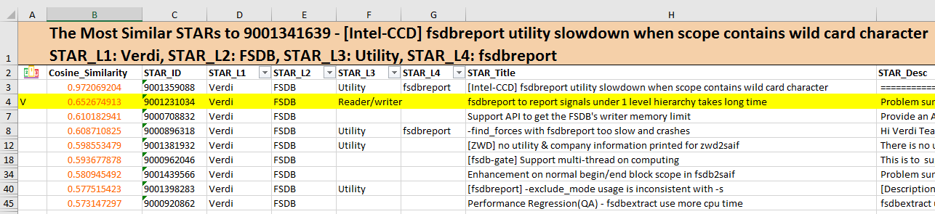
Get the similar STARs through Doc2Vec model
Step 10: output results to Excel file (report_star_rca.xlsx)
Query STARs
(for incoming analysis)
Preprocess text
Load the model
Infer vector and get most similar STARs
Output results as .xlsx
get_similar_star.py

Slide 26
Assess the accuracy of model
A simple way check is to re-infer a vector for each document (STAR) already in the training set. If the model is well-trained, the nearest document should be the same document.
Our experiment shows about 94% (52185/55444) of the inferred documents are found to be most similar to itself.
Also note that because the underlying training/inference algorithms are an iterative approximation problem that makes use of internal randomization, repeated inferences of the same text will return slightly different vectors. [4]

Slide 27
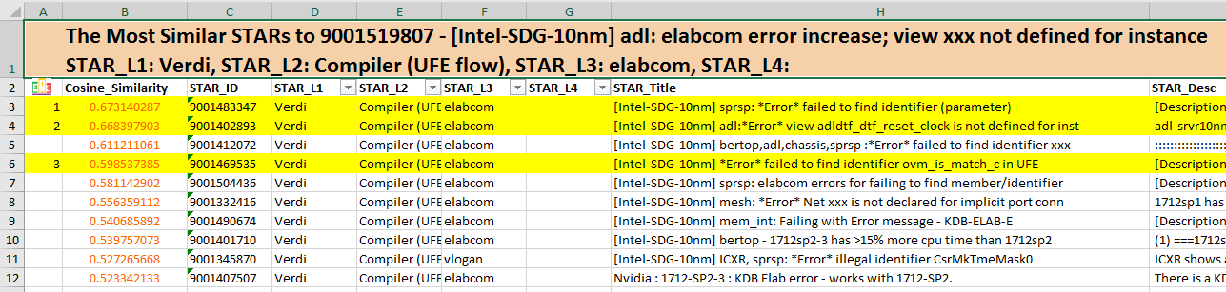
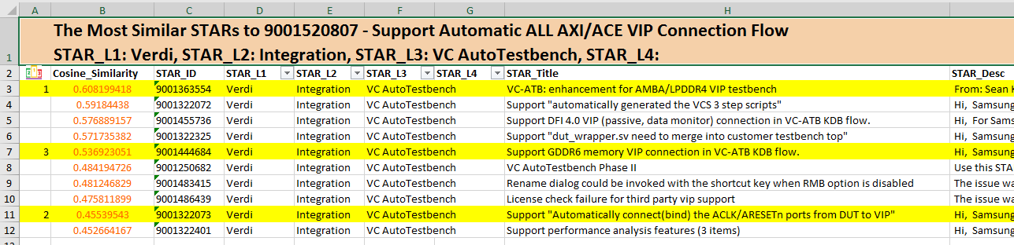
Analyze the generated report

Slide 28
Future Work
1. How to improve the model accuracy?
Custom stop-word list
Grouping Verdi stars by product L2 before training Doc2Vec (need to predict L2 for those stars having ‘unknown’ L2, and this can be done using logistic regression classifier)
Consider the star link information while training Doc2Vec
2. Phase II: find similar testcases with Doc2Vec model

Slide 29
References
[1] https://papers.nips.cc/paper/5021-distributed-representations-of-words-and-phrases-and-their-compositionality.pdf
[2] https://cs.stanford.edu/~quocle/paragraph_vector.pdf
[3] https://www.youtube.com/watch?v=64qSgA66P-8
[4] https://github.com/RaRe-Technologies/gensim/blob/develop/docs/notebooks/doc2vec-lee.ipynb
[5] https://www.machinelearningplus.com/nlp/gensim-tutorial/

Slide 30
Thank you!

Slide 32
Statistics of Product L2 of Verdi
about 40 categories…
Notes:
Number of products: 42
Counter({'unknown': 7072, 'Interactive Debug': 5264, 'Coverage Debug': 5089, 'Low Power Debug': 4042, 'nTrace': 3281, 'VIA': 3181, 'VC Static': 2881, 'Dumper': 2227, 'Testbench': 2183, 'Compiler': 2178, 'nWave': 2148, 'Compiler (UFE flow)': 2043, 'FSDB': 1854, 'Transaction Debug': 1681, 'nSchema': 1668, 'Behavior Analysis': 1166, 'AMS': 1060, 'Integration': 914, 'GUI/QT': 854, 'C/SystemC Debug': 619, 'BaseTech(BT)': 517, 'Assertion Debug': 411, 'Utility': 359, 'nECO': 342, 'HW/SW Debug': 319, 'Documentation': 302, 'Data Agent': 276, 'nCompare': 270, 'SmartLog': 263, 'nClock': 223, 'Design Analysis (nAnalyzer)': 205, 'OneSearch': 127, 'Licensing': 108, 'nState': 72, 'OEM Build': 62, 'Collaborative Debug': 49, 'nMemory': 43, 'License': 39, 'nRegister': 15, 'autoRCA': 12, 'nTime': 7, 'Secondary Platform Specific': 2})

Slide 33
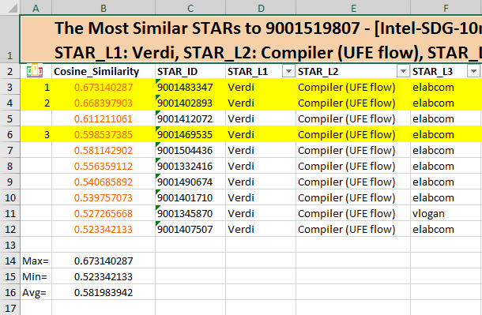
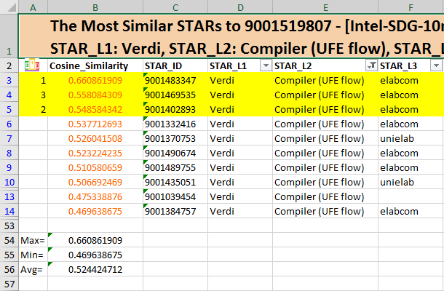
Group STARs by Product L2 Before Training
Group by L2
Not group by L2

Slide 34
How to Update Doc2Vec Model?
Currently gensim Doc2Vec doesn’t support
https://stackoverflow.com/questions/47775557/updating-training-documents-for-gensim-doc2vec-model
https://github.com/RaRe-Technologies/gensim/issues/419
https://groups.google.com/forum/#!topic/gensim/AysuYp1BX_k

