Slide 1

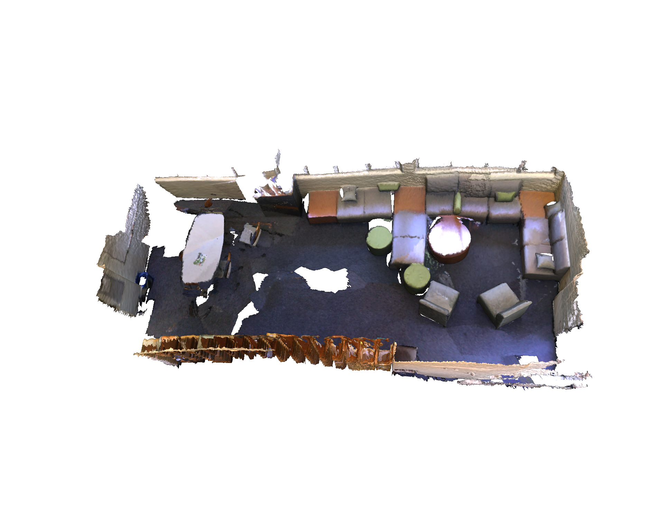







Pseudo Label Generator (PLG)
CBM
Feature Backbone
Transformer Decoder
$${\overline{Y}}_{K}^{t}$$
Selection
$${\tilde{Y}}_{K}^{t,w}$$
$$(P,Y^{t})$$
$${\tilde{Y}}_{K}^{t}$$
Feature Backbone
Transformer Decoder
$$ℒ_{CI−3DIS}$$
Current model (${\text{Φ}}^{t}$)
$${\hat{Y}}^{t}$$

Slide 2
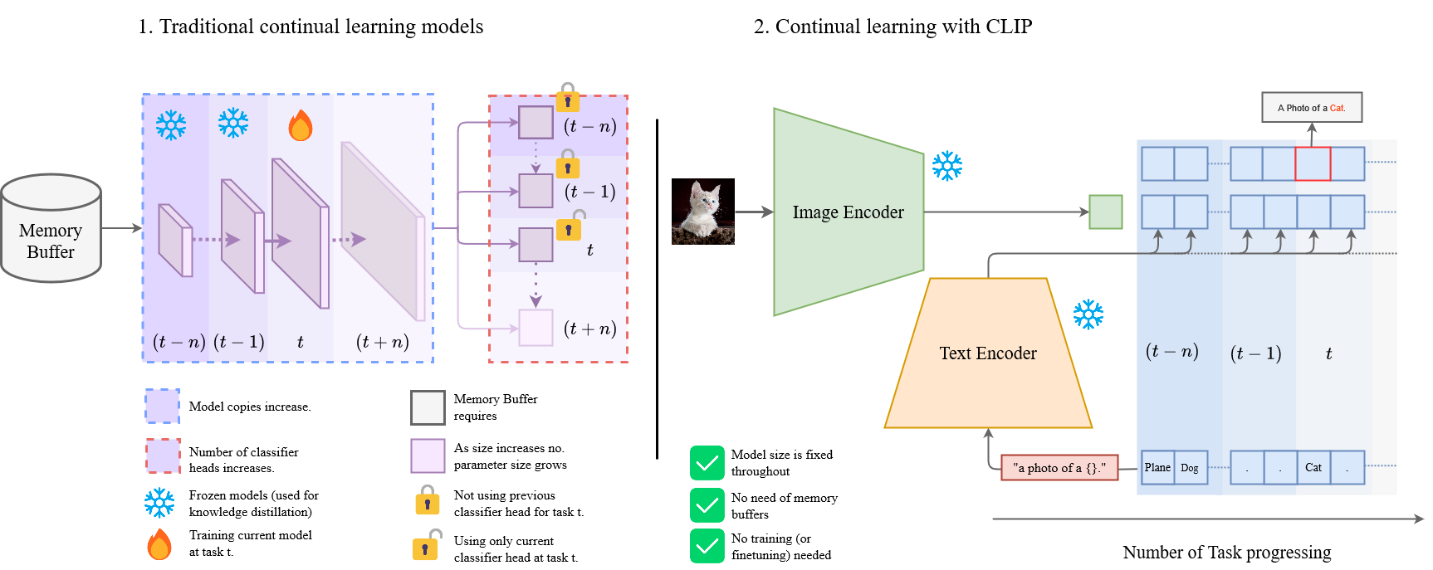

Slide 3




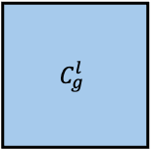




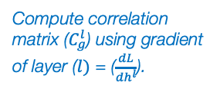



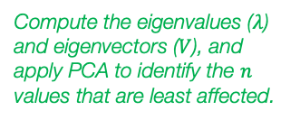




Task $t−1$ Hidden layers
Task $t−1$ Hidden layer
$$1$$
…
$$l$$
…
$$L$$
$$l$$
Equation (3)
Input Image
Outputs
Compute correlation matrix ($C_{g}^{l}$) using gradient of layer ($l)$ = ($\frac{dL}{{dh}^{l}}$).
$$W_{t_{k}}^{l}$$
$$C_{g}^{l}$$
$$V_{t_{k−1}}^{l}$$
$$n_{l}$$
$$n_{l}$$
$$n_{l}$$
$$W_{tr}^{l}$$
Compute the eigenvalues ($λ$) and eigenvectors ($V$), and apply PCA to identify the $n$ values that are least affected.
$$n$$
$$n_{l}$$
$$n$$

Slide 4
