Slide 1
vRO AI Studio
Supercharging vRBT Development with Claude AI
Generate · Review · Test · Explain · Onboard
Powered by Anthropic Claude | VS Code Extension

Slide 2
What is vRBT?
VMware Aria Automation / vRealize Build Tools
⚙️ vRBT
📦 TypeScript Actions
VMware's official toolchain for building and deploying vRealize Orchestrator (vRO) workflows and actions, using a Maven-based project structure.
Write automation logic in TypeScript. vRBT compiles, packages, and pushes actions to your vRO endpoint via mvn vro:push.
🔗 vCenter Integration
🚀 CI/CD Ready
Interact directly with vSphere APIs — manage VMs, networks, storage — all through typed vRO scripting backed by a live vCenter.
Integrates with pipelines (GitHub Actions, Jenkins) for automated testing and deployment of your automation packages.

Slide 3
Claude & AI-Assisted Development
How Anthropic's Claude accelerates vRO automation development
Claude is Anthropic's AI assistant — trained to be safe, accurate, and helpful. In vRO AI Studio, Claude understands vRO's TypeScript APIs and vCenter SDK, letting it generate production-ready automation code from plain English descriptions.
✍️
🔍
🧪
📖
Generate
Review
Test
Explain
Describe a task; Claude writes the vRO action with error handling, logging, and JSDoc.
Automatically detect anti-patterns, blocking calls, and security issues.
Generate Jasmine spec files covering happy paths, nulls, edge cases, and API errors.
Get a plain-English summary of any vRO action — ideal for onboarding and docs.

Slide 4
Adding Credits to Use the Solution
Claude API access requires an Anthropic account with active billing
1
Create an Anthropic Account
Visit console.anthropic.com and sign up for a free account using your work email.
2
Go to Billing Settings
Navigate to Settings → Billing. Click 'Add payment method' and enter your credit card details.
3
Purchase Credits
Select a credit amount (e.g. $10–$100). Credits are pre-paid and consumed as you make API calls.
4
Generate Your API Key
In API Keys section, click 'Create Key'. Copy and store it securely — you'll configure it in vRO AI Studio settings.
5
Configure in VS Code
Open vRO AI Studio settings in VS Code and paste your API key. The extension will validate the connection automatically.

Slide 5
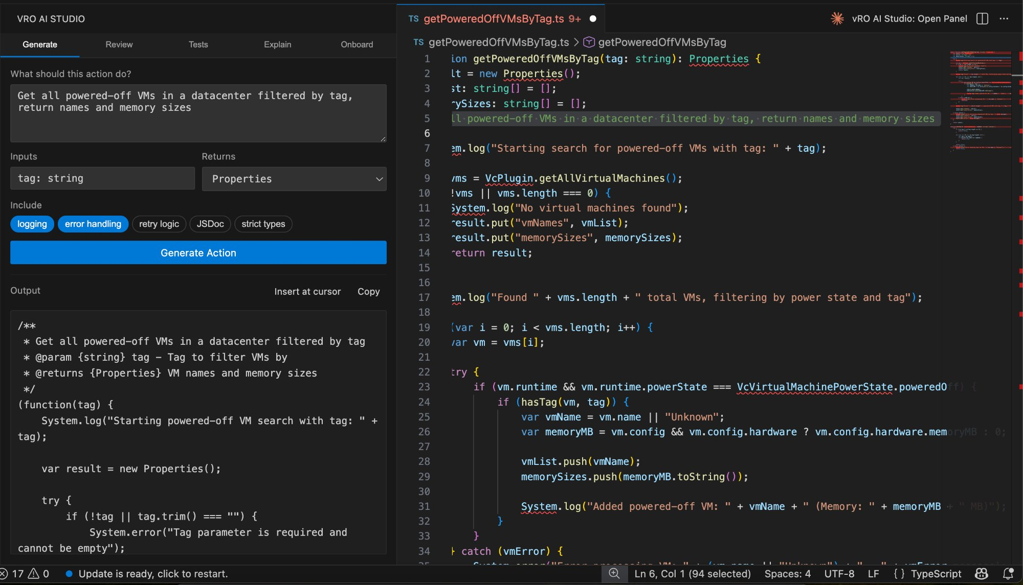
GENERATE
Generate vRO Actions from Natural Language
Describe the action goal in plain English — Claude writes fully typed TypeScript with logging, error handling, and JSDoc automatically.

Slide 6
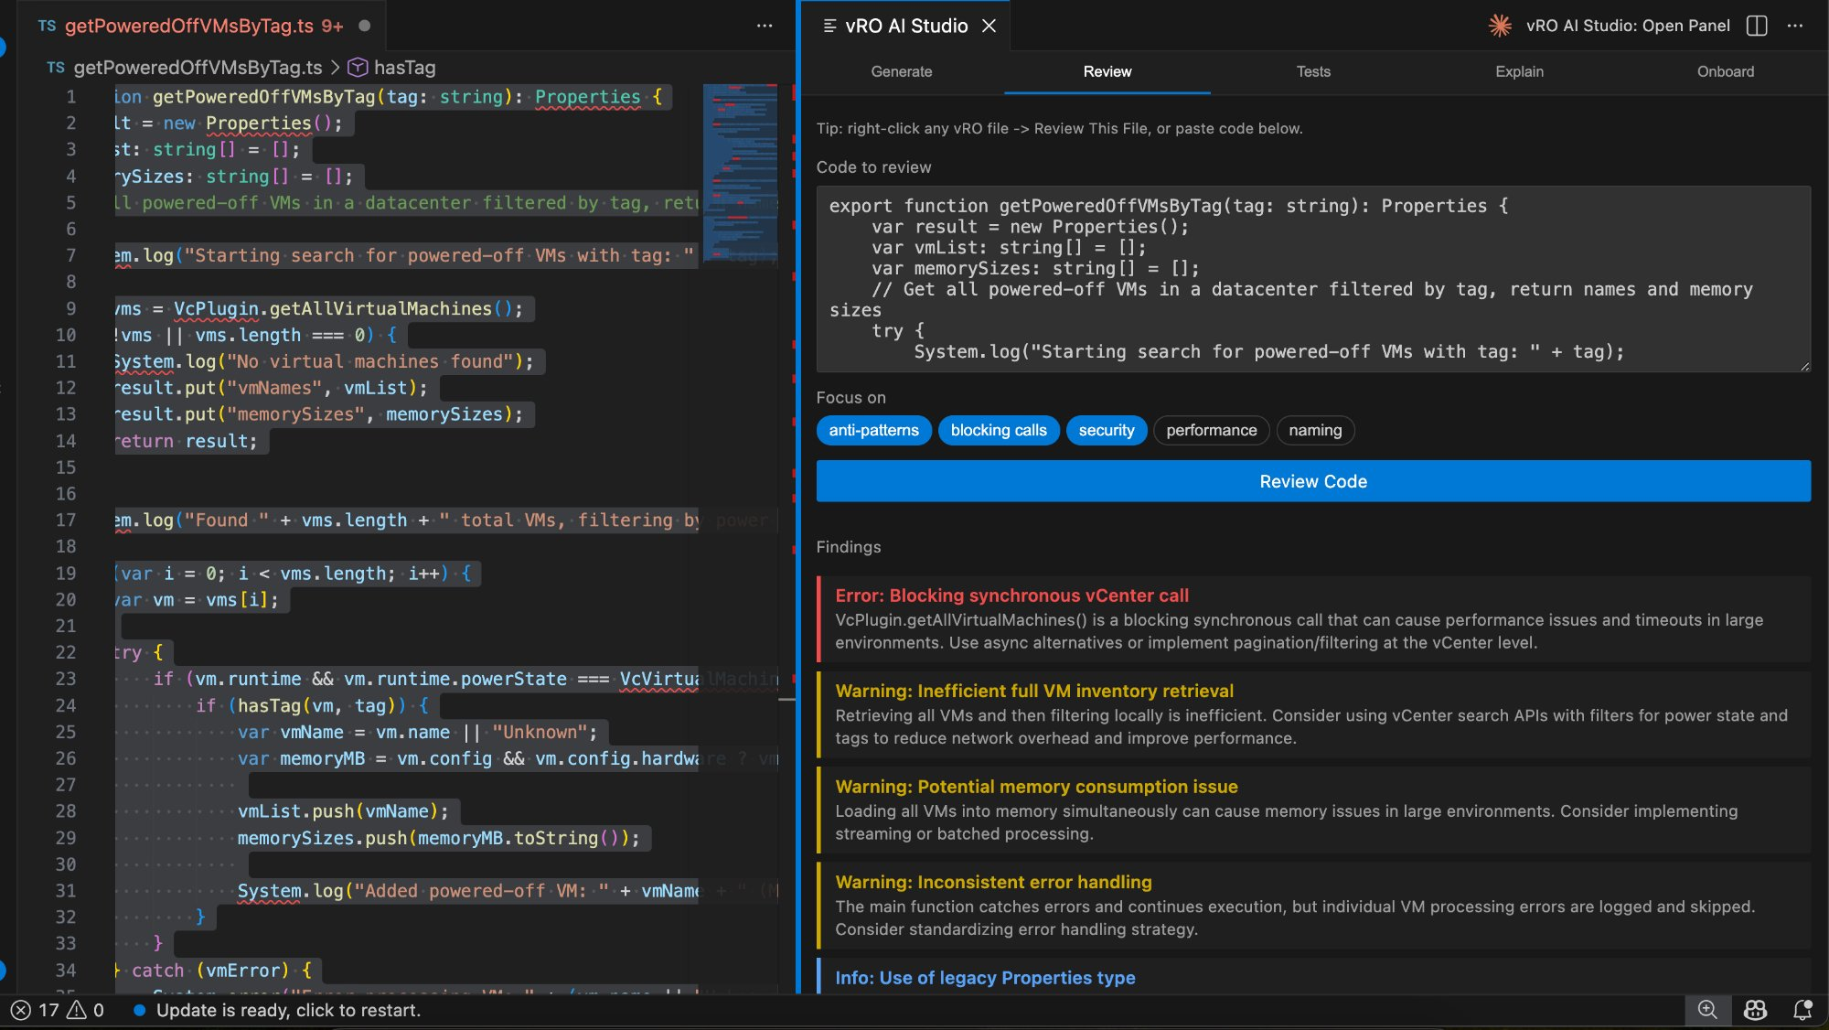
REVIEW
Automated Code Review & Best-Practice Checks
Claude analyses the code and surfaces blocking synchronous calls, memory issues, inconsistent error handling, and legacy API usage — color-coded by severity.

Slide 7
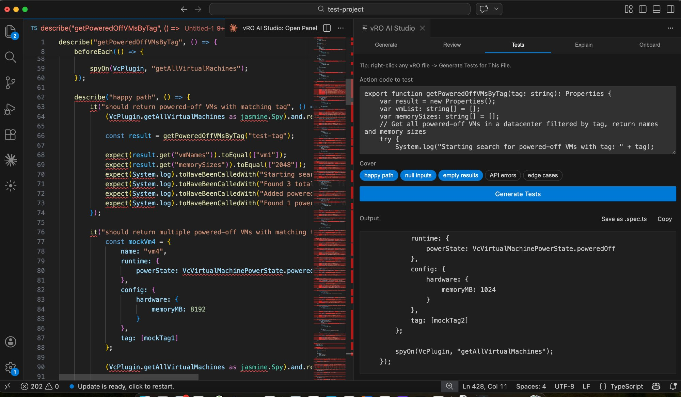
TESTS
Instant Jasmine Test Suite Generation
Select the coverage areas (happy path, null inputs, edge cases) and Claude generates a complete .spec.ts file with mocks, spies, and assertions ready to run.

Slide 8
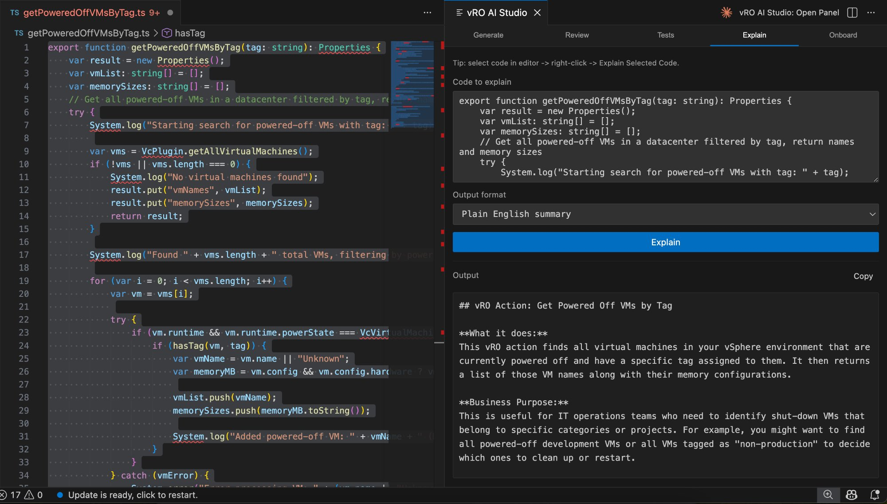
EXPLAIN
Plain-English Code Explanations
Select any vRO action and Claude produces a business-readable summary of what it does and why — perfect for documentation and handoffs.

Slide 9
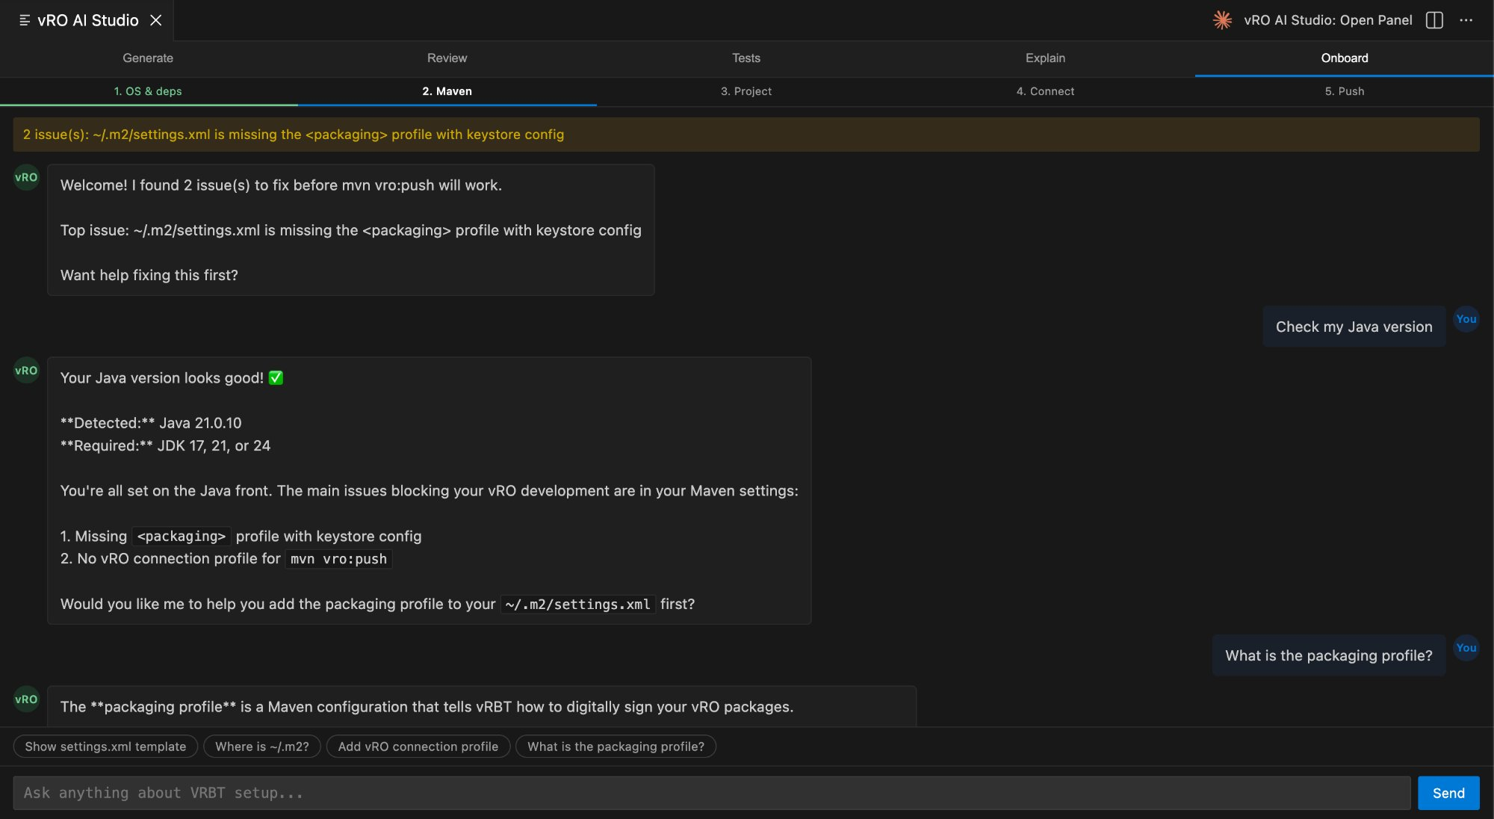
ONBOARD
Step-by-Step Environment Setup Assistant
The Onboard tab detects missing Maven profiles, Java versions, and vRO connection settings, then walks you through each fix conversationally.

Slide 10
Start Building Smarter
vRO AI Studio + Claude = faster, safer vRBT automation
console.anthropic.com · marketplace.visualstudio.com
Thank you

