Slide 1
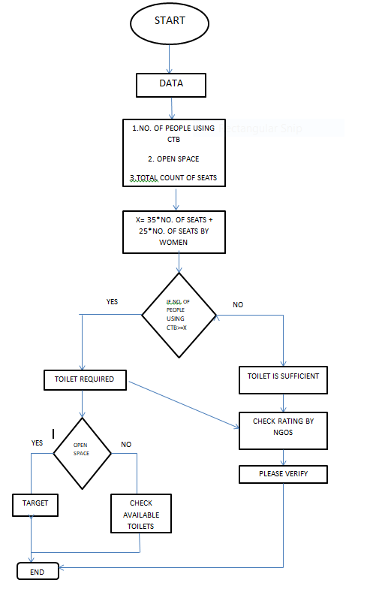

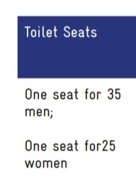
Z=((population-(N+HH+SBM+Shared))/335)/11

