Slide 1

JAZ Library System
Zhitian Zheng
Abdelillah Faddaoui
Joy Zhou
__01/24/2016

Slide 2
Function Model Diagram
Main page
Login page
Edit and Add
Member page
Add book
page
Add Periodical
page
System Controller
Member
Account Map
Account Entry
Check Out Record
Check Out Entry
Book & Periodical
Account
Access
Data Access
File Systems

Slide 3
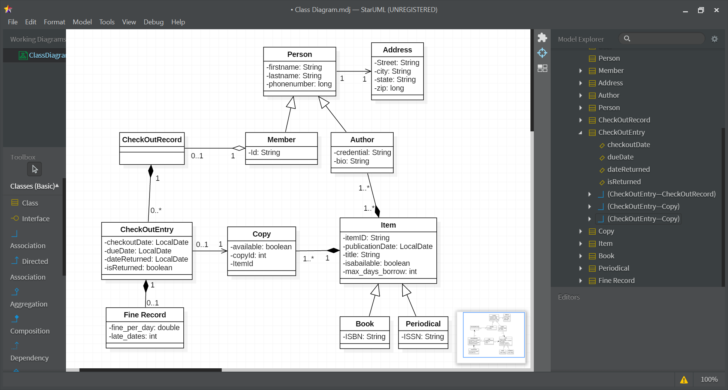
Class Diagram

Slide 4
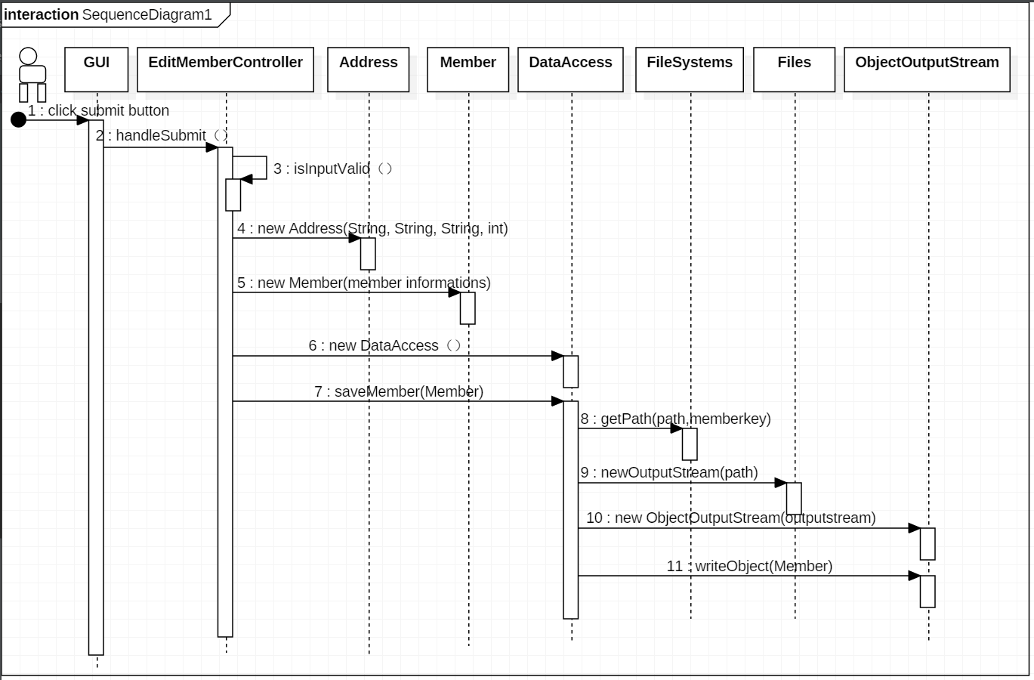
Add Member Sequence

Slide 5


JAZ

