Slide 1
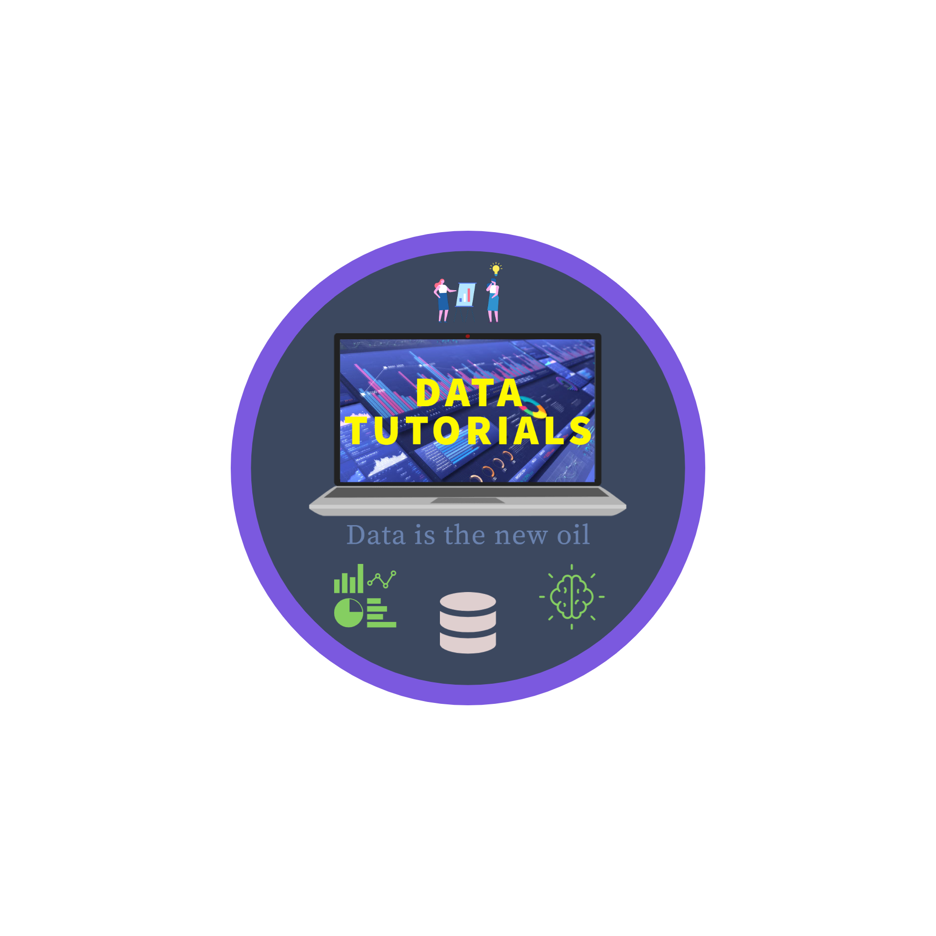

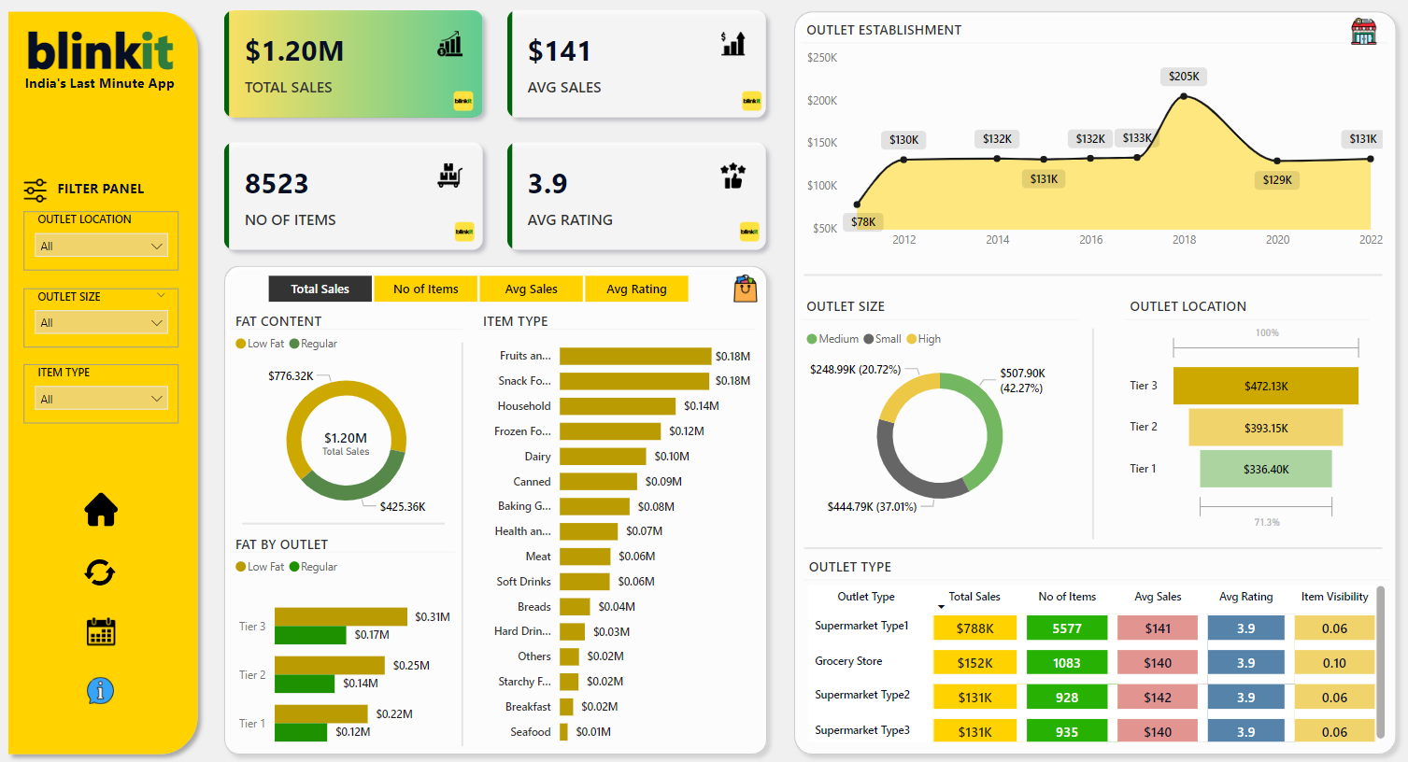
blinkit Analysis

Slide 2


blinkit Analysis
STEPS IN PROJECT
Requirement Gathering/ Business Requirements
Data Walkthrough
Data Connection
Data Cleaning / Quality Check
Data Modeling
Data Processing
DAX Calculations
Dashboard Lay outing
Charts Development and Formatting
Dashboard / Report Development
Insights Generation

Slide 3
blinkit Analysis
BUSINESS REQUIREMENT
To conduct a comprehensive analysis of Blinkit's sales performance, customer satisfaction, and inventory distribution to identify key insights and opportunities for optimization using various KPIs and visualizations in Power BI.
KPI’s Requirements
Total Sales: The overall revenue generated from all items sold.
Average Sales: The average revenue per sale.
Number of Items: The total count of different items sold.
Average Rating: The average customer rating for items sold.

Slide 4
blinkit Analysis
BUSINESS REQUIREMENT
Chart’s Requirements
1. Total Sales by Fat Content:
Objective: Analyze the impact of fat content on total sales.
Additional KPI Metrics: Assess how other KPIs (Average Sales, Number of Items, Average Rating) vary with fat content.
Chart Type: Donut Chart.
2. Total Sales by Item Type:
Objective: Identify the performance of different item types in terms of total sales.
Additional KPI Metrics: Assess how other KPIs (Average Sales, Number of Items, Average Rating) vary with fat content.
Chart Type: Bar Chart.
3. Fat Content by Outlet for Total Sales:
Objective: Compare total sales across different outlets segmented by fat content.
Additional KPI Metrics: Assess how other KPIs (Average Sales, Number of Items, Average Rating) vary with fat content.
Chart Type: Stacked Column Chart.
4. Total Sales by Outlet Establishment:
Objective: Evaluate how the age or type of outlet establishment influences total sales.
Chart Type: Line Chart.

Slide 5
blinkit Analysis
BUSINESS REQUIREMENT
Chart’s Requirements
5. Sales by Outlet Size:
Objective: Analyze the correlation between outlet size and total sales.
Chart Type: Donut/ Pie Chart.
6. Sales by Outlet Location:
Objective: Assess the geographic distribution of sales across different locations.
Chart Type: Funnel Map.
7. All Metrics by Outlet Type:
Objective: Provide a comprehensive view of all key metrics (Total Sales, Average Sales, Number of Items, Average Rating) broken down by different outlet types.
Chart Type: Matrix Card.

Slide 6
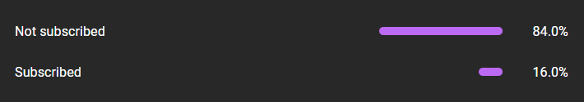

blinkit Analysis

