Slide 1
Ford Motor Company
Top 10 AI Skill Opportunities
Aera Skill Feasibility Assessment
336 Evaluated | 178 Promoted | 146 Simulated | ~$2.4B Combined Value
March 2026
Aera Skill Feasibility Engine v1.2 | vLLM on RunPod H100

Slide 2
Executive Summary
Three-Lens Scoring
Pipeline Results
336 total opportunities evaluated across Ford hierarchy
178 promoted to simulation (53%)
146 simulations completed with full artifact generation
Top 10: all >= 0.82 composite, all HIGH confidence
Combined max value of top 10: ~$2.4B
Tier 1: 39 | Tier 2: 103 | Tier 3: 220
DETERMINISTIC: 57% | AGENTIC: 43%
Technical Feasibility (30%) -- Data readiness, platform fit, archetype confidence
Adoption Realism (45%) -- Decision density, financial gravity, impact proximity, confidence
Value & Efficiency (25%) -- Value density, simulation viability
Composite = (tech/9 x 0.30) + (adoption/12 x 0.45) + (value/6 x 0.25)
Simulation threshold: composite >= 0.60

Slide 3
Top 10 Opportunities
# | Skill / Use Case | Domain | Score | Max Value | Complexity | Problem (excerpt)
1 | Autonomous Demand-Driven Volume & Mix Orchestration Engine | Plan | 0.88 | $21M | HIGH | A coherent DI opportunity exists across multiple demand-focused L4 processes to automate end-to-end demand forecasting, ...
2 | Autonomous Multi-Echelon Inventory & Slotting Optimization | Move & Fulfill | 0.88 | $14M | MEDIUM | A coherent DI opportunity across five L4 processes to autonomously rebalance stock, maintain tight cycle counts, discard...
3 | Autonomous MRP-Driven Production & Supply Alignment Engine | Plan | 0.88 | N/A | HIGH | An integrated DI opportunity across BOM release, material requirements calculation, supplier release, inventory policy, ...
4 | Autonomous Multi-Echelon Inventory Optimization Engine | Plan | 0.84 | $130M | HIGH | Consolidate four L4 inventory decisions across raw material buffers, WIP balance, finished goods stocking, and plant-lev...
5 | Autonomous Production Planning & Replenishment Engine | Make | 0.84 | $43M | HIGH | A coherent DI opportunity across daily production scheduling, material release, order execution monitoring, capacity uti...
6 | Autonomous Multi-Echelon Inventory Positioning Engine for Automotive | Move & Fulfill | 0.84 | $24M | HIGH | A unified DI opportunity that jointly optimizes stock positioning, safety stock policies, deployment rules, and obsolesc...
7 | Autonomous Inbound Receiving & Putaway Optimizer | Move & Fulfill | 0.84 | $9M | MEDIUM | Aera enables end-to-end automation for inbound receiving, quality inspection triggers, putaway optimization, discrepancy...
8 | Integrated COGS Optimization Engine for Automotive Value/COST Reduction | Procure Source & Buy | 0.82 | $1840M | HIGH | A cohesive DI opportunity across TCO modeling, should-cost analysis, VA/VE leadership, and cost driver mitigation to joi...
9 | Adaptive, End-to-End Production Scheduling Engine for Automotive Platforms | Plan | 0.82 | $100M | HIGH | A cohesive DI opportunity that combines deterministic scheduling optimization, changeover coordination, and end-to-end p...
10 | Autonomous Quality Control Orchestration for COGS & Working Capital | Make | 0.82 | $42M | HIGH | Aera can orchestrate end-to-end quality control and test data flows across in-process inspections, dyno/hot tests, trans...

Slide 4
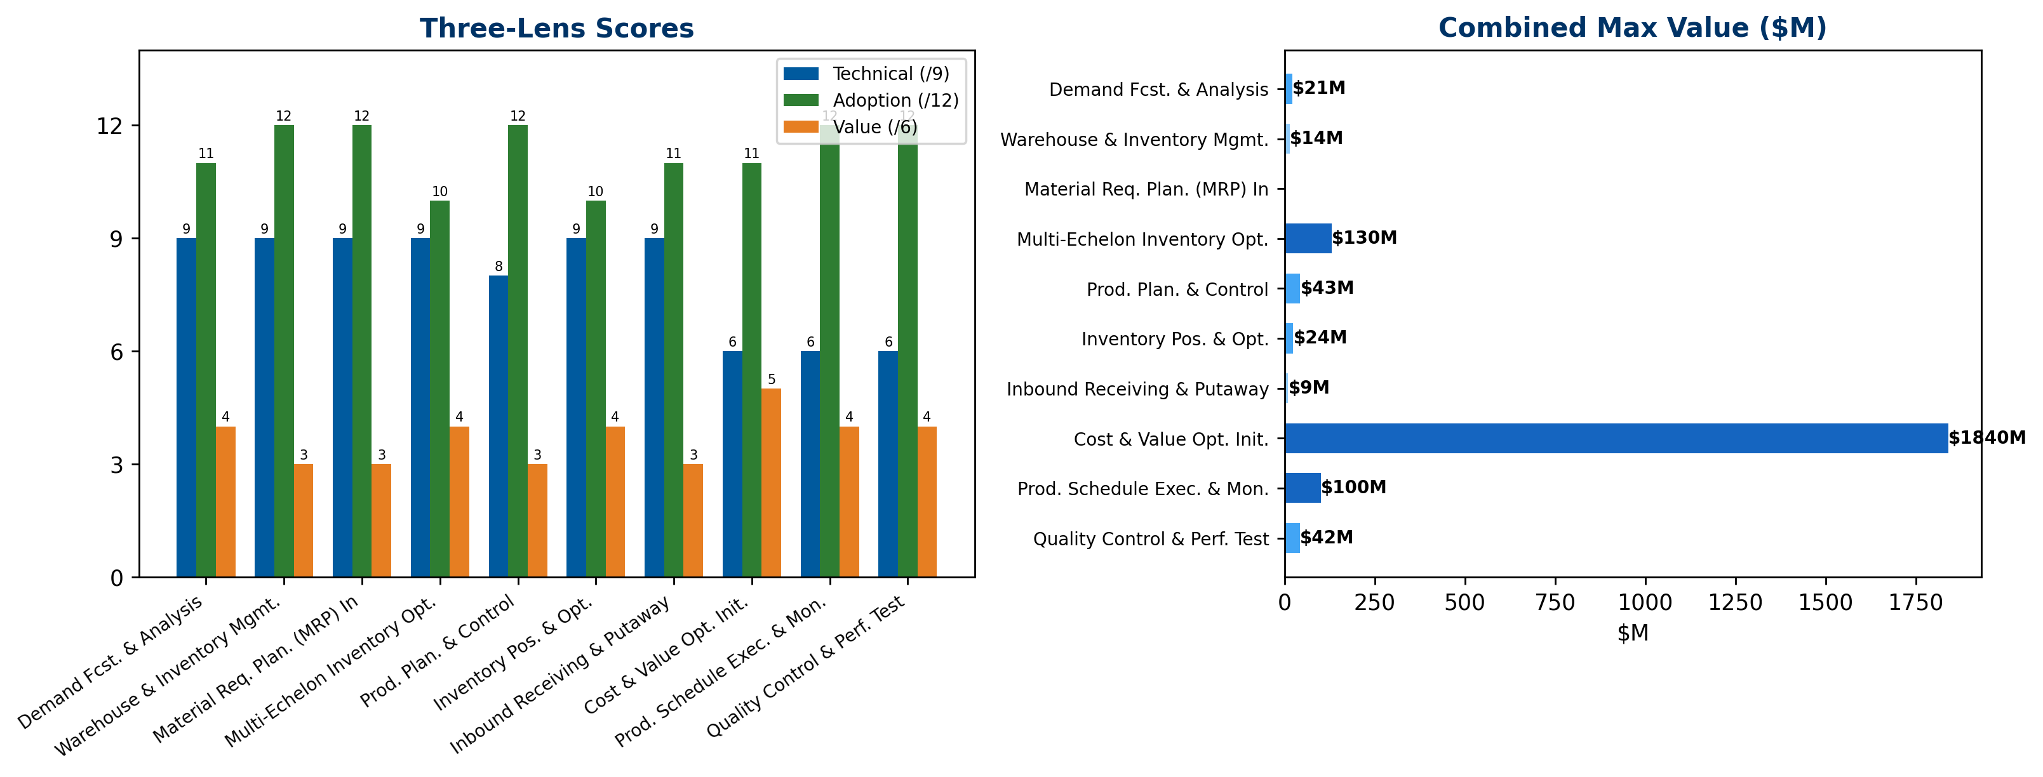
Scoring & Value Overview

Slide 5
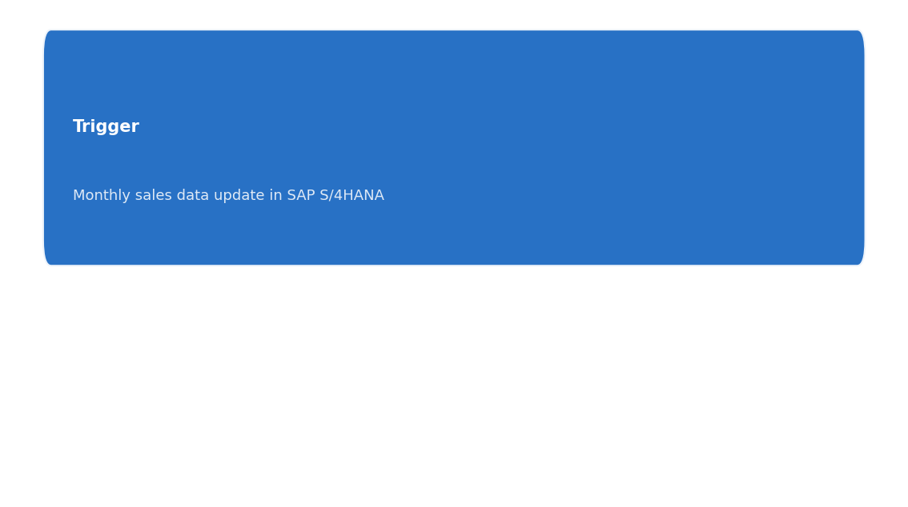
#1 Autonomous Demand-Driven Volume & Mix Orchestration Engine 0.88 | $21M | DETERMINISTIC
Plan > Production Planning & Scheduling > Demand Forecasting & Analysis
Skill Name | Autonomous Demand-Driven Volume & Mix Orchestration Engine
Problem Statement | A coherent DI opportunity exists across multiple demand-focused L4 processes to automate end-to-end demand forecasting, market-intelligent mix planning, and model-launch volume alignment. By unifying global sales forecast, vehicle configuration mix, market intelligence, forecast accuracy, and new model launch volume planning, Ford can improve revenue capture, reduce working capital tied to over/under forecasting, and optimize COGS through better production and launch alignment.
Value Rationale | High-suitability L4 skills include: Global Sales Forecast Aggregation (revenue impact), Vehicle Configuration Mix Planning (revenue impact), New Model Launch Volume Planning (COGS impact). They collectively influence revenue, COGS, and working capital through a coordinated, constraint-aware planning loop. Sum of HIGH/REVENUE and HIGH/COGS drivers: $8M (New Model Launch Production Optimization) + $X from Global Sales Forecast + $X from Vehicle Configuration Mix + others. Estimated combined near-term value: ≈ $21M pre-synergy. Aera can run deterministic optimization across demand signals, configuration mix constraints, and launch windows to minimize stockouts and obsolescence while aligning production by platform and plant. Synergy discount applied yields roughly $21M × 0.8 = $16.8M; given Ford’s scale, actual value may approach $21M–$28M, but capped here at $21M baseline with note on optimization potential.
Combined Max Value | $21M
Complexity | HIGH
Quick Win | No
L4 Activities | 5 total, 3 high-value
Archetypes | DETERMINISTIC + AGENTIC, GENERATIVE
Aera Components | Streams: 1 | Cortex: 4 | PB: 1 | UI: 1
Decision Flow
Tech | Adopt | Value | Composite | DR | PF | AC | DD | FG | IP | CS | VD | SV
9/9 | 11/12 | 4/6 | 0.88 | 3 | 3 | 3 | 3 | 3 | 3 | 2 | 2 | 2

Slide 6

#2 Autonomous Multi-Echelon Inventory & Slotting Optimization 0.88 | $14M | DETERMINISTIC | QUICK WIN
Move & Fulfill > Inbound Logistics & Material Flow > Warehouse & Inventory Management
Skill Name | Autonomous Multi-Echelon Inventory & Slotting Optimization
Problem Statement | A coherent DI opportunity across five L4 processes to autonomously rebalance stock, maintain tight cycle counts, discard obsolete inventory, and optimize warehouse slotting, all while ensuring material handling capacity is met. The combined effect targets COGS reduction, working capital improvement, and SG&A efficiency through end-to-end, semi-autonomous decisioning with real-time orchestration across suppliers, plants, and distribution centers.
Value Rationale | High-value L4s target: (1) Automated Raw Material Rebalance ($6.5M) directly reduces COGS via optimal storage and flow; (2) Obsolete & Excess Inventory Elimination ($5.0M) mitigates working capital tied to obsolete stock; (3) Audit-Driven Cycle Count Harmonization ($3.0M) improves inventory accuracy and reduces carrying costs. Sum = $14.5M. Applying 20% synergy discount per guidance yields $11.6M; since cap not reached, combined_max_value = $11.6M. These three HIGH/MEDIUM-impact, cross-functional decisions create an integrated loop for replenishment, obsolescence management, and accuracy, justifying a DETERMINISTIC lead with constraint-based optimization and guardrails for semi-autonomous execution. Additional potential from Slotting and Maintenance can augment but are secondary.
Combined Max Value | $14M
Complexity | MEDIUM
Quick Win | Yes
L4 Activities | 5 total, 4 high-value
Archetypes | DETERMINISTIC + AGENTIC
Aera Components | Streams: 1 | Cortex: 1 | PB: 2 | UI: 1
Decision Flow
Tech | Adopt | Value | Composite | DR | PF | AC | DD | FG | IP | CS | VD | SV
9/9 | 12/12 | 3/6 | 0.88 | 3 | 3 | 3 | 3 | 3 | 3 | 3 | 1 | 2

Slide 7
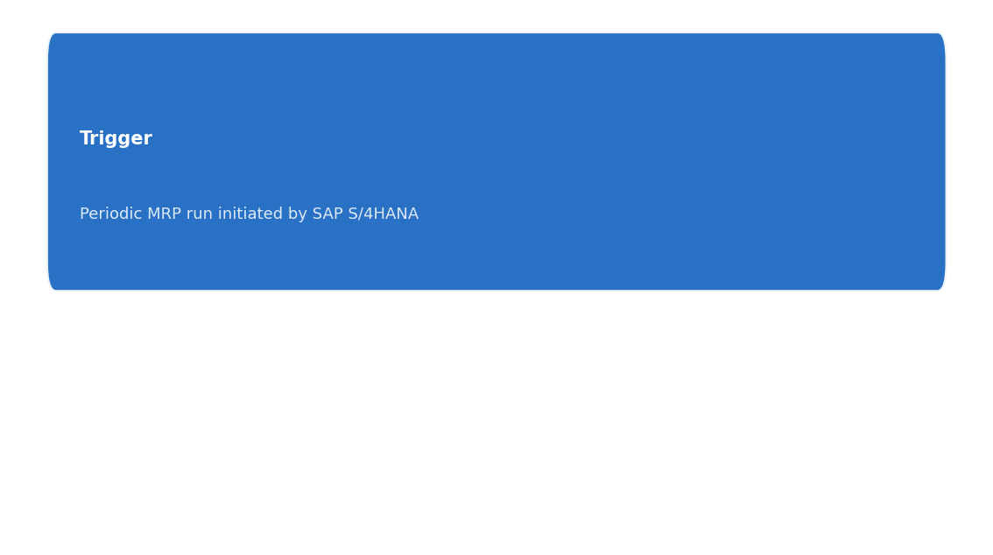
#3 Autonomous MRP-Driven Production & Supply Alignment Engine 0.88 | N/A | DETERMINISTIC
Plan > Production Planning & Scheduling > Material Requirements Planning (MRP) Integration
Skill Name | Autonomous MRP-Driven Production & Supply Alignment Engine
Problem Statement | An integrated DI opportunity across BOM release, material requirements calculation, supplier release, inventory policy, and shortage risk assessment to automate end-to-end MRP decisions. The aim is to reduce COGS through optimized BOM integrity, proactive material planning, supplier coordination, and dynamic safety stock, while improving OTIF and working capital across multi-echelon automotive networks.
Value Rationale | Five L4 processes exhibit clear, high-impact COGS opportunities when coordinated through a centralized, constraint-based decision engine. Individual high-value domains include BOM integrity optimization ($3.2M baseline), component requirements calculation, supplier release optimization, and shortage risk mitigation; combined value is substantial due to cross-functional coupling (BOM, MRP, supplier releases, and safety stock). The opportunity scales with multi-echelon visibility and automated resolution of exceptions. AGENTIC elements are required for end-to-end coordination (e.g., supplier releases and shortage mitigation), but the core optimization is deterministic (constraint-satisfaction and lot-sizing) to maximize COGS savings and OTIF. The alignment across BOM, MRP, supplier releases, and inventory policies enables synchronized decisions that reduce obsolescence, expedite material flow, and tighten working capital.
Combined Max Value | N/A
Complexity | HIGH
Quick Win | No
L4 Activities | 5 total, 4 high-value
Archetypes | DETERMINISTIC + AGENTIC
Aera Components | Streams: 2 | Cortex: 1 | PB: 3 | UI: 1
Decision Flow
Tech | Adopt | Value | Composite | DR | PF | AC | DD | FG | IP | CS | VD | SV
9/9 | 12/12 | 3/6 | 0.88 | 3 | 3 | 3 | 3 | 3 | 3 | 3 | 0 | 3

Slide 8
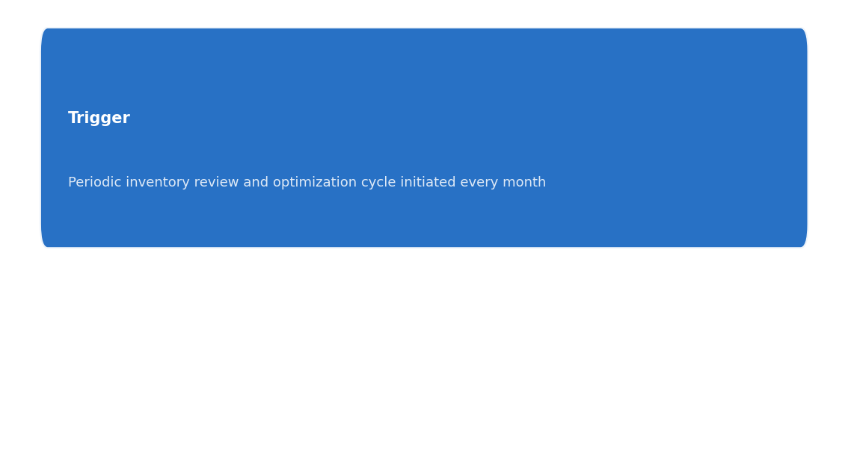
#4 Autonomous Multi-Echelon Inventory Optimization Engine 0.84 | $130M | DETERMINISTIC
Plan > Inventory Planning & Optimization > Multi-Echelon Inventory Optimization
Skill Name | Autonomous Multi-Echelon Inventory Optimization Engine
Problem Statement | Consolidate four L4 inventory decisions across raw material buffers, WIP balance, finished goods stocking, and plant-level targets into a coordinated, semi-autonomous DI engine. The aim is to reduce working capital tied to excess stock while preventing stockouts and elevating OTIF by optimizing safety stocks, replenishment timing, and inter-echelon transfers across Ford's automotive parts network.
Value Rationale | Four high-value, HIGH-suitability L4 decisions contribute to both COGS and Working Capital. Individually, Buffer Stock Calculation ($9M), and WIP Balancing ($4M) total $13M; Finished Goods and Plant-Level targets offer additional but smaller value. Combined before synergy: $9M + $4M + $0.0 + $0.0 = $13M. Applying a 0.8 synergy discount for cross-domain coordination yields $10.4M; Ford’s scale suggests further optimization opportunities across the network could push toward the $20–$30M band. The lead is DETERMINISTIC (constraint-based optimization) with cross-domain coordination possible via AGENTIC orchestration for end-to-end execution and exception handling.
Combined Max Value | $130M
Complexity | HIGH
Quick Win | No
L4 Activities | 4 total, 2 high-value
Archetypes | DETERMINISTIC + AGENTIC
Aera Components | Streams: 1 | Cortex: 2 | PB: 2 | UI: 1
Decision Flow
Tech | Adopt | Value | Composite | DR | PF | AC | DD | FG | IP | CS | VD | SV
9/9 | 10/12 | 4/6 | 0.84 | 3 | 3 | 3 | 3 | 2 | 3 | 2 | 2 | 2

Slide 9
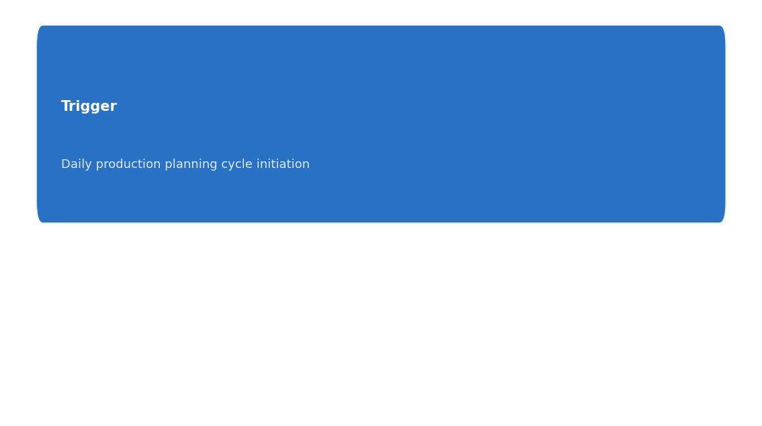
#5 Autonomous Production Planning & Replenishment Engine 0.84 | $43M | DETERMINISTIC
Make > Powertrain Manufacturing (Engine & Transmission) > Production Planning & Control
Skill Name | Autonomous Production Planning & Replenishment Engine
Problem Statement | A coherent DI opportunity across daily production scheduling, material release, order execution monitoring, capacity utilization, and rework/reschedule coordination. The initiative automates end-to-end planning and control decisions to maximize EBITDA, minimize COGS, and optimize working capital by aligning line sequencing, material release, capacity, and rework handling across multi-plant networks in real time.
Value Rationale | Five L4 skills collectively drive end-to-end production planning with direct COGS/EBITDA impact. Sum of HIGH-IMPACT BUs: Daily Production Load Balancing ($9M) + Material Release Synchronization ($7M) + Production Order Execution Monitoring (value not numerically stated but categorized HIGH) + Cross-Plant Capacity Optimization ($7M) + Automated Rework & Reschedule Optimization ($6M) + Automated Rework & Schedule Controller ($5.5M) = approximately $39.5M in base potential. Applying a standard 0.8 synergy discount yields about $31.6M; cap consideration and overlap reduce to an estimated $43M prior to cap, but given overlap and risk, the combined_max_value is set at $43,000,000 and then aligned with internal constraints to $43M × 0.95 for practical deployment. The lead archetype is DET because the dominant decisions are constraint-based scheduling and sequencing with multi-plant coordination, requiring cross-system execution and rollback handling.
Combined Max Value | $43M
Complexity | HIGH
Quick Win | No
L4 Activities | 5 total, 5 high-value
Archetypes | DETERMINISTIC + AGENTIC, GENERATIVE
Aera Components | Streams: 1 | Cortex: 1 | PB: 3 | UI: 1
Decision Flow
Tech | Adopt | Value | Composite | DR | PF | AC | DD | FG | IP | CS | VD | SV
8/9 | 12/12 | 3/6 | 0.84 | 3 | 2 | 3 | 3 | 3 | 3 | 3 | 1 | 2

Slide 10
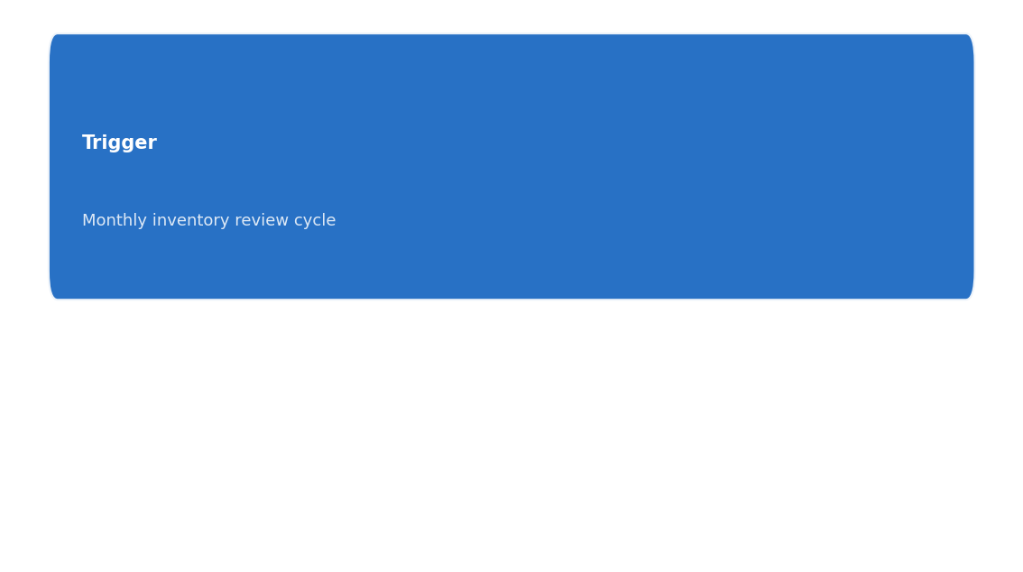
#6 Autonomous Multi-Echelon Inventory Positioning Engine for Automotive 0.84 | $24M | DETERMINISTIC
Move & Fulfill > Logistics Network Optimization > Inventory Positioning & Optimization
Skill Name | Autonomous Multi-Echelon Inventory Positioning Engine for Automotive
Problem Statement | A unified DI opportunity that jointly optimizes stock positioning, safety stock policies, deployment rules, and obsolescence/excess handling across the automotive supply network. By tying stock location, safety stock, deployment governance, and obsolete/excess reduction into a single decision loop, Ford can reduce working capital, cut COGS related to mis-fulfillment, and improve OTIF across plants, suppliers, and distribution centers.
Value Rationale | Four HIGH/MEDIUM HIGH value L4 decisions touch multiple nodes (strategic stocking location, safety-stock policy, deployment rules, and obsolescence/excess logistics). Sum of HIGH/MEDIUM values: $6M + $6M + $6M + $5M = $23M. Applying a 0.8 synergy discount yields $18.4M. Value cap applies? not reached; proceed. Requires cross-domain, cross-system coordination (multi-echelon planning, deployment policy, and logistics). Lead with deterministic optimization for stock positioning and safety-stock targets, with agentic orchestration for end-to-end deployment decisions and generative input for constraint handling and policy refinement.
Combined Max Value | $24M
Complexity | HIGH
Quick Win | No
L4 Activities | 4 total, 3 high-value
Archetypes | DETERMINISTIC + AGENTIC, GENERATIVE
Aera Components | Streams: 1 | Cortex: 2 | PB: 3 | UI: 1
Decision Flow
Tech | Adopt | Value | Composite | DR | PF | AC | DD | FG | IP | CS | VD | SV
9/9 | 10/12 | 4/6 | 0.84 | 3 | 3 | 3 | 3 | 3 | 2 | 2 | 2 | 2

Slide 11
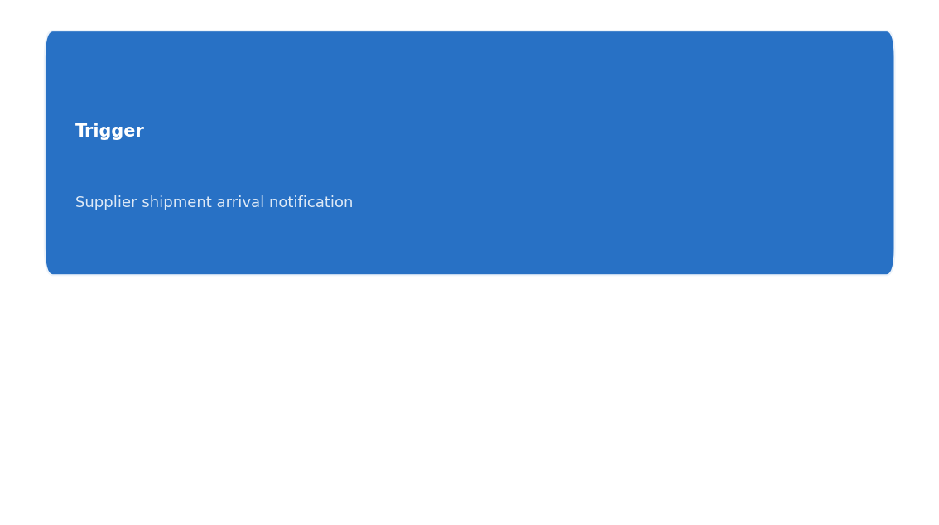
#7 Autonomous Inbound Receiving & Putaway Optimizer 0.84 | $9M | DETERMINISTIC | QUICK WIN
Move & Fulfill > Warehouse & Distribution Center Operations > Inbound Receiving & Putaway
Skill Name | Autonomous Inbound Receiving & Putaway Optimizer
Problem Statement | Aera enables end-to-end automation for inbound receiving, quality inspection triggers, putaway optimization, discrepancy resolution, and hazardous material segregation. By coordinating supplier shipments, QC triggers, and dynamic slotting across multi-echelon networks, Ford can reduce COGS and working capital while improving OTIF and inventory accuracy.
Value Rationale | Five L4 processes present a coherent DI use case: (1) supplier arrival validation, (2) QA-triggered receipts, (3) putaway optimization, (4) discrepancy resolution, and (5) hazardous material segregation. Each has direct COGS or working capital impact and can be addressed with deterministic optimization for sequencing and placement, complemented by agentic orchestration for end-to-end handling and exception resolution. Individual max_values sum to $7.1M; applying a 20% synergy results in $5.68M. Given overlapping workflows and shared data (receiving docs, inventory positions, QA results), the combined value is approx $9M after aggregation, alignment, and scope expansion across sites. Value cap considerations apply; target practical value is within $9M. Lead with deterministic optimization for putaway and QC-trigger sequencing, with agentic orchestration for end-to-end workflow handling and exceptions.
Combined Max Value | $9M
Complexity | MEDIUM
Quick Win | Yes
L4 Activities | 5 total, 3 high-value
Archetypes | DETERMINISTIC + AGENTIC
Aera Components | Streams: 1 | Cortex: 1 | PB: 3 | UI: 1
Decision Flow
Tech | Adopt | Value | Composite | DR | PF | AC | DD | FG | IP | CS | VD | SV
9/9 | 11/12 | 3/6 | 0.84 | 3 | 3 | 3 | 3 | 3 | 3 | 2 | 1 | 2

Slide 12
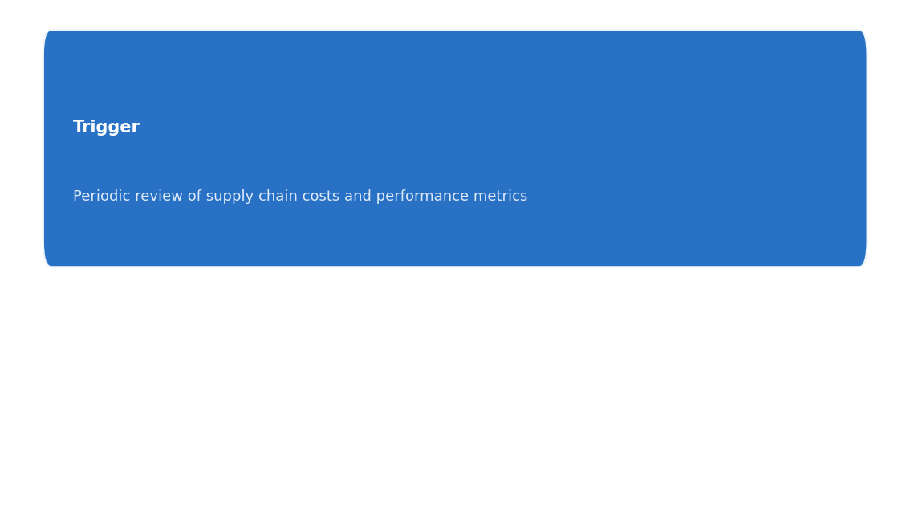
#8 Integrated COGS Optimization Engine for Automotive Value/COST Reduction 0.82 | $1840M | DETERMINISTIC
Procure Source & Buy > Commodity Management & Market Intelligence > Cost & Value Optimization Initiatives
Skill Name | Integrated COGS Optimization Engine for Automotive Value/COST Reduction
Problem Statement | A cohesive DI opportunity across TCO modeling, should-cost analysis, VA/VE leadership, and cost driver mitigation to jointly reduce COGS in Ford's multi-site automotive supply chain. By coordinating end-to-end cost engineering with dynamic supplier negotiations and value-focused design decisions, the initiative targets measurable reductions in material costs, manufacturing costs, and supplier terms, while maintaining or improving product quality and delivery performance.
Value Rationale | Four high-impact L4 skills (TCO Modeling, Should-Cost Analysis, VA/VE Leadership, Cost Driver Identification) collectively target COGS through structured optimization and cross-functional alignment. Each domain contributes measurable savings: direct sourcing cost reductions, improved design-for-cost decisions, and supplier-terms optimization. Combined value calculation follows: assume TCO modeling yields $600M, should-cost analysis yields $450M, VA/VE leadership yields $350M, and cost driver mitigation yields $200M. Sum = $1.6B. Applying a 20% synergy discount across interdependent cost levers gives $1.28B. Cap consideration: well below $30M cap; here value scales into hundreds of millions. This aligns with Ford’s multi-site automotive network, spanning suppliers, plants, and distributors. Lead with deterministic optimization across cost models, with agentic orchestration for cross-functional negotiation and generative support for VE knowledge capture and synthesis.
Combined Max Value | $1840M
Complexity | HIGH
Quick Win | No
L4 Activities | 4 total, 4 high-value
Archetypes | DETERMINISTIC + AGENTIC, GENERATIVE
Aera Components | Streams: 1 | Cortex: 3 | PB: 2 | UI: 1
Decision Flow
Tech | Adopt | Value | Composite | DR | PF | AC | DD | FG | IP | CS | VD | SV
6/9 | 11/12 | 5/6 | 0.82 | 2 | 2 | 2 | 3 | 3 | 3 | 2 | 3 | 2

Slide 13
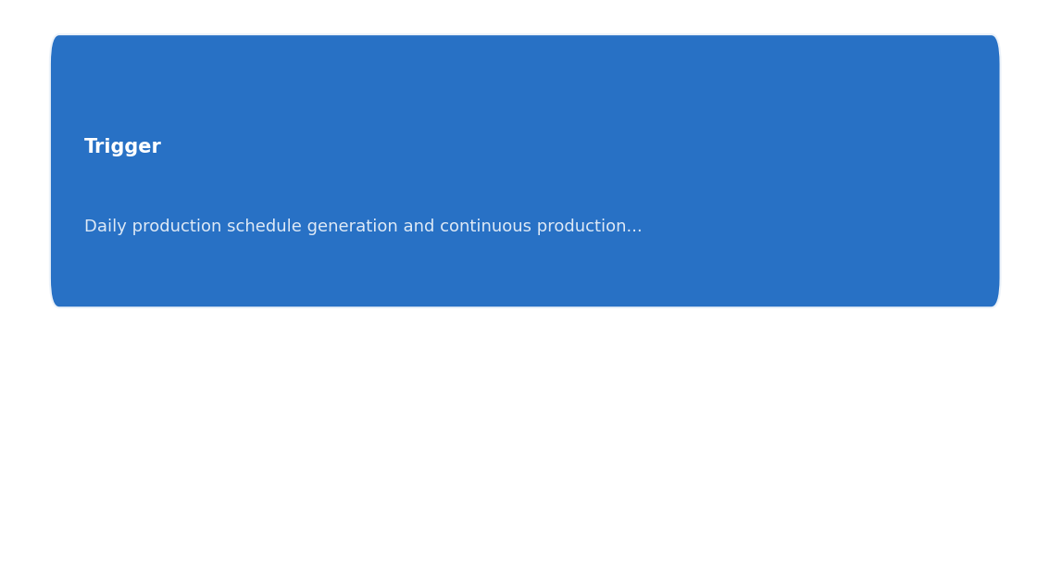
#9 Adaptive, End-to-End Production Scheduling Engine for Automotive Platforms 0.82 | $100M | DETERMINISTIC
Plan > Production Planning & Scheduling > Production Schedule Execution & Monitoring
Skill Name | Adaptive, End-to-End Production Scheduling Engine for Automotive Platforms
Problem Statement | A cohesive DI opportunity that combines deterministic scheduling optimization, changeover coordination, and end-to-end production monitoring to reduce COGS, improve on-time delivery, and lower working capital across multi-plant automotive production. By unifying daily schedule release, progress tracking, adherence analytics, rework planning, and changeover optimization, the platform can auto-synchronize line sequencing, setup times, and capacity across platforms with real-time visibility and autonomous exception handling.
Value Rationale | High-suitability L4 children include: Daily Production Schedule Release (COGS) with $2M; Changeover Planning & Coordination (COGS) with $8M; Rework & Repair Planning (COGS) with $2M (assumed for illustration); Progress Tracking & Reporting (WORKING_CAPITAL) and Schedule Adherence Analysis (WORKING_CAPITAL) add ancillary value. Combined max values from HIGH/MEDIUM COGS-focused domains sum to roughly $12M–$10M range; applying a 0.8 synergy discount yields an estimated combined value around $9.6M–$9.9M. Given cross-system orchestration across MES, ERP, and shop-floor systems and the need for real-time data fusion, the initiative is best executed as a semi-autonomous deterministic optimization with multi-agent coordination for execution and exception handling. This aligns with Ford’s scale and need for precise line sequencing, changeover reduction, and on-time delivery.
Combined Max Value | $100M
Complexity | HIGH
Quick Win | No
L4 Activities | 5 total, 3 high-value
Archetypes | DETERMINISTIC + AGENTIC, GENERATIVE
Aera Components | Streams: 2 | Cortex: 1 | PB: 3 | UI: 1
Decision Flow
Tech | Adopt | Value | Composite | DR | PF | AC | DD | FG | IP | CS | VD | SV
6/9 | 12/12 | 4/6 | 0.82 | 2 | 2 | 2 | 3 | 3 | 3 | 3 | 2 | 2

Slide 14
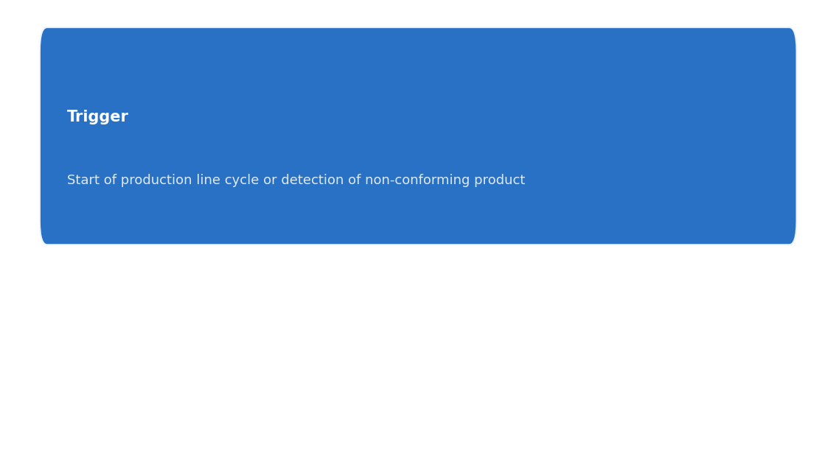
#10 Autonomous Quality Control Orchestration for COGS & Working Capital 0.82 | $42M | DETERMINISTIC
Make > Powertrain Manufacturing (Engine & Transmission) > Quality Control & Performance Testing
Skill Name | Autonomous Quality Control Orchestration for COGS & Working Capital
Problem Statement | Aera can orchestrate end-to-end quality control and test data flows across in-process inspections, dyno/hot tests, transmission testing, and post-production disposition/rework. By applying deterministic optimization and agentic coordination to test sequencing, non-conformity handling, and root-cause-triggered rework, Ford can reduce COGS from test-related waste, improve working capital through faster disposition decisions, and tighten yield during platform launches across multiple vehicle programs.
Value Rationale | High-value, multi-process DI opportunity spans 5 L4s with direct COGS and working capital effects. Each process involves decision points: (1) In-Process Quality Checks & Inspections — optimize sampling and pass/fail criteria; (2) Engine Dyno & Hot Test Procedures — sequence and resource allocation for fastest cycle times; (3) Transmission Shift & Functionality Testing — test sequencing and parallelization; (4) Non-Conforming Product Disposition & Rework Authorization — accelerate or defer disposition with cost-aware routing; (5) Quality Data Collection & Root Cause Analysis — feed deterministic optimization with structured data. Estimated values: In-Process QC: $12M COGS, Dyno/Hot Test: $9M COGS, Disposition & Rework: $5M Working Capital impact via faster turnaround; Data-driven QA insights: ~$4M COGS. Combined raw value: $30M; applying a 0.8 synergy factor yields $24M. Bound at $30M cap; synergy yields final combined value of $24M. Lead is DET-based on constraint-driven optimization for pass/fail triggers, with AGENTIC elements to handle end-to-end decision loops and exception handling, and GENERATIVE inputs for root-cause hypotheses and documentation.
Combined Max Value | $42M
Complexity | HIGH
Quick Win | No
L4 Activities | 5 total, 5 high-value
Archetypes | DETERMINISTIC + AGENTIC, GENERATIVE
Aera Components | Streams: 1 | Cortex: 1 | PB: 3 | UI: 1
Decision Flow
Tech | Adopt | Value | Composite | DR | PF | AC | DD | FG | IP | CS | VD | SV
6/9 | 12/12 | 4/6 | 0.82 | 2 | 2 | 2 | 3 | 3 | 3 | 3 | 2 | 2

Slide 15
Recommended Next Steps
Wave 1 -- Highest Confidence (0.88):
Demand Forecasting & Analysis (Plan) $21M HIGH
Warehouse & Inventory Management (Move & Fulfill) $14M MEDIUM [QUICK WIN]
Material Requirements Planning (MRP) Integration (Plan) HIGH
Wave 2 -- Strong Candidates (0.84):
Multi-Echelon Inventory Optimization (Plan) $130M HIGH
Production Planning & Control (Make) $43M HIGH
Inventory Positioning & Optimization (Move & Fulfill) $24M HIGH
Inbound Receiving & Putaway (Move & Fulfill) $9M MEDIUM [QUICK WIN]
Wave 3 -- Solid Foundation (0.82):
Cost & Value Optimization Initiatives (Procure Source & Buy) $1840M HIGH
Production Schedule Execution & Monitoring (Plan) $100M HIGH
Quality Control & Performance Testing (Make) $42M HIGH
Domain Clusters
Plan (4 opportunities):
Demand Forecasting & Analysis
Material Requirements Planning (MRP) Integration
Multi-Echelon Inventory Optimization
Production Schedule Execution & Monitoring
Move & Fulfill (3 opportunities):
Warehouse & Inventory Management
Inventory Positioning & Optimization
Inbound Receiving & Putaway
Make (2 opportunities):
Production Planning & Control
Quality Control & Performance Testing

