Slide 1

Agentic Development: A Case Study
How Claude Code + fine-grained planning shipped 213K LOC in 93 minutes
Autonomous software delivery with test-driven development, checkpoint recovery, and zero frameworks

Slide 2



Most AI features fail at adoption, not technology
THE PROBLEM
Technical feasibility scoring alone produces features nobody uses. The gap is between what can be built and what will be adopted.
Traditional approach
Adoption-first approach
Technical feasibility weighted 50%
Adoption and change management weighted 30%
Value metrics weighted 20%
Result: technically sound features that real users reject or ignore
Technical feasibility weighted 30%
Adoption realism weighted 45% (highest)
Value and efficiency weighted 25%
Result: features scored on whether organizations will actually use them

Slide 3
An offline-first engine that scores with adoption realism
THE PROBLEM
Single CLI command evaluates an Aera enterprise hierarchy export across three weighted lenses, runs unattended overnight.
Zod-validated JSON
5 Red Flags + 3 Tiers
3-Lens Composite
4 Artifact Types
Git Auto-Commit
Parse any client hierarchy export
Filter bad opps before LLM scoring
Tech + Adoption + Value scoring
Mermaid, YAML, mock tests, specs
Overnight-safe with checkpoints

Slide 4
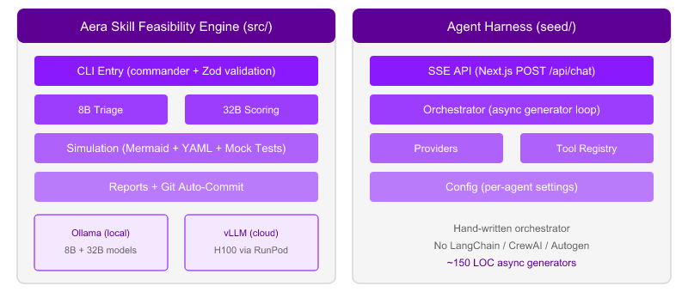
Two complementary systems in one repository
ARCHITECTURE
The Aera Engine (src/) evaluates enterprise opportunities. The Agent Harness (seed/) provides the agentic loop pattern with zero framework dependencies.

Slide 5
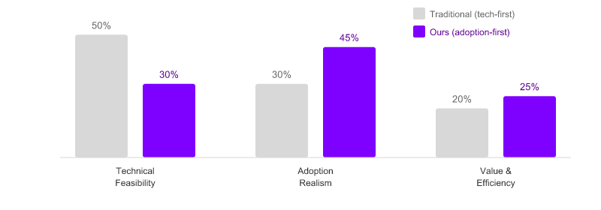
Adoption realism is the highest-weighted lens
ARCHITECTURE
Weighting adoption at 0.45 prevents the common failure mode: technically sound features that nobody uses. A 0.60 composite threshold gates promotion to simulation.
Composite = (Technical x 0.30) + (Adoption x 0.45) + (Value x 0.25) -- threshold 0.60 to advance

Slide 6
Five red flags filter bad opportunities early
ARCHITECTURE
Pure-function triage runs before expensive LLM scoring. Bad opportunities are skipped, demoted, or flagged automatically.
Red Flag | Detection Rule | Action | Purpose
DEAD_ZONE | 0% decision density across all L4s | Skip | No decisions = no skill to build
PHANTOM | opportunity_exists = false | Skip | Opportunity does not actually exist
NO_STAKES | Zero HIGH financial + all SECOND order | Demote | Too low-value for LLM investment
CONFIDENCE_GAP | >50% of L4s have LOW confidence | Flag | Data quality too poor for reliable scoring
ORPHAN | l4_count < 3 | Flag | Too few activities for meaningful analysis

Slide 7



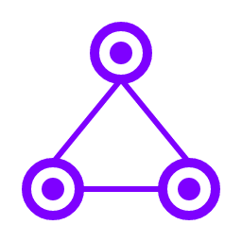
Every generated spec maps to real Aera components
ARCHITECTURE
The simulation pipeline produces four artifact types, each validated against 21 UI components and 22 Process Builder nodes bundled in the engine.
Mermaid decision flows
YAML component maps
Validated flowchart syntax
Aera component labels
Retry up to 3x on validation failure
Maps to Streams, Cortex, PB, Agent Teams
confirmed/inferred confidence flags
Knowledge base enforcement (KNOW-04)
Mock decision tests
Integration surfaces
Sample inputs from actual client financials
Uses decision_articulation from L4 data
Expected outputs with tolerance bands
Source systems from company ERP stack
Aera pipeline mapping
Unmatched sources marked as TBD

Slide 8
One interface, zero scoring code changes
ARCHITECTURE
The ChatFn dependency injection pattern lets the same scoring logic run on local Ollama or cloud vLLM -- no code changes to scoring, triage, or simulation.
ChatFn Interface
type ChatFn = (messages, format) => Promise<ChatResult>
The seam that decouples scoring from transport. Three lens scorers, the retry policy, and simulation generators all accept ChatFn via dependency injection.
Ollama Adapter
ollamaChat(messages, format) --> POST /api/chat
Default path for offline operation. Runs on 36GB Apple Silicon with Qwen 8B (triage) and 32B (scoring). Zero cloud dependency.
vLLM Adapter
createVllmChatFn(baseUrl, model) --> POST /v1/chat/completions
Cloud path translating Ollama format to OpenAI response_format. Schema translator handles $ref resolution and additionalProperties stripping.

Slide 9



Claude Code as autonomous builder, not a copilot
HOW WE BUILT IT
Not suggesting snippets. Executing 31 atomic plans with TDD, git commits, and checkpoint recovery -- fully autonomous within each plan boundary.
Traditional copilot
Agentic development
What changed
Developer writes code
AI suggests completions
Human reviews each snippet
Linear, manual process
Speed gain: 10-30%
Human defines plan (PLAN.md)
Agent writes tests first (TDD)
Agent implements until green
Agent commits and verifies
Speed gain: 10-50x per plan
Human role: strategy + planning
Agent role: implementation
Plans are the unit of work
STATE.md enables continuity
93 min for 213K LOC

Slide 10
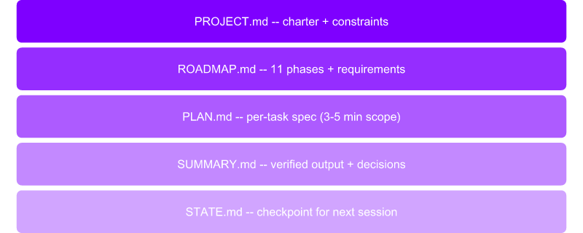
31 atomic plans across 11 phases, 3 min average
HOW WE BUILT IT
Each plan has a clear spec (PLAN.md), verified output (SUMMARY.md + VERIFICATION.md), and an atomic git commit. Plans are the unit of resumable work.
Each plan boundary:
1. Read STATE.md
2. Execute PLAN.md with TDD
3. Write SUMMARY.md
4. Git commit
5. Update STATE.md
3-minute plans are the sweet
spot: context stays fresh and
errors stay small.

Slide 11

run.sh overcomes context window limits
HOW WE BUILT IT
An infinite bash loop restarts Claude Code on context limits. Each new session reads STATE.md and picks up where the last session stopped.
Session 1
Reads program.md and STATE.md. Executes plans until context limit. Commits progress.
Session 2+
Reads next-session.md handoff note. Picks up from last completed plan. No work is repeated.
Resilience
10 sessions over 2 days shipped the entire v1.0 milestone. Each session is self-contained.

Slide 12
412 tests, zero external dependencies required
HOW WE BUILT IT
Node.js built-in test runner with pure-function core logic. Tests run without Ollama -- deterministic by design via dependency injection.
Phase | Tests Added | Pattern
Phase 1: Foundation | 22 | Zod schema validation
Phase 3: Triage + Red Flags | 61 | Pure-function triage with 5 red flags
Phase 4: Scoring Engine | 48 | DI via chatFn -- tested without Ollama
Phase 6: Simulation | 62 | Mermaid/YAML validation + knowledge base
Phase 8: Resilience | 56 | Checkpoint recovery + retry policies
Phase 9: Reports | 42 | Markdown/TSV output formatting

Slide 13

150 LOC of async generators replace 10,000+ LOC
HOW WE BUILT IT
The orchestrator.ts is a hand-written agentic loop using standard async generators. No LangChain, CrewAI, or Autogen -- proving robust patterns work with stdlib.
Our orchestrator (~150 LOC)
Framework alternatives
async function* runAgent(history)
Yields SSE events via AsyncGenerator
Tool calls: getTool() from registry
Streaming: provider.stream(history)
Max rounds limit with forced summary
Result truncation prevents context explosion
Dependencies: 0 framework libraries
LangChain: ~10,000+ LOC in agent modules
CrewAI: multi-agent abstractions
Autogen: conversation orchestration
Common trade-offs:
Heavy dependency trees
Opinionated abstractions
Version compatibility issues
Harder to debug and customize

Slide 14
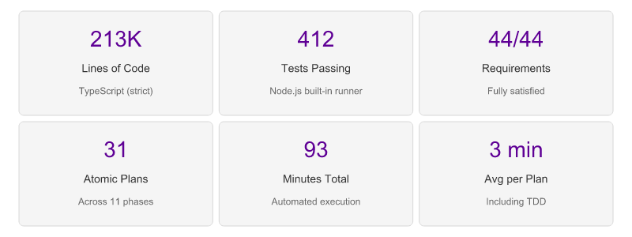
v1.0 shipped in 2 days with 100% requirement coverage
RESULTS
These are evidence metrics from real project artifacts -- every number is traceable to git commits, test outputs, and planning documents.
Source: .planning/MILESTONES.md, .planning/RETROSPECTIVE.md -- all metrics from actual project artifacts

Slide 15
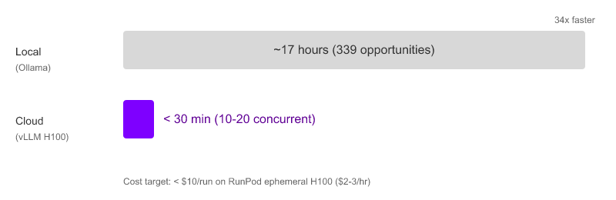
17 hours local to under 30 minutes cloud
RESULTS
v1.1 adds vLLM on RunPod H100 as an optional backend. The ChatFn pattern means zero changes to scoring logic -- only the transport layer changes.
10-20 concurrent opportunities via semaphore-bounded pipeline. Pre-flight schema validation prevents wasted GPU time.

Slide 16


Three tiers of resilience for unattended runs
RESULTS
Crash recovery, retry policies, and git auto-commit enable multi-hour scoring runs that complete without human intervention.
Tier 1: Retry
Tier 2: Fallback
Tier 3: Skip + Log
LLM call fails? Retry up to 3x
Exponential backoff
Same prompt, same parameters
Handles transient failures
Structured output fails?
Simplify the prompt
Reduce schema constraints
Get partial result vs none
Opportunity is intractable?
Log error to checkpoint.json
Skip and continue pipeline
Report failures in summary

Slide 17
Agentic development is not future-state
IMPLICATIONS
A solo developer with Claude Code shipped production-grade software faster than traditional teams. This has direct implications for delivery timelines and staffing models.
Delivery speed: 213K LOC in 93 minutes of automated execution challenges assumptions about project timelines. The bottleneck shifts from implementation to planning and verification.
Quality assurance: 412 tests with 100% requirement coverage demonstrates that agent-built code meets enterprise quality standards when guided by TDD discipline and fine-grained plans.
Staffing models: One developer + one coding agent replaced what would traditionally require a team of 4-6 over 2-3 months. The human role shifts to architecture, planning, and client strategy.
Cost structure: Coding agent execution costs (API usage) are a fraction of equivalent developer-hours. The economic model for software delivery changes fundamentally.

Slide 18

Four transferable patterns for any project
IMPLICATIONS
These patterns are not specific to this project. They work for any enterprise software engagement where a coding agent is part of the delivery team.
Fine-grained planning
TDD discipline
3-5 minute execution windows
PLAN.md with clear specs and exit criteria
SUMMARY.md with verified output
Plans are resumable units of work
Tests first, implementation second
Pure functions in core logic (no I/O)
Dependency injection for testability
Factory helpers for minimal test objects
Checkpoint + resume
Offline-first architecture
STATE.md tracks current position
Crash-safe: resume from last checkpoint
Git auto-commit after each phase
Context archive between sessions
Local models as default (zero cloud cost)
Cloud as opt-in acceleration
Same interface for both paths (ChatFn)
No vendor lock-in on scoring logic

Slide 19
Custom skills create a composable agent toolkit
IMPLICATIONS
This very deck was generated by /acnpptx. Each skill is a reusable capability that compounds across projects -- the more you build, the faster you move.
Skill | Capability | Impact
/acnpptx | PowerPoint generation with brand compliance | This presentation -- 20 slides from project artifacts
/gsd | Fine-grained planning and state tracking | 31 plans, 11 phases, checkpoint recovery
/build-e2e-skill | End-to-end skill creation workflow | New skills from spec to verified output
/review-pr | Automated pull request review | Code quality checks on agent-generated code
Skills compound: each new capability accelerates every future project that uses it

Slide 20

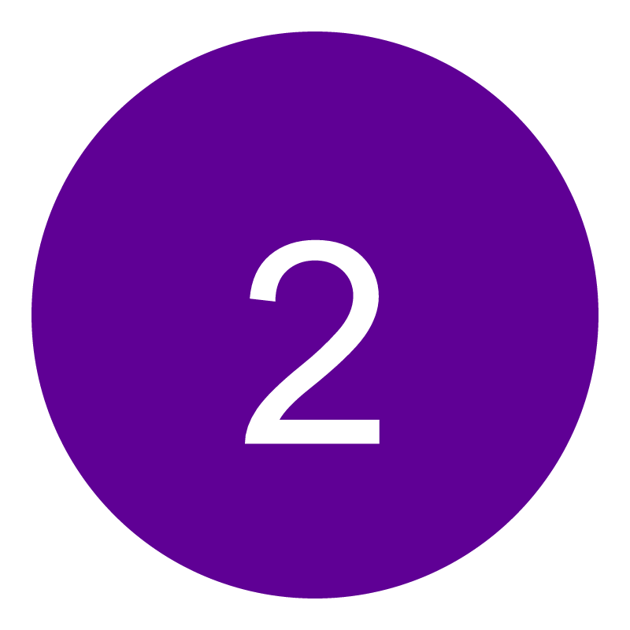

The agent-augmented consultant
CLOSING
The future of consulting is not AI replacing consultants. It is consultants armed with autonomous agents that handle implementation while humans focus on strategy.
Agents handle implementation
Fine-grained plans + TDD + checkpoint recovery enable autonomous code delivery at enterprise scale
Humans focus on strategy
Client relationships, adoption planning, architecture decisions, and quality verification remain human responsibilities
The toolkit is real today
Claude Code + custom skills + the patterns shown here are available now -- not a future roadmap item
Ready to explore agentic development for your next engagement? Let's talk.

