Slide 1

Adoption-first scoring for
enterprise AI feasibility
How to identify the skills that will actually get used
Aera Skill Feasibility Engine | Methodology Briefing

Slide 2



Most AI feasibility assessments score the wrong thing
The Problem
Traditional assessments weight technical capability highest. The result: technically sound features that nobody adopts.
Traditional approach
Technical capability weighted 50%
Adoption factors weighted 30%
Value & ROI weighted 20%
Outcome: 60%+ of enterprise AI features fail at adoption, not technology
Adoption-first approach
Technical capability weighted 30%
Adoption realism weighted 45%
Value & ROI weighted 25%
Outcome: every evaluation forces the question "will anyone actually use this?"

Slide 3



What the engine delivers in a single overnight run
The Problem
One CLI command. Fully unattended batch processing. Actionable output an SE team can execute on.
Three-lens scoring
Automated triage
Grounded simulation
Adoption realism at 45%
9 sub-dimensions scored 0-3
Composite threshold gate at 0.60
5 data-driven red flags
3-tier priority binning
Archetype classification
Decision flow diagrams
Component maps (YAML)
Mock tests + integration specs

Slide 4
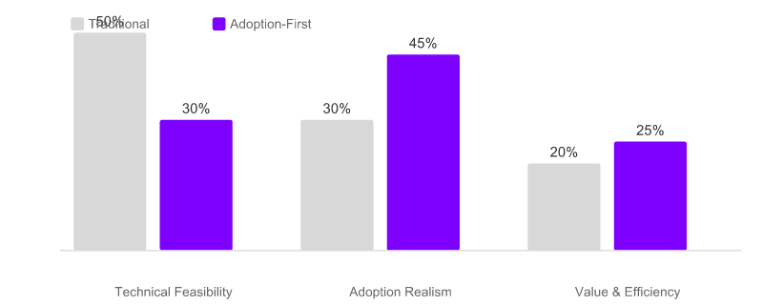
Adoption realism gets the highest weight at 45%
Three-Lens Scoring
Three lenses produce a composite score. Traditional assessments weight technical capability first. This engine deliberately inverts that.
Weight rationale
Technical (30%)
Can we build it? Necessary but not dominant.
Adoption (45%)
Will anyone use it? The differentiator.
Value (25%)
Is it worth it? ROI and simulation viability.

Slide 5
Technical feasibility: necessary but deliberately not dominant
Three-Lens Scoring
Three sub-dimensions scored 0-3. Max raw score: 9. Weight: 30%.
Data Readiness
Are the needed data sources available and mappable to Aera's ingestion layer? Evaluates whether source systems (ERP, CRM, operational databases) can feed the required Streams.
Aera Platform Fit
Does the opportunity's archetype (DETERMINISTIC, AGENTIC, or GENERATIVE) map cleanly to an Aera component? Process Builder for rules, Agent Teams for orchestration, Cortex for ML models.
Archetype Confidence
How certain is the archetype classification? Directly exported classifications score higher than heuristically inferred ones.

Slide 6
Adoption realism at 45% prevents operationally dead features
Three-Lens Scoring
Four sub-dimensions scored 0-3. Max raw score: 12. Weight: 45%.
Decision Density
Are there actual, recurring business decisions to automate? Opportunities with zero decision density are flagged as DEAD_ZONE.
Financial Gravity
Does the outcome have measurable financial impact? Evaluates revenue effect, cost reduction potential, and financial rating distribution.
Impact Proximity
Is the benefit felt immediately by users, or is it distant and abstract? First-order impact (direct user value) scores higher than second-order (indirect).
Confidence Signal
Does the organization have conviction about this opportunity? Derived from rating confidence across constituent activities.
45% weight prevents technically perfect but operationally dead implementations

Slide 7
Value and efficiency: grounded in real client financials
Three-Lens Scoring
Two sub-dimensions scored 0-3. Max raw score: 6. Weight: 25%.
Value Density
Revenue impact as a percentage of company annual revenue. The engine ingests actual financial data from the hierarchy export (annual revenue, COGS, operating costs) to compute value density. This prevents inflated ROI claims detached from real business scale.
Simulation Viability
Can the impact be quantified and tested before full rollout? Evaluates whether the opportunity has enough structured data and decision patterns to generate a credible mock decision test with sample inputs, expected outputs, and integration points.

Slide 8
Composite score gate at 0.60 focuses simulation effort
Three-Lens Scoring
Each lens is normalized 0-1, weighted, and summed. Only opportunities at or above 0.60 advance.
Worked example: Supply Chain Demand Sensing
Technical: 7/9 = 0.78 normalized x 0.30 weight = 0.233
Adoption: 10/12 = 0.83 normalized x 0.45 weight = 0.375
Value: 4/6 = 0.67 normalized x 0.25 weight = 0.167
Composite: 0.233 + 0.375 + 0.167 = 0.775 (above 0.60 gate)
PROMOTED TO SIMULATION

Slide 9
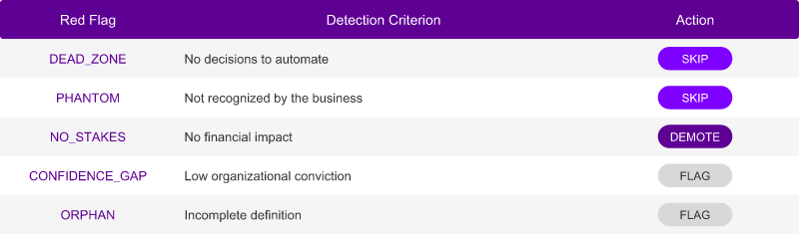
Five red flags catch data problems before scoring begins
Automated Triage
Before any scoring, the engine detects structural problems in the hierarchy data. Each flag triggers a deterministic action: skip, demote, or flag for review.
SKIP: removes the opportunity from further processing entirely
DEMOTE: drops the opportunity one tier (e.g., Tier 1 to Tier 2)
FLAG: marks the issue for review but continues processing

Slide 10

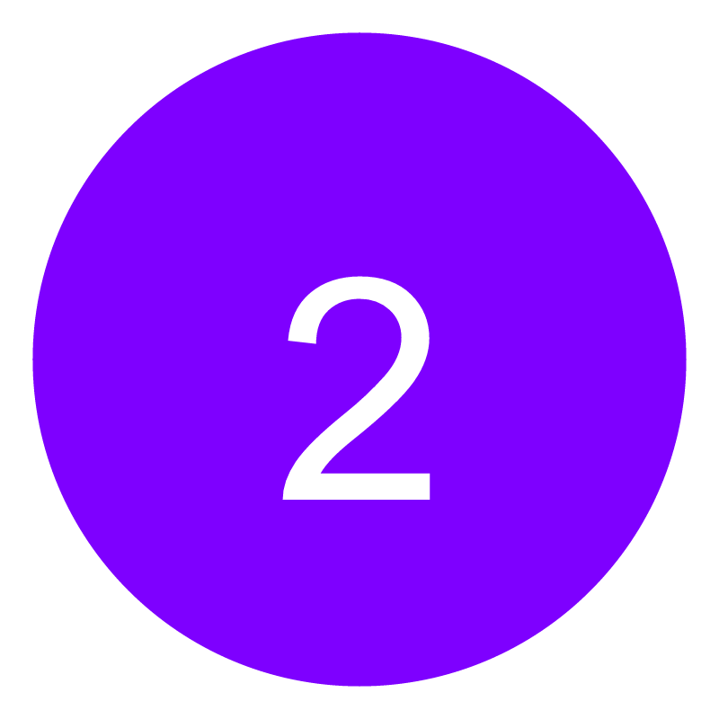

Three tiers bin opportunities by ROI potential
Automated Triage
Tier 1 is checked first. Red flags can demote. Tiers determine analysis depth and simulation priority.
Tier 1: Premium
Tier 2: Moderate
Tier 3: Default
quick_win flag = true
Combined value > $5M
Maximum ROI priority
Full simulation package
>= 50% HIGH ai_suitability
Good technical fit
Standard simulation
Scorecard + component map
Everything else
Baseline evaluation
Scorecard only
Triage summary in TSV

Slide 11
Archetype routing maps opportunities to platform components
Automated Triage
Each opportunity is classified as DETERMINISTIC, AGENTIC, or GENERATIVE. This determines which Aera components are used in simulation.
DETERMINISTIC
AGENTIC
GENERATIVE
~56%
~43%
<1%
Process Builder
IF/Rules/Transaction nodes
Structured workflows
Highest prevalence
Agent Teams + Functions
Multi-step orchestration
Decision-density driven
Growing category
Agent Teams + LLM Agents
Cortex model integration
Unstructured reasoning
Rare in enterprise ops

Slide 12




Every simulation artifact is grounded in a real knowledge base
Simulation
The engine bundles 21 UI components, 22 Process Builder nodes, and 7 workflow patterns. Every reference is validated. Confidence: confirmed (KB match) or inferred (flagged).
Mermaid diagram
Trigger to outcome
Real PB node labels
Visual workflow
YAML structure
Streams + Cortex
PB nodes + Agents
UI components
Sample scenario
Client financials
Expected output
Integration points
Data flow topology
Source systems
Aera ingestion
Processing to UI

Slide 13

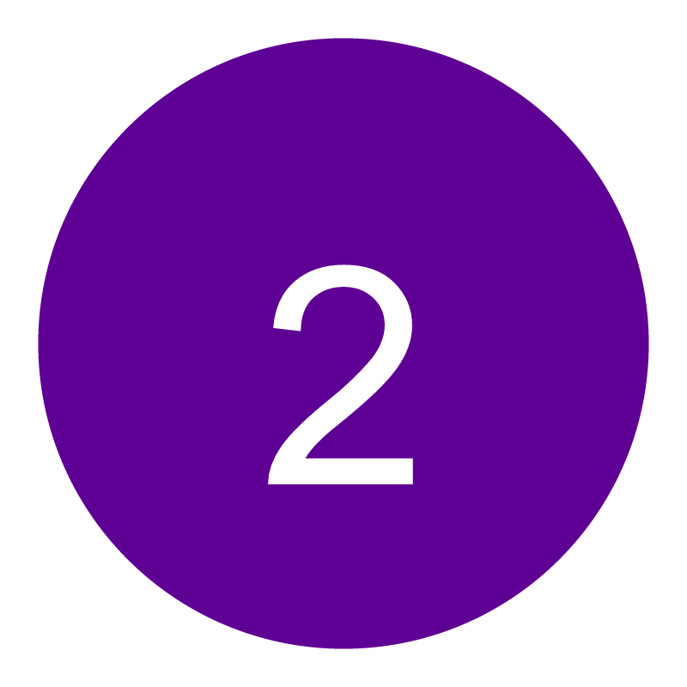

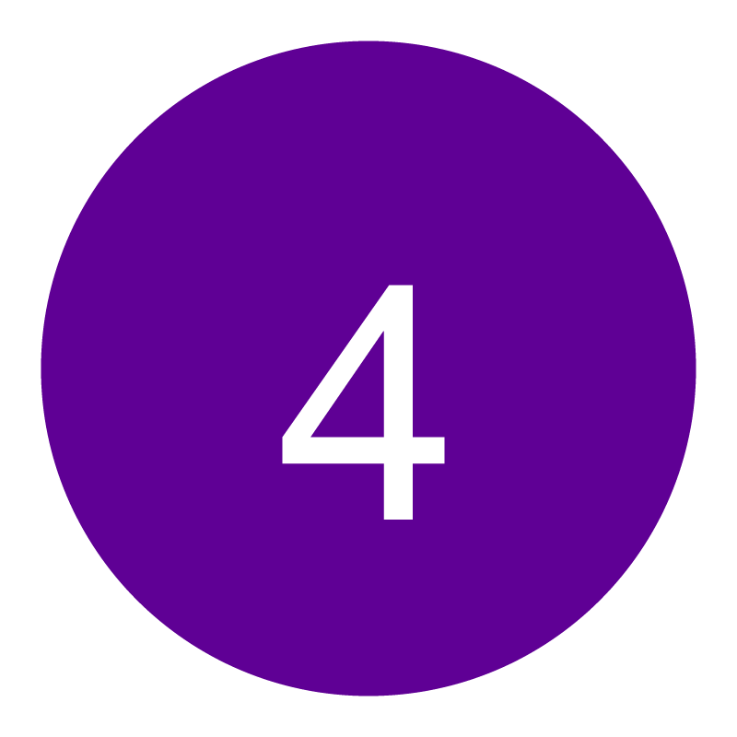
Four artifacts per qualifying opportunity, all validated
Simulation
Each artifact is generated by a dedicated generator module. Knowledge base validation flags any component not in the bundled catalog.
Mermaid decision flow
YAML component map
Mock decision test
Integration surface
Visual workflow: trigger to decision nodes to outcome
Nodes labeled with real Process Builder types
Validates Mermaid syntax automatically
Which Streams, Cortex models, PB nodes, Agent Teams, and UI components
Every component checked against 21 UI + 22 PB node catalog
Confidence: confirmed (exact KB match) or inferred
Sample scenario using real client financial data
Expected output with decision rationale
Integration points for downstream systems
Full data flow topology from source to UI
Source systems, Aera ingestion, processing layer
Identifies external system dependencies

Slide 14

The evaluation directory an SE team can act on Monday morning
Simulation
Every run produces a structured output directory. All artifacts are machine-readable and human-reviewable.
Triage summary (TSV)
Sortable spreadsheet of all opportunities with flags, tiers, and actions
Feasibility scorecards
9-dimension numeric grading for every opportunity across three lenses
Tier 1 deep analysis
Detailed report for premium opportunities with scoring reasoning
Simulation packages
Per-opportunity folders with flows, maps, tests, and integration specs
Catalog analysis
Meta-reflection on domain strengths, archetype distribution, and KB coverage

Slide 15
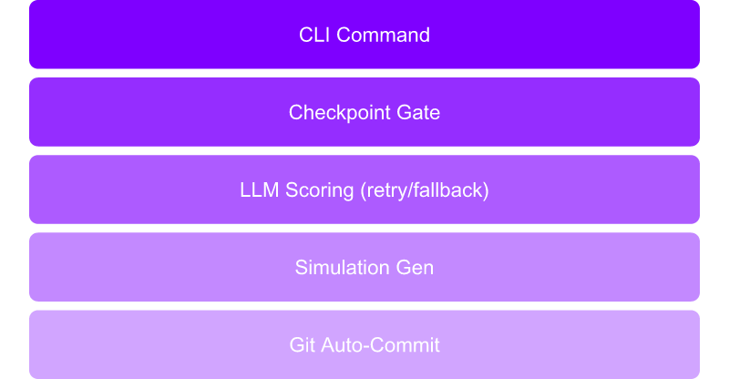
The engine runs overnight with zero babysitting
Resilience & Scale
Four resilience mechanisms ensure unattended operation completes reliably.
Checkpoint recovery
Crash mid-run? Resume from last completed opportunity. No re-scoring.
Three-tier retry
LLM failure triggers retry, then fallback prompt, then skip-and-log.
Git auto-commit
Artifacts committed after each phase with markers for traceability.
Conservative confidence
Overall confidence = MIN of lens confidences. Never overstates certainty.

Slide 16
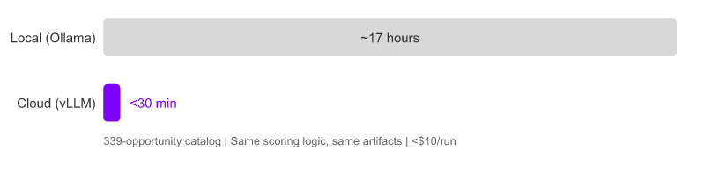
Optional cloud path reduces 17 hours to under 30 minutes
Resilience & Scale
Local Ollama path works fully offline. Optional vLLM on H100 enables concurrent scoring. Same logic, same artifacts, same quality.
Cloud specs
Backend: vLLM on H100
Concurrency: 10-20 simultaneous
Cost target: < $10/run
Provisioning: Ephemeral, auto-teardown
CLI flag: --backend vllm
Default: Ollama (offline)
339-opportunity Ford hierarchy catalog used as reference dataset

Slide 17
You do not need this exact tool. You need this approach.
Implications
The three-lens framework applies to any enterprise AI portfolio evaluation. Technical feasibility alone has never been the binding constraint on adoption.
Adoption-first weighting prevents the most common failure mode. When 45% of the score comes from decision density, financial gravity, impact proximity, and confidence signals, operationally dead features cannot score well.
Red flag triage catches data quality issues before expensive analysis. Five deterministic checks eliminate phantom opportunities and dead zones without consuming LLM inference time.
Grounded simulation prevents hallucinated specs from reaching implementation. A bundled knowledge base of real platform components means every generated artifact maps to something that actually exists.
Offline operation makes it suitable for air-gapped or sensitive client environments. The local Ollama path requires zero cloud connectivity. The cloud path is opt-in for speed, never required.

Slide 18
Score what matters
The question is not "can we build it?" It is "will they use it?"
Adoption realism at 45% forces that question to the front of every evaluation. The engine makes this repeatable, defensible, and overnight-fast.
The best enterprise AI skill is the one that gets adopted.

