Slide 1


Slide 2
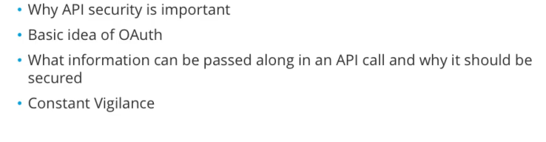

Slide 3
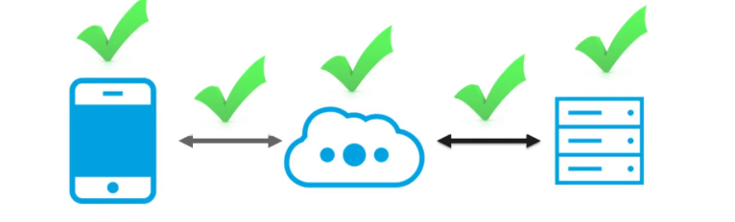
Securing your Api is
Keeping your network secure, so that hackers cannot break in .
Different parts of Api interaction that have to be secured
All though chain of events, there’s security you can put on :-
Api Consumer i.e smartphones,desktops etc..
Network,so that data passing is encypted and secure
Api provider i.e Server location

Slide 4
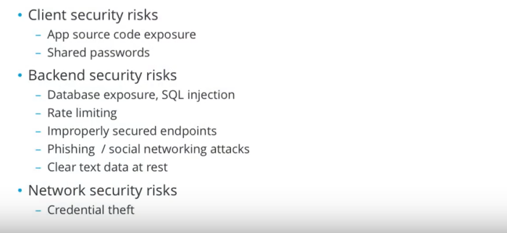

Slide 5
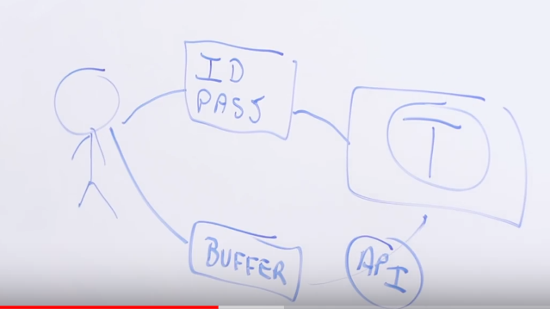
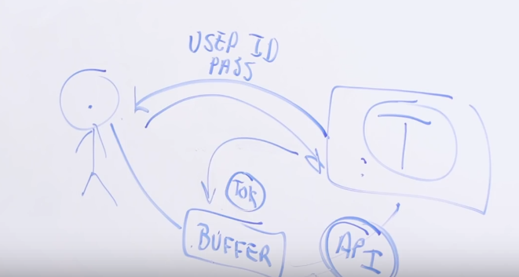

Slide 6
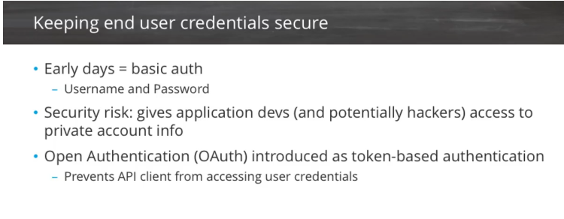

Slide 7
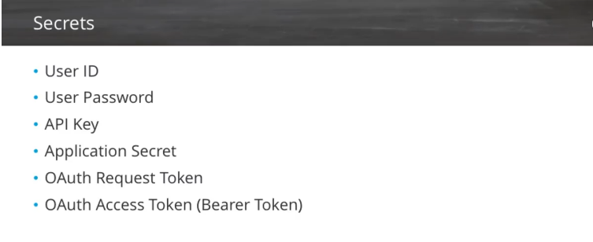

Slide 8
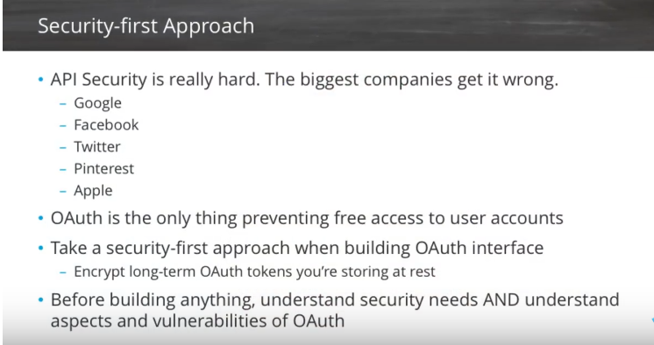

Slide 9
Token based authentication in ASP.NET Web API
Nowadays Web API adoption is increasing at a rapid pace. So it's very essential to implement security for all types of clients trying to access data from Web API services. Nowadays the most preferred approach to secure server resources by authenticating users in WEB API is to use signed token, which contains enough data to identify a particular user.This is called token-based approach. This is because of following reason:
Loose Coupling - The client application is not tied to a particular authentication scheme. The token is generated, validated and perform the authentication by the server.
Mobile Friendly - In native platform like iOS, Android, Windows 8 etc. handling cookies are not an easy task. Token-based approach simplifies this a lot.

Slide 10
How token based authentication actually works?
In the Token based approach, the client application first sends a request to Authentication server endpoint with an appropriate credential. Now If the username and password are found correct then the Authentication server send a token to the client as a response. This token contains enough data to identify a particular user and an expiry time.The client application then uses the token to access the restricted resources in next requests till the token is valid.

Slide 11
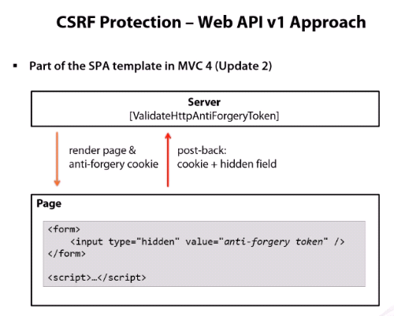

Slide 12
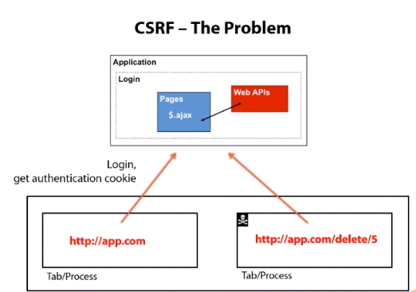

Slide 13
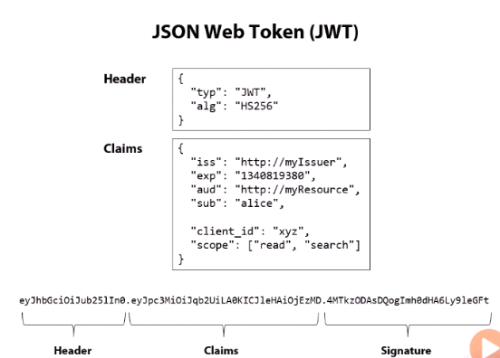
JWT

Slide 14
JWT
JSON Web Token (JWT) with Web API. The modern approach for authenticating a user is through token based authentication scheme. It relies on signed tokens which are sent by user to server with each request.
you put all claims in json web structure.
you sign structure using asymmetric key and encode whole thing in Base64.
validating signature,issuer and audience

Slide 15
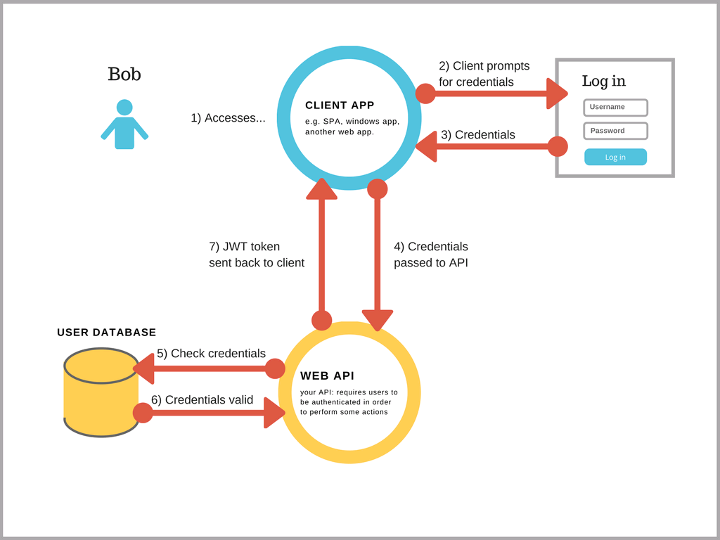
JWT

Slide 16
OWIN
OWIN
Open Web Interface for.NET (OWIN) is an open-source specification that describes an abstraction layer between web servers and application components. It defines a standard interface between .NET web servers and web applications.
The primary goal of OWIN is to decouple the server and application, encouraging development of small and focused application.

Slide 17
OWIN
In simple explanation token authentication is a 2 step process.
Initially user pass his credentials (UserName +Password) to the Authorization server
Authorization server returns security token if credentials are correct.
Any further transactions can be processed by just passing the security token.

Slide 18
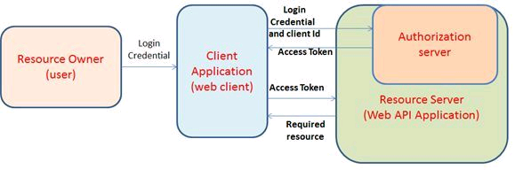
OWIN

Slide 19
Why We Need token based authentication?
Token-based authentication is predominantly used on the web because it allows users to stay logged onto a website without the use of cookies.
In addition to a more user-friendly experience, tokens are more secure because they can be used to replace a user's actual credentials.

Slide 20
How token based authentication actually works?
In the Token based approach, the client application first sends a request to Authentication server endpoint with an appropriate credential.
Now If the username and password are found correct then the Authentication server send a token to the client as a response.
This token contains enough data to identify a particular user and an expiry time. The client application then uses the token to access the restricted resources in next requests till the token is valid.

Slide 21
Benefit of token authentication:
Scalability of Servers: The token sent to the server is self contained which holds all the user information needed for authentication, so adding more servers to your web farm is an easy task, there is no dependent on shared session stores.
Loosely Coupling: Your front-end application is not coupled with specific authentication mechanism, the token is generated from the server and your API is built in a way to understand this token and do the authentication.
Mobile Friendly: Cookies and browsers like each other, but storing cookies on native platforms (Android, iOS, Windows Phone) is not a trivial task, having standard way to authenticate users will simplify our life if we decided to consume the back-end API from native applications.

Slide 22
Access Token
An Access Token is a credential that can be used by an application to access an API.
Access Tokens can be either an opaque string or a JSON web token. They inform the API that the bearer of the token has been authorized to access the API and perform specific actions specified by the scope that has been granted.
The grant_type URL parameter is required by OAuth2 RFC for the /token endpoint, which exchanges a grant for real tokens. So the OAuth2 server knows what you are sending to it. You are using the Resource Owner Password Credentials Grant, so you must specify it with the value password.
The grant_type=password means that you are sending a username and a password to the /token endpoint.

