Slide 1
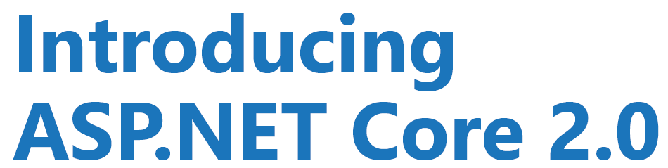
.net
By : Vishal Garg

Slide 2

What is .NET Core?
Characteristics of .NET Core?
Installation
Using CLI
Startup and Configuration
Managing Middleware
ASP.NET Core MVC and Web APIs
Tag Helpers and Razor Pages
Testing ASP.NET Core
Demo

Slide 3
Difference
 | .NET Framework | .NET Core
High-performance | - | Faster
Docker containers support | - | Better
Command Line | - | Better
Cross – Platform | No | Yes
Pre - Configured | Better | -
Open Source | No | Yes
Future | - | Yes

Slide 4
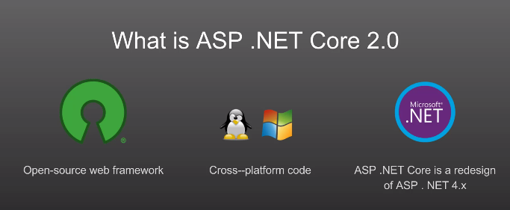
What is .Net Core?
.NET Core is a free, open-source framework for building modern, scalable, and high-performance cross-platform software applications.
.NET Core is a general-purpose framework that may be used to build software applications for Windows, Linux, and MacOS.

Slide 5
Characteristics of .NET Core?
.NET Core is Free and Open Source.
.NET Core is Cross-platform.
.NET Core is Sharable.
.NET Core is Modern.
.NET Core is Fast.
.NET Core is Lightweight.

Slide 6
Installation
To develop ASP.NET Core application, the following must be installed in your system:
.NET Core SDK
Integrated Development Environment (IDE)
Go to https://www.microsoft.com/net/core and select the platform you are using.
You can develop, restore, build and run .NET Core application either with Visual Studio or with command line interface for .NET Core.

Slide 7
CLI
The .NET Core command-line interface (CLI) is a new cross-platform tool for creating, restoring packages, building, running and publishing .NET applications.
The following is a command structure :-
dotnet <command> <argument> <option>
E.g:-
dotnet new console
dotnet build
dotnet run
dotnet new mvc

Slide 8
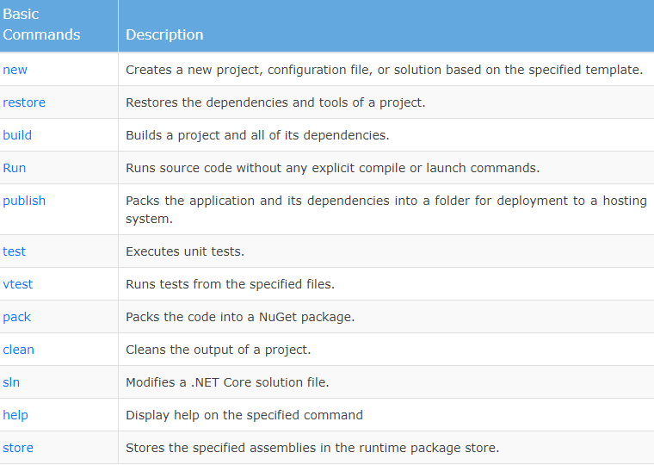
CLI

Slide 9
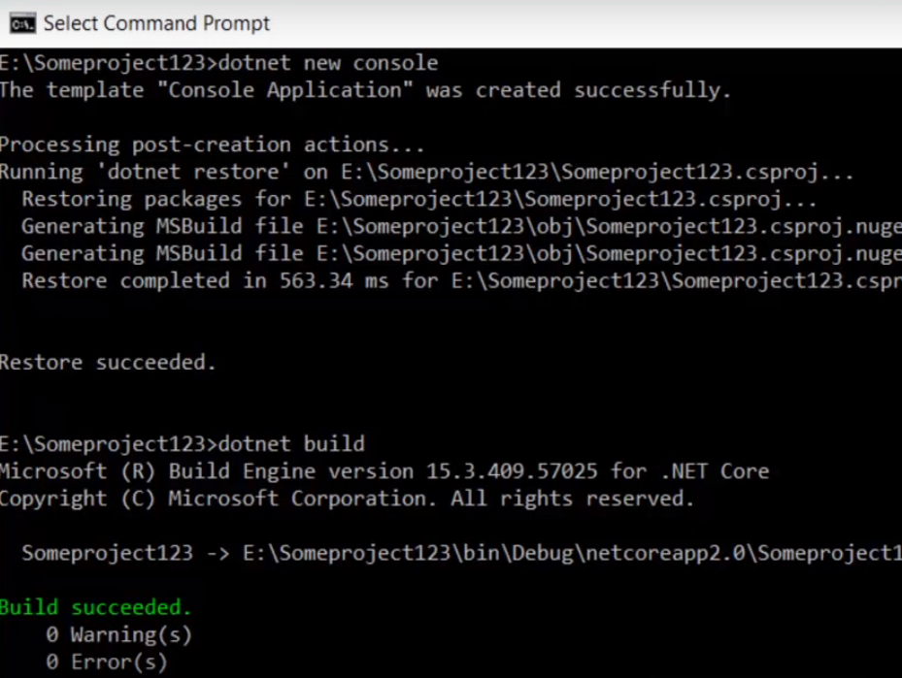
CLI

Slide 10
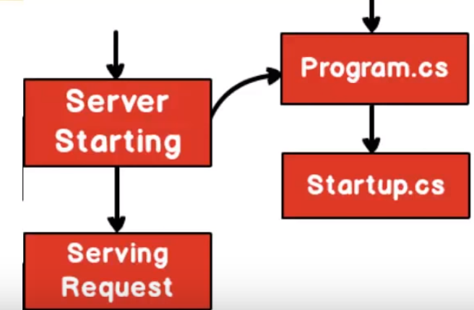
Structure
Server starting :- Loads application,services,cache
Serving request :- starts serving the request

Slide 11
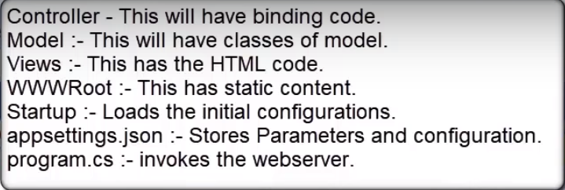
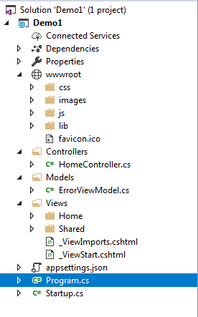
Structure

Slide 12
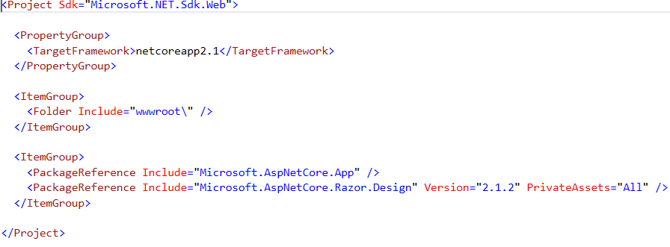
Structure
.csproj file

Slide 13
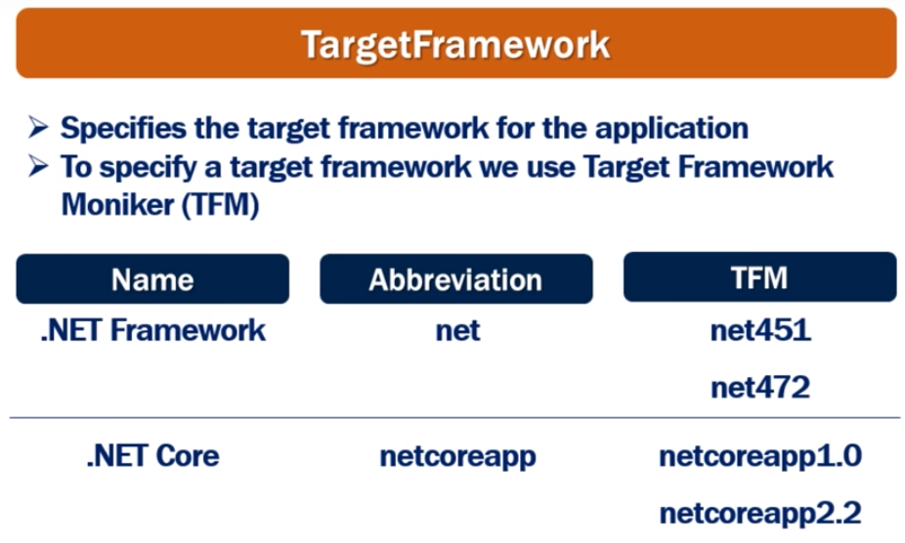
Structure

Slide 14
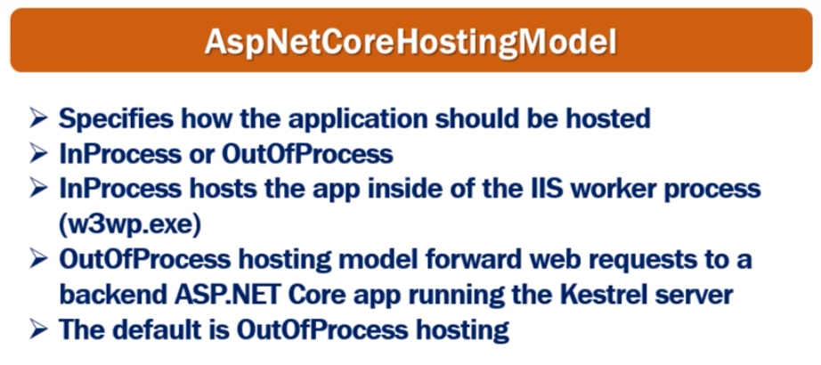
Structure
Core application can be hosted: -
InProcess or
OutOfProcess

Slide 15
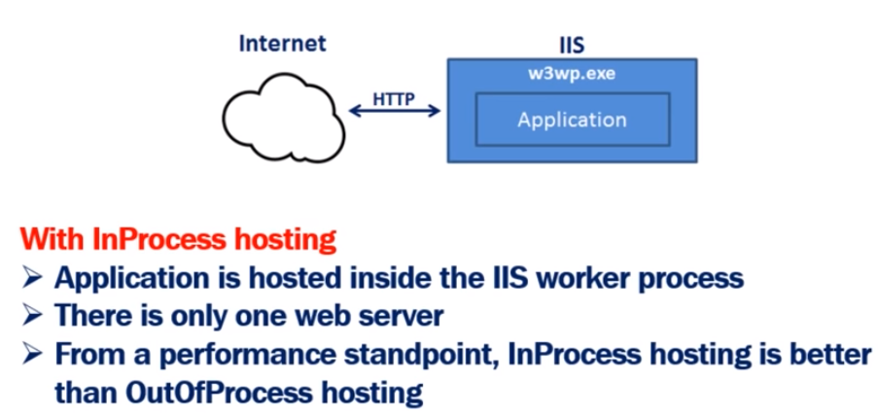
InProcess Hosting
Demo:- Core_HostProcess

Slide 16

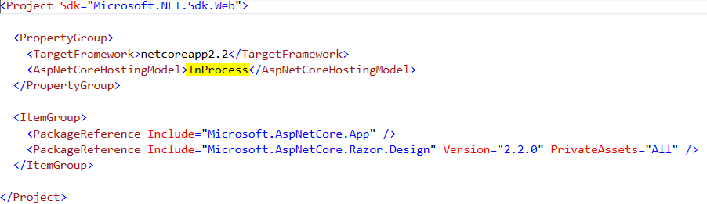

InProcess Hosting
Demo:- Core_HostProcess

Slide 17
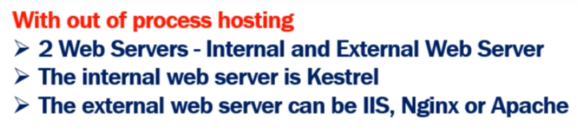
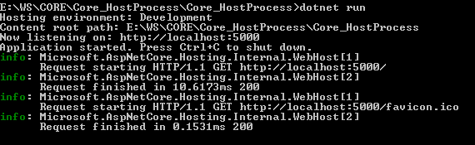
OutOfProcess Hosting
CLI :- Kestrel server is used
Demo:- Core_HostProcess

Slide 18

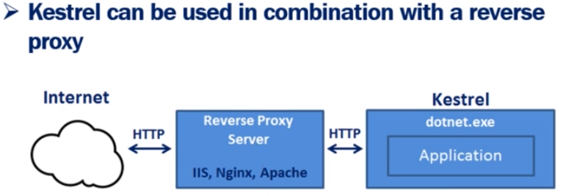
Kestrel Server
Demo:- Core_HostProcess

Slide 19
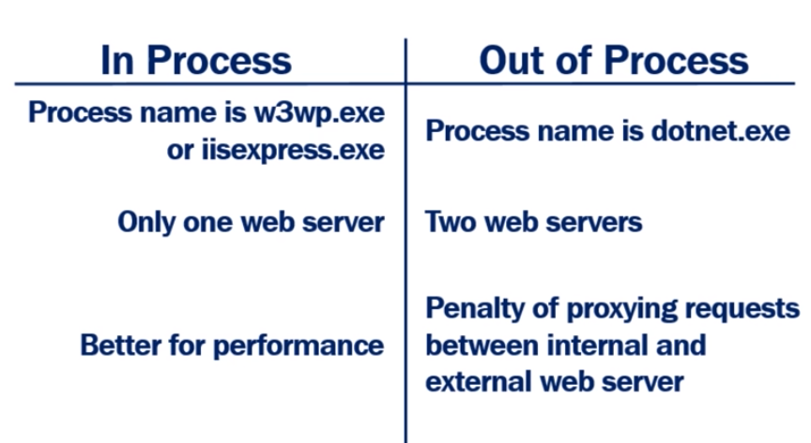
InProcess VS OutOfProcess
Demo:- Core_HostProcess

Slide 20
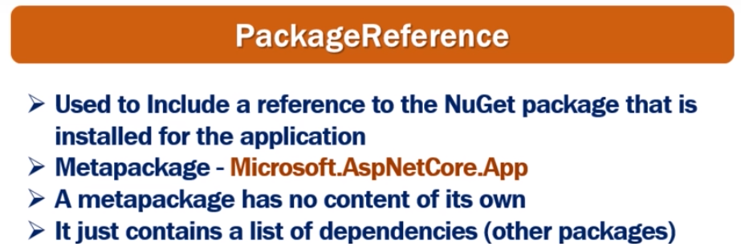
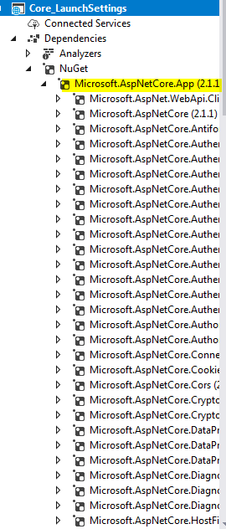
Structure

Slide 21
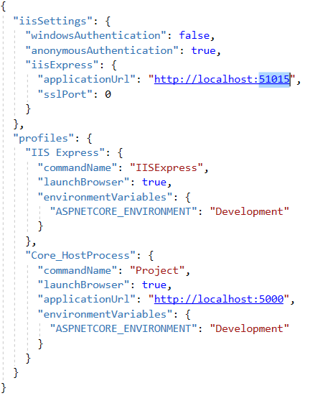
LaunchSettings.json
Demo:- Core_HostProcess

Slide 22
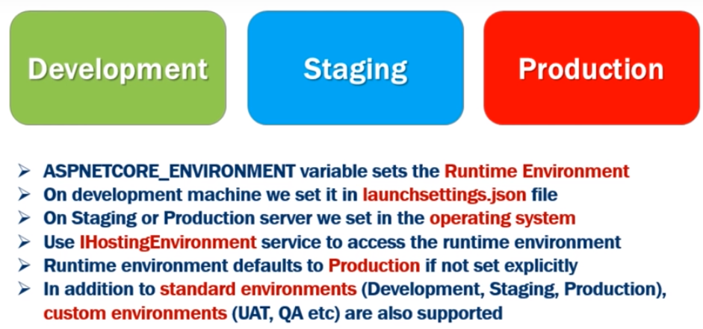
Development Environments
Demo:- Core_HostProcess

Slide 23

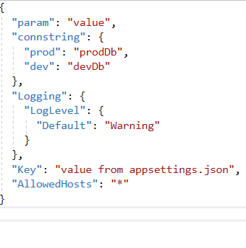
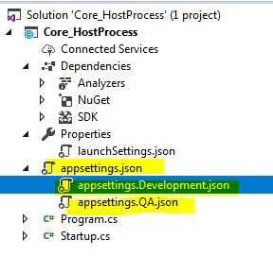
AppSettings.json
Configuration Order :-
appSettings.json
appSettings.{Environment}.json
Environment variables
Command – Line
Override
Demo:- Core_HostProcess

Slide 24
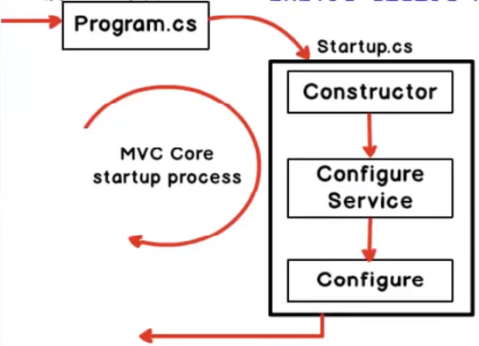
Structure

Slide 25
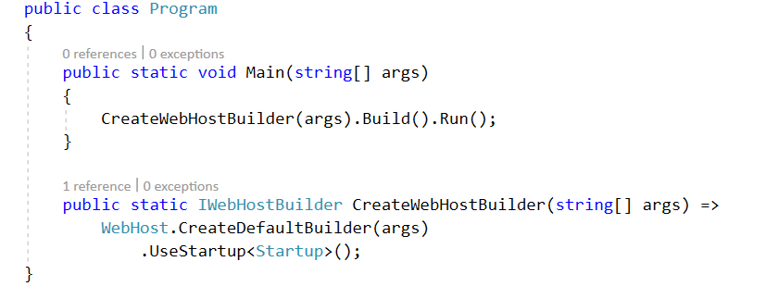
Program.cs
Program.cs is the first thing which runs in mvc core application
It does 2 things :-
1. It starts the web server (Kestrel server)
2. It invokes startup.cs file.

Slide 26

startup.cs
It does 3 things :-
1. Loads a configuration
2. Add services
3.Configure services
Plug and play model
In mvc core we can pick and choose services

Slide 27
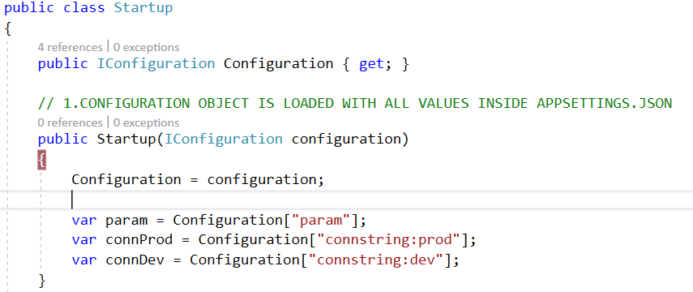
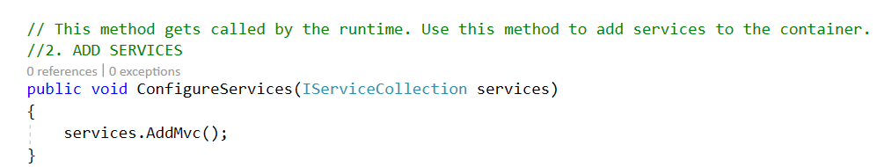
startup.cs

Slide 28
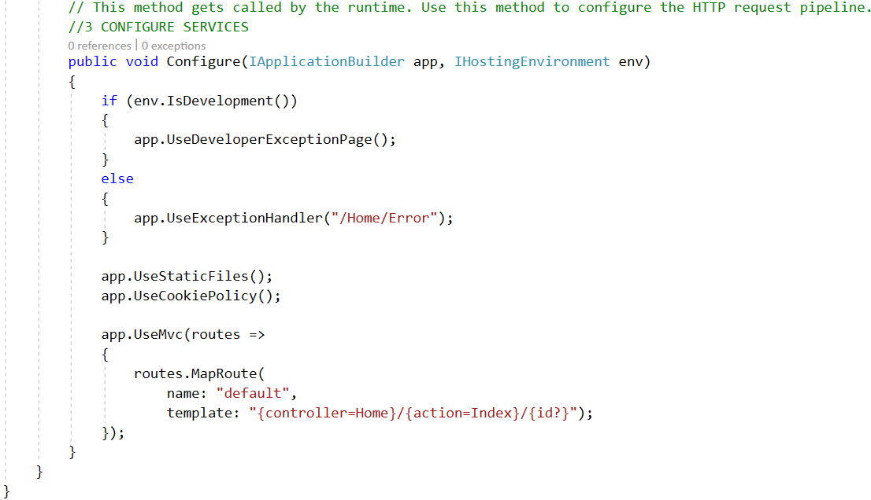
startup.cs
Example : - Demo1

Slide 29
Middleware
Pieces of code that handle requests and responses.
Middleware are chained to each other to form a pipeline
Middleware can do all sort of things, such as handling authentication, errors, static files, etc…
We can set the order of middleware execution in the request pipeline
Executed in order they are added
Memory and performance

Slide 30
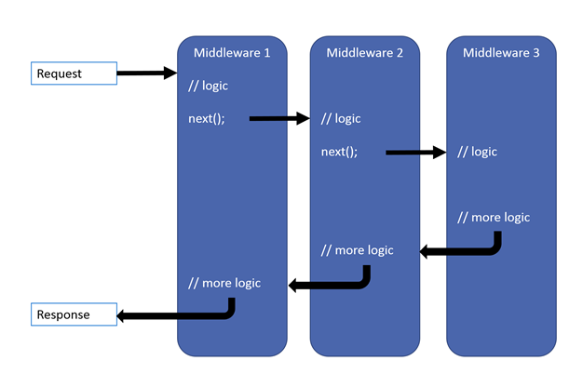
Middleware Pipeline

Slide 31
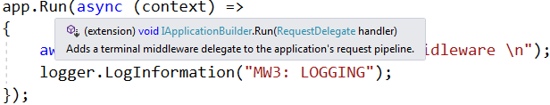
Short circuiting middleware
A middleware doesn’t necessarily have to call the next middleware.
Terminal middleware : -
Doesn’t call next middleware
app.Run(context)

Slide 32
Call Next Middleware
To call next middleware we use
app.use(context,next)
Call next middleware

Slide 33
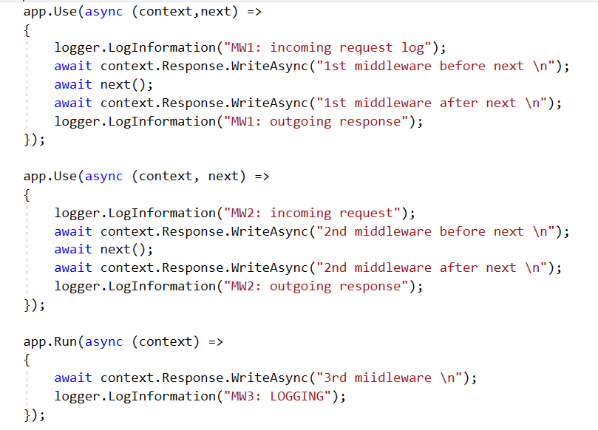
Middleware Example
Demo : - Core_Middleware

Slide 34

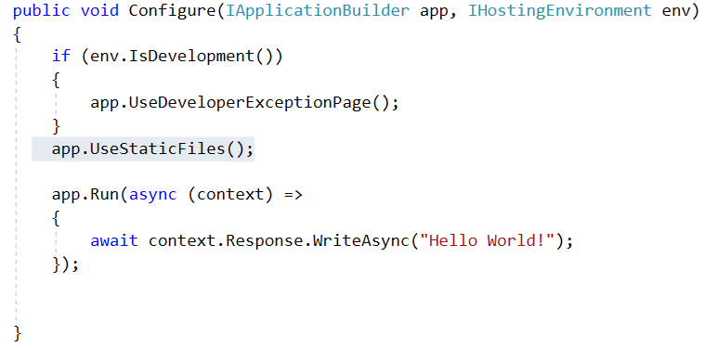
Static Files
Present in “wwwroot” folder.
Static file middleware is required
app.UseStaticFiles()

Slide 35
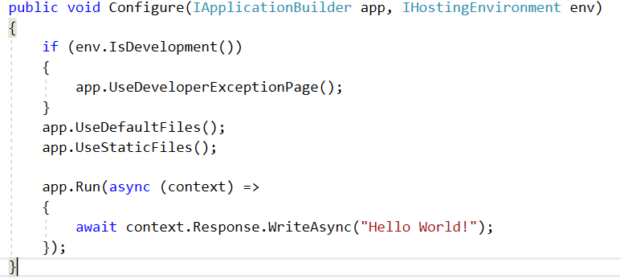
Default Files
Present in “wwwroot” folder.
Default file middleware is required
app.UseDefaultFiles()

Slide 36
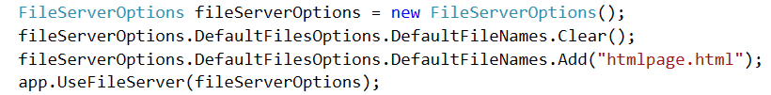
Default Files
App.UseDefaultFiles() :- combination of default files
And static files
Demo : - Core_StaticFiles

Slide 37
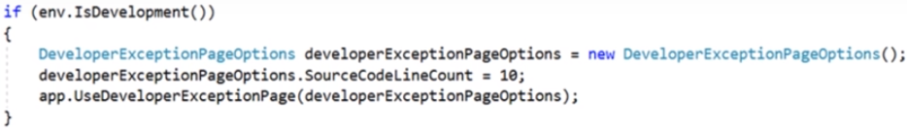
Developer Exception page
UseDeveloperExceptionPage middleware is required
app.UseDeveloperExceptionPage()
Plugged in pipeline as early as possible
Contains stack trace, query string, cookies etc..

Slide 38
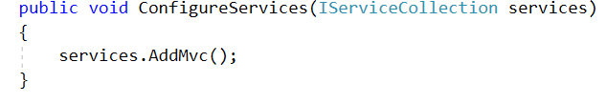
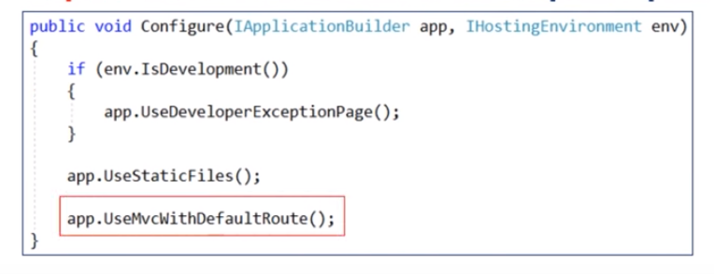
Setup MVC in ASP.NET CORE
2 steps : -
1 ) Add MVC services
2) Add MVC Middleware
Demo :- core_MVC_Setup

Slide 39
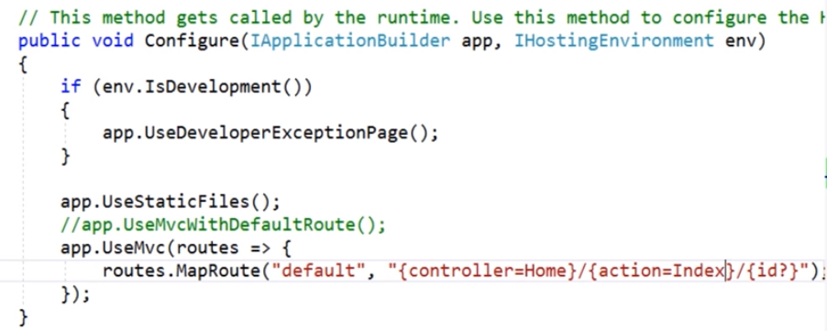
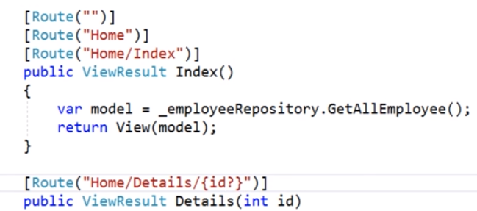
Routing
Attribute routing :-

Slide 40
Tag helpers
Importing Tag Helper
Demo :- core_MVC_Setup

Slide 41
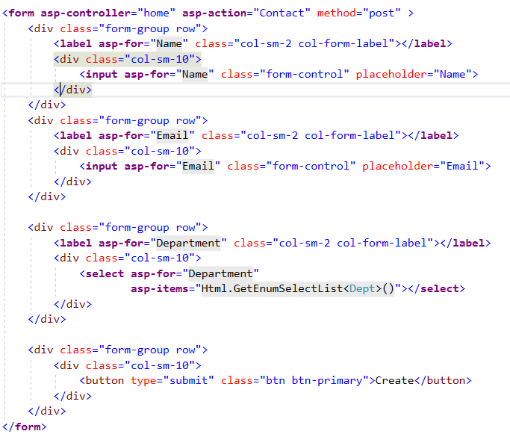
Tag helpers
Form Tag Helper
Demo :- core_MVC_Setup

Slide 42
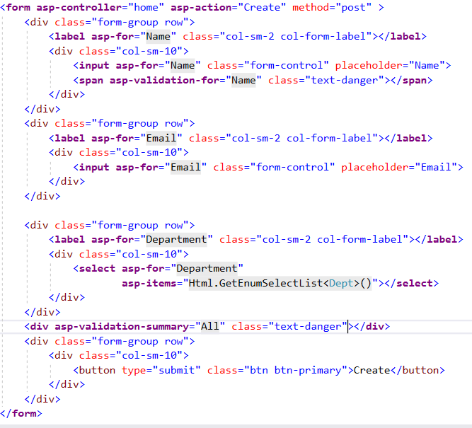
Tag helpers
Validation Tag Helper
Demo :- core_MVC_Setup

Slide 43
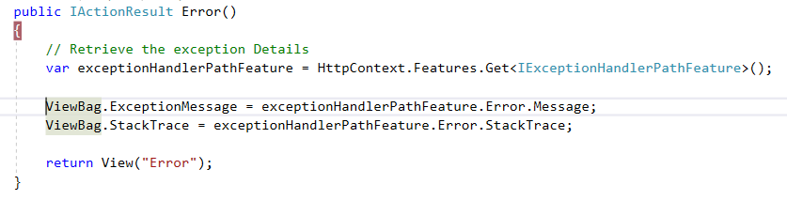
Exception Handling
Add Exception handling middleware
Example : - Core_Exception_handling

Slide 44
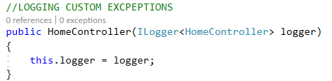
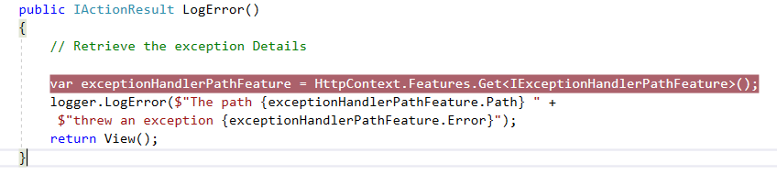
Logging
Instance an instance of ILogger
Example : - Core_Exception_handling

Slide 45
Publish cross-platform .NET app
.NET Core application deployment options : -
framework-dependent applications
self-contained applications.
framework-dependent 1.Net core framework required 2. Run on any O.S without any modifications | self-contained 1.App contains everything(not req.) 2. need to publish an OS-specific version
Example : -
1.Core_FrameworkDependantApp
2. Core_Self-contained app

