Slide 1
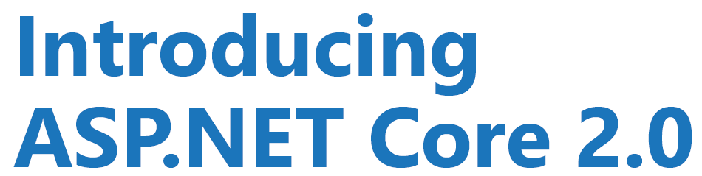
By : Vishal Garg

Slide 2

What is .NET Core?
Characteristics of .NET Core?
Installation
Using CLI
Startup and Configuration
Managing Middleware
ASP.NET Core MVC and Web APIs
Tag Helpers and Razor Pages
Testing ASP.NET Core
Demo

Slide 3
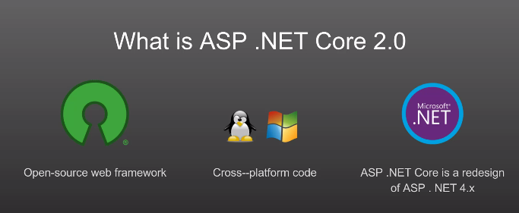
What is .NET Core?
.NET Core is a free, open-source framework for building modern, scalable, and high-performance cross-platform software applications.
.NET Core is a general-purpose framework that may be used to build software applications for Windows, Linux, and MacOS.

Slide 4
Characteristics of .NET Core?
.NET Core is Free and Open Source.
.NET Core is Cross-platform.
.NET Core is Sharable.
.NET Core is Modern.
.NET Core is Fast.
.NET Core is Lightweight.

Slide 5
Installation
To develop ASP.NET Core application, the following must be installed in your system:
.NET Core SDK
Integrated Development Environment (IDE)
Go to https://www.microsoft.com/net/core and select the platform you are using.
You can develop, restore, build and run .NET Core application either with Visual Studio or with command line interface for .NET Core.

Slide 6
CLI
The .NET Core command-line interface (CLI) is a new cross-platform tool for creating, restoring packages, building, running and publishing .NET applications.
The following is a command structure :-
dotnet <command> <argument> <option>
E.g:-
dotnet new console
dotnet build
dotnet run
dotnet new mvc

Slide 7
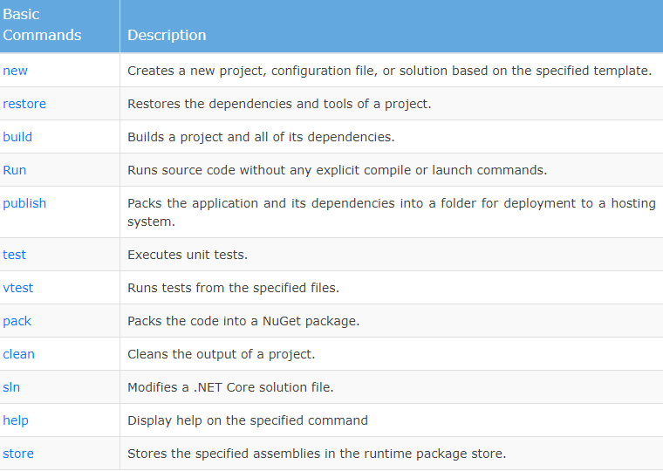
CLI

Slide 8
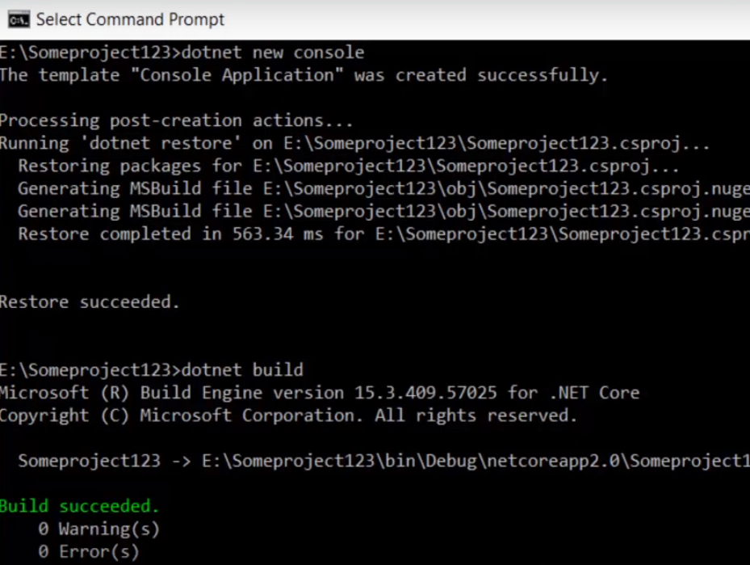
CLI

Slide 9
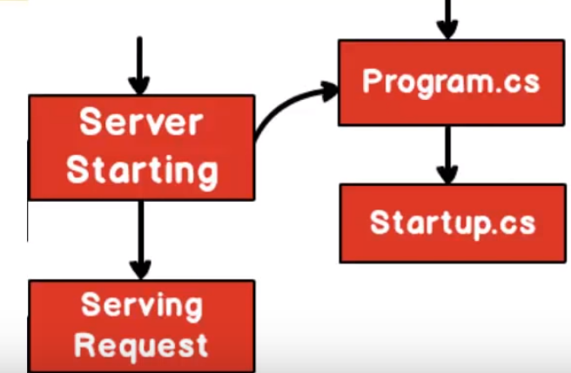
Structure
Server starting :- Loads application,services,cache
Serving request :- starts serving the request

Slide 10
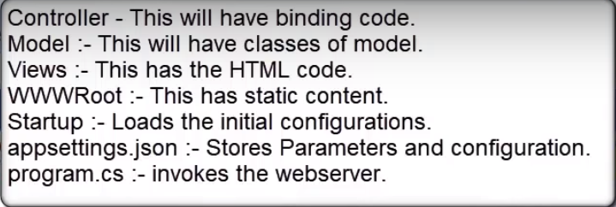
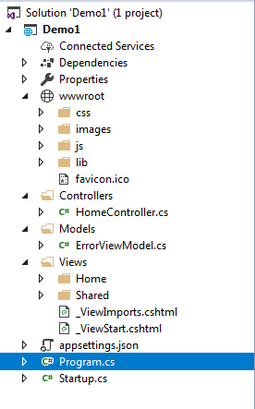
Structure

Slide 11
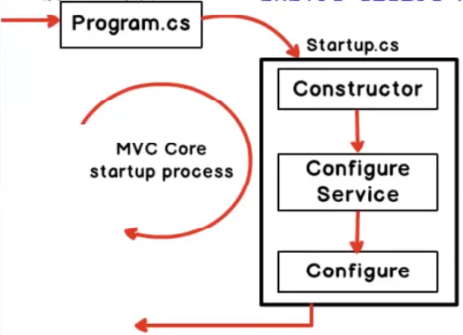
Structure

Slide 12
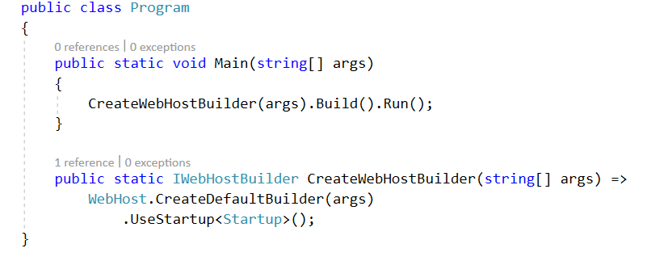
Program.cs
Program.cs is the first thing which runs in mvc core application
It does 2 things :-
1. It starts the web server (Kestrel server)
2. It invokes startup.cs file.

Slide 13
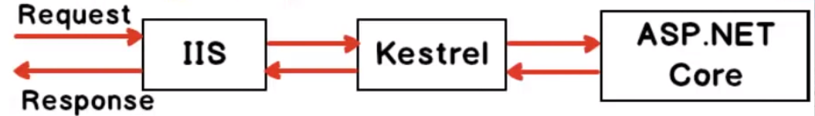
Program.cs
Kestrel server is cross-platform server
Reverse proxy

Slide 14

startup.cs
It does 3 things :-
1. Loads a configuration
2. Add services
3.Configure services
Plug and play model
In mvc core we can pick and choose services

Slide 15
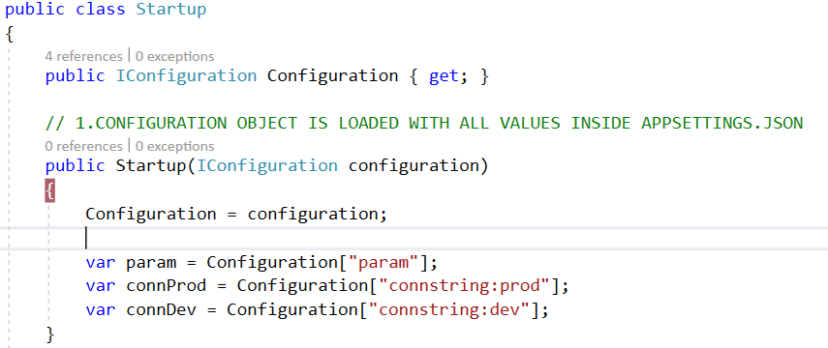
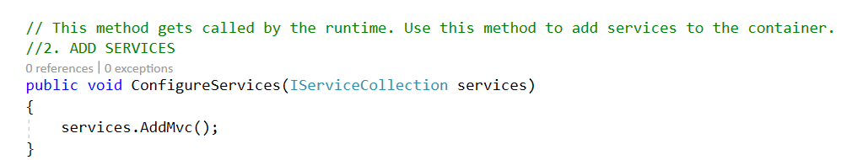
startup.cs

Slide 16
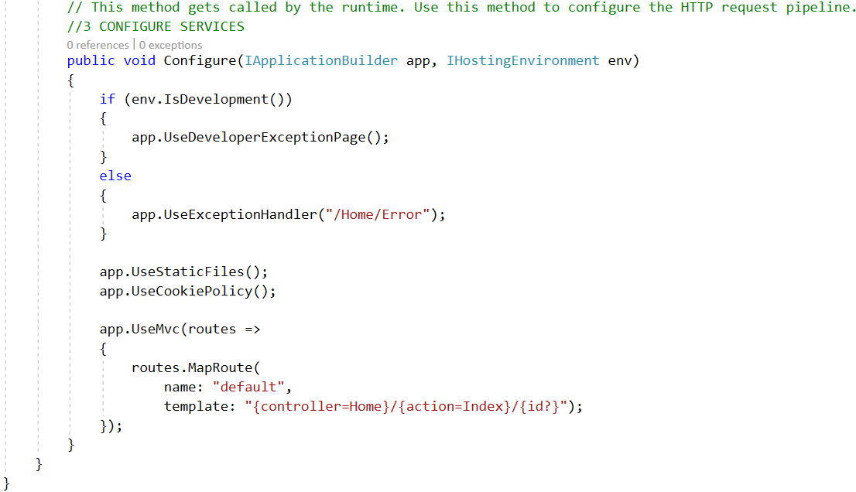
startup.cs

Slide 17
Demo
Example : - Demo1

Slide 18
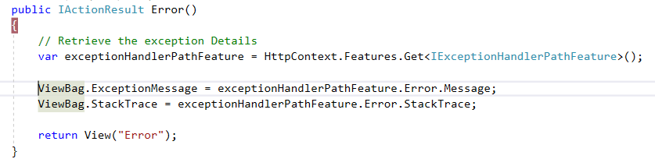
Exception Handling
Add Exception handling middleware
Example : - Core_Exception_handling

Slide 19
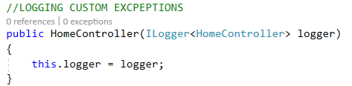
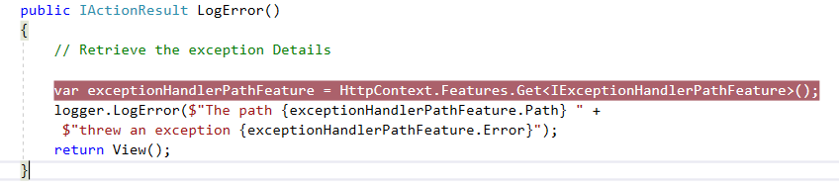
Logging
Instance an instance of ILogger
Example : - Core_Exception_handling

Slide 20
Publish cross-platform .NET app
.NET Core application deployment options : -
framework-dependent applications
self-contained applications.
framework-dependent 1.Net core framework required 2. Run on any O.S without any modifications | self-contained 1.App contains everything(not req.) 2. need to publish an OS-specific version
Example : -
1.Core_FrameworkDependantApp
2. Core_Self-contained app

