Slide 1


Slide 2
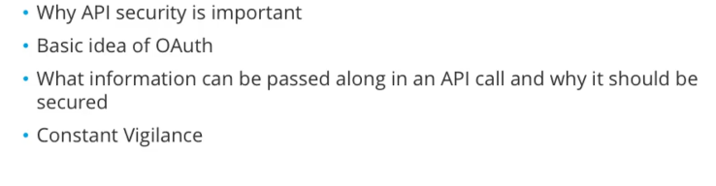

Slide 3
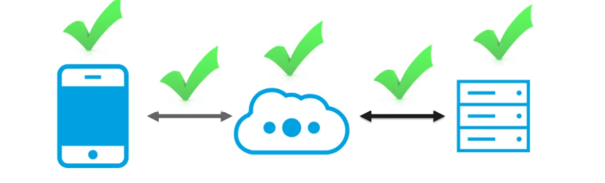
Securing your Api is
Keeping your network secure, so that hackers cannot break in .
Different parts of Api interaction that have to be secured
All though chain of events, there’s security you can put on :-
Api Consumer i.e smartphones,desktops etc..
Network,so that data passing is encypted and secure
Api provider i.e Server location

Slide 4
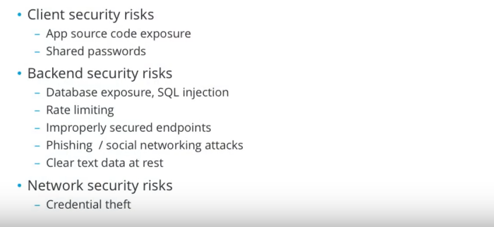

Slide 5
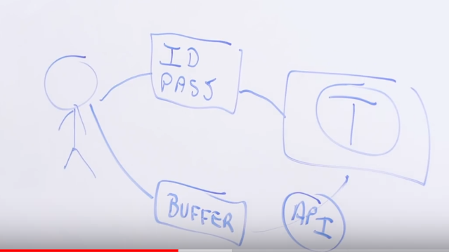
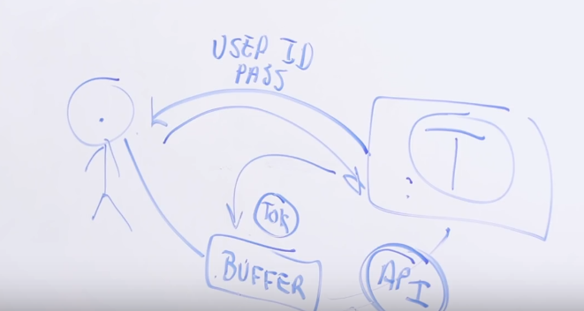

Slide 6
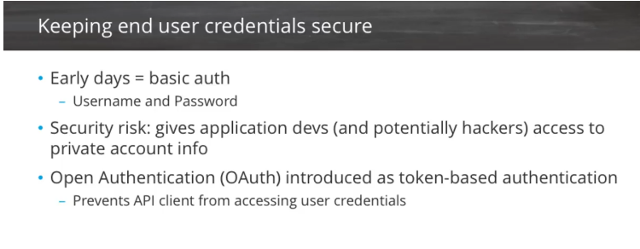

Slide 7
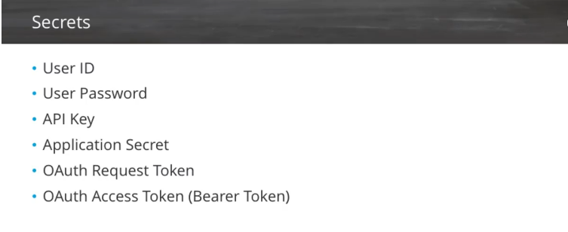

Slide 8
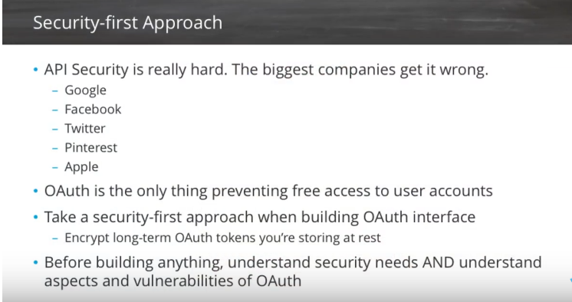

Slide 9
Token based authentication in ASP.NET Web API
Nowadays Web API adoption is increasing at a rapid pace. So it's very essential to implement security for all types of clients trying to access data from Web API services. Nowadays the most preferred approach to secure server resources by authenticating users in WEB API is to use signed token, which contains enough data to identify a particular user.This is called token-based approach. This is because of following reason:
Loose Coupling - The client application is not tied to a particular authentication scheme. The token is generated, validated and perform the authentication by the server.
Mobile Friendly - In native platform like iOS, Android, Windows 8 etc. handling cookies are not an easy task. Token-based approach simplifies this a lot.

Slide 10
How token based authentication actually works?
In the Token based approach, the client application first sends a request to Authentication server endpoint with an appropriate credential. Now If the username and password are found correct then the Authentication server send a token to the client as a response. This token contains enough data to identify a particular user and an expiry time.The client application then uses the token to access the restricted resources in next requests till the token is valid.

