Slide 1
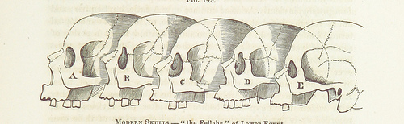
F9 Microkernel Interrupt Handling
Viller Hsiao <villerhsiao@gmail.com>

Slide 2
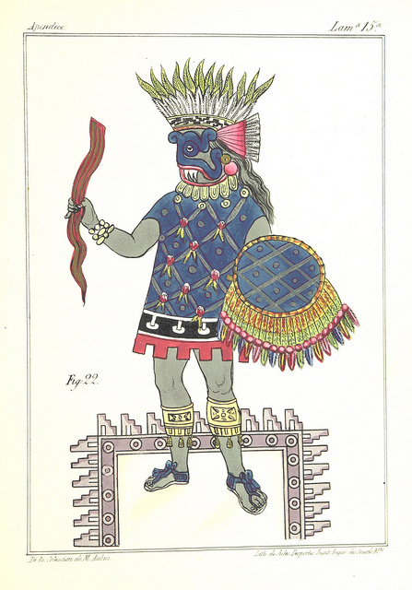



Rights to Copy copyright © 2014 Viller Hsiao
Attribution – ShareAlike 3.0
You are free
  to copy, distribute, display, and perform the work
  to make derivative works
  to make commercial use of the work
Under the following conditions
    Attribution. You must give the original author credit.
    Share Alike. If you alter, transform, or build upon this work, you may distribute the resulting work only under a license identical to this one.
For any reuse or distribution, you must make clear to others the license terms of this work.
  Any of these conditions can be waived if you get permission from the copyright holder.
Your fair use and other rights are in no way affected by the above.
License text: http://creativecommons.org/licenses/by-sa/3.0/legalcode
Corrections, suggestions, contributions and translations are welcome!

Slide 3
F9 Microkernel [1]
New open source implementation built from scratch, which deploys modern kernel techniques, derived from L4 microkernel designs, to deep embedded devices.
  BSD License
Characteristics of F9 microkernel
  Efficiency: performance + power consumption
  Security: memory protection + isolated execution
  Flexible development environment
Repository
  https://github.com/f9micro

Slide 4
Example Hardware Device
STM32F4Discovery board
  Cortex-M4F
    ARMv7-M
    MPU
    SysTick
    FPU

Slide 5
Agenda

Slide 7
Thread
Exception
handler
20003480: push {r4, r5, r6, lr}
20003482: ldr r3, [pc, #52]
20003484: ldr r4, [r3, #0]
20003486: ldr r0, [pc, #52]
20003488: bl 20002168 <__l4_puts>
2000348c: mov.w r0, #16384
20003490: ldr r1, [pc, #44]
20003492: ldr r2, [pc, #48]
20003494: ldr r3, [pc, #48]
20001984 <nvic_handler52>:
20001984: push {lr}
20001986: bl 200018e8 <__uart_irq_handler>
2000198a: ldr r3, [pc, #16]
2000198c: ldr r2, [r3, #0]
2000198e: orr.w r2, r2, #268435456
20001992: str r2, [r3, #0]
20001994: ldr.w lr, [sp], #4
20001998: bx lr
20003496: bl 20002710 <dbg_printf>
2000349a: cbz r4, 200034b4
2000349c: ldr r6, [pc, #44]
2000349e: mov.w r5, #16384
200034a2: mov r0, r5
200034a4: mov r1, r6
200034a6: mov r2, r4
200034a8: ldr r3, [r4, #8]

Slide 8
CPU Register Dirtied by Exception Handler
Thread
Exception
handler
20003480: push {r4, r5, r6, lr}
20003482: ldr r3, [pc, #52]
20003484: ldr r4, [r3, #0]
20003486: ldr r0, [pc, #52]
20003488: bl 20002168 <__l4_puts>
2000348c: mov.w r0, #16384
20003490: ldr r1, [pc, #44]
20003492: ldr r2, [pc, #48]
20003494: ldr r3, [pc, #48]
20001984 <nvic_handler52>:
20001984: push {lr}
20001986: bl 200018e8 <__uart_irq_handler>
2000198a: ldr r3, [pc, #16]
2000198c: ldr r2, [r3, #0]
2000198e: orr.w r2, r2, #268435456
20001992: str r2, [r3, #0]
20001994: ldr.w lr, [sp], #4
20001998: bx lr
20003496: bl 20002710 <dbg_printf>
2000349a: cbz r4, 200034b4
2000349c: ldr r6, [pc, #44]
2000349e: mov.w r5, #16384
200034a2: mov r0, r5
200034a4: mov r1, r6
200034a6: mov r2, r4
200034a8: ldr r3, [r4, #8]
Register value is dirtied!

Slide 9
Final Exception Handling Flow
Thread
Exception
handler
20003480: push {r4, r5, r6, lr}
20003482: ldr r3, [pc, #52]
20003484: ldr r4, [r3, #0]
20003486: ldr r0, [pc, #52]
20003488: bl 20002168 <__l4_puts>
2000348c: mov.w r0, #16384
20003490: ldr r1, [pc, #44]
20003492: ldr r2, [pc, #48]
20003494: ldr r3, [pc, #48]
Push
Registers
20001984 <nvic_handler52>:
20001984: push {lr}
20001986: bl 200018e8 <__uart_irq_handler>
2000198a: ldr r3, [pc, #16]
2000198c: ldr r2, [r3, #0]
2000198e: orr.w r2, r2, #268435456
20001992: str r2, [r3, #0]
20001994: ldr.w lr, [sp], #4
20001998: bx lr
20003496: bl 20002710 <dbg_printf>
2000349a: cbz r4, 200034b4
2000349c: ldr r6, [pc, #44]
2000349e: mov.w r5, #16384
200034a2: mov r0, r5
200034a4: mov r1, r6
200034a6: mov r2, r4
200034a8: ldr r3, [r4, #8]
Pop
registers

Slide 12
Hardware Interrupt Sources
Periphral
Interrupt
Fault
Handling
NMI
CPU
NVIC
INTs
from
devices
MPU
bus
systick

Slide 13
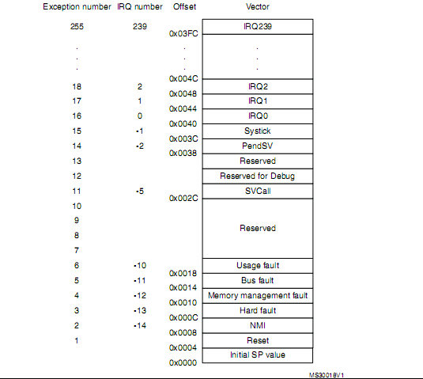
Vector Table
ISR_VECTOR
  Init.c
    g_pfnVectors

Slide 14
Vector Table
Reset
  Handler
    __l4_start()
    Entry in linker script
  Stack
    kernel_stack_end

Slide 15
Vector Table
Fault handler
  Hard fault
    hard_fault_handler()
  Memory management fault
    memmange_handler()
  Bus fault
    busfault()
  Usage fault
    nointerrupt()

Slide 16
Vector Table
System handler
  SVC call
    svc_handler()
  Debug monitor
    debugmon_handler()
    Used for kprobe
  Pendsv
    pendsv_handler()
    Trigger re-schedule

Slide 17
Vector Table
Hardware interrupt
  NMI
    nmi_handler()
  ARMv7M Systick
    ktimer_handler()
    Used for ktimer
  Vendor specific
    nvic_handlerx()
      x from 0 ~ 81
    ARMv7M NVIC

Slide 18
IRQ Driver Interface
Register handler
  IRQ_HANDLER()

Slide 19
Softirq Driver Interface
Declare Softirq event
  softirq_type_t in include/softirq.h
Register Softirq handler
  softirq_register()
Invoke Softirq
  softirq_schedule()
  Usually invoked in IRQ handler

Slide 20
Reference
Jim Huang (Dec 9, 2013), “F9: A Secure and Efficient Microkernel Built for Deep Embedded Systems”

Slide 21
THE END

