Slide 1
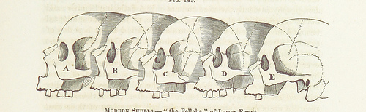
F9 Microkernel MCU Interation
Viller Hsiao <villerhsiao@gmail.com>

Slide 2




Rights to Copy copyright © 2014 Viller Hsiao
Attribution – ShareAlike 3.0
You are free
  to copy, distribute, display, and perform the work
  to make derivative works
  to make commercial use of the work
Under the following conditions
    Attribution. You must give the original author credit.
    Share Alike. If you alter, transform, or build upon this work, you may distribute the resulting work only under a license identical to this one.
For any reuse or distribution, you must make clear to others the license terms of this work.
  Any of these conditions can be waived if you get permission from the copyright holder.
Your fair use and other rights are in no way affected by the above.
License text: http://creativecommons.org/licenses/by-sa/3.0/legalcode
Corrections, suggestions, contributions and translations are welcome!

Slide 3
F9 Microkernel [1]
New open source implementation built from scratch, which deploys modern kernel techniques, derived from L4 microkernel designs, to deep embedded devices.
  BSD License
Characteristics of F9 microkernel
  Efficiency: performance + power consumption
    Tickless
  Security: memory protection + isolated execution
  Flexible development environment
Repository
  https://github.com/f9micro

Slide 4
Agenda

Slide 7
IRQ handling

Slide 8
Thread Model

Slide 9
Context Switch

Slide 10
Address Space

Slide 11
F9 Microkernel MCU Integration

Slide 12
Example Hardware Device
STM32F4Discovery board
  Cortex-M4
    ARMv7-M

Slide 13
Reference
Jim Huang (Dec 9, 2013), “F9: A Secure and Efficient Microkernel Built for Deep Embedded Systems”

Slide 14
THE END

