Slide 1
Meet-cute between eBPF and Kernel Tracing
Viller Hsiao <villerhsiao@gmail.com>
May. 26, 2016

Slide 2

Who am I ?
Viller Hsiao
Embeded Linux / RTOS engineer
http://image.dfdaily.com/2012/5/4/634716931128751250504b050c1_nEO_IMG.jpg

Slide 3
BPF
Berkeley Packet Filter
by Steven McCanne and Van Jacobson, 1993

Slide 4
Berkeley Packet Filter
Packet filter: tcpdump -nnnX port 3000

Slide 5

In-kernel Packet Filter
tcpdump -nnnX port 3000
Applications
monitor
user
kernel
network
stack
port 3000
VM
net if
http://www.iconsdb.com/icons/download/gray/empty-filter-512.png

Slide 6
Berkeley Packet Filter
Improve unix packet filter

Slide 7
Berkeley Packet Filter
Improve unix packet filter
Replace stack-based VM with register-based VM

Slide 8
Berkeley Packet Filter
Improve unix packet filter
Replace stack-based VM with register-based VM
20 times faster than original design

Slide 9
In-Kernel VM for Filtering
Flexibility
Efficiency
Security

Slide 10
Areas Use BPF
Linux-3.4 (2012), Seccomp filters of syscalls (chrome sandboxing)
Packet classifier for traffic contol
Actions for traffic control
Xtables packet filtering
Tracing

Slide 11

Story today,
When kernel tracing meets ebpf
http://2.blog.xuite.net/2/4/7/8/11001626/blog_70864/txt/17378250/0.jpg

Slide 12
BPF in Linux
a.k.a. Linux Socket Filter
kernel 2.1.75, in 1997

Slide 13
BPF Filter Program Example
ICMP
random packet sampling
1 in 4
ARP packets
ldh [12]
jne #0x806, drop
ret #-1
drop: ret #0
ldh [12]
jne #0x800, drop
ldb [23]
jneq #1, drop
ld rand
mod #4
jneq #1, drop
ret #-1
drop: ret #0
helper
extensions

Slide 14
BPF Example: Translate to Binary
$ ./bpf_asm -c foo
Opcode JT JF K
{ 0x28, 0, 0, 0x0000000c },
{ 0x15, 0, 1, 0x00000806 },
{ 0x06, 0, 0, 0xffffffff },
{ 0x06, 0, 0, 0000000000 },

Slide 15
Userspace Application
struct sock_filter code[] = {
{ 0x28, 0, 0, 0x0000000c },
{ 0x15, 0, 8, 0x000086dd },
…
};
struct sock_fprog bpf = {
.len = ARRAY_SIZE(code),
.filter = code,
};
sock = socket(PF_PACKET, SOCK_RAW, htons(ETH_P_ALL));
if (sock < 0)
/* ... bail out ... */
ret = setsockopt(sock, SOL_SOCKET, SO_ATTACH_FILTER, &bpf, sizeof(bpf));
if (ret < 0)
/* ... bail out ... */
BPF Binary

Slide 16
Introduct BPF JIT Compiler in 2011
Linux-3.0, by Eric Dumazet
BPF JIT
  x86_64, SPARC, PowerPC, ARM, ARM64, MIPS and s390
$ echo 1 > /proc/sys/net/core/bpf_jit_enable

Slide 17
extended BPF
Linux-3.15
by Alexei Starovoitov, 2013

Slide 18
Classic BPF
vs
Internal BPF (a.k.a extended BPF)

Slide 19
eBPF Design Goals
Just-in-time map to modern 64-bit CPU with minimal performance overhead
Write programs in restricted C and compile into BPF with GCC/LLVM
Guarantee termination and safety of BPF program in kernel with simple algorithm

Slide 20
cBPF vs eBPF
 | BPF | eBPF
registers | A, X | R0 - R10
width | 32 bit | 64 bit
opcode | op:16, jt:8, jf:8, k:32 | op:8, dst_reg:4, src_reg:4, off:16, imm:32
JIT support | x86_64, SPARC, PowerPC, ARM, ARM64, MIPS and s390 | x86-64, aarch64, s390x

Slide 21
BPF Calling Convention
R0
    return value from in-kernel function, and exit value for eBPF program
R1 – R5
    arguments from eBPF program to in-kernel function
R6 – R9
    callee saved registers that in-kernel function will preserve
R10
    read-only frame pointer to access stack

Slide 22
Designed to be JITed for 64-bit Architecture
push %rbp
mov %rsp,%rbp
sub $0x228,%rsp
mov %rbx,-0x228(%rbp)
mov %r13,-0x220(%rbp)
mov %rdi,%rbx
mov $0x2,%esi
mov $0x3,%edx
mov $0x4,%ecx
mov $0x5,%r8d
callq foo
mov %rax,%r13
mov %rbx,%rdi
mov $0x2,%esi
mov $0x3,%edx
mov $0x4,%ecx
mov $0x5,%r8d
callq bar
add %r13,%rax
mov -0x228(%rbp),%rbx
mov -0x220(%rbp),%r13
leaveq
retq
/* restore ctx for next call */
bpf_mov R6, R1x
bpf_mov R2, 2
bpf_mov R3, 3
bpf_mov R4, 4
bpf_mov R5, 5
bpf_call foo
/* save foo() return value */
bpf_mov R7, R0
/* restore ctx for next call */
bpf_mov R1, R6
bpf_mov R2, 6
bpf_mov R3, 7
bpf_mov R4, 8
bpf_mov R5, 9
bpf_call bar
bpf_add R0, R7
bpf_exit
x86_64

Slide 23
How does it work?

Slide 24
BPF Programming Flow
app
BPF
bytecode
user
kernel
subsys
BPF VM

Slide 25
BPF Programming Flow
app
BPF
bytecode
user
bpf syscall
kernel
BPF_PROG_LOAD
subsys
BPF
bytecode
Interpreter
JIT

Slide 26
BPF Programming Flow
app
BPF
bytecode
user
bpf syscall
kernel
verifier
subsys
BPF
bytecode
Interpreter
JIT

Slide 27
BPF Verifier
Do static check in verifier as possible
Directed Acyclic Graph(DAG) program
  Max 4096 instructions
  No loop
  unreachable insns exist
Instruction Walk
  Read a never-written register
  Do arithmetic of two valid pointer
  Load/store registers of invalid types
  Read stack before writing data into

Slide 28
BPF Programming Flow
app
BPF
bytecode
user
bpf syscall
kernel
BPF_MAP_CREATE
BPF_MAP_LOOKUP_ELEM
BPF_MAP_UPDATE_ELEM
….
verifier
MAP
subsys
BPF
bytecode
Interpreter
JIT

Slide 29
BPF MAP
BPF_MAP_TYPE_HASH
BPF_MAP_TYPE_ARRAY
BPF_MAP_TYPE_PROG_ARRAY
BPF_MAP_TYPE_PERF_EVENT_ARRAY
Tracepoint
Event A
Tracepoint
Event B
Tracepoint
Event C
sk_buff on
eth0
Tracing
prog_1
Tracing
prog_2
sock
prog_3
map1
map2
map3

Slide 30
BPF Programming Flow
app
BPF
bytecode
user
bpf syscall
kernel
verifier
MAP
BPF_PROG_RUN
subsys
BPF
bytecode
Interpreter
JIT

Slide 31
BPF Programming Flow
app
BPF
bytecode
user
bpf syscall
kernel
verifier
MAP
BPF_PROG_RUN
subsys
BPF
bytecode
helper
Interpreter
JIT
Other
subsys

Slide 32
BPF Helpers
bpf_func_id
map
system
net
perf
trace

Slide 33
BPF Programming Flow
app
BPF
bytecode
user
bpf syscall
kernel
verifier
MAP
BPF_PROG_RUN
subsys
BPF
bytecode
helper
Interpreter
JIT
Other
subsys

Slide 34
Kernel Instrumentation

Slide 35
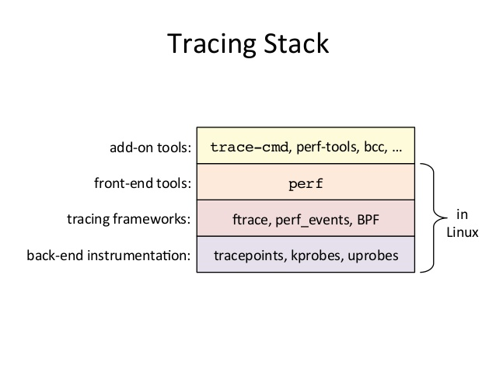
Kernel Tracing
http://www.slideshare.net/brendangregg/linux-systems-performance-2016

Slide 36
tracefs
(debugfs in past)
# ls /sys/kernel/tracing/
README saved_cmdlines
available_events saved_cmdlines_size
available_filter_functions set_event
available_tracers set_event_pid
buffer_size_kb set_ftrace_filter
buffer_total_size_kb set_ftrace_notrace
current_tracer set_ftrace_pid
dyn_ftrace_total_info set_graph_function
enabled_functions set_graph_notrace
events trace
free_buffer trace_clock
instances trace_marker
kprobe_events trace_options
kprobe_profile trace_pipe
max_graph_depth tracing_cpumask
options tracing_on
per_cpu tracing_thresh
printk_formats

Slide 37
ftrace
void Func ( … )
{
Line 1;
Line 2;
…
}
void Func ( … )
{
mcount (pc, ra);
Line 1;
Line 2;
…
}
gcc -pg

Slide 38
Dynamic ftrace
mcount:
nop
inst 1
inst 2
…
jump ra
mcount:
jump ftrace_caller
inst 1
inst 2
…
jump ra
enabled

Slide 39
Static Probe: Tracepoint
include/trace/events/subsys.h
DECLARE_TRACE( subsys_eventname,
TP_PROTO(int firstarg, struct task_struct *p),
TP_ARGS(firstarg, p));
subsys/file.c
#include <trace/events/subsys.h>
DEFINE_TRACE(subsys_eventname);
void somefct(void)
{
...
trace_subsys_eventname(arg, task);
...
}

Slide 40
Dynamic Probe
Uprobe
user
Kprobe
Kretprobe
Jprobe
Kernel

Slide 41
kprobe
register_kprobe()
address
sym + offset
INST
BREAK
pre_handler()
post_handler()
Write Kernel Module to
register a kprobe

Slide 42
kprobe
exception
pre_handler()
BREAK
address
BREAK
INST
post_handler()
Note: More details are not revealed

Slide 43
Kprobe-based Event Tracing
# echo 'r:myretprobe do_sys_open $retval' >> /sys/kernel/tracing/kprobe_events
# echo 1 > /sys/kernel/tracing/events/kprobes/myretprobe/enable
# cat /sys/kernel/tracing/trace
# tracer: nop
#
# TASK-PID CPU# |||| TIMESTAMP FUNCTION
# | | | |||| | |
sh-746 [000] d... 40.96: myretprobe: (SyS_open+0x2c/0x30 <- do_sys_open) arg1=0x3
sh-746 [000] d... 42.19: myretprobe: (SyS_open+0x2c/0x30 <- do_sys_open) arg1=0x3
…..

Slide 44
uprobe
echo 'p:bashme /bin/bash:0x4245c0' > /sys/kernel/tracing/uprobe_events

Slide 45
perf
perf-tool
Get counter statistics
$ perf stat my-app-cmd arg1
Or
Get sampling
$ perf record my-app-cmd arg1
user
perf_event
kernel
Perf
HW
Event
SW
Event
Trace
Event
dynamic
Event
PMU
trace
point
Kprobe
uprobe

Slide 46

Before BPF Integration
Components are isolated
Complex filters and scripts can be expensive
https://i.ytimg.com/vi/elc3FdKxaOk/maxresdefault.jpg

Slide 47
People desire more powerful tool like dtrace
some attemptation: systemtap, ktap

Slide 48
Linux-4.1
“One of the more interesting features in this cycle is the ability to attach eBPF programs (user-defined, sandboxed bytecode executed by the kernel) to kprobes. This allows user-defined instrumentation on a live kernel image that can never crash, hang or interfere with the kernel negatively. “
~Ingo Molnár
https://lkml.org/lkml/2015/4/14/232

Slide 49
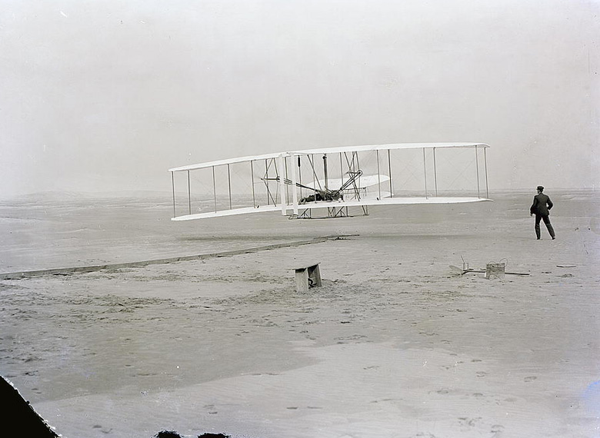
Instrument powered by eBPF
“If DTrace is Kixy Hawk, eBPF is a jet engine”
~ Brendan Gregg
http://www.ait.org.tw/infousa/zhtw/american_story/assets/es/nc/es_nc_kttyhwk_1_e.jpg

Slide 50
Attach Kprobe tracepoint is added, too
Alexei Starovoitov
  tracing: attach BPF programs to kprobes
  tracing: allow BPF programs to call bpf_ktime_get_ns()
  tracing: allow BPF programs to call bpf_trace_printk()
prog_fd = bpf_prog_load(...);
struct perf_event_attr attr = {
.type = PERF_TYPE_TRACEPOINT,
.config = event_id, /* ID of just created kprobe event */
};
event_fd = perf_event_open(&attr,...);
ioctl(event_fd, PERF_EVENT_IOC_SET_BPF, prog_fd);

Slide 51
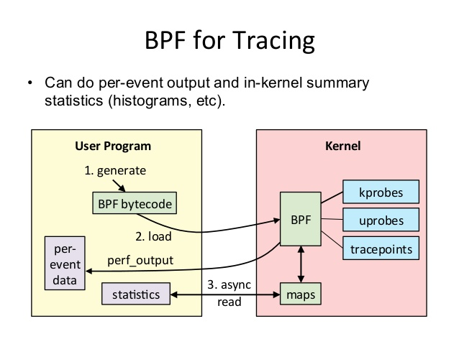
BPF for Tracing
The output data is not limited to PMU counters but data like time latencies, cache misses or other things users want to record.
http://www.slideshare.net/brendangregg/linux-bpf-superpowers

Slide 52
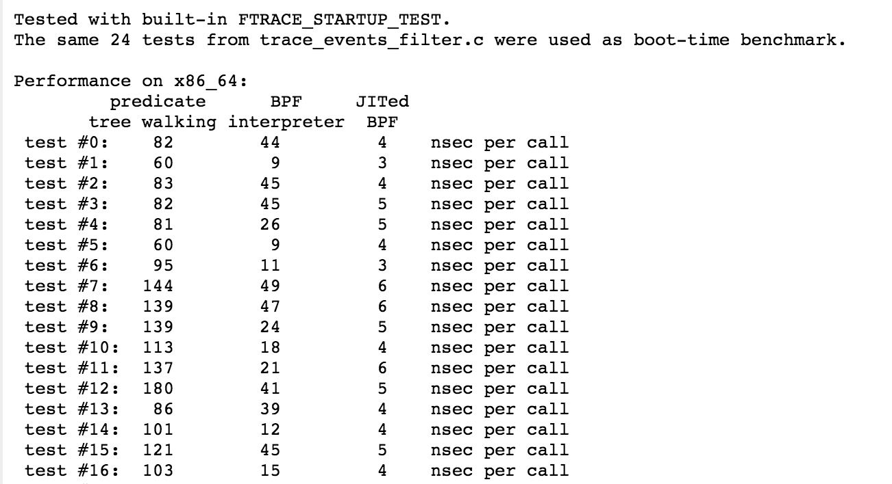
Filter Interpreter on eBPF
(not merged yet?)
"field1 == 1 || field2 == 2"

Slide 53

The Evolution of eBPF User Programming
http://www.bitrebels.com/wp-content/uploads/2011/04/Evolution-Of-Man-Parodies-333.jpg

Slide 54
Programming for eBPF
eBPF
assembly
Restrict C
or
LLVM
( up 3.7)
userspace
program
bytecode

Slide 55
Write a eBPF Program by C Looks Good
But
What's the rule of “restrict C” ?

Slide 56
1. Samples in Kernel Source
foo_user.c + foo_kern.c
All prog/data needed when loading bpf
Userspace
1. BPF load
2. Flow control
3. Data presentaion

Slide 57
foo_kern.c
struct bpf_map_def SEC("maps") my_map = {
.type = BPF_MAP_TYPE_PERF_EVENT_ARRAY,
…...
.max_entries = 32,
};
SEC("kprobe/sys_write")
int bpf_prog1(struct pt_regs *ctx)
{
u64 count;
u32 key = bpf_get_smp_processor_id();
char fmt[] = "CPU-%d %llu\n";
count = bpf_perf_event_read(&my_map, key);
bpf_trace_printk(fmt, sizeof(fmt), key, count);
return 0;
}
char _license[] SEC("license") = "GPL";
u32 _version SEC("version") = LINUX_VERSION_CODE;
MAP
MAP
BPF
program
Other
Info

Slide 58
Program Flow
Take kprobe as example
map 1
sec(“map”)
Create map
(map sections)
map 2
clang
--target=bpf
bpf_prog1
sec(“kprobe/foo”)
Load bpf_prog
(kprobe/xxx, license, … sections)
bpf_prog2
bpf_prog_load
Setup /sys/.../krpobe_events
(kprobe/xxx sections)
bpf_prog3
license
sec(“license”)
foo_kern.c
foo_kern.o
(elf)
libbpf

Slide 59
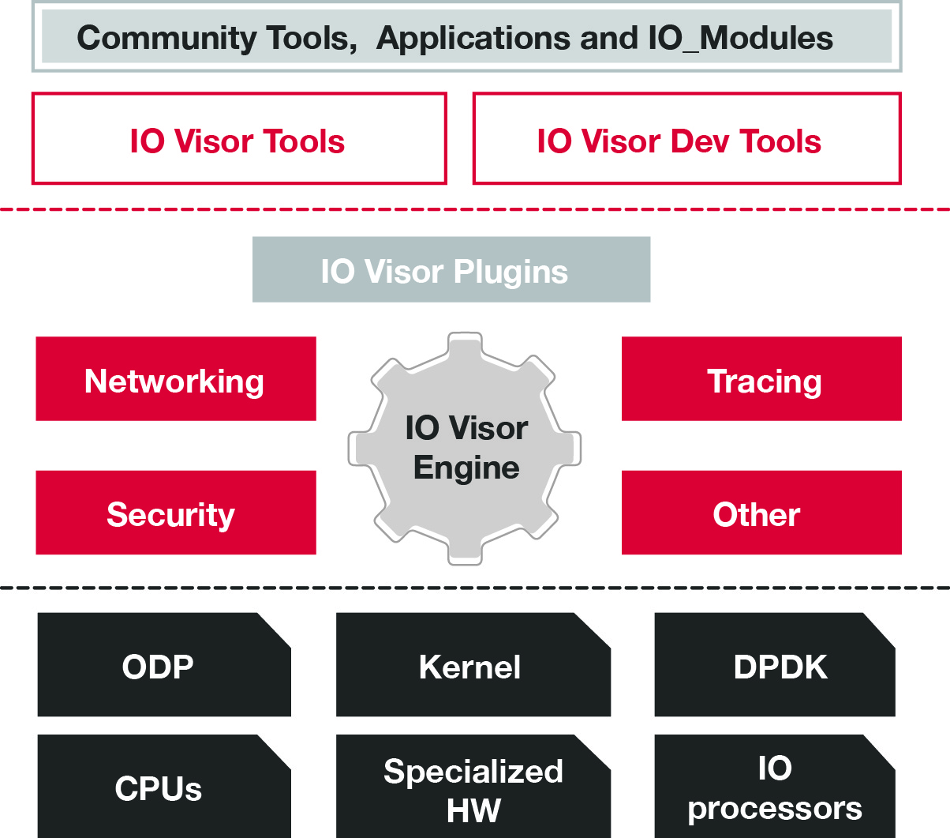
2. IO Visor
The project enables developers to build, innovate, and share open, programmable data plane with dynamic IO and networking functions
https://www.iovisor.org/sites/cpstandard/files/pages/images/io_visor.jpg

Slide 60
BPF Compiler Collection
Frontend
python, lua
restrict BPF C code
BCC modules
iovisor
BCC
libbpf.so
clang / llc
BPF bytecode
perf event / trace_fs
bpf syscall

Slide 61
BCC Example BPF Part looks simpler than kernel samples
BPF_HASH(start, struct request *);
void trace_start(struct pt_regs *ctx, struct request *req) {
…...
}
void trace_completion(struct pt_regs *ctx, struct request *req) {
u64 *tsp, delta;
tsp = start.lookup(&req);
if (tsp != 0) {
delta = bpf_ktime_get_ns() - *tsp;
bpf_trace_printk("%d %x %d\n", req->__data_len,
req->cmd_flags, delta / 1000);
start.delete(&req);
}
}

Slide 62
BCC Example User Part
from bcc import BPF
b = BPF(src_file="disksnoop.c")
b.attach_kprobe(event="blk_start_request", fn_name="trace_start")
b.attach_kprobe(event="blk_mq_start_request", fn_name="trace_start")
b.attach_kprobe(event="blk_account_io_completion", fn_name="trace_completion")
…....
# format output
while 1:
(task, pid, cpu, flags, ts, msg) = b.trace_fields()
…....
print("%-18.9f %-2s %-7s %8.2f" % (ts, type_s, bytes_s, ms))

Slide 63
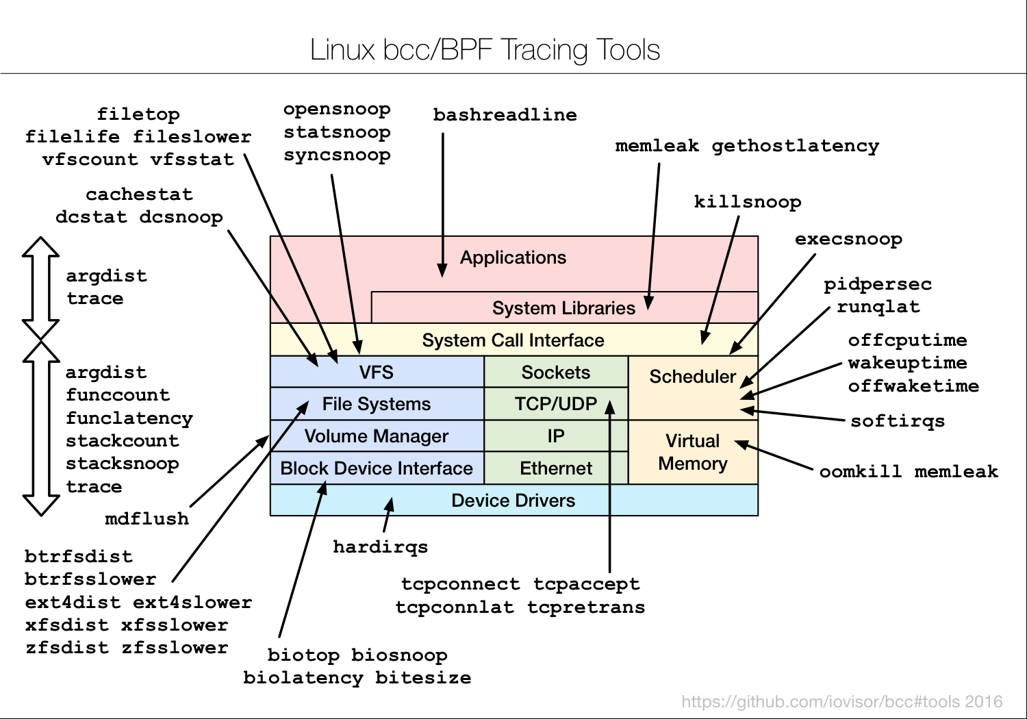
Existed Tracing Scripts within BCC
Tools for BPF-based Linux IO analysis, networking, monitoring, and more
https://raw.githubusercontent.com/iovisor/bcc/master/images/bcc_tracing_tools_2016.png

Slide 64
3. iovisor ply project
Lightweight alternative to bcc
Simpler DSL script
No run-time dependencies
  Only depends on flex and bison
#!/usr/bin/env ply
kprobe:SyS_read
{
$sizes.quantize(arg(2))
}

Slide 65
4. perf tool
Introduced by Wang Nan
$ perf bpf sample_bpf.o

Slide 66
Summary
eBPF: In-kernel VM designed to be JITed
Used by many subsystems for filtering
  Packet monitor filtering
  Tracing and perf
  Seccomp
  Networking
Tools
  perf
  BCC: Easy to customized script for probe kernel
    Kernel >=4.1, LLVM >= 3.7
  ply

Slide 67
Q & A

Slide 68
Reference
Alexei Starovoitov (May. 2014), “tracing: accelerate tracing filters with BPF”, KERNEL PATCH
Alexei Starovoitov, (Feb. 2015), "BPF – in-kernel virtual machine", presented at Collaboration Summit 2015
Brendan Gregg, (Feb. 2016), "Linux 4.x Performance Using BPF Superpowers", presented at Performance@ scale 2016
Elena Zannoni (Jun. 2015), “New (and Exciting!) Developments in Linux Tracing ”, presented at Linuxcon Japan 2015
Gary Lin (Mar. 2016), “eBPF: Trace from Kernel to Userspace ”, presented at OpenSUSE Technology Sharing Day 2016
Jonathan Corbet. (May. 2014), “BPF: the universal in-kernel virtual machine”, LWN
Kernel documentation, “Using the Linux Kernel Tracepoints”
Suchakrapani D. Sharma (Dec. 2014), “Towards Faster Trace Filtersvusing eBPF and JIT”

Slide 69
Rights to Copy copyright © 2016 Viller Hsiao
HCSM is the community of Hsinchu Coders in Taiwan.
iovisor is a project of Linux Foundation
ARM are trademarks or registered trademarks of ARM Holdings.
Linux Foundation is a registered trademark of The Linux Foundation.
Linux is a registered trademark of Linus Torvalds.
Other company, product, and service names may be trademarks or service marks
of others.
The license of each graph belongs to each website listed individually.
The others of my work in the slide is licensed under a CC-BY-SA License.
  License text: http://creativecommons.org/licenses/by-sa/4.0/legalcode

Slide 70
THE END

