Slide 1
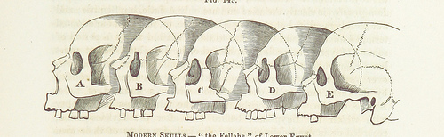
F9 Microkernel ktimer
Viller Hsiao <villerhsiao@gmail.com>

Slide 2
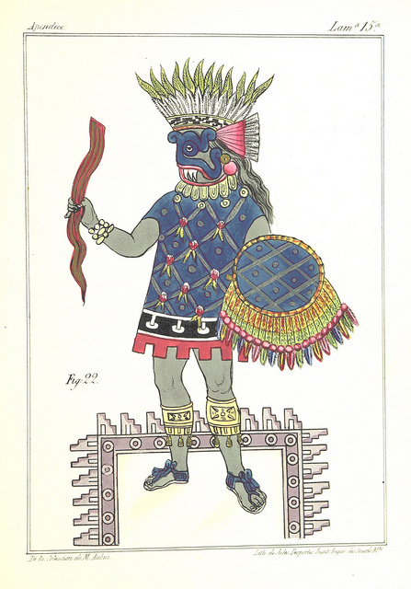



Rights to Copy copyright © 2014 Viller Hsiao
Attribution – ShareAlike 3.0
You are free
  to copy, distribute, display, and perform the work
  to make derivative works
  to make commercial use of the work
Under the following conditions
    Attribution. You must give the original author credit.
    Share Alike. If you alter, transform, or build upon this work, you may distribute the resulting work only under a license identical to this one.
For any reuse or distribution, you must make clear to others the license terms of this work.
  Any of these conditions can be waived if you get permission from the copyright holder.
Your fair use and other rights are in no way affected by the above.
License text: http://creativecommons.org/licenses/by-sa/3.0/legalcode
Corrections, suggestions, contributions and translations are welcome!

Slide 3
Agenda
Concept about operation system kernel time subsystem
F9 Microkernel ktimer introduction

Slide 4
Concept about Operation System Kernel Time Subsystem

Slide 5
OS Kernel Time Subsystem
Current Time
  System time, UTC/GMP time, … etc
Alarm, the time event
Process timeslice
Timeout
Time delay

Slide 6
System Time and Tick
“System time represents a computer system's notion of the passing of time.“
“System time is measured by a system clock, which is typically implemented as a simple count of the number of ticks that have transpired since some arbitrary starting date, called the epoch.”
~ from WIKIPEDIA

Slide 7


How Is Tick Implemented?
Hardware timer device
  Assert interrupt after a programmable inteval
    Handling tick stuff in Timeout Interrupt Service Routine (ISR)
HW
Timer
CPU
Adjust system time
Handle timeout event
….
Timeout interrupt
Control
Read Counts
SetUP timeout value

Slide 8
How Is Tick Implemented? (Cont.)
Type 1: Incremental timer
  Example: Cortex-A9 MP Global Timer
1
+
Current Value
0x12abc
Y
Interrupt
clock
=
Incremental value
0x36000
Compare Value
0x36000
+
Y
Auto
Increament?

Slide 9
How Is Tick Implemented? (Cont.)
Type 2: Counting down timer
  Example: Cortex-M4 SysTick
0
Interrupt
=
Y
clock
1
-
Current Value
0x12abc
Reload value
0x36000
=
Y
Auto
Load?

Slide 10
How Is Tick Implemented? (cont.)
Timeout ISR
  Increase system ticks
  Execute handler of timeout event
  Re-schedule if required

Slide 11
Time Diagram of Ticks
event2
event1
event3
event4
HW
Timer
interrupt
CPU
activities

Slide 12
Time Diagram of Ticks (Cont.)
event2
event1
event3
event4
HW
Timer
interrupt
CPU
activities
CPU waken up for timekeeping only

Slide 13
Where Is the Problem?
Context switch overhead
Unecessary power consumed
Tick resolution
  Performance, power v.s. timer precision

Slide 14
Solution: Tickless
event2
event1
event3
event4
Timer
interrupt
New
CPU
activities
Previous
CPU
activities

Slide 15
Example: Linux Time Subsystem
Device level
  Clock source
    jiffies
  Clock event
Hrtimer
Tickless
  CONFIG_NO_HZ

Slide 16
F9 Microkernel ktimer Introduction

Slide 17
F9 Microkernel

Slide 18
Example Hardware Device
STM32F4Discovery board
  Cortex-M4 EVB
    Use SysTick as the HW timer device
      24-bit system timer
      Counting down
      Calibration is required
      DM00046982.pdf

Slide 19
ktimer Features
System time
Time event
Tickless

Slide 20
ktimer Configurations
CONFIG_KTIMER_HEARTBEAT
  HW cycles per ktimer tick
CONFIG_KTIMR_MINTICKS
  Minimum ktimer ticks unit for time event
CONFIG_KTIMER_TICKLESS
  Enable tickless

Slide 21
ktimer Event Utility
ktimer_event_create()
  Arguments
    Timeout ticks
    Timeout handler
    Pointer to arguments for timeout handler
  Return Non-zero to reschedule event again
    Freed automatically if not be re-scheduled

Slide 22
ktimer Anotomy
System time
  ktime_now
ktimer event list
  event_queue
  Managed by ktable

Slide 23
ktimer Anotomy (Cont.)
Life cycle of time event
  One-shot
  Continuous
How to control life cycle in ktimer?
  By return value of handler as next timeout delta

Slide 24
ktimer Anotomy (Cont.)
Two stage interrupt handling
  ISR
  Softirq

Slide 25
ktimer Anotomy (Cont.)
HW Timer ISR
  __ktimer_handler()
    Increase tick
    Arrange Softirq for handling timer events

Slide 26
ktimer Anotomy (Cont.)
HW timer softirq handler
  ktimer_event_handler()
    Find timeout event and executing its handler
    Re-insert event if required

Slide 27
ktimer Anotomy (Cont.)
Tickless
  Enter tickless right before going to CPU idle state
  Set interval of next timer interrupt as delta of next event
    Or KTIMER_MAXTICKS
  Adjust system time after wake up

Slide 28
ktimer Anotomy (Cont.)
Tick compensation

Slide 29
ktimer Anotomy (Cont.)
Debugging

Slide 30
Q & A

Slide 31
THE END

