Slide 1
COSCUP 2016 –
Linux Kernel Tracing
Viller Hsiao <villerhsiao@gmail.com>
Aug. 21, 2016

Slide 2

Who am I ?
Viller Hsiao
Embedded Linux / RTOS engineer
http://image.dfdaily.com/2012/5/4/634716931128751250504b050c1_nEO_IMG.jpg

Slide 3
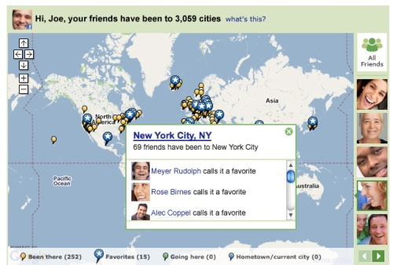
What's Tracing
https://www.tnooz.com/wp-content/uploads/2010/12/tripadvisor-facebook-rampup1.jpg

Slide 4
What's Tracing
Famous way in C: printf()
void myfunc(int type)
{
if (type > 20) {
/* do some things */
printf (“I like it goes here!\n”);
} else if (type < 100) {
/* do other things */
printf (“But it goes here!\n”);
} else {
/* error handling */
printf (“Oh! I hate it's here! Wrong type is %d\n”, type);
}
}

Slide 5
What's tracing data used for?
Observe program behavior

Slide 6
What's tracing data used for?
Observe program behavior
Debug program

Slide 7
What's tracing data used for?
Observe program behavior
Debug program
Profile and get statistics
and so on

Slide 8
Well-known tool in kernel: printk()
printk() is intuitive, but

Slide 9
Issue of printk()
High overhead
“using printk(), especially when writing to the serial console, may take several milliseconds per write.” ~ [1]

Slide 10
Issue of printk()
High overhead
Lack of flexibility

Slide 11
Topic today
Systematic tracing mechanisms in Linux kernel
How kernel exhausts compiler and CPU tricks to implement flexible and low overhead system tracing

Slide 12

Tracing in Linux
Frontend Tools
user
Interface for userspace
Tracing Frameworks
kernel
Tracing Implementations

Slide 13
ftrace

Slide 14
ftrace
Linux-2.6.27
Linux kernel internal tracer framework
  Function tracer
  Tracing data output
  Tracepoint
  hist triggers

Slide 15
Function Tracer
void Func ( … )
{
Line 1;
Line 2;
…
}
void Func ( … )
{
mcount (pc, ra);
Line 1;
Line 2;
…
}
gcc -pg
Re-use gprof mechanism, then re-implement mcount()

Slide 16
Function Tracer
void Func ( … )
{
Line 1;
Line 2;
…
}
void Func ( … )
{
mcount (pc, ra);
Line 1;
Line 2;
…
}
gcc -pg
Data recorded: function and its caller

Slide 17
Dynamic Function Tracer
void Func ( … )
{
nop;
Line 1;
Line 2;
…
}
void Func ( … )
{
mcount (pc, ra);
Line 1;
Line 2;
…
}
Enabled
Disabled

Slide 18
Tracing Data Output
trace_printk()
/sys/kernel/debug/tracing/
  tracefs (debugfs in the beginning)
“Writing into the ring buffer with trace_printk() only takes around a tenth of a microsecond or so” ~ [1]

Slide 19
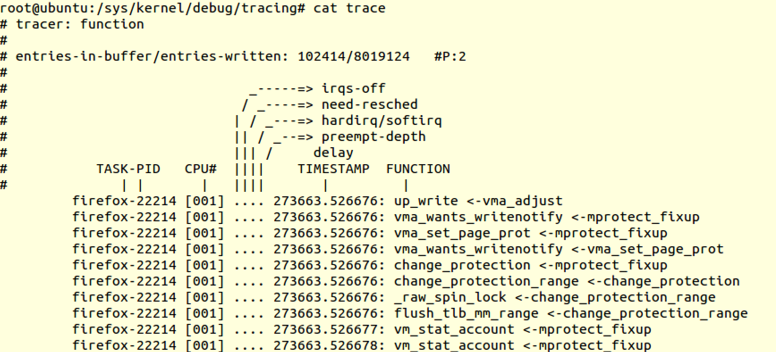
Example: Function Tracer

Slide 20
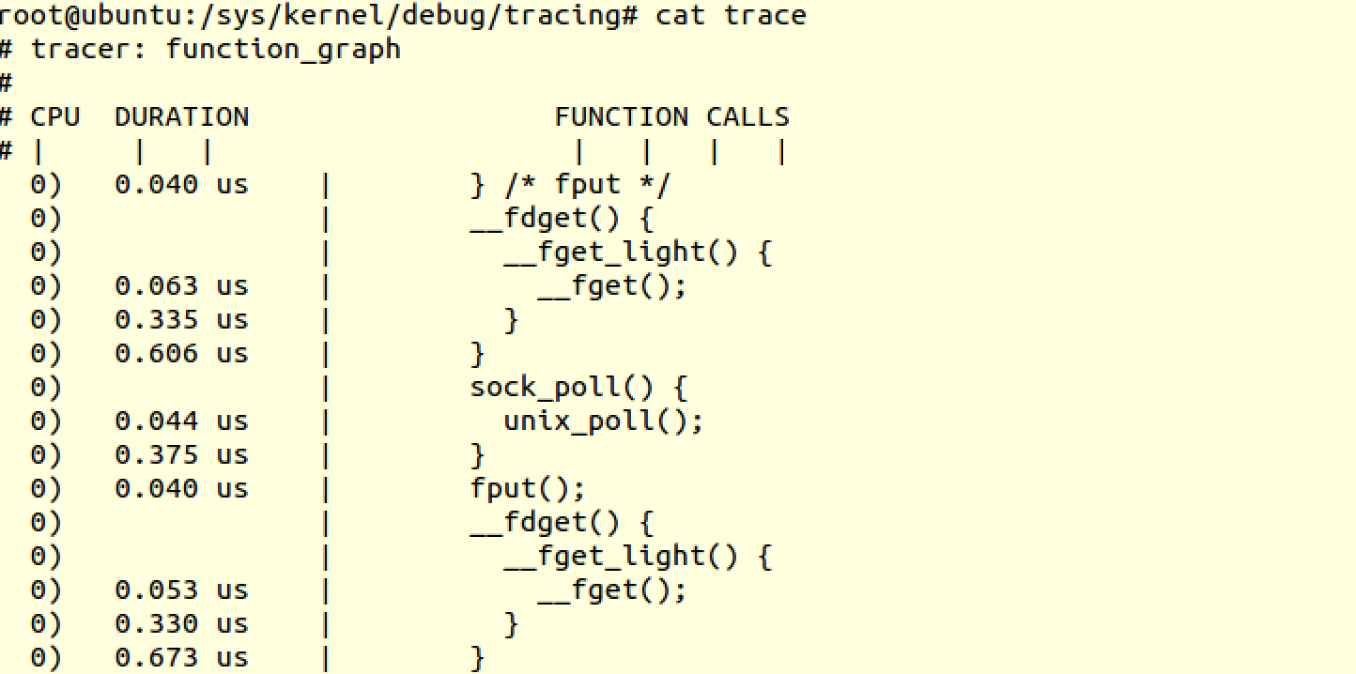
Example: Function Graph Tracer

Slide 21
Tracepoint

Slide 22
Tracepoint
Linux-2.6.32
Define and insert hook in static point like printk()

Slide 23
Tracepoint – Declare Event
#include <linux/tracepoint.h>
TRACE_EVENT(mm_page_allocation,
TP_PROTO(unsigned long pfn, unsigned long free),
TP_ARGS(pfn, free),
TP_STRUCT__entry(
__field(unsigned long, pfn)
__field(unsigned long, free)
),
TP_fast_assign(
__entry->pfn = pfn;
__entry->free = free;
),
TP_printk("pfn=%lx zone_free=%ld", __entry->pfn, __entry->free)
);

Slide 24
Tracepoint – Probe Event
. . .
trace_mm_page_allocation(page_to_pfn(page),
zone_page_state(zone, NR_FREE_PAGES));
. . .
Data recorded: custom defined data

Slide 25
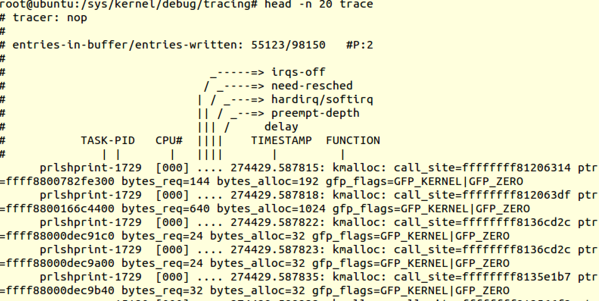
Example: Tracepoint

Slide 26
trace-cmd
# trace-cmd record -e 'sched_wakeup*' -e sched_switch your-application
# kernelshark

Slide 27
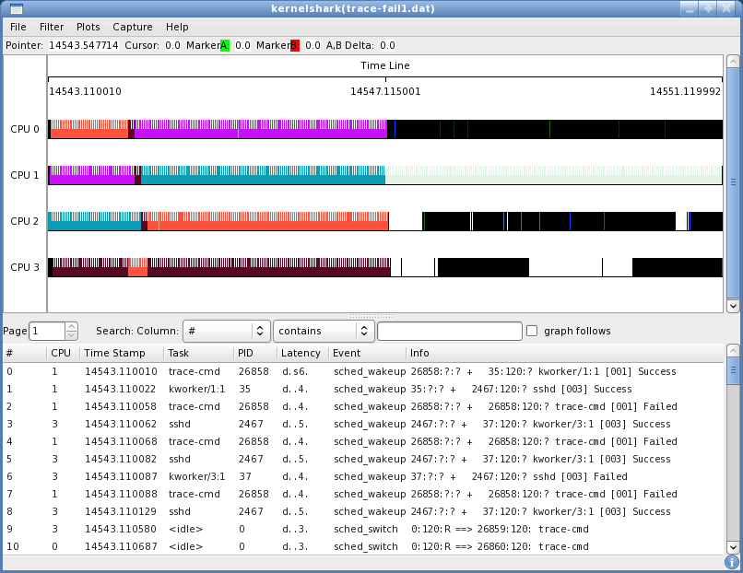
Kernelshark
https://static.lwn.net/images/2011/ks-fail1-open.png

Slide 28
hist triggers
Introduced in Linux-4.7
Create custom, efficient, in-kernel histograms
# echo 'hist:key=common_pid.execname:values=ret:sort=ret if ret >= 0' \
> /sys/kernel/tracing/events/syscalls/sys_exit_read/trigger

Slide 29
Example hist triggers Logs
# cat /sys/kernel/tracing/events/syscalls/sys_exit_read/hist
[...]
{ common_pid: bash [ 16608] } hitcount: 4 ret: 11722
{ common_pid: bash [ 16616] } hitcount: 4 ret: 12386
{ common_pid: bash [ 16617] } hitcount: 4 ret: 12469
{ common_pid: irqbalance [ 1189] } hitcount: 36 ret: 21702
{ common_pid: snmpd [ 1617] } hitcount: 75 ret: 22078
{ common_pid: sshd [ 32745] } hitcount: 329 ret: 165710
[...]
http://www.brendangregg.com/blog/2016-06-08/linux-hist-triggers.html

Slide 30
Kprobe Family

Slide 31
Kprobe
Linux-2.6.9
Write probe hooks in kernel module
Insert
kprobe module
user
kernel
pre()
register_kprobe()
addr
post()

Slide 32
Kprobe
register_kprobe()
address
sym + offset
INST
BREAK

Slide 33
Kprobe
save regs
exception
pre_handler()
BREAK
address
BREAK
INST
post_handler()
restore regs

Slide 34
Kprobe
save regs
exception
pre_handler(pt_regs)
BREAK
address
BREAK
INST
post_handler(pt_regs)
restore regs
Data recorded: CPU register values

Slide 35
Kprobe Variants
Uprobe
user
Kprobe
Kretprobe
Jprobe
Kernel

Slide 36
Uprobe
Linux-3.5
userspace breakpoints in kernel
echo 'p:myapp /bin/bash:0x4245c0' > /sys/kernel/tracing/uprobe_events

Slide 37
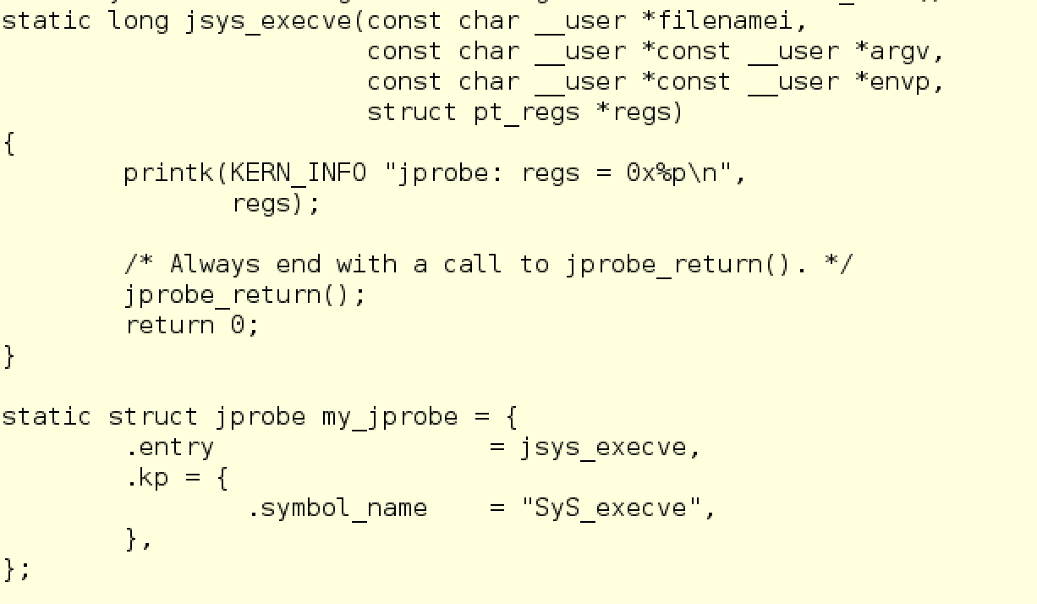
jprobe
data: probed function
arguments

Slide 38
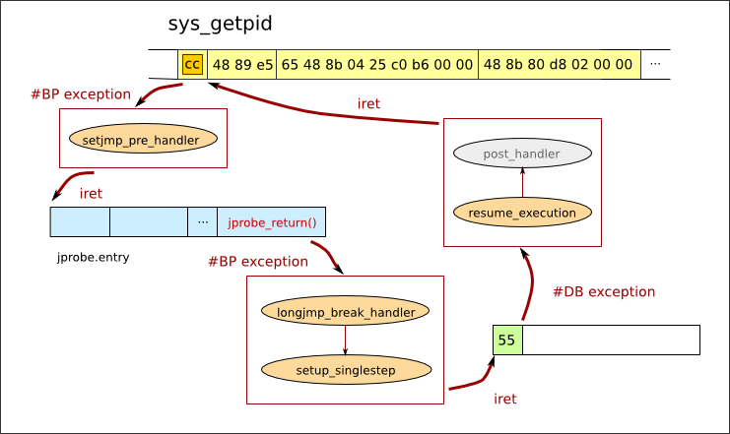
jprobe
http://pds19.egloos.com/pds/201008/02/35/c0098335_4c55a764e1689.png

Slide 39
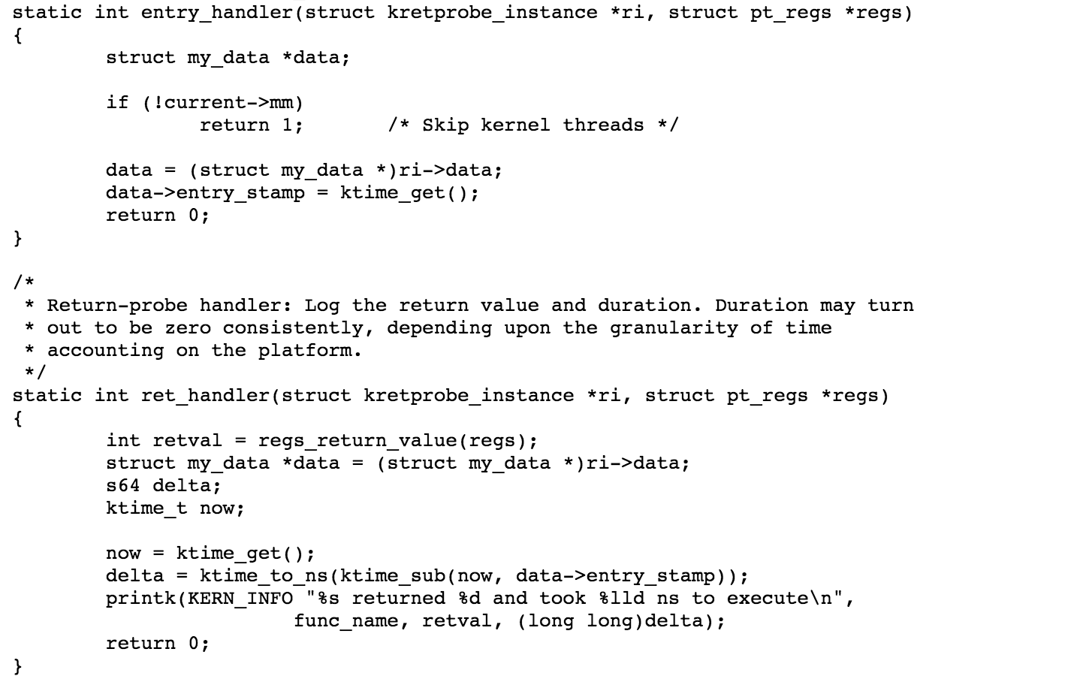
kretprobe

Slide 40
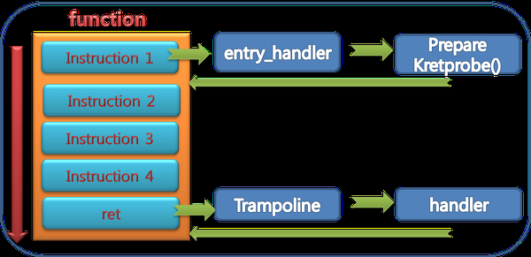
kretprobe
http://cfile26.uf.tistory.com/image/1311D5455136D6AF3B7251

Slide 41
Kprobe Overhead [7]
cycles per iteration
AMD Athlon 1.7GH Pentium III 860MHz
kprobe 0.99 us 0.95 us
jprobe 0.82 us 1.61 us

Slide 42
Kprobe-based Event Tracing
# echo 'r:myretprobe do_sys_open $retval' >> /sys/kernel/tracing/kprobe_events
# echo 1 > /sys/kernel/tracing/events/kprobes/myretprobe/enable
# cat /sys/kernel/tracing/trace
# tracer: nop
#
# TASK-PID CPU# |||| TIMESTAMP FUNCTION
# | | | |||| | |
sh-746 [000] d... 40.96: myretprobe: (SyS_open+0x2c/0x30 <- do_sys_open) arg1=0x3
sh-746 [000] d... 42.19: myretprobe: (SyS_open+0x2c/0x30 <- do_sys_open) arg1=0x3
…..

Slide 43
Utilities for Kprobe
tracefs files
  perf probe
systemtap
  debuted in 2005 in Red Hat Enterprise Linux 4
  Probe by DSL script based on kprobe

Slide 44
Userspace Scripts: systemtap
debuginfo
foo.stp
systemtap
kprobe
tracepoint
syscall
...
foo.ko
output
user
kernel
kprobe, ...
relayfs

Slide 45
perf + Tracing

Slide 46
perf
Linux-2.6.31
Statistics data
# perf stat my-app args
Sampling record
# perf record my-app args
Other sub cmds of perf tool
perf-tool
user
perf_event
perf framework
kernel
PMU
CPU
Performance Monitors

Slide 47
perf Events
perf-tool
user
perf_event syscall
perf framework
HW event
SW event
trace
event
dynamic
event
kernel
PMU
CPU
Counters
trace
point
kprobe
uprobe

Slide 48
perf Events
# perf record -e 'syscalls:sys_enter_*' -a -g -- sleep 60

Slide 49
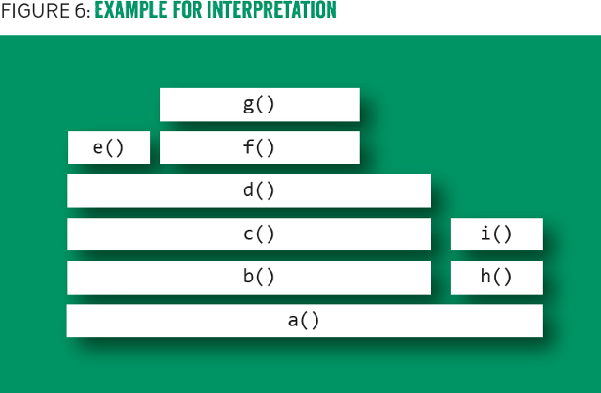
Flame Graph
http://deliveryimages.acm.org/10.1145/2930000/2927301/gregg6.png

Slide 50
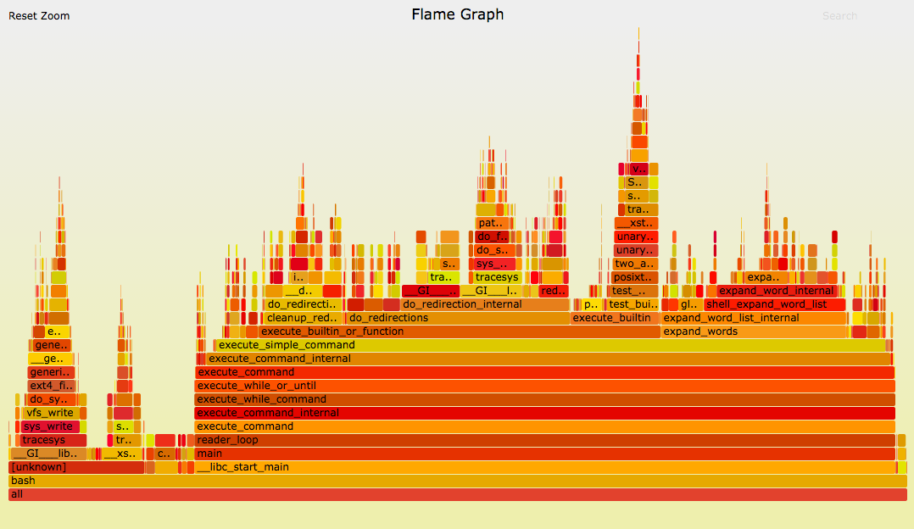
Flame Graph
http://www.brendangregg.com/FlameGraphs/cpu-bash-flamegraph.png

Slide 51
Flame Graph Tools for perf Data
# perf record -F 99 -a -g -- sleep 60
# perf script > out.perf
# /path/to/flamegraph/stackcollapse-perf.pl out.perf > out.folded
# /path/to/flamegraph/flamegraph.pl out.kern_folded > kernel.svg

Slide 52
LTTng

Slide 53
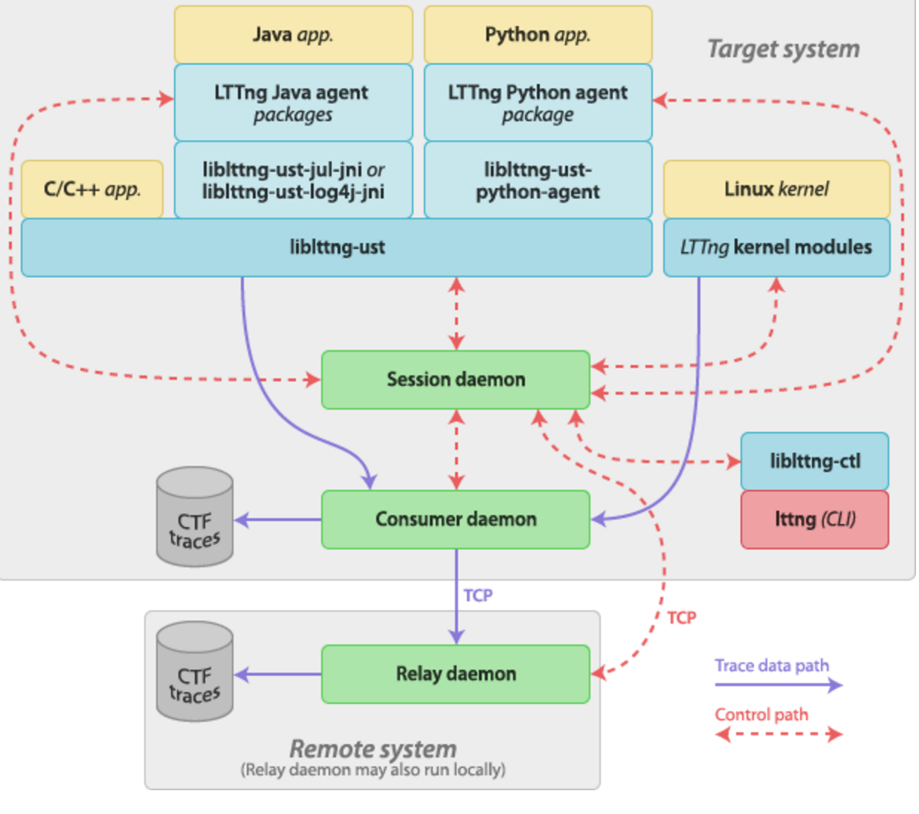
LTTng
http://lttng.org/images/docs27/plumbing-27.png

Slide 54
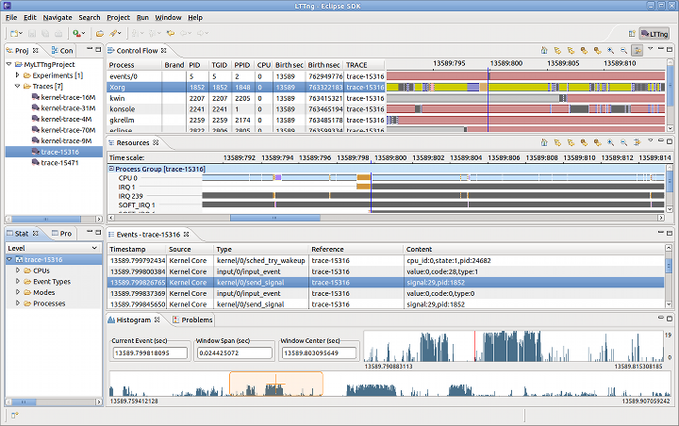
Eclipse LTTng Support
https://wiki.eclipse.org/images/e/ec/LTTngPerspective.png

Slide 55
Disadvantage of
Previous Kernel Tracing
Components are isolated
Complex filters and scripts can be expensive
Need more comprehensive tools. Some solutions
  systemtap
  LTTng
  Dtrace
  ktap

Slide 56
Tracing + eBPF

Slide 57

BPF – In-kernel Packet Filter
tcpdump -nnnX port 3000
Applications
sniffer
user
network
stack
port 3000
kernel
VM filter
(BPF)
net if
http://www.iconsdb.com/icons/download/gray/empty-filter-512.png

Slide 58
eBPF
(Linux-3.15) Re-designed by Alexei Starovoitov
  Write programs in restricted C
    compile to BPF with LLVM
  Just-in-time map to modern 64-bit CPU with minimal performance overhead

Slide 59
Areas Use eBPF more than a filter today
Seccomp filters of syscalls (chrome sandboxing)
Packet classifier for traffic contol
Actions for traffic control
Xtables packet filtering
Tracing
  (Linux-4.1) attach to kprobe
  (Linux-4.7) attach to tracepoint

Slide 60
eBPF Architecture
Tracer
BPF
binary
user
bpf syscall
kernel
verifier
MAP
subsys
BPF_PROG_RUN
BPF
binary
helper
BPF Interpreter/JIT
Other
subsys

Slide 61
Write Customized Tracing Script
Is Possible Now!

Slide 62
eBPF Utilitiy – IO Visor BCC
User
program
Frontend
python, lua
BPF C text/code
BCC module
BCC
libbcc.so
llvm library
BPF bytecode
perf event / trace_fs
bpf syscall

Slide 63
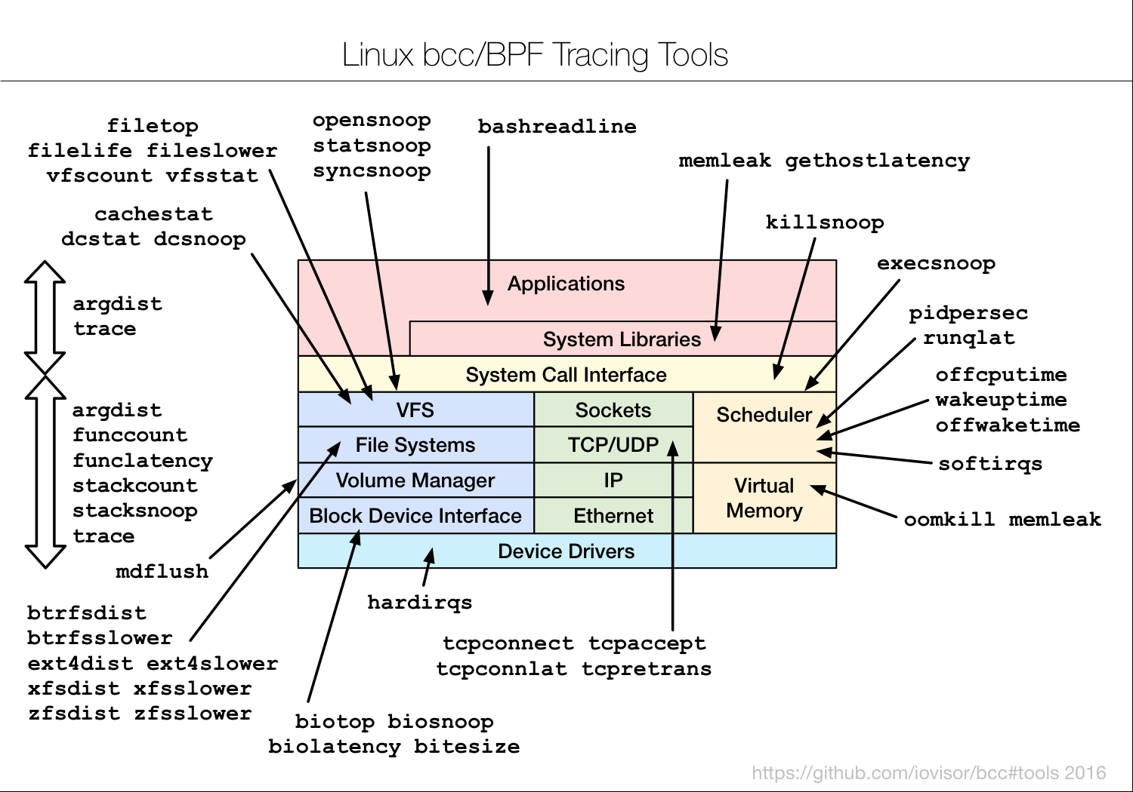
Current Tracing Scripts in BCC
Tools for BPF-based Linux IO analysis, networking, monitoring, and more
https://raw.githubusercontent.com/iovisor/bcc/master/images/bcc_tracing_tools_2016.png

Slide 64
perf + eBPF [8]
Linux-4.8-rc (?) by Wang Nan in Huawei
On-goning staff and future plans
  Load BPF
  Tracing rare outliner
  Integrate LLVM and other frontend

Slide 65
Summary

Slide 66
Linux Kernel Tracing
BCC
Kernelshark
Flamegraph
systemtap
LTTng
eBPF
library
trace-cmd
perf-tool
ftrace, hist trigger, perf, eBPF
function
tracer
tracepoint
kprobe
uprobe

Slide 67
Q & A

Slide 68
Reference
Steven Rostedt (Dec. 2009), “Debugging the kernel using Ftrace - part 1”, LWN
Steven Rostedt (Feb. 2011), “Using KernelShark to analyze the real-time scheduler”, LWN
章亦春, “动态追踪技术漫谈”
Brendan Gregg, (Feb. 2016), "Linux 4.x Performance Using BPF Superpowers", presented at Performance@ scale 2016
Gary Lin (Mar. 2016), “eBPF: Trace from Kernel to Userspace ”, presented at OpenSUSE Technology Sharing Day 2016
Kernel documentation, “Using the Linux Kernel Tracepoints”
William Cohen (Feb. 2005), “cost of kprobe and jprobe operations”, systemtap mailing list
Wang Nan (Aug. 2016), “Performance Monitoring and AnalysisUsing perf+BPF” , LinuxCon North America 2016

Slide 69
Rights to Copy copyright © 2016 Viller Hsiao
COSCUP is the Conference for Open Source Coders, Users and Promoters in Taiwan.
iovisor is a project of Linux Foundation
ARM are trademarks or registered trademarks of ARM Holdings.
Linux Foundation is a registered trademark of The Linux Foundation.
Linux is a registered trademark of Linus Torvalds.
Other company, product, and service names may be trademarks or service marks
of others.
The license of each graph belongs to each website listed individually.
The others of my work in the slide is licensed under a CC-BY-SA License.
  License text: http://creativecommons.org/licenses/by-sa/4.0/legalcode

Slide 70
THE END

