Slide 1
TWLKH:
Linux vsyscall and vDSO
Viller Hsiao <villerhsiao@gmail.com>
Jan. 24, 2017

Slide 2
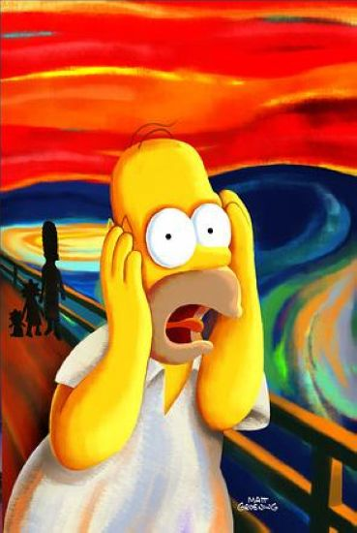
Who am I ?
Viller Hsiao
Embedded Linux / RTOS engineer
http://image.dfdaily.com/2012/5/4/634716931128751250504b050c1_nEO_IMG.jpg

Slide 3
Recall to sigreturn
x86_64
(gdb) info symbol __restore_rt
__restore_rt in section .text of /lib/x86_64-linux-gnu/libc.so.6
arm64
(gdb) info symbol __kernel_rt_sigreturn
__kernel_rt_sigreturn in section .text of system-supplied DSO at 0x7fb7ffd000
What is system-supplied DSO?

Slide 4
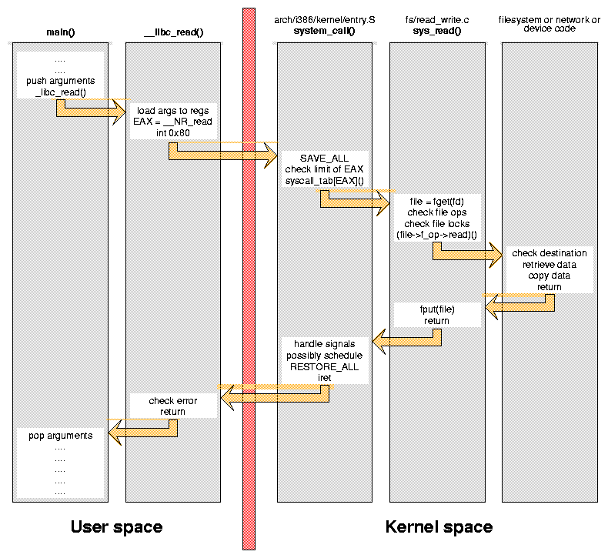
Linux syscall
http://www.linux.it/~rubini/docs/ksys/ksys-figure1.png

Slide 5
Making syscall Can Be Slow
“In x86 32-bit systems, you can trigger a software interrupt (int $0x80) to tell the kernel you wish to make a system call. However, this instruction is expensive: it goes through the full interrupt-handling paths in the processor's microcode as well as in the kernel.” ~ [1]

Slide 6
vsyscall [2]
Virtual system call
maps into user space a page containing
some variable and the implementation of some syscalls.
Only apply to safe syscalls (only read a variable)
  gettimeofday()
  time()
  getcpu()

Slide 7
Limitations & Problems of vsyscall
The memory allocated is small
Allows only 4 system calls
Statically allocated to the same address in each process

Slide 8
vDSO
virtual ELF dynamic shared object
  A small shared library that the kernel automatically maps into the address space of all user-space applications.
  Get benifit of address space layout randomization (ASLR)

Slide 9
vDSO Library
user ABI vDSO name
─────────────────────────────
aarch64 linux-vdso.so.1
arm linux-vdso.so.1
ia64 linux-gate.so.1
mips linux-vdso.so.1
ppc/32 linux-vdso32.so.1
ppc/64 linux-vdso64.so.1
s390 linux-vdso32.so.1
s390x linux-vdso64.so.1
sh linux-gate.so.1
i386 linux-gate.so.1
x86_64 linux-vdso.so.1
x86/x32 linux-vdso.so.1

Slide 10
Functions in vDSO
x86_64
symbol version
─────────────────────────────────
__vdso_clock_gettime LINUX_2.6
__vdso_getcpu LINUX_2.6
__vdso_gettimeofday LINUX_2.6
__vdso_time LINUX_2.6
arm64
symbol version
──────────────────────────────────────
__kernel_rt_sigreturn LINUX_2.6.39
__kernel_gettimeofday LINUX_2.6.39
__kernel_clock_gettime LINUX_2.6.39
__kernel_clock_getres LINUX_2.6.39

Slide 11
Now We Know from [1],
vDSO
  Emulate fast syscall
  Provided by kernel, then mapped to userspace
  Loaded by ELF loader
  soname and syscall naming

Slide 12

But, More Questions
How kernel generates ld-linux.so.1?
How userspace access kernel data structure?
Where is the page mapped to?
How to write a vsyscall?
How glibc handle it?
https://c2.staticflickr.com/8/7133/7623744452_7222654f38_b.jpg

Slide 13
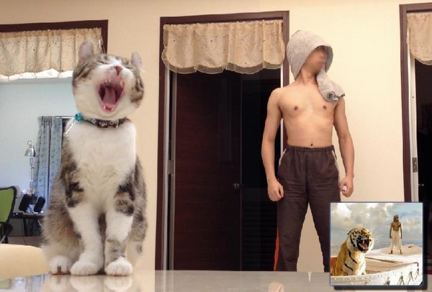
Let's Go to Find the Answers
http://cdn2.ettoday.net/images/210/d210416.jpg

Slide 14
MMAP of vDSO
vDSO man page says that we can get vDSO address from ELF auxiliary vector
  What is ELF auiliary vector?
/* vdso man page */
void *vdso =
(uintptr_t) getauxval(AT_SYSINFO_EHDR);

Slide 15
execve and Load ELF
execve
Check and open an interpreter
Setup virtual memory
Setup stack
Setup credentials
…
LWN: How programs get run[4]
search_binary_handler
load_elf_binary
start_thread

Slide 16
ELF Auxiliary Vector
load_elf_binary()
Open ELF interpreter
setup stack
args[], auxv[], env[]
create_elf_tables()

Slide 17
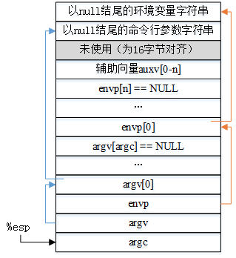
Final View in Stack
http://www.cnblogs.com/chenwu128/p/4194638.html

Slide 18
AT_SYSINFO_EHDR
load_elf_binary()
Open ELF interpreter
setup stack
args[], auxv[], env[]
arch_setup_additional_pages()
mm->context.vdso
create_elf_tables()
ARCH_DLINFO
AT_SYSINFO_EHDR=
current->mm->context.vdso

Slide 19
vDSO Source in Kernel
Linux/arch/arm64
kernel/vdso.c
kernel/vdso/
gettimeofday.S
sigreturn.S
vdso.lds.S
vdso.S

Slide 20
Manipulate linux-vdso.so.1
Linux/arch/arm64
kernel/vdso.c
kernel/vdso/
gettimeofday.S
vdso.so.dbg
linux-vdso.so.1
sigreturn.S
vdso.lds.S
objcopy -S
vdso.S
vdso.so
incbin

Slide 21
Example of Accessing vdso_data
Application
__kernel_gettimeofday
vdso_data
Readonly mapping
update_vsyscall()
vdso_data
update
timekeeping_update()

Slide 22
arch_setup_additional_pages()
[vvar]
vdso_data
mm->context.vdso
vdso_base
[vdso]
vdso.so
vdso text bin
AT_SYSINFO_EHDR
Process VM space

Slide 23
vDSO Handling in
Glibc Dynamic Linker/Loader

Slide 24
Related Operations
Read AT_SYSINFO_EHDR value
Read vDSO symbols address
vDSO functions wrapper

Slide 25
Load ELF Auxiliary Vector [6]
_start() of ld.linux.so.1
_dl_start()
_dl_sysdep_start()
Setup
_dl_argc
_dl_argv
_envrion
_dl_auxv

Slide 26
Read Symbols
_init()
_libc_vdso_platform_setup()

Slide 27
gettimeofday() Implementation
__gettimeofday()
__vdso_gettimeofday == NULL
__vdso_gettimeofday
!= NULL
syscall version
__vdso_gettimeofday()

Slide 28
Q & A

Slide 29
Questions
How is gettimeofday implemented in static linked application?
  Is there vDSO in static linked application?
vDSO functions in RISC-V?
Why does some architecure implement rt_sigreturn in vDSO?
Why does fix-mapped vsyscall be so dangerous?
Why are vDSO functions implemented in assembler instead of C ?
What's the purpose of vDSO seqcount?

Slide 30
Reference
Linux Programmer's Manual - VDSO(7)
Adrien schischi Schildknecht (Mar. 2014), “vsyscall and vDSO”
The Definitive Guide to Linux System Calls
David Drysdale (Feb. 2015), “How programs get run: ELF binaries“, LWN
Kevin Brodsky (Nov. 2016), “The vDSO on arm64”, Linux Plumbers Conference
Linux程序的加载、运行和终止

Slide 31
Rights to Copy copyright © 2017 Viller Hsiao
Taiwan Linux Kernel Hackers (TWLKH) is the Facebook group about Linux kernel development
ARM are trademarks or registered trademarks of ARM Holdings.
Linux is a registered trademark of Linus Torvalds.
Other company, product, and service names may be trademarks or service marks
of others.
The license of each graph belongs to each website listed individually.
The others of my work in the slide is licensed under a CC-BY-SA License.
  License text: http://creativecommons.org/licenses/by-sa/4.0/legalcode

Slide 32
THE END

