Slide 1
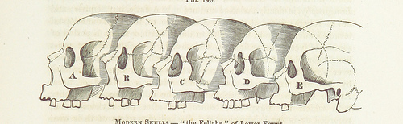
F9 Microkernel ktimer
Viller Hsiao
villerhsiao@gmail.com

Slide 2
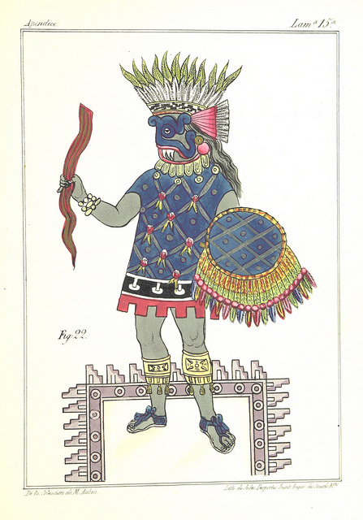
Agenda
Concept about operation system time subsystem
F9 Microkernel ktimer introduction

Slide 3
Concept about Operation System Time Subsystem

Slide 4
OS Time Subsystem
Current Time
  System time, UTC/GMP time, … etc
Alarm, the time event
Process timeslice
Timeout
Time delay

Slide 5
System Time and Tick
“System time represents a computer system's notion of the passing of time.“
“System time is measured by a system clock, which is typically implemented as a simple count of the number of ticks that have transpired since some arbitrary starting date, called the epoch.”
~ from WIKIPEDIA

Slide 6
How Is Tick Implemented?
Hardware time device
  Assert interrupt after a programmable inteval
    Handling tick stuff in timeout Interrupt Service Routine (ISR)
  Two types
    Incremental: ARMv7A generic timer
    Counting down: STM32F4DISCOVERY SYSTICK

Slide 7
How Is Tick Implemented? (cont.)
Timeout ISR
  Increase system ticks
  Execute handler of timeout event
  Re-schedule if required

Slide 8
Time Diagram of Ticks
event2
event1
event3
event4
Timer
interrupt
CPU
activities

Slide 9
Where Is the Problem?
Context switch overhead
Unecessary power consumed
Tick resolution
  Performance, power v.s. timer precision

Slide 10
Solution: Tickless
event2
event1
event3
event4
Timer
interrupt
New
CPU
activities
Previous
CPU
activities

Slide 11
Example: Linux Timer Subsystem
Device level
  Clock source
    jiffies
  Clock event
Hrtimer
Tickless
  CONFIG_NO_HZ

Slide 12
F9 Microkernel ktimer Introduction

Slide 13
Features
System time
Time event
Tickless

Slide 14
Configurations
CONFIG_KTIMER_HEARTBEAT
  HW cycles per ktimer tick
CONFIG_KTIMR_MINTICKS
  Minimum ktimer ticks unit for time event
CONFIG_KTIMER_TICKLESS
  Enable tickless

Slide 15
ktimer Event Utility
ktimer_event_create
  Arguments
    Timeout ticks
    Timeout handler
    Pointer to arguments for timeout handler
  Return Non-zero to reschedule event again
    Freed automatically if not be re-scheduled

Slide 16
Anotomy
System time
  ktime_now
ktimer event list
  event_queue
  Managed by ktable

Slide 17
Anotomy (Cont.)
Life cycle of time event
  One-shot
  Continuous
  Controlled by return value of handler

Slide 18
Anotomy (Cont.)
HW Timer ISR
  __ktimer_handler()
    Increase tick
    Arrange Softirq for handling timer events

Slide 19
Anotomy (Cont.)
HW timer softirq handler
  ktimer_event_handler()
    Find timeout event and executing its handler
    Re-insert event if required

Slide 20
Anotomy (Cont.)
Tickless
  Enter tickless right before going to CPU idle state
  Set interval of next timer interrupt as delta of next event
    Or KTIMER_MAXTICKS
  Adjust system time after wake up

Slide 21
Q & A

Slide 22
THE END

