Slide 1
Yet Another Introduction to
Linux RCU
Viller Hsiao <villerhsiao@gmail.com>
May. 14, 2015

Slide 2

Who am I ?
Viller Hsiao
Embedded Linux / RTOS engineer
http://image.dfdaily.com/2012/5/4/634716931128751250504b050c1_nEO_IMG.jpg

Slide 3

Presented For HCSM
http://www.anec.com/assets/images/call_before_you_dig.jpg

Slide 4
What is RCU ?
Read-Copy Update
A kind of read/write synchronization mechanism

Slide 5
Agenda
Synchronization inside Linux
RCU basic operations
Linux RCU internal

Slide 6
Synchronization inside
Linux Kernel

Slide 7
R/W Synchronization in SMP System
Protect Shared data from concurrent access
Synchronization mechanism
  atomic operation
  spinlock
  reader-writer spinlock (rwlock)
  seqlock
  RCU

Slide 8
Atomic Operation
Operations that read and change data within a single, uninterruptible step
Architecture support
  test-and-set (TSR)
  compare-and-swap (CAS)
  load-link/store-conditional (ll/sc)

Slide 9
spinlock
Implement by mutual exclusive
Owner 1
sp
in
read
u
spin
update
u
Owner 2
spin
read
u
Owner 3
spin
update
u

Slide 10
rwlock
Allow multi reader
Mutual exclusive between reader and writer
Reader1
sp
in
read
u
spin
read
u
Reader2
sp
in
u
spin
read
spin
read
u
Reader3
sp
in
read
u
spin
read
u
Writer
spin
update
u

Slide 11
seqlock
Consistent mechanism without starving writers.
Start with even seq
Same seq with start point
seq = 0
seq = 2
seq = 2
Reader
First trial
Retry
Writer
Update data
seq = 1
seq = 2

Slide 12
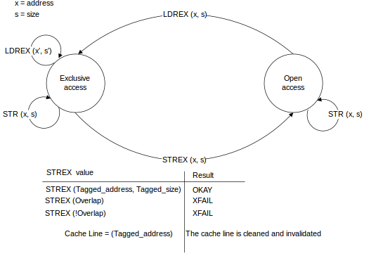
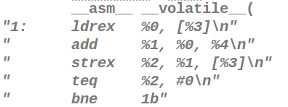
Architecture Support – Atomic Ops
Load-link store-conditional
    e.g. ARMv7 ldrex/strex
http://infocenter.arm.com/help/topic/com.arm.doc.ddi0360f/graphics/exclusive_monitor_state_machine2.svg

Slide 13
Architecture Support – Barrier
Optimization in modern computer architecture
  Optimizing compilers
  Multi-issuing
  Out-of-Order Execution
  Load/Store optimization
  … etc
CPU 1 CPU 2
====== =======
{ A = 1; B = 2 }
A = 3; x = B;
B = 4; y = A;

Slide 14
Architecture Support – Barrier (Cont.)
Compiler barrier
CPU barrier instructions
  Ensure the order of some operations
  e.g. dmb/dsb/isb, ldar/stlr
void foo()
{
A = B + 1;
asm volatile("" ::: "memory");
B = 0;
}

Slide 15
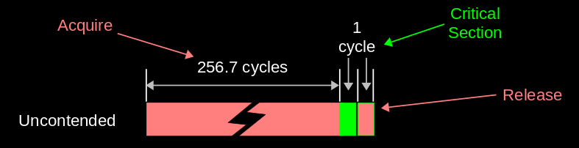
The problem
Bad in scalability and performance
  Multiple CPUs to break even with single CPU
http://www.rdrop.com/~paulmck/RCU/RCU.2014.05.18a.TU-Dresden.pdf

Slide 16
RCU Basic Operation

Slide 17
RCU Operations – Read
Blocking/preemption within an RCU read-side critical section is illegal
rcu_read_lock();
p = rcu_dereference(gp); /* p = gp */
if (p != NULL) {
c do_something(p->a, p->b);
}
rcu_read_unlock();
Read side
Critical section

Slide 18
RCU Operations – Update & Reclaim
Maintain multiple version of recently updated object
Spinlock is acquired if multiple udpater
q = kmalloc(sizeof(*q), GFP_KERNEL);
q->a = 1;
q->b = 2;
rcu_assign_pointer(gp, q); /* gp = q */
synchronize_rcu(); /* call_rcu (&callbacks()) */
kfree(p);
Removal
(Updater)
Reclaimer

Slide 19
RCU Primitives
preempt-disable
only if
preemptible kernel
rmb only on
DEC alpha
READER
rcu_dereference()
rcu_assign_pointer()
rcu_read_lock()
rcu_read_unlock()
wmb
UPDATER
RECLAIMER
call_rcu()
synchronize_rcu()
Re-painted from [13]

Slide 20
Quiz: Why does it improve scalability in read side?

Slide 21
Why RCU is better?
Almost nothing in read side lock (non preempt kernel)
static inline void rcu_read_lock(void)
{
__asm__ __volatile__("": : :"memory");
(void) 0;
do { } while (0);
do { } while (0);
}
Real content of rcu_read_lock() after preprocessor. (! PREEMPT)

Slide 22
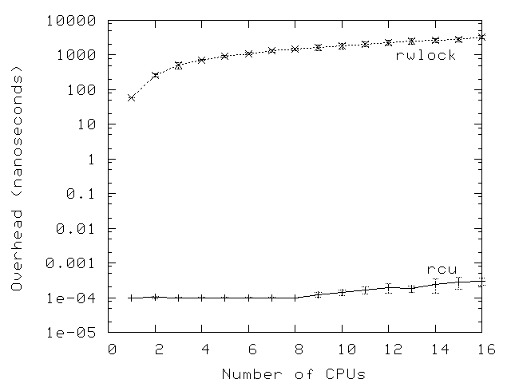
Read side Lock Overhead Comparison
http://lwn.net/images/ns/kernel/rcu/rwlockRCUperf.jpg

Slide 23
What's the benifit?
Zero-overhead and wait-free in read side
  No memory barrier is required
  No lock is required
  Allow recursive lock
  No deadlock between readers and writer

Slide 24
RCU List APIs [10]
Operations | list Circular doubly linked list | hlist Linear doubly linked list
Initialization | INIT_LIST_HEAD_RCU()
Full traversal | list_for_each_entry_rcu() | hlist_for_each_entry_rcu() hlist_for_each_entry_rcu_bh() hlist_for_each_entry_rcu_notrace()
Resume traversal | list_for_each_entry_continue_rcu() | hlist_for_each_entry_continue_rcu() hlist_for_each_entry_continue_rcu_bh()
Stepwise traversal | list_entry_rcu() list_first_or_null_rcu() list_next_rcu() | list_first_rcu() hlist_next_rcu() hlist_pprev_rcu()
Add | list_add_rcu() list_add_tail_rcu() | hlist_add_after_rcu() hlist_add_before_rcu() hlist_add_head_rcu()
Delete | list_del_rcu() | hlist_del_rcu() hlist_del_init_rcu()
Replacement | list_replace_rcu() | hlist_replace_rcu()
Splice | list_splice_init_rcu()

Slide 25
RCU Model
Reader
Reader
Reader
Reader
Reader
Reader
Reader
Reader
Reader
Removal
Reclamation
Grace Period
Repainted from https://lwn.net/images/ns/kernel/rcu/GracePeriodGood.png

Slide 26
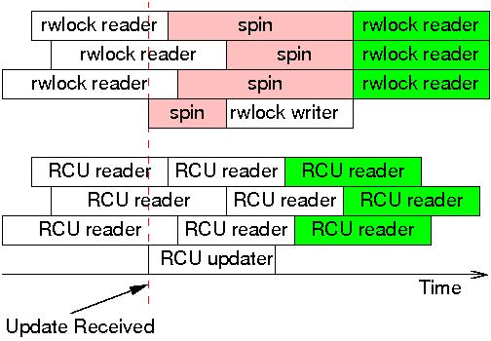
RCU vs rwlock
RCU has lower overhead and better scalability
RCU readers see updated data faster
rwlock readers get the consistent data after writer updated
c
https://lwn.net/Articles/263130/

Slide 27
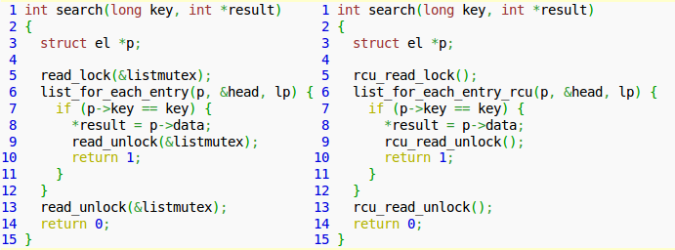
Replace rwlock by RCU[13]
http://en.wikipedia.org/wiki/Read-copy-update

Slide 28
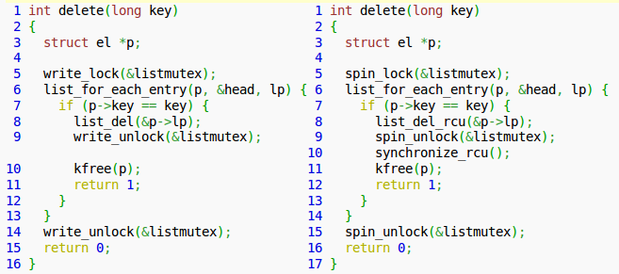
Replace rwlock by RCU[13]
http://en.wikipedia.org/wiki/Read-copy-update

Slide 29
What is RCU, again
Read-Copy Update
A kind of read-write synchronization mechanism
A publish-subscribe mechanism[5]
A poor man's garbage collector[5]

Slide 30
But
Quiz: How does reclaimer know the time to release old object?

Slide 31
Linux RCU Internal

Slide 32
History and Contributors[9][13]
1980 H. T. Kung and Q. Lehman
  use of garbage collectors to defer destruction of nodes in a parellel binary search tree.
1986, Hennessy, Osisek, and Seigh
  Passive serialization, which is an RCU-like mechanism that relies on the presence of "quiescent states" in the VM/XA hypervisor
1995 J. Slingwine and P. E. McKenney
  US Patent 5,442,758, implement RCU in DYNIX/ptx kernel.
2002, D. Sarma
  added RCU to version 2.5.43 of the Linux kernel
2005, P. E. McKenney
  Permitting preemption of RCU realtime critical sections
2009, P. E. McKenny
  Introduce user-level RCU implementation
Work of P. E. McKenney, Mathieu Desnoyers, Alan Stern, Michel Dagenais, Manish Gupta, Maged Michael, Phil Howard, Joshua Triplett, Jonathan Walpole, and the Linux kernel community

Slide 33
The Problem
How can we know when it's safe to reclaim
memory without paying too high a cost?
  especially in the read path
  Possible implementation
    Reference count
    Hazard pointer
~ The page is extracted and tweaked from [14]

Slide 34

Lock-based Synchronization Model
Reader 1
Reader n
Reader 1
Reader n
Reader 1
Reader n
Obj 1
Obj n
Updater 1
Update n
<lock icon url>

Slide 35
RCU Synchronization Model
Reader 1
Reader 2
Reader n
Reader 1
Reader 2
Reader n
Reader 1
Reader 2
Reader n
Updater 1
Update 2
Update n
RCU Core
Reclaimer 1
Reclaimer 2
Reclaimer n

Slide 36
Terms
Recall that constraint of read side critical section operations
  Non-blocked inside read lock (!PREEMPT)
  Non-preempted (PREEMPT)
  Irq disable, bh disable imply read side critical section

Slide 37
Terms – Grace Period
Reader
Reader
Reader
Reader
Reader
Reader
Reader
Reader
Reader
Removal
Reclamation
Grace Period
Repainted from https://lwn.net/images/ns/kernel/rcu/GracePeriodGood.png

Slide 38
Terms – Quiescent State
Period outside the read critical section
  It implies complete of one grace period in its CPU
Reader
Reader
Reader
Quiescent State

Slide 39
Toy RCU Implementation
#define rcu_read_lock()
#define rcu_read_unlock()
#define rcu_dereference(p) \
({ \
typeof(p) _p1 = (*(volatile typeof(p)*)&(p)); \
smp_read_barrier_depends(); \
_p1; \
})
Read
#define rcu_assign_pointer(p, v) \
({ \
smp_wmb(); \
(p) = (v); \
})
void synchronize_rcu(void)
{
int cpu;
for_each_online_cpu(cpu)
run_on(cpu);
}
Update

Slide 40
RCU Core State
CPU 0: call_rcu(cb)
list 0
cb
cb
cb
list 1
cb
cb
cb
RCU State
list n
cb
cb
cb
Quiescent State Recorder
CPU 0
CPU 1
CPU n

Slide 41
Quiescent State
Condition of quiescent state
  Context switch
  Dynticks or idle
  User mode execution
Check RCU state and execute RCU operations in system background

Slide 42
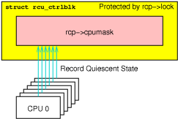
RCU Implementation – Classical RCU
a.k.a tiny RCU
  Single data structure to record Quiescent State
  Scalability is not good for large numbers of CPUs, e.g. 4096 CPUs
http://lwn.net/Articles/305782/

Slide 43
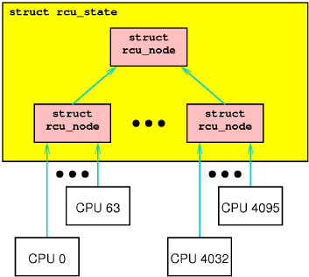
RCU Implementation – Hirarchical RCU
a.k.a tree RCU
  Towards a more scalable RCU implementation
  Default solution in Linux kernel
http://lwn.net/Articles/305782/

Slide 44
Tree RCU Core – List Operations
CPU x
call_rcu(cb)
nxtlist
cb0
cb1
cb2
cbx
cb
CPUx
RCU Data
DONE
TAIL
WAIT
TAIL
NEXT READY
TAIL
NEXT
TAIL
gpnum
complete
Next
Complete
(DONE)
Next
Complete
(WAIT)
Next
Complete
(NXTRDY)
Next
complete
RCU State /
RCU Node
gpnum
complete
gpnum
complete

Slide 45
Tree RCU Core – System Components
Updater
tick_handle_periodic
Pass QSs
call_rcu()
rcu_check_callback()
rcu_bh_qs()
rcu_sched_qs()
Put callback
into list
invoke_rcu_core()
RCU SOFTIRQ
Call callback
invoke_rcu_core()
rcu_process_callbacks()
rcu_do_batch()
rcu_gp_kthread_invoke()
rcu_gp_kthread
Process GP

Slide 46
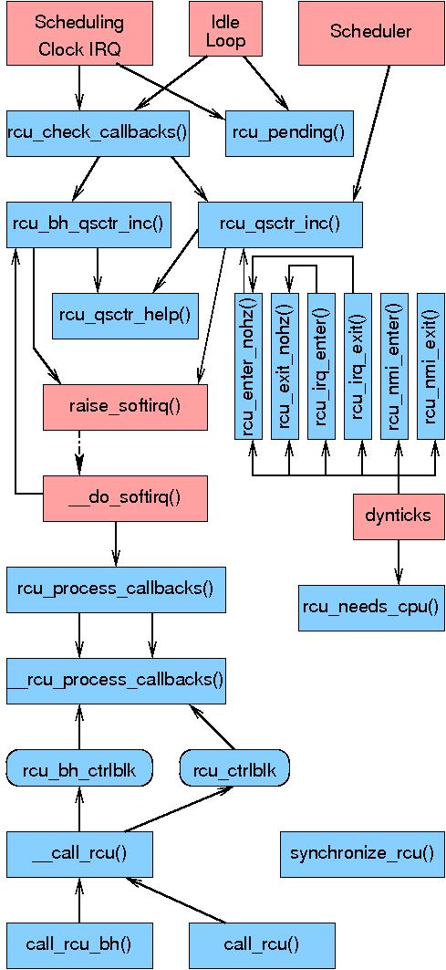
Tree RCU Core
http://lwn.net/images/ns/kernel/brcu/RCUbweBlock.png

Slide 47
RCU state: rcu-sched vs rcu-bh
What the #$I#@(&!!! is RCU-bh For???
  Ran a DDoS workload that hung the system
    Load was so heavy that system never left irq!!!
  No context switches, no quiescent states, no grace periods
    Eventually, OOM!!!
Dipankar created RCU-bh
  Additional quiescent state in softirq execution
  Routing cache converted to RCU-bh, then withstood DDoS”
~ The page is extracted from [8]

Slide 48
Condition of Quiescent State
rcu_sched
  Context switch
  Dynticks or idle
  User mode execution
rcu_bh
  Any code outside of softirq with interrupt enabled

Slide 49
Condition of Quiescent State
When to check it?
  Scheduler
  __do_softirq()
  Scheduler clock interrupt handler
    rcu_check_callbacks()

Slide 50
RCU Stall[16]
Possiblility of memory leak if it takes a long grace period
  Force Quiescent state
Part of conditions of which RCU stall happened
  Documentation/RCU/stallwarn.txt
  A CPU looping in an RCU read-side critical section.
  A CPU looping with interrupts disabled. This condition can result in RCU-sched and RCU-bh stalls.
  A CPU looping with preemption disabled. This condition can result in RCU-sched stalls and, if ksoftirqd is in use, RCU-bh stalls.
  A CPU looping with bottom halves disabled. This condition can result in RCU-sched and RCU-bh stalls.

Slide 51
Topic – Sleepable RCU[2]
Blocking or sleeping of any sort is strictly prohibited in classical RCU. This has frequently been an obstacle to the use of RCU
Implement the sleepable RCU (SRCU) that permits arbitrary sleeping (or blocking) within RCU read-side critical sections.

Slide 52
Topic – Userspace RCU[7]
Use cases
  LTTng
  Atomic operation API utilities
  Barrier
  URCU protected hash
  URCU stack/queue API

Slide 53
Other Topics
Dynticks
  When some CPU is sleeping in dynticks mode
    Waking up CPU for quiescent state consumes power
    Extened its quiescent state
Use RCU in kernel module
CPU hotplugs
nocb
realtime
  RCU priority boost

Slide 54
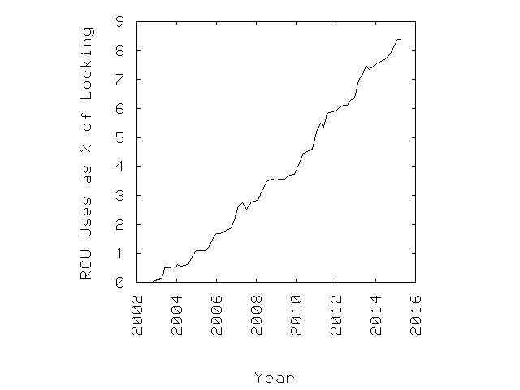
RCU Uses in Linux Kernel
http://www2.rdrop.com/~paulmck/RCU/linuxusage.html

Slide 55
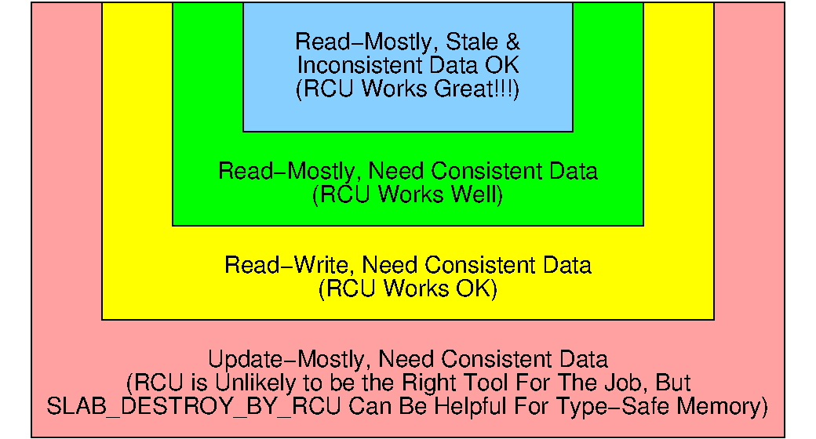
What is RCU's Area of Applicability?
Choose the suitable mechanism for your application
https://www.kernel.org/pub/linux/kernel/people/paulmck/Answers/RCU/RCUAreaApp.html

Slide 56
Q & A

Slide 57
Reference
McKenney, Paul E., “Introduction to RCU”
McKenney Paul E. (Oct. 2006), “Sleepable RCU”, LWN
McKenney Paul E. (Feb. 2007), “Priority-Boosting RCU Read-Side Critical Sections”, LWN
McKenney, Paul E.; Walpole, Jonathan (Dec. 2007), “What is RCU, Fundamentally?”, LWN.
McKenney Paul E. (Dec. 2007), “What is RCU? Part 2: Usage”, LWN.
McKenney Paul E. (Dec. 2008), “Hierarchical RCU”, LWN.
McKenney Paul E. (Nov. 2013), “User-space RCU”, LWN
McKenney, Paul E. (Sep. 2009), “RCU and Breakage ”, presented to Netconf 2009
McKenney, Paul E. (May 2014), “What Is RCU? ”, presented to TU Dresden Distributed OS class
Jake (Sep. 2014), "The RCU API tables", LWN.
Wiki: “Load-link/store-conditional”
Wiki: “Memory Barrier”
Wiki: “Read-Copy Update”

Slide 58
Reference (Cont.)
杨燚, (Jul. 2005), “Linux 2.6内核中新的锁机制--RCU“, IBM Developer Work
Leiflindholm, (Mar. 2011), “Memory access ordering - an introduction”, ARM Connected Community
Walpole, Jonathan (2014), “CS510 Concurrent Systems: What is RCU, Fundamentally?”
“What is RCU's Area of Applicability?”
All Linux kernel documentations under Documentation/RCU/

Slide 59
Rights to Copy copyright © 2015 Viller Hsiao
ARM are trademarks or registered trademarks of ARM Holdings.
DYNIX (short for DYNamic unIX) is an operating system developed by Sequent Computer Systems.
Linux is a registered trademark of Linus Torvalds.
The RCU, spinlock, seqlock are the joint work of its maintainers and the Linux kernel community.
HCSM is the community of Hsinchu Coders in Taiwan.
Other company, product, and service names may be trademarks or service marks
of others.
The license of each graph belongs to each website listed individually.
The others of my work in the slide is licensed under a CC-BY-SA License.
  License text: http://creativecommons.org/licenses/by-sa/4.0/legalcode

Slide 60
THE END

