Slide 1
Introduction to mbed-OS uvisor
Viller Hsiao <villerhsiao@gmail.com>
Oct. 18, 2015

Slide 2

Who am I ?
Viller Hsiao
Embedded Linux / RTOS engineer
http://image.dfdaily.com/2012/5/4/634716931128751250504b050c1_nEO_IMG.jpg

Slide 3
mbed OS
ARM® mbed™ OS is an open source embedded operating system designed specifically for the "things" in the Internet of Things (IoT). [1]

Slide 4
mbed OS
Modulized packages
Managed by yotta

Slide 5
mbed-OS uvisor
self-contained software hypervisor that
  creates independent secure domains on ARM Cortex-M3 and M4 microcontrollers
  Like a sandbox
  Still in beta version now

Slide 6
Modules Relationship
User links objects in uvisor-lib module
uvisor module contains full source
uvisor
uvisor-lib
application
module
compile
object
Full
uvisor
source
Linked
uvisor
object

Slide 7
uvisor Funtionalities
Protect resources
Secure function call
Low level APIs
  Interrupt management
  register level security [4]

Slide 8
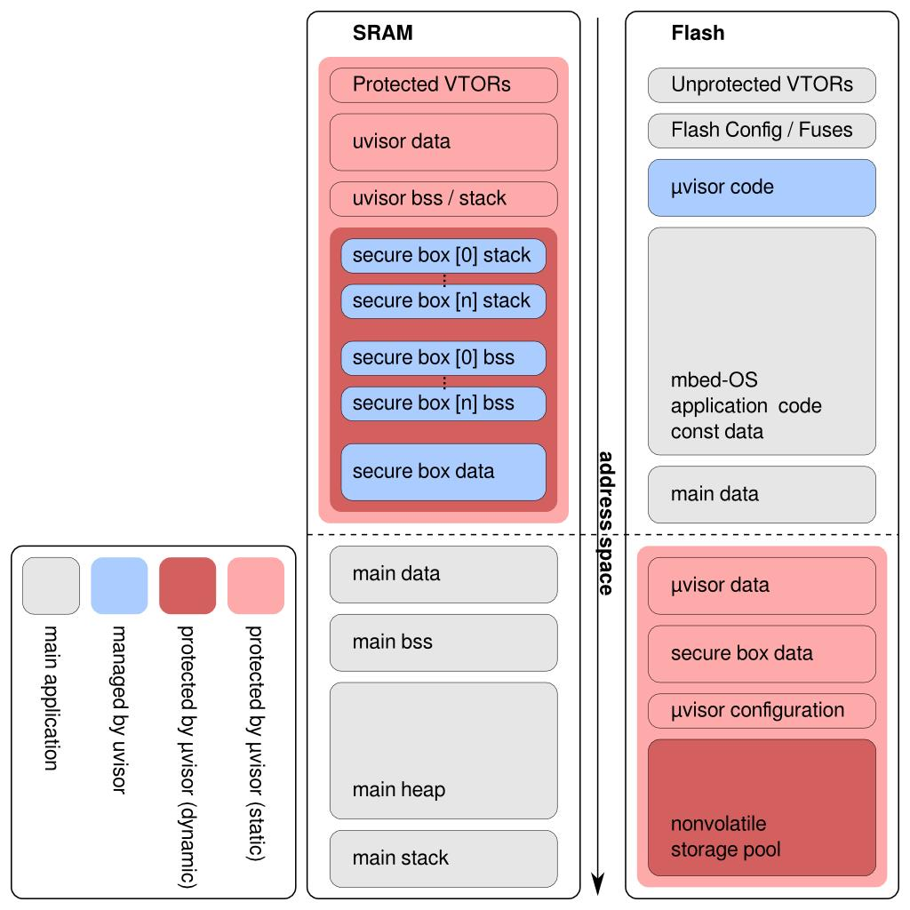
Memory Layout under uvisor
https://github.com/ARMmbed/uvisor/blob/master/k64f/docs/memory_layout.png

Slide 9
Protect Resources
Access Control Lists (ACLs)
Private box contexts
Box 2
Box 1
Box n
Access not permitted
uvisor
RAM
I2C
FLASH
TIMER
UART
Box n
context
Box 2
context
Box 1
context
General
ACLs
device

Slide 10
Implementation of ACLs
ACLs and Box contexts isolation are implementd by MPU
Box1 view
MPU
Box2 view
Box1
context
Generic
ACLs
Box2
context

Slide 11
Secure Fucntion Call
Secure gateway
  Critical functions are executed from the context of the secure box
Non-secure Box
Secure Box
func(args)
secure
gateway
return

Slide 12
Secure Function Call (Cont.)
Secure gateway internals
Box 1
Box 2
unpriviledge
secure_gateway (func, args)
func()
return
svc
svc
uvisor
svc handler

Slide 13
Low Level APIs – Interrupt Management
Interrupt management
  vIRQ_SetVectorX()
  vIRQ_GetVector()
  vIRQ_EnableIRQ()
  vIRQ_DisableIRQ()
  vIRQ_ClearPendingIRQ()
  vIRQ_SetPendingIRQ()
  vIRQ_GetPendingIRQ()
  vIRQ_SetPriority()
  vIRQ_GetPriority()
  vIRQ_GetLevel()

Slide 14
Low Level APIs – Interrupt Management
Box Context
vIRQ_xxxxxxxx ( args)
svc
NVIC_xxxxxxxx ( args)
uvisor

Slide 15
To be continue

Slide 16
Q & A

Slide 17
Reference
ARM® mbed™ (beta) site
mbed-os uvisor repository
mbed-os uvisor-lib repository
uvisor-helloworld issue #20, “uvisor-helloworld could not work on STM32F429I-Discovery ”

Slide 18
Rights to Copy copyright © 2015 Viller Hsiao
ARM are trademarks or registered trademarks of ARM Holdings.
mbed™ OS is an open source embedded operating system designed specifically for the "things" in the Internet of Things (IoT). It is developed by ARM® and target for a connected product based on an ARM Cortex-M microcontroller.
Other company, product, and service names may be trademarks or service marks
of others.
The license of each graph belongs to each website listed individually.
The others of my work in the slide is licensed under a CC-BY-SA License.
  License text: http://creativecommons.org/licenses/by-sa/4.0/legalcode

Slide 19
THE END

